Slide 1
Chapter 2: Policies and models
Prof. E.B. Fernandez

Slide 2
Examples
The following slides describe solutions to examples of basic security concepts

Slide 3
Q1. Is a high level of Internet anonymity a good thing? Discuss its advantages and disadvantages.
Advantages:
--Protects my privacy, what places I visit, what messages I send
--Saves from persecution political activists, dissenters,…
Disadvantages:
--Helps possible criminals or terrorists, they can communicate better, defame people, propagate false news, do bullying,…

Slide 4
1.1. A computer system doesn’t perform authentication. However, it performs Authorization (assume it works properly). What kinds of general security attacks are possible here? Consider also the effect of having or not having logging. By general, we mean not tied to some implementation.

Slide 5
No Authentication but Authorization
No authentication
Files
--------------------
Process
Authorization
F1
(A)
A can read F1
B can read F1, F2
Anybody can say
he is A or B
F2
--------------------
F3
(B)
Printer
Memory

Slide 6
No Authentication but Authorization
If there is no authentication, any impostor can enter to the system. Because there is authorization, the impostor has to find out the user names and what resources that users can access.
In this case, the general security attacks can be the following:
Confidentiality violation: an impostor can read any file
Integrity violation: an impostor can write to any file
Denial of service violation: an impostor can access a resource many times (print tons of papers) and the users cannot access it
Lack of accountability: an impostor can send an email or access resources using any legal user name
If we keep a log of actions for any resource, we cannot catch an impostor since he can use a legitimate user name, which is not his.

Slide 7
1.10
Would you hire somebody convicted of some computer crime to be the security expert in your company? Justify your answer.

Slide 8
Advantages:
Clearly the person is an expert in hacking and could use this knowledge to defend our system
She may know other hackers and find ways to stop them
Disadvantages:
Dubious ethical values of the hacker
Attack and defense require different personal and knowledge attributes
Expertise may be rather narrow--not adaptable to changes or useful for a broad set of attacks

Slide 9
Distributed Denial of Service (DDoS) attack
Attacker penetrates a system as an operations base
From there, other systems are penetrated and special programs are inserted, these are the slaves or zombies
Attacker commands the slaves to send streams of messages to the victim

Slide 10
Draw a sequence diagram for the case of a Distributed Denial of Service attack.

Slide 11
Distributed Denial of Service attack

Slide 12
The design of secure systems
Principles
Development methodology
Standards
Running examples
Patterns

Slide 13
Current situation
The Internet is an insecure place and attacks keep occurring
One of the main reasons is the poor quality of the software used in systems and application software
An attacker needs to find only one hole to get in; a defender must plug all holes
Software engineering neglected security for a long time

Slide 14
Need for a global holistic view
Need for a global view, not disjoint pieces. Disjoint mechanisms cannot prevent threat that are combinations of legal actions
Security should be based on institution policies
Methods based on low-level approaches, e.g., cryptography , are very important to enforce the high-level restrictions but are not adequate in isolation.
Notes:
Without institution policies security is hopeless. In that case security will become a series of patches and isolated measures with enormous holes in between.
This is the case of many places now.

Slide 15
Need for a conceptual approach I
Security should be applied where the application semantics is understood
Security is an all-levels problem
We should start from high-level policies that can be mapped to the lower levels
We need precise models to guide system development
Consider a layered architecture

Slide 17
Need for conceptual structure II
A unified system is easier to understand: better design, better administration
Easier to analyze effect of new hardware or software
Start from policies and models
Apply security throughout the lifecycle

Slide 18
Software lifecycle

Slide 19
Use of object-oriented modeling
Strong conceptual modeling capability , applicable to hardware, software, applications, authorization rules
Abstraction from irrelevant details
Intuitive , graphic, semiformal approach
Can be enhanced with formal specifications

Slide 20
Possible remedies
Help designers build secure systems using a systematic approach
Provide units of security (encapsulated solutions to specific problems)
Build security together with the functional part of the application
Use a model-based approach with emphasis on architectural aspects

Slide 21
Patterns
A pattern is a solution to a recurrent problem in a specific context
Idea comes from architecture of buildings (C. Alexander)
Applied initially to software and then extended to other domains
Appeared in 1994 and are increasingly (but slowly) being accepted by industry

Slide 22
Patterns
A pattern provides a solution for a recurring design problem that appears in some context. Patterns encapsulate experience and knowledge of designers (best practices)
Patterns can be used to document design experience and specific design decisions.
Patterns are concerned with sets of classes, above the abstractions presented by classes or objects, so they provide a larger unit of reuse.
Patterns provide a communication vocabulary for designers.
Patterns can be used as guidelines for new designs. The designer can know in this way which parts of a new system or product are basic and which ones can be added later.
Patterns can be used to evaluate existing designs. We can see if a product we are considering has features we consider important.

Slide 23
Why security patterns?
Analysis patterns can be used to build conceptual models of software, design patterns can be used to make software more flexible and reusable, and security patterns can be used to build secure systems, including software and hardware.
Security has had a long trajectory, starting from the early models of Lampson and Bell/LaPadula in the early 70s, and resulting in a variety of approaches to analyze security problems and to design security mechanisms. It is natural to try to codify this expertise in the form of patterns.
Security patterns describe mechanisms to stop or mitigate attacks and apply principles of good design

Slide 24
Value of security patterns
Can guide the use of security mechanisms in an application (stop specific threats)
Can apply security principles directly (Least privilege) or describe security mechanisms able to stop specific threats or that can correct a vulnerability
Can guide the design and implementation of the security mechanism itself, e.g. a firewall
Can help understanding and using complex standards (XACML, WS-Policy)
Convenient for teaching security principles and mechanisms

Slide 25
Security Patterns
Software Architecture
Security
Software
Engineering

Slide 26
Pattern mining
How do we find patterns?
Consider problems that appear in different systems, e.g. authentication
Look for analogies in systems. If two or more systems have similar ways of solving a problem you have a pattern
Describe standards and regulations, e.g. HIPAA, Sarbanes-Oxley, FEMA, Web services security standards
From your own practice, remember similar solutions

Slide 27
Pattern description: Templates
A template describes a pattern using a collection of sections that make explicit the function and use of the pattern
There are three commonly-used templates:
Gang of Four (GOF):
E. Gamma, R. Helm, R. Johnson, J. Vlissides
Principles of Software Architecture (POSA):
Buschmann et al.
C. Alexander (an architect of buildings)

Slide 28
POSA template
Intent (thumbnail)
Example
Context
Problem and forces
Solution: in words, UML models (static and dynamic)
Implementation
Example resolved
Known uses
Consequences
See also (related patterns)

Slide 29
Using the patterns
Catalogs of patterns are not enough, designers must be given guidance in their use
There are many patterns (growing in number) and the task of selecting them gets harder
A first approach is to classify the patterns according to some criteria, e.g., architectural levels where they are used

Slide 30
Sec Pattern classification
Use a multidimensional matrix
Dimensions may include: architectural level, lifecycle stage, concern, type of pattern, domain,…
Example: XACML

Slide 32
Security layers

Slide 33
Examples of systems
The Splendid Hotel and Casino in Las Vegas is a group of several hotels. They require a new information system.
Most of the functions of the planned system have security requirements. You are the security specialist of your company and you are expected to produce a security architecture for this project.
The strongest need is to protect the money collected in the gambling operations of the hotels. The obvious physical security, i.e. vaults and guards, is not enough. Software is needed to control who can open the vault and to have access to specific compartments in the vault.
The reservations system has privacy needs. Also potential terrorist threats could occur if it is known that a particular person or group is in the hotel.

Slide 34
The rooms need to be protected against burglars.
The hotels have expensive art objects and paintings that need protection.
We cannot put guards at all objects, which are scattered around the hotels.
Room TV can be used to order room service, tickets, movies, etc.
They can also be used as Internet terminals. They bring up privacy concerns and they should be restricted only to the room occupants, e.g. a maid cannot watch movies.
Each room has a bar and a safe which should only be opened by authorized persons.
We need to keep track of the employees of the hotel group and there will be physical areas restricted to only some employees.

Slide 35
Medical records
The US Congress is about to pass a law letting patients access their own medical records and where they will be notified of accesses to those records by others. This is already standard in the UK and other European countries. We need to implement a system where medical records can be stored in any type of database connected together by some distribution architecture and where accesses to records are performed through web browsers. Browsers run the usual http protocol to get data but they also can run applets with CORBA to perform transactions through the internet. Other than patients, the data is also read or updated by doctors, nurses, insurance company employees, and hospital employees.
a) Define some security policies for the system.
b) Discuss possible attacks at each architectural level
c) Define a security model to guide your design and apply the policies.
d) Discuss how to implement this model in the given architecture. Assign security mechanisms at each level and describe how they contribute to stop the threats.
Try to be as precise as possible, providing OO models, patterns, formal descriptions whenever possible.

Slide 36
A remote voting system
Voters register in advance at a voting precinct (based on where they live). Voting precincts keep lists of all the voters registered at their locations. When there is an election registered voters can vote in two ways: Going to the voting precinct and using a local terminal there. Through the Internet using a remote browser.In order to vote, a user must be authenticated and the system checks that she has not already voted.
Each precinct keeps its own database of the received votes and tallies the results after the end of the voting period. A central elections authority receives local precinct results and adds them together to determine the result of the election. This authority also keeps a list of all voters to avoid double registrations.

Slide 37
Security standards
Orange Book
Common Criteria (NIST)
IEEE
IETF (Internet Engineering Task Force)
OASIS (Open Applications…)
W3C
ISO (International Standards Organization)
Industry ad hoc groups: IBM, Microsoft,…

Slide 38
Principles to build secure systems
To design secure systems we should apply good principles
Several principles have been extracted from experience
The first set came from a 1975 paper by Saltzer and Schroeder (MIT)
Other principles have been added later
If we build systems using patterns we can apply those principles implicitly

Slide 39
Security principles for system design
Closed system. Anything not explicitly allowed is forbidden. Here the policy is applied to application rights and to process resource access during execution.
Open design. When the mechanism is subject to public scrutiny it is easier to find flaws and with time it becomes increasingly secure. Some of the data used in the security system could be secret though, e.g., passwords, keys.
Least privilege. This is the application of a basic security policy at all design levels.
Economy of mechanism. The security mechanisms should be as simple and small as possible. This makes comprehension, testing, and analysis easier.

Slide 40
Security principles II
Complete mediation. Every request for access must be validated.
Minimal trust. The parts of the system that must be trusted should be minimal.
Separation of privilege. Critical actions may need two independent mechanisms to agree before being performed.
Least common mechanism. Minimize the amount of mechanism common to more than one user and depended on by all users.
Ease of use or transparency. Users must accept the security system or they will not use it. Security functions must be transparent or at least easy to use.
Information hiding and encapsulation. Implementation details should not be exposed, only a clear, functional interface should be shown. This principle comes from [Neu86] and points toward object-oriented design.

Slide 41
Security principles III
Holistic approach--Cover all architectural levels and all units, apply security in all phases of system design
Highest level—security constraints must be defined where their semantics are clear and propagated down
Defense in depth—have more than one line of defense
Separate and compartmentalize –isolate units that do related work at execution time
Safe defaults—failures (crashes) should close everything for access, everything not explicitly granted is forbidden
Submarine principle—we can accept to lose some units but we preserve essential units
We can also define principles for specific systems

Slide 43
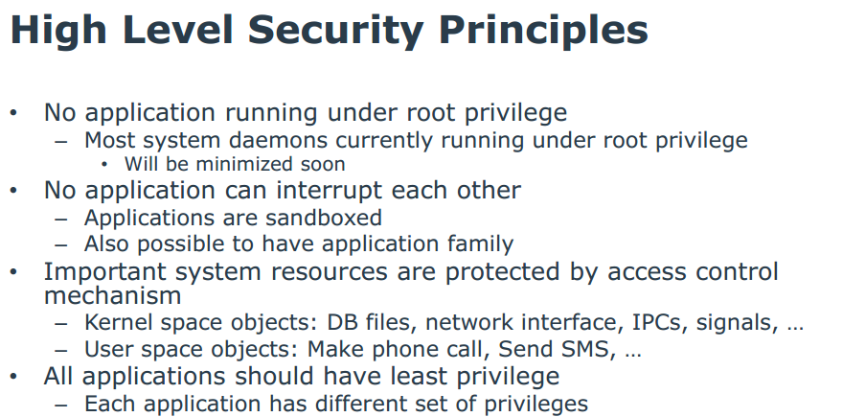
Tizen OS (Samsung) principles

Slide 44
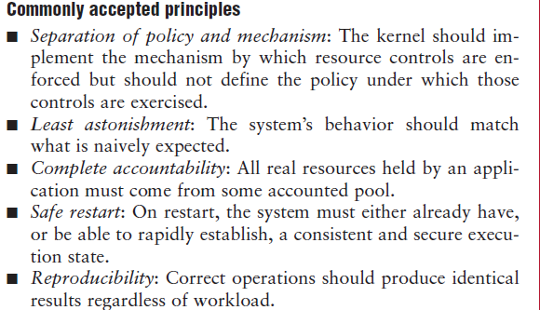
Principles used in the EROS OS J. Shapiro, IEEE Software, Jan/Feb 2002

Slide 45
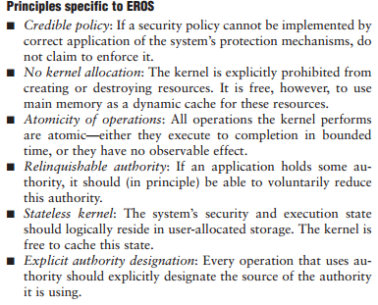

Slide 46
Policies
Institution policies
Security policies
Example

Slide 47
Need for policies
The policies of an institution define its way of accomplishing its objectives
Security policies define its way to protect its information
Without policies we don’t know what we should protect
Policies are realized by security mechanisms (possibly described as patterns)

Slide 48
Institution policies I
Laws, rules, and practices that regulate how an institution manages and protects resources. Another definition is: high-level guidelines concerning information security. Computer mechanisms should enforce these policies.

Slide 49
Some security policies
Open/closed systems--In a closed system everything is forbidden unless explicitly allowed, forgetting a rule may bring annoyance but no security problems
Need-to-know (Least privilege)-- Give enough rights to perform duties, many attacks happen because users have too much access
Granularity– amount of information to control: a whole file, a data item

Slide 50
Security policies II
Obligation—What has to be done before or after accessing data
Separation of duty—Separate critical functions into parts to be done by different people or systems. Requires collusion for illegal actions
Content-dependent access control—Access decision are based on the values of the data. I can see my own information but not others’.
Authenticate all transactions—needed for accountability and access control

Slide 51
Security policies III
Centralized/decentralized control-- In a decentralized system its units or divisions have their own administrators and authority to define their own policies or enforcement mechanisms as far as they don’t violate global policies.
Ownership and administration-- In many systems the user that creates some data becomes its owner and has all the rights on it. An administrative policy separates the administration of the data from its use. Ownership may violate separation of duty in that the user of information is also its administrator, which for institution data is a conflict of interest but it is acceptable for personal files.

Slide 52
Use of policies
Secure systems must be closed but sometimes open access to information is more important, e.g., libraries, data warehouses, …
The need-to-know principle must be applied with an appropriate granularity, many attacks happen because of too many rights
Policies should be defined using some governance strategy at the institution level, not left to system administrators

Slide 53
Example of university policies
An instructor can look at all the information about the course he is teaching.
An instructor can change the grades of the students in the course he is teaching
A student may look at her grades in a course she is taking
The department head can add/delete course offerings
The registrar can add/delete students from course offerings
Faculty members can look at information about themselves

Slide 54
Roles in policies
Originator—The person who issues a document
Authorizer—The person who controls access over the document
Custodian—The person who keeps the document and controls its use
User—The person who reads and/or modifies the document
Auditor—The person who checks the actions, results, and controls applied to documents.

Slide 55
Roles in Web services
Creator—this is a person or business that creates a web service and places it in a public repository. He wants only authorized customers to access his services.
Keeper of repositories of web services—these are the institutions that provide public catalogs of services. They must assure authorized access to these catalogs.
Provider or keeper of web services—these store the web services code and data. They may be the same as the keepers of repositories or the creators of web services, but could also be specialized institutions. As providers of web site functions they are concerned about proper access to their services and possible denial of service to their sites.
Consumer of web services—they expect good quality services without malicious software. If they send their data to a web service, this data should be used in the proper way and protected from leakage or corruption.

Slide 56
Other policies
Chinese Wall policy—Information is grouped into “conflict of interest “classes and a person is allowed access to at most one set of information in each class
Originator controlled (ORCON)—A document is released only to people or units in a list specified by the originator

Slide 57
Applying security policies to stop threats Example: a financial institution
Consider a financial company that provides investment services to its customers.
Customers can open and close accounts in person or through the Internet.
Customers who hold accounts can send orders to the company for buying or selling commodities (stocks, bonds, real estate, art, etc.).
Each customer account is in the charge of a custodian (a broker), who carries out the orders of the customers.
Customers send orders to their brokers by email or by phone.
A government auditor visits periodically to check for application of laws and regulations.
The Figure shows the Use Case diagram for this institution.

Slide 58
A financial institution

Slide 59
From threats to policies
A systematic way to identify system threats, and determining policies to stop and/or mitigate their effects
Analysis of the flow of events in a use case or a group of use cases, in which each activity is analyzed to uncover related threats. This analysis should be performed for all the system uses cases
Then we select appropriate security policies which can stop and/or mitigate the identified threats.

Slide 60
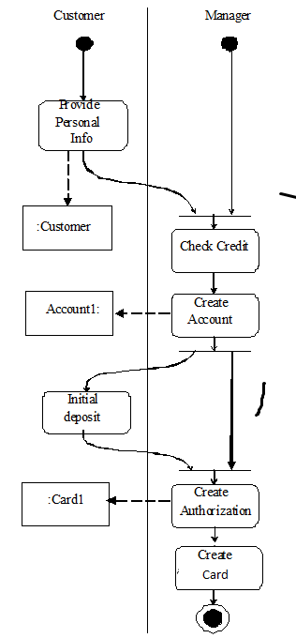

Slide 61
Threats for this use case
Use Cases 1 and 2: Customer is an impostor. Possible confidentiality and integrity violations.
Manager impersonation. Can capture customer information. Confidentiality attack.
Use Cases 3 and 4. Broker impersonation. Possible confidentiality violation.
Customer can deny giving a trade order. Repudiation. Customer impersonation. Confidentiality or integrity attacks.
Stockbroker embezzling customer’s money.
Use Case 5. Impersonation of auditor. Confidentiality violation.

Slide 63
Threats
T1.The customer is an impostor and opens an account in the name of another person
T2.The customer provides false information and opens an spurious account
T3.The manager is an impostor and collects data illegally
T4.The manager collects customer information to use illegally
T5.The manager creates a spurious account with the customer’s information
T6.The manager creates a spurious authorization card to access the account
T7.An attacker tries to prevent the customers to access their accounts
T8.An attacker tries to move money from an account to her own account

Slide 64
Use case analysis leads to policies
T1. T3. Mutual authentication. Every interaction across system nodes is authenticated.
T2. Verify source of information.
T4. Logging. Since the manager is using his legitimate rights we can only log his actions for auditing at a later time.
T5. T6. Separation of administration from use of data. For example, a manager can create accounts but should have no rights to withdraw or deposit in the account.
T7. Protection against denial of service. We need some redundancy in the system to increase its availability.
T8. Authorization. If the user is not explicitly authorized he should not be able to move money from any account.
Policies can be realized with patterns

Slide 65
Systematic mapping of threats to policies

Slide 66
Threat enumeration

Slide 67

Another example (better threat notation)
Q1 (Chapter 2): Consider a use case to borrow a book in a library. It has the following actions: A1: the customer presents a book she wants to borrow to be scanned; A2: the customer presents her card to have the book charged to it; A3: the catalog of available books is updated.
a) Enumerate the possible threats
b) Indicate policies to stop these threats

Slide 68
Q1 solution
We assume that Attacker can only apply the same operation on assets as the activity (action)
A1 (action 1)- T11 (threat 1 of Action 1)—Asset: Book--Attacker can change the book id information after it has been scanned (we cannot control physical attacks to books by using software) and replace it with the one of a cheaper book (the system would not allow to charge no book) so he could make some money (an integrity attack)
A2-T21—Asset: Customer Card--Attacker can have the book charged to another customer to obtain a free book (integrity attack)
A3- T31—Asset: Catalog-Attacker can change information about availability of books for disruption purposes (DoS attack)

Slide 69
Security models
Security models are a more precise and detailed expression of policies and are used as guidelines to build and evaluate systems. Usually they are described in formal or semi-formal way.
Authentication
Authorization/Access control
Access matrix
Role-Based Access Control
Multilevel security

Slide 70
Authenticator
How to verify that a subject is who it says it is? Use a single point of access to receive the interactions of a subject with the system and apply a protocol to verify the identity of the subject.

Slide 71
Class diagram of Authenticator

Slide 72
Authentication

Slide 73
Access control
Authorization: rules that specify who has access to what and how
Different models define rules appropriate for specific environments
Enforcement: intercept access requests and verify that they are authorized
Enforcement is embodied in a Reference Monitor

Slide 74
Access Control Models
Authorization Models can be discretionary or mandatory. In a discretionary model, holders of rights can be allowed to transfer them at their discretion. In a mandatory model only designated roles are allowed to grant rights and users cannot transfer them
An orthogonal classification divides models into those based on the Access Matrix, Role-Based Access Control (RBAC), and Multilevel models. The first two of these models control access while the last one attempts to control information flow. Mandatory and discretionary models can be combined with the access matrix and the multilevel model.

Slide 75
Classification of authorization models
Multilevel --users and data are assigned security levels
Access matrix -- subject has specific type of access to data objects
Mandatory --access rules defined only by administrators
Discretionary -- users own data and can grant access to other users

Slide 77
Access matrix authorization rules
Basic rule ( s, o, t ) , where s is a subject (active entity), t is an access type, and o is an object
Extended rule ( s, o , t , p,f) , where p is a predicate (access condition or guard) and f is a copy flag
These and other models can be described by patterns

Slide 78
Administrative rights
transfer{t/t*} to M(s,o)---transfer can be destructive or not, depending on the policy.
grant{t/t*} to M(s,o)—in a grant both grantor and grantee have the right after the grant.
delete t from M(s,o)—a right is removed from a subject.
read M(s,o)—inspect the right of a subject for an object.
create object o
delete object o
create subject s
delete subject s

Slide 79
Authorization pattern

Slide 80
Authorization mapping

Slide 81
Enforcement: Reference Monitor
Each request for resources must be intercepted and evaluated for authorized access
Abstract concept, implemented as memory access manager, file permission checks, CORBA adapters, etc.

Slide 82
Reference Monitor idea

Slide 83
Reference monitor pattern (implied binary decision)

Slide 84
Reference monitor (reified decision)

Slide 85
Enforcing access control

Slide 86
Role-Based Access Control
Users are assigned roles according to their functions and given the needed rights (access types for specific objects)
When users are assigned by administrators, this is a mandatory model
Can implement least privilege and separation of duty policies
Reduces number of rules

Slide 87
Basic RBAC pattern

Slide 88
Growing models
We can grow models by adding classes, e.g. from Authorization to RBAC we add a Role class.
We can add sessions as execution context
We can add hierarchies of roles and of objects (Composite pattern)
Subroles inherit role rights from superclass roles.
Access to an object gives implicit access to its subobjects

Slide 90
More extensions to RBAC
Separation of administrative roles: administrators have special rights to create users, roles, grant rights,…
Groups of users: a set of users taken as a whole for access rights
5/9/2016
90

Slide 91
Extended RBAC pattern

Slide 92
Attribute (metadata)-Based Access Control
In the Internet we need to deal with non-registered users
Determine effective subjects and objects based on attribute values

Slide 94
Pattern diagrams
Show relationships between patterns
Nodes are patterns
Links are relationships
Links are labeled with type of dependency or contribution
Useful to guide the designer in the selection of patterns
Can go in Introduction to a set of patterns, or in Context, or in See also

Slide 97
Role rights for financial institution
Customers can open/close accounts
Customers can initiate trade
Broker can perform trade
Auditor can inspect (read) trade transactions
5/9/2016
97

Slide 98
A financial institution

Slide 99
Analysis stage
Analysis patterns can be used to build the conceptual model. Security patterns describe abstract security mechanisms.
We can build a conceptual model where repeated applications of a security pattern realize the rights determined from use cases.
Abstract Security Patterns (ASPs) describe conceptual security defenses with no implementation details

Slide 100
Use cases can also be used to find actor rights (authorization rules)
Use cases describe all possible uses of the system
All use cases define all possible and legal accesses
Each actor can be given its needed rights to perform its functions

Slide 102
Role rights for financial institution
Customers can open/close accounts
Customers can initiate trade
Broker can perform trade
Auditor can inspect (read) trade transactions

Slide 103
5/9/2016
103

Slide 104
Adding more security: authentication, logging, separation of duty
openAcct
closeAcct
Not as Acct
User Role
MRight
…
1
Manager
*
…
Account
*
*
Acct User Role
*
Transaction
*
*
log
1
1
Authenticator
Logger
1

Slide 105
Multilevel models
Because of the way they control security they have also been called data (information) flow models, they control the allowed flow of data between hierarchical levels. These models have been formalized in three different ways:
The Bell-La Padula model, intended to control leakage of information between levels.
The Biba model, which controls data integrity.
The Lattice model, which generalizes the partially ordered levels of the previous models using the concept of mathematical lattices.

Slide 106
Features of the multilevel models
Users and data are assigned classifications or clearances
They are mandatory models (users are assigned to classifications by administrators)
Classifications include levels (top secret, secret,…), and categories (compartments) (engDept, marketingDept, Army, …)
Typically use data labels (tags) to indicate their classifications or levels, used to enforce security
In each level an access matrix may further refine access control.
Need trusted processes to perform administrative functions (e.g., declassify documents, increase a user’s clearance) so secure flow of control is not violated

Slide 107
Categories and levels
Army
Navy
Air Force
Top Secret
Secret
Levels
Confidential
Classified

Slide 108
Bell-LaPadula rules (confidentiality)
Simple security (ss) property. A subject s may read object o only if its classification dominates the object’s classification, i.e., C(s) => C(o). This is the no read-up property.
*-Property. A subject s that can read object o is allowed to write object p only if the classification of p dominates the classification of o, i.e., C(p) => C(o). This is the no write-down property.
A security classification dominates another if and only if its level is greater or equal than the other level and its categories include the other categories. For example, in the next figure, level L1 dominates level L2. Security levels L1 and L3 or L2 and L3 are incomparable.

Slide 110
Example of Bell and LaPadula Model
O₅
high
(w)
(w)
S₂
O₄
(r)
(r)
O₃
(w)
(w)
S₁
O₂
(r)
(r)
low
O
S
O₁

Slide 111
The Biba integrity model
Biba’s model classifies the data into integrity levels and defines two properties dual to the simple security and * properties. This model includes the properties:
Single integrity property. Subject s can modify object o only if I(s) >= I(o).
Integrity *-property. If subject s has read access to object o with integrity level I(o), s can write object p only if I(o) >= I(p).
The first property establishes that an untrusted subject cannot write in objects of a higher level of integrity or she would degrade that object.
The * property protects information from flowing up the hierarchy

Slide 112
Biba Model (2)
BLP
BIBA
O₅
high
(w)
(r)
(w)
S₂
O₄
(r)
(r)
(w)
(w)
O₃
(w)
(r)
(r)
(w)
(w)
S₁
O₂
(r)
(r)
(w)
(w)
O₁
low
(r)

Slide 113
Multilevel security pattern (BellLaPadula)

Slide 114
Assignment submission
Email only one file of type doc, docx, ppt, pptx, or pdf to ed@cse.fau.edu Call your file EFDSecAssign_X (replace EF by your own initials, X is 1 now). Put your name, course, and assignment number in the paper I will acknowledge reception within two days; if not, resend your paper.
Your answers should be precise and concise. Separate concerns in different paragraphs (itemized list), do not write one long paragraph. Do not include unnecessary descriptions, just answer the questions. Research question answers should be backed by references.

