Slide 1
Chapter 5: Cloud Computing Security
Dr. E.B.Fernandez

Slide 2
Q1: Find threat for the activities of Use Case “Delete course section”: A1: Find courses with enrollment under 5 students A2: Delete their enrolled students A3: Delete the courses from the semester catalog
T11: Increase number of students and keep a course that should have been deleted
Reading number of students is not considered a problem
T12: select courses with more than 5 students (will make them to be deleted in A2 and A3)
T21: read list of students (confidentiality misuse)
T22: delete students from a course that should have been kept (result of T12) (DoS and integrity misuses)
T31: delete course which should have not been deleted (result of T12)
(DoS, not available to any student)

Slide 3
Q2: Follow the SSF metamodel to build a SSF for RBAC and combine it with an Authentication SSF

Slide 4
RBAC and Authentication SSFs
requires
Abstract RBAC --------------------- Abstract Authenticator
|-------------------------- | Session-based RBAC | Certificate
…. Ref. Monitor |
DBMS RBAC X.509 SAML
| |
OS RBAC Verizon X.509

Slide 5
Q3: Describe three Semantic Analysis patterns that could be useful to build. Indicate their main use cases.
Secure Inventory (seen in class): E.B. Fernandez, "Stock manager: An analysis pattern for inventories", Procs. of PLoP 2000 http://jerry.cs.uiuc.edu/~plop/plop2k/proceedings/proceedings.html
Student registration-- Use cases: add course offering, delete course offering, enroll student in course offering, get student transcript, add pre-requisite, check student prereq. : X.Yuan and E.B.Fernandez, "An analysis pattern for course management", Procs. EuroPLoP 2003, http://hillside.net/europlop
Voting: E.B. Fernandez, David La Red Martinez, and J. I. Pelaez, "A conceptual approach to voting based on patterns", Government Information Quarterly. 30 (2013), 64-73
Service evaluation
Service setup
Product ordering and invoicing: E.B.Fernandez and X. Yuan, "An Analysis Pattern for Invoice Processing", Procs. of the 16th Conf. on Pattern Languages of Programs (PLoP 2009), and Xiaohong Yuan and E. B. Fernandez, "Patterns for Business-to-Consumer E-Commerce Applications", International Journal of Software Engineering & Applications (IJSEA), vol. 2 No 3, July 2011, 1-20, http://airccse.org/journal/ijsea/papers/0711ijsea01.pdf

Slide 6
More SAPs
Mei Fullerton and E. B.Fernandez, "An analysis pattern for Customer Relationship Management (CRM)", Procs. of the 6th Latin American Conference on Pattern Languages of Programming (SugarLoafPLoP’2007), May 27-30, 2007, Porto de Galinhas, Pernambuco, Brazil, 80-90.
Secure legal case handling: E. B. Fernandez, D. L. LaRed M., J. Forneron, V. E. Uribe, and G. Rodriguez. “A secure analysis pattern for handling legal cases”, Procs. of the 6th Latin American Conference on Pattern Languages of Programming ( SugarLoafPLoP’2007), 178-187. http://sugarloafplop.dsc.upe.br/AnaisSugar2007_WEB.pdf
Patient hospital admission Tami Sorgente, E B.Fernandez, and Maria M. Larrondo-Petrie, "Analysis patterns for patient treatment", Procs. of the Pattern Languages of Programs Conference (PLoP 2004) http://hillside.net/plop/2004/papers/tsorgente0/PLoP2004_tsorgente0_0.doc
Accounts: UCs: open account, close acct., perform transaction,…E.B.Fernandez and Y.Liu, "The Account Analysis Pattern", Procs. of EuroPLoP 2002 (Pattern Languages of Programs). http://www.hillside.net/patterns/EuroPLoP/submissions-2002.html
Sport competitions: E.B.Fernandez and R. Pan, "The Sports Manager pattern", Procs. of PLoP (Pattern Languages of Programs) 2002,

Slide 7
Assignment 2 (due Wed., June 1st)
1. Modify the RBAC pattern solution (UML class model) to include hierarchical administration role delegation. An administrator can delegate his administrative rights on a specific administrative domain to another administrator and revoke them later if needed. An administrative domain is a related set of data items and resources managed as a whole.
2. Express in UML the following policies:
P1. Students have transcripts that record their grades in all the courses they have taken.
P2. Students can see their own transcripts.
P3. Graduate students do theses and have one advisor for a thesis.
P4. A thesis requires a committee with four members including the advisor.
P5.The advisor has the right to approve the thesis.
3. What is the advantage of adding tactics between policies and patterns? Be precise and concise, no long essays.

Slide 8
Clouds
Clouds combine two old ideas which are now feasible with current technology:
Utility computing—an infrastructure provides a set of resources to be shared by applications which use them as needed and pay only for what they use. This approach lets applications have access to a variety of almost unlimited resources (at the cost of giving up control about where and how data is processed).
Virtual machines—this is a concept used for supporting the execution of operating systems sharing the same hardware. The virtual machine seen by a given customer is created from one or more servers in the cloud and has practically unlimited power and storage capacity.
Clouds can also be seen as an extension of the concept of Service-Oriented Architecture (SOA), where every architectural level of the system, from hardware to applications, can be accessed as services.

Slide 9
Cloud services

Slide 10
Service-Oriented Architecture (SOA)
A service is a logical representation of a business activity that has a specified outcome
SOA is an architectural style in which a system is composed from a set of loosely coupled services that interact with each other by sending messages
In order to interoperate, each service publishes its description, which defines its interface and expresses constraints and policies that must be respected in order to interact with it.
Applications are built by coordinating and assembling services (workflow style)
A key principle about services is that they should be easily reusable and discoverable, even in an inter-organizational context

Slide 11
Software as a Service (SaaS)
The user rents software from the cloud provider instead of buying it. The software is hosted in the data center managed by the provider, and it is available over the network, typically the Internet. Examples of SaaS: CRM, ERP, Word Processor, Spreadsheet, database applications, etc.
SaaS has the following characteristics:
Access via the web: end users access the application via the Internet using a web browser instead of the traditional PC-based client.
Vendor support: the application is hosted and operated by the cloud provider.
Subscription Pricing: users only pay only for what they use. They do not invest on upfront fees such as licensing fees.
Low Customization: the applications are highly standardized across customers, often hosted in a “multi-tenant” architecture model.
Managed Upgrades: functionality enhancements such as upgrades and installations are completely controlled by the vendor.

Slide 12
Platform as a Service (PaaS)
It offers an environment for developers where they can develop, test, and run their applications
A programming platform is offered to the user (developer), which provides a complete software lifecycle management, from planning to design to building applications to testing to maintenance
Two examples are Google’s App Engine and Force.com. Google’s App Engine offers APIs for storage, platform, and database. It supports applications written in different programming languages such as Java and Python. The Force.com platform is similar, but it uses a custom programming language called Apex.

Slide 13
Infrastructure as a Service (IaaS)
Infrastructure as a Service provides computing infrastructure to customers
The IaaS layer virtualizes computing power, storage and network connectivity of the data centers, and offers it as services to customers.
Amazon (EC2), Microsoft, and Google are some of the companies that offer infrastructure services.

Slide 14
Main players in the IaaS space (10/14)
Amazon Web Services (AWS), which offers a full range of compute and storage products
Windows Azure, especially appropriate for those used to working with Microsoft platforms
HP Helion, which leverages HP’s enterprise success to integrate existing IT infrastructure with private and public cloud services
Google Compute Engine, which leverages its reputation and lead in Search, and its famously efficient cloud data centers, to extend competition to the infrastructure space as well.
Rackspace Open Cloud, which has a strong focus on customer service
VMware Hybrid Cloud Services, which leverages VMware’s success in virtualization to offer a solution spanning from Data Center to Public Cloud
Next is Gartner’s Magic Quadrant (ability to execute (y) vs completeness (x))

Slide 15
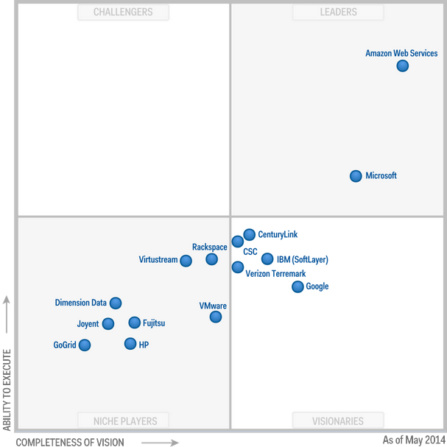
http://www.gartner.com/technology/reprints.do?id=1-1UM9419&ct=140529&st=sb

Slide 16
HP Helion
HP Helion is an enterprise cloud platform by HP consisting of hardware, software, and services hosted in the private, public, and hybrid cloud. HP Helion was announced and launched in May 2014. HP has revealed it will commit 1 billion USD over two years to develop and market the platform.
A transparent, enterprise-grade public cloud based on OpenStack® technology. Offers on-demand, pay-as-you-go cloud services for computing and storage infrastructure as well as platform services.

Slide 17
OpenStack
OpenStack is a cloud computing project to provide an infrastructure as a service (IaaS). It is free open source software released under the terms of the Apache License. The project is managed by the OpenStack Foundation, a non-profit corporate entity established in September 2012 to promote, protect and empower OpenStack software and its community.
More than 150 companies joined the project among which are AMD, Brocade Communications Systems, Canonical, Cisco, Dell, Ericsson, Groupe Bull, HP, IBM, Inktank, Intel, NEC, Rackspace Hosting, Red Hat, SUSE Linux, VMware, and Yahoo!.

Slide 18
Deployment
Public – public clouds are run by third party providers. They provide services to any client who pays for their services. These services can be accessed across the Internet or a private network. Public clouds are preferable for non-critical applications
Private – private clouds are built for the exclusive use of an institution, providing strong control over data, security, and quality of service. Private clouds can be built and managed by the organization or by a cloud provider. Their use is significantly more expensive than public clouds.
Hybrid – combines the two previous approaches. Hybrid clouds are environments in which an organization manages some resources in-house and uses external clouds for other services.
Community – community clouds might be established where different organizations that share similar requirements want to share the infrastructure. Community clouds can be deployed using any of the three models mentioned before.

Slide 19
Required properties
Scalability: This is its strongest point. The provider can have many servers and the users can lease them according to their needs.
Application development and deployment support. The provider can have a variety of tools and application assistance that would be hard to duplicate in a small company.
Availability. The cloud provider can have replicated servers such that the cloud environment is always available to the application.
Fine access control. Only specific users of the cloud should be able to access its data and only in specific ways. This applies to the employees of the application company and to the employees of the service provider.
Compliance with regulations. The application owner must comply with the appropriate regulations, depending on the type of application, e.g., medical-related applications must comply with HIPAA. Service providers must follow regulations about the protection they provide to the hosted data.
Recovery. It is the responsibility of the service provider to completely recover the data in a timely manner in case of a crash or attack.

Slide 20
More requirements
Data persistence.If the provider goes out of business or is acquired by another company, we should guarantee the persistence and security of the data until somebody takes over.
Survivability. There should be no catastrophic failures, where the customer’s data or programs just disappear –
Isolation. A cloud application is sharing resources with other applications. The application should be protected from interference from other applications.
Data location. Different countries have different data protection and privacy laws. The service provider should guarantee that the laws of the country of the owner of the application are followed.
Interoperability. Clouds which follow standards are more flexible and allow more freedom to its customers. This is particularly important in applications which may partially run in more than one cloud. Hard to get from SPs.
Portability. This is usually a weak point. Once you move to some cloud, it is hard to migrate to a different cloud. From a cloud provider point of view, limiting portability or being able to control how applications are moved to different platforms, may actually be a design coal.
Dynamic adaptation. Changes in services do not require work for the customer

Slide 21
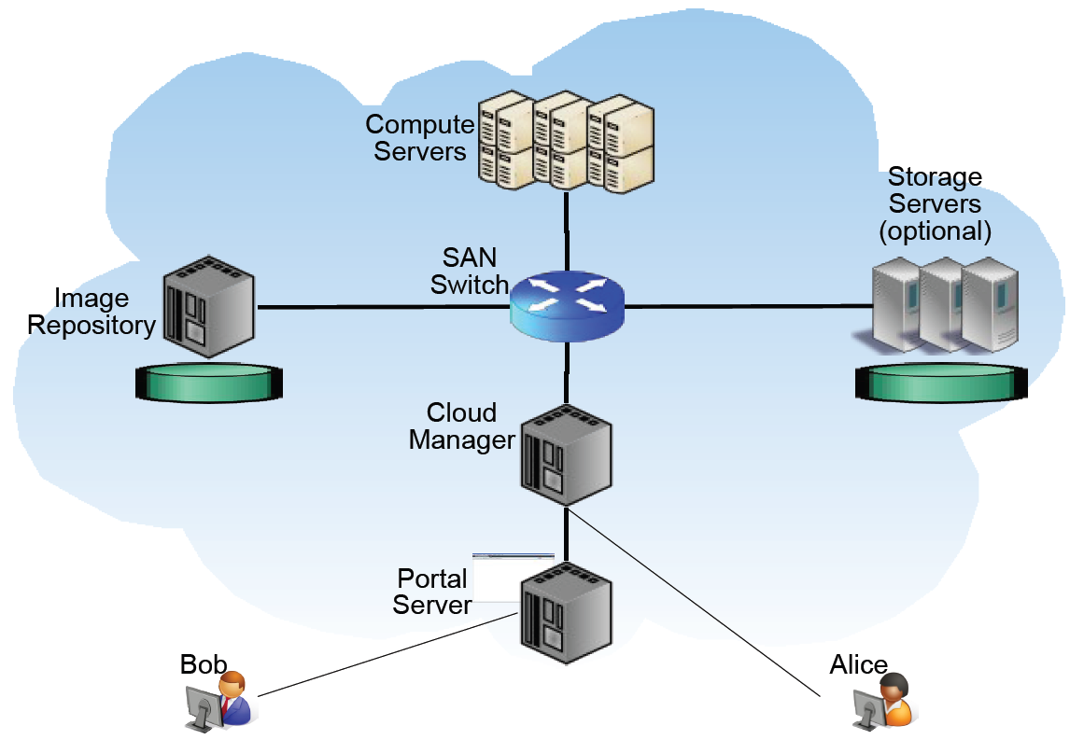

Slide 22
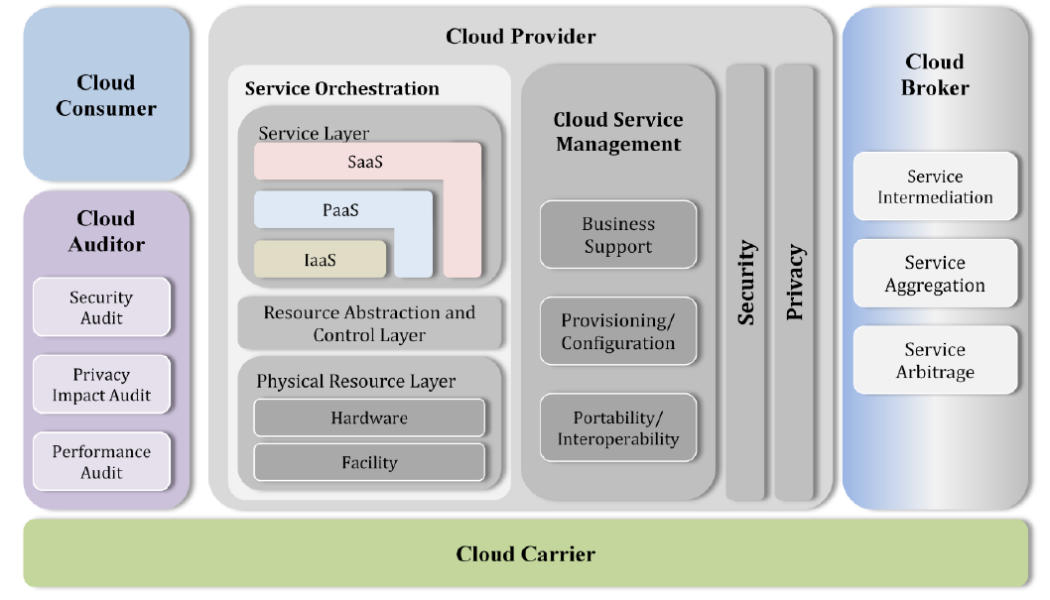
NIST reference architecture

Slide 23
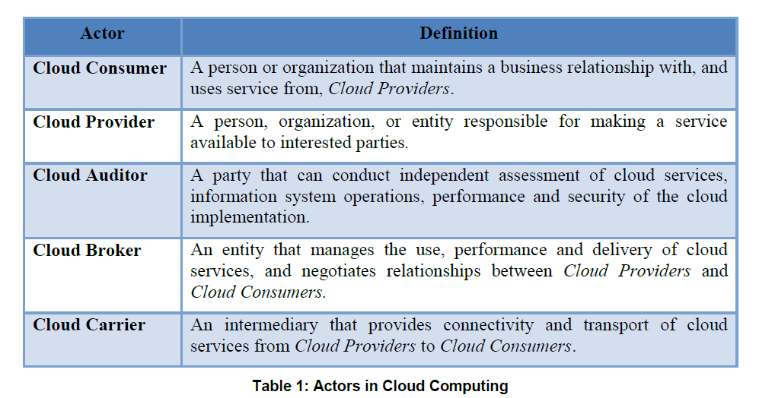

Slide 24
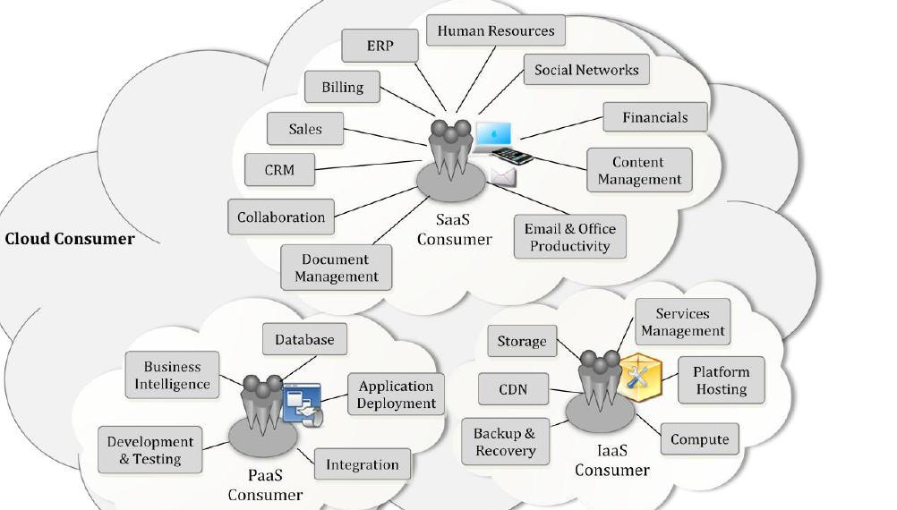
Services available to actors

Slide 25
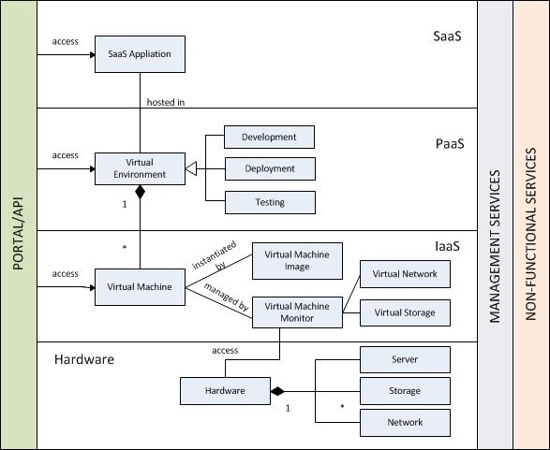
Keiko Hashizume, Eduardo B. Fernandez, and Maria M. Larrondo-Petrie “A Reference Architecture for Cloud Computing

Slide 26
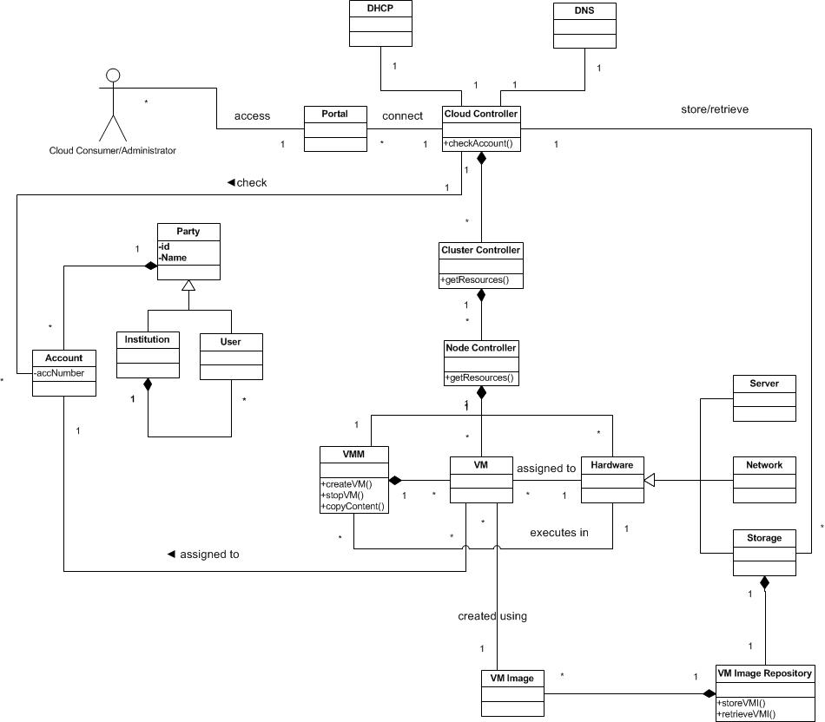

Slide 27
System architecture for IaaS
A User creates one or more Accounts in order to use the Provider’s infrastructure.
Accounts can be individual or institutional (Party pattern)
The Provider is composed of a Hypervisor, Hardware (server, storage and network), a DNS (Domain Name System) and a DHCP (Dynamic Host Configuration Protocol).
The Virtual Machine Monitor (VMM) creates Virtual Machines (VM) and assigns their instances to the users who requested them.
VMs are created using Images (VMIs)
When the instance is launched, it is assigned to a physical server and given other hardware resources.
The Virtual Machine passes system calls to the Virtual Machine Monitor which executes those calls in the Hardware.

Slide 28
Use Case Create a VM for a user
Summary: The Provider creates a Virtual Machine for a user.
Actor: User
Precondition: The user must have an account with the Provider
Description:
The User requests to the Provider to create a virtual machine. He specifies the physical location and the type of the instance.
The Provider checks if the user has an account and redirects the request to the Hypervisor.
The Virtual Machine Monitor creates an instance of the Virtual Machine and assigns it to a server and to the user.
Postcondition: A Virtual Machine is created in the specified location and assigned to a server and to the user.

Slide 29
UC Create a VM

Slide 30
Service Level Agreements (SLAs)
Contract between customers and providers about level of service to be provided
Performance metrics: throughput, response time,…
Problem management
Security capabilities
Penalties for non-performance

Slide 31
Security issues
Secure outsourcing: Customers must trust their sensitive information to a third (and maybe even a fourth) party
Accountability. It may not be clear who is responsible for compliance
Multiple tenancy. Several customers may run their processes in the same hardware, which brings a new set of security threats
Proper sharing of security concerns between customers and cloud providers
The administration of cloud resources and its implication on security and reliability is an aspect about which there is scarce experience
Cloud vendors may provide different degrees of independence; for example, a provider may offer a type of hardware without showing its details or offer specific hardware services
Customers may be unwilling to reveal sensitive data to a third party, as the task specification and problem parameters alone may leak sensitive information.

Slide 32
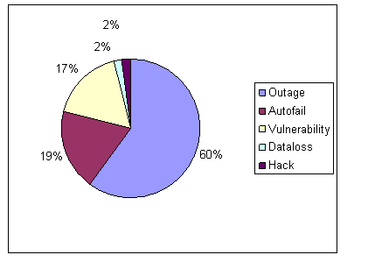
Cloud computing incidents: 128, 40, 37, 4, 4

Slide 33
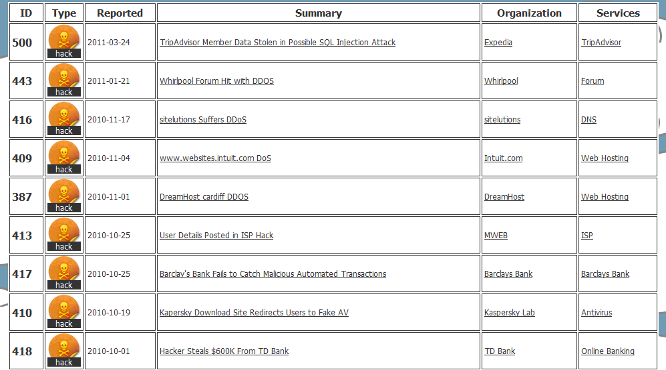
Cloutage.org

Slide 34
Cloud Security Alliance
https://cloudsecurityalliance.org/download/cloud-computing-vulnerability-incidents-a-statistical-overview/

Slide 35
A VM attack
Researchers at the University of California at San Diego and at M.I.T. say they can buy cloud services from Amazon and place a virtual machine on the same physical machine as a target application.
Once there, they can use their virtual machine’s access to the shared resources of the physical machine to steal data such as passwords.
We did a misuse pattern from this possibility

Slide 36
Use of cloud-based service to get Wi-Fi passwords
For $34, a new cloud-based hacking service can crack a WPA (Wi-Fi Protected Access) network password in just 20 minutes, its creator says.
The WPA Cracker service bills itself as a useful tool for security auditors and penetration testers who want to know if they could break into certain types of WPA networks. It works because of a known vulnerability in Pre-shared Key (PSK) networks, which are used by some home and small-business users.
WPA Cracker customers get access to a 400-node computing cluster that employs a custom dictionary, designed specifically for guessing WPA passwords. If they find the $34 price tag too steep, they can use half the cluster and pay $17, for what could be a 40-minute job. Marlinspike declined to say who operates his compute cluster.
The attack will work if the network's password is in Marlinspike's 135 million-phrase dictionary, but if it's a strong, randomly generated password it probably won't be cracked.

Slide 37
Analysis of Cloud systems security issues
We did first a categorization of security issues for Cloud Computing considering its service models SaaS, PaaS and IaaS.
We identified the main vulnerabilities and the most important threats.
We also showed some countermeasures related to these threats.
We related compliance to security
We now develop a Security Reference Architecture

Slide 38
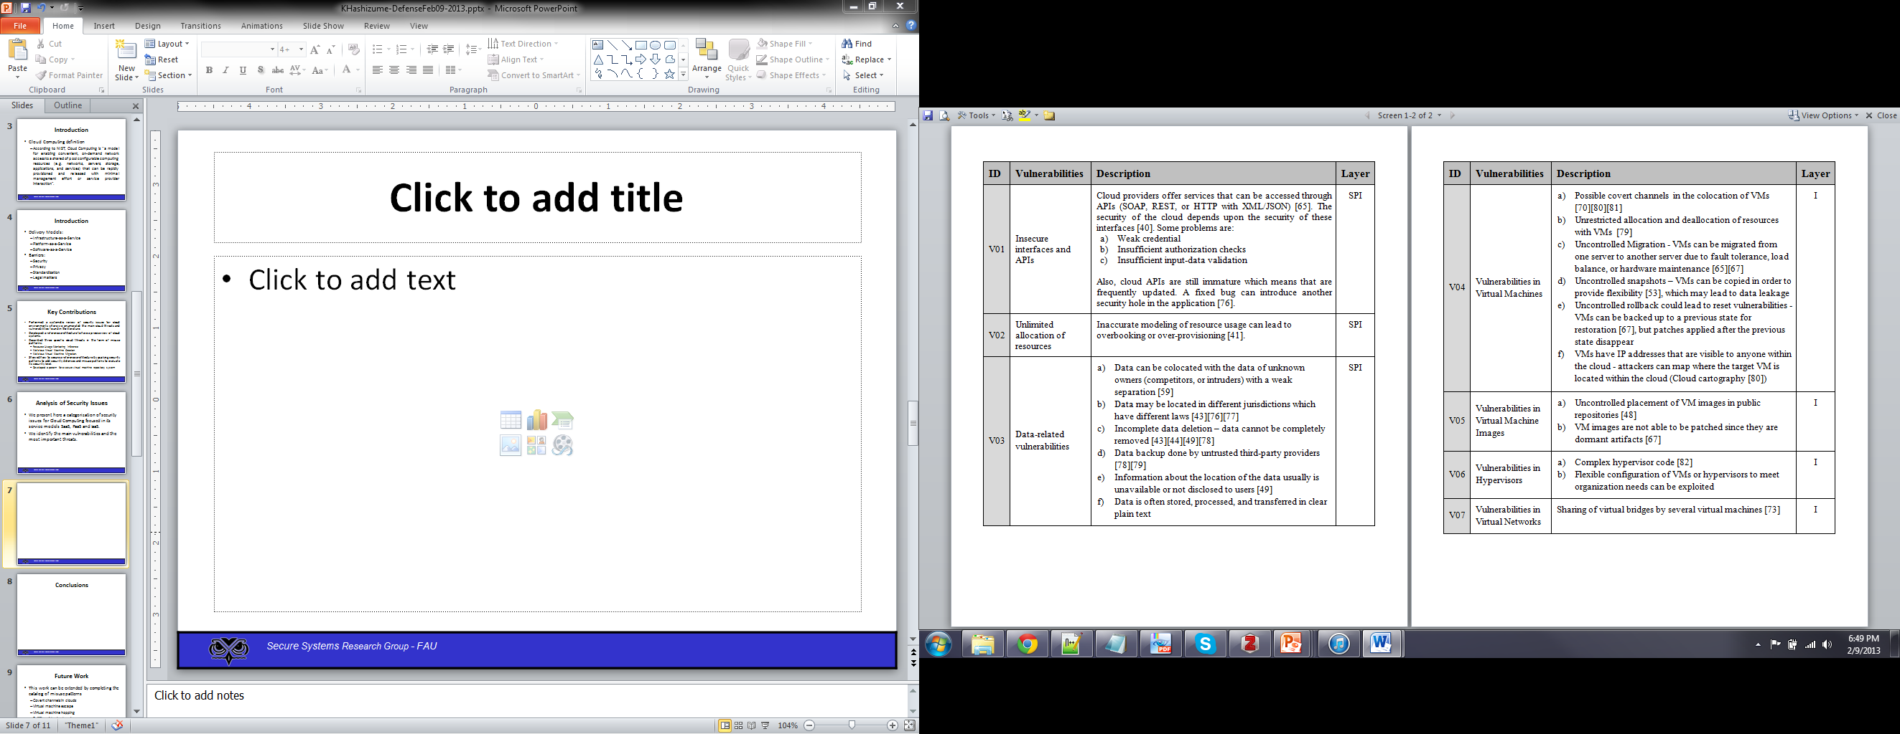
Vulnerabilities in Cloud Computing

Slide 39
Vulnerabilities in Cloud Computing II

Slide 40
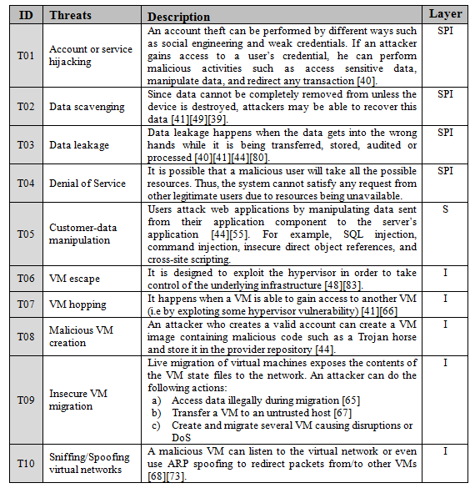
Threats in Cloud Computing

Slide 41
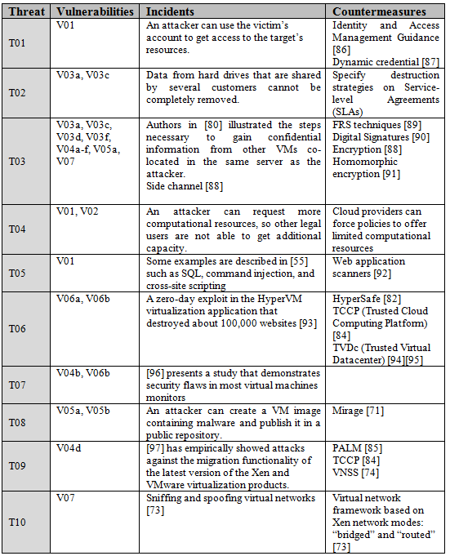
Relationships between Threats, Vulnerabilities, and Countermeasures

Slide 42
Threats vs. Defenses
ID | Threats | Defense
T11 | The cloud consumer is malicious and inserts malicious code into the VMI | Authenticator - Authorizer
T21 | An external attacker listens to the network to obtain information about the VMI | Secure Channel
T22 | VMI may be modified while in transit | Secure Channel
T23 | Disavows sending a VMI | Security Logger/Auditor
T31 | The IaaS administrator is malicious and collects information within the VMI | Authenticator - Authorizer
T32 | The IaaS disavows receiving a VMI | Security Logger/Auditor
T33 | Insert malicious code in the image | Authenticator - Authorizer
T41 | The IaaS administrator stores a malicious VMI | Authorizer – Authorizer Filter

Slide 43
Securing an RA
We start from a list of use cases which describe the typical cloud uses and their associated roles. Lists of cloud use cases are shown in [Bad12], [nis11], and [Has13c].
We analyze each use case looking for vulnerabilities and threats as in [Bra08]. This implies checking each activity in the activity diagram of the use cases to see how it can be attacked. This approach results in a systematic enumeration of threats.
We use the list of threats from [Has13a] to confirm these threats and to find possible further vulnerabilities and threats.
These threats are expressed in the form of misuse patterns. We developed some misuse patterns for Cloud Computing in [Has13b], we show more later.
We apply policies to handle the threats and we identify security patterns to realize the policies. There are also regulatory policies which are realized as security patterns.

Slide 44
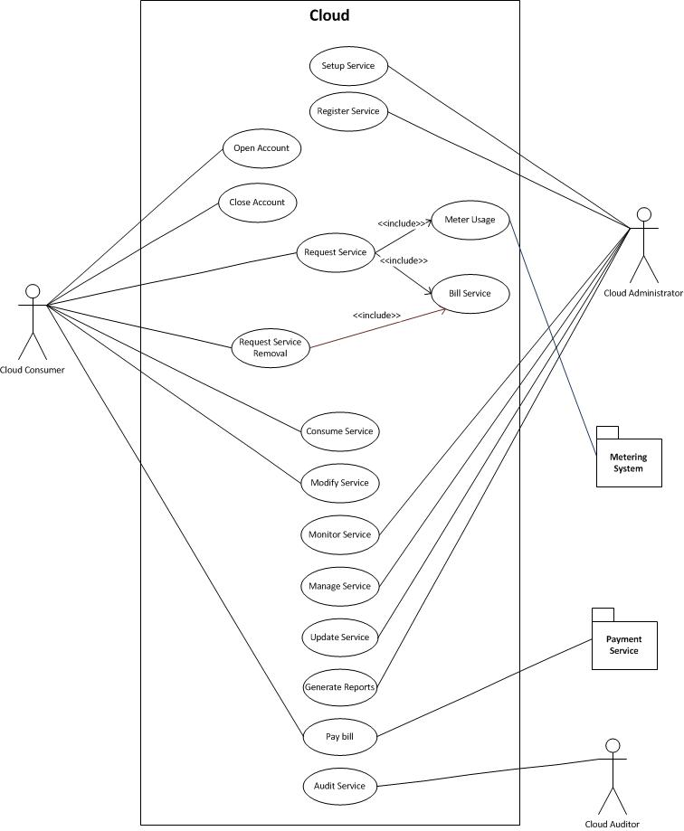

Slide 45
Analysis of Security Issues
Attacks to storage, virtualization, and networks are the biggest security concerns in Cloud Computing.
The relationships and dependencies between cloud components may also be a source of security risks.
We need a way to describe in detail how these threats happen so we can avoid them (misuse patterns).
We first built patterns for each layer and then some cloud misuse patterns

Slide 46
Applying misuse patterns
Misuse patterns can be used to evaluate the security of a reference architecture.
We need to develop a catalog for misuse patterns.
The catalog is based on the threat analysis of clouds
We started with three misuse patterns for clouds

Slide 47
Malicious VM Creation
Intent
An attacker may create a VM image that contains malicious code.
The attacker may read also confidential data from images.
Context
Some IaaS providers offer a VM image repository where users can retrieve images in order to initialize their VM.

Slide 48
Malicious VM Creation
Problem
To perform some types of misuse it is necessary to be able to create and publish VM images.
The attack can be performed by taking advantage of the following vulnerabilities:
Any valid user can create and register a VM image.
Common place to share VM images.
VM images contain prepackaged software components for an application.
VM images contain installed and fully configured applications.

Slide 49
Malicious VM Creation
Solution
Any valid user of the cloud is able to use an image to instantiate his VM.
This VM image can contain malicious code.
The attacker can have control of the VM and perform malicious activities.
Infected VM may appear briefly, infect other virtual machines, and disappear before they can be detected

Slide 50
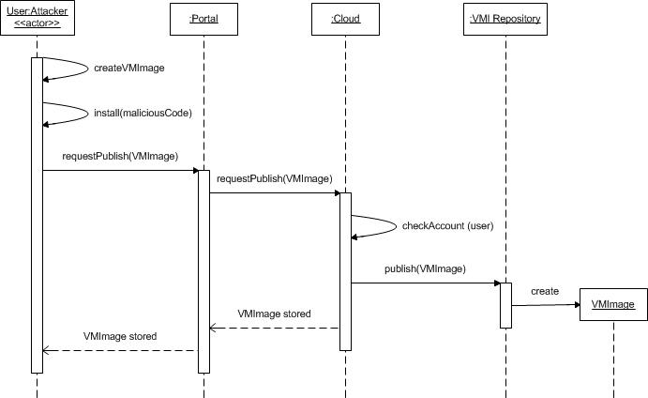
Malicious VM Creation
Sequence Diagram for the Use Case Publish a Malicious VM Image

Slide 51
Vulnerabilities
Security
Analysis
Threats
Cloud
Countermeasures
stopped by
Misuse patterns
Security patterns
Reference Architecture
threats
IaaS
defenses
PaaS
SaaS
defenses
Security best practices

Slide 52
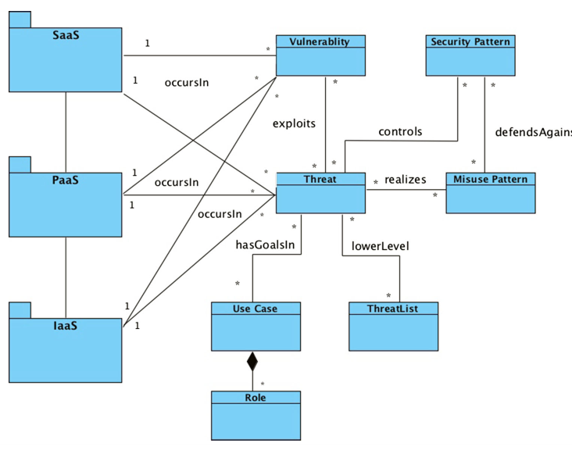
Metamodel for security concepts

Slide 53
Enumerating threats
We can enumerate threats systematically by considering each activity in each use case and analyzing its possible threats
For illustration we use a running example of a Virtual Machine Image (VMI) Repository, which stores VM images for use by service consumers and which is part of the administrative functions of the cloud
We apply to each action in this repository the STRIDE attacks , e.g. Read a VMI (confidentiality attack), Tamper with a VMI (integrity attack).

Slide 54
Enumerating threats

Slide 55
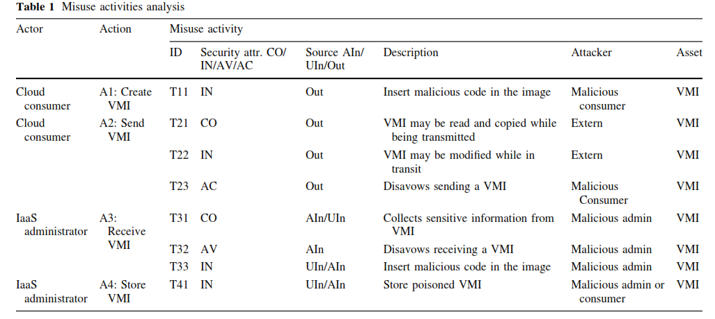

Slide 56
Cloud security patterns
Secure migration process – provides protection for live and offline migration.
Secure hypervisor – reinforces the security of the hypervisor to avoid some attacks.
Secure virtual network – secures the communication among virtual machines.
Virtualized Trusted Platform – provides a framework to determine whether the environment is secure before launching a virtual machine.
Secure DNS, where Access Control Lists (ACLs) are used to protect the DNS (PLoP2014)
Security Group Firewall. Divides the firewall into customer groups that have similar filtering requirements [Fer14b]
Cloud-based Web Application Firewall (CWAF). Controls access to web applications communicating through HTTP according to authorization rules with the objective of stopping XSS, SQL injection, and similar attacks.
Secure DHCP

Slide 57
Misuse patterns for clouds
Covert channels in clouds – covert channels allow inter-VM communication bypassing the security rules of the hypervisor.
Virtual machine escape – describes how to exploit the hypervisor in order to take control of the underlying platform.
Virtual machine hopping – describes how a virtual machine can access other virtual machines, for example by exploiting the hypervisor.
Sniffing virtual networks – describes how a virtual machine can listen to the virtual network traffic in order to get confidential information.
Spoofing virtual networks – describes how a malicious virtual machine can intercept information in the virtual network with the purpose of altering its routing function.

Slide 58
Some definitions
A Reference Architecture (RA) is an abstract software architecture, based on one or more domains, with no implementation aspects
An RA should define the fundamental concepts of a system expressed as ASPs and the interactions among these units. An RA should be reusable, extendable, and configurable; that is, it is a kind of composite pattern for whole architectures and it can be instantiated into a concrete software architecture by adding platform aspects
After adding security patterns to neutralize identified threats in an RA we have a Security Reference Architecture (SRA)
We can also add compliance patterns to produce a Compliance Reference Architecture.

Slide 59
SRA
The threat analysis shows how each threat can be controlled by a corresponding security pattern. Once security patterns are selected, we apply them into the RA in order to stop or mitigate threats
Security mechanisms are added to the basic RA, including Authenticator, Authorizer, Security Logger/Auditor and others that mitigate specific threats.
To avoid impostors we can use the Authenticator so that every action with the cloud is authenticated
The Security Logger/Auditor is used to log all activities that can be used for auditing at a later time
For authorization we use Role-Based Access Control (RBAC), or a similar model, so only authorized users can perform some actions to assets.
To avoid storing infected VMI, they are scanned and filtered before storing them in the VMI Repository.
VM=Virtual machine, VMM=virtual machine monitor, VMI= virtual machine image

Slide 61
Secure IaaS

Slide 62
Validation of the SRA
RAs are not directly implementable; they are abstract models and cannot be evaluated with respect to security or performance through experimentation or testing.
An RA is similar to a pattern and it has similar value, it is a paradigm to guide implementation of new systems or evaluation of existing systems.
Their evaluation must be based on how well they represent the relevant concepts of the systems they describe, how well they handle abstract threats, how complete they are, how precise they are, how they can be applied to the design or evaluation of systems, and how useful they are for other relevant functions.
Their final validation comes from practitioners using them to build concrete architectures.
We identified a variety of uses for a cloud SRA

Slide 63
Uses of a SRA
Security Service Level Agreement (SSLA). An RA can provide a framework for defining the requirement of the provider with respect to the requirements of the consumer; the SRA can define the security mechanisms that the SP has or could have and the customer can then select them for the corresponding SSLA. In particular, a SSLA can include several levels and the SRA makes clear where the services belong. SSLAs require monitoring to assure that the SP fulfilled its contact.
Reference for monitoring functions. Monitoring requires mechanisms to obtain information about the system status. A SRA provides guidelines about the places where security events should be collected in order to fulfill SLAs requirements and for system administration.
A way to understand vendor SRAs (can serve as validation also)

Slide 64
SRAs in practice—used to validate our SRA
NIST
IBM
Oracle
Fujitsu
Amazon
VmWare
Cisco
Trend Micro
Intel

Slide 65
More uses of SRAs
A holistic security view. Several authors emphasize the need to develop secure systems in a holistic way. Systems built piecemeal omit important interactions that may result in vulnerabilities. A SRA provides such a holistic view by indicating the places where security mechanisms can be attached and their effect in the functional parts of the architecture. As such a SRA can be useful for developing secure cloud development methodologies. We can expand the SRA by indicating all the points where threats are neutralized with corresponding security patterns. Holistic views are very important to combine quality factors such as safety or reliability with security.
A way to unify cloud terminology. Different vendors have different ways to describe their security services and products. A SRA can be used as a framework to unify terms and descriptions. This is useful for selecting cloud providers. Some ontologies for this purpose exist, but they don’t relate the terms to a RA, much less to a SRA.

Slide 66
Evaluating degree of security
Verify that all misuse cases have been controlled by some security pattern
If we enumerate all the threats we just need to verify that the architecture includes a security pattern that can neutralize all the threats
If T={t₁,…t_{i}…}is the set of threats, and SP= {sp₁…sp_{j}…} is the set of security patterns, we have: ∀ t_{i} ∈ T ⇒ ∃ sp_{j} ∈ SP, ∋ sp_{j} controls t_{i}
When the SRA is instantiated to define a specific type of cloud, each misuse pattern can be realized following the specific architecture components, which means that we may need further security patterns to stop them
If MP=[ap₁,…ap_{i},…}, where ap_{i} is an attack pattern used by the MP, if ∃ sp_{j} ∋ sp_{j} stops ap_{i}, the misuse case cannot occur.
An attack (threat) pattern describes a specific step leading to a misuse [Uzu14]; e.g., using a stolen credential to have access to a DBMS where we can perform a misuse by using SQL injection.

Slide 67
Are clouds secure?
Consider a typical business application, e.g. a financial application: high security requirements, remote access, highly available
If it is in our control, we can put authentication, authorization, logging, firewalls, IDS, cryptography, where needed
If in a cloud from some provider, we need to specify the same defenses through the SLA
If provider satisfies these requirements, we need to consider extra threats: Internet access to the cloud itself, multitenancy, insecure images, migration attacks, insider attacks from provider employees,…
Best security in the cloud will always be less than best security under our control
In practice, it is harder to tell because we might not have enough expertise, not enough money for security, …

Slide 68
In summary
For a company that manages well its security, has appropriate expertise, and has installed enough security mechanisms, the cloud may be a decrease in security due to the extra threats, lack of control, and dependency on a provider that may not be as careful.
For a company that does not have enough expertise and not enough money to buy security products, training, etc. , the cloud may be a clear improvement.
The choice is affected by the application requirements, the value of the assets to be put in the cloud, compliance, and quality factors.

Slide 69
Security perspective
Identification and Authentication (I&A)—Passwords, biometrics, cryptography
Authorization and Access control (A & A)—Authorization systems in application, databases, operating systems
Logging and Auditing—In database system and/or operating system
Hiding of information—It is usually performed by the use of cryptography but steganography is another option. Protects messages in transit
Intrusion detection—Intrusion Detection Systems (IDS) combined with firewalls
Antimalware: virus detectors
Filtering—done using firewalls
DDoS controlled by replication, IDS, and firewalls

Slide 70
Security SLA
Specifies the security obligations of the SP associated with a service
No SP offers them now
SRA can be used as a guideline to specify what the customer wants and to indicate where the contract values can be monitored

Slide 71
Need for Transparency
The split responsibility makes it hard to draw broad generalizations about cloud providers’ ability to meet audit requirements. A major issue is a perceived lack of visibility into cloud providers’ operations and security.
“At the moment, cloud providers seem to want customers to treat them like a black box,” says Craig Balding of Cloud Security
Patterns could be a way to provide this transparency: the provider provides in the SLA a list of the security patterns that they use to support security and compliance.
This approach gives a guarantee to the user and keeps most of the secrecy of the provider. The pattern provides an abstraction of security mechanisms not details of implementation. The customer only cares about this conceptual security.

Slide 72
Cloud security products
Terremark (a high-security cloud service)
Intel ECA 360
WAF
Lenovo
vmWare
IBM
CASB (Cloud Access Security Broker): several vendors

Slide 73
Terremark
Verizon acquired the hosting firm Terremark for $1.4 billion.
The deal builds on a relationship the two companies began in September 2010, under which Verizon sold cloud services to small and medium-sized businesses out of Terremark’s data centers.
Terremark was early to market with cloud services in 2008 and joined the VMware vCloud initiative in 2009.
That year VMware took a 5% stake in Terremark, approximately $20 million of stock, to ensure that the company built out its cloud infrastructure on VMware technology. Verizon is also a member of the vCloud initiative and runs its cloud on VMware.

Slide 74
Verizon/Terremark
Verizon plans to operate the new unit as a wholly owned subsidiary, with the Terremark name retained and the company's management team continuing to run operations.
Headquartered in Miami, Terremark operates 13 data centers in the U.S., Europe and Latin America.
The company's Enterprise Cloud service provides some of the world’s largest companies and U.S. government agencies with on-demand computing resources
Like all cloud providers, it's had it's share of outages, but Terremark made a name for itself in the secure cloud services market, a big deal when selling to traditional enterprise IT organizations.

Slide 75
Intel® Expressway Cloud Access 360 http://info.intel.com/rs/intel/images/Intel-Cloud-Access-360_Data-Sheet.pdf
It is a solution suite designed to control the entire lifecycle of access security for enterprises and their partners connecting to the cloud applications
Control: The identity lifecycle with account de-provisioning and automatic identity data syncronization to maintain data quality. Enforce context-aware authorization, deliver integrated strong authentication, and empower users with seamless SSO from multiple devices–all tied to authoritative IdM systems.
Visibility: Monitor user, administrator and API access activity…receive alerts against SLAs…all from a central administrative console.

Slide 76
ECA 360
• Compliance: Protect access to sensitive information with strong authentication soft/hard OTP, maintain audit records of identity lifecycle events, and correlate cloud user activity with on-premise logs for end-to-end compliance. Detect and de-provision orphan accounts to meet industry regulations.
• Protect Client to Cloud: Deploy mission critical apps in the cloud and enforce sophisticated client aware security policies to ensure requests are received from an attested client device or application.

Slide 77
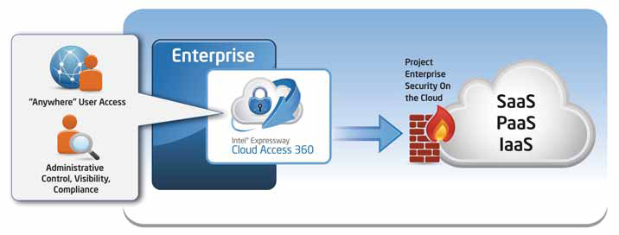
360 Access for the Cloud

Slide 78
Cloud Standards and ECA
At an industry level, Intel & some solution providers have formed the Intel® Cloud Builders program to define and prototype reference cloud architectures.
Intel Expressway has a reference architecture for the “Cloud Access” usage model.
Intel is also a member of the Cloud Security Alliance which promotes the use of best practices for providing security assurance within cloud computing.

Slide 79
Solutions to Control the Cloud Access lifecycle
Intel® ECA 360 is an integrated suite of Intel & Nordic Edge (an Intel company) identity technologies that can be deployed to secure enterprise user access to SaaS/PaaS/IaaS providers.
SSO-Intel® ECA 360 has a web based administrative console that makes it easy to view, author, and control access policy by cloud provider. Packaged with the solution are first mile “session look-up” connectors to common IdM & enterprise platforms such as Microsoft* SharePoint and “last mile” session creation & account provisioning connectors to popular SaaS and PaaS platforms. Federated authentication and authorization protocols are based on SAML, XACML, and emerging Oauth & Open ID identity standards that can connect internet based identity providers (e.g. Facebook) with corporate identities and authorization policy.
Mobile strong authentication
Two-factor authentication for mobile or remote clients

Slide 80
Protecting Cloud Services
Cloud security is not just about safe user access…its also about ensuring on premise or cloud hosted apps can securely expose and initiate system to system web service interactions for internal developers, or any application that needs to access data on the user’s behalf. Based on mature, ten year old technology, Intel has provided the leading XML Security. The appliance is deployed as a proxy at
the network edge to address common XML, and SOA problem areas such as acceleration, SOAP & REST security, service mediation, runtime governance, API security, and STS security token mapping for enterprise to cloud services.
For administrators, 360 access and CONTROL is achieved from a single administrative console where complex role-based access, time, network, and location based authorization policies are authored and enforced by provider.
COMPLIANCE is delivered with account deprovisioning reports and aggregated audit
logging correlated with log management platforms.
VISIBILITY means monitoring user activity and developer API access across cloud applications and provider platforms.

Slide 81
Cloud-based Web Application Firewall
This technology is unique due to the fact that it is platform agnostic and does not require any hardware or software changes on the host. All providers but one require a DNS change, wherein all web traffic is routed through the WAF where it is inspected and threats are thwarted. Cloud-based WAFs are typically centrally orchestrated, which means that threat detection information is shared among all the tenants of the service. This collaboration results in improved detection rates and lower false positives. Like other cloud-based solutions, this technology is elastic, scalable and is typically offered as a pay-as-you grow service.
XyberShield is the only cloud-based WAF which does not require a DNS change^{[13]}, instead relying upon a local 4k script and constant communication to its global service platform of 55 points of presence.
In 2010, Imperva spun out Incapsula to provide a cloud-based WAF to small to medium sized businesses.
Since 2011, United Security Providers provides the Secure Entry Server as an Amazon EC2 Cloud-based Web Application Firewall
Akamai Technologies offers a cloud-based WAF that incorporates advanced features such as rate control and custom rules enabling it to address both layer 7 and DDoS attacks.
Since 2012, Penta Security Systems, Inc. offers a cloud-based WAF, named WAPPLES V-Series^{[14]}, to the public with the strategic partnership with ISPs including KT, Korea.

Slide 82
Lenovo cloud security
Lenovo has a secure and manageable way of accessing Web applications by adding a cloud-connecting client to its desktop and laptop computers.
Cloud Ready Clients, are ThinkPad laptops and ThinkCentre desktops equipped with client software powered by webNetwork, an application delivery method developed by Lenovo partner Stoneware. The cloud-ready PCs have to be powered by Intel's second-generation Core or Core vPro processors.
Intel is involved because Lenovo uses its application programming interfaces that expose security, management, and power management features in the hardware. These features are used by Lenovo's client software, which it calls Secure Cloud Access.

Slide 83
Lenovo II
For example, customers could tie a fingerprint reader on a PC to a cloud application for authentication. SCA also can be used to automatically detect the hosting device's processor performance, free memory, graphics and available bandwidth, and then fit the application delivery within those parameters.
Available security methods includes SSL or VPN access, integration with Active Directory, eDirectory or LDAP directories, and the ability to incorporate additional layers of authentication when such security measures do not already exist on the device. SCA tries to prevent virus contamination by providing access to corporate applications and print and file resources, while walling off its intranet.
The cloud-ready software allows single sign-on to applications, whether Windows, Web, internal or hosted, and services. This is meant to reduce the number of password resets by IT management. Lenovo also offers a built-in fingerprint reader with its PCs to complement or replace application-unique passwords.
SCA has a starting price of about $80 per user, and is available only in North America.

Slide 84
VmWare security
VMware vCloud Suite is an integrated solution for building and managing a complete cloud infrastructure that meets IT’s most critical needs. vCloud Suite fulfills the promise of the software-defined datacenter by pooling industry-standard hardware and running each layer of the datacenter as software-defined services. It creates pools of servers, storage and networking with dynamically configurable security, availability and management services which can meet the needs of any and all applications. Built-in self-service portal and catalog, policy-based infrastructure and application provisioning and automated operations management help to complete the picture. As delivered by VMware vCloud Suite, the software-defined datacenter provides all the cloud infrastructure characteristics essential for success: Standardized—Homogeneous infrastructure delivered across pools of standard x86 hardware, to eliminate unnecessary complexity. Holistic—A unified platform optimized for the entire datacenter fabric, to support any and all workloads. Adaptive—Self-programmable infrastructure that dynamically configures and reconfigures the environment according to changing application demands. Automated—A management framework with built-in intelligence to eliminate complex and brittle scripting, for cloud-scale operations with less manual effort and significant cost savings. Resilient—A software-based architecture that compensates for failing hardware, delivering unprecedented resiliency at minimum cost. http://www.vmware.com/products/datacenter-virtualization/vcloud-suite/overview.html

Slide 85
IBM Cloud security services (10/14)
The Dynamic Cloud Security portfolio concentrates on aiding enterprises in three of areas of security: authenticating access in the cloud, protecting applications and data in the cloud, and improving visibility into the effectiveness of security controls watching over cloud resources.
More than 200 engineers helped build the portfolio over the past year. The services extend IBM's collection of security software programs, such as QRadar security event management software and the Guardian data protection software, so they can be used to guard cloud resources as well.
The portfolio includes a central portal that offers a summary of the state of security across all of an organization's assets. Most security breaches can take weeks or even months to discover, IBM has estimated. The longer a breach goes undiscovered, the more damage an attacker can do. So a security portal can help identify problems as soon as they arise.

Slide 86
IBM security services II
The IBM services can scan the applications being used in the cloud for potential vulnerabilities, and can alert developers or system administrators of any potential security weaknesses. They can identify sensitive data in the cloud, and then monitor that data for any unauthorized usage. Pricing is based on different services used, overall usage and other factors.
IBM itself already collects more than 20 billion daily security events in the course of its duties managing security for clients. This intelligence allows IBM to identify threats early on.
IBM has identified security as a growth market for the company. It has acquired 12 security companies in the past decade, and has invested more than $2 billion into security research, garnering more than 3,000 patents in this area.
In the field of cloud security, IBM will be competing against a wide variety of companies such as Symantec, Barracuda, Qualys, SafeNet, TrendMicro and WatchGuard

Slide 87
IBM and the cloud
IBM has two tiers of cloud services, under the umbrella name of the IBM SmartCloud.
One, the Enterprise service, is an infrastructure-as-a-service offering similar to those from Amazon Web Services. Customers can deploy Windows or Linux applications in IBM data centers and IBM says it will guarantee 99.5 percent uptime annually.
The other, Enterprise Plus, offers higher levels of security and a 99.9 percent uptime guarantee, plus the option to run virtual machines on dedicated hardware, rather than servers shared with other customers, and the option to use AIX as well Windows and Linux. It also has more flexible management, security, and availability options. IBM will manage just the hardware and hypervisors, for example, or almost any combination of the OS, middleware, application, or entire business process.

Slide 88
Cloud Access Security Broker (CASB)
Intent
CASBs are security enforcement points between consumers and service providers that apply security controls to access cloud services, usually SaaS services. They may also control access to internal company resources. Security controls may include authentication (credentials and passwords), authorization policy enforcement, intrusion prevention, antimalware filters, security logging/auditing, and encryption.

Slide 89
Solution idea

Slide 90
Class diagram of CASB

Slide 91
Solution
Consumers (users) request services through the Broker, which in turn gets them from one of the Service Providers
The Broker includes a set of security mechanisms such as a SecurityLogger/Auditor, an Authorizer, an Authenticator, an Encryptor, and maybe others
Consumers and CASBs can be mutually authenticated. The CASB enforces rights for the consumers when they try to access an application. InternalResources (applications) can also be controlled by the CASB. An Identity Federation provides identifiers across consumers and SPs.

Slide 92
Use case “Access an application service”

Slide 93
Known uses
Adallom [Ada15]—integrates with the authentication services in SaaS to let institutions monitor the activities of users in any location and any device. This product includes a behavior analysis component to assess the possible risk of specific transactions.
Bitglass [Bit]—provides RBAC, encryption, session control, identity, and DRM.
Cipher Cloud [Cip]-- protection controls include encryption, tokenization, monitoring, data loss prevention, and malware detection.
Elastica Cloudsoc [Ela15]—Provides authentication, authorization, monitoring, and other services. It can interact with third-party APIs.
Skyhigh Networks [Sky]—includes encryption, logging/auditing, access control, and anomaly detection (IDS). It also provides risk ratings of cloud services. Integrates authentication with standards such as SAML.
IBM (http://www-03.ibm.com/security/cloud/cloud-security-enforcer.html)

Slide 94
References
K. Beckers, I. Coté, S. Fassbender, M. Heisel, and S. Hofbauer, “A pattern-based method for establishing a cloud-specific information security management system”, Requirements Eng. vol. 18, 2013, 343-395.
Cook, Milojicic, and Talwar, “Manageability”, J. Internet Serv. Appl. Dec 2011
E.B. Fernandez, Nobukazu Yoshioka, Hironori Washizaki, “Cloud Access Security Broker (CASB): A pattern for accessing secure cloud services”, Procs. of 4th AsianPLoP (Pattern Languages of Programs) 2015, Tokyo, Japan, March 2015.
M.R. Head, A. Sailer, H. Shaikh, and M. Viswanathan, IBM http://domino.research.ibm.com/library/cyberdig.nsf/papers/F56608FC1F69819185257669005E6167/$File/rc24883.pdf
Karuna Pande Joshi et al., "Automating Cloud Services Lifecycle through Semantic technologies", IEEE Transactions on Service Computing, January 2014

Slide 95
References II
E.B.Fernandez, O.Ajaj, I.Buckley, N.Delessy-Gassant, K.Hashizume, M.M.Larrondo-Petrie, “A Survey of Patterns for Web Services Security and Reliability Standards.” Future Internet 2012, 4, 430-450. http://www.mdpi.com/1999-5903/4/2/430/
E.B.Fernandez, Raul Monge, and Keiko Hashizume, “Building a security reference architecture for cloud systems”, Requirements Engineering. DOI: 10.1007/s00766-014-0218-7 , 2015
Keiko Hashizume, David G. Rosado, Eduardo Fernández-Medina, Eduardo B. Fernandez, “An Analysis of Security issues for Cloud Computing”, Journal of Internet Services and Applications 2013, 4:5 (27 February 2013)

Slide 96
Refs. III
K. Hashizume, E. B. Fernandez, and M. M. Larrondo-Petrie, “Cloud Service Model Patterns,” in 19th Conference on Pattern Languages of Programs, 2012.
K. Hashizume, E. B. Fernandez, and M. M. Larrondo-Petrie, “A pattern for Software-as-a-Service in Clouds,” in Workshop on Redefining and Integrating Security Engineering (RISE’12), Washington, DC, USA, 2012.
K. Hashizume, E. B. Fernandez, and M. M. Larrondo-Petrie, “Cloud Infrastructure Pattern,” in First International Symposium on Software Architecture and Patterns, in conjunction with the 10th Latin American and Caribbean Conference for Engineering and Technology, Panama, 2012.
K. Hashizume, N. Yoshioka, and E. B. Fernandez, “Three Misuse Patterns for Cloud Computing,” in Security Engineering for Cloud Computing: Approaches and Tools, D. G. Rosado, D. Mellado, E. Fernandez-Medina, and M. Piattini, Eds. IGI Global, 2013, pp. 36–53.
K. Hashizume, N. Yoshioka, and E.B.Fernandez, "Misuse Patterns for Cloud Computing", Procs. of Asian PLoP 2011.
Keiko Hashizume, Eduardo B. Fernandez, and Nobukazu Yoshioka, "Misuse patterns for cloud computing: Malicious virtual machine creation"", Procs. of the Twenty-Third International Conference on Software Engineering and Knowledge Engineering (SEKE 2011), Miami Beach, USA, July 7-9, 2011
E.B.Fernandez and M. VanHilst, ''The Secure Domain Name System pattern'', 21st Conf. on Pattern Languages of Programs (PLoP 2014)

Slide 97
References IV
E.B. Fernandez, Raul Monge, and Keiko Hashizume, "Two patterns for cloud computing: Secure Virtual Machine Image Repository and Cloud Policy Management Point"20th Conf. on Pattern Languages of Programs (PLoP 2013)
E. B. Fernandez, Nobukazu Yoshioka, and Hironori Washizaki, “Patterns for cloud firewalls”, Procs. of AsianPLoP (Pattern Languages of Programs) 2014, Tokyo, Japan, March 2014.
Oscar Encina, E.B. Fernandez, and Raúl Monge, “A misuse pattern for Denial-of-Service in federated Inter-Clouds”, Procs. of AsianPLoP (Pattern Languages of Programs) 2014, Tokyo, Japan, March 2014.
D.A,B.Fernandes, et al., “Security issues in cloud environment”, Int. J. of Information Security, 2014.
A. Juels and A. Oprea, "New approaches to security and availability for cloud data", Comm. of the ACM, vol. 56, No 2, February 2013, 64-73.

Slide 98
Refs.
[Ama] Amazon Web Services LLC, “Amazon Elastic Compute Cloud (Amazon EC2)”, http://aws.amazon.com/ec2
[Daw] W. Dawoud, I. Takouna, and C. Meinel, “Infrastructure as a Service Security: Challenges and Solutions”, the 7th International Conference on Informatics and Systems, 2010
[For] Force Platform, “Force Platform”, http://forceplatform.com/
[GoG] GoGrid, “How GoGrid works”, http://www.gogrid.com
[Hut10] G. Hutch, “Getting the most out of Virtualization”, The Architecture Journal, http://msdn.microsoft.com/en-us/architecture/ff803574.aspx
[Luo10] Y. Luo, “Network I/O virtualization for cloud computing”, IEEE IT Pro, Sept./Oct. 2010, 36-41
[Nur09] D. Nurmi, et al., “The Eucalyptus Open-source Cloud-computing system”, 9th IEEE/ACM Int. Symposium on Cluster Computing and the grid, 2009, 124-131.
[Pop74] G. Popek and R.P. Goldberg, “Formal requirements for virtualizable third generation architectures”, Comm. of the ACM, vol. 17, No 7, 1974. http://en.wikipedia.org/wiki/Popek_and_Goldberg_virtualization_requirements
[VMw] VMware, http://www.vmware.com
[You08] L. Youseff, M. Butrico, and D. Da Silva, “Toward a Unified Ontology of Cloud Computing”, Grid Computing Environments Workshop 2008 (GCE’08)

