Slide 1
Chapter 6. Security aspects of distributed and networked systems
Dr. E.B.Fernandez

Slide 2
Security services

Slide 3
Unit of protection
In centralized applications the unit of protection, where we apply security services, is a class
In distributed applications and systems, we protect services (which may imply operations in several classes)

Slide 4
Security Logger and Auditor
Intent
How can we keep track of user’s actions in order to determine who did what and when?
Log all security-sensitive actions performed by users and provide controlled access to records for Audit purposes.
Variants
Most systems have a System Logger, used to undo/rollback actions after a system crash. That type of Logger has different requirements but sometimes is merged with the Security Logger [SAP01]. System logs are of interest to system and database administrators, while security logs are used by security administrators, auditors, and system designers.
Another variant could include the automatic rising of alarms by periodic examination of the Log, searching records that match a number of rules that characterize known violations. For example, Intrusion Detection Systems use this variant.
We can also add logging for reliability, to detect accidental errors.

Slide 5
Class diagram of Logger/Auditor

Slide 6
Distribution architectures
Ad hoc methods, used in early systems
Distributed objects: CORBA, Java RMI, Microsoft .NET Remoting
Web services: XML and REST (next chapter)
Cloud Computing (Chapter 5)
Distributed applications are needed more and more so we have to use some type of distribution
Can be combined, typically web services and clouds

Slide 7
Distributed Objects
Unit of distribution is an object
A local progran can apply operations to remote objects as if they were local (location transparency)
CORBA: has well developed security specifications
.NET Remoting: Windows-based approach, uses .Net security
RMI: based on Java, uses Java A&A
Combinations of the above with the Internet as communication vehicle

Slide 8
Client
OS
process
object request with parameters
Processor
CORBA
.NET
Remoting
Network
RMI
…
Objects
results
OS
Server
process
Processor
Objects

Slide 9
Middleware support for application architecture
General architecture styles: MVC, Broker, Pipes and Filters, Blackboard, N-tier architectures, Enterprise Service Bus
Support patterns: Publish/Subscribe, Adapter, Façade
Secure versions of them include Authentication, Authorization, Security Logger/Auditor
An application can use general styles and then add security or use secure patterns
The network must complement distribution security

Slide 10
Middleware patterns

Slide 11
Architectural styles
Define the general structure of the system architecture

Slide 12
MVC pattern-- intent
The model contains the core functionality and data. Views display information to the user. Controllers handle user input. Views and controllers together comprise the user interface. A change-propagation mechanism ensures consistency between the user interface and the model.

Slide 13
Problem
User interfaces are especially prone to change requests. When you extend the functionality of an application, you must modify menus to access these new functions.
A customer may call for a specific user interface adaptation, or a system may need to be ported to another platform with a different ‘look and feel’ standard.
Even upgrading to a new release of your windowing system can imply code changes.
The user interface platform of long-lived systems thus represents a moving target.

Slide 14
Forces
The same information is presented differently in different windows, for example, in a bar or pie chart.
The display and behavior of the application must reflect data manipulations immediately.
Changes to the user interface should be easy, and even possible at run-time.
Supporting different ‘look and feel’ standards or porting the user interface should not affect code in the core of the application.

Slide 15
Class diagram of MVC

Slide 16
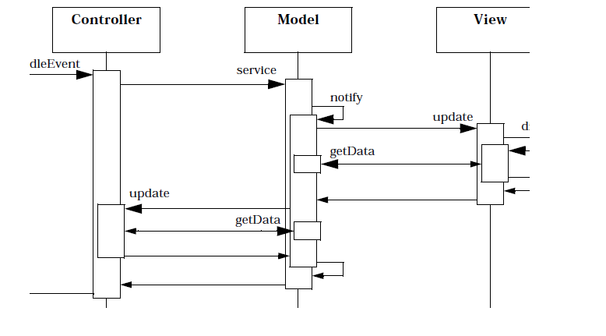
Propagating an event

Slide 17
MVC in the web
The model is the information in an application or the database
The controller is an instance of ASP or JSP that assembles information from the application or database
The views are the browser interfaces that are used to access data

Slide 18
Secure MVC

Slide 19
Broker
Intent
The Broker structures distributed systems with separate components that interact by remote service calls. A broker coordinates communications, including forwarding requests and sending back results and exceptions.
Forces
Components should be able to access remote services in a location-transparent way.
Components may need to be exchanged, added, or removed at execution time.
Implementation details should be hidden from the users of components and services.

Slide 20
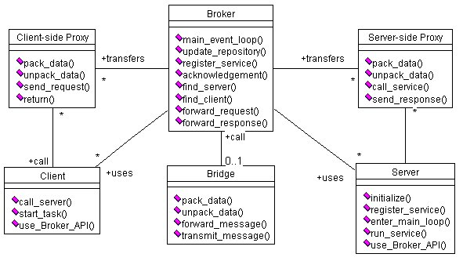
Class diagram of Broker

Slide 21
UCs: Register and Request Service

Slide 22
Known uses
CORBA
IBM’s SOM/DSOM
Microsoft’s DCOM, .NET Remoting
Sun’s RMI
This pattern (and the Layers and Lookup patterns) are used in the Bluetooth specification

Slide 23
Consequences
Advantages
Remote objects or units can be accessed transparently, as if they were local
Changeability and extensibility of components
Interoperability between different Broker systems
Portability of a broker system because low level details are hidden from users
Reusability
Liabilities
Error handling
Lower fault tolerance
Restricted efficiency
Testing and debugging

Slide 24
Secure Broker: problems
Illegal access. Client access to servers may need to be restricted and server access to clients may need to be restricted for compliance and application semantics purposes.
Message interception or replaying. An attacker may intercept the messages from client to server and read or modify them. Message replaying is another possibility.
Spoofing (Forgery). If a rogue server can portray itself as valid to the Broker, it can appear to service client requests while also compromising client data, or perform a wide variety of other attacks on clients. Likewise, if a rogue Broker can portray itself as valid to Servers and Clients, it can do harm by recording traffic between clients and servers, substituting other clients and servers for valid ones, and so on. And if a client can forge its identity to a Broker, it can access services for which it does not have rights. There are a wide variety of attacks based on Forgery: redirection of traffic from official sites to forged sites; spamming while masking the source's destination; Cache Poisoning, where invalid entries are stored in the Broker's repository; and routing attacks, where traffic intended for one destination is sent to another.
Denial of Service. Valid entries in the repository could be removed, and they will not be accessible. And with access to the Broker's server repository, DoS attacks can be launched against member servers. By limiting the server’s abilities to respond to requests, clients can be disabled.

Slide 25
Securing a Broker

Slide 26
Secure Pipes and Filters
The Secure Pipes and Filters pattern provides secure handling of data streams. Each processing step applies some data transformation or filtering. The rights to apply specific transformations to the data can be controlled. The communication of data between stages can be also protected. The operations applied can be logged.

Slide 27
Secure Pipes and Filters object diagram

Slide 28
UC “Apply an operation on a data stream”

Slide 29
Blackboard
A Blackboard system is used to receive and modify information about a problem in progress from several data sources. The execution platform for this kind of system is normally distributed, with knowledge sources possibly remote. The data is exchanged between blackboard and knowledge sources in a client/server fashion.

Slide 30
Object diagram of Blackboard pattern

Slide 31
Secure Blackboard
The Secure Blackboard pattern provides secure handling of data when its blackboard is accessed by some knowledge sources. Each knowledge source reads data from the blackboard, applies some processing or data transformation, and updates the blackboard.
In order to prevent violations of integrity and confidentiality, the rights to reading and updating data are controlled according to their predefined rights and their actions are logged.
The sources are authenticated before being allowed to access the blackboard.

Slide 32
Secure Blackboard

Slide 33
Use case “Apply an operation on the Blackboard”

Slide 34
Secure Three-Tier Architecture Pattern
The Three-Tier Architecture pattern provides a means of structuring and decomposing applications into tiers or layers, where each tier provides a different level of responsibility. One tier deals with the presentation part of the system (user and system interfaces), another handles the business logic, being the core of the system, and the last tier represents the data storage.
The Secure Three-Tier Architecture pattern extends the Three-tier Architecture pattern by enforcing a global view of security for all the three layers. In the presentation part of the system, security aspects dealing with user interaction are enforced; in the business logic, global security constraints are applied; the data storage applies policies to constrain access of users to data.

Slide 35
Secure Three-tier (N-tier in general)

Slide 36
Enterprise Service Bus (ESB) pattern
Components connect to a variety of message bus via their service interfaces
Extension: Internet Service Bus [D.F.Ferguson]
A SOA Registry (repository, catalog), is used for service description, naming, location, It includes Registry, Activator, and Lookout patterns

Slide 37
ESB pattern
Intent: Provide a convenient infrastructure to integrate a variety of distributed services and related components in a simple way.
Forces:
Interoperability. It is fundamental for a business unit in an institution to be able to interact with a variety of services, internal or external.
Simplicity of structure: we want a simple way to interconnect services; this simplifies the work of the integrators.
Scalability: we need to have the ability to expand the number of interconnected services without making changes to the basic architecture.
Message flexibility: we need to provide a variety of message invocation styles (synchronous and asynchronous) and formatting. We can thus accommodate all component needs.

Slide 38
Forces (Cont.)
Simplicity of management: we need to monitor and manage many services, perform load balancing, logging, routing, format conversion, and filtering.
Flexibility: New types of services should be accommodated easily.
Transparency: we should be able to find services without needing to know their locations.
Quality of service: we may need to provide different degrees of security, reliability, availability, or performance.
Use of policies: we need a policy-based configuration and management. This allows convenient governance and systematic changes. Policies are high-level guidelines about architectural or institutional aspects and are important in any system that supports systematic governance [Sch06].
Standard interfaces: we need explicit and formal interface contracts.

Slide 39
ESB structure

Slide 40
ESB class model

Slide 41
ESB service access

Slide 42
ESB related patterns

Slide 43
Support patterns
Provide auxiliary functions in an application

Slide 44
Publish Subscribe
Intent: Decouple the publishers of events from those interested in the events (subscribers).
Problem: Having each client call a publisher is inefficient and non-scalable. Also, more than one client could be interested in the events.
The number of clients is dynamic
Solution
Use an event channel (a queue) where publishers send their events and interested subscribers can receive the events. For event transmission it is possible to use push and pull approaches

Slide 45
Distributed P/S
Intent: In a distributed system, decouple the publishers of events from those interested in the events (subscribers).
Context: Distributed applications using web services, as well as related services such as directories, databases, security, and monitoring. There may be also other types of components (J2EE, .NET). There may be different standards applying to specific components and components that do not follow any standards.
Problem: Having each client call a publisher to find out if they have something of interest to them is inefficient and non-scalable. Also, more than one client could be interested in the same events. How do we organize publishers and subscribers in a more efficient way?

Slide 46
Solution
Use an event channel where publishers send their events and interested subscribers can receive the events. Subscribers register for the events on which they are interested.
Structure Subscribers can register to receive specific events. Their conditions are described in the class Subscription. The Channel represents different ways of publishing events.
Dynamics Figure 6 shows a sequence diagram for the use case Publish Event. Other use cases include Register Subscriber and Remove Subscriber.

Slide 47
Dist. P/S class diagram

Slide 48
UC: Publish an event

Slide 49
Implementation
For event transmission it is possible to use push and pull approaches
The event channel can be any type of asynchronous channel and may use an ESB.
Subscribers usually receive only a subset of the total messages published. The process of selecting messages for reception and processing is called filtering. There are two common forms of filtering: topic-based and content-based [wik].
An example of implementation is given in [Rou02].

Slide 50
Known uses
The IBM MQSeries provides guaranteed, once-only delivery of messages between IT systems. It can connect different types of platforms, including those from IBM, Microsoft, Sun, and HP using a variety of communications protocols
Software AG has an Integrator Server that distributes documents using a Broker as publishing channel
Oracle uses Publish/Subscribers in conjunction with their database architectures

Slide 51
Variants
If we add security mechanisms we can define a Secure Publish/Subscriber which uses the Secure Channel pattern for event channel, uses RBAC pattern for control of contents, provides mutual authentication, and includes logging.
[Cor06] describes variants based on the type of service provided: topic-based, content-based, concept-based, and type-based.
We can also define a P/S focusing on its functional or conceptual aspects, not in its software realization as we have done here. That is an style.

Slide 52
Advantages
Interoperability. Because of its decoupling effect, this pattern allows the interaction of any type of publishers and subscribers.
Freedom: Subscribers only need to register to receive some events; after this they can go on their own businesses and they are notified when there is something new.
Dynamicity: We can add or remove subscribers at any time. Subscribers can also change their interests by changing their type of subscription.
Scalability: The number of subscribers can be extended by just extending the subscriber list as far as we have appropriate communication channels for the events.

Slide 53
More advantages
Loose coupling: Publishers can work without knowledge of their subscriber details and vice versa. As far as their interfaces remain constant, both can change independently.
Location Transparency: Neither subscribers nor publishers need to know each other’s locations, a lookup service can find their locations.
Security: if events are sensitive we can encrypt the event channel. We can also use digital signatures for authenticity. See the description of the Secure P/S variant.
Selectivity: it is possible for the clients to select the published events according to different criteria, e.g., topic-based, content-based, concept-based, and type-based [Cor06].
Role changing: Publishers and subscribers may be just roles that can be taken by any entity.

Slide 54
Liabilities
There is some overhead in the event structure,, i.e. a tight coupling of subscribers to their publishers would have better performance at the cost of flexibility.
There may be coordination problems because of the decoupling.

Slide 55
Secure P/S

Slide 56
Adapter (www.vico.org)
Intent: The Adapter pattern converts the interface of an existing class into a more convenient interface, expected by a client.
Also Known As: Wrapper
Applicability: An existing class may have an interface that doesn’t match a new application. We may make its interface look like the new application by adapting it. Now the clients see a class according to the new application; calls to that interface are passed over to the old class.
GOF book gives sample code.

Slide 57
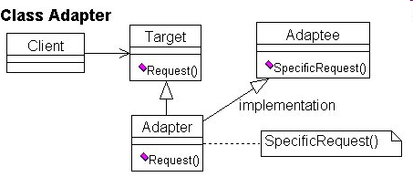
Class Adapter

Slide 58
Façade
Intent: Provide a unified higher-level interface to a set of interfaces in a subsystem.
Applicability: Use Façade when you want to provide a simple interface to a complex object-oriented subsystem or you want an entry point to a layer in a layered system.

Slide 59
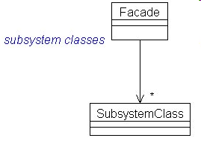
Façade class diagram

Slide 60
Consequences
Shields clients of details from subsystem units
Units in the subsystems can vary without affecting clients
Can improve security and reliability by hiding implementation details

Slide 61
Network security
Cryptography is the most important mechanism
Protocols apply cryptography to build secure channels
VPNs provide cryptographic tunnels
IDS (Intrusion Detection Systems) detect attacks in real time and alert the system
Firewalls filter traffic

Slide 62
Cryptography
Cryptography is the study of message concealment
Cryptanalysis is the study of how to discover the encrypted message.
Cryptology includes both

Slide 63
Use of encryption in the architecture

Slide 64
Cryptography value
Authentication—Can authenticate the identity of users, transactions, and systems.
Protection of messages—Can protect the secrecy of a message and prevent illegal modification. Cannot protect against destruction of the message.
Protection of software and data—Can protect the confidentiality of them although not avoid their destruction. For example, passwords can be encrypted.
Digital signatures—Can authenticate the origin of a message.
Nonrepudiation—A user that signed or otherwise authenticated a document using cryptography cannot deny having sent

Slide 65
Mechanism
Encryption is encoding a message to hide its meaning.
Plaintext is converted into cyphertext. Formally, C=E(P) and P=D(C) .
The cryptosystem must produce P=D(E(P)) to be useful

Slide 66
Symmetric cryptosystem

Slide 67
Symmetric Encryption
Encryption protects message confidentiality by making a message unreadable to those that do not have access to the key. Symmetric encryption uses the same key for encryption and decryption.

Slide 69
UC “Encrypt a message”

Slide 70
UC “Decrypt a message”

Slide 71
Public Key systems
The main problem with symmetric encryption is that to be secure, it requires periodic change of the common encryption key
A secure channel is required for key exchange, which makes the scheme inconvenient
The main feature that distinguishes public-key from symmetric-key schemes is the separation of encryption and decryption capabilities.
The public key algorithms use two keys, one of which is public and the other secret. The approach is based on the infeasibility of determining the decryption key given the algorithm and the public key
Instead of permutations and substitutions these algorithms use properties of mathematical functions. In particular, they use the theory of NP functions, those for which there is no known polynomial time solution algorithm. The most famous public key cipher is the RSA cipher developed by Rivest, Shamir, and Adelman, which is used in most current systems. This cipher takes advantage of the difficulty of factoring a large number into primes.

Slide 72
Public key systems
6/2/2016
72

Slide 73
Digital signature requirements
a) Authenticity - the signature must be authentic, i.e. belongs only to the signing user
b) Unforgeable - no other user can sign on behalf of the valid user, or forge his signature
c) Nonrepudiation - the signing user, once he has signed, cannot deny his signature. That is, it is impossible to claim that a certain message was “made up” by someone else and has the sender’s authentic signature.

Slide 74
Digital signatures
PK algorithms have the property that the roles of the keys can be reversed; that is, D(E(M)) = E(D(M)) = M. This is the basis for digital signatures.
The sender does: SIG = D private key(M)
Now using E which is known, everybody can recover M. However, only the sender could have signed it, since only he knows the private key, that is, the signature verification scheme is:
M =? E public key (SIG)

Slide 75
Certificates
To make sure that public keys are valid, and to prevent the "man in the Middle" attacks, one uses the notion of Certificates. Certificates use the following principles:
The public keys are normally registered with a certification authority (CA). This authority distributes certificates, which are public keys with the signature of the CA.
There are authentication and attribute certificates. Attribute certificates assert that certain properties are true of the owner of some authentication certificate. Attribute certificates are also used in SSL and other protocols.

Slide 76
Certificate contents
Version – which version of the standard
Serial number – unique, used for Revocation
Algorithm Id – which algorithm is used for the signature
Issuer – the CA issuing the certificate
Period of validity
The subject – attributes describing the subject (name, position, etc.)
Public key – of the subject
Signature – of the above by the private key of the CA

Slide 77
Secure channels
6/2/2016
77

Slide 78
IPsec
IPsec defines security protocols for the IP layer and can be used with TCP or UDP. It provides for confidentiality, authentication, and key management. It can also be used to build VPNs (see later).
Its advantages include being transparent to applications and to users because it is below the transport layer.
Two protocols provide security: an authentication protocol using the message header (AH) and an encryption/authentication protocol, the Encapsulation Security Payload (ESP).

Slide 79
SSL/TLS
SSL (Secure Sockets Layer) was developed by Netscape to provide message con­fidentiality and integrity. SSL has now been replaced by TLS (Transport Layer Security) which is standardized by the IETF.
Both SSL and TLS are transport layer protocols: They encrypt the traffic between two communicating applications. SSL/TLS is positioned just above TCP. In many cases it is used to encrypt communication between a Web browser and a Web server. However, its application is not restricted to the Web — in principle it is possible to use it between any two parts of a communicating application. It is, for example, also often used between an email client and an email server when the client retrieves mail from the server using POP3 (Post Office Protocol 3).
SSL/TLS is a two-layer protocol. The SSL/TLS Record Protocol is responsible for encryption between the two endpoints of the communications channel. The SSL/TLS Handshake Protocol is the second layer. It authenticates the parties who will be communicating, and negotiates an encryption algorithm and keys to use during communication.

Slide 80
TLS (SSL) protocol pattern

Slide 81
UC: Request service

Slide 82
Virtual Private Networks (VPNs)
VPNs make use of public network resources to access the internal nodes of an enterprise. The transmission is protected through a cryptographic tunnel that provides message confidentiality and integrity.
There may be authentication at each endpoint

Slide 83
Intrusion Detection Systems (IDSs)
Statistical anomaly detection --based on profiles of normal user and system behavior. Events that deviate from this behavior are considered suspicious. The profiles are built from past audit logs.
Rules-based detection -- based on sequences of events (attack signatures), that correspond to known types of attack.
6/2/2016
83

Slide 85
Firewalls
Firewalls control access from networks to internal systems (boundary protection)
Network layer firewall --analyzes packets
Application layer firewall -- uses application proxies
Stateful firewall-- keeps the state of connections
6/2/2016
85

Slide 86
Network layer firewall
6/2/2016
86

Slide 87
Application (Proxy) layer firewall
Uses security proxies to represent services
Uses a variety of the Proxy pattern
Prevents direct access
Analyzes application commands
Keeps logs for later auditing
Poor scalability
Complex if no proxies are available
6/2/2016
87

Slide 88
Application layer firewall
6/2/2016
88

Slide 90
Software Defined Networks (SDN)
Network intelligence is (logically) centralized in software-based SDN controllers, which maintain a global view of the network. As a result, the network appears to the applications and policy engines as a single, logical switch.
With SDN, enterprises and carriers gain vendor-independent control over the entire network from a single logical point, which greatly simplifies the network design and operation.
SDN also greatly simplifies the network devices themselves, since they no longer need to understand and process thousands of protocol standards but merely accept instructions from the SDN controllers

Slide 91
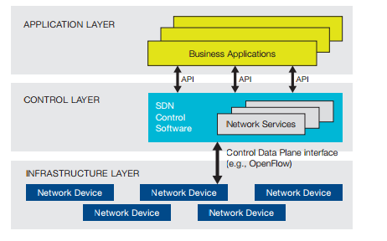
Software Defined Network (SDN) Architecture

Slide 92
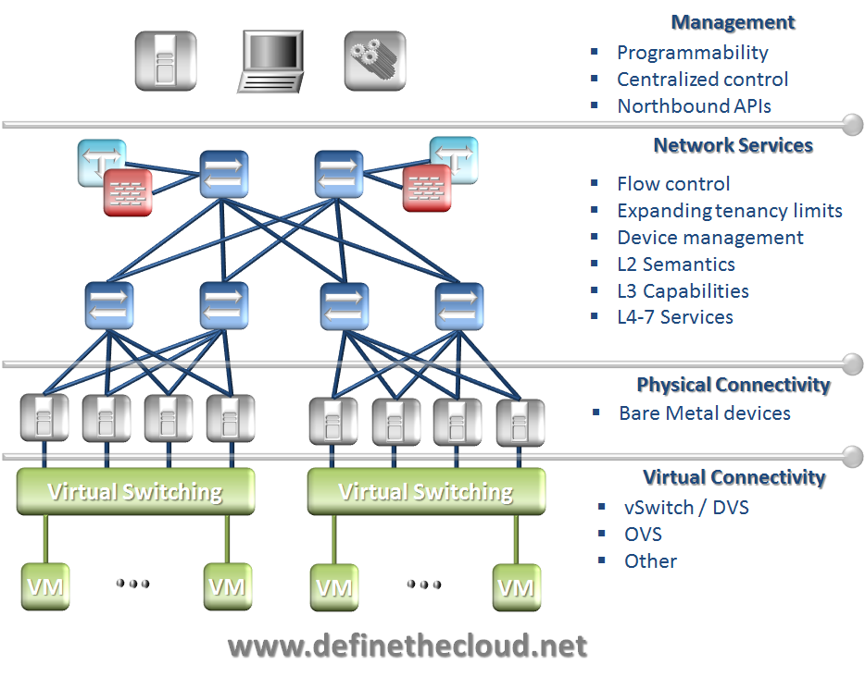

Slide 94
Operating system support for clouds
VM Operating System
Virtualization

Slide 95
VM execution

Slide 96
VM operating system

Slide 97
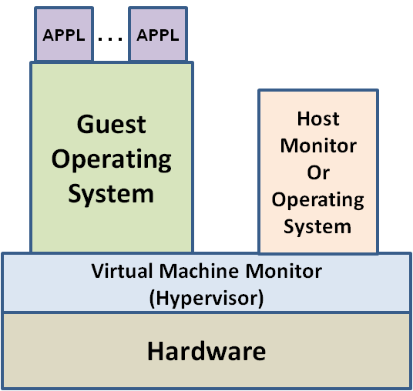
Overview of VM Technology
VM technology grouped into 6 categories
Hardware Virtualization (Emulation)
Full or Native Virtualization
Paravirtualization
Operating System Virtualization
Library Level Virtualization
Virtual Container
Principal Components
Hardware
Virtual Machine Monitor (Hypervisor)
Guest Operating System
Host Monitor or Operating System
Applications
VM works on the principle that VMM manages all system resources
I/O
Memory
Privileged Instructions
VMM handles all system resource requests by taking
control and managing request. Guest operating systems
and applications usually have no knowledge of the VMM.

Slide 98
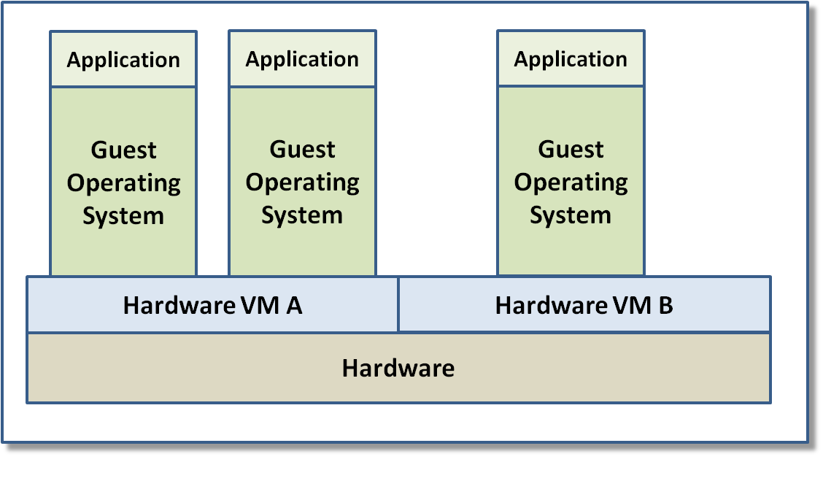
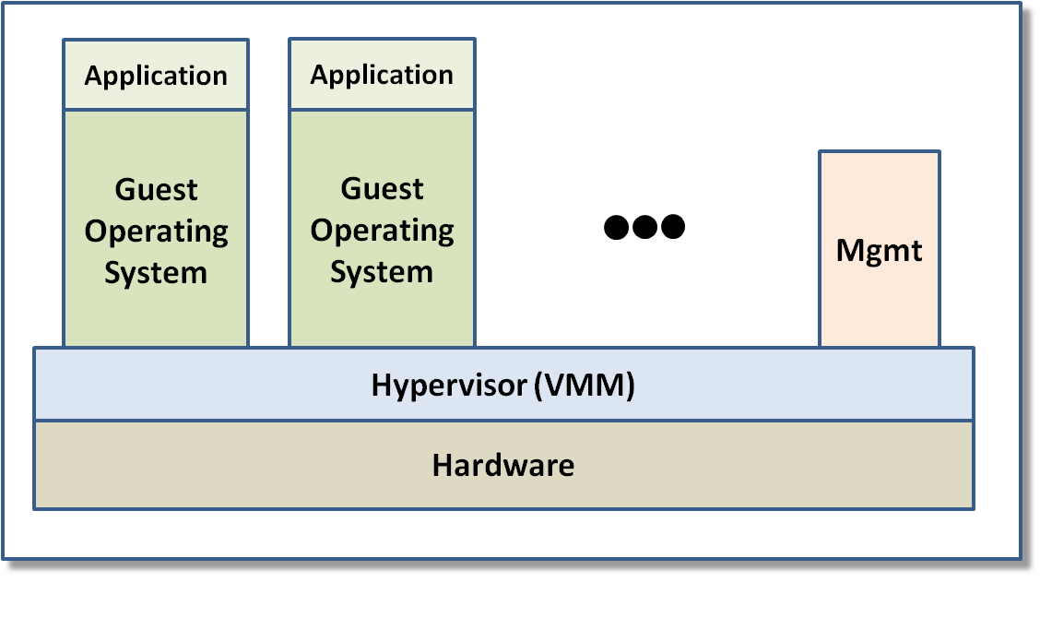
Overview of VM Technology
Hardware Virtualization (Emulation)
HVM emulates guest hardware platform
HVM manages all system resources
New hardware platforms
Multi-hardware platform utilization
Legacy hardware, operating system, and
application platforms
Inefficient instruction ratio – 100 to 1000 : 1
For legacy systems this may be ok
Full Virtualization
Hardware Virtualization – Trap & Emulate
Software Virtualization – Binary Translation(BT)
VMM manages all system resource requests
Guest OS have no knowledge of VM environment
Sometimes VMM has I/O driver suite
Faster but a lot of new I/O code development
Sometimes Host OS manages I/O driver suite
Slower but little new I/O code development
Some Combine both for best performance/code
tradeoff
Hardware Virtualization
Full Virtualization

Slide 99
References
[Bus96] F. Buschmann, R. Meunier, H. Rohnert, P. Sommerland, and M. Stal., Pattern-oriented software architecture, Wiley 1996.
[Hut10] G. Hutch, “Getting the most out of Virtualization”, The Architecture Journal, http://msdn.microsoft.com/en-us/architecture/ff803574.aspx
[Luo10] Y. Luo, “Network I/O virtualization for cloud computing”, IEEE IT Pro, Sept./Oct. 2010, 36-41
[Sch95] D.C. Schmidt, “Using design patterns to develop reusable object-oriented communication software”, Comm. of the ACM, vol. 38, No 10, October 1995, 65-74.
[Sch99] D.C. Schmidt and C. Cleeland, “Applying patterns to develop extensible ORB middleware”, IEEE Comm. Mag., April 1999, 54-63.
[Sch00] D. C. Schmidt, M. Stal, H. Rohnert, and F. Buschmann, Pattern-Oriented Software Architecture,” Wiley 2000.

