Slide 1
Chapter 7 Web Security
Dr. E.B.Fernandez

Slide 2
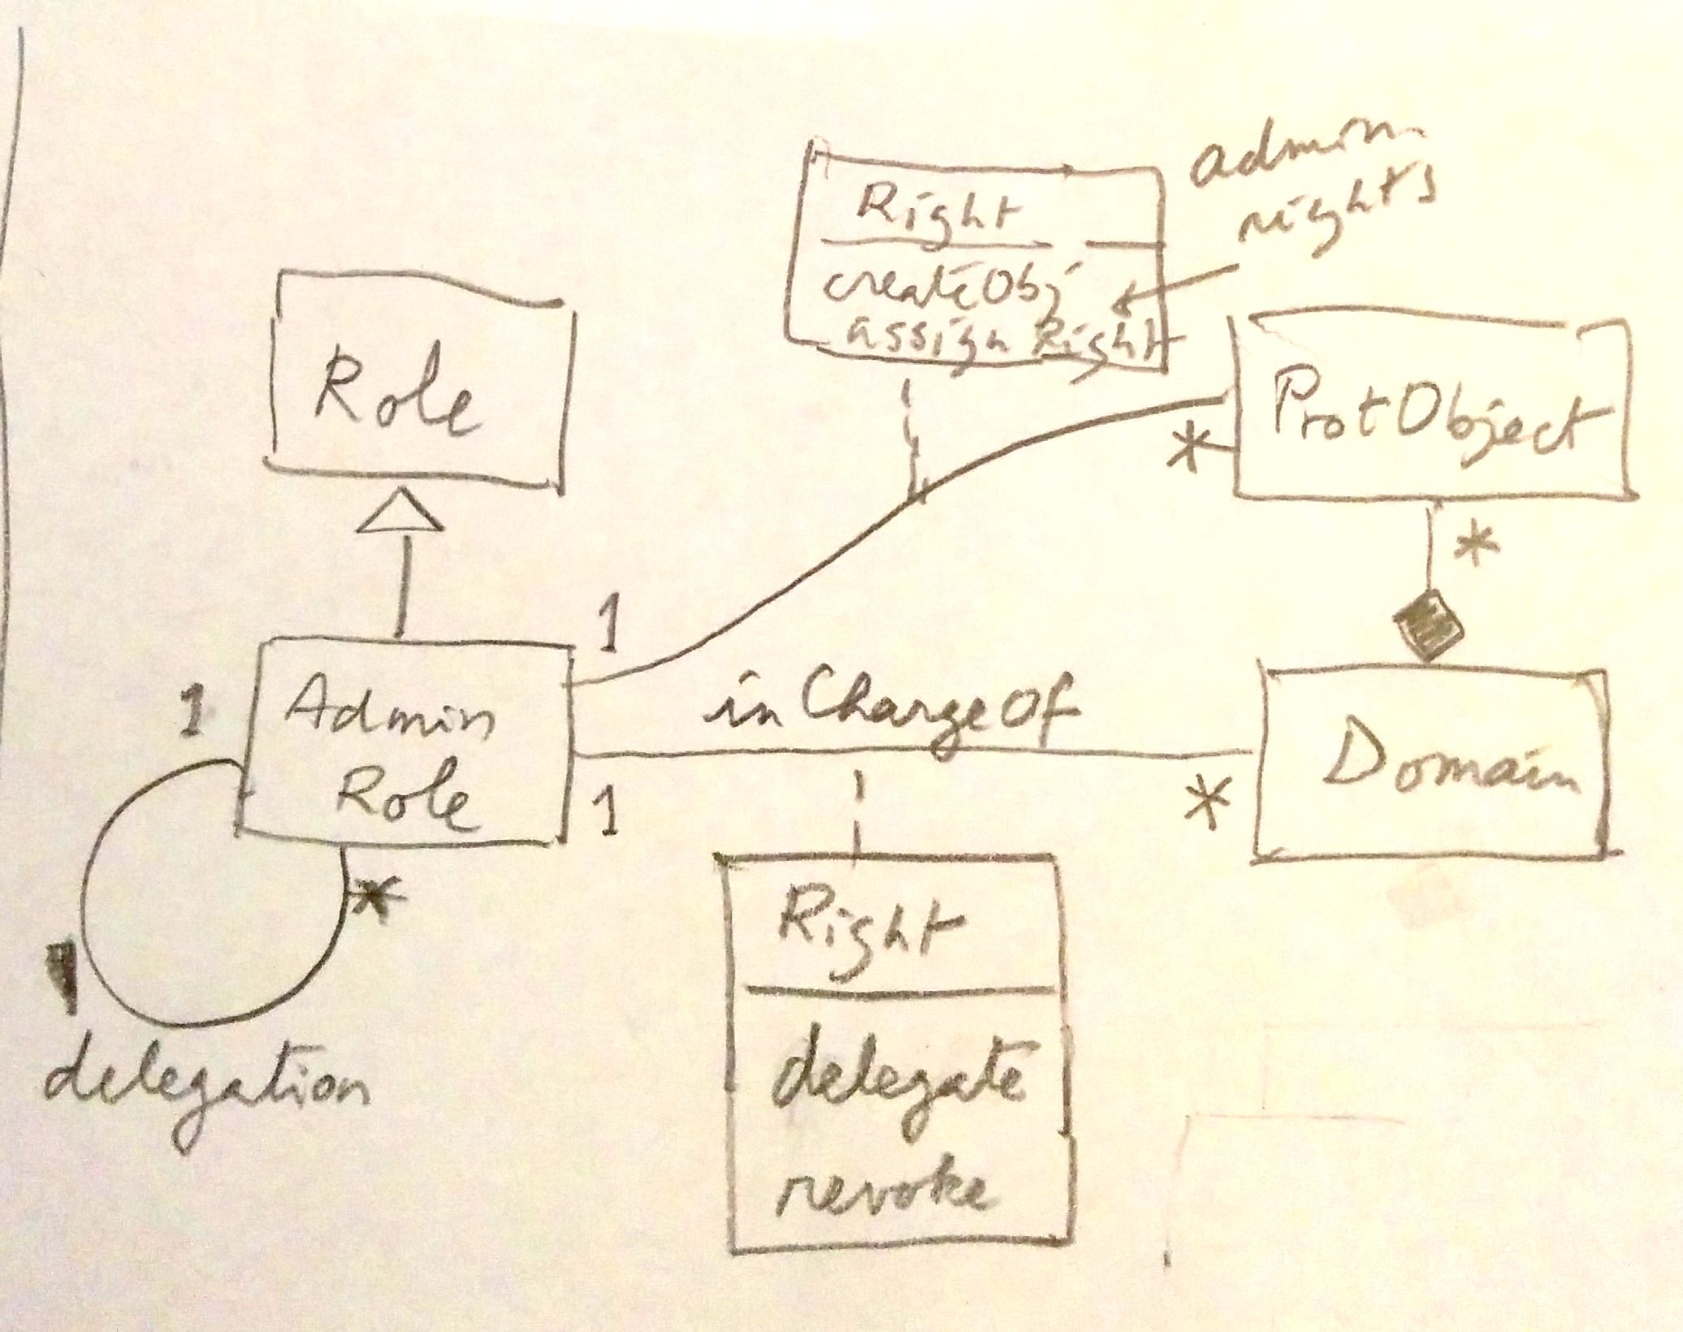
Q1:. Modify the RBAC pattern solution (UML class model) to include hierarchical administration role delegation. An administrator can delegate his administrative rights on a specific administrative domain to another administrator and revoke them later if needed. An administrative domain is a related set of data items and resources managed as a whole

Slide 3
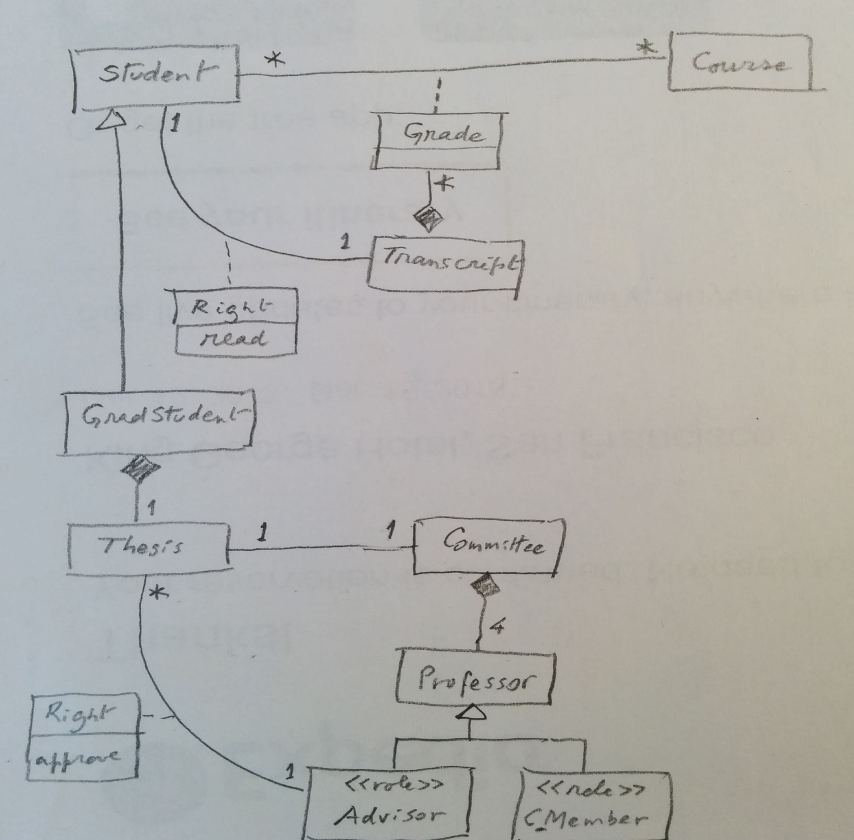
Q2:Express in UML the following policies: P1. Students have transcripts that record their grades in all the courses they have taken. P2. Students can see their own transcripts. P3. Graduate students do theses and have one advisor for a thesis. P4. A thesis requires a committee with four members including the advisor. P5.The advisor has the right to approve the thesis.

Slide 4
Q3:What is the advantage of adding tactics between policies and patterns? Be precise and concise, no long essays.
Policies are defined by managers or regulations, software architects interpret them using tactics, software developers use them in applications by applying patterns; tactics make more precise the transition from policies to software.
Policies may be too general and vague, tactics are more specific but still do not define realizations, patterns lead to software realizations.
Tactics may help select Security Solution Frames (or other sets of software artifacts) because they are more general than patterns

Slide 5
Web security
Web services security standards
XACML
XML Encryption
SAML
REST
Web threats
Products: XML Firewall and Gateway

Slide 6
Web Services
A Web Service (XML web service) is a type of component that is available on the web and can be incorporated in applications or used as a standalone service
Requires a standards-based supporting framework
The web was intended to become a marketplace of web services (did not quite happen)

Slide 7
Use of web services

Slide 8
Web services standards
We need many standards so the services are self-descriptive and can interoperate with any platform (hardware, OS, language).
For security we need to specify all the ways for web services to interact in a secure way
Standards form a hierarchy where basic standards are used as building blocks by more complex standards

Slide 9
Standards for web services security

Slide 10
WS standards
Security Standards
WS- SecureConversation
WS-Federation
WS-Authorization
WS-Policy
WS-Trust
WS-Privacy
WS-Security
XKMS
SAML
XACML
SPML
SOAP Foundation
XML Encryption
XML Digital Signature

Slide 11
Patterns for web services security standards

Slide 12
XACML
Special technical committee of OASIS
Specification of policies for information access over the Internet and their enforcement
Combines work of IBM Tokyo and University of Milano, Italy (Prof. E. Damiani).
Implemented by Sun in early 2003
Defines access matrix authorization rules to control access to documents or portions of a document
Rule has subject, right, object, and condition
Separates rule definition from enforcement

Slide 13
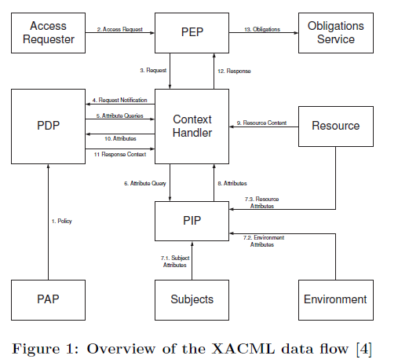

Slide 15
Components of XACML
A Policy Target is the part of a policy that specifies matching criteria for figuring out whether a particular policy is applicable to an incoming service request.
A Target contains three basic "matching" components: Subjects, Actions, and Resources. All of these components must be matched to the context of an incoming request for the policy to be applicable.
Typically, a Target defined at the Rule level is used to replace and so tighten a broader match specification found at the overall Policy level.

Slide 16
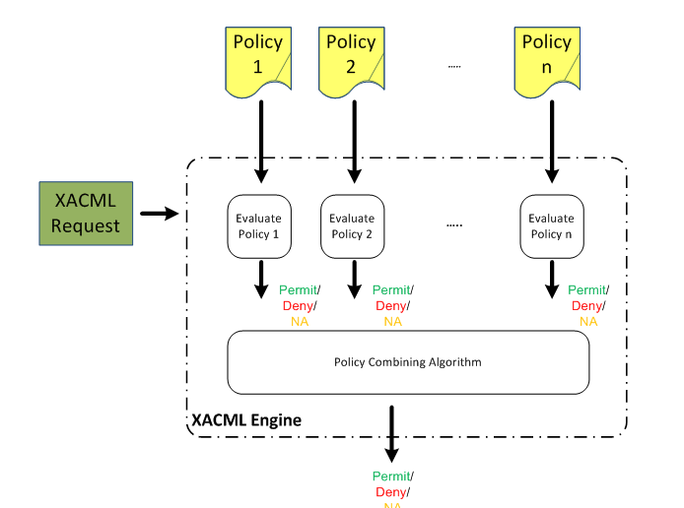

Slide 17
Enforcement: Reference Monitor

Slide 18
Reference monitor pattern

Slide 19
Reified Reference Monitor

Slide 20
RRM
In the RRM the decision, instead of being ‘yes’ or ‘no’, is a class to which we can apply operations (reification)
There is zero or one decision per request
Information about the context or any other information can be used to produce the decision

Slide 22
Abstraction in the use of patterns
We can see the Composite and Authorization patterns in XACML Authorization
We can see the Reference Monitor in XACML Evaluation
Abstraction helps model understanding

Slide 23
Use of encryption in the architecture

Slide 24
XML encryption requirements
XML Encryption Working Group (W3C)
Granularity of encryption to the element (including start/end tags) or element content (between the start/end tags)
Can reduce overhead by not encrypting all the document
Can improve security by encrypting with different keys

Slide 25
XML Encryption
The XML Encryption standard describes the syntax to represent XML encrypted data and the process of encryption and decryption. XML Encryption provides confidentiality by hiding selected sensitive information in a message using cryptography.
The yellow part is an abstract symmetric cryptography pattern (seen earlier)

Slide 26
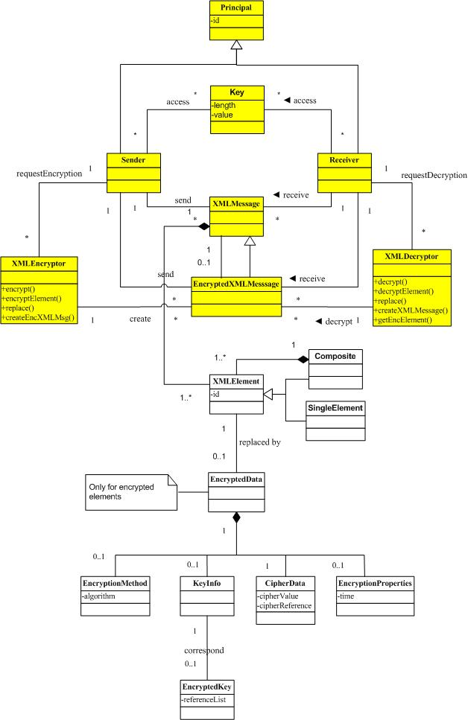

Slide 27
Structure
A Principal may be a user or an organization that sends and receives XMLMessages and/or EncryptedXMLMessages. This principal may have the roles of Sender and Receiver.
Both an XMLMessage and a EncryptedXMLMessage are composed of XML elements. Each XMLElement may have many children, and each child also can be composed by other XML elements, and so on. The Encryptor and the Decryptor encipher a message and decipher an encrypted message respectively.
The EncryptedData contains other subelements such as the encryption method, key information, cipher value, and encryption properties. The EncryptionMethod is an optional element that specifies the algorithm used to encrypt the data. If this element is not specified, the receiver must know the encryption algorithm.
The KeyInfo (optional) contains the same key information as the one described in the XML Signature standard [19]. However, this standard defines two other subelements: EncryptedKey and ReferenceList. The EncryptedKey contains similar elements as the EncryptedData; however, they are not shown in the class diagram. The EncryptedKey includes an optional ReferenceList element that points to data or keys encrypted using this key. The CipherData is a mandatory element that stores either the cipher value or a pointer (cipher reference) where the encrypted data is located. The EncryptionProperties element holds information such as the time that the encryption was performed or the serial number of the hardware used for this process.

Slide 28
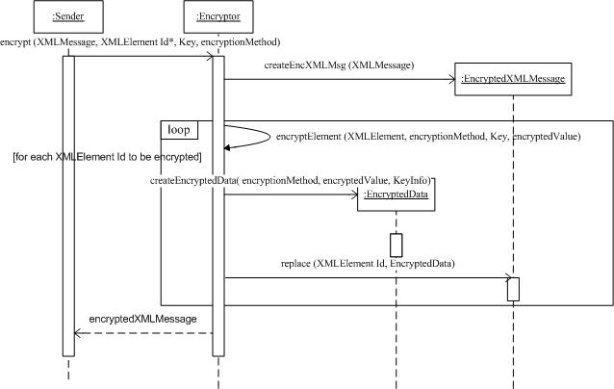
Encrypting elements

Slide 29
Consequences
Advantages:
Only users that know the key can decrypt and read the message. Each recipient can only decrypt parts of a message that are intended for him but is unable to decrypt the rest.
The EncryptedData is an XML element that replaces the data to be encrypted. The EncryptedData as well as the EncryptedKey are composed by other subelements such as encryption method, key information, and cipher value.
The entire XML message or only some parts can be encrypted.
If both the sender and the receiver have not exchanged the keys previously, the key can be sent in the message encrypted using public key system.
Liabilities:
The general liabilities of symmetric and asymmetric encryption still apply.
The structure is rather complex and users may get confused.
Unencrypted portions in the message, they may help a possible attacker. This might be improved by superencryption of the whole message at a lower level, e.g. using TLS.

Slide 30
Public Key Infrastructure
XML Key Management Specification (XKMS)
Registration of key pairs (X-KRSS)
Location of keys for later use
Validation information associated with a key (X-KISS)
X-KRSS and X-KISS use SOAP and XML

Slide 31
WS-Security
Standard from IBM, Microsoft, and Verisign
Defines security tokens
Tokens may include certificates and Kerberos tickets
Tokens can be used for claims of authentication or rights
SAML can be used for headers

Slide 32
Security tokens
Signed Security Token -- A signed security token is a token that contains a set of related claims (assertions) cryptographically endorsed by an issuer. Examples of signed security tokens include X.509 certificates and Kerberos tickets.
Claims -- A claim is a statement about a subject either by the subject or by an relying party that associates the subject with the claim.

Slide 33
Security Assertion Markup Language (SAML)
Part of XML-based Security Services
XML framework for exchanging authentication and authorization information
SAML information can be added to XML messages
6/6/2016
33

Slide 34
Three types of assertions
Authentication
Authorization
Attributes (groups, roles,…)

Slide 38
SOAP
Originally defined as Simple Object Access Protocol, is a protocol specification for exchanging structured information in the implementation of web services.
It uses XML for its message format, and usually relies on other Application Layer protocols, most notably Remote Procedure Call (RPC) and Hypertext Transfer Protocol (HTTP), for message negotiation and transmission
SOAP can form the foundation layer of a web services protocol stack, providing a basic messaging framework upon which web services can be built.
This protocol consists of three parts: an envelope, which defines what is in the message and how to process it, a set of encoding rules for expressing instances of application-defined data types, and a convention for representing procedure calls and responses.

Slide 39
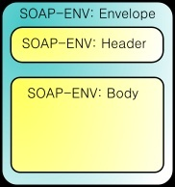
SOAP

Slide 40
REST
Representational State Transfer (REST) is a style of software architectures for distributed hypermedia systems
REST exemplifies how the Web's architecture emerged by characterizing and constraining the macro-interactions of the four components of the Web, namely origin servers, gateways, proxies, and clients, without imposing limitations on the individual participants.
REST architectures consist of clients and servers. Clients initiate requests to servers; servers process requests and return appropriate responses.
Requests and responses are built around the transfer of representations of resources. A resource can be any coherent and meaningful concept that may be addressed. A representation of a resource is typically a document that captures the current or intended state of a resource.

Slide 41
REST and web services
A RESTful web service (also called a RESTful web API) is a simple web service implemented using HTTP and the principles of REST. It is a collection of resources, with three defined aspects:
the base URI for the web service, such as http://example.com/resources/
the media type of the data supported by the web service. This is often JSON, XML, or YAML but can be any other valid Internet media type.
the set of operations supported by the web service using HTTP methods (e.g., POST, GET, PUT or DELETE).
A good overview:
A. Rodriguez, “RESTful web services: the basics”
http://www.ibm.com/developerworks/webservices/library/ws-restful/

Slide 42
REST or SOAP?
Most of the web functionality on the Internet now uses REST: Twitter, Yahoo’s web services use REST, others include Flickr, pubsub, bloglines, technorati, and several others. Both eBay and Amazon have web services for both REST and SOAP.
SOAP is mostly used for Enterprise applications to integrate wide types and large numbers of applications and to integrate with legacy systems. Google implements its web services using SOAP, with the exception of Blogger, which uses XML-RPC.
REST is a low-level protocol and cannot enforce precise security so it is used for applications that don’t require high security.

Slide 43
REST security
REST does not have predefined security methods so developers define their own, and often, developers in a hurry to just get their web services deployed don't treat them with the same level of diligence as they treat web applications.
These conditions lead to web services with serious vulnerabilities. For instance, most APIs handle authentication using a key but no secret, essentially requiring a user name but no password. Another problem is using HTTP basic authentication (with no SSL) and letting the user name and password cross the wire with no encryption.
REST APIs typically have the same attack vectors as standard web applications, including injection attacks, cross-site scripting (XSS), broken authentication and cross-site request forgery (CSRF).

Slide 44
Some threats
XSS
CSRF
WSDL threats
REST threats

Slide 45
Cross-site scripting (XSS) attacks
Another type of code injection which targets the HTML output function that sends data from a server to a browser
Idea: Use special characters to cause web browser interpreters to switch from a data context to a code context
When an HTML page references a user input as data an attacker includes the tag <script> which invokes the javaScript interpreter
The attacker can then perform exploits such as account hijacking, cookie poisoning, DoS, and web content manipulation

Slide 46
Cross-site scripting (XSS) attacks
Typical input sources: HTML forms, cookies, URLs, external files
Can use JavaScript, VBScript, Flash
Defenses can be applied in the server or the client, based on input validation
There are many varieties and no general solution
[Sha12] Shar, L K, and Tan H B K, “Defending against Cross-Site Scripting Attacks," Computer 45(3), 55-62, IEEE, March 2012.

Slide 47
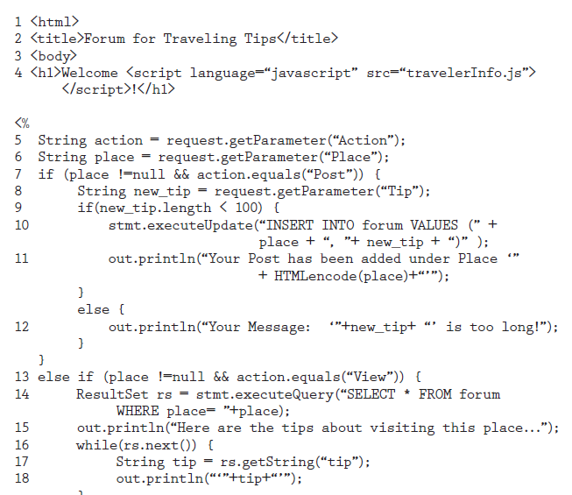

Slide 48
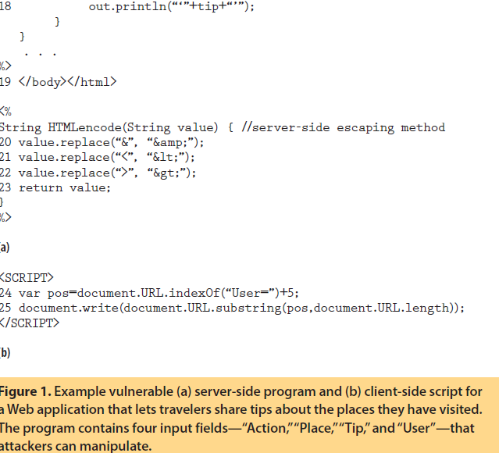

Slide 49
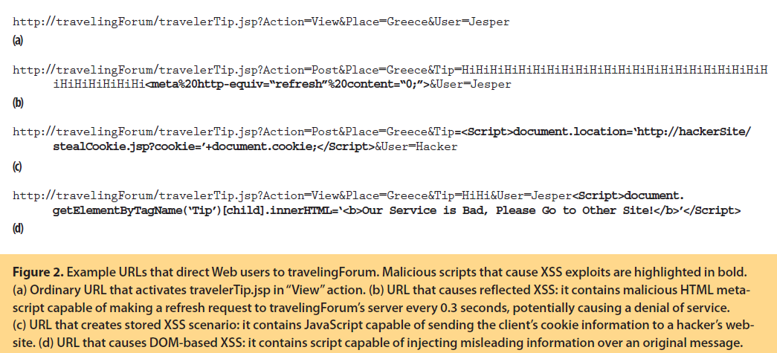

Slide 50
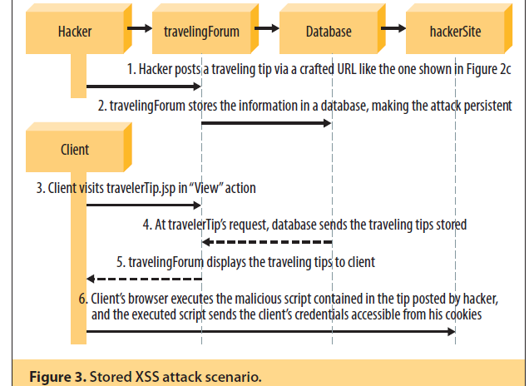

Slide 51
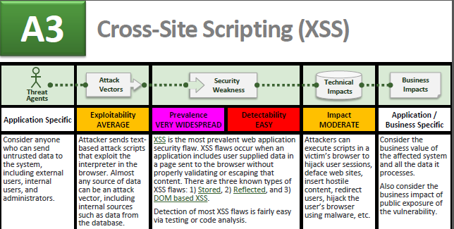
OWASP Top Ten

Slide 52
Cross-site request forgery
Also known as a one-click attack or session riding and abbreviated as CSRF or XSRF, is a type of malicious exploit of a website whereby unauthorized commands are transmitted from a user that the website trusts.
Unlike XSS, which exploits the trust a user has for a particular site, CSRF exploits the trust that a site has in a user's browser.
The attack works by including a link or script in a page that accesses a site to which the user is known (or is supposed) to have been authenticated.

Slide 53
Example
Alice, might be browsing a chat forum where another user, Eve, has posted a message. Suppose that Eve has crafted an HTML image element that references an action on Alice's bank's website (rather than an image file), e.g., <img src="http://bank.example.com/withdraw?account=Alice&amount=1000000&for=Eve">
If Alice's bank keeps her authentication information in a cookie, and if the cookie hasn't expired, then the attempt by Alice's browser to load the image will submit the withdrawal form with her cookie, thus authorizing a transaction without Alice's approval.
For the attack to be successful, an authenticated session with A must exist when the user surfs to the malicious site E. The likelihood of success can be increased by making E content-related to A, for instance to attack a banking site, the attacker poses as a site offering financial advice.

Slide 54
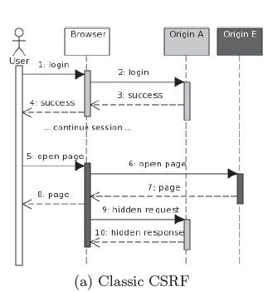

Slide 55
Misuse patterns
We did XSS: Rohini Sulatycki and Eduardo B. Fernandez, “A threat pattern for the “Cross-Site Scripting (XSS)” attack”, 22nd Conference on Pattern Languages of Programs 2015, Pittsburgh, PA, October 24-26, 2015
We do not have a pattern for CSRF

Slide 56
WSDL attacks
WSDL descriptions are public documents indicating how to use the service
WSDL contain an XML schema that can tell a hacker what requests are valid
Goal of attcker: manipulate a valid request to include illegal content and find out what error messages result
Hacker can find operations that perform no or little validation to insert invalid data to perform DoS or other attacks

Slide 57
WSDL attacks II
By observing how the system reacts to invalid data the hacker can find out about the parser and validation functions and detect vulnerabilities
The hacker can go through all the operations of the service with different request patterns until a weakness is found
The valid parameters are described in the WSDL decription and the hacker can try parameters too long or wrong type

Slide 58
WSDL attacks III
Recursive payloads—Make an infinite loop in a document
Oversize payloads—deplete system resources with a very large document
Replay attack—repetitive SOAP requests to produce a DoS
Routing detours—WS-Addressing spec directs SOAP traffic by use of tags, hacker insert tags to route the document to his site or nowhere

Slide 59
REST threats
They also have some unique vulnerabilities and attack vectors, including mashup related issues in which the mashup requires end-users to place too much trust in the mashup provider.
For example, a mashup that pulls data from multiple APIs might require user names and passwords. It's up to the mashup provider to authenticate end-users' access credentials. End users must trust the mashup provider not to steal (or inadvertently reveal) their credentials, and the API providers must trust that the mashup provider has authenticated the valid user of this account, not a hacker or malicious user.
Other vulnerabilities stem from immature grass-roots protocols such as OAuth 1.0, which is vulnerable to a session-fixation attack and could result in an attacker stealing the identity of an API end-user.

Slide 60
XML firewall
Controls input/output of XML applications
Detects not-well-formed documents (schema as reference)
Detects harmful data (wrong type or length)
Can perform encryption and decryption
Can sign documents or verify signatures
6/6/2016
60

Slide 61
6/6/2016
61

Slide 62
Components of Access control
Policy Enforcement Point defines application of enforcement (Reference Monitor)
Policy Authorization Point (Definition Point) includes information needed for authentication and authorization
ContentInspector checks for harmful data (wrong parameter lengths and types), conformance with predefined schema, can do encryption and decryption of documents, and verify signatures

Slide 63
Forum XML Gateway (web page of June 2016)
Updated beyond XML: secure XML, SOAP, JSON and REST traffic
Forum Sentry is the industry’s only FIPS 140-2 and NIAP NDPP certified XML Gateway for enabling secure connectivity between users, applications and the cloud.
With the industry’s most comprehensive built-in support for data formats and communication protocols, Forum Sentry enables companies to rapidly integrate internal XML and external RESTful systems.
http://www.forumsys.com/en/api-cloud-solutions/xml-gateway/?gclid=CJvV1YPcjc0CFTUo0wodjKEESA

