Slide 1
Ch8: CPSs, Cloud ecosystems, and IoT
Prof. E.B.Fernandez

Slide 2
Cyber-physical systems
A CPS processes and reacts to data from external stimuli from the physical world and makes decisions that may impact the physical world
Include flight avionics, smart grids, medical devices, building control,…
Reliability, safety, and security are very important; they are also usually real-time systems
Mobile devices have sensors and can participate in CPSs
Clouds are starting to be used in CPSs

Slide 3
Sensor node structure
Transceiver
Sensor
Power Source
Processor
ADC
Memory
Sensor

Slide 4
Sensor node pattern

Slide 5
A sensor network

Slide 6
Sensor network architecture

Slide 7
Advantages
If some nodes cannot reach the sink directly, other nodes can help them by relaying their data.
Clusters allow the management or securing of sec­tions of the network by deﬁning a cluster head that can control different functions.
Specialized, resource-rich nodes (called supernodes in this paper) can be inserted in the network. For example they can have more processing power to do ﬁltering, to keep logs, or to store authentication information, or they can have a larger communication range. Using supernodes, the WSN could achieve better performance such as longer network lifetime, better latency, and reliability [Sta05].
The model is also suitable for simulations.
Depending on the application requirements, a WSN can have more or less number of sensor nodes and it can be homogeneous or heterogeneous. Architectures using clusters or supernodes are scalable with the number of sensor nodes. The number of supernodes deployed will depend on the network size.
Depending on the application requirements, the WSN can be extended with security mechanisms.
Organizing the sensors in a WSN provides a cost efficient solution, since the same sensor nodes are used both in data sensing and data relaying.

Slide 8
Infrastructure systems
Infrastructure systems are needed to sustain a civilized life
They include transportation, finance and banking, government, chemical, energy, oil and gas production and distribution, health services, information management, water (drinking and irrigation), emergency services (fire, police), garbage collection, and other areas
All of these infrastructure functions are controlled by CPSs which are complex and becoming increasingly interdependent; each system typically depends on one or two other systems
Some are even mutually dependent, e.g. electric power generation may require oil, and oil production may require electricity.
Most of them are organized as control systems (SCADA: Supervisory and Data Acquisition )

Slide 9
Examples of cyberattacks to infrastructure
In the spring of 2000 a disgruntled Australian employee used a radio transmitter to disrupt the controls of a sewage treatment system. He caused some pumping stations to malfunction which resulted in large amounts of raw sewage to be released into several local rivers
In October of 2002, a coordinated DDoS attack flooded all root servers of the Internet with a high volume of traffic. The servers incurred significant delays but were able to keep up with the traffic
Spyware was discovered in computers in the office of the German chancellor, Angela Merkel, and in some other government offices. The suspects were China’s People Liberation Army (PLA).
Russian hackers attacked the websites of the government and financial institutions in Estonia. This was a response to Estonia’s removal of a Soviet war monument in Tallinn (the capital). The attacks involved denial of service and web site defacing and disrupted these sites for several weeks.
In September 2004, air traffic controllers lost voice contact with 400 airplanes over the SW US, when the main voice communication system shutdown unexpectedly. The backup system that took over also crashed almost immediately after taking over. Air controllers resorted to cell phones and most planes had collision avoidance systems, and there were no collisions.

Slide 10
Supervisory Control and Data Acquisition (SCADA) systems structure

Slide 11
SCADA units
A control loop. This includes sensors, controllers, actuators, and communication links, that operate on a controlled process. Sensors collect information from the controlled process and send it to the controller which adjusts parameters based on these values and their set points.
A human-machine interface (HMI). Used by engineers and operators to define set points, control algorithms, and adjust parameters. The HMI also displays status information and historical information.
Remote diagnostic and maintenance functions. Used to identify and recover from failures or attacks.
Databases. Contain control information, settings, historical information (logs), …
Communication networks. To connect all the units.
SCADAs are the most important type of CPS.

Slide 12
General SCADA architecture

Slide 13
SCADA Pattern
Central Controller
Communication Network
Field Unit
1
1
1
1
*
*
*
1
Human-Machine Interface
Data Server
Field Unit
Local Controller

Slide 14
SCADA threats
Threats against/through the central controller include those such as (i) physical attacks, (ii) malicious settings of the field units, (iii) wrong commands to the field units, (iv) malicious alteration of the runtime parameters of the central controller, and (v) denial of service attacks.
Threats against/through the field units include those such as (i) physical attacks, (ii) malicious alteration of the runtime parameters of the field units, (iii) wrong commands to the field units, (iv) malicious alarms to the central controller, and (v) denial of service.
Threats against/through the communication networks include (i) sniffing, (ii) spoofing, and (iii) denial of service.
Attacks against the central controller and the network are more harmful since they may disable the whole system, whereas attacks against ﬁeld units only affect speciﬁc units

Slide 15
Countermeasures
Central controller. To stop T1, we use security patterns for physical access control such as the Role-Based Access Control (RBAC) pattern combined with the Authenticator Pattern and the Logger Pattern
To stop T2, T3, and T4, we use the Authorization Pattern together with the Authenticator Pattern and the Secure Logger Pattern. The Authenticator restricts access to the system to only registered employees, the Authorization pattern controls the actions that the employees can do on the controller, and the logger is useful for those cases where a legitimate employee is trying to perform sabotage (we cannot stop the attack but we have a record of who did it)
To stop T5, we use the Firewall Pattern together with an Intrusion Detection System (IDS) pattern. The IDS detects the attack and instructs the firewall to block traffic from the attacking addresses

Slide 16
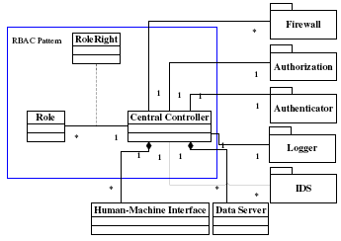
Defenses for the Central Controller

Slide 17
Rest of the system
Similarly we can analyze the network and the field units
For them we find the threats and we apply security patterns to control them
This results in a Secure SCADA pattern

Slide 18
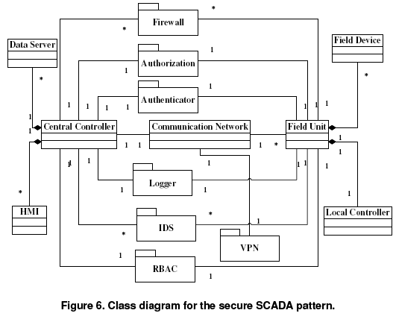

Slide 19
The weak spot under the hood http://www.nytimes.com/2015/09/27/business/complex-car-software-becomes-the-weak-spot-under-the-hood.html
New high-end cars are among the most sophisticated machines on the planet, containing 100 million or more lines of code.
The sophistication of new cars brings numerous benefits — forward-collision warning systems and automatic emergency braking that keep drivers safer are just two examples. But with new technology comes new risks.
The unfolding scandal at Volkswagen — in which 11 million vehicles were outfitted with software that gave false emissions results — showed how a carmaker could take advantage of complex systems to flout regulations.
it is possible to disable a car’s brakes with an infected MP3 file inserted into a car’s CD player. A hacking demonstration by security researchers exposed how vulnerable new Jeep Cherokees can be.

Slide 20
Stuxnet
It is a highly sophisticated worm. Discovered in June 2010, Stuxnet initially spreads via Microsoft Windows, and targets Siemens industrial software and equipment. While it is not the first time that hackers have targeted industrial systems, it is the first discovered malware that spies on and subverts industrial systems, and the first to include a programmable logic controller (PLC) rootkit.

Slide 21
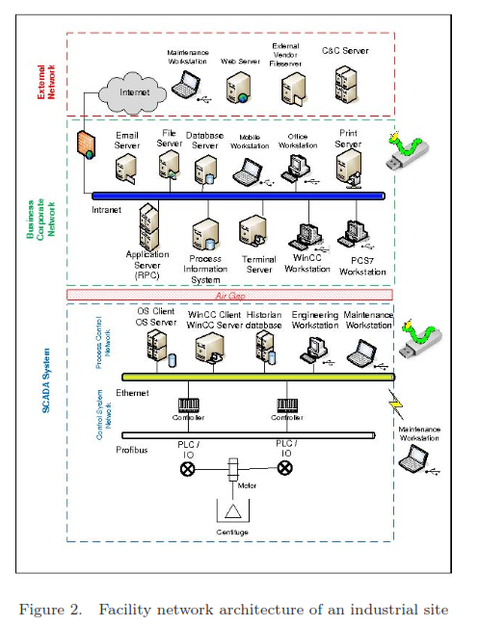

Slide 22
Children of Stuxnet
Duqu--On 1 September 2011, a new worm was found, thought to be related to Stuxnet. The Laboratory of Cryptography and System Security (CrySyS) of the Budapest University of Technology and Economics analyzed the malware, naming the threat Duqu.^{[120][121]} Symantec, based on this report, continued the analysis of the threat, calling it "nearly identical to Stuxnet, but with a completely different purpose", and published a detailed technical paper.^{[122]} The main component used in Duqu is designed to capture info such as keystrokes and system informationn
In May 2012, the new malware "Flame" was found, thought to be related to Stuxnet.^{[124]} Researchers named the program "Flame" after the name of one of its modules.^{[124]} After analysing the code of Flame, Kaspersky said that there is a strong relationship between Flame and Stuxnet. An early version of Stuxnet contained code to propagate infections via USB drives that is nearly identical to a Flame module that exploits the same vulnerability.^{[125]}

Slide 23
Internet of Things (IoT)
Tagged objects that communicate through the Internet
Users can query their status and even control them
Physical objects can be part of applications
Examples: smart homes, wireless patient care, transportation systems,…
Large amounts of real-time information
Preprocessing usually needed

Slide 24
IoT
The Internet of Things (IoT) is the interconnection of uniquely identifiable embedded computing devices within the existing Internet infrastructure. Typically, IoT is expected to offer advanced connectivity of devices, systems, and services that goes beyond machine-to-machine communications (M2M) and covers a variety of protocols, domains, and applications.^{[1]} The interconnection of these embedded devices (including smart objects), is expected to usher in automation in nearly all fields, while also enabling advanced applications like a Smart Grid.
Things, in the IoT, can refer to a wide variety of devices such as heart monitoring implants, biochiptransponders on farm animals, automobiles with built-in sensors, or field operation devices that assist fire-fighters in search and rescue.^{[3]} Current market examples include smart thermostat systems and washer/dryers that utilize wifi for remote monitoring.
As the Internet of Things spreads widely, cyber attacks are likely to become an increasingly physical (rather than simply virtual) threat. In a January 2014 article in Forbes, cybersecurity columnist Joseph Steinberg listed many Internet-connected appliances that can already "spy on people in their own homes" including televisions, kitchen appliances, cameras, and thermostats. Computer-controlled devices in automobiles such as brakes, engine, locks, hood and truck releases, horn, heat, and dashboard have been shown to be vulnerable to attackers who have access to the onboard network. (These devices are currently not connected to external computer networks, and so are not vulnerable to Internet attacks.)

Slide 25
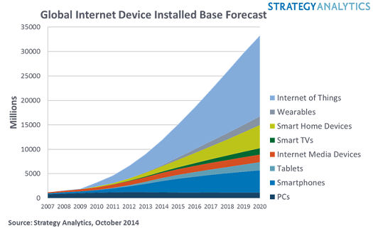

Slide 26
City transportation systems
Tags in vehicles, tags in fixed positions, tag readers,…
Can track location of vehicles, perform real-time traffic analysis, determine optimal routes,…
Use hybrid networks, combining Wi-Fi, GSM, GPS, IP, …
Used in bus systems, taxis,…

Slide 27
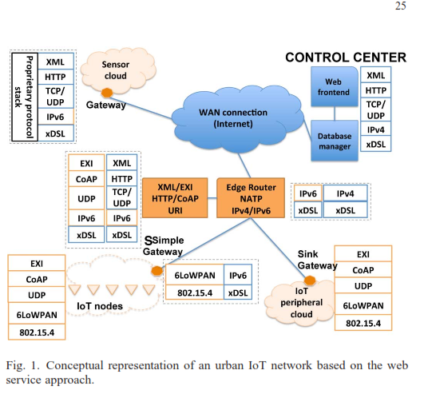

Slide 28
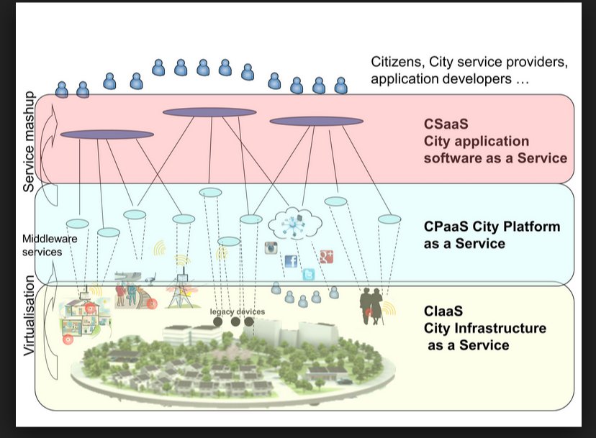

Slide 29
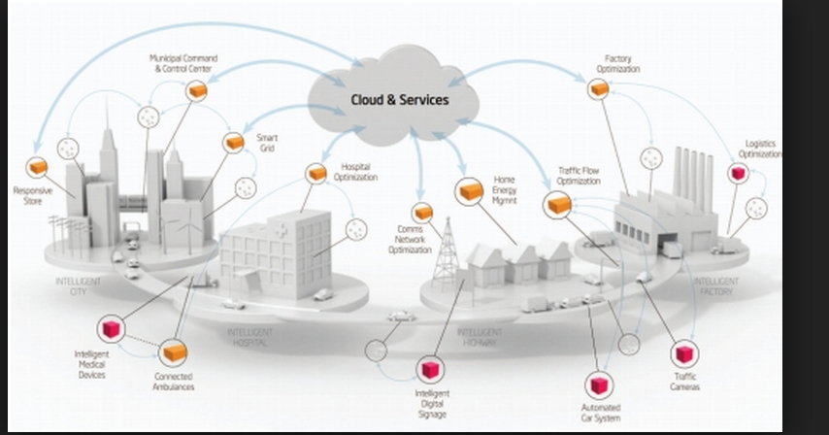

Slide 30
Interclouds
An Inter-Cloud is a system in which heterogeneous service providers join their services in order to provide an extensive catalog of services to their Consumers and enlarge their resource pool. Inter-Cloud can be classified into two modes, federated and non-federated, the first one is also called federated Inter-Cloud and the second Multi-Cloud. In federated Inter-Cloud, Service Providers (SP) can share their capabilities in order to supply a large amount of services/resources to their clients .
The Cloud Broker’s aim is to decentralize the satisfaction of requests using the Cloud Exchange component; for that reason, their main use cases are related to the forwarding of request across the Service Provider and the Cloud Exchange. It is reasonable also to think in the Cloud Broker as a cache.

Slide 31
Cloud Federation pattern model
A Service Provider is part of a Cloud Federation and processes requests from Consumers through a Portal. The Service Provider can be assembled in different ways such as an aggregation of clouds, a set of peers, implied, etc. The Service Provider performs requests to a Cloud Broker. The Cloud Broker redirects the request to the Cloud Exchange component. The Cloud Exchange consults its Catalog (a.k.a. Information Repository) looking for the best match for the request. The Catalog lists several kinds of Services. The Cloud Exchange is aware of the condition of the entire system through status information coming from Cloud Brokers. The Catalog is updated considering the information sent by the Cloud Brokers.

Slide 32
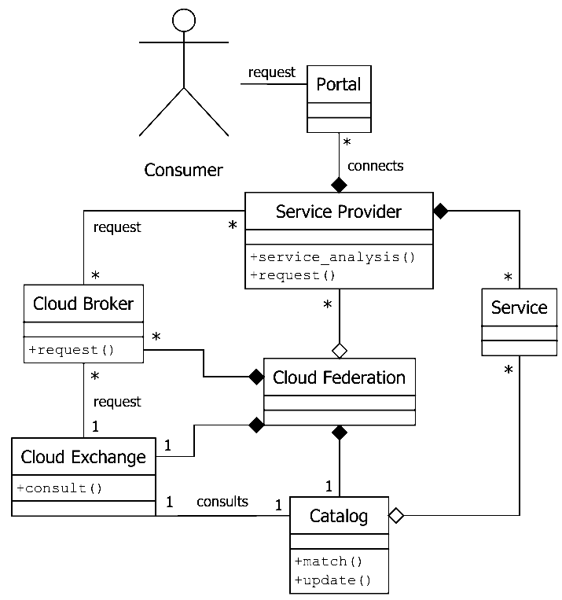
Class diagram of a Cloud Federation

Slide 33
Cloud ecosystems
Ecosystems were initially defined from a biological perspective: systems formed by the interaction of a community of organisms with their physical environment
The term was later applied to software systems: “a collection of software systems, which are developed and co-evolve in the same environment”
Another definition: the expansion of a software product line architecture to include systems outside the product which interact with the product
An ecosystem is advantageous to suppliers who can offer a larger variety of products or services, and to consumers who can find more products to help them reach their business goals
Several companies are developing ecosystems around their products, e.g. Cisco, Apple, and Microsoft.
In cloud ecosystems their complementary systems may not be produced by the same vendor and may use different protocols although able to interact with other products in the ecosystem.

Slide 34
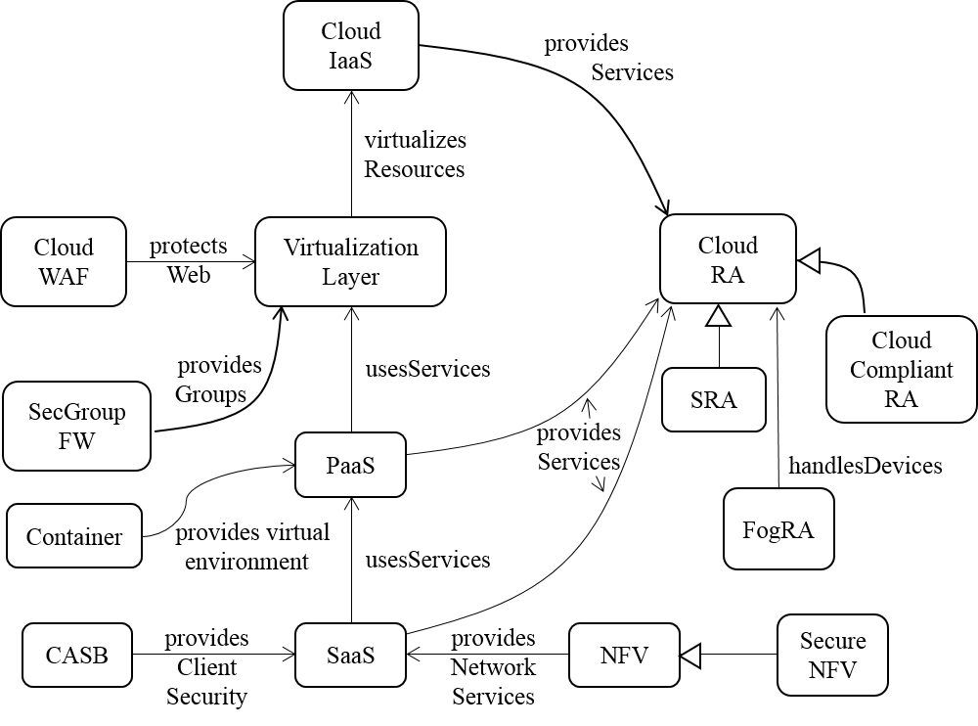
Pattern Diagram of Cloud Ecosystem

Slide 35
The core pattern of this ecosystem is the Cloud Reference Architecture (Cloud RA) .
Addition of security patterns to a Cloud RA converts it into a Cloud Security RA (Cloud SRA). The Cloud SRA includes security patterns for Authentication, Authorization, and Logging, among others, which can help control known threats to the cloud
Patterns that describe how regulations apply to the Cloud RA are included in the Cloud Compliant RA
Other components of the ecosystem include the service layers of a cloud, IaaS, PaaS and SaaS .
Network Functions Virtualization (NFV) is a network architecture where network functions are provisioned in software using virtualization.
Filtering functions are provided by Cloud Web Application Firewalls (Cloud WAF) and Security Group Firewalls (SecGroup FW).
Cloud Access Security Brokers (CASBs) are security enforcement points between consumers and service providers that apply security controls to access cloud services, usually SaaS services.
Recent entities that have been added to this ecosystem include containers and fog computing.

Slide 36
What have we done so far?
We have defined the ecosystem in the form of a pattern diagram
Some of the units of this system have been already modeled as patterns and reference architectures using UML models, but some are missing
We added to the cloud ecosystem newly identified components, described as patterns (container, fog computing).
We studied new types of systems, like IoT, which are driving the changes in cloud ecosystems.
We also discussed how this evolution is changing the way we handle software development and deployment.

Slide 37
Cloud models
We started by describing models for clouds:
E.B.Fernandez, “Security patterns in practice: Building secure architectures using software patterns”, Wiley Series on Software Design Patterns, 2013 (Chapter 15 describes cloud architectures)
E.B.Fernandez, Raul Monge, and Keiko Hashizume, “Building a security reference architecture for cloud systems”, Requirements Engineering. Doi: 10.1007/s00766-014-0218-7, June 2016, Volume 21, Issue 2, pp 225-249.

Slide 38
Models of Ecosystem Components
Software Container
Fog Computing
Notes:
-A pattern diagram for cloud ecosystem gives a holistic and unified view and the next step is to define detailed models for each of its components.
-Some of these components have already been described as patterns,
-here we include patterns for two components which were not present in our earlier work
-Complete patterns can be found in their respective references, just main functions of the components are included here.
Pattern descriptions also include Forces, Consequences, Implementation, and Related Patterns sections.
The idea here is that we can build patterns for every participant in the ecosystem, which provides a unified view of the complete system.

Slide 39
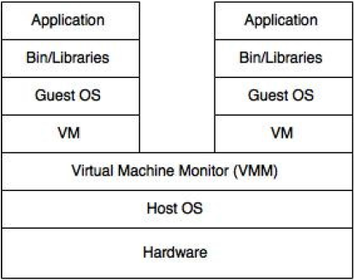
Software Container
Intent: A Software Container provides an execution environment for applications sharing a host OS, binaries, and libraries with other containers with strong isolation between them.
Containers are lightweight, portable, extensible, reliable, and secure.
Docker is a popular example of software containers.
Figure 1. “Two containers sharing one OS” vs “A Virtual machine”

Slide 40
Class Diagram for Software Container

Slide 41
DevOps
The cloud has had an impact on all facets of the computing world including software development.
Emerging technologies like Cloud Computing, IoT and DevOps are mutually influencing each other.
DevOps is being enabled by the cloud.

Slide 42
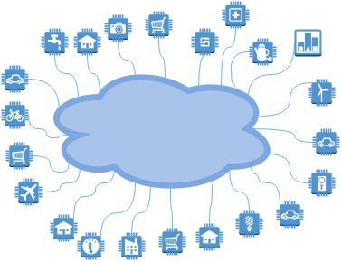
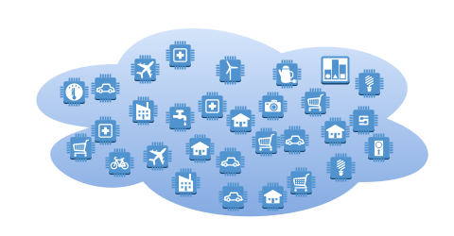
Internet of Things - Cloud

Slide 43
Problem Domain
Cloud Ecosystems
Internet of Things
Security and Privacy
Security Issues in Fog Computing
Fog Computing

Slide 44
Internet of Things
The IoT has found its application in various domains.
Examples include smart traffic control, smart grid, wireless sensor networks, precision agriculture, intelligent buildings, health care, industrial automation, oil and gas, etc.
The IoT has brought about an explosive proliferation of endpoints.
According to an estimate, nearly 50 billion heterogeneous devices will be connected to the internet by 2020.
Storage and processing costs are declining and the devices are getting smaller and less expensive.
Increased intelligence of these devices
Huge amounts of data
90% of the world’s data was created in the last 2 years, and it is increasing exponentially.
We need to manage the large number of devices and process the data produced by them.
Notes:
Cloud computing has established itself as a promising computing paradigm. However, the recent p

Slide 45
Internet of Things and Fog Computing
IoT applications require low latency, mobility support, location awareness and support for geo-distribution.
Popularity of IoT has made the limitations of clouds more apparent, We need new solutions.
Fog computing offers one of such solutions.
It complements rather than replaces the cloud.
Cisco fog computing solutions, Amazon Web Services (AWS) Amazon IoT cloud service, IBM IoT solutions for analytics.
Numerous papers discuss these IoT applications in connection to fog computing. Ours is the first pattern for fog computing.
Containers are also providing more lightweight, portable virtualization solutions that will offer support for IoT applications.
Notes:
Cloud computing has established itself as a promising computing paradigm. However, the recent p

Slide 46
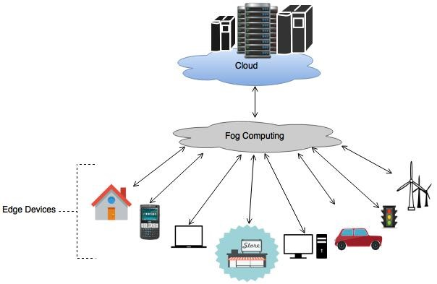
Fog Computing
Intent Fog Computing is a virtualized platform that stands between cloud computing systems and Internet devices, providing to these computation, storage, and networking services and allowing a cloud to control and communicate with these devices.
Fog can offer low latency, location awareness, efficient use of bandwidth and storage services.
Cisco provides fog computing platforms
Figure 3: Idea of Fog Computing

Slide 47
Solution
Introduce a platform to provide cloud computing-like services closer to the devices to be monitored or controlled. This is called Fog Computing.
It provides computation, storage, and networking services between end user devices and cloud providers. Data is processed locally for better response. Aggregated data and other relevant information can be forwarded to the cloud for analysis.
The Fog is a collection of several distributed tiny clouds called Fog Nodes. They can be resource-rich servers, routers, access points, mobile devices etc.
A Fog Node has resources including hardware (compute, networking and storage) capabilities.
These nodes provide local real-time data analytics capabilities using an Analytics Engine.
Applications can be hosted in the fog nodes using virtualization, Virtual Machine (VM) and/or Containers.
A database stores both application data and necessary metadata for service orchestration.
It also has information about hardware and software capabilities of nodes, information about the state of fog nodes and services, policies for security, filtering, and configuration.
Fog computing uses Reference monitor to perform policy-based service orchestration.
A Policy Manager is triggered by service requests and a Decision Maker Engine (Reference Monitor) gathers relevant policies and metadata to decide about requests. Also, depending on the information received, new policies can be added to the Policy Repository [Dsouza et al. 2014].
Data is transferred between fog nodes, the decision maker and the various components of the Fog.
Reference monitor enforces the authorization rules and authenticator is used for providing access control. In addition, services like filtering, aggregation of data, logging, etc., can be provided.

Slide 48
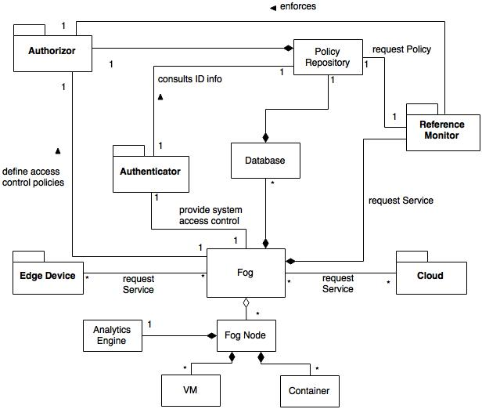
Class diagram of the Fog Computing pattern

Slide 49
Implementation
Fog computing requires multi-tenancy support for applications, from different software companies or developers, that need to execute without interfering with each other. So, the cloud platform in devices comprising the fog platform should support multi-tenancy for applications.
Despite multi-tenancy fog devices should be able to execute applications in isolation to prevent unwanted interference from other processes.
Policies have to be defined to control service orchestration, filtering and for adding security.
Decentralized management mechanisms need to be established to setup and configure a large number of devices in fog [Vaquero and Merino 2014].
Bonomi et al. [2014] mentions a local software agent on each fog node, called foglet, which monitors the state of the node and services. Foglets also perform lifecycle activities and orchestration. Also they mention fog abstraction layer which provides uniform programmable interface for resource control and management. It provides generic APIs to monitor and manage heterogeneous fog devices.

Slide 50
Consequences
Large number of nodes, Latency, Mobility, Location awareness, Heterogeneity, Transparency, Big data analytics, Cloud Support, Scalability/Flexibility, Multi-tenancy, Multiplicity of providers, Security, Filtering

Slide 51
Liabilities
Use of fog computing means device users will have less control over selection of fog service providers as compared to the cloud. A limited number of providers are involved in service provisioning in the case of clouds. However in the case of fogs, smaller fog servers will be larger in number and can be owned by different providers. Trust and security will most likely be more difficult to establish. Number and types of 3rd parties can be an issue.
Devices are now sharing resources in a more distributed environment. The confidentiality of the users can be a concern and mechanisms have to be adopted which provide authentication and authorization for ensuring user privacy. Authentication and authorization will be required at three levels: user devices, fog device and cloud providers. Policies must be mapped between these levels. Stojmenovic and Wen [2014] discusses security and privacy issues in fog computing.
A multiplicity of providers may also lead to compliance problems, especially when health or financial data is involved.
Fog computing should support multi-tenancy which can bring a potential security problem unless strong isolation is ensured between these applications.
Heterogeneous mobile devices that are geographically distributed over a large area and are owned by different providers, could make management and configuration a problem as compared to the cloud where a centralized approach is used.

Slide 52
Value of Cloud ecosystems
Can control heterogeneity
Can provide a holistic and unified security view
Analyzing security aspects of an ecosystem, use it to answer several security questions
Starting with security in fog controlling variety of devices
Lack of unified view can make integration of systems, each with its own security policies, very challenging
Compliance with standards and regulations
Support for software development
Agile software development framework, DevOps which is enabled by cloud
Notes:
Containers facilitate application distribution, especially for DevOps teams.
It calls for increased communication, collaboration and smooth integration between developers and operations teams. It enables continuous development and frequent releases of software to the end user, which can lead to earlier problem detection and solution delivery.
DevOps is driven by the wide availability of virtualized and cloud infrastructure.

Slide 53
Conclusions
Ecosystems have been around for a while and have become very important
Clouds require a variety of related components to be effective and cloud ecosystems are starting to be defined.
A holistic, unified treatment is needed for security and it is fundamental to handle the complexity of cloud-based systems. This is especially true for handling security and privacy, a unified approach reduces complexity, one of the most important weaknesses used by attackers and can enable analysis of the propagation of threats and data leaks
The existing models oversimplify this complexity and are not appropriate to study security and reliability aspects, so ours appears to be the first attempt to produce a more precise model
As part of this work we identified several possible patterns, which define future work. Future work also includes showing how security and privacy constraints propagate across components.

Slide 54
Future Work: Security issues of ecosystems
After having defined architectures for all the current components and we can use these models to analyze security and related aspects
Security aspects of the fog systems as part of a cloud ecosystem.
Develop a holistic security view across all the elements of the ecosystem.
Defining security policies across hierarchical cloud-fog computing model.
Policies are high level guidelines defining how an institution conducts its activities in its business, professional, economic, social, and legal environment
Security policies include rules, laws, and practices that regulate how an institution uses, manages and protects resources.
Possible conflicts
Each component may have its own set of policy rules or may inherit from other components

Slide 55
Future Work
We intend to define policies for regulating cloud-fog, fog-devices, fog-fog data exchanges
Data from the cloud can be sent to the devices or what data from the devices can be sent to the cloud.
Devices may contain sensitive data whose disclosure would affect the privacy of users.
The fog platform itself contains data and the access of that data should conform with cloud policies as well as device policies; that is, security constraints in the cloud and devices should propagate across levels.
Fog platforms may communicate with other fogs and may need authorizations to perform actions in remote fog systems.
Perform a systematic analysis of threats, the introduction of products may bring new vulnerabilities; each use case of a new product or service must be analyzed to consider possible attacker goals related to it.

Slide 56
In summary
Model-based architectural approach to security
Semi-formal but let us see the whole picture, fundamental for security
Patterns and RAs give us guidelines and insights about unit effect on security and about their interactions, key to attacks
Working with patterns does not restrict creative ideas

Slide 57
Patterns and creativity
Does the use of patterns restrict your creativity to build systems or invent new security architectures?
Absolutely not, patterns don’t prescribe solutions, they only provide guidelines for a solution
Patterns provide abstractions so the designer can concentrate on the important aspects and not be confused with details

Slide 58
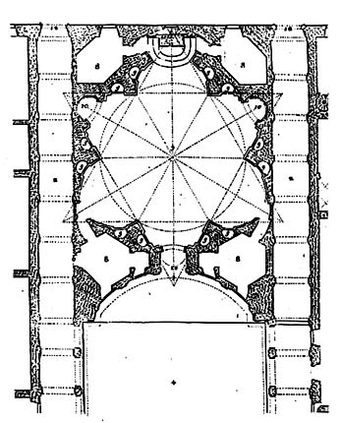
Borromini: Sant’Ivo alla Sapienza

Slide 59
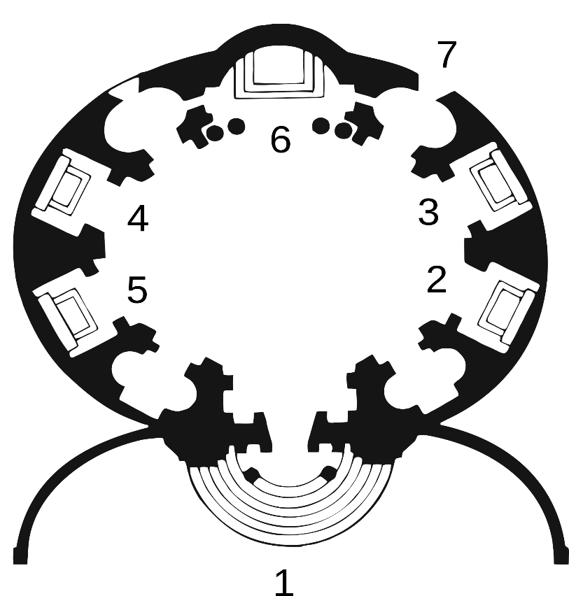
Bernini: Santa Maria al Quirinale

Slide 60
Our recent publications
Madiha H. Syed and Eduardo B. Fernandez, “The Software Container pattern”, 22nd Conference on Pattern Languages of Programs (PLoP 2015), Pittsburgh, PA, October 24-26, 2015
Madiha H. Syed, E.B.Fernandez, M.Ilyas, “A pattern for fog computing”, Pattern Languages of Programming (VikingPLoP 2016), 7th-10th April 2016, Leerdam, Netherlands
Madiha H. Syed and E.B.Fernandez, “Cloud ecosystems support for Internet of Things and DevOps using patterns”, First International Workshop on Interoperability, Integration, and Interconnection of Internet of Things Systems (I4T), part of the IEEE Int. Conf. on Cloud Engineering (IC2E), Berlin, Germany, April 4-8, 2016.
E.B. Fernandez, Nobukazu Yoshioka, Hironori Washizaki, and Madiha H. Syed, “Modeling and security in cloud ecosystems”, J. Future Internet, 2016, vol. 8, 13.
E.B.Fernandez, Raul Monge, and Keiko Hashizume, “Building a security reference architecture for cloud systems”, Requirements Engineering. Doi: 10.1007/s00766-014-0218-7, June 2016, Volume 21, Issue 2, pp 225-249.
E.B.Fernandez, “Security patterns in practice: Building secure architectures using software patterns”, Wiley Series on Software Design Patterns, 2013 (Chapter 15 describes cloud architectures)

Slide 61
References
A.A. Cardenas, S. Amin, Z.-S. Lin, Y.-L.Huang, C.H.Huang, and S. Sastry, “Attacks against process control systems: Risk assessment, detection, and response”, Procs. of ASSIACS’11, March 22-24, 2011, Hong Kong, China, 355-366.
Oscar Encina, E.B. Fernandez, and Raúl Monge, “Towards Secure Inter-Cloud Architectures”. Proceedings of Nordic Pattern Conference on Pattern Languages of Programs, Sagadi Manor, Estonia, April 2014.
A.N.Khan, M.L.Mat Kiah, S.U.Khan, and S.A.Madani, “Towards secure mobile computing: A survey”, Future Generation Comp. Systs., 29 (2013), 1278-1299, doi:10.1016/j.future.2012.08.003
Anupama Sahu, E.B. Fernandez, Mihaela Cardei, and M. VanHilst, "A pattern for a sensor node", Procs. 17th Conf. on Pattern Languages of Programs, PLoP 2010. http://www.hillside.net/plop/2010/index.php?nav=program
M. Satyanarayanan, Grace Lewis, Edwin Morris, Soumya Simanta, and Jeff Boleng, Kiryong Ha, “The role of cloudlets in hostile environments”, IEEE Pervasive Computing, Oct-Dec 2013

Slide 62
References
A. Banerjee, K.K. Venkatasubramanian,T. Mukherjee, and S.K.S. Gupta, “Ensuring safety, security, and sustainability of mission-critical cyber-physical systems”, Procs. of the IEEE, vol. 100, No 1, January 2012, 283-299.
E.B.Fernandez and M.M. Larrondo-Petrie, "Designing secure SCADA systems using security patterns", Procs. of the 43rd Hawaii Conf. on Systems Science, Honolulu, HI, Jan.2010, 1-8. http://ieeexplore.ieee.org/stamp/stamp.jsp?tp=&arnumber=5428672
E.B.Fernandez, Jose Ballesteros, Ana C. Desouza-Doucet, and M.M. Larrondo-Petrie, “Security Patterns for Physical Access Control Systems”, in S. Barker and G.J. Ahn (Eds.), Data and Applications Security XXI, LNCS 4602, 259-274, Springer 2007. Procs. of the 21st Annual IFIP WG 11.3 Working Conference on Data and Applications Security, Redondo Beach, California, U.S.A, July 8-11, 2007
Carolina Marin, E.B.Fernandez, and M.M. Larrondo-Petrie, "Patterns for social networks in Web 2.0", Procs. of the 8th Latin American and Caribbean Conf. for Eng. and Technology (LACCEI'2010), June 1-4, 2010, Arequipa, Peru
Mihaela Cardei, E. B.Fernandez, Anupama Sahu, and Ionut Cardei, "A pattern for Wireless System Architectures", Procs. of Asian PLoP 2011, Tokyo, Japan.

Slide 63
Final exam (due July 1st, 2016), Q1
Add to the university policies of Assignment 2 the following requirements in the form of security patterns (make necessary assumptions about the environment):
Add secure remote message communication of professors with their advisees.
Add logging their actions with respect to thesis communications.
Theses are to be kept in a secure database with interfaces to let the students read and write on them and their advisors to read and approve them.
We need a shared area where we can prepare papers for publication. A paper is the work of a student with an advisor and maybe other collaborators. Those working on a paper can propose to add, delete, or change parts of a paper.
Draw a UML model superimposed on the solution of Assignment 2 showing where these patterns would be applied.

Slide 64
Final Exam Q2
How would a cloud SRA improve a secure system development methodology such as ASE or similar? Be as precise as possible, showing what effect the SRA would have in each stage of the lifecycle and justify your decisions. Would appropriate SRAs be useful for systems that do not use clouds (justify your answer with an example)?

Slide 65
Exam submission
Email only one file of type doc, docx, ppt, pptx, or pdf to ed@cse.fau.edu Call your file EFDistSecExam (replace EF by your own initials). Put your name and email on the paper I will acknowledge reception within two days; if not, resend your paper.
Your answers should be precise and concise. Separate concerns in different paragraphs (itemized list), do not write one long paragraph. Do not include unnecessary descriptions, just answer the questions.
Models sometimes require assumptions, make them explicit. Research question answers should be backed by references.

