Slide 1
Parallel Programming
C# .NET

Slide 2
Overview 1
The primary use case for PFX is parallel programming: leveraging multicore processors to speed up computationally intensive code.
Partition it into small chunks.
Execute those chunks in parallel via multithreading.
Collate the results as they become available, in a thread-safe and performant manner.

Slide 3
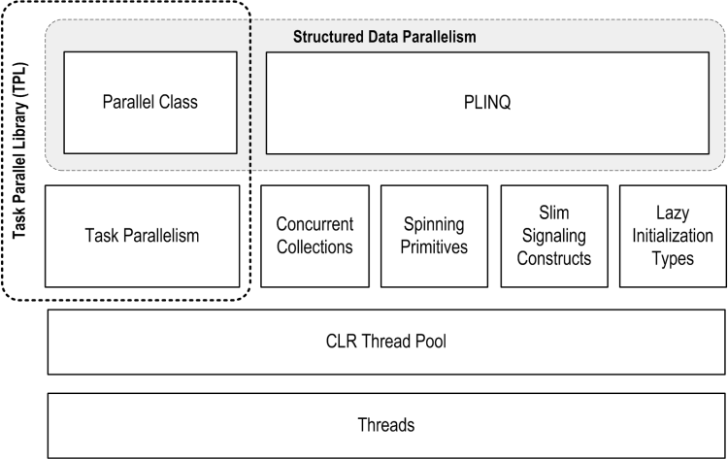
Overview 2
PLINQ offers the richest functionality: it automates all the steps of parallelization.
Parallel class, you must collate results yourself.
Task, you must partition the work yourself.

Slide 4
Task -1 Basic
CreateTask, Factory/new
Result
Task

Slide 5
Task Cancel
Cancel Task/Tasks (Demo 1/ Demo 2)
Detect Cancel, token.Register or Use another Task (Demo 3/ Demo 4)

Slide 6
Task Exception
Problem | Solution | Demo
Basic Exceptions | Catch System.AggregateException when call trigger member(Task.Wait, Task.WaitAll, Task.WaitAny, Task.Result) and get an enumerable AggregateException.InnerExceptions | Demo1
Iterative Handler | Call the AggregateException.Handle() method, providing a delegate that takes a System.Exception and returns true if the exception has been handled and false if it should be escalated. | Demo2
Task Properties | Call the IsCompleted, IsFaulted, IsCancelled and Exception properties of the Task class | Demo3
Custom Escalation Policy | Register an event handler with System.Threading.Tasks.TaskScheduler.UnobservedTaskException | Demo4

Slide 7
Task synchronize - 1
Barrier
CountdownEvent
ManualResetEventSlim
SpinLock

Slide 8
Task synchronize - 2
Wait
ContinueWith
WhenAll
WhenAny

Slide 9
Parallel class
Parallel.For
Parallel.ForEach
Parallel.Invoke
All three methods block until all work is complete
Because the loop body in a parallel For or ForEach is a delegate, you can’t exit the loop early with a break statement. Instead you must call Break or Stop on a ParallelLoopState object.

Slide 10
PLINQ -1-LINQ
What is LINQ(Language-Integrated Query)?
Language-Integrated Query (LINQ) is an innovation introduced in the .NET Framework version 3.5 that bridges the gap between the world of objects and the world of data.
https://msdn.microsoft.com/en-us/library/mt693042.aspx

Slide 11
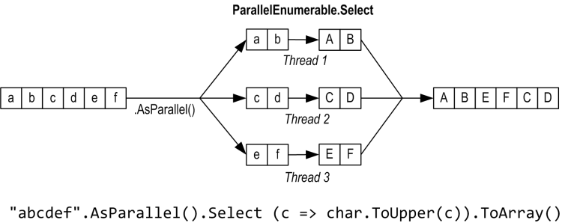
PLINQ -2-basic
PLINQ is only for local collections: it doesn’t work with LINQ to SQL or Entity Framework
Like ordinary LINQ queries, PLINQ are lazily evaluated.

Slide 12
PLINQ - 3 : Optimize
Output-side optimization : ForAll
Input-side optimization
Strategy | Element allocation | Relative performance
Chunk partitioning | Dynamic | Average
Range partitioning | Static | Poor to excellent
Hash partitioning | Static | Poor

Slide 13
Appendix 1-Concurrency Collection
ConcurrentQueue
ConcurrentStack
ConcurrentBag
ConcurrentCollection
ConcurrentDictionary

Slide 14
Reference
http://www.albahari.com/threading/part5.aspx#_Parallel_Execution_Ballistics

