Slide 1
Parallel Programming
C# .NET

Slide 2
Overview 1
The primary use case for PFX is parallel programming: leveraging multicore processors to speed up computationally intensive code.
Partition it into small chunks.
Execute those chunks in parallel via multithreading.
Collate the results as they become available, in a thread-safe and performant manner.

Slide 3
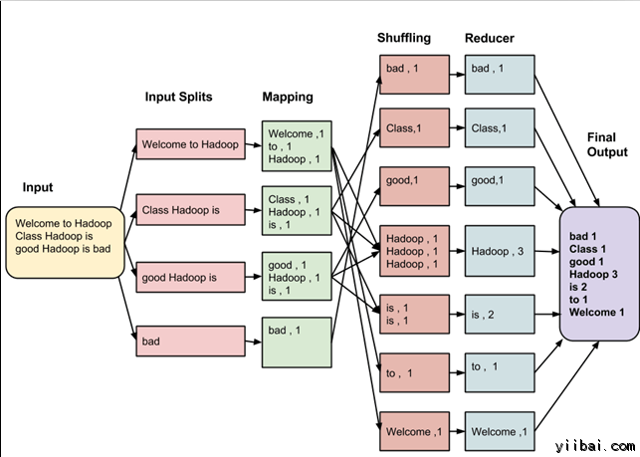

Slide 4
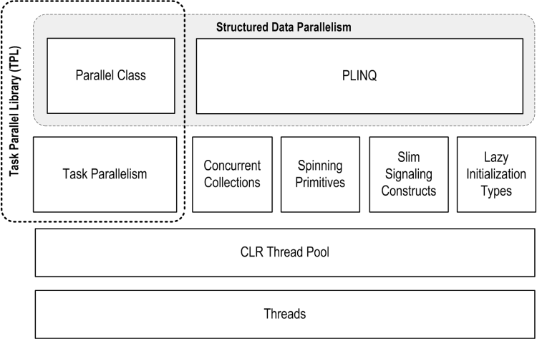
Overview 2
PLINQ offers the richest functionality: it automates all the steps of parallelization.
Parallel class, you must collate results yourself.
Task, you must partition the work yourself.
Data Parallelism, Task Parallelism

Slide 5
Task Basic
Create Task, Result
Task Status (Initial/final)
TaskCreationOptions
LongRunning | Specifies that a task will be a long-running, coarse-grained operation involving fewer, larger components than fine-grained systems.
None | Specifies that the default behavior should be used.
AttachedToParent | Specifies that a task is attached to a parent in the task hierarchy
PreferFairness | A hint to a TaskScheduler to schedule a task in as fair a manner as possible, meaning that tasks scheduled sooner will be more likely to be run sooner, and tasks scheduled later will be more likely to be run later.
TaskStatus
Created | The task has been initialized but has not yet been scheduled
WaitingForActivation | The task is waiting to be activated and scheduled internally by the .NET Framework infrastructure.
WaitingToRun | The task has been scheduled for execution but has not yet begun executing.
Canceled | The task acknowledged cancellation by throwing an OperationCanceledException with its own CancellationToken while the token was in signaled state, or the task's CancellationToken was already signaled before the task started executing. For more information, see Task Cancellation.
Faulted | The task completed due to an unhandled exception
RanToCompletion | The task completed execution successfully.
Running | The task is running but has not yet completed.

Slide 6
Task Cancellation
How to cancel Task/Tasks? (Demo 1/ Demo 2)
Detect Cancel, token.Register or Use another Task (Demo 3/ Demo 4)

Slide 7
Task Wait and Continuation
Task.WaitAll, Task.WaitAny
ContinueWith
TaskContinuationOptions
OnlyOnCanceled | Specifies that the continuation should be scheduled only if its antecedent was canceled.
OnlyOnFaulted | Specifies that the continuation task should be scheduled only if its antecedent threw an unhandled exception.
RunContinuationsAsynchronously | Specifies that the continuation task should be run asynchronously.
NotOnFaulted | Specifies that the continuation task should not be scheduled if its antecedent threw an unhandled exception.

Slide 8
Task Exception
Problem | Solution | Demo
Basic Exceptions | Catch System.AggregateException when call trigger member(Task.Wait, Task.WaitAll, Task.WaitAny, Task.Result) and get an enumerable AggregateException.InnerExceptions | Demo1
Iterative Handler | Call the AggregateException.Handle() method, providing a delegate that takes a System.Exception and returns true if the exception has been handled and false if it should be escalated. | Demo2
Task Properties | Call the IsCompleted, IsFaulted, IsCancelled and Exception properties of the Task class | Demo3
Custom Escalation Policy | Register an event handler with System.Threading.Tasks.TaskScheduler.UnobservedTaskException | Demo4

Slide 9
Task synchronize
Barrier
CountdownEvent
ManualResetEventSlim
SpinLock

Slide 10
Parallel class
Parallel.For
Parallel.ForEach
Parallel.Invoke
All three methods block until all work is complete
Because the loop body in a parallel For or ForEach is a delegate, you can’t exit the loop early with a break statement. Instead you must call Break or Stop on a ParallelLoopState object.

Slide 11
PLINQ -1-LINQ
What is LINQ(Language-Integrated Query)?
Language-Integrated Query (LINQ) is an innovation introduced in the .NET Framework version 3.5 that bridges the gap between the world of objects and the world of data.
https://msdn.microsoft.com/en-us/library/mt693042.aspx

Slide 12
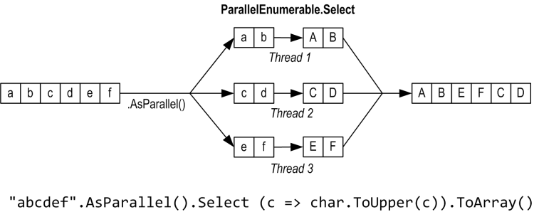
PLINQ -2-basic
PLINQ is only for local collections: it doesn’t work with LINQ to SQL or Entity Framework
Like ordinary LINQ queries, PLINQ are lazily evaluated.

Slide 13
PLINQ - Exception
Also AggregateException
PLINQ is delay execution, Add try/catch where data is consumed.
Demo

Slide 14
PLINQ-MapReduce
Demo

Slide 15
PLINQ - 3 : Optimize
Output-side optimization : ForAll
Input-side optimization
Strategy | Element allocation | Relative performance
Chunk partitioning | Dynamic | Average
Range partitioning | Static | Poor to excellent
Hash partitioning | Static | Poor

Slide 16
Appendix 1-Concurrency Collection
ConcurrentQueue
ConcurrentStack
ConcurrentBag
ConcurrentCollection
ConcurrentDictionary

Slide 17
Reference
http://www.albahari.com/threading/part5.aspx#_Parallel_Execution_Ballistics

