Slide 1
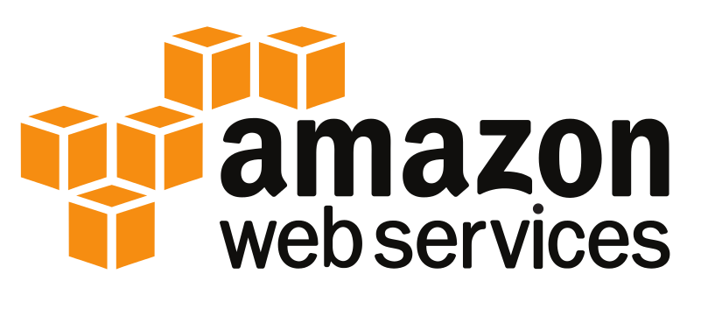
Chapter 1:
Introduction to AWS

Slide 2
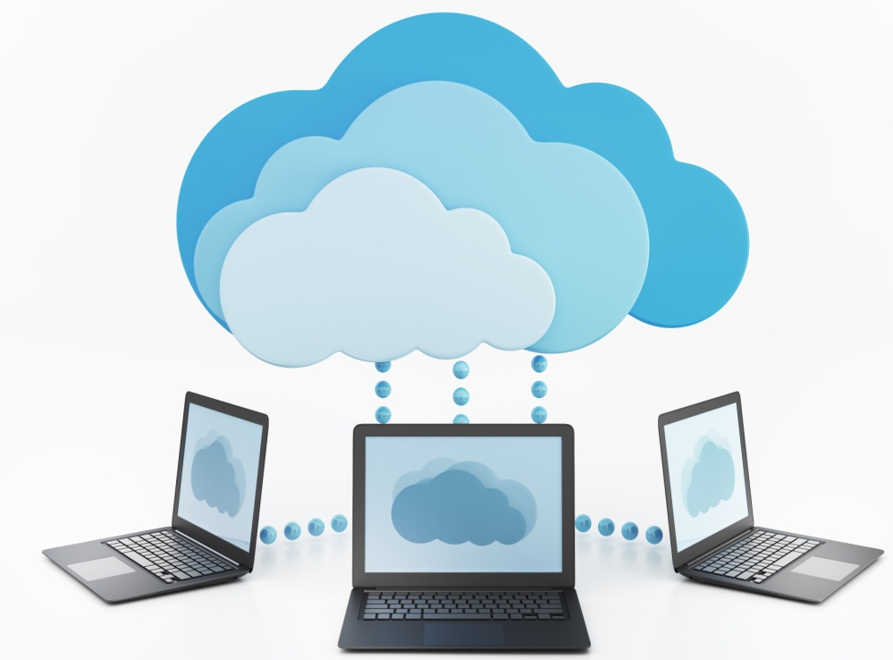
Introduction to AWS
What is Cloud Computing?
Is the on-demand delivery of IT resource and applications via the internet with pay-as-go pricing
Sharing of resources and information
No large up-front hardware investments
No hardware management
Access as needed

Slide 3
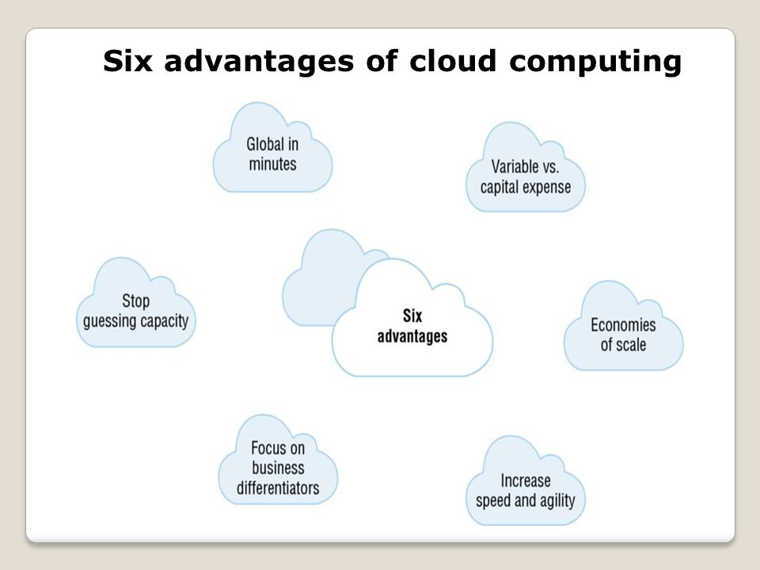
Introduction to AWS
Advantages of Cloud Computing
A innovative way to obtain, use, and manage how an organization pay for technology services

Slide 4
Introduction to AWS
Global in Minutes – deploy application to multiple locations around the world
Stop Guessing Capacity – no longer have to make capacity decisions before deployment – access as much or as little as needed
Focus on Business Differentiators – focus on business priorities instead of computing power
Increase Speed and Agility – needed IT resources are only a click away
Economies of Scale – lower variable costs that is much less than the cost of ownership
Variable vs. Capital Expense – instead of paying for for data centers pay for consumed resources

Slide 5
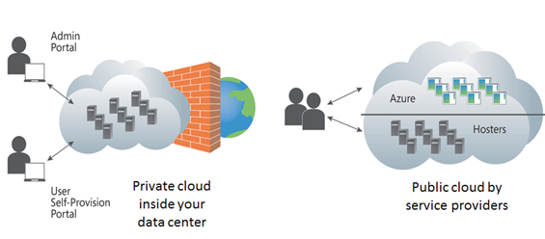
Introduction to AWS
Cloud Computing Deployment Models
Two primary models:
All-In Cloud Deployment – fully deployed in the cloud
Hybrid Deployment – common approach that connects enterprise infrastructure and application between cloud resources

Slide 6
AWS Fundamentals
Amazon Web Services is on-demand of IT resources via the Internet on a secure cloud services platform
Global Infrastructure – AWS serves over One million active customers in more than 190 countries
Infrastructure platforms are in multiple locations worldwide
The locations are composed of Regions and Availability Zones
A region is located in a separate geographic area
Each region has multiple, isolated locations called Availability Zones
Regions are independent and designed to be completely isolated from other regions

Slide 7
AWS Fundamentals
Security – AWS bases security on the CIA Triad:
Confidentiality
Integrity
Availability
Security is AWS number one priority
Offers hundreds of tools and features to meet security objectives
Compliance – AWS uses best practices and IT Security Standards
Service Organizational Controls
Federal Information Security Management Act
Payment Card Industry Data Security Standard
International Organization for Standardization
Note: Will cover deeper in Chapters 12 and 13

Slide 8
Computing Platform
Cloud services can be combined to meet business requirements
Services are arranged in Seven Categories:
Accessing the Platform
Compute and Networking Services
Storage and Content Delivery
Database Services
Management Tools
Security and Identity
Application Services

Slide 9
Computing Platform
Accessing the Platform:
Management Console – web application with a intuitive user interface
Each service has its own console
Command Line Interface – a unified tool used to manage services
Used to control multiple services
Software Development Kit – provide Application Programming Interface (APIs)
Support different programming languages

Slide 10
Computing Platform
Compute and Networking Services – provides a variety of services to deliver core functionality that is leveraged by other services:
Amazon Elastic Compute Cloud (EC2) – provides resizable compute capacity
Select:
Operating System
Memory
CPU
Storage
Launch compute resources as needed

Slide 11
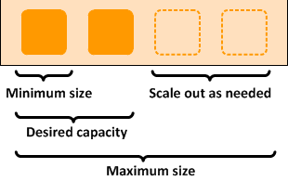
Computing Platform
Lambda – is a zero administration platform for back-end web developers
Runs code across multiple Availability Zones
Auto Scaling – allow for scaling of EC2 capacity up and down automatically according to conditions
Well equipped for stable demand patterns and those that experience hourly, daily or weekly variability

Slide 12
Computing Platform
Elastic Load Balancing – automatically distributes incoming traffic across multiple EC2 instances
Elastic Beanstalk – fast and easy way to get web applications up and running
Upload code and the service handles all the details:
Resource provisioning
Load balancing
Auto scaling
Monitoring
Support a variety of platforms:
Java
Python
Ruby
.NET
And others

Slide 13
Computing Platform
Virtual Private Cloud (VPC) – allows for provisioning a logically isolated section of the cloud – Virtual Private Network
Direct Connect – establishes a dedicated network connection from the data center to AWS
Route 53 – highly available and scalable Domain Name System

Slide 14
Computing Platform
Storage and Content Delivery– provides a variety of services to meet storage requirements:
Amazon Simple Storage Services (S3) – provides a highly durable and scalable object storage that can handle a unlimited amount of data and large numbers
Glacier – a secure extremely low-cost service for data archiving and long-term backup storage
Cold storage – information is not immediately available
Elastic Block Store (EBS) – provides persistent block level storage volumes for use with EC2 instances
Automatically replicates within its Availability Zone

Slide 15
Computing Platform
Storage Gateway – a service used to connect an on-premise software appliance with cloud base storage
CloudFront – a content delivery web service
A easy way to distribute content to users around the world
Uses a low latency high data transfer

Slide 16
Computing Platform
Database Services – provides a managed relational and NoSQL database services, in-memory caching and petabyte scale data warehouse solutions
Relational Database Service (RDS) – fully managed relational database
Support open source and commercial database engines
Amazon manages administration tasks
DynamoDB – a NoSQL database service
Support both document and key/value data models
Redshift – data warehouse service
Provides a standard SQL interface
ElastiCache – simple deployment for in-memory cache

Slide 17
Computing Platform
Management Tools – helps to manage resources
CloudWatch – a monitoring services for resources and application running
Collects and tracks:
Metrics
Log files
Set alarms
CloudFormation – a way for developer and administrators to create and manage a collection of related resources, provisioning and updating
CloudTrail– a services that records API Calls
Config – provides a resource inventory, configuration history and configuration change notifications

Slide 18
Computing Platform
Security and Identity – provides a way to secure data
Identity and Access Management (IAM) – provides a way to control access to services and resources for users
Key Management Service (KMS) – provides a way to create and control the encryption keys and protect those keys
Directory Service – allows the setup, control, and running of Microsoft Active Directory
Certificate Manager - provision. manage, and control Secure Sockets Layer/Transport Layer Security certificates
Web Application Firewall (WAF) – protects applications from common attacks and exploits

Slide 19
Computing Platform
Application Services – provides a variety of managed services to use with applications
API Gateway – easy way to create, publish, maintain, monitor, and secure APIs
Elastic Transcoder– is a media transcoding (converting) media files from source format into versions that will play back on devices
Simple Notification Service (SNS) – coordinates and manages the delivery and sending of messages to recipients
Simple Workflow Service (SWF) – help developers build, run, and scale background jobs that have parallel or sequential steps

Slide 20
Computing Platform
Simple Mail Service (SES) – cost-effective email service for transactional email, marketing messages or any type of content to customers
Simple Queue Service (SQS) – fully managed message queuing service

Slide 21
Summary
On-demand delivery of IT resources vas the Internet with pay-as-you go pricing is referred to as Cloud Computing
AWS manages and maintains the Cloud infrastructure in a secure environment
Offers a broad set of services:
Compute
Storage
Database
Analytics
Application deployment
AWS is arranged in Regions and Availability Zone
Availability Zone are connected via low latency links

