Slide 1
Releasing VDM Proof Obligations with SMT Solvers
Hsin-Hung Lin, Bow-Yaw Wang
Institute of Information Science, Academia Sinica
MEMOCODE’17@Vienna
Sep. 30, 2017
Notes:
Good afternoon, everyone. My name is Hsin-Hung. It is my pleasure to present my work-in-progress here.

Slide 2
Contents
Introduction
VDM and Proof Obligations
Motivation and Objective
Approach
Strategy and Steps
Preliminary Case Studies
Summary
Notes:
The contents today will be firstly an introduction about VDM proof obligations and the objective of this research.
Then I will talk about the approach and preliminary case studies.
Finally, I will summarize this talk and you may ask questions or kindly give me some advices or comments.

Slide 3
Introduction

Slide 4
Vienna Development Method (VDM)
Developed by IBM Vienna Lab. in the 70’s
Specification Language of VDM (VDM-SL)
Types, （state）variables, operations, functions
Primitive types: bool, int, nat, token, quote
Compound types: set, seq, map, record
Constraints
functions, operations: pre/post-condition
types, variables: invariant
proof obligation generation
Notes:
At first. I would like to talk about the Vienna Development Method, VDM.
VDM is a formal method firstly developed in the 70’s, at Vienna.
And we are in Vienna. What a coincidence!
Generally, VDM is a methodology of software development from software specification to implementation.
VDM has a specification language called VDM-SL
VDM-SL is like a programming language with more abstraction.
VDM-SL has basic types such as Boolean, integers, natural numbers which are commonly used in programming languages.
Some basics types like token and quote are not. They can be used to describe software in an abstracted way.
VDM-SL has compound types like sets, sequences, maps that are recently started being used in programming languages.
Besides types, another important feature of VDM-SL is specifying constraints.
Constraints include pre and post conditions, type constraints.
From these constraints, we may generate proof obligations that should be proved to ensure the consistency of a VDM-SL model.

Slide 5
Vienna Development Method (VDM)
Dialects of VDM specification languages
VDM++ (Object-Oriented)
VDM-RT (Real-Time Scheduling)
Animation by interpreter
Specifications need to be specified explicitly
Verification/Validation by Testing
Tools support editing, type checking, and animation
Overture Tool (http://overturetool.org/)
VDMTools (http://fmvdm.org/)
Notes:
Because VDM is developed very early, with the advances of software and programming languages, there are dialects of VDM.
VDM++ is an extension of VDM-SL for object-oriented software development.
VDM-RT further extends for real-time feature for modeling Cyber-Physical-Systems.
Today we will focus on VDM-SL.
Within a subset of VDM-SL, a VDM-SL model can be executed by the interpreter.
This is a feature welcomed by the industries because they can test software specifications described in VDM-SL models.
There are two tools support modeling with VDM. In this work we will use Overture tool.

Slide 6
VDM-SL model CMDS(1/2)
module CMDS
definitions
types
CMD = <R> | <L>;
CMD_series = seq of [CMD];
CMD_times = map CMD to nat;
state S of
commands : CMD_series
inv s == forall k in set {1,...,len s.commands - 1} &
s.commands(k) <> s.commands(k+1)
init p == p = mk_S([])
end
Notes:
For some of you not familiar with VDM. This is a simple VDM-SL model:
In tis model, CMD is a quote type, which is usually used to represent enumeration.
CDM_series is a sequence of CMD with optional nil.
CMD_times is a map from CDM to natural numbers
In VDM-SL, state is defined as a special type, “inv” part specifies the state invariant.
In this model, the state is a sequence of commands, and the state invariant says that:
For every element in the sequence, its next element has to be different.

Slide 7
VDM-SL model CMDS(2/2)
operations
push_cmd(a:[CMD])
pre commands = [] or hd commands <> a
post hd commands = a and tl commands = commands~;
functions
times_count : CMD_series -> CMD_times
times_count(a) == {
<R> |-> len [ i | i in set inds a & a(i)=<R> ],
<L> |-> len [ i | i in set inds a & a(i)=<L> ]
};
end CMDS
Notes:
In VDM-SL, we may define operations which may change the value of state.
In this model, we have defined an operation push command
This operation has pre and post condition
The precondition says the command sequence in the state has to be empty or different to the command to be pushed
The postcondition says the new command sequence after the operation execution shall be the pushed command concatenated with the old command sequence
You may notice the tild symbol post-fixed to “commands”, it represents the oldstate in postcondition of an operation.
This operation is defined implicitly where no body is specified, only pre and post conditions.
This model also has a function to count the occurrences of commands. The function is defined explicitly. This way the function is executable by the interpreter.

Slide 8
VDM Proof Obligations (PO)
PO: Statements must be proved to ensure consistency
Three Classes of PO
Type compatibility: type invariant or subtype
Domain checking: partial functions/operators
Satisfiability: postconditions
PO: context information ==> predicate
Notes:
VDM proof obligation is in the form: context information implies a specific predicate
In VDM, there are three classes of proof obligations
First one is type compatibility, which is relates to type invariant, or subtype.
Second one is domain checking, which Is regarding partial function and operators
Simply speaking, this is very like checking divide by zero in a division.
The last one is satisfiability which concerns the satisfiability of postconditions

Slide 9
POs of CMDS (1/2)
-- //spec. segment
state S of
commands : seq of [<R> | <L>]
inv s == forall k in set {1,...,len s.commands - 1} &
s.commands(k) <> s.commands(k+1)
init p == p = mk_S([])
end
Notes:
Let us recall the state definition of the simple VDM-SL model introduced.
In this model, the state is a sequence of commands, and the state invariant says that:
For every element in the sequence, its next element has to be different

Slide 10
POs of CMDS (2/2)
-- //PO1: state invariant satisfiable obligation
-- // (subtype check: state invariant)
(exists commands:seq of [<R> | <L>] &
(forall k in set { 1, ... ,((len (s.commands)) - 1) } &
( (s.commands)(k) <> (s.commands)((k + 1)) )
))
-- //PO2: legal sequence application obligation
-- // (domain check: apply operator of sequence)
(forall s:CMDS`S &
(forall k in set
{ 1, ... ,((len (s.commands)) - 1) } &
(k in set (inds (s.commands)))))
Notes:
From the state invariant, there are two proof obligations
The upper one is a subtype check: is there exists a sequence of commands that satisfies the state invariant
The lower one is a domain check regarding the sequence application operator (check previous slide)
This proof obligation says that the index “k” shall be defined in the command sequence.

Slide 11
Motivation and Objective
A VDM-SL model may have a large number of POs compared to its LOC
For example, CMDS: 24 LOC with 10 POs
Too many to prove manually or interactively with theorem provers
Existing Approach
Prove with HOL/Isabella theorem prover
Translate VDM-SL to Isabella
Generate and prove POs in Isabella
Specialists of theorem provers are required
Automation relies on proof tactics
Get little hint from unsuccessful proofs
Notes:
As explained shortly in previous slides, a few lines of VDM-SL code may produce about same number of proof obligations.
In the VDM-SL model CMDS, 24 lines of code results in 10 proof obligations.
So, to prove them all with theorem provers, even interactively with machine support, will consume much time and effort.
Currently, an approach that translate VDM-SL code to Isabella was proposed.
This approach generates proof obligations in Isabella and prove them with tactics
But this still need well trained specialists to conduct the process and the tactics are not always work.
Also, if a proof obligation is not proved, there is little information whether the model has bug or just lack of lemma.

Slide 12
Motivation and Objective
Satisfiability Modulo Theories (SMT)
State-of-the-art technology for HW/SW verification
Efficient solving
Automated proof
Counterexample
Prove VDM POs as many as possible with SMT solvers
Encoding VDM POs to SMT formulas
Difficulty
higher order logic, logic of partial function
Notes:
Here we think about the satisfiability modulo theories.
SMT has become a powerful technique for software verification.
SMT can efficiently solve hundreds or thousands of formulas automatically.
If unsatisfied, SMT solver will return a counterexample model, which is very convenient for debug
So, our objective is to apply SMT solvers for discharging VDM proof obligations as many as possible.
Our approach is to encode VDM proof obligations to SMT formulas and prove the proof obligations by SMT solving.
However, this is not a easy task because VDM is generally higher older logic with partial function, while SMT is good at solving quantifier free FOL.

Slide 13
Encoding Strategy

Slide 14
for each PO in model M
POG
(Overture Tool)
Determine Context Information
VDM model
Encode context information:
type invariant
pre/post-conditions
Proof Obligations
M
Obligation Negation /
Quantifier Elimination
Encoding
Solve SMT formulas (Z3Py)
SMT formulas
(Z3Py)
Examine Results
Notes:
This is the encoding strategy of our approach.
The right side shows the VDM-SL model and proof obligations generated by the Overture tool.
The encoding results in a set of SMT formulas in Z3Py, a Python API of Z3 SMT solver.
The encoding process is simplified as several steps as the left diagram shows.
For each proof obligation, firstly, we determine its context information, then encode the context information
The context information mainly contains type invariants and pre/post conditions.
Then we encode the predicate of the proof obligation.
Before solve the obligation, we apply the obligation negation and quantifier elimination if possible.
Finally we solve the SMT formals with Z3Py and examine the result.

Slide 15
Encoding Strategy
Determine context information
Types and constraints involved (invariants, pre/post-conditions)
Encode context information
Encode type/state invariant only when the type/state (a:typename,oldstate,newstate) is mentioned
Encode pre/post-condition if pre_<name> or post_<name> is mentioned
Obligation negation / Quantifier elimination
Negation also does quantifier elimination
Solve formulas with SMT solver (Z3Py)
Notes:
For more details, when encoding the context information, because an obligation does not explicitly describe the full information needed.
We encode type invariants only when the type is explicitly mentioned.
For states, oldstate and newstate in an obligation means the state before and after the execution of an operation.
For pre and post conditions, they are mentioned in the form of pre_ function or operation name, post_ function or operation name.
Currently, the encoding process is done by hand.

Slide 16
Preliminary Case Studies

Slide 17
Abstract Pacemaker
A simplified pacemaker
Definitions about heartbeat signals detected and recorded
Primary types: Quote, Sequence
Encoding in Z3Py
Sequence: array sort with constraints
len operator: function
Notes:
We have done two preliminary case studies. The two models were collected from the repository of Overture tool site, and the encoding was manually done.
The first case is an abstract pacemaker.
This model defines a pacemaker partly, only focus on heartbeat signals
The types used in this model are quote and sequence.
To encode in SMT, we represent sequence as array sort with constraints in Z3
In this model, we need to also encode the “len” operator that returns the length of a sequence.

Slide 18
PO 8: legal sequence application
-- PO8
(forall tr:Trace, aperi:nat1, vdel:nat1,
oldstate &
(forall i in set (inds (tl tr)) &
(((i mod aperi) = (vdel + 1)) =>
(i in set (inds tr)))
))
VDM type definition (contex information)
-- type: sequence of quotes
Trace = seq of [Event];
Event = <A> | <V>;
Encoding in Z3Py
-- VDM types encoded in z3py
Event_lift, (A, V, nil, NDF) =
EnumSort('Event_lift',
['A', 'V', 'nil', 'NDF'])
Trace = ArraySort(IntSort(),Event_lift)
Notes:
For example, look at the obligation 8 here, tr:Trace is explicitly mentioned so we will need to encode the type “Trace” which is a sequence of Events, and an event is the enumeration of [A] or [V]
We encode Trace as array sort.
Here we encode Event type in “lifted” form because VDM uses partial functions, this means there is not always value defined.
For the undefined case we use “NDF” to represent so we have full function in Z3.

Slide 19
Constraints of seq (Z3Py):
Undefined below index one
If defined, indice, all defined for indice between 1 and itself
If undefined, all undefined for higher indice
Note: Constraints are applied on instance variable, not type
tr = Const('tr',Trace)
[i,j] = Ints('i j')
ForAll(i,
Implies( i<=0, tr[i]==NDF ) )
ForAll(i,
Implies(
And(i>=1,tr[i]!=NDF),
ForAll(j,
Implies(And(j>=1,j<=i),
tr[j]!=NDF)
)) )
ForAll(i,
Implies(
And(i>=1,tr[i]==NDF),
ForAll(j,
Implies(j>=i,tr[j]==NDF)
)) )
Notes:
Also, array is not sequence, so we added 3 constraints to restrict array to sequence.
The first constraint is that below index zero, all elements are undefined since a sequence in VDM starts from index 1
The second constraints is that if we find an element of index i is defined, then all indexes below i and greater than 1 shall be defined.
The third constraint is that if we find an element of index i is undefined, then all indexes above i shall be undefined.

Slide 20
Operator len (Z3Py):
A uninterpreted accepts a Trace and returns Integer.
The return value must be zero, where undefined at index one, or
A number greater then zero, where undefined next to the index of lenfth.
len_tr=Function('len_tr',Trace,IntSort())
Or(
And( len_tr(tr)==0, tr[1]==NDF ),
And(
len_tr(tr)>0,
tr[len_tr(tr)]!=NDF,
tr[len_tr(tr)+1]==NDF )
)
Notes:
For operator of length, we use uninterpreted function to encode it.
This formula says that the ‘len’ function must be zero or the length is the biggest index of defined elements.

Slide 21
Telephone Exchange
An abstracted telephone exchange system
Specifying operations (events) of a telephone exchange system
Ex: lift, connect, answer, etc.
Operations changes system state
Subscriber (user)
Connecting status between subscribers
Types used: Quote, Map
Notes:
The other case study is a telephone exchange model.
This model specified events in the system like lift a phone, connect users, and so on.
This model has types of quote and map.

Slide 22
PO 14: enumeration map injectivity
-- PO14
(r in set (dom (status :> {<WR>}))) =>
(forall m1, m2 in
set {{r |-> <SR>},
{(inverse calls)(r) |-> <SI>}} &
(forall d3 in set (dom m1),
d4 in set (dom m2) &
((d3 = d4) => (m1(d3) = m2(d4)))
))
VDM definition related to PO14 (context information)
-- operation Answer
Answer(r: Subscriber)
ext rd calls
wr status
pre r in set dom (status :> {<WR>})
post status = status~ ++ {r |-> <SR>, (inverse calls)(r) |-> <SI>};
Counterexample found:
calls must be an injective map and its key and value must not be the same.
Notes:
To save time, I will go fast with this case study. So the code will not be explained in detail.
This slide shows obligation 14 that relates to map injectivity from the definition of Answer operation.
The obligation is to prove the consistency of applying inverse to “calls”
**Back from slide 25:
Actually we found a counterexample to this obligation.
The counterexample suggested that “calls” is not allow to have its key and value the same.
This means in this system, a subscriber shall not connect to him or her self.

Slide 23
VDM type definition
-- type: map of quotes
Subscriber = token;
Initiator = <AI> | <WI> | <SI>;
Recipient = <WR> | <SR>;
Status = <fr> | <un> | Initiator | Recipient;
state Exchange of
status: map Subscriber to Status
calls: inmap Subscriber to Subscriber
inv mk_Exchange(status, calls) ==
forall i in set dom calls &
(status(i) = <WI> and
status(calls(i)) = <WR>) or
(status(i) = <SI> and
status(calls(i)) = <SR>)
init s == s = mk_Exchange({|->},{|->})
end
Notes:
The state definition in this model has two maps:
Here we only interest to “calls”, which is an injective map that maps subscribers to subscribers. This represents the connection relation of subscribers.

Slide 24
Encoding in Z3Py
Recipient = Datatype('Recipient')
Recipient.declare('WR')
Recipient.declare('SR')
Recipient = Recipient.create()
Status = Datatype('Status')
Status.declare('fr')
Status.declare('un')
Status.declare('INITIATOR',('get_initiator', Initiator))
Status.declare('RECIPIENT',('get_recipient', Recipient))
Status = Status.create()
Status_lift = Datatype('Status_lift')
Status_lift.declare('STATUS',('get_status', Status))
Status_lift.declare('NDF')
Status_lift = Status_lift.create()
status = Function('status',Subscriber,Status_lift)
calls = Function('calls',Subscriber,Subscriber_lift)
token is treated as enumeration type with predefined values
Notes:
In this case, we encode map with uninterpreted function.
Similar to pacemaker case study, we also define VDM types with lift.

Slide 25
Encoding injective map
k = Const('k',Subscriber)
l = Const('l',Subscriber)
ForAll([k,l],
If(
k==l,
calls(k)==calls(l),
Or(
And(
calls(k)==Subscriber_lift.NDF,
calls(l)==Subscriber_lift.NDF
),
calls(k)!=calls(l)
)
)
)
Note: Constraints are applied on instance variable, not type
Notes:
“calls” is a injective type, which means its key and value are one-to-one.

Slide 26
Some frequently used encoding patterns (in both case studies)
-- VDM code
i in set (inds (tl tr)
-- encoding in z3py
And(i>=1, i<=len_tr(tr)-1)
-- VDM code
i in set (dom calls)
-- encoding in z3py
calls(i) != Subscriber_lift.NDF
Notes:
One more thing.
In the two case studies, some encoding patterns are used frequently.
For example, the set inclusion operator “in set” is encoded as the formula that the index is within the corresponding range.
For maps, “in set dom” can be encoded as the formula that the value of the key is defined.

Slide 27
Summary
What types/patterns are encoded
quote type
seq/map of quotes
array sort with constraints
uninterpreter function with constraints
Introducing undefined value (NDF) and lift for map tpyes
Encoding pattern
seq: hd, tl, in set inds
map: in set dom, in set rng

Slide 28
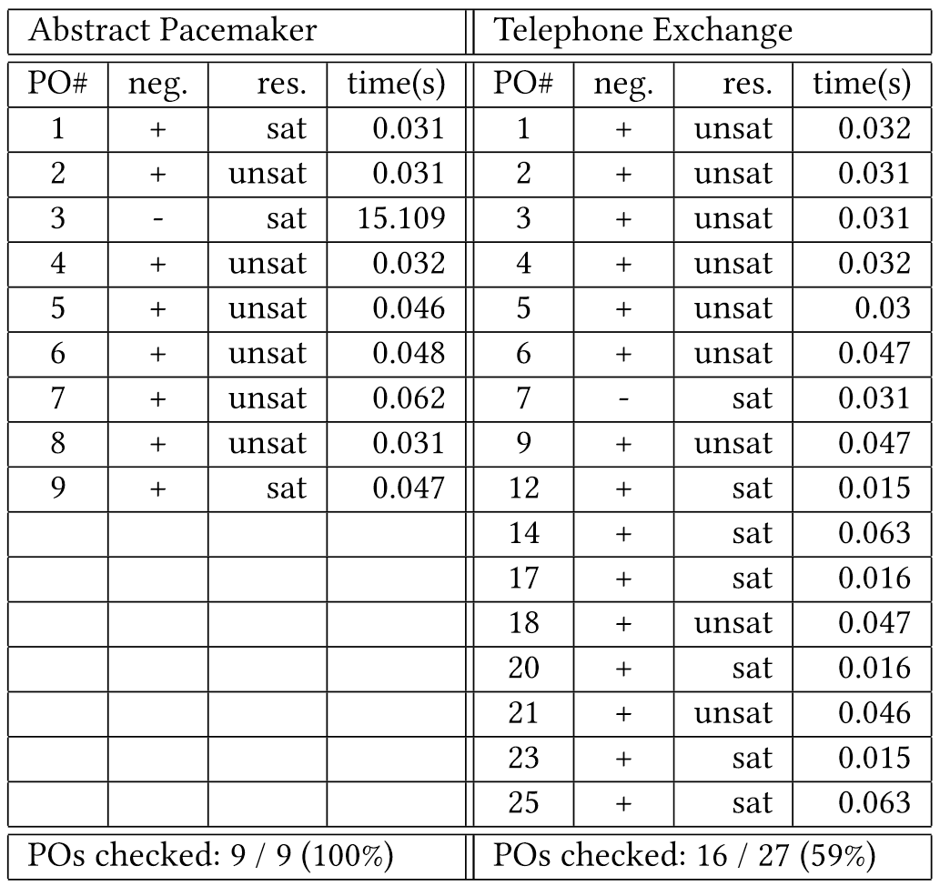
Notes:
The results of the two case studies.
The abstract pacemaker, we managed to prove all proof obligations
The telephone exchange, we managed to prove 59% of the proof obligations.
From the time consumed, the efficiency is quite good.
PO3 of the pacemaker model is an operation postcondition satisfiability obligation.
But the postcondition/obligation does not have oldstate in its predicate.

Slide 29
Discussions: Some Issues
Encoding set using array sort
Encoding cardinality: frequently used in VDM
Function/Operation satisfiability obligations in the telephone case study
In the form with multiple quantifiers
For set, seq, map types, Z3 returns unknown
forall a:type_a, oldstate:STATE &
pre_f(a,oldstate) =>
exists newstate:STATE &
post_f(a,oldstate,newstate)
Notes:
We still have issues to be solved.
In the two case studies, we did not encode set type.
This is because the set cardinality is difficult but it is frequently used in VDM.
Also, we encountered proof obligations with multiple quantifiers.
This usually happens in postcondition satisfiability obligation.
For the above issues, though we can still encode with array and uninterpreted function, Z3 returns unknow and fails to prove nor gives counterexample.

Slide 30
Summary

Slide 31
Summary
An approach to releasing VDM proof obligations with SMT solvers
Objective: discharge as many as possible
Pros: automated proof, efficiency, counterexample
Actually found bugs not found before (telephone exchange case)
Issues
Array sort or uninterpreted function can not be applied to every Types and POs
Work on going
Define a subset of VDM-SL appropriate to encoding
Must be VDM-like (set, seq, map must be included)
Finite vs. Infinite
Notes:
So, as the summary of this talk, we proposed an approach to releasing VDM proof obligations with SMT solvers.
The preliminary case studies showed good results but we still have issues to be solved.
Now we are working on these issues.
That’s all.
It is great if I can have some advices or comments form you.
Thank you very much.

