Slide 1


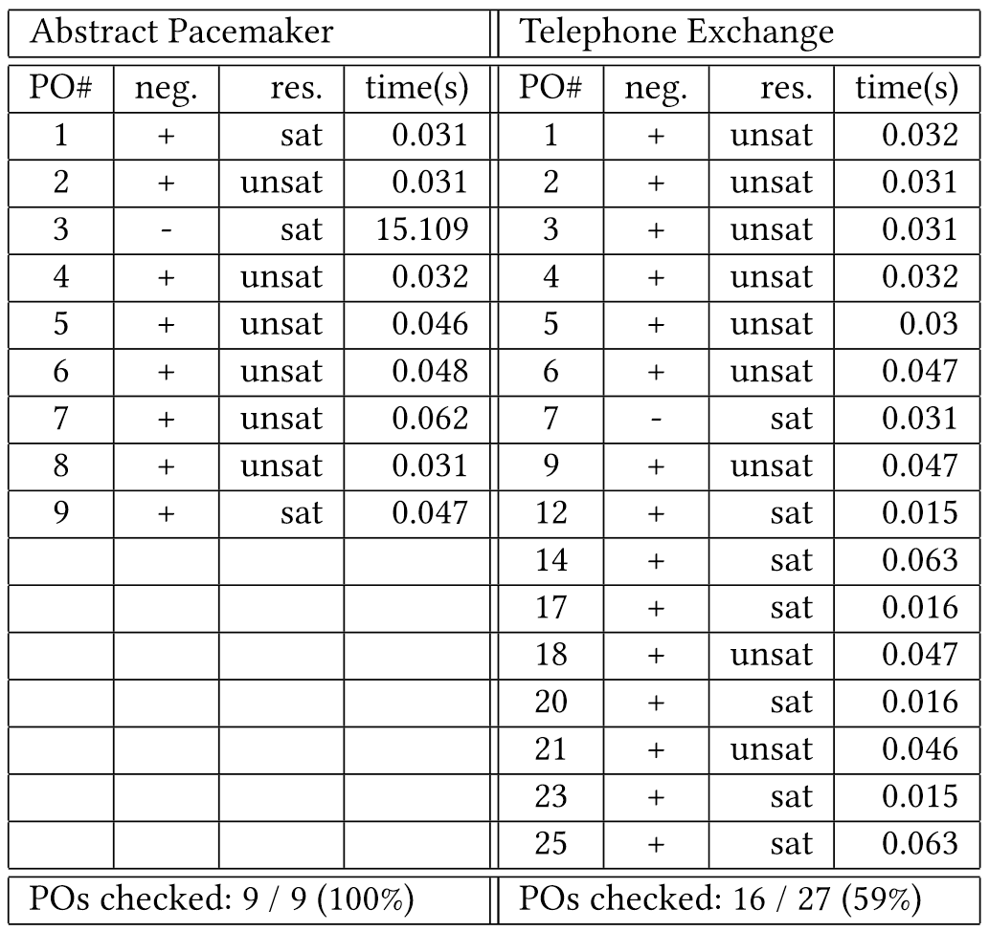
Releasing VDM Proof Obligations
with SMT Solvers
Hsin-Hung Lin and Bow-Yaw Wang
Institute of Information Science
Academia Sinica
Motivation and Objective
The Vienna Development Method (VDM) is a formal method that supports modeling and analysis of software systems at various levels of abstractions. For a model specified by the VDM specification language (VDM-SL), the correctness of the model relies on discharging the proof obligations (POs), especially in the case of implicit specifications. Due to the higher-order-logic and partial function characteristics, a VDM model of small LOC may have a lot of POs to discharge. This research proposes an approach that encodes and discharges POs of VDM-SL models as many as possible with the state-of-
the-art verification technology, Satisfiability Modulo Theories (SMT) solvers.
VDM Proof Obligations
-- //PO1: state invariant satisfiable obligation
-- // (subtype check: state invariant)
(exists commands:seq of [<R> | <L>] &
(forall k in set { 1, ... ,((len (s.commands)) - 1) } &
( (s.commands)(k) <> (s.commands)((k + 1)) )
))
-- //PO2: legal sequence application obligation
-- // (domain check: apply operator of sequence)
(forall s:CMDS`S &
(forall k in set
{ 1, ... ,((len (s.commands)) - 1) } &
(k in set (inds (s.commands)))))
-- //spec. segment
state S of
commands : seq of [<R> | <L>]
inv s == forall k in set
{1,...,len s.commands - 1} &
s.commands(k) <> s.commands(k+1)
init p == p = mk_S([])
end
Three classes of POs:
subtype check, domain check, function/operation satisfiability
Encoding Strategy
Preliminary Case Studies
for each PO in model M
Determine Context Information
VDM model
POG
(Overture Tool)
Encode context information:
type invariant
pre/post-conditions
Proof Obligations
Obligation Negation /
Quantifier Elimination
M
Encoding
Solve SMT formulas (Z3Py)
SMT formulas
(Z3Py)
Examine Results
Encoding Patterns
Discussion
Pattern for VDM Types
seq: array sort with constrints
map: uninterpreted functions with undefined values (lifted)
Pros of the approach:
Be able to solve the majority of POs (preliminary results).
Automated proof, Efficiency, Counterexample.
We actually found bugs not found before in the telephone exchange case study.
Issues to be solved
Encoding sets: cardinality
Satisfiability obligation has multiple quantifiers where array sort / uninterpreted function can not be solved by Z3 (returns unknown).
-- VDM code
i in set (inds (tl tr)
-- encoding in z3py
And(i>=1, i<=len_tr(tr)-1)
-- VDM code
i in set (dom calls)
-- encoding in z3py
calls(i) != Subscriber_lift.NDF

