Slide 1
NS-3 MANET ROUTING EXPERIMENT
Adaptive DSR Route Cache
Thesis
In high mobility, DSR should trust cached routes for less time. The experiment tests whether speed-scaled cache timers improve delivery.
Parameter sweep comparing mobility-scaled LinkCache timers against fixed DSR cache behavior
Fernando Molina Rodriguez Rajat Chaudhary
50
10
4
200s
NODES
FLOWS
SWEEP POINTS
RUNTIME
Random waypoint MANET
one-to-one UDP pairs
10%, 50%, 110%, 150%
one CSV row per second
Adaptive DSR route cache | 01

Slide 2
PROBLEM
DSR cache reuse is valuable until mobility turns cached routes stale.
Why the cache can hurt
Adapt cache trust to movement
DSR avoids repeated route discovery by keeping learned source routes and link state.
The experiment keeps the default MANET scenario and metrics, but computes cache timers from node speed before installing DSR.
In RandomWaypoint mobility, a route that worked earlier can point through a now-broken link.
Higher node speed -> shorter route and link stability timers
Long cache lifetimes can keep stale state alive long enough to drop packets before repair.
Adaptive DSR route cache | 02

Slide 3
FORMULA
A single mobility scale converts base cache timers into effective DSR values.
adaptive_value = clamp(base_value * cache_reference_speed / node_speed, min_value, max_value)
Formula variables
This sweep used a 0.25 mobility scale
base_value: original timer multiplied by the sweep percentage
cache_reference_speed: speed where base timers are preserved, 5 m/s
node_speed: scenario speed used for cache trust, 20 m/s
clamp: keeps timers inside configured safety bounds
cache_reference_speed / node_speed = 5 / 20 = 0.25
Example: the 50% timeout starts at 150 s, then becomes clamp(150 * 0.25, 30, 300) = 37.5 s.
30-300s
2-25s
10-120s
ROUTECACHETIMEOUT
INITSTABILITY
USEEXTENDS
route lifetime bounds
new link confidence
successful-use extension
Adaptive DSR route cache | 03

Slide 4
IMPLEMENTATION
The adaptive values are computed before DSR is installed on the nodes.
Command-line switches
Config::SetDefault("ns3::dsr::DsrRouting::RouteCacheTimeout",
TimeValue(Seconds(m_effectiveRouteCacheTimeout)));
Config::SetDefault("ns3::dsr::DsrRouting::InitStability",
TimeValue(Seconds(m_effectiveInitStability)));
Config::SetDefault("ns3::dsr::DsrRouting::UseExtends",
TimeValue(Seconds(m_effectiveUseExtends)));
adaptiveRouteCache
adaptiveLinkStability
cacheType
baseRouteCacheTimeout
baseInitStability
baseUseExtends
cacheReferenceSpeed
Placement matters: defaults must be set before dsrMain.Install(...) creates the routing objects.
Adaptive DSR route cache | 04

Slide 5
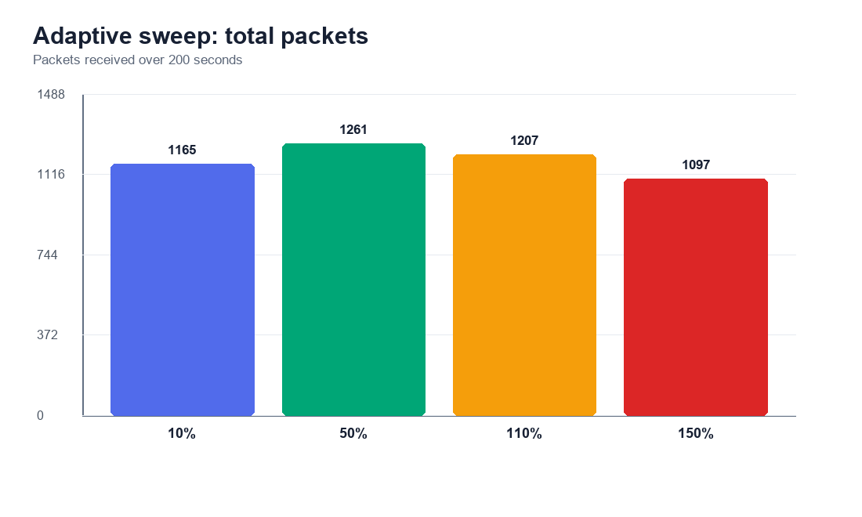
ADAPTIVE SWEEP
The 50% adaptive setting delivered the strongest packet count in this run.
1261
BEST PACKET COUNT
50% adaptive run
3.228
AVG KBPS
full 200-second average
37.5s
EFFECTIVE TIMEOUT
50% base after scaling
Adaptive DSR route cache | 05

Slide 6
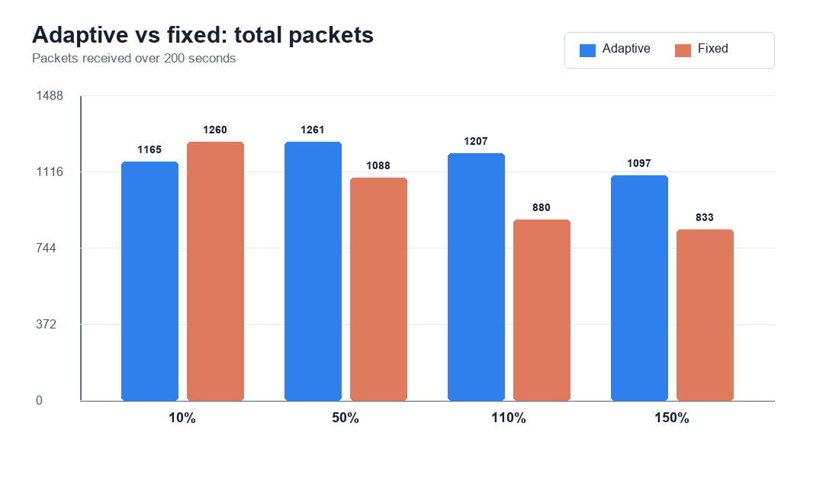
FIXED COMPARISON
Adaptive tuning beat fixed cache behavior at 50%, 110%, and 150%.
+173
50% PACKET DELTA
adaptive vs fixed
+327
110% PACKET DELTA
largest improvement
-95
10% PACKET DELTA
low-end clamp loses
Adaptive DSR route cache | 06

Slide 7
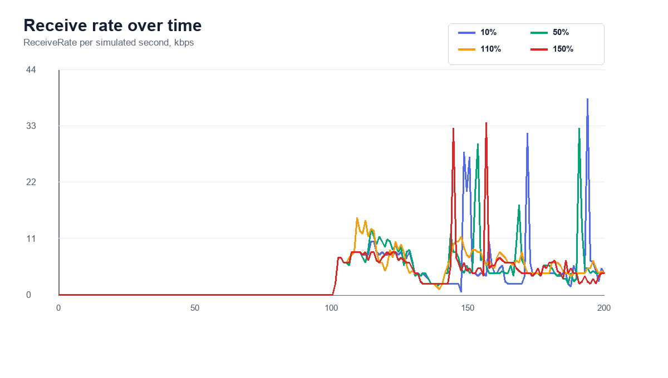
TIME SERIES
Packet delivery starts after traffic begins and differs mainly during active seconds.
How to read it
Rows are one simulated second. Traffic starts around 100 s, so the first half of each metrics file is intentionally zero. The comparisons use total packets and average kbps across the full 200 s for consistency with the default ns-3 example.
Adaptive DSR route cache | 07

Slide 8
TAKEAWAYS
Adaptive cache timing looks promising, but it needs seed and scenario sweeps next.
What the experiment suggests
Future work
A moderate effective timeout outperformed both very short and long-lived cache assumptions.
Repeat runs across random seeds
Sweep cacheReferenceSpeed independently
Compare LinkCache and PathCache
Sweep node speed and node density
Track routing overhead alongside delivery
The adaptive policy helped most when fixed DSR would otherwise keep stale cache state too long.
The 10% case exposes the impact of clamp bounds, so low-end tuning deserves separate attention.
3/4
50%
next
ADAPTIVE WINS
BEST SWEEP POINT
VARIANCE TESTING
Adaptive DSR route cache | 08
against fixed comparator
1261 packets received
multi-seed validation

