Slide 1
TDD
Test Driven Development

Slide 2
Test Driven Development
TDD forces you to separate the “what” (test) from the “how” (implementation) so you can focus on one at a time.
That’s why it can also be seen as Test Driven-Design and why the test is also known as spec (i.e. specification).
It relies on repetition of short development cycles that focus on specific test cases based on software requirements instead of just code implementation.
This approach results in production ready code that is extensible, maintainable and of high quality.

Slide 3
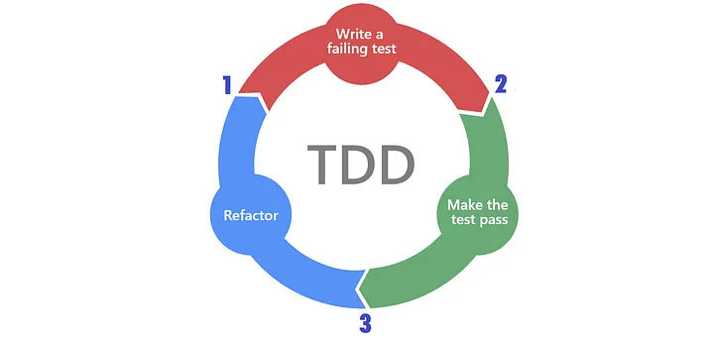
TDD Cycle Diagram
✅ → 🔴: only to add a test that fails;
🔴 → ✅: only to implement a failing test;
✅ → ✅: only to refactor an implementation or a test.
The consequences of this are:
you never refactor in a red state;
you never add a test in a red state;
you only implement what’s required to return to green.

Slide 4
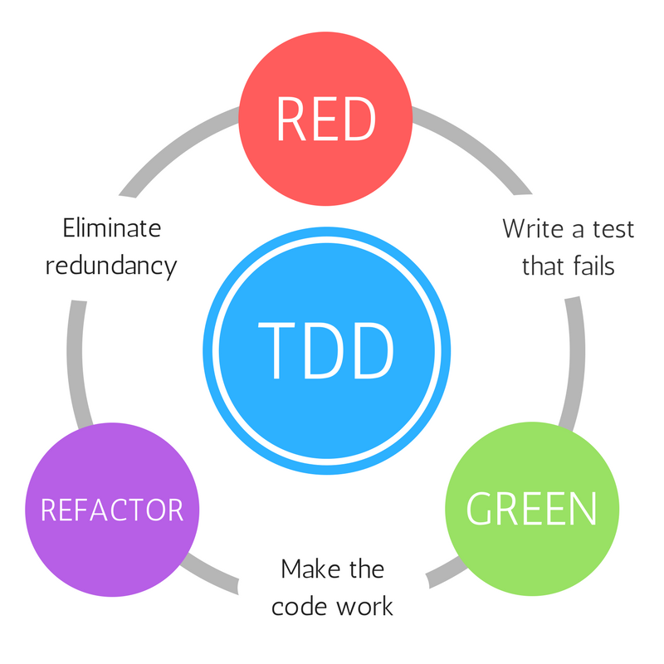
Red, Green, Refactor Approach
This approach helps developers focus their efforts into three specific phases:
Red
▸ Write test for a behavior to be implemented
▸ Analyze the requirements without the implementation
▸ Behavior of the interface as expected by the caller
▸ Should be clean and consumable
Green
▸ Write just enough production code to pass the test
▸ Don’t worry about algorithms or its performance
▸ Less code is better
Refactor
▸ Rework the code to make it more efficient and optimized

Slide 5
The AAA (Arrange-Act-Assert) Pattern
It suggests that you should divide your test method into three sections:
Arrange, Act and Assert
Each one of them only responsible for the part in which they are named after.
Arrange :
The arrange section you only have code required to setup that specific test. Here objects would be created, mocks setup (if you are using one) and potentially expectations would be set.
Act:
Then there is the Act, which should be the invocation of the method being tested.
Assert:
On assert you would simply check whether the expectations were met.

Slide 6
Happy Path Testing
One of the earliest tests run on a product is a happy path test. It's a test of the product's function under perfect conditions.
Assuming the user does everything exactly as expected, does the product work?
Until the answer is an unequivocal yes, there's no point in moving on to testing more complex scenarios.

Slide 7
Unhappy Path Testing
There's no consensus on what to call the opposites of happy paths, but popular terms include "unhappy paths," "sad paths," or "exception paths."
These are the paths on which the user experiences lots of errors, pain points, and friction.
Unhappy path tests look at what happens when things go wrong.

Slide 8
Required And Optional Properties
Test constructor
Initial constructor with all required references
Initial constructor with optional references(in addition required references )
Exceptional test for each unhappy paths

Slide 9
Using Test Builder And Why
In order to create object with internal constructor
In order to construct complex objects
In order to constructor object with proper values

Slide 10
Test Double
Gerard Meszaros uses the term Test Double as the generic term for any kind of pretend object used in place of a real object for testing purposes.
The name comes from the notion of a Stunt Double in movies. (One of his aims was to avoid using any name that was already widely used.)
Meszaros then defined five particular kinds of double:
Dummy
Stub
Spy
Mock
Fake
https://blog.cleancoder.com/uncle-bob/2014/05/14/TheLittleMocker.html
https://martinfowler.com/articles/mocksArentStubs.html
https://tanzu.vmware.com/developer/guides/test-doubles

Slide 11
Test Double - Dummy
Dummy — When we use an object to stand in place of a real object, but never make of the object, then the object is called a Dummy. Its usually done to fill the parameter list, so that the code compiles and the compiler stays happy.
Notes:
Objects are passed around but never actually used. Usually they are just used to fill parameter lists.
A dummy is a test double that throws a NullArgumentException exception when a method on it is invoked. Because if anybody tried to use that Dummy, they’d get an exception and you don’t want the Dummy to be used.
These test objects were called mocks. But that’s slang.
https://tanzu.vmware.com/developer/guides/test-doubles/#dummy

Slide 12
Test Double - Stub
A stub is a test double that returns pre-configured, hard-coded data when its methods are called.
Stubs — These are objects which we hard code to provide canned responses whenever specific methods are called on those objects. Usually not responding at all to anything outside what's programmed in for the test.
Used for providing the tested code with "indirect input"
You use a stub to ensure that the code you’re testing has known, predictable data on which to operate.
In order for a stub to be useful, you have to set it up with the hard-coded data it will return before the code being tested executes. This is because the code being tested has to be able to retrieve the hard-coded data from the stub when it executes, so the stub needs to have that data ready.
https://tanzu.vmware.com/developer/guides/test-doubles/#stub

Slide 13
Test Double - Spy
Spy — Used for verifying "indirect output" of the tested code, by asserting the expectations afterwards, without having defined the expectations before the tested code is executed. It helps in recording information about the indirect object created. Actually Spies are stubs that also record some information based on how they were called.
e.g. One form of this might be an email service that records how many messages it was sent.
You can use Spies to see inside the workings of the algorithms you are testing.
You have to be careful. The more you spy, the tighter you couple your tests to the implementation of your system. And that leads to fragile tests. (A test that breaks for reasons that shouldn’t break a test.)
A spy is a test double that records the invocations of its methods, along with any parameters passed in, so that you can find out afterward whether and how its methods were called.
You use a spy when you want to be sure that, under the conditions of your test, a certain dependency got called, and with certain parameters.
In order to be useful, you have to wait to ask a spy if its methods got called until after the code being tested has executed. This is because the code being tested is the code that calls the methods on the spy in the first place, so until that code executes, the methods haven’t yet been called.
Some testing frameworks and/or testing tools have built-in support for spies, in which case you don’t have to write them yourself. But writing a spy isn’t that difficult, and you might prefer to write your own.
https://tanzu.vmware.com/developer/guides/test-doubles/#spy

Slide 14
Test Double - Mock
Mocks — These are objects which we use for verification by checking whether particular methods were called on the object, with specific parameters. So these objects become the basis for the results of our tests. Again using mockito as an example, any object used inside the verify method is a mock.
A mock is a combination of stub and spy, i.e., a test double that allows you to control the data it returns while also recording the calls made to it so that you can check that it was called with the correct parameters.
Notes:
The term 'Mock Objects' has become a popular one to describe special case objects that mimic real objects for testing.
Used for verifying "indirect output" of the tested code, by first defining the expectations before the tested code is executed.
Most language environments now have frameworks that make it easy to create mock objects.
What's often not realized, however, is that mock objects are but one form of special case test object, one that enables a different style of testing.
Mock objects encourage testing based on behavior verification.
You use a mock for situations where you want to both control the data returned by a method and also confirm that the method was called with the correct values as arguments.
A mock allows you to stub the hard-coded return value in advance, while giving you a method—verify()—to call afterward to confirm that it received the expected method invocations.
https://tanzu.vmware.com/developer/guides/test-doubles/#mock

Slide 15
Test Double - Fake
Fake —Used as a simpler implementation, e.g. using an in-memory database in the tests instead of doing real database access.
e.g. A great example of this is the in-memory database object which we can use just for our testing purposes, while we use the real database object in production.
A fake is a test double that has the same business-logic behavior as the real component it’s doubling, but using a simplified implementation. Because it has behavior, fakes must themselves be tested, and ideally, tested using the same test cases as those used for the real component.
Notes:
Fakes have real business behavior; stubs do not. Indeed, none of the other test doubles we’ve talked about have real business behavior.
We can say that a Mock is a kind of spy, a spy is a kind of stub, and a stub is a kind of dummy. But a fake isn’t a kind of any of them. It’s a completely different kind of test double.
Most commonly, you’ll use a fake for stateful components. A typical example is a database-backed service.
https://tanzu.vmware.com/developer/guides/test-doubles/#fake

Slide 16
Using Constants

Slide 17
Boundary Value Analysis(BVA)
Boundary Value Analysis is based on testing the boundary values of valid and invalid partitions. The behavior at the edge of the equivalence partition is more likely to be incorrect than the behavior within the partition, so boundaries are an area where testing is likely to yield defects.
It checks for the input values near the boundary that have a higher chance of error. Every partition has its maximum and minimum values and these maximum and minimum values are the boundary values of a partition.
It is defined as a black box test technique that identifies the errors and bugs between the extreme limits or boundaries of a software program or module.
The extreme ends are also known as boundary values and are tested thoroughly in this process.
It doesn’t require focusing on the internal coding structure, know-how of the internal paths, and implementation details.
It tests the behavior of the module at the boundary values or input levels instead of checking the errors in the center of the module.

Slide 18
Boundary Value Testing
To perform boundary value testing, you need to set the boundary values or input variables at:
A boundary value for a valid partition is a valid boundary value.
A boundary value for an invalid partition is an invalid boundary value.
For each variable we check-
Minimum
Just above the minimum
Just below the minimum
A nominal value
Just below the maximum
Maximum
Just above the maximum

Slide 19
Why Boundary Value Testing Needed?
Functionality errors are likely to be higher at the boundaries than at the core of the program.
It tests both valid and invalid input limits for a specific range of a software module.
Conducted on a limited number of test values (largely only on the boundary values) instead of using every value in the test data.
One of the most appropriate testing techniques used for calculation-intensive and extensive test cases with exhaustive test input variables.
The test cases for boundary value testing are designed based on clear guidelines and framework. Thus, eliminating any chance of compromising the boundary values and ensuring maximum testing effectiveness.

Slide 20
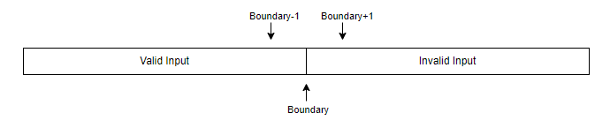
Boundary Test
Boundary testing is a type of black-box testing that tests the boundary values between partitions of input values.

Slide 21
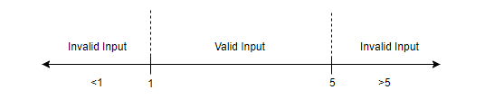
Boundary Test
Consider an ordering system in which the minimum number of items that can be ordered is 1 and the maximum number of items that can be ordered is 5. The input value partitions for the system will be as follows:
Boundary values
Valid boundary values: 1, 2, 4, 5
Invalid boundary values: 0, 6
Test cases
The test cases of the example above will be as follows:
Test case 1: Number of items ordered = less than 1
Test case 2: Number of items ordered = 1
Test case 3: Number of items ordered = value between 2 - 4
Test case 4: Number of items ordered = 5
Test case 5: Number of items ordered = greater than 5

Slide 22
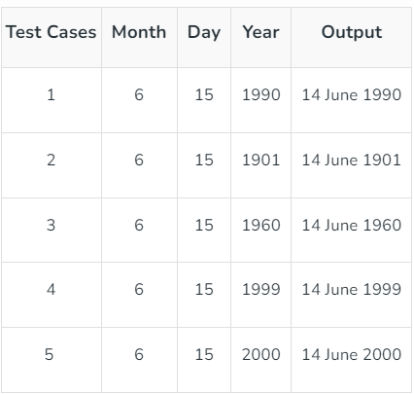
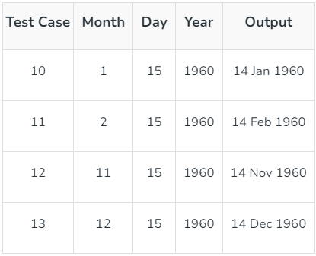
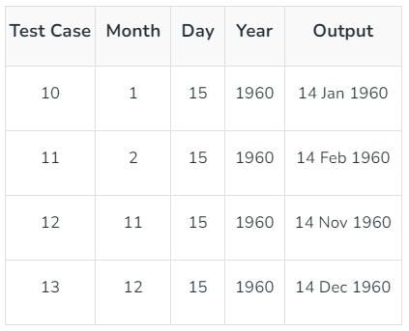
Boundary Test
Single Fault Assumption: When more than one variable for the same application is checked then one can use a single fault assumption. Holding all but one variable to the extreme value and allowing the remaining variable to take the nominal value. For n variable to be checked:
Maximum of 4n+1 test cases
Problem: Consider a Program for determining the Previous Date
Input: Day, Month, Year with valid ranges as-
1 ≤ Month≤12 1 ≤ Day ≤31 1900 ≤ Year ≤ 2000
Taking the year as a Single Fault Assumption Taking Day as Single Fault Assumption Taking Month as Single Fault Assumption
Tests: 4 × 3 + 1 =13

Slide 23
Test Abstract Class

Slide 24
White Box Testing vs. Black Box testing

Slide 25
Classfications

Slide 26
Black Box testing
Black box testing is a fundamental testing methodology that tests the functional capabilities of the software and ensures the software meets the expectations of the client.
And when it comes to black box testing, nothing can beat boundary value testing.

Slide 27
Unhappy paths vs. edge cases
Some engineers refer to these paths as edge cases, but there's a slight (but important) difference.
Edge cases are also part of unhappy path testing and they are true outliers — extreme errors that are unusual, but still possible, for users to encounter.
The errors encountered on unhappy paths are the result of common, intuitive user behaviors.
Unhappy path test example
Input the incorrect credit card number
Cancel their order while it's processing
Edge cases example
Add items from many different sellers to one cart
Try to remove cart items after their order is processed

Slide 28
Unit Test Naming Conventions
There are few recommendations regarding test naming:
Test name should express a specific requirement
Test name could include the expected input or state and the expected result for that input or state
Test name should be presented as a statement or fact of life that expresses workflows and outputs
Test name could include the name of the tested method or class
Pattern | Example
MethodName_StateUnderTest_ExpectedBehavior Tiba : put underline after every word | isAdult_AgeLessThan18_False
MethodName_ExpectedBehavior_StateUnderTest | isAdult_False_AgeLessThan18
Should_ExpectedBehavior_When_StateUnderTest | Should_ThrowException_When_AgeLessThan18
When_StateUnderTest_Expect_ExpectedBehavior | When_AgeLessThan18_Expect_isAdultAsFalse
test[Feature being tested] This one makes it easy to read the test as the feature to be tested is written as part of test name. Although, there are arguments that the “test” prefix is redundant. | testFailToWithdrawMoneyIfAccountIsInvalid
Given_Preconditions_When_StateUnderTest_Then_ExpectedBehavior — Behavior-Driven Development (BDD) | Given_UserIsAuthenticated_When_InvalidAccountNumberIsUsedToWithdrawMoney_Then_TransactionsWillFail

Slide 29
Unit Testing Naming Guidelines
Adhere to the following guidelines to write expressive, easily readable test names:
No rigid naming policy. You simply can’t fit a high-level description of a complex behavior into a narrow box of such a policy. Allow freedom of expression.
Name the test as if you were describing the scenario to a non-programmer who is familiar with the problem domain. A domain expert or a business analyst are good examples.
Separate words by underscores. It helps improve readability, especially of long names.

Slide 30
Unit Test Naming Conventions
[MethodUnderTest]_[Scenario]_[ExpectedResult]
Plain English sentence
A sentence from classes and methods names
Nested classes and methods

Slide 31
Unit Test Naming Conventions (1)
public class CalculatorTests {
[MethodUnderTest]_[Scenario]_[ExpectedResult]
MethodUnderTest is the name of the method you are testing.
Scenario is the condition under which you test the method.
ExpectedResult is what you expect the method under test to do in the current scenario.
With simple phrases, you can describe the system behavior in a way that’s meaningful to a customer or a domain expert.
Read more in the book The Art of Unit Testing (my takeaways here)
public class CalculatorTests
{
[Fact]
public void Sum_of_two_numbers()
public void Sum_TwoNumbers_ReturnsSum() {
}
}
Notes: Sometime writing test names in plain text is much simpler -> Next convention
The initial name written in plain English is much simpler.
Don’t include the name of the SUT’s method into the test’s name. So You can decide to rename the method under test and it will have no effect on the SUT’s behavior. On the other hand, if you follow the this naming convention, you’ll have to rename the test. (Vladimir Khorikov)
Remember, you don’t test code, you test application behavior.

Slide 32
Unit Test Naming Conventions (2)
Plain English sentence
This convention uses sentences in plain English for test names.
We describe in a sentence what we’re testing in a language easy to understand, even for non-programmers.
For more readability, we separate each word in our sentence with underscores.
You could read more about this convention in Vladimir Khorikov’s You are naming your tests wrong!

Slide 33
Unit Test Naming Conventions (3)
A sentence from classes and methods names
This naming convention uses sentences in plain English too. In this case, class names will act as the subject of our sentences and method names as the verb and the complement. We write units of work or entry points in class names and expected results in method names.
Also, we can split different scenarios into separate classes.
In the class names, we add the keyword Given followed by the scenario under test.
With this convention, we can read our test names like complete sentences in the “Test Explorer” menu.
You can read more about this convention in ardalis’ Unit Test Naming Convention

Slide 34
Unit Test Naming Conventions (4)
Nested classes and methods
This last convention uses sentences split into class and method names too. Unlike the previous naming convention, each scenario has its own nested class.
Kevlin Henney’s presentation Structure and Interpretation of Test Cases.

Slide 35
Test Code Characteristics
Your test code should respect most, if not all, rules of production code. It should avoid meaningless magic numbers, should avoid violating principles like DRY, YAGNI, SRP and KISS.
Test code, in the same way as production code, is supposed to be clean and self-explanatory.
You can still have a clear distinction of the three steps(Arrange-Act-Assert) by using spaces and indentation.

Slide 36
TDD Pros
Faster Development Cycles That result int more innovative code
Having a suite of automated test cases to make sure no new bugs have been introduced
Easier automation through CI/CD. Run the tests quickly and deploy the changes
Less documentation dependent
It also aids knowledge sharing , thereby making the team more effective overall
Make your code more flexible and extensible
The code can be refactored on moved with minimal risk of introducing bugs
Refactored code will force the developer(s) to think about “how” the code will be used and make it more reusable. This results in better design decisions for the development process, producing more maintainable code
It also allows one to write a smaller piece of code focusing on single responsibility rather than monolithic procedures with multiple responsibilities

Slide 37
Importance Of Failure
Failing test cases can provide very important feedback. Some of the important characteristics of failures in TDD are:
A failing test is the road to a passing test
A failing test provides a safety net
A failing test gives us assurance
A failing test provides vital information
Note: A failing test should assert just one failing test case. When you assert two failures in a test method , the assertion may become invalid because of the order in which the variables are checked.

Slide 38
Common Pitfalls
Test cases should be run and successfully executed before new ones are added.
All new test cases should be written with requirements in mind; they should not be written if they’re not needed.
Some of the common pitfalls to avoid when writing test cases are:
Forgetting to run tests frequently
Writing too many tests together
Writing large or complex tests
Writing tests that are missing assertions

Slide 39
Closing Thoughts
It’s easy to get sidetracked and miss out on code optimizations. It’s the developer’s responsibility to take a step back and analyze the code to see if any improvements can be added or not. A few helpful tips to stay on track are:
Make a change, run the test(s) and get the feedback
If you get stuck, go back to your last predictable place when you knew exactly what was happening
Simplify the logic as much as possible
Use the IDE tools to play with language syntax
If your pair is stuck, talk to another pair

Slide 40
Test Classifications

