Slide 1
Git Learning
https://learngitbranching.js.org/

Slide 2
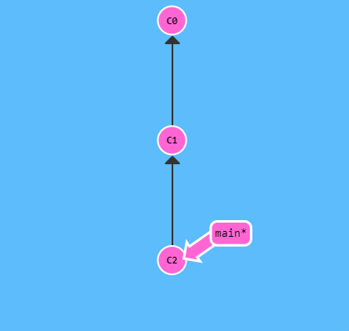
Git Commits
A commit in a git repository records a snapshot of all the (tracked) files in your directory. It's like a giant copy and paste, but even better!
Git also maintains a history of which commits were made when. That's why most commits have ancestor commits above them.
Commits are very lightweight and switching between them is wicked fast!
Note: In the picture there are three commits right now -- the first initial commit, C0, and one commit after that C1, and another commit after C2, that might have some meaningful changes.

Slide 3
Git Commits : Command
Git commit –m <commit-name>
Git commit –am <commit-name>

Slide 4
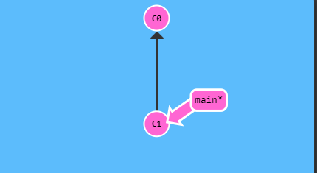
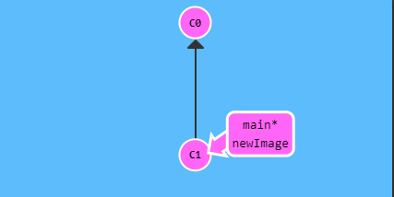
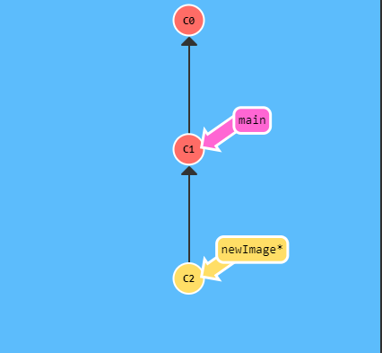
Git Branches
Branches in Git are incredibly lightweight as well. They are simply pointers to a specific commit -- nothing more.
‘Branch early, and branch often’
Because there is no storage / memory overhead with making many branches, it's easier to logically divide up your work than have big beefy branches.
A Branch essentially says:
"I want to include the work of this commit and all parent commits."

Slide 5
Git Branches : Command
git checkout <branch-name>
git switch (NEW *)
git checkout -b <your-branch-name> //Create a new branch AND check it out

Slide 6
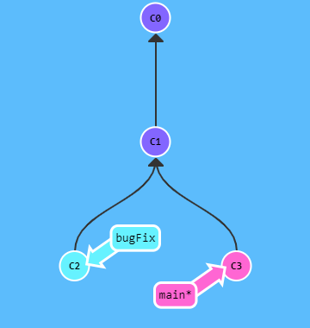
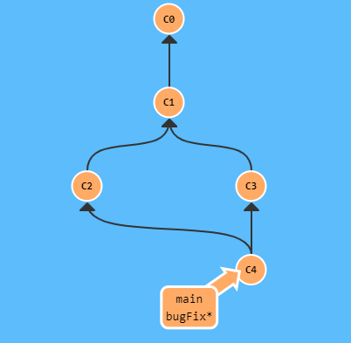
Git Merge
Merging in Git creates a special commit that has two unique parents.
Since bugFix was an ancestor of main, git didn't have to do any work; it simply just moved bugFix to the same commit main was attached to.
Merge main into bugFix. Current branch is main.
> git merge bugFix

Slide 7
Git Merge: Command
git merge <branch-name-to-merge-into-current-branch>

Slide 8
Git Rebase
The second way of combining work between branches is rebasing.
Rebasing essentially takes a set of commits, "copies" them, and plops them down somewhere else.
The advantage of rebasing is that it can be used to make a nice linear sequence of commits.
The commit log / history of the repository will be a lot cleaner if only rebasing is allowed.

Slide 9
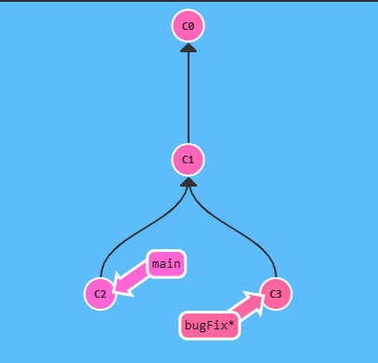
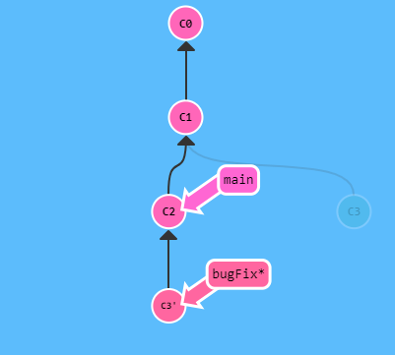
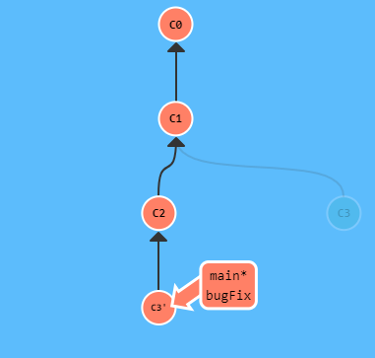
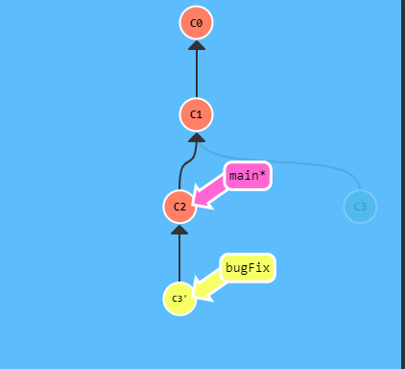
Git: Rebase -> Sample
Note that the bugFix branch is currently selected(note the asterisk or *). We would like to move our work from bugFix directly onto the work from main (Two first pictures).
>git rebase main
Now the work from our bugFix branch is right on top of main and we have a nice linear sequence of commits. Note that the commit C3 still exists somewhere (it has a faded appearance in the tree), and C3' is the "copy" that we rebased onto main. The only problem is that main hasn't been updated either, let's do that now... (Two last pictures)
> git checkout main
> git merge bugFix
Since main was an ancestor of bugFix, git simply moved the main branch reference forward in history.

Slide 10
Git Rebase: Command
> Git rebase <branch-name>

Slide 11
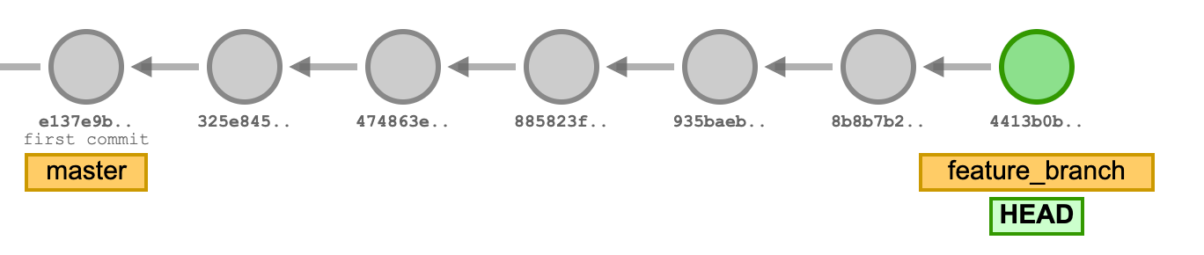
Git HEAD
A git HEAD is simply a pointer that points to a specific version or state of a git repository. It can point to either the latest commit on a branch or to a specific commit directly.
When you switch or checkout to a branch, the HEAD points to the latest commit made on that branch. It points to the current or active branch reference. Let’s visualize what a HEAD on a git branch looks like below:
The HEAD points to the active branch reference - the feature_branch in this case - where the latest commit is made.

Slide 12
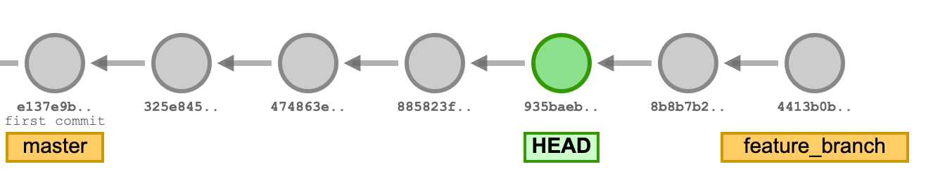
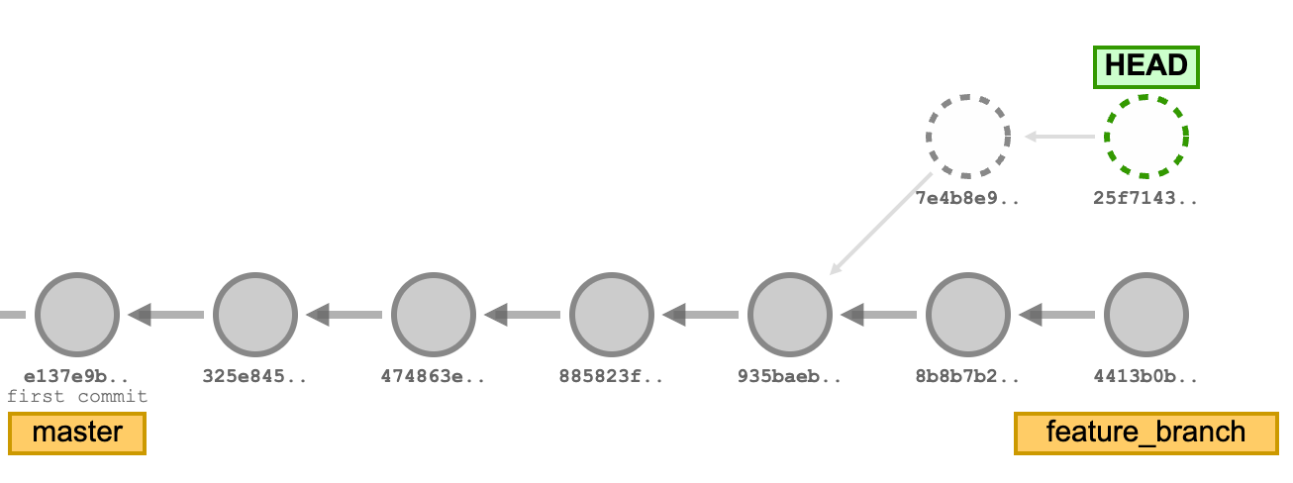
Detached HEAD State
When you are in a git detached HEAD state, you are not on any branch. The HEAD references or points to a commit directly instead of a branch. Let’s visualize what a git detached HEAD looks like:
From the image above, we switched or checked out to the commit hash, 935baeb. The HEAD moved from the feature_branch reference to now point directly to the commit with hash 935baeb, which is not on any branch. You can still create more commits when in a git detached HEAD state.

Slide 13
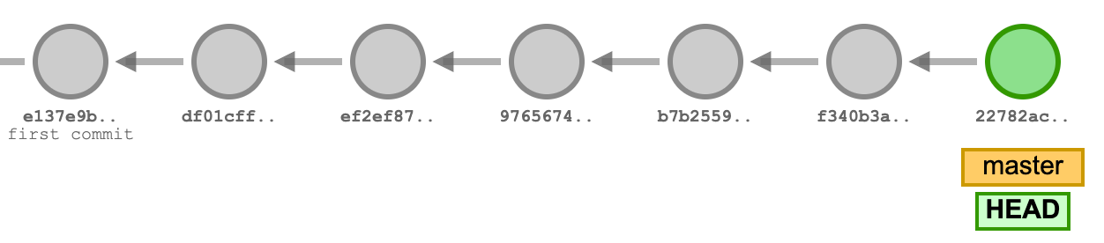
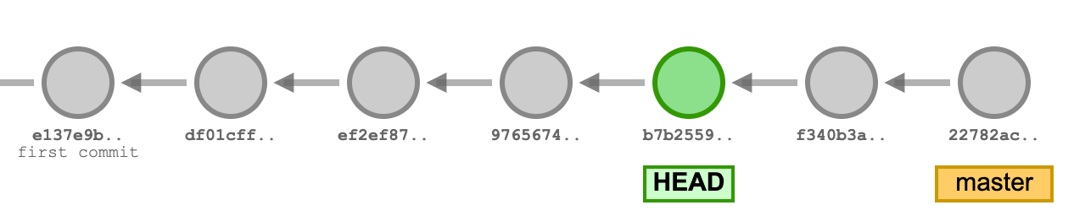
Detaching Head : Command
1) git switch <commit_hash> or git checkout <commit_hash>
Note: When you switch or check out directly to a commit via its hash, it puts you in a git detached HEAD state
2) git switch <relative_commit_reference> or git checkout <relative_commit_reference>
git checkout b7b2559
git checkout HEAD~2
https://kodekloud.com/blog/git-detached-head/

Slide 14
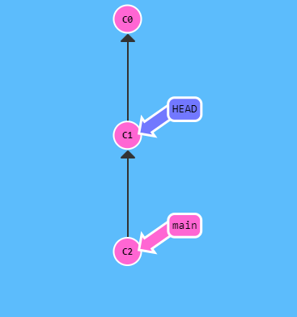
Relative Refs
Specifying commits by their hash isn't the most convenient thing ever, which is why Git has relative refs. With relative refs, you can start somewhere memorable (like the branch bugFix or HEAD) and work from there.
Relative commits are powerful, but we will introduce two simple ones here:
Moving upwards one commit at a time with ^
Moving upwards a number of times with ~<num>
> git checkout main^
So saying main^ is equivalent to "the first parent of main".
main^^ is the grandparent (second-generation ancestor) of main.

Slide 15
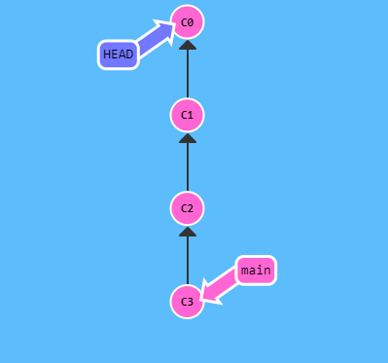
Relative Refs
You can also reference HEAD as a relative ref.
We can travel backwards in time with HEAD^.
> git checkout C3
> git checkout HEAD^
> git checkout HEAD^
> git checkout HEAD^

Slide 16
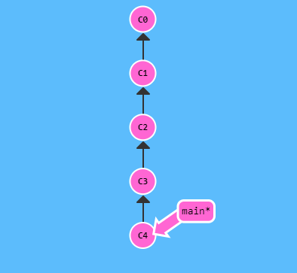
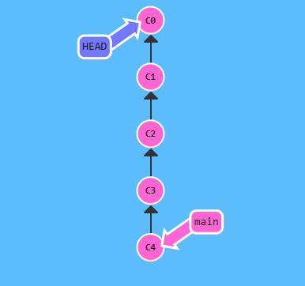
The "~" operator
Say you want to move a lot of levels up in the commit tree. It might be tedious to type ^ several times, so Git also has the tilde (~) operator.
> git checkout HEAD~4

Slide 17
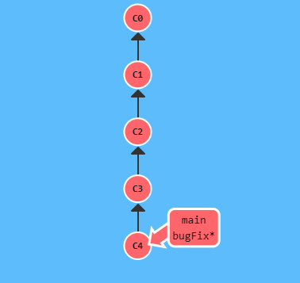
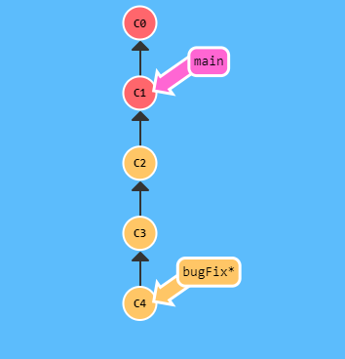
Branch Forcing
One of the most common ways I use relative refs is to move branches around.
You can directly reassign a branch to a commit with the -f option.
So something like:
> git branch -f main HEAD~3
Relative refs gave us a concise way to refer to C1 and branch forcing (-f) gave us a way to quickly move a branch to that location.
Note: In a real git environment git branch -f command is not allowed for your current branch.

Slide 18
Reversing Changes

