Slide 1
Git Learning
https://learngitbranching.js.org/

Slide 2
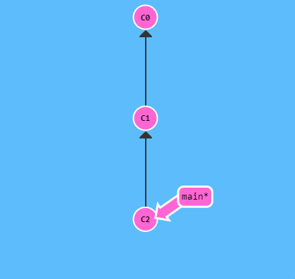
Git Commits
A commit in a git repository records a snapshot of all the (tracked) files in your directory. It's like a giant copy and paste, but even better!
Git also maintains a history of which commits were made when. That's why most commits have ancestor commits above them.
Commits are very lightweight and switching between them is wicked fast!
Note: In the picture there are three commits right now -- the first initial commit, C0, and one commit after that C1, and another commit after C2, that might have some meaningful changes.

Slide 3
Git Commits : Command
Git commit –m <commit-name>
Git commit –am <commit-name>

Slide 4
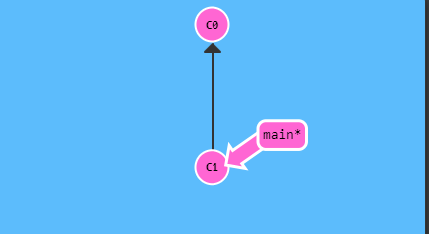
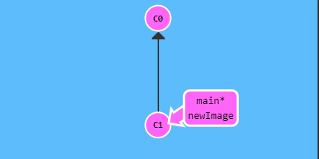
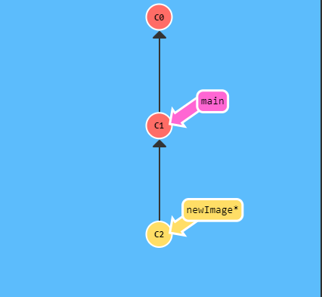
Git Branches
Branches in Git are incredibly lightweight as well. They are simply pointers to a specific commit -- nothing more.
‘Branch early, and branch often’
Because there is no storage / memory overhead with making many branches, it's easier to logically divide up your work than have big beefy branches.
A Branch essentially says:
"I want to include the work of this commit and all parent commits."

Slide 5
Git Branches : Command
Git checkout <name>
Git switch (NEW *)
git checkout -b [your-branch-name] //Create a new branch AND check it out

Slide 6
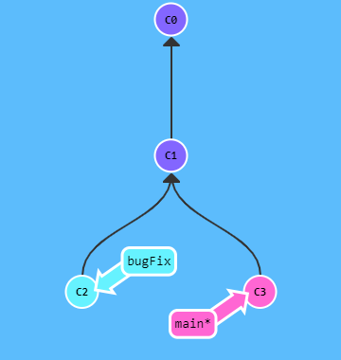
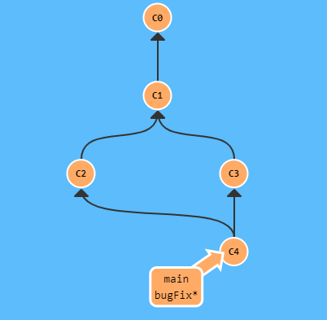
Git Merge
Merging in Git creates a special commit that has two unique parents.
Since bugFix was an ancestor of main, git didn't have to do any work; it simply just moved bugFix to the same commit main was attached to.
//merge main into bugFix. Current branch is main.
> Git merge main

Slide 7
Git Merge: Command
Git merge <branch-name-to-merge-into-current-branch>

Slide 8
Git Rebase
The second way of combining work between branches is rebasing.
Rebasing essentially takes a set of commits, "copies" them, and plops them down somewhere else.
The advantage of rebasing is that it can be used to make a nice linear sequence of commits.
The commit log / history of the repository will be a lot cleaner if only rebasing is allowed.

Slide 9
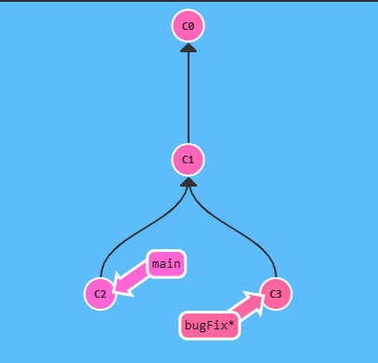
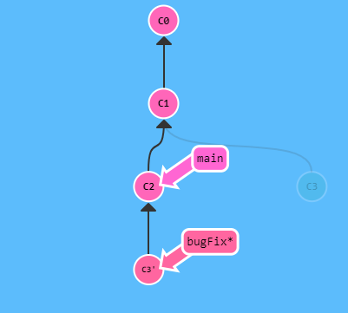
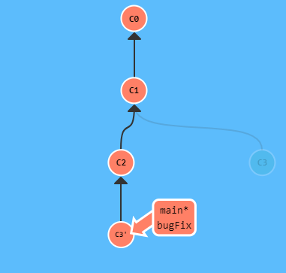
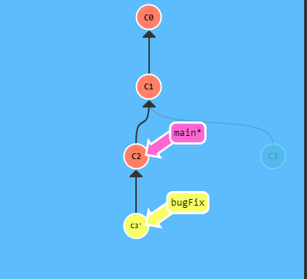
Git: Rebase -> Sample
Note that the bugFix branch is currently selected(note the asterisk or *). We would like to move our work from bugFix directly onto the work from main (Two first pictures).
>Git rebase main
Now the work from our bugFix branch is right on top of main and we have a nice linear sequence of commits. Note that the commit C3 still exists somewhere (it has a faded appearance in the tree), and C3' is the "copy" that we rebased onto main. The only problem is that main hasn't been updated either, let's do that now... (Two last pictures)
> Git checkout main
> Git merge bugFix
Since main was an ancestor of bugFix, git simply moved the main branch reference forward in history.

Slide 10
Git Rebase: Command
> Git rebase <branch-name>

Slide 11
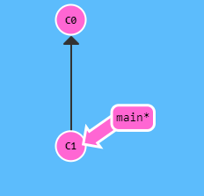
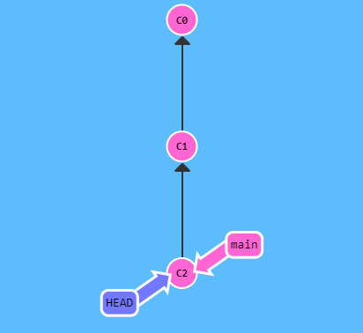
HEAD
HEAD is the symbolic name for the currently checked out commit.
HEAD always points to the most recent commit which is reflected in the working tree. Most git commands which make changes to the working tree will start by changing HEAD.
Normally HEAD points to a branch name (like bugFix). When you commit, the status of bugFix is altered and this change is visible through HEAD.
HEAD was hiding underneath our main branch all along.

Slide 12
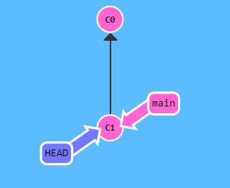
Detaching HEAD
Detaching HEAD just means attaching it to a commit instead of a branch. This is what it looks like beforehand:
HEAD -> main -> C1
> Git checkout C1
And now it's
HEAD -> C1

