Slide 1
Neo4j
Graph-Based Database

Slide 2
What is Cypher?
Cypher is Neo4j’s declarative graph query language. It was created in 2011 by Neo4j engineers as an SQL-equivalent language for graph databases. Similar to SQL, Cypher lets users focus on what to retrieve from graph, rather than how to retrieve it.
Cypher provides a visual way of matching patterns and relationships. It relies on the following ascii-art type of syntax:
(nodes)-[:CONNECT_TO]→(otherNodes).
Rounded brackets are used for circular nodes, and -[:ARROWS]→ for relationships.

Slide 3
Queries : Core Concepts
Neo4j graph database consists of three core entities:
nodes, relationships, and paths.
Cypher® queries are constructed to either match or create these entities in a graph.

Slide 4
Nodes
The data entities in a Neo4j graph database are called nodes. Nodes are referred to in Cypher using parenthesis ().
The node includes the following:
label: Labels are like tags, and are used to query the database for specific nodes. A node may have multiple labels, for example Person and Actor.
property: Properties are defined within curly braces, {}, and are used to provide nodes with specific information, which can also be queried for and further improve the ability to pinpoint data.
variable: Variables allow referencing specified nodes in subsequent clauses.
MATCH (n:Person {name:'Anna’}) RETURN n.born AS birthyear
MATCH(category: Category{categoryName:'Seafood'}) RETURN category

Slide 5
Relationships
Nodes in a graph can be connected with relationships.
A relationship must have a start node, an end node, and exactly one type.
Relationships are represented in Cypher with arrows (e.g. -->) indicating the direction of a relationship.
Notes:
Unlike nodes, information within a relationship pattern must be enclosed by square bracke, []
Note that while nodes can have several labels, relationships can only have one type.
Nodes can have any number or type of relationships without sacrificing performance.
Although relationships are always directed, they can be navigated efficiently in any direction.
MATCH (:Person {name: 'Anna'})-[r:KNOWS WHERE r.since < 2020]->(friend:Person)
RETURN count(r) As numberOfFriends

Slide 6
Paths
Paths in a graph consist of connected nodes and relationships. Exploring these paths sits at the very core of Cypher.
Paths can also be assigned variables.
MATCH (n:Person {name: 'Anna'})-[:KNOWS]-{1,5}(friend:Person WHERE n.born < friend.born)
RETURN DISTINCT friend.name AS olderConnections
MATCH p=shortestPath((:Person {name: 'Anna'})-[:KNOWS*1..10]-(:Person {nationality: 'Canadian’}))
RETURN p

Slide 7
Finding paths
Finding Shortest path To find the shortest possible path between two nodes, use the shortestPath algorithm.
match p = shortestPath((:Person {name:'Keanu Reeves'})-[*]-(:Person{name:'Tom Hanks'})) return p

Slide 8
Delete Graph
MATCH (n)
DETACH DELETE n

Slide 9
Install Neo4j Desktop
Install Neo4j
https://neo4j.com/developer/neo4j-desktop/
https://neo4j.com/download/?ref=developer-neo4j-desktop
Project
Create Project
Import sample project
Memory configuration
Remote connection
Graph apps
Browser
bloom
Action bar
Files
Cypher files
DBMS
Create a DBMS from a dump file
Connect to a remove DBMS
Upgrade a DBMS
Install a plugin
Data path
Getting updates

Slide 10
Neo4j Browser
Neo4j Browser is a developer-focused tool that allows you to execute Cypher queries and visualize the results. It is the default developer interface for both Enterprise and Community editions of Neo4j.

Slide 11
Neo4j Bloom
Bloom is used to visualize graph data using search inputs. In addition to these, other graph apps are available from a Graph Apps Gallery inside Desktop.

Slide 12
DBMS
A DBMS, database management system, is a Neo4j server instance which contains a minimum of the system database and a default database.
Upon creation of a DBMS, the default database is called neo4j, but you can rename it or create a new database as the default.

Slide 13
Conditional Expression
Simple case
CASE test
WHEN value THEN result
[WHEN ...]
[ELSE default]
END
match(p:Person) where p.eyes <> 'null’
return case p.eyes when 'blue' then 1 when 'brown' then 2 else 3 end as result , p.eyes
Generic CASE
CASE
WHEN predicate THEN result
[WHEN ...]
[ELSE default]
END
match(p:Person) where p.eyes <> 'null'
return case when p.eyes = 'blue' then 1 when p.eyes = 'brown' then 2 else 3 end as result , p.eyes
Note: The results of a CASE expression can be used to set properties on a node or relationship.

Slide 14
Graph Data Modeling

Slide 15
Graph Data Modeling
Graph data modeling is the process in which a user describes an arbitrary domain as a connected graph of nodes and relationships with properties and labels. A Neo4j graph data model is designed to answer questions in the form of Cypher queries and solve business and technical problems by organizing a data structure for the graph database.
Graph Data Model = Whiteboard-Friendly
Instead of modifying the data model to fit a normalized table structure, the graph data model stays exactly as it was drawn on the whiteboard.
This is where the graph data model gets its name for being whiteboard-friendly.
Nodes represent objects (noun)
Nodes can have properties(name/value pairs)
Relationships connect nodes and represent actions(verbs)
Relationships are directional
Relationships can have properties(name/value pairs)

Slide 16
Graph Data Modeling (2)
You can often find nodes for the graph model by identifying nouns in your domain.
e.g. Entities such as a car, a person, a customer, a company, an asset, and others similar can be defined as nodes for a good starting point.
We can identify nodes as entities with a unique conceptual identity.
A label is a named graph construct that is used to group nodes into sets. Many database queries can work with these sets instead of the whole graph, making queries easier to write and more efficient.
A node may be labeled with any number of labels, including none, making labels an optional addition to the graph.
You can identify labels by generic nouns or groups of persons, places, or things.
E.g. General nouns that fit groups of items such as Vehicle, Person, Customer, Company, Asset, and similar terms can be used as labels in your graph.
A relationship connects two nodes and allows us to find related nodes of data. It has a source node and a target node that shows the direction of the arrow.
The one core, consistent rule in a graph database is "No broken links", ensuring that an existing relationship will never point to a non-existing endpoint. Since a relationship always has a start and end node, you cannot delete a node without also deleting its associated relationships.
you can often find relationships for the graph model by identifying actions or verbs in your domain.
e.g. Actions such as DRIVES, HAS_READ, MANAGES, ACTED_IN, and others similar can be defined as different types of relationships to exist between nodes.

Slide 17
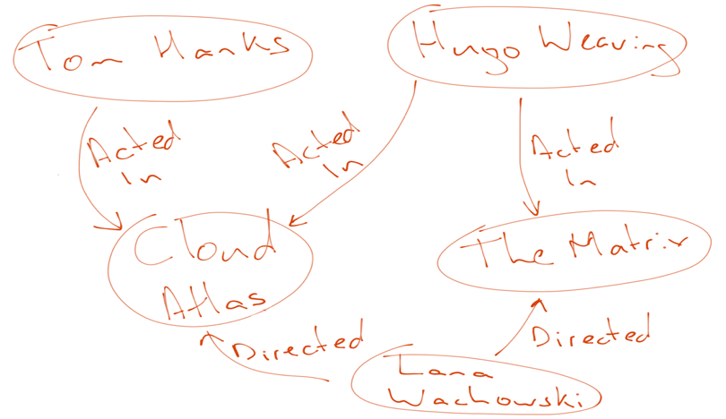
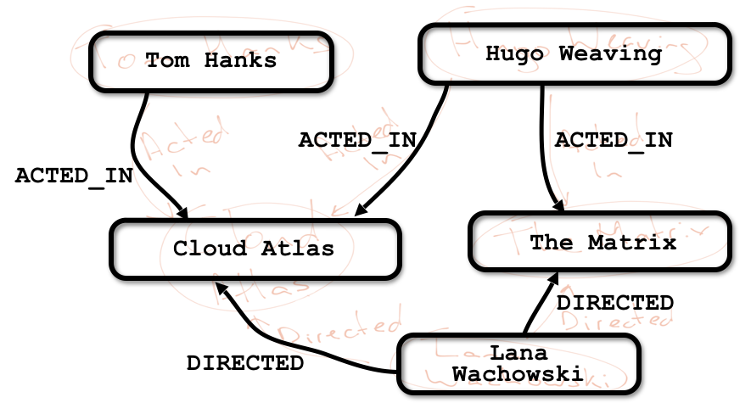
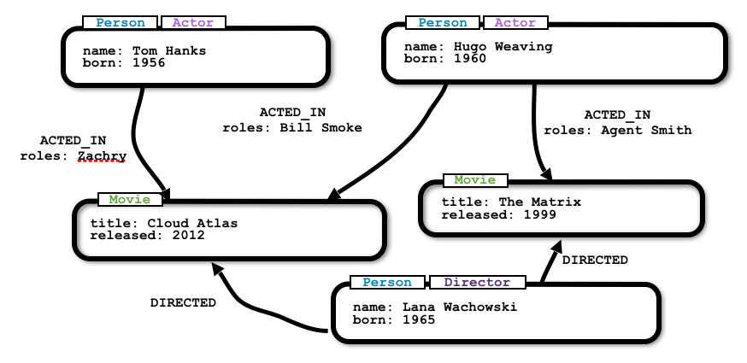
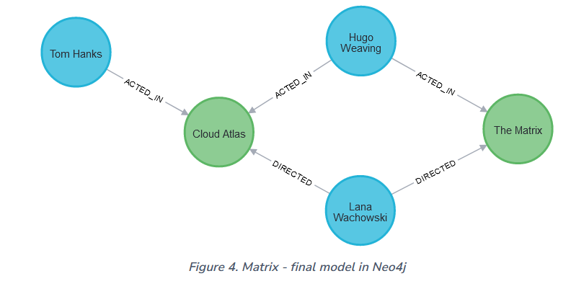
Graph Data Modeling (3) Matrix whiteboard model

Slide 18
Basic Query
MERGE
A tricky aspect of the combination of MATCH and CREATE is that you get one row per matched pattern. This causes subsequent CREATE statements to be executed once for each row. In many cases, this is what you want. If that’s not intended, move the CREATE statement before the MATCH, or change the cardinality of the query with means discussed later or use the get or create semantics of the next clause: MERGE.
A MERGE clause without any previously assigned variables in it either matches the full pattern or creates the full pattern. It never produces a partial mix of matching and creating within a pattern.
So foremost MERGE makes sure that you can’t create duplicate information or structures, but it comes with the cost of needing to check for existing matches first.
Especially on large graphs, it can be costly to scan a large set of labeled nodes for a specific property.
You can alleviate some of that by creating supporting indexes or constraints, which are discussed in the upcoming sections. But it’s still not for free, so whenever you’re sure to not create duplicate data use CREATE over MERGE.
MERGE can also assert that a relationship is only created once.
MERGE (m:Movie {title: 'Cloud Atlas'})
ON CREATE SET m.released = 2012
RETURN m

Slide 19
Filtering Results
So far you have matched patterns in the graph and always returned all results you found. Now let’s look into options for filtering the results and only return the subset of data that you are interested in. Those filter conditions are expressed using the WHERE clause.
Other options are
numeric comparisons,
matching regular expressions,
and checking the existence of values within a list.
Notice that on the second query a comma is used after the first MATCH line and another pattern is added to match on the next line. This allows you to chain patterns together, similar to when you used the WHERE exists(<pattern>) syntax above. With this structure, you can add multiple different patterns and link them together, allowing you to traverse various pieces of the graph with certain patterns.

Slide 20
Clausaes

Slide 21
Reading clauses
These comprise clauses that read data from the database.
Clause | Description
MATCH | Specify the patterns to search for in the database.
OPTIONAL MATCH | Specify the patterns to search for in the database while using nulls for missing parts of the pattern.

Slide 22
Finding Nodes
The MATCH clause is used to find a specific pattern in the graph, such as a specific node. The RETURN clause specifies what of the found graph pattern to return.
MATCH (keanu:Person {name:'Keanu Reeves'})
RETURN anu.name AS name, keanu.born AS born
LIMIT
Limits the results to only include five rows.
match(p:Person) return p limit 5
Finding connected nodes
To discover how nodes are connected to one another, relationships must be added to queries. Queries can specify relationship types, properties, and direction, as well as the start and end nodes of the pattern.
MATCH (m:Movie {title: 'The Matrix'})<-[d:DIRECTED]-(p:Person)
RETURN p.name as director
It also possible to look for the type of relationships that connect nodes to one another. The below query searches the graph for outgoing relationships.
MATCH (tom:Person {name:'Tom Hanks'})-[r]->(m:Movie)
RETURN type(r) AS type, m.title AS movie

Slide 23
Finding Nodes (2)
NOT label expression (!)
The below query uses a NOT label expression (!) to return all relationships connected to Tom Hanks that are not of type ACTED_IN.
MATCH (:Person {name:'Tom Hanks'})-[r:!ACTED_IN]->(m:Movie)
Return type(r) AS type, m.title AS movies
match(p:Person {name : 'Tom Hanks'})-[r:!ACTED_IN]-> (m:Movie) return p.name , m.title

Slide 24
Projecting Cluases
Clause | Description
RETURN -​ [AS] | Defines what to include in the query result set.
WITH -​ [AS] | Allows query parts to be chained together, piping the results from one to be used as starting points or criteria in the next.
UNWIND -​ [AS] | Expands a list into a sequence of rows.

Slide 25
Reading sub-clauses
These comprise sub-clauses that must operate as part of reading clauses.
Sub-clause | Description
WHERE | Adds constraints to the patterns in a MATCH or OPTIONAL MATCH clause or filters the results of a WITH clause.
ORDER BY [ASC[ENDING] | DESC[ENDING]] | A sub-clause following RETURN or WITH, specifying that the output should be sorted in either ascending (the default) or descending order.
SKIP | Defines from which row to start including the rows in the output.
LIMIT | Constrains the number of rows in the output.

Slide 26
Writing clauses
These comprise clauses that write the data to the database.
Clause | Description
CREATE | Create nodes and relationships.
DELETE | Delete nodes, relationships or paths. Any node to be deleted must also have all associated relationships explicitly deleted.
DETACH DELETE | Delete a node or set of nodes. All associated relationships will automatically be deleted.
SET | Update labels on nodes and properties on nodes and relationships.
REMOVE | Remove properties and labels from nodes and relationships.
FOREACH | Update data within a list, whether components of a path, or the result of aggregation.

Slide 27
Reading/Writing clauses
These comprise clauses that both read data from and write data to the database.
Clause | Description
MERGE | Ensures that a pattern exists in the graph. Either the pattern already exists, or it needs to be created.
--- ON CREATE | Used in conjunction with MERGE, this write sub-clause specifies the actions to take if the pattern needs to be created.
--- ON MATCH | Used in conjunction with MERGE, this write sub-clause specifies the actions to take if the pattern already exists.
CALL …​ [YIELD …​ ] | Invokes a procedure deployed in the database and return any results.

Slide 28
Subquery clauses
Clause | Description
CALL { …​ } | Evaluates a subquery, typically used for post-union processing or aggregations.
CALL { …​ } IN TRANSACTIONS | Evaluates a subquery in separate transactions. Typically used when modifying or importing large amounts of data.

Slide 29
Set operations
Clause | Description
UNION | Combines the result of multiple queries into a single result set. Duplicates are removed.
UNION ALL | Combines the result of multiple queries into a single result set. Duplicates are retained.

