Slide 1
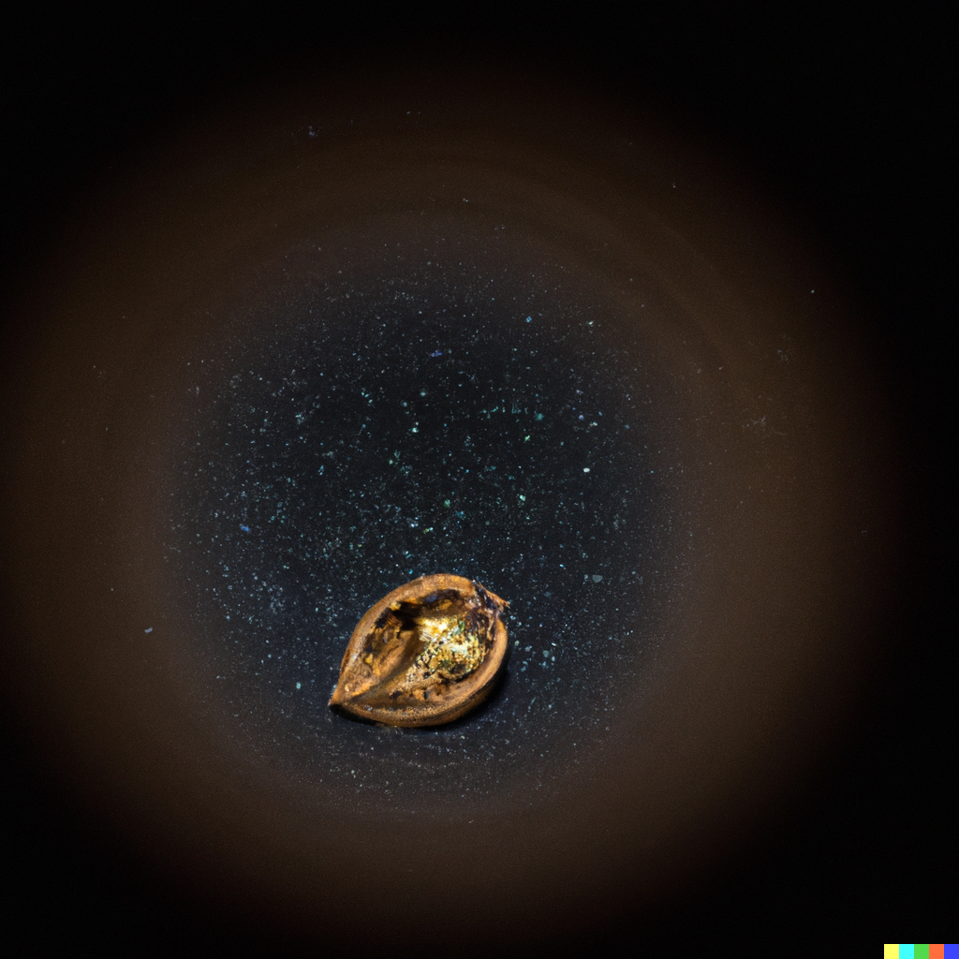

SDSS data in half a nutshell
Francisco M. Montenegro Montes María Zambrano fellow, UCM, IPARCOS
DALL-E 2

Slide 2
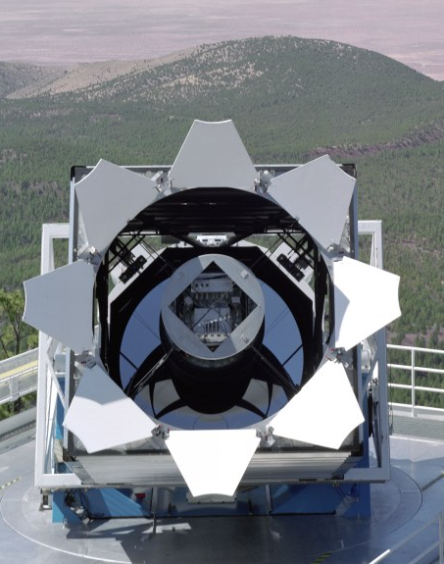
Sloan Digital Sky Survey
A dedicated 2.5-m telescope to map a large fraction of the northern sky
Collecting data since 2000. Still going on…
Images in 5 filters (colors) and spectra for selected sources
Huge database with images, spectra and parameters derived from their analysis. Easily accessible by the community

Slide 3
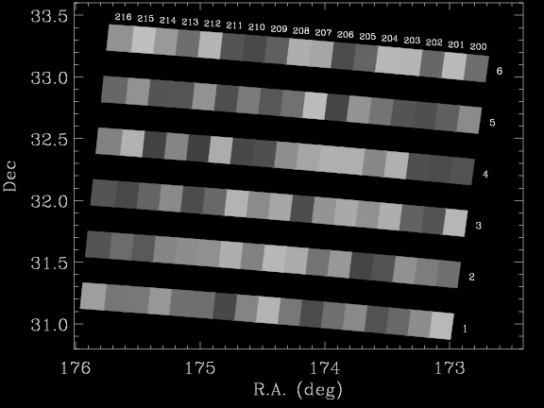
Observing methodology: Images
fields
Observing “run”
camcols

Slide 4
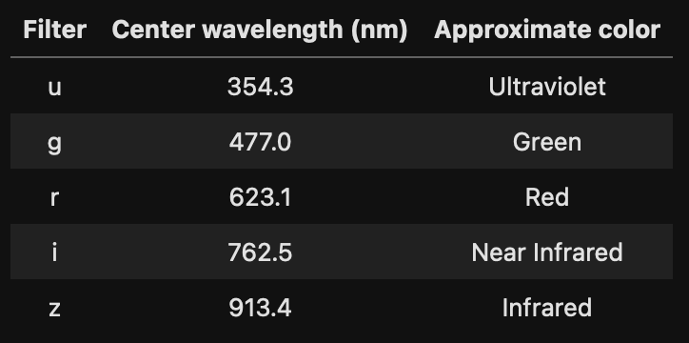
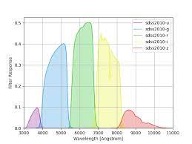
Images
Each field is observed 5 times with a different filter. Filters are called u, g, r, I and z
fields
Observing “run”
camcols

Slide 5
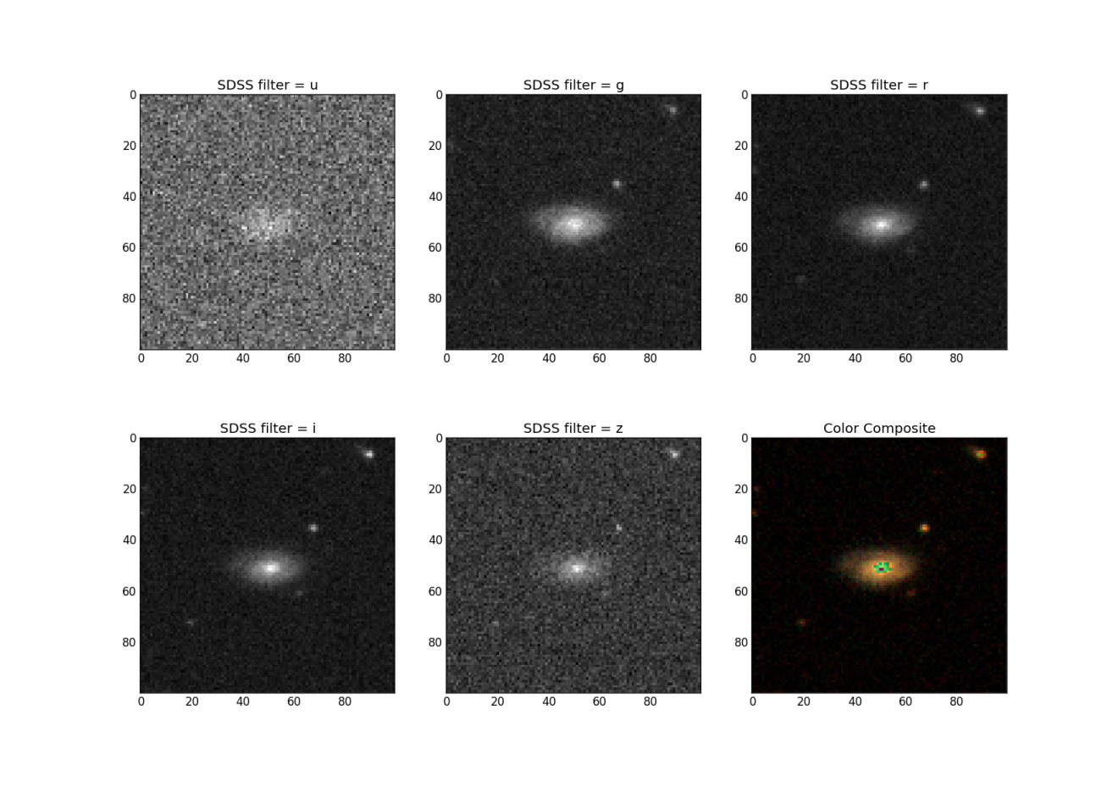
Images

Slide 6
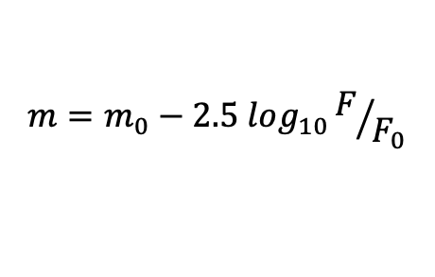
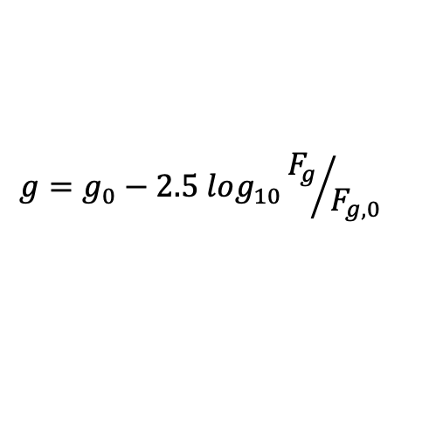
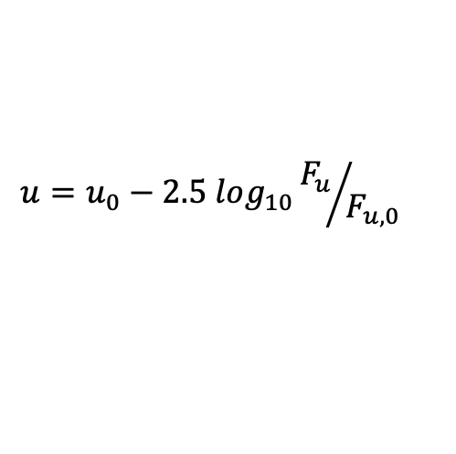
Images
Count the photons inside the circles and measure the “flux” of each object.
Astronomers normally express these in a logarithmic scale: magnitudes
$$m=m_{0}−2.5 log_{10}F/{F_{0}}$$
$$u=u_{0}−2.5 log_{10}{F_{u}}/{F_{u,0}}$$
$$g=g_{0}−2.5 log_{10}{F_{g}}/{F_{g,0}}$$
…

Slide 7
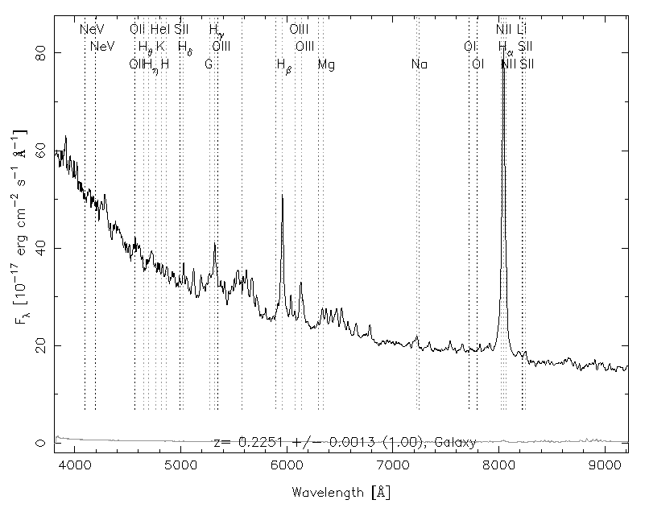
Spectra. How do you get it?

Slide 8
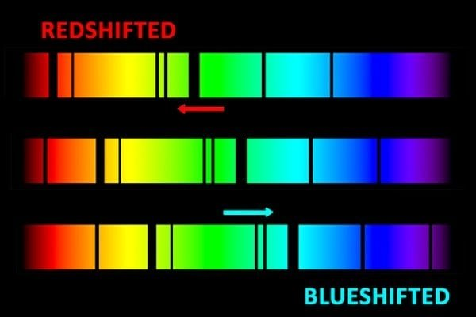
Spectra
A wealth of information is coming from the spectrum:
Emission and absorption lines produced by atomic transitions associated with the object -> Elements present, physical conditions, etc…
Shape of the continuum emission
Redshift : displacement of the emission lines due to movement in the line of vision or due to the expansion rate of the universe

Slide 9
Spectra are great but expensive…
With all this information we can reliably know what our source is: Star, Galaxy, QSO, etc…
Let’s take spectra of everything!

Slide 10
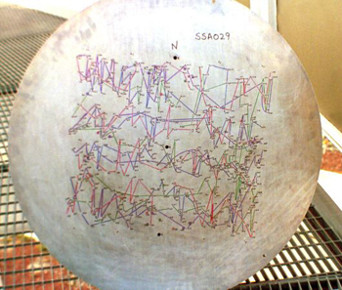
Spectra are great but expensive…
With all this information we can reliably know what our source is: Star, Galaxy, QSO, etc…
Let’s take spectra of everything!
Spectra take 10x longer time to take than images.
SDSS could only take a limited number of them per “plate”
fibers
SDSS ”plate”

Slide 11
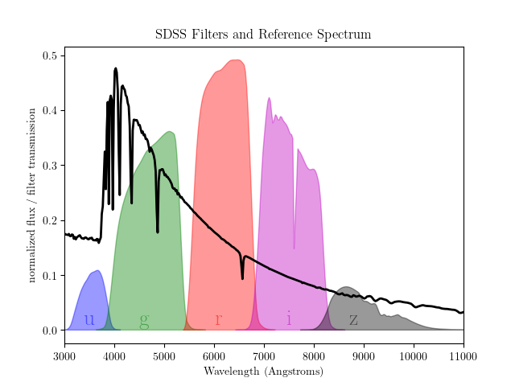
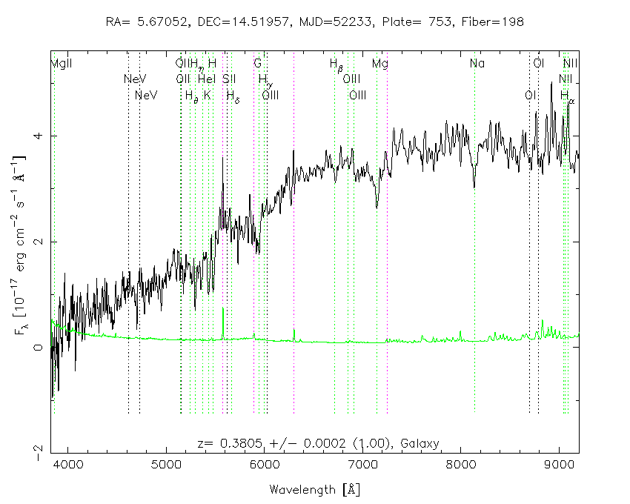
But still…
Vega, Blue star
Some Luminous Red galaxy

Slide 12
ML can help us classifying objects without spectra

Slide 13
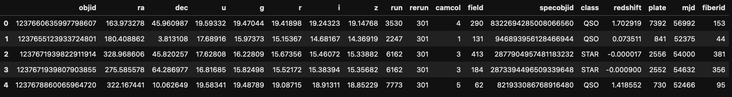
Our dataset
20000 objects catalogued by the SDSS survey for which spectra have been obtained
We have information from the photometry (images) and about their spectra
Labels are the “type of object” we could infer from the spectrum
redshift
Identifiers
Spectral
parameters
Coordinates on the sky
Magnitudes from images
Label
Imaging parameters
3 categories: STAR, GALAXY, QSO

Slide 14
Our exercise:
Let’s train a machine-learning model that can predict the labels (class for each object) from the other parameters we have in our table
Let’s measure the performance of our classifier
Let’s reflect about the result and see if we can do better

Slide 15
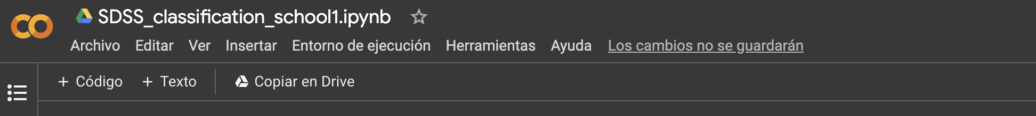
Let’s get started!
First go to this notebook in colab
https://colab.research.google.com/drive/1sMAIQ-j3OwheuWCODmPD8PDoWKEbq3bc
You have read access only, so in order to introduce changes you should copy it to your local Google drive
Get the data file from indico: SDSS_20k.csv and place it in your home folder in your Google drive
Once you open your local copy of the notebook, you can run it and make changes. You should be able to read the data file directly from the notebook.

