Slide 1
Compositional Choreographies
By Fabrizio Montesi and Nobuko Yoshida
Presenter: Diana Hooper

Slide 2
Table of Contents
Motivation
Example of Use
Compositional Choreographies
Typing
Properties of Compositional Choreographies

Slide 3
Motivation
Choreographies avoid unsafe systems (Lesser errors and easier detection).
Programmer has to implement behaviour of all roles in a protocol.
  Existing systems and libraries cannot be partially reused, and reusable libraries cannot be developed.
Providing new programming model and typing system, while still preserving properties such as deadlock-freedom and progress.
Notes:
Guidelines = programming model
If two choreographies can be composed, their endpoints can be composed as well, while preserving their properties (Such as deadlock freedom and typability)
Previously all models require that all roles of the protocol are implemented, which hinders reusability(fx dev of libraries or use of prev libraries)
Want partial choreographies, comm through message passing.

Slide 4
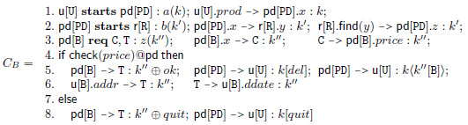

Example of Use
Buyer wishes to purchase a product from one of many seller companies.
  Buyer
  Seller
  Composition
Notes:
System of buyer dev indep. From seller and latter has modules which dont show internal implementation details. Selects company based on product, runtime. So one implements B other implements C and T.
Line 1-2 are complete, describe all participants.
Partial rely on some external implementing the missing parts.
R = service registry, contacts seller
C = product catalogue, executed by seller company
First accept to create session k'' and offer spawn of c and t
Roles as interfaces. Compose buyer seller in network with parallel operator. Allows communication

Slide 5
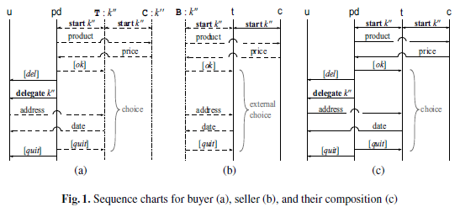
Example of Use
From their choreographies we can see they are compatible.
Notes:
(b) can see that seller does not care for pd having the role as buyer first, it sees not the delegation.

Slide 6
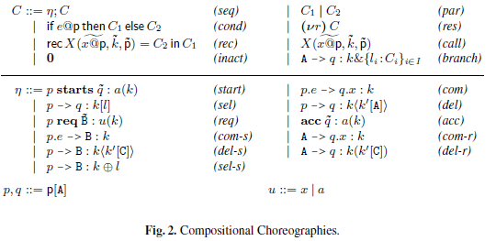
Compositional Choreographies
Syntax
  Let η be a complete or partial action
Semantics
  Labelled Transition System (lts)
Notes:
Complete terms: start, com, sel and del complete in eta, with if@p(for conditionals) and closed under (vr) fx start
Partial partial under eta with A → q:k& l closed under (vr) fx com-s
Give semantics to labelled transition system

Slide 7
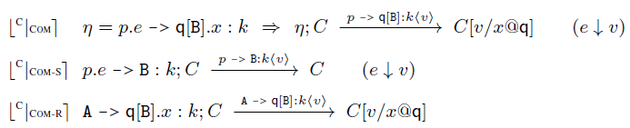

Compositional Choreographies
Semantics
  Start
  Communication, Sender and Receiver
  Parallel
  Synchronisation
    Based on rules:
Notes:
Start, same, start session restricting names
Par makes global act observable and we can block partial acts if their counterpart is in branch C2
Act, cleanup stuff that makes no difference at beginning
Composition function Pact x Pact → Cact
If not defined, then the choreographies are not compatible.

Slide 8
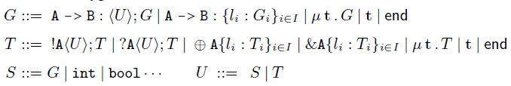
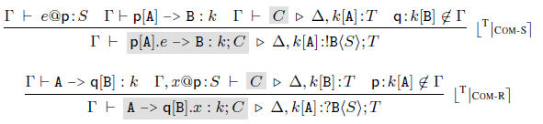
Typing
Typing Judgement – Global Types and Local Types
  Linear Session Typing Env. and Unrestricted Service Env.
Typing Rules
  Communication, Sender and Receiver
    Restrict counterpart to avoid deadlock!
Notes:
S=typing values or shared channels
Delta session, tau channel. P multi roles in tau not in session
C is well-typed if shared channels are used according to tau and sessions according to delta
! send ? Receive of type U
Cross select & offer branches
Others are standard
k[A]:T mapping of local type T to role A in session k
Ensure no process q takes on role of B, since this role is filled by external process. Deadlock could occur since p would have no process to comm with in parallel in rule sync
Type check chors against global types
Start & ACC basically same

Slide 9
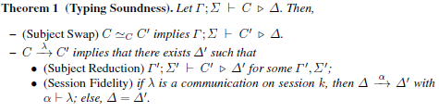
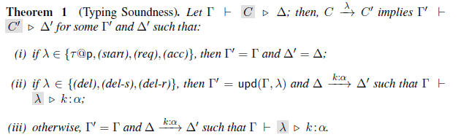
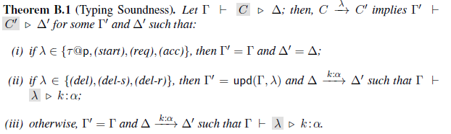
Main Property of Typing System
Theorem 1 (Typing Soundness)
  Let a choreography C be well-typed. Then,
    If C can be swapped with C', then C' must be well-typed.
    A transition C to C' with label λ (some communication) implies that there exists some transition of local types with label α. Then λ must be of the same session as α and respect its roles and carried type.
Notes:
Well typed for some local type, then when we make a step, the step for the local type is made accordingly.
So we preserve well-typed over steps.
Otherwise we have performed a step which gives us the same environment for C'(fx start, req and acc)
Main property of typing system.

Slide 10
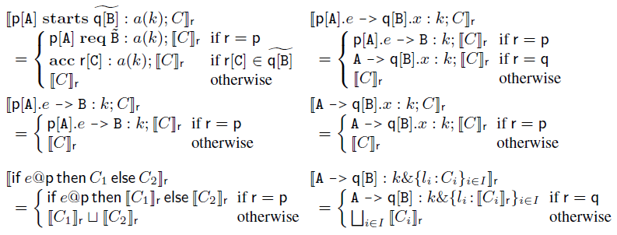
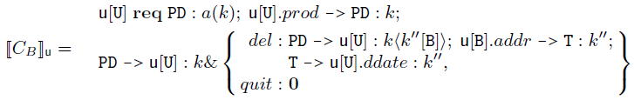
Properties of Compositional Choreographies
Endpoint Projection (EPP)
The process projection of user from our earlier example
Notes:
EPP gen correct code
EPP is for partial choreographies, which are then composed to complete EPP

Slide 11


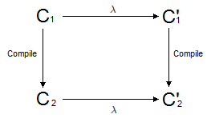

Properties of Compositional Choreographies
Definition 1 (Endpoint Projection)
  For each p in the choreography, we generate the code and put each part in parallel.
Theorem 2 (EPP Type Preservation)
  If C is well-typed, then compile(C) is well-typed.
Theorem 3 (EPP Theorem)
  Let C be a well-typed choreography, then C and compile(C) are operationally equivalent.
Notes:
Def 1: for each process in
Thm 3 compile correctness

Slide 12



Properties of Compositional Choreographies
Definition 2 (Deadlock Freedom)
  A choreography C is deadlock-free if it is either empty or there exists a C' and step such that the transition from C to C' is deadlock-free.
Theorem 4 (Deadlock-freedom for Complete Choreographies)
  Let C be a complete choreography and contain no free variable names. Then, C is deadlock-free.
By Thm 3 and 4, we get Corollary 1 (Deadlock-freedom for EPP)
  Let C be a complete choreography, contain no free variable names, and be well-typed. Then compile(C) is deadlock-free
Notes:
Corollary 1 by thm 3 and 4, we see that the EPP of C, well typed,fn(C) = Ø is also deadlock-free
Thm 4 from the semantics we see we can always perform a complete action, so as long as we have no partial actions or complete choreographies in C we're good

Slide 13
Properties of Compositional Choreographies
Theorem 5 (Progress for Partial Choreographies)
  Let C be a choreography, be well-typed and contain no (par) terms. Then, there exists C' such that C and C' can be put in parallel and the result will be well-typed and deadlock-free.
By Thm 2 and 5 we get Corollary 2 (Progress for EPP)
  Let C be a choreography, be well-typed and contain no (par) terms. Then, there exists C' such that compile(C) and C' can be put in parallel and the result will be well-typed and deadlock-free.
Notes:
Thm 2 C well typed then cmpile C welltyped
Lemma 2, C = C1 | C2 well-typed, then compile(C) eq compile(C1)|compile(C2)

Slide 14
Properties of Compositional Choreographies
Finally Corollary 3 (Compositional Choreographies)
  Let C | C' be well-typed. Then,
    compile(C) | compile(C') is well-typed
    compile(C) | compile(C') is operationally equivalent to C | C'
And so we can develop choreographies independently and compose their projections.
Notes:
Corollary for main issue, C and C' can be developed independently and their projections be composed

Slide 15
Literature
Compositional Choreographies by Fabrizio Montesi and Nobuko Yoshida, published in CONCUR 2013 pp 425-439

