Slide 1
Chapter 3: Introduction to SQL

Slide 2
Chapter 3: Introduction to SQL
Overview of the SQL Query Language
Data Definition
Basic Query Structure
Additional Basic Operations
Set Operations
Null Values
Aggregate Functions
Nested Subqueries
Modification of the Database
Notes:
1

Slide 3
History
IBM Sequel language developed as part of System R project at the IBM San Jose Research Laboratory
Renamed Structured Query Language (SQL)
ANSI and ISO standard SQL:
SQL-86, SQL-89, SQL-92
SQL:1999, SQL:2003, SQL:2008, SQL:2008, SQL:2012, SQL:2014
Commercial systems offer most, if not all, SQL-92 features, plus varying feature sets from later standards and special proprietary features.
Not all examples here may work on your particular system.

Slide 4
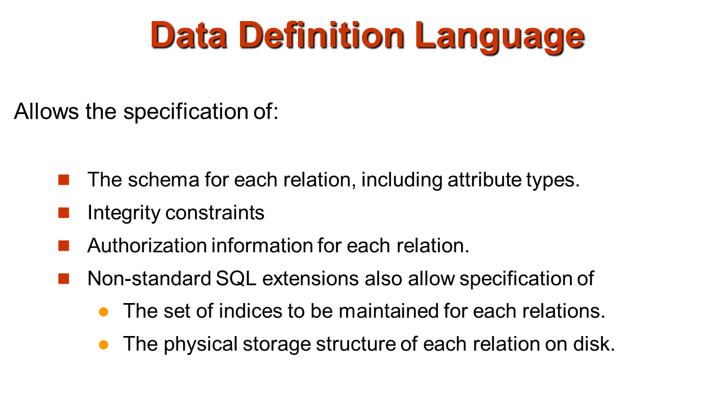

Slide 5
Domain Types in SQL
char(n). Fixed length character string, with user-specified length n.
varchar(n). Variable length character strings, with user-specified maximum length n.
int. Integer (a finite subset of the integers that is machine-dependent).
smallint. Small integer (a machine-dependent subset of the integer domain type).
numeric(p,d). Fixed point number, with user-specified precision of p digits, with n digits to the right of decimal point.
real, double precision. Floating point and double-precision floating point numbers, with machine-dependent precision.
float(n). Floating point number, with user-specified precision of at least n digits.
More are covered in Chapter 4.

Slide 6
Create Table Construct
An SQL relation is defined using the create table command:
create table r (A₁ D₁, A₂ D₂, ..., A_{n} D_{n}, (integrity-constraint₁), ..., (integrity-constraint_{k}))
r is the name of the relation
each A_{i} is an attribute name in the schema of relation r
D_{i} is the data type of values in the domain of attribute A_{i}
Example:
create table instructor ( ID char(5), name varchar(20) not null, dept_name varchar(20), salary numeric(8,2))
insert into instructor values (‘10211’, ’Smith’, ’Biology’, 66000);
insert into instructor values (‘10211’, null, ’Biology’, 66000);

Slide 7
Integrity Constraints in Create Table
not null
primary key (A₁, ..., A_{n} )
foreign key (A_{m}, ..., A_{n} ) references r
Example: Declare ID as the primary key for instructor
.
create table instructor ( ID char(5), name varchar(20) not null, dept_name varchar(20), salary numeric(8,2), primary key (ID), foreign key (dept_name) references department)
primary key declaration on an attribute automatically ensures not null

Slide 8
And a Few More Relation Definitions
create table student ( ID varchar(5), name varchar(20) not null, dept_name varchar(20), tot_cred numeric(3,0), primary key (ID), foreign key (dept_name) references department) );
create table takes ( ID varchar(5), course_id varchar(8), sec_id varchar(8), semester varchar(6), year numeric(4,0), grade varchar(2), primary key (ID, course_id, sec_id, semester, year), foreign key (ID) references student, foreign key (course_id, sec_id, semester, year) references section );
Note: sec_id can be dropped from primary key above, to ensure a student cannot be registered for two sections of the same course in the same semester

Slide 9
And more still
create table course ( course_id varchar(8) primary key, title varchar(50), dept_name varchar(20), credits numeric(2,0), foreign key (dept_name) references department) );
Primary key declaration can be combined with attribute declaration as shown above

Slide 10
Drop and Alter Table Constructs
drop table student
Deletes the table and its contents
delete from student
Deletes all contents of table, but retains table
alter table
alter table r add A D
alter table student add NID int
where A is the name of the attribute to be added to relation r and D is the domain of A.
All tuples in the relation are assigned null as the value for the new attribute.
alter table r drop A
where A is the name of an attribute of relation r
Dropping of attributes not supported by many databases

Slide 11
Basic Query Structure
The SQL data-manipulation language (DML) provides the ability to query information, and insert, delete and update tuples
A typical SQL query has the form: select A₁, A₂, ..., A_{n} from r₁, r₂, ..., r_{m} where P
A_{i} represents an attribute
R_{i} represents a relation
P is a predicate.
The result of an SQL query is a relation.
Notes:
2

Slide 12
The select Clause
The select clause list the attributes desired in the result of a query
corresponds to the projection operation of the relational algebra
Example: find the names of all instructors: select name from instructor
NOTE: SQL names are case insensitive (i.e., you may use upper- or lower-case letters.)
E.g. Name ≡ NAME ≡ name
Some people use upper case wherever we use bold font.
Notes:
3

Slide 13
The select Clause (Cont.)
SQL allows duplicates in relations as well as in query results.
To force the elimination of duplicates, insert the keyword distinct after select.
Find the names of all departments with instructor, and remove duplicates
select distinct dept_name from instructor
The keyword all specifies that duplicates not be removed.
select all dept_name from instructor
Notes:
4

Slide 14
The select Clause (Cont.)
An asterisk in the select clause denotes “all attributes”
select * from instructor
The select clause can contain arithmetic expressions involving the operation, +, –, , and /, and operating on constants or attributes of tuples.
The query:
select ID, name, salary/12 from instructor
would return a relation that is the same as the instructor relation, except that the value of the attribute salary is divided by 12.
Notes:
5

Slide 15
The where Clause
The where clause specifies conditions that the result must satisfy
Corresponds to the selection predicate of the relational algebra.
To find all instructors in Comp. Sci. dept with salary > 80000 select name from instructor where dept_name = ‘Comp. Sci.' and salary > 80000
Comparison results can be combined using the logical connectives and, or, and not.
Comparisons can be applied to results of arithmetic expressions.
Notes:
6

Slide 16
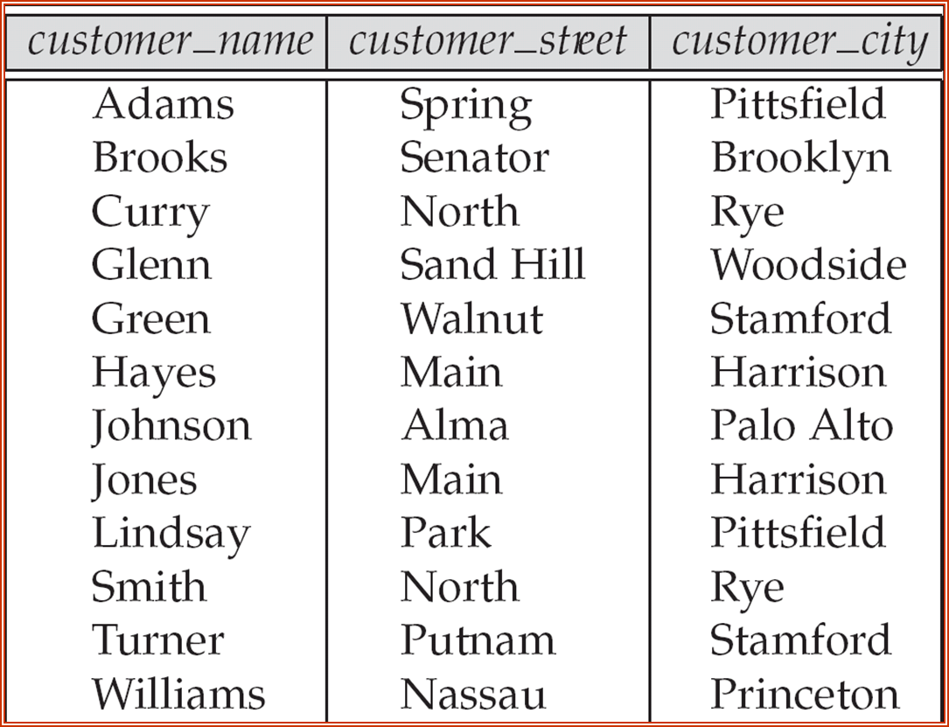
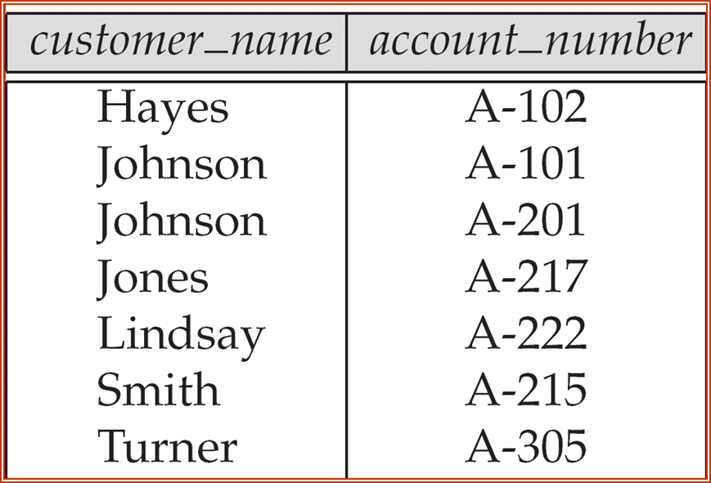
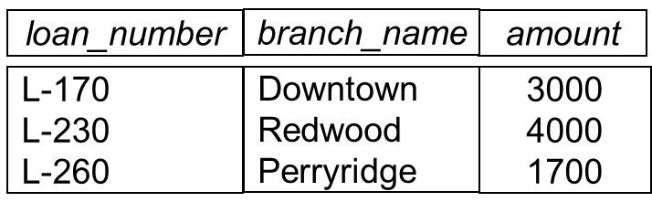
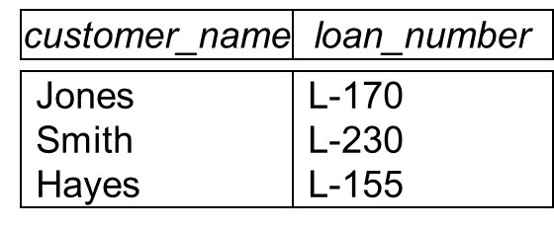
Customer
Depositor
Loan
Borrower

Slide 17
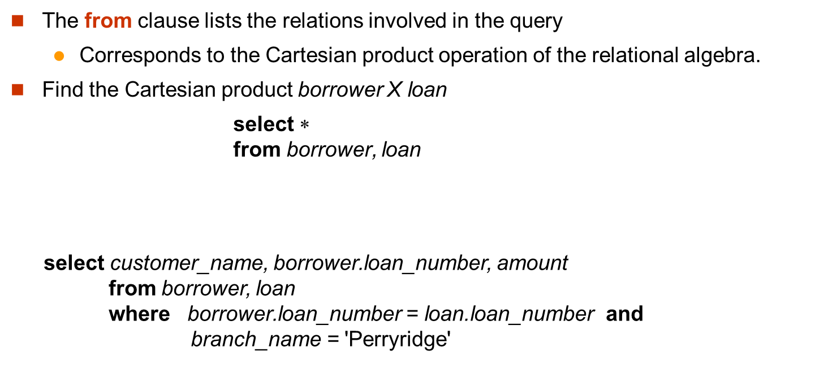
The from Clause

Slide 18
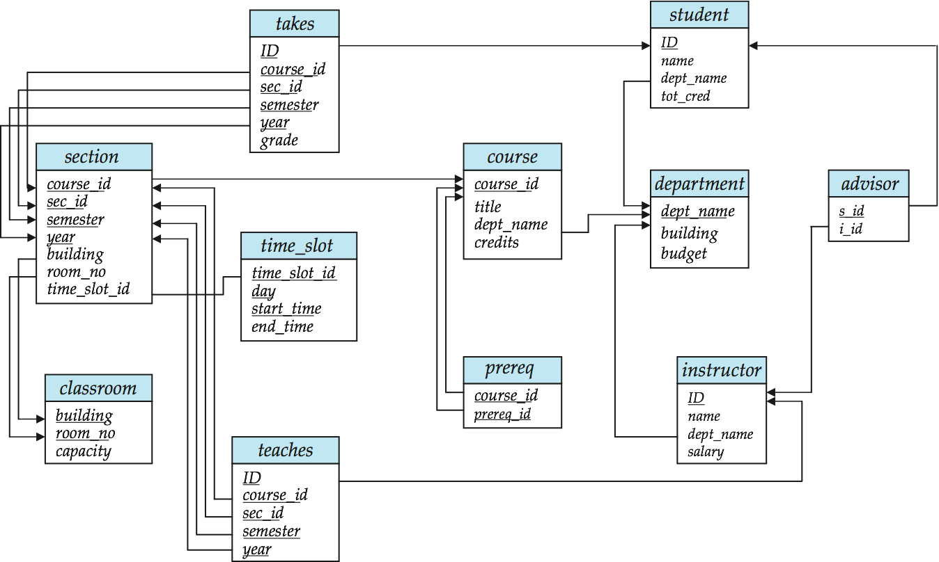
Joins
For all instructors who have taught some course, find their names and the course ID of the courses they taught.
select name, course_id from instructor, teaches where instructor.ID = teaches.ID
Find the course ID, semester, year and title of each course offered by the Comp. Sci. department
select section.course_id, semester, year, title from section, course where section.course_id = course.course_id and dept_name = ‘Comp. Sci.'

Slide 19
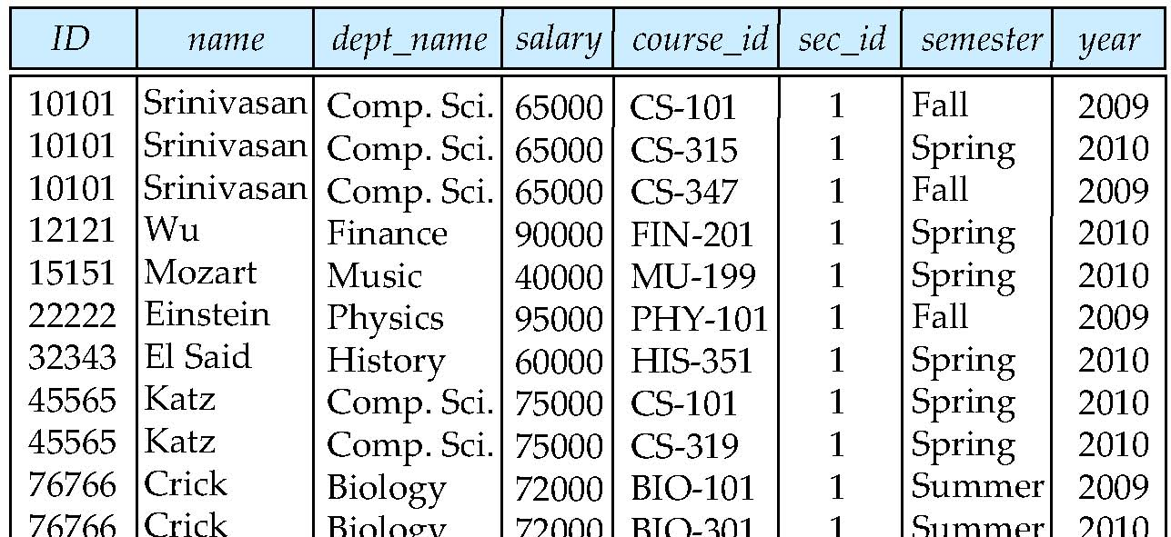
Natural Join
Natural join matches tuples with the same values for all common attributes, and retains only one copy of each common column
select * from instructor natural join teaches;

Slide 20
Natural Join Example
List the names of instructors along with the course ID of the courses that they taught.
select name, course_id from instructor, teaches where instructor.ID = teaches.ID;
select name, course_id from instructor natural join teaches;

Slide 21
Natural Join (Cont.)
Danger in natural join: beware of unrelated attributes with same name which get equated incorrectly
List the names of instructors along with the the titles of courses that they teach
Incorrect version (makes course.dept_name = instructor.dept_name)
select name, title from instructor natural join teaches natural join course;
Correct version
select name, title from instructor natural join teaches, course where teaches.course_id = course.course_id;
Another correct version
select name, title from (instructor natural join teaches) join course using(course_id);

Slide 22
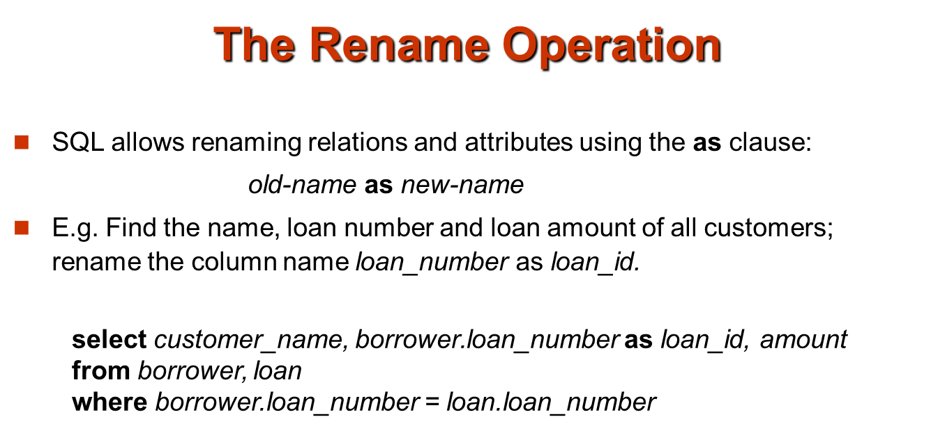
E.g.
select ID, name, salary/12 as monthly_salary
from instructor
Notes:
9

Slide 23
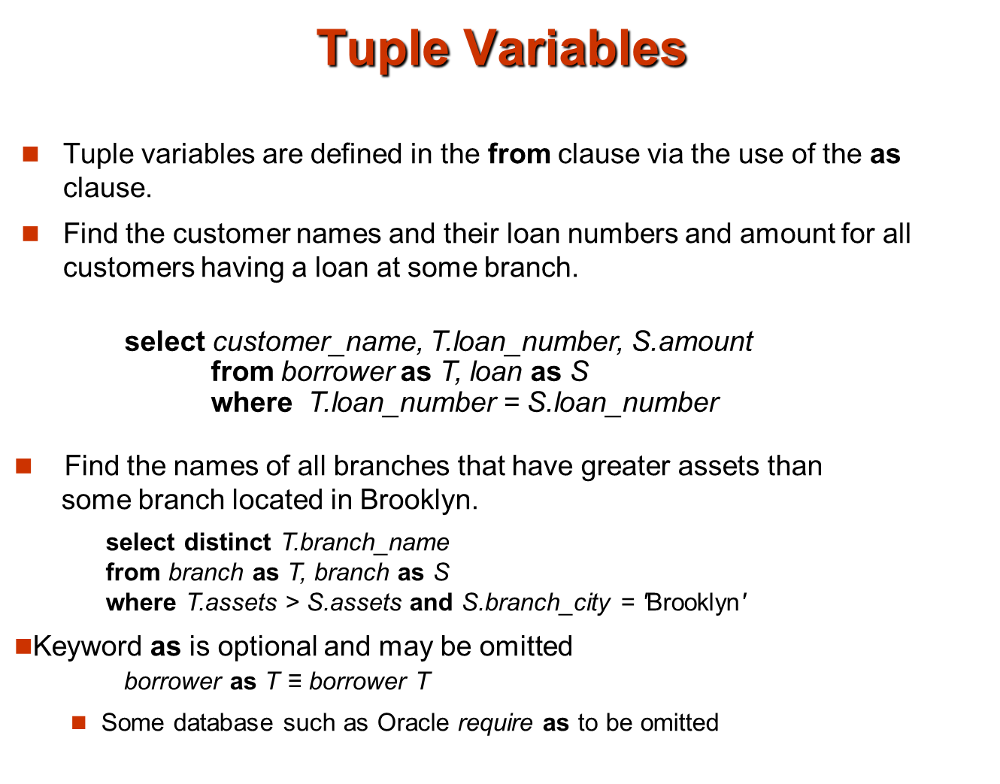

Slide 24
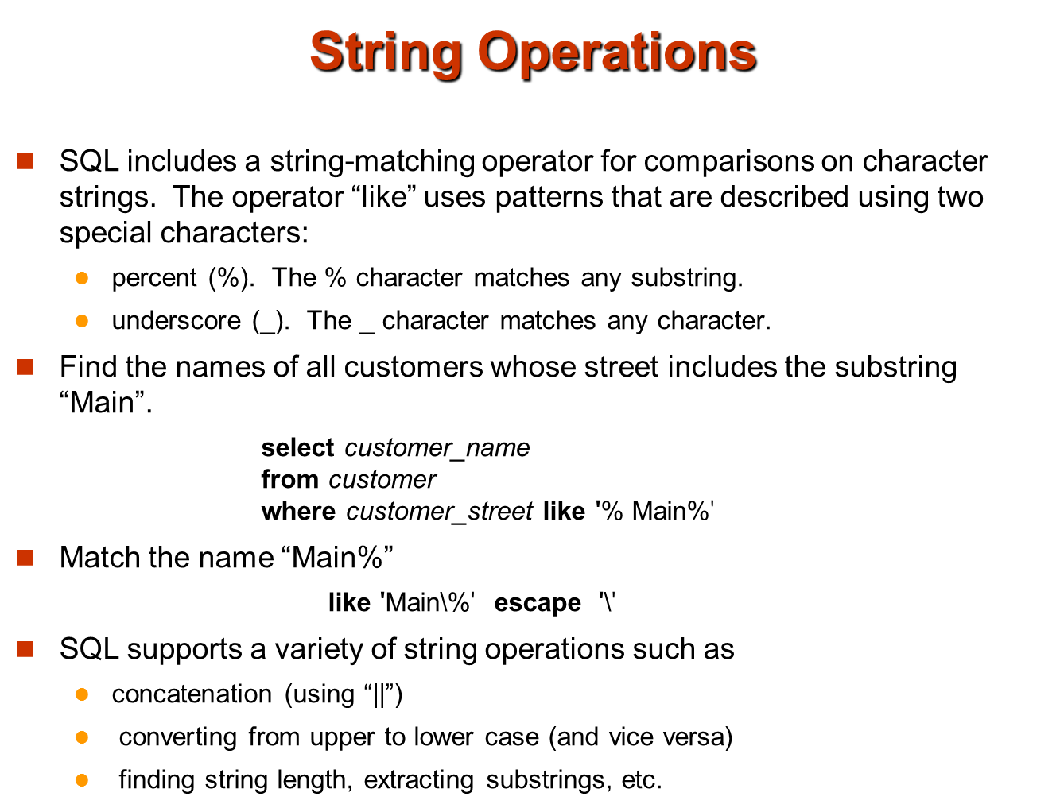

Slide 25
String Operations (Cont.)
Patters are case sensitive.
Pattern matching examples:
‘Intro%’ matches any string beginning with “Intro”.
‘%Comp%’ matches any string containing “Comp” as a substring.
‘_ _ _’ matches any string of exactly three characters.
‘_ _ _ %’ matches any string of at least three characters.
SQL supports a variety of string operations such as
concatenation (using “||”)
converting from upper to lower case (and vice versa)
finding string length, extracting substrings, etc.

Slide 26
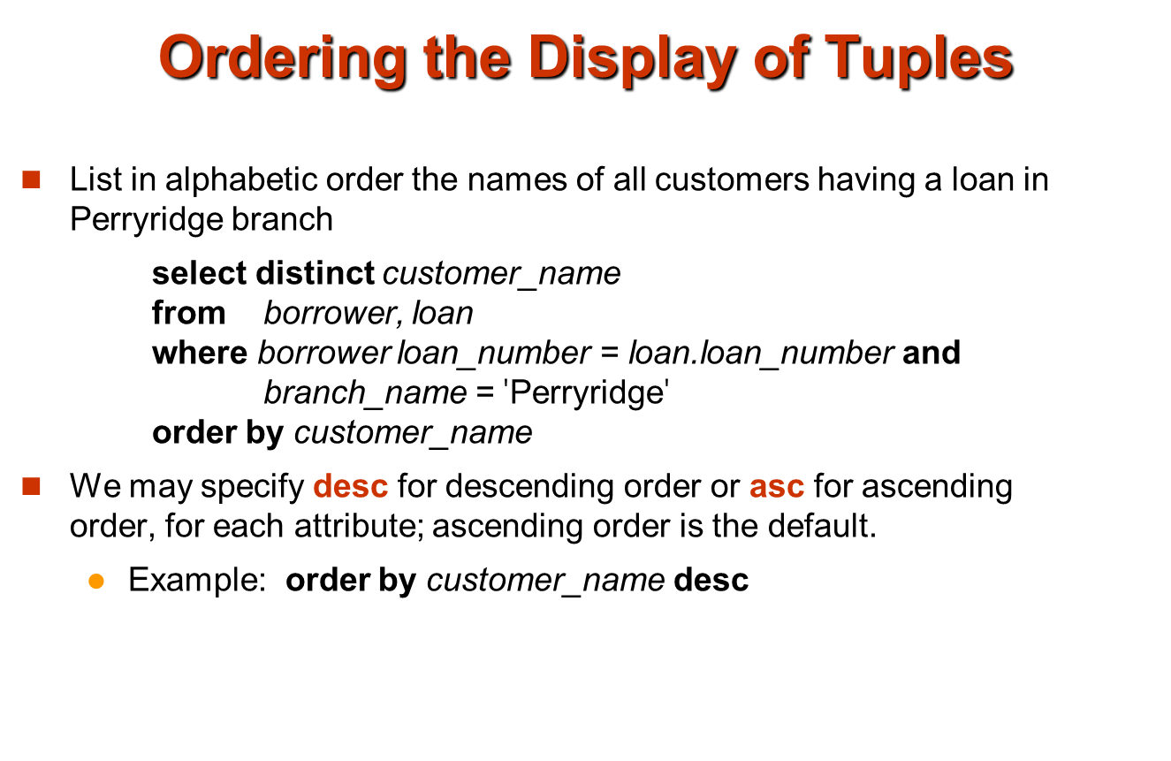

Slide 27
Where Clause Predicates
SQL includes a between comparison operator
Example: Find the names of all instructors with salary between $90,000 and $100,000 (that is,  $90,000 and  $100,000)
select name from instructor where salary between 90000 and 100000
Tuple comparison
select name, course_id from instructor, teaches where (instructor.ID, dept_name) = (teaches.ID, ’Biology’);
Notes:
7

Slide 28
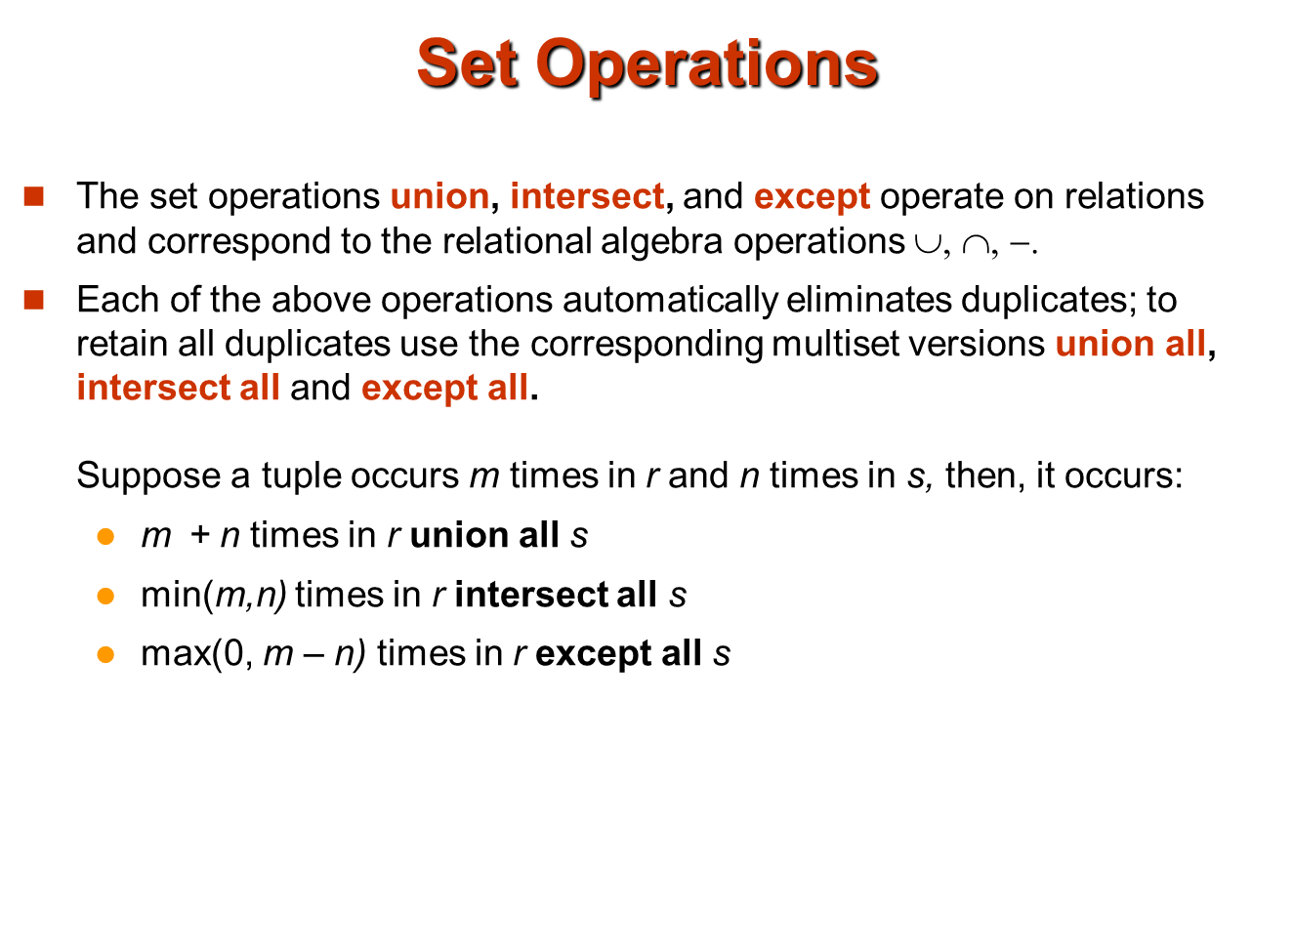

Slide 29
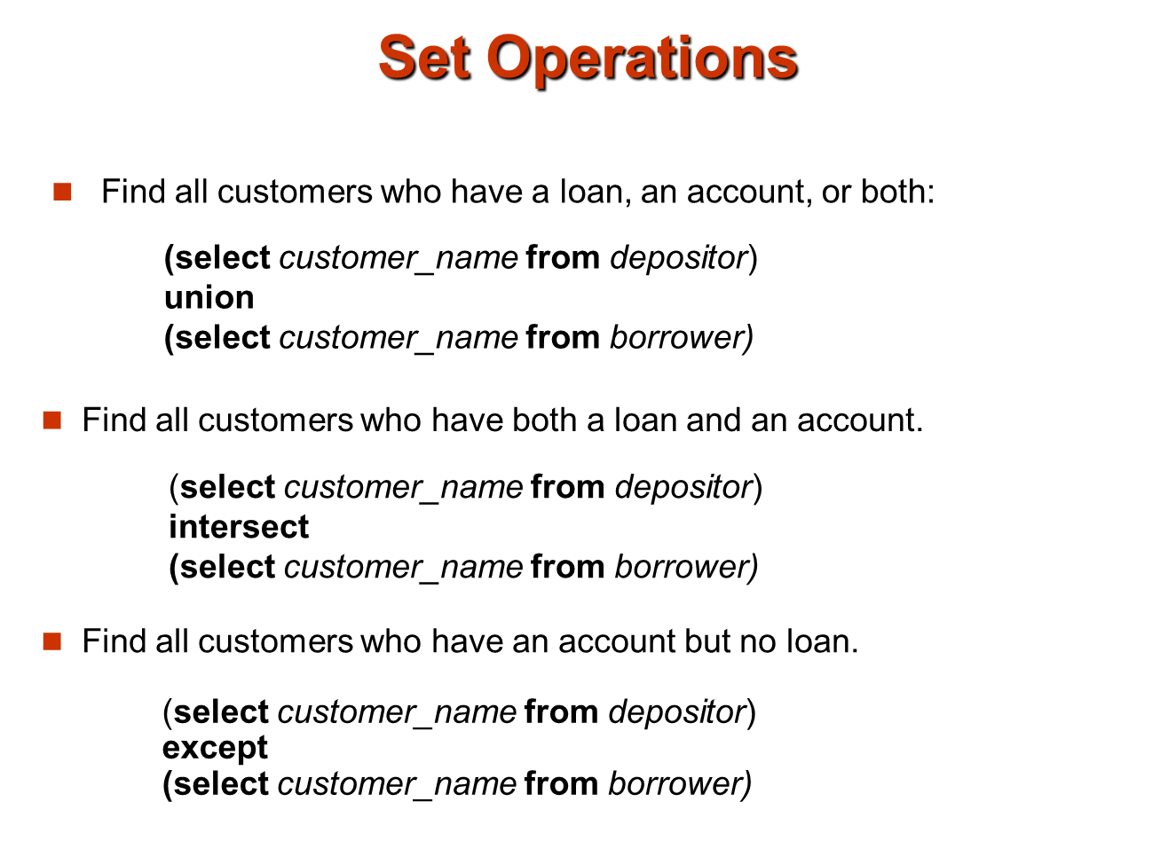

Slide 30
Set Operations
Find courses that ran in Fall 2009 or in Spring 2010
(select course_id from section where sem = ‘Fall’ and year = 2009) union (select course_id from section where sem = ‘Spring’ and year = 2010)
Find courses that ran in Fall 2009 and in Spring 2010
(select course_id from section where sem = ‘Fall’ and year = 2009) intersect (select course_id from section where sem = ‘Spring’ and year = 2010)
Find courses that ran in Fall 2009 but not in Spring 2010
(select course_id from section where sem = ‘Fall’ and year = 2009) except (select course_id from section where sem = ‘Spring’ and year = 2010)

Slide 31
Aggregate Functions
These functions operate on the multiset of values of a column of a relation, and return a value
avg: average value min: minimum value max: maximum value sum: sum of values count: number of values

Slide 32
Aggregate Functions (Cont.)
Find the average salary of instructors in the Computer Science department
select avg (salary) from instructor where dept_name= ’Comp. Sci.’;
Find the total number of instructors who teach a course in the Spring 2010 semester
select count (distinct ID) from teaches where semester = ’Spring’ and year = 2010
Find the number of tuples in the course relation
select count (*) from course;

Slide 33
Null Values
It is possible for tuples to have a null value, denoted by null, for some of their attributes
null signifies an unknown value or that a value does not exist.
The result of any arithmetic expression involving null is null
Example: 5 + null returns null
The predicate is null can be used to check for null values.
Example: Find all instructors whose salary is null.
select name from instructor where salary is null

Slide 34
Null Values and Three Valued Logic
Any comparison with null returns unknown
Example: 5 < null or null <> null or null = null
Three-valued logic using the truth value unknown:
OR: (unknown or true) = true, (unknown or false) = unknown (unknown or unknown) = unknown
AND: (true and unknown) = unknown, (false and unknown) = false, (unknown and unknown) = unknown
NOT: (not unknown) = unknown
“P is unknown” evaluates to true if predicate P evaluates to unknown
Result of where clause predicate is treated as false if it evaluates to unknown

Slide 35
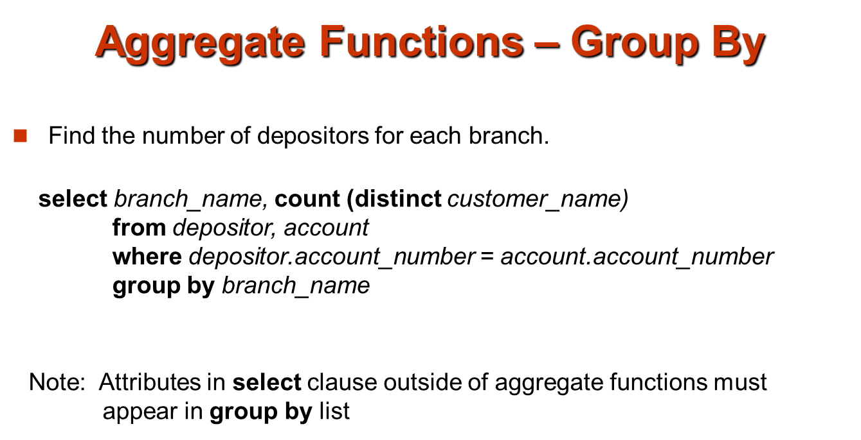
Attributes in select clause outside of aggregate functions must appear in group by list
/* erroneous query */ select dept_name, ID, avg (salary) from instructor group by dept_name;

Slide 36
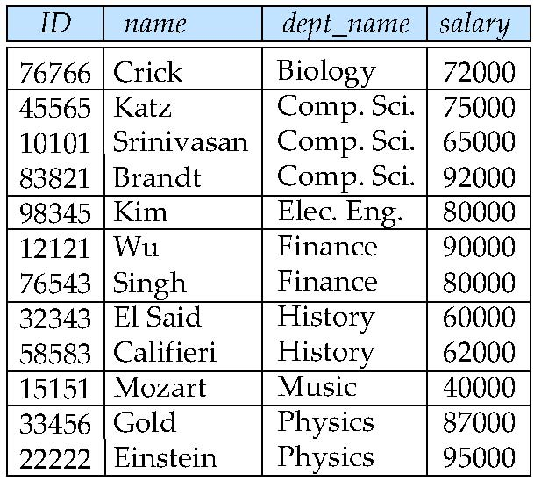
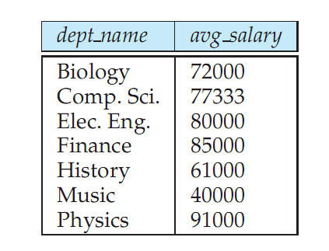
Aggregate Functions – Group By
Find the average salary of instructors in each department
select dept_name, avg (salary) from instructor group by dept_name;
Note: departments with no instructor will not appear in result

Slide 37
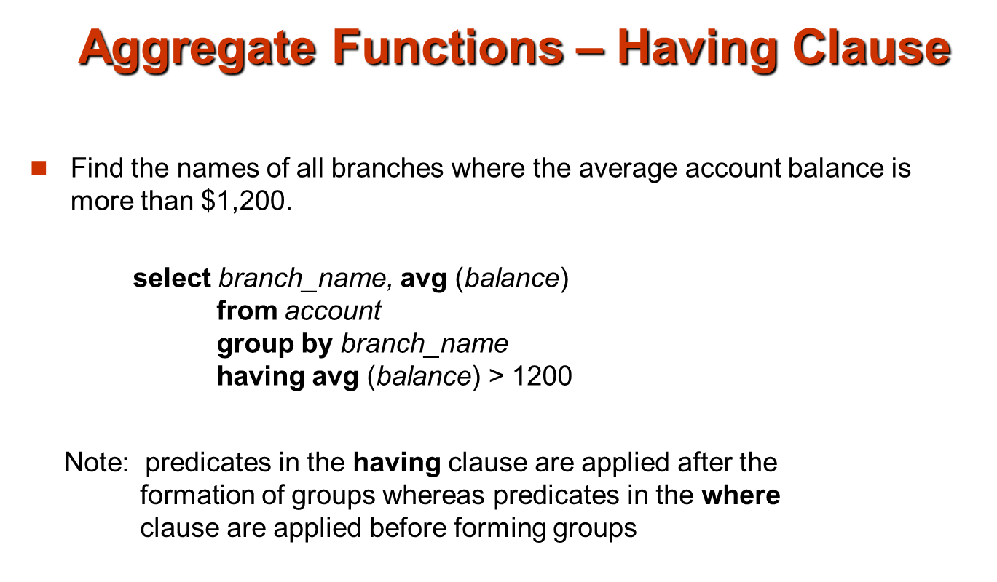
Find the names and average salaries of all departments whose average salary is greater than 42000
select dept_name, avg (salary) from instructor
group by dept_name
having avg (salary) > 42000;

Slide 38
Null Values and Aggregates
Total all salaries
select sum (salary ) from instructor
Above statement ignores null amounts
Result is null if there is no non-null amount
All aggregate operations except count(*) ignore tuples with null values on the aggregated attributes
What if collection has only null values?
count returns 0
all other aggregates return null

Slide 39
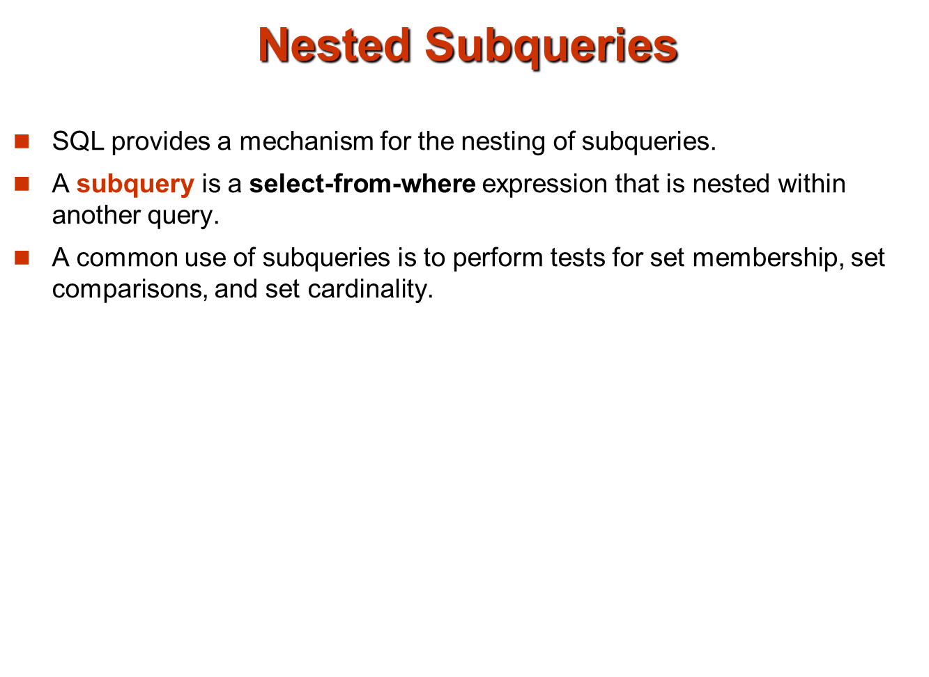

Slide 40
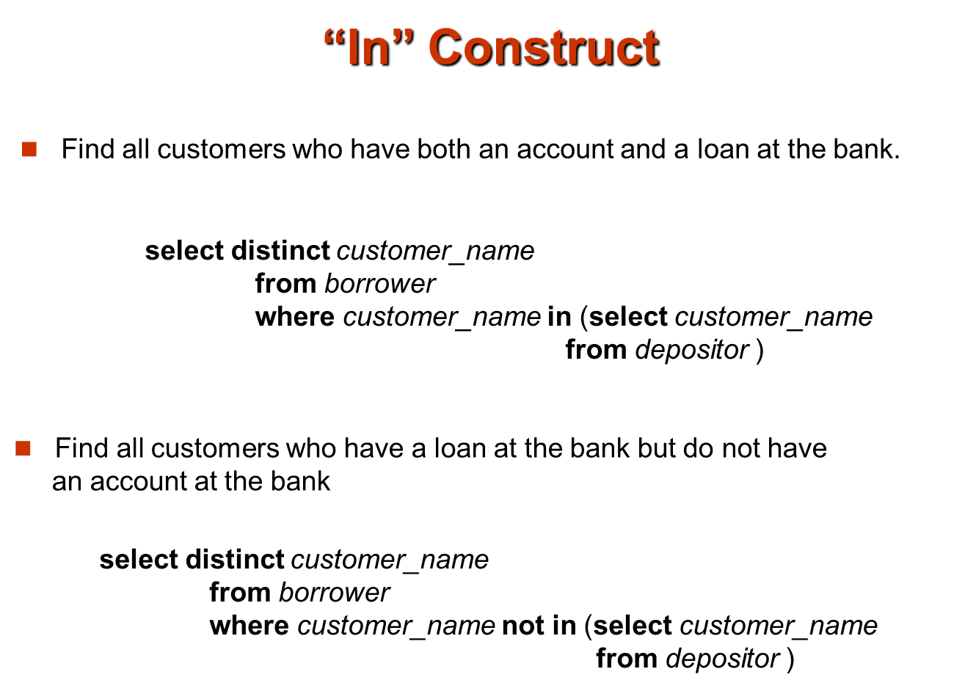

Slide 41
Example Query
Find courses offered in Fall 2009 and in Spring 2010
select distinct course_id
from section
where semester = ’Fall’ and year= 2009 and course_id in (select course_id
from section
where semester = ’Spring’ and year= 2010);
Find courses offered in Fall 2009 but not in Spring 2010
select distinct course_id
from section
where semester = ’Fall’ and year= 2009 and course_id not in (select course_id
from section
where semester = ’Spring’ and year= 2010);

Slide 42
Example Query
Find the total number of (distinct) students who have taken course sections taught by the instructor with ID 10101
select count (distinct ID)
from takes
where (course_id, sec_id, semester, year) in (select course_id, sec_id, semester, year
from teaches
where teaches.ID= 10101);
Note: Above query can be written in a much simpler manner. The formulation above is simply to illustrate SQL features.

Slide 43
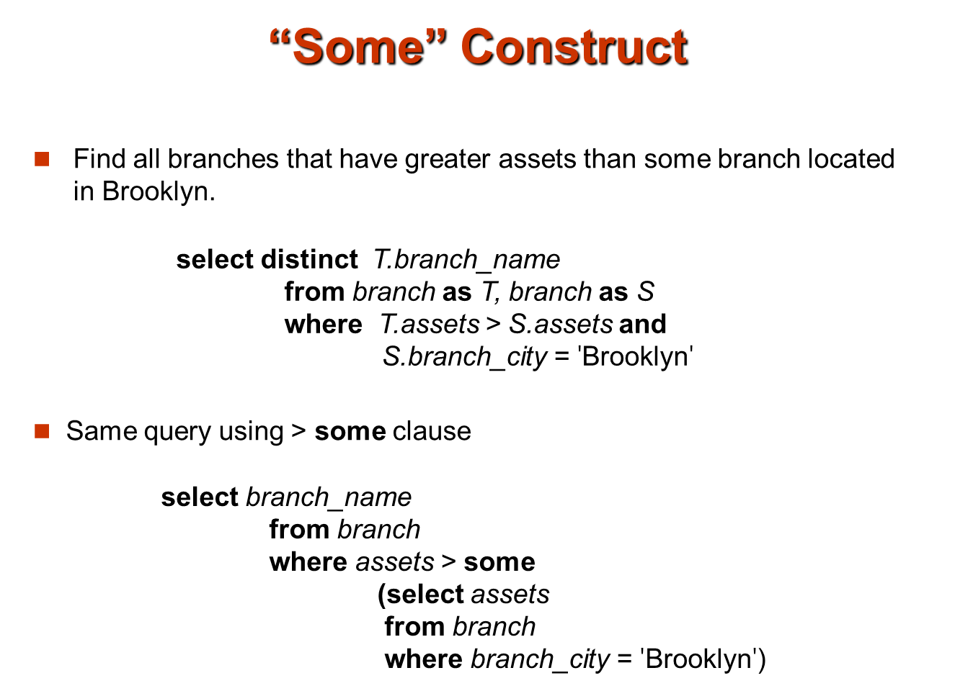

Slide 44
Set Comparison
Find names of instructors with salary greater than that of some (at least one) instructor in the Biology department.
select distinct T.name
from instructor as T, instructor as S
where T.salary > S.salary and S.dept_name = ’Biology’;
Same query using > some clause
select name
from instructor
where salary > some (select salary
from instructor
where dept_name = ’Biology’);

Slide 45
Definition of Some Clause
F <comp> some r ⇔ ∃ t ∈ r such that (F <comp> t ) Where <comp> can be: <, ≤, >, =, ≠
0
(5 < some
5
) = true
(read: 5 < some tuple in the relation)
6
0
(5 < some
5
) = false
0
(5 = some
) = true
5
0
(5 ≠ some
5
) = true (since 0 ≠ 5)
(= some) ≡ in
However, (≠ some) ≡ not in

Slide 46
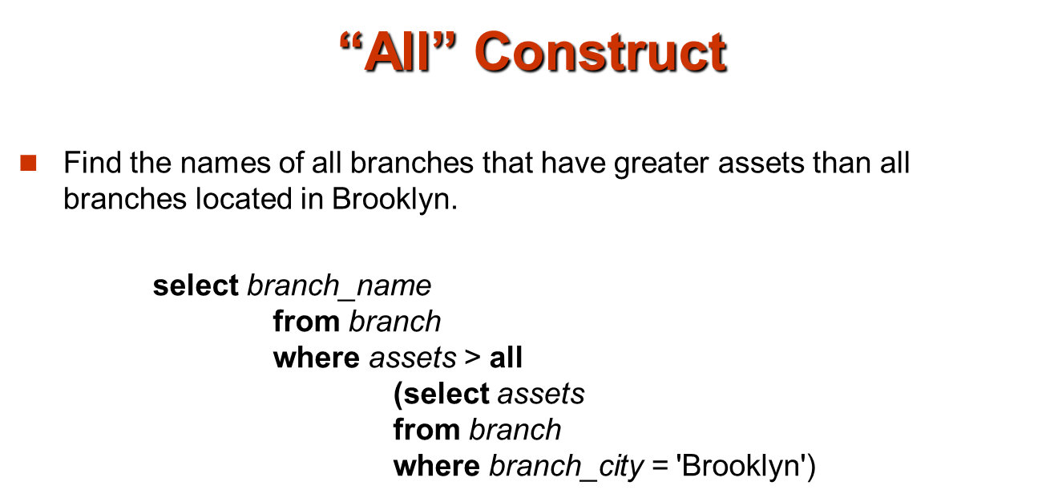

Slide 47
Example Query
Find the names of all instructors whose salary is greater than the salary of all instructors in the Biology department.
select name
from instructor
where salary > all (select salary
from instructor
where dept_name = ’Biology’);

Slide 48
Definition of all Clause
F <comp> all r ⇔ ∀ t ∈ r (F <comp> t)
0
(5 < all
5
) = false
6
6
(5 < all
) = true
10
4
(5 = all
) = false
5
4
(5 ≠ all
) = true (since 5 ≠ 4 and 5 ≠ 6)
6
(≠ all) ≡ not in
However, (= all) ≡ in

Slide 49
Correlation Variables
Yet another way of specifying the query “Find all courses taught in both the Fall 2009 semester and in the Spring 2010 semester”
select course_id from section as S where semester = ’Fall’ and year= 2009 and exists (select * from section as T where semester = ’Spring’ and year= 2010 and S.course_id= T.course_id);
Correlated subquery
Correlation name or correlation variable

Slide 50
Not Exists
Find all students who have taken all courses offered in the Biology department.
select distinct S.ID, S.name
from student as S
where not exists ( (select course_id
from course
where dept_name = ’Biology’)
except
(select T.course_id
from takes as T
where S.ID = T.ID));
Note that X – Y = Ø ⇔ X ⊆ Y
Note: Cannot write this query using = all and its variants

Slide 51
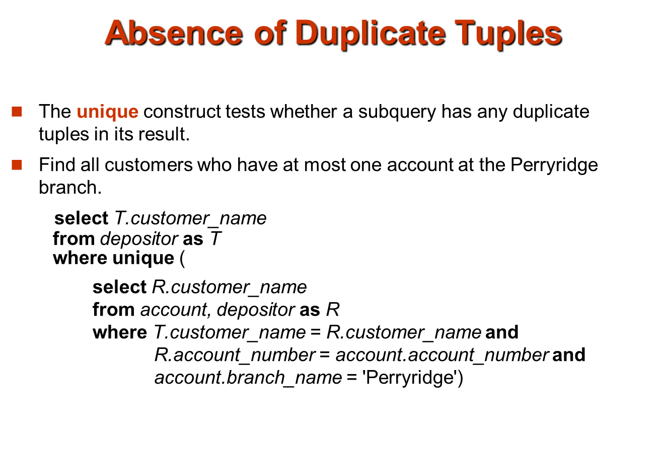
Find all courses that were offered at most once in 2009
select T.course_id from course as T where unique (select R.course_id from section as R where T.course_id= R.course_id and R.year = 2009);

Slide 52
Subqueries in the From Clause
SQL allows a subquery expression to be used in the from clause
Find the average instructors’ salaries of those departments where the average salary is greater than $42,000.
select dept_name, avg_salary from (select dept_name, avg (salary) as avg_salary from instructor group by dept_name) where avg_salary > 42000;
Note that we do not need to use the having clause
Another way to write above query
select dept_name, avg_salary from (select dept_name, avg (salary) from instructor group by dept_name) as dept_avg (dept_name, avg_salary) where avg_salary > 42000;

Slide 53
Subqueries in the From Clause (Cont.)
And yet another way to write it: lateral clause
select name, salary, avg_salary from instructor I1, lateral (select avg(salary) as avg_salary from instructor I2 where I2.dept_name= I1.dept_name);
Lateral clause permits later part of the from clause (after the lateral keyword) to access correlation variables from the earlier part.
Note: lateral is part of the SQL standard, but is not supported on many database systems; some databases such as SQL Server offer alternative syntax

Slide 54
With Clause
The with clause provides a way of defining a temporary view whose definition is available only to the query in which the with clause occurs.
Find all departments with the maximum budget with max_budget (value) as (select max(budget) from department) select budget from department, max_budget where department.budget = max_budget.value;

Slide 55
Complex Queries using With Clause
With clause is very useful for writing complex queries
Supported by most database systems, with minor syntax variations
Find all departments where the total salary is greater than the average of the total salary at all departments
with dept _total (dept_name, value) as
(select dept_name, sum(salary)
from instructor
group by dept_name),
dept_total_avg(value) as
(select avg(value)
from dept_total)
select dept_name
from dept_total, dept_total_avg
where dept_total.value >= dept_total_avg.value;

Slide 56
Scalar Subquery
Scalar subquery is one which is used where a single value is expected
E.g. select dept_name, (select count(*) from instructor where department.dept_name = instructor.dept_name) as num_instructors from department;
E.g. select name from instructor where salary * 10 > (select budget from department where department.dept_name = instructor.dept_name)
Runtime error if subquery returns more than one result tuple

Slide 57
Modification of the Database
Deletion of tuples from a given relation
Insertion of new tuples into a given relation
Updating values in some tuples in a given relation

Slide 58
Modification of the Database – Deletion
Delete all instructors
delete from instructor
Delete all instructors from the Finance department delete from instructor where dept_name= ’Finance’;
Delete all tuples in the instructor relation for those instructors associated with a department located in the Watson building.
delete from instructor where dept_name in (select dept_name from department where building = ’Watson’);

Slide 59
Deletion (Cont.)
Delete all instructors whose salary is less than the average salary of instructors
delete from instructor
where salary< (select avg (salary) from instructor);
Problem: as we delete tuples from deposit, the average salary changes
Solution used in SQL:
1. First, compute avg salary and find all tuples to delete
2. Next, delete all tuples found above (without recomputing avg or retesting the tuples)

Slide 60
Modification of the Database – Insertion
Add a new tuple to course
insert into course values (’CS-437’, ’Database Systems’, ’Comp. Sci.’, 4);
or equivalently insert into course (course_id, title, dept_name, credits) values (’CS-437’, ’Database Systems’, ’Comp. Sci.’, 4);
Add a new tuple to student with tot_creds set to null
insert into student values (’3003’, ’Green’, ’Finance’, null);

Slide 61
Insertion (Cont.)
Add all instructors to the student relation with tot_creds set to 0
insert into student select ID, name, dept_name, 0 from instructor
The select from where statement is evaluated fully before any of its results are inserted into the relation (otherwise queries like insert into table1 select * from table1 would cause problems, if table1 did not have any primary key defined.

Slide 62
Modification of the Database – Updates
Increase salaries of instructors whose salary is over $100,000 by 3%, and all others receive a 5% raise
Write two update statements:
update instructor set salary = salary * 1.03 where salary > 100000;
update instructor set salary = salary * 1.05 where salary <= 100000;
The order is important
Can be done better using the case statement (next slide)

Slide 63
Case Statement for Conditional Updates
Same query as before but with case statement
update instructor set salary = case when salary <= 100000 then salary * 1.05 else salary * 1.03 end

Slide 64
Updates with Scalar Subqueries
Recompute and update tot_creds value for all students
update student S set tot_cred = ( select sum(credits) from takes natural join course where S.ID= takes.ID and takes.grade <> ’F’ and takes.grade is not null);
Sets tot_creds to null for students who have not taken any course
Instead of sum(credits), use:
case when sum(credits) is not null then sum(credits) else 0 end

