Slide 1
Chapter 2:
Introduction to Relational Model

Slide 2
Relational Model
The relational data model is based on a collection of tables each of which is assigned a unique name.
The user of the database system may query these tables, insert new tuples, delete tuples, and update (modify) tuples. There are several languages for expressing these operations.

Slide 3

Example of a Relation
attributes
(or columns)
tuples
(or rows)
Relation:
  A Table
Tuple:
  A Row
Attributes:
A Column header

Slide 4
Attribute Types
The set of allowed values for each attribute is called the domain of the attribute
Attribute values are (normally) required to be atomic; that is, indivisible
The special value null is a member of every domain
The null value causes complications in the definition of many operations

Slide 5
Relation Schema and Instance
The schema of a relation refers to its logical design. The schema of a relation includes its attributes, and optionally the types of the attributes and constraints on the relation such as primary and foreign key constraints.
Example: instructor(id, name, dept_name, salary)
An instance of the relation refers to its contents at a point in time.
The current values (relation instance) of a relation are specified by the row a of a table.
An element t of r is a tuple, represented by a row in a table.

Slide 6

Relations are Unordered
Order of tuples is irrelevant (tuples may be stored in an arbitrary order)
Example: instructor relation with unordered tuples

Slide 7
Database
A database consists of multiple relations
Information about an enterprise is broken up into parts
instructor
student
advisor
Bad design:
univ (instructor -ID, name, dept_name, salary, student_Id, ..)
results in
  repetition of information (e.g., two students have the same instructor)
  the need for null values (e.g., represent an student with no advisor)
Normalization theory (Chapter 7) deals with how to design “good” relational schemas

Slide 8
Database Keys
Keys are very important part of Relational database. They are used to establish and identify relation between tables. They also ensure that each record within a table can be uniquely identified by combination of one or more fields within a table.
    Super Key
    Candidate Key
    Primary Key
    Foreign Key
    Composite Key
    Secondary or Alternative key
    Non-prime Attribute

Slide 9
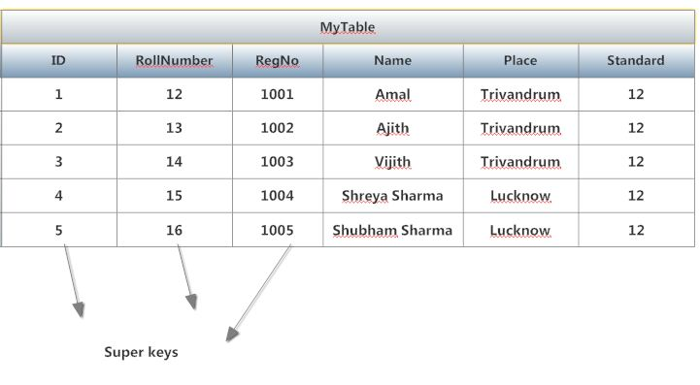
Super Key
Super Key
A Super key is any combination of fields within a table that uniquely identifies each record within that table.
Or
Super Key is defined as a set of attributes within a table that uniquely identifies each record within a table. Super Key is a superset of Candidate key.

Slide 10
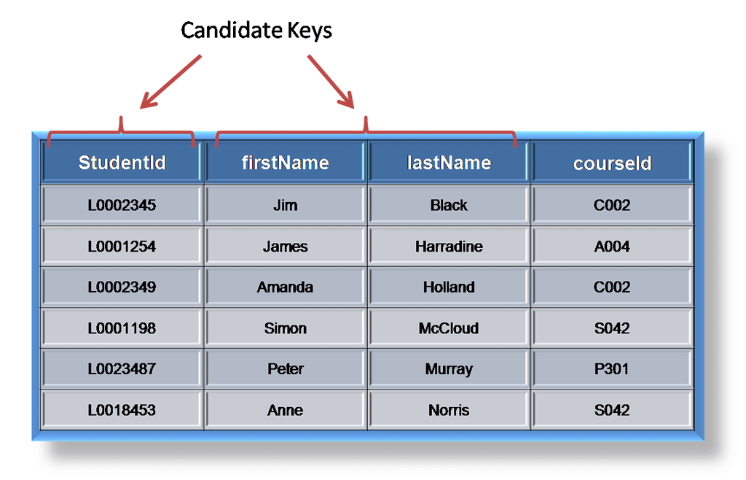
Candidate Key
Candidate Key
A candidate is a subset of a super key. A candidate key is a single field or the least combination of fields that uniquely identifies each record in the table.
Or
A Candidate Key can be any column or a combination of columns that can qualify as unique key in database. There can be multiple Candidate Keys in one table. Each Candidate Key can qualify as Primary Key
The least combination of fields distinguishes a candidate key from a super key. Every table must have at least one candidate key but at the same time can have several.

Slide 11
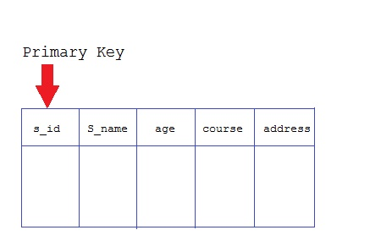
Primary Keys
Primary Keys
The primary key consists of one or more columns whose data contained within is used to uniquely identify each row in the table.
Or
A primary key is a column (or columns) in a table that uniquely identifies the rows in that table.
When a primary key is composed of multiple columns, the data from each column is used to determine whether a row is unique.

Slide 12
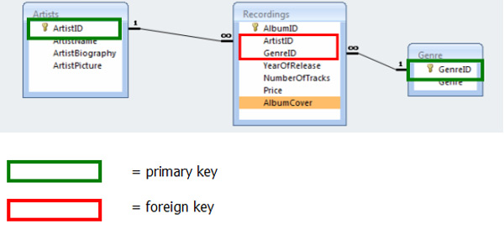
Foreign Key
Foreign Key
A foreign key is generally a primary key from one table that appears as a field in another where the first table has a relationship to the second.
Or
A foreign key is a set of one or more columns in a table that refers to the primary key in another table.
In other words, if we had a table A with a primary key X that linked to a table B where X was a field in B, then X would be a foreign key in B.

Slide 13
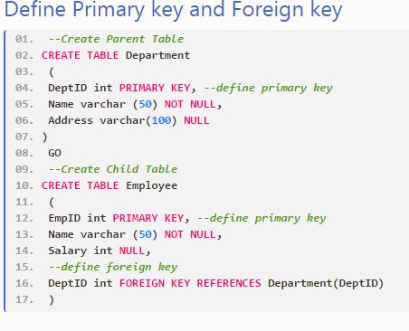

Slide 14
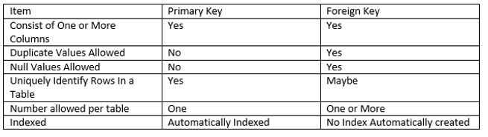
Comparison of Primary Keys to Foreign Keys

Slide 15
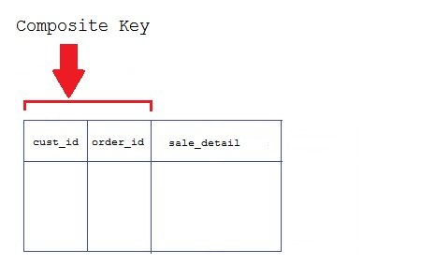
Composite Key
Key that consist of two or more attributes that uniquely identify an entity occurrence is called Composite key. But any attribute that makes up the Composite key is not a simple key in its own.
Secondary or Alternative key
The candidate key which are not selected for primary key are known as secondary keys or alternative keys
Non-prime Attribute
An attribute, which is not a part of the prime-key, is said to be a non-prime attribute.

Slide 16

Schema Diagram for University Database

Slide 17
Relational Query Languages
Procedural vs.non-procedural, or declarative
Procedural: the user instructs the system to perform a sequence of operations on the database to compute the desired result.
Non-procedural: the user describes the desired information without giving a specific procedure for obtaining that information.
“Pure” and formal languages:
  Relational algebra
  Tuple relational calculus
  Domain relational calculus
Relational operators

Slide 18

Selection of tuples
Relation r
Select tuples with A=B and D > 5
σ _{A=B and D > 5} (r)

Slide 19

Selection of Columns (Attributes)
Relation r:
Select A and C
  Projection
  Π _{A, C} (r)

Slide 20

Joining two relations – Cartesian Product
Relations r, s:
r x s:

Slide 21

Union of two relations
Relations r, s:
r ∪ s:

Slide 22

Set difference of two relations
Relations r, s:
r – s:

Slide 23

Set Intersection of two relations
Relation r, s:
r ∩ s

Slide 24
Joining two relations – Natural Join
Let r and s be relations on schemas R and S respectively.
Then, the “natural join” of relations R and S is a relation on schema R ∪ S obtained as follows:
  Consider each pair of tuples t_{r} from r and t_{s} from s.
  If t_{r} and t_{s} have the same value on each of the attributes in R ∩ S, add a tuple t to the result, where
    t has the same value as t_{r} on r
    t has the same value as t_{s} on s

Slide 25

Natural Join Example
Relations r, s:
Natural Join
  r s

Slide 26

Figure in-2.1

Slide 27
End of Chapter 2

Slide 28
Figure 2.01

Slide 29

Figure 2.02

Slide 30

Figure 2.03

Slide 31
Figure 2.04

Slide 32

Figure 2.05

Slide 33

Figure 2.06

Slide 34

Figure 2.07

Slide 35

Figure 2.10

Slide 36

Figure 2.11

Slide 37

Figure 2.12

Slide 38

Figure 2.13

