Slide 1
Entity/Relationship Modelling

Slide 2
Entity/Relationship Modelling
Modelling:
A database can be modeled as:
a collection of entities,
relationship among entities.
E/R Modelling is used for conceptual design
Entities - objects or items of interest
Attributes - facts about, or properties of, an entity
Relationships - links between entities
Example
In a University database we might have entities for Students, Modules and Lecturers. Students might have attributes such as their ID, Name, and Course, and could have relationships with Modules (enrolment) and Lecturers (tutor/tutee)

Slide 3
Entity/Relationship Diagrams
E/R Models are often represented as E/R diagrams that
Give a conceptual view of the database
Are independent of the choice of DBMS
Can identify some problems in a design
Lecturer
ID
Name
Course
Tutors
Student
Module
Studies

Slide 4
Entities
Entities represent objects or things of interest
Physical things like students, lecturers, employees, products
More abstract things like modules, orders, courses, projects
Entities have
A general type or class, such as Lecturer or Module
Instances of that particular type, such as Steve Mills, Natasha Alechina are instances of Lecturer
Attributes (such as name, email address)

Slide 5
Diagramming Entities
Lecturer
ID
Name
Course
In an E/R Diagram, an entity is usually drawn as a box with rounded corners
The box is labelled with the name of the class of objects represented by that entity
Tutors
Student
Module
Studies

Slide 6
Attributes
Attributes are facts, aspects, properties, or details about an entity
Students have IDs, names, courses, addresses, …
Modules have codes, titles, credit weights, levels, …
Attributes have
A name
An associated entity
Domains of possible values
Values from the domain for each instance of the entity they are belong to
Attribute types:
Simple and composite attributes.
Single-valued and multivalued attributes
Example: multivalued attribute: phone_numbers
Derived attributes
Can be computed from other attributes
Example: age, given date_of_birth

Slide 7
Diagramming Attributes
Lecturer
ID
In an E/R Diagram attributes may be drawn as ovals
Each attribute is linked to its entity by a line
The name of the attribute is written in the oval
Name
Course
Tutors
Student
Module
Studies

Slide 8
Relationships
Relationships are an association between two or more entities
Each Student takes several Modules
Each Module is taught by a Lecturer
Each Employee works for a single Department
Relationships have
A name
A set of entities that participate in them
A degree - the number of entities that participate (most have degree 2)
A cardinality ratio

Slide 9
Mapping Cardinality Constraints
Express the number of entities to which another entity can be associated via a relationship set.
Most useful in describing binary relationship sets.
For a binary relationship set the mapping cardinality must be one of the following types:
One to one
One to many
Many to one
Many to many

Slide 10
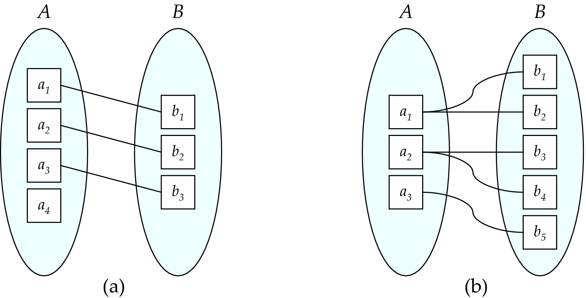
Mapping Cardinalities
One to one
One to many
Note: Some elements in A and B may not be mapped to any elements in the other set

Slide 11
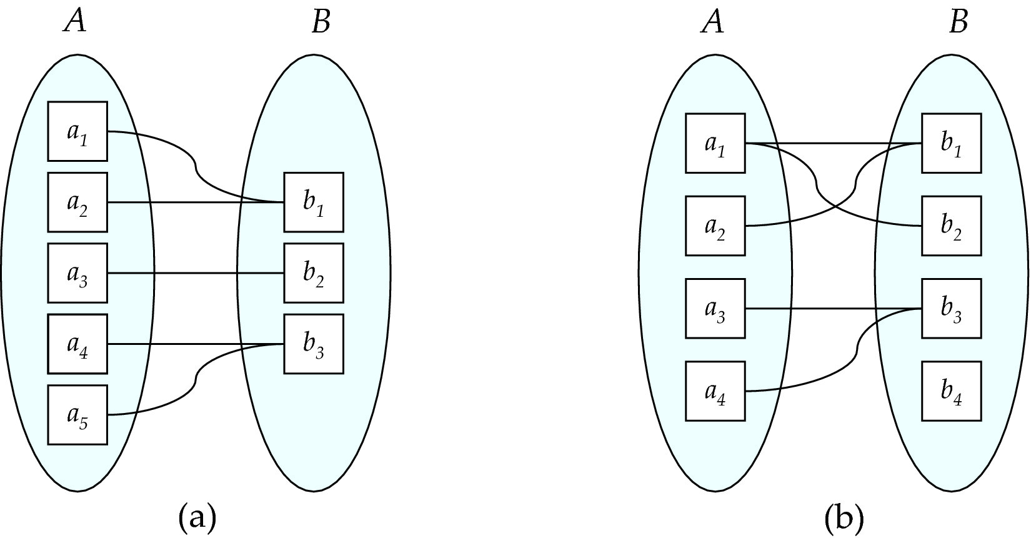
Mapping Cardinalities
Many to one
Many to many
Note: Some elements in A and B may not be mapped to any elements in the other set

Slide 12
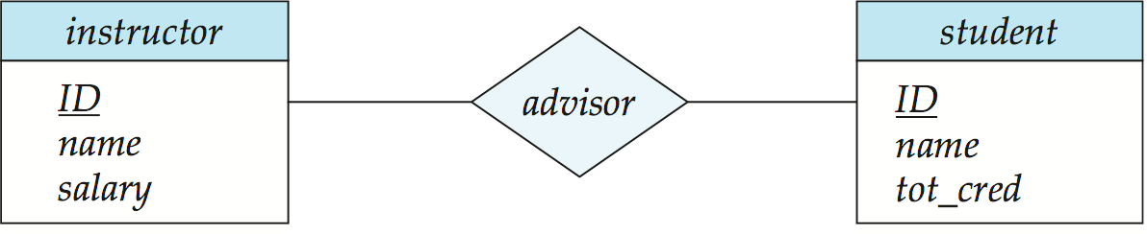
E-R Diagrams
Rectangles represent entity sets.
Diamonds represent relationship sets.
Attributes listed inside entity rectangle
Underline indicates primary key attributes

Slide 13
Cardinality Ratios
Each entity in a relationship can participate in zero, one, or more than one instances of that relationship
This leads to 3 types of relationship…
One to one (1:1)
Each lecturer has a unique office
One to many (1:M)
A lecturer may tutor many students, but each student has just one tutor
Many to many (M:M)
Each student takes several modules, and each module is taken by several students

Slide 14
Diagramming Relationships
Lecturer
ID
Relationships are links between two entities
The name is given in a diamond box
The ends of the link show cardinality
Name
Course
Tutors
Student
One
Many
Module
Studies

Slide 15
Removing M:M Relationships
Student
Many to many relationships are difficult to represent
We can split a many to many relationship into two one to many relationships
An entity represents the M:M relationship
Student
Has
Studies
Enrolment
In
Module
Module

Slide 16
Making E/R Models
To make an E/R model you need to identify
Enitities
Attributes
Relationships
Cardinality ratios
from a description
General guidelines
Since entities are things or objects they are often nouns in the description
Attributes are facts or properties, and so are often nouns also
Verbs often describe relationships between entities

Slide 17
Example
A university consists of a number of departments. Each department offers several courses. A number of modules make up each course. Students enrol in a particular course and take modules towards the completion of that course. Each module is taught by a lecturer from the appropriate department, and each lecturer tutors a group of students
Example - Entities
A university consists of a number of departments. Each department offers several courses. A number of modules make up each course. Students enrol in a particular course and take modules towards the completion of that course. Each module is taught by a lecturer from the appropriate department, and each lecturer tutors a group of students
Example - Relationships
A university consists of a number of departments. Each department offers several courses. A number of modules make up each course. Students enrol in a particular course and take modules towards the completion of that course. Each module is taught by a lecturer from the appropriate department, and each lecturer tutors a group of students

Slide 18
Example - E/R Diagram
Entities: Department, Course, Module, Lecturer, Student
Department
Course
Module
Lecturer
Student

Slide 19
Example - E/R Diagram
Each department offers several courses
Offers
Department
Course
Module
Lecturer
Student

Slide 20
Example - E/R Diagram
A number of modules make up each courses
Offers
Department
Course
Includes
Module
Lecturer
Student

Slide 21
Example - E/R Diagram
Students enrol in a particular course
Offers
Department
Course
Includes
Module
Lecturer
Enrols In
Student

Slide 22
Example - E/R Diagram
Students … take modules
Offers
Department
Course
Includes
Module
Lecturer
Takes
Enrols In
Student

Slide 23
Example - E/R Diagram
Each module is taught by a lecturer
Offers
Department
Course
Includes
Module
Teaches
Lecturer
Takes
Enrols In
Student

Slide 24
Example - E/R Diagram
a lecturer from the appropriate department
Offers
Department
Employs
Course
Includes
Module
Teaches
Lecturer
Takes
Enrols In
Student

Slide 25
Example - E/R Diagram
each lecturer tutors a group of students
Offers
Department
Employs
Course
Includes
Module
Teaches
Lecturer
Takes
Enrols In
Student
Tutors

Slide 26
Example - E/R Diagram
Offers
Department
Employs
Course
Includes
Module
Teaches
Lecturer
Takes
Enrols In
Student
Tutors

Slide 27
Entities and Attributes
Sometimes it is hard to tell if something should be an entity or an attribute
They both represent objects or facts about the world
They are both often represented by nouns in descriptions
General guidelines
Entities can have attributes but attributes have no smaller parts
Entities can have relationships between them, but an attribute belongs to a single entity

Slide 28
Example - Entities/Attributes
Example
We want to represent information about products in a database. Each product has a description, a price and a supplier. Suppliers have addresses, phone numbers, and names. Each address is made up of a street address, a city, and a postcode.
Entities or attributes:
product
description
price
supplier
address
phone number
name
street address
city
postcode
Products, suppliers, and addresses all have smaller parts so we can make them entities
The others have no smaller parts and belong to a single entity

Slide 29
Example - E/R Diagram
Price
Street address
Description
Product
Address
City
Postcode
Example - Relationships
Each product has a supplier
Each product has a single supplier but there is nothing to stop a supplier supplying many products
A many to one relationship
Each supplier has an address
A supplier has a single address
It does not seem sensible for two different suppliers to have the same address
A one to one relationship
Name
Supplier
Phone number

Slide 30
Example - E/R Diagram
Price
Description
Product
Has A
Street address
Name
Supplier
Has A
Address
City
Phone number
Postcode

Slide 31
One to One Relationships
Some relationships between entities, A and B, might be redundant if
It is a 1:1 relationship between A and B
Every A is related to a B and every B is related to an A
Example - the supplier-address relationship
Is one to one
Every supplier has an address
We don’t need addresses that are not related to a supplier
a
x
b
A
B
y
Redundant Relationships
We can merge the two entities that take part in a redundant relationship together
They become a single entity
The new entity has all the attributes of the old one
c
z
a
x
b
AB
y
c
z

Slide 32
Example - E/R Diagram
Price
Description
Product
Has A
Name
Supplier
City
Phone number
Postcode
Street address

Slide 33
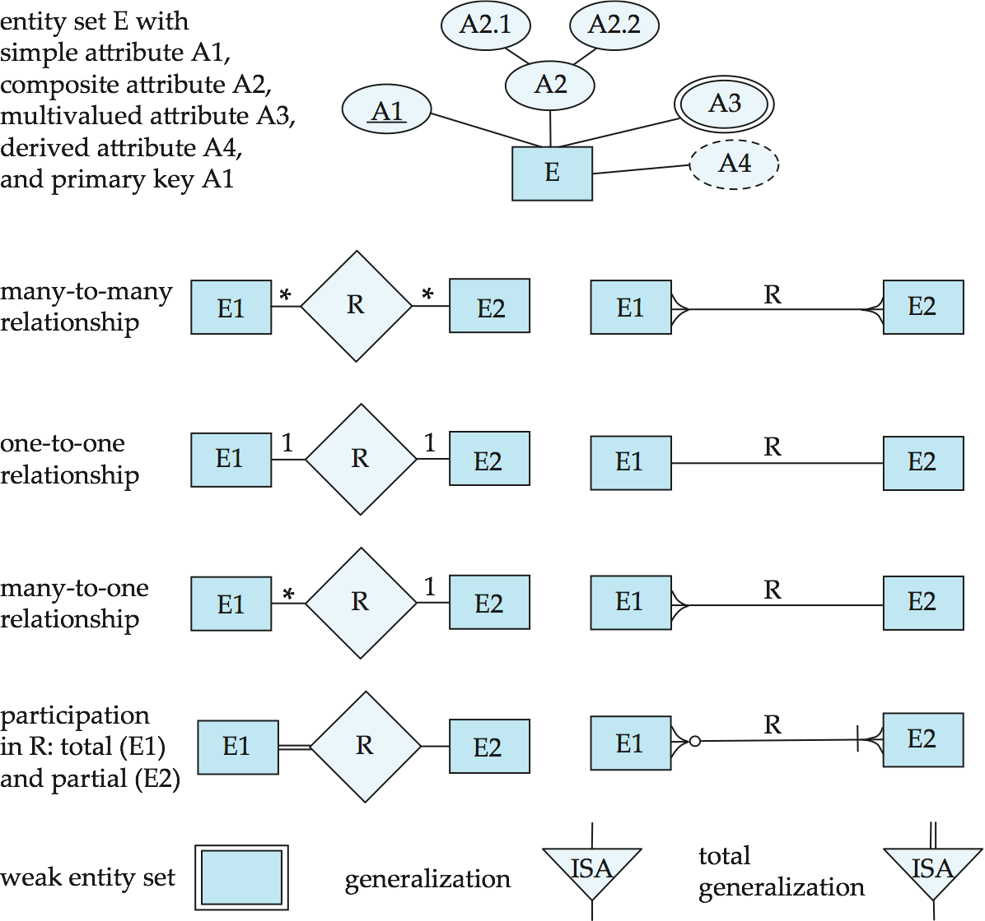
Alternative ER Notations
Chen IDE1FX (Crows feet notation)

Slide 34
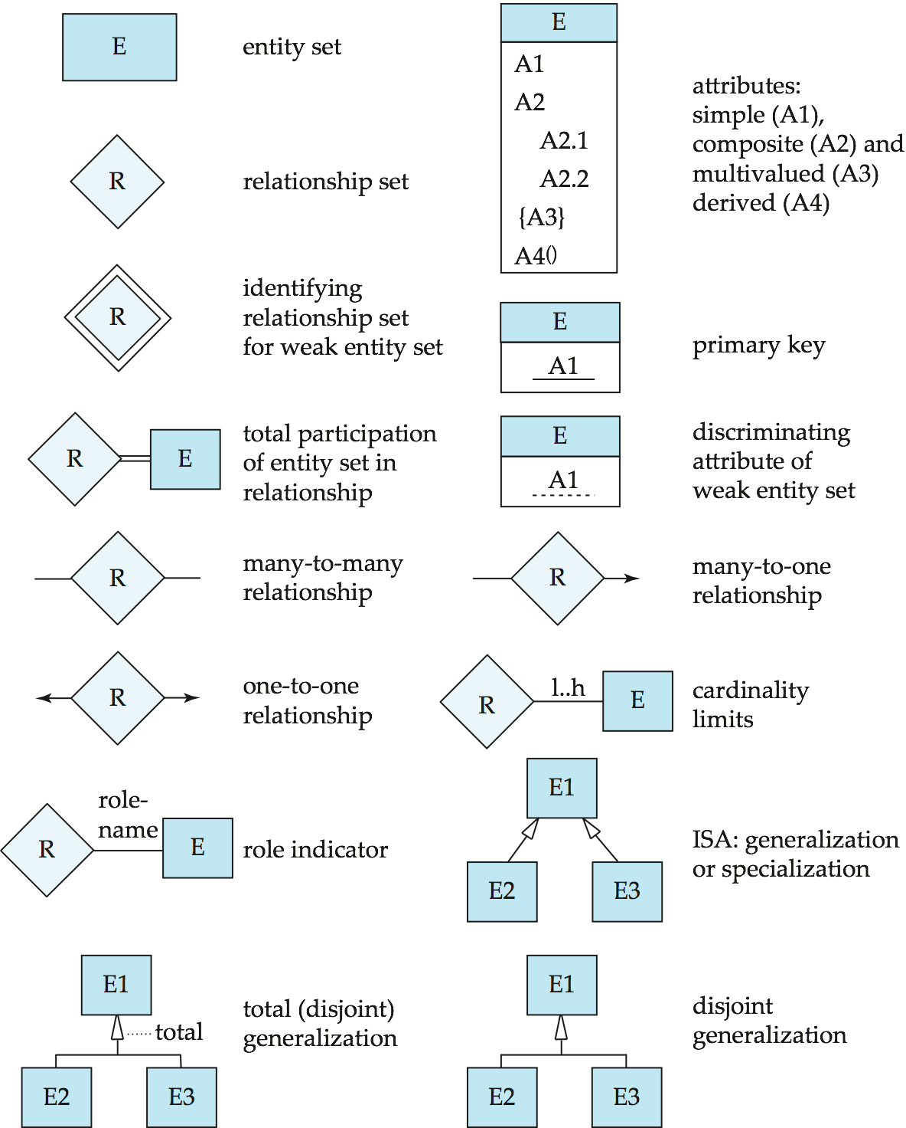
Summary of Symbols Used in E-R Notation

Slide 35
Symbols Used in E-R Notation (Cont.)

Slide 36
Alternative ER Notations
Chen, IDE1FX, …

