Slide 1

Welcome to the Presentation

Slide 2
Presentation on Wirelessly Controlled Multipurpose Robot (WCMR)
Submitted by
Farhan Masud
ID: 151311051
Department of Computer Science and Engineering
Varendra University
Rajshahi, Bangladesh
Submitted to
Shayban Nasif
Lecturer
Computer Science and Engineering
Varendra University
Rajshahi, Bangladesh

Slide 3
Outlines
Introduction
Features of the project
Used Technology
Block Diagram
Related Works
Our Device
Future Development
Project Completion Planning

Slide 4
Introduction
Robot control systems are usually complex systems whose users must be well trained to use them.
Also, control process is mainly carried out near the robot or by using wired connections.
There is a need for a solution that can provide convenient and intuitive robot control with user’s location independence, easy adjustment and simultaneously monitoring of robot motion tasks.
Android devices are powerful mobile devices with open architecture and permanently Bluetooth connection that can be applied to resolving those issues

Slide 5
Features
Wireless control using Bluetooth communication
Smart phone control
Robotic ARM controlling using servo motor

Slide 6
Used Technology
Arduino Platform
Servo motor
Motor Driver
Wireless Communication Technology(Bluetooth/Wi-Fi/GPS)

Slide 7
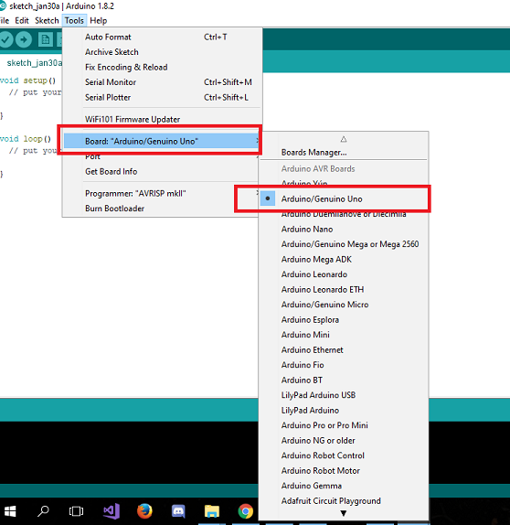
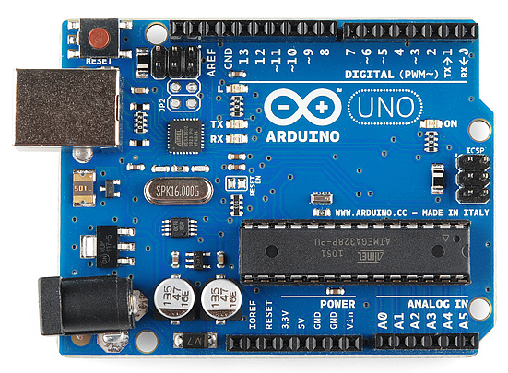
Arduino
Arduino IDE
Arduino Board

Slide 8
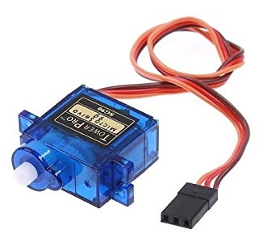
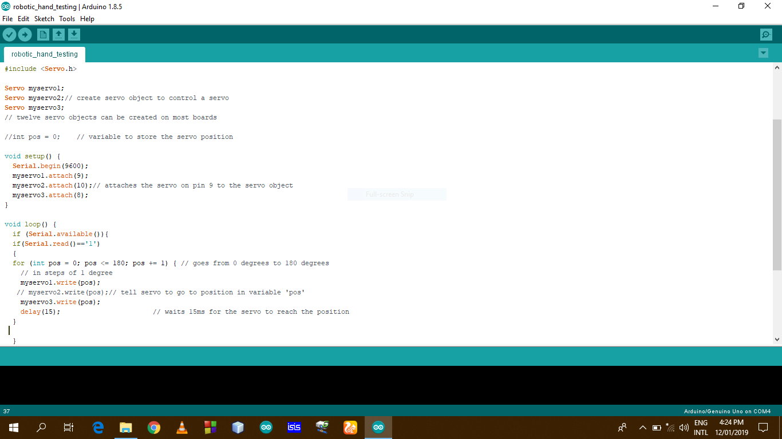
Servo Motor
Servo hand IDE
Servo Motor

Slide 9
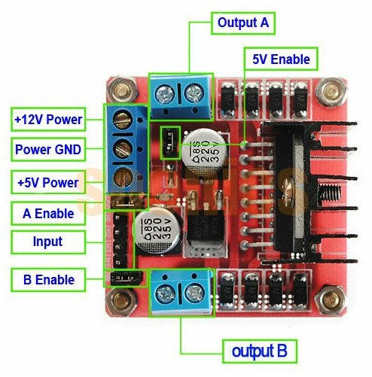
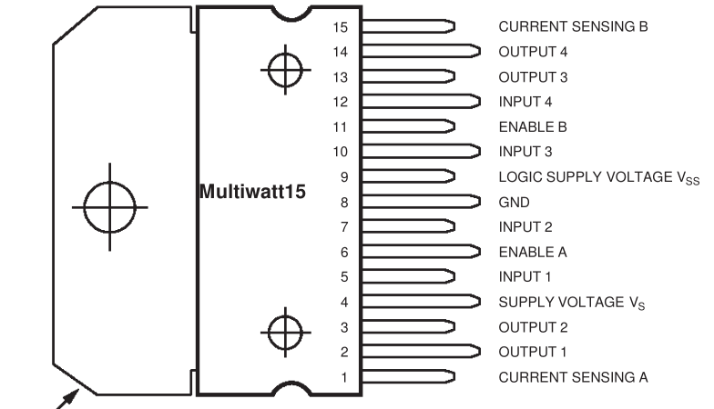
Motor Driver
Pin config.
Motor Driver(L293D)

Slide 10
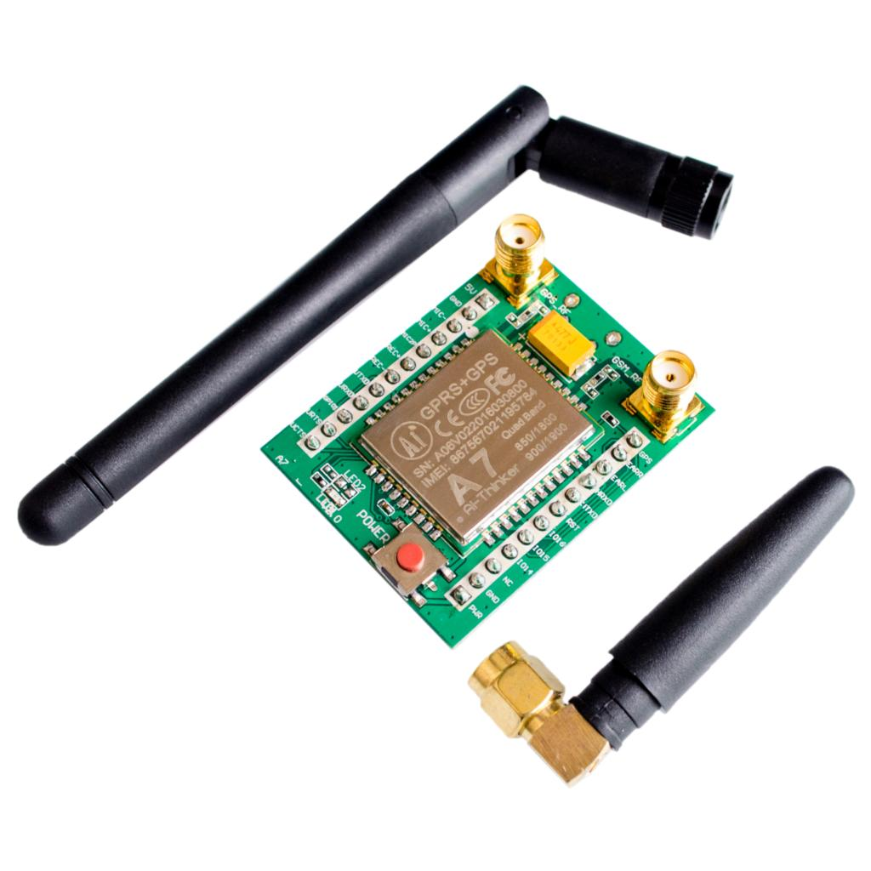
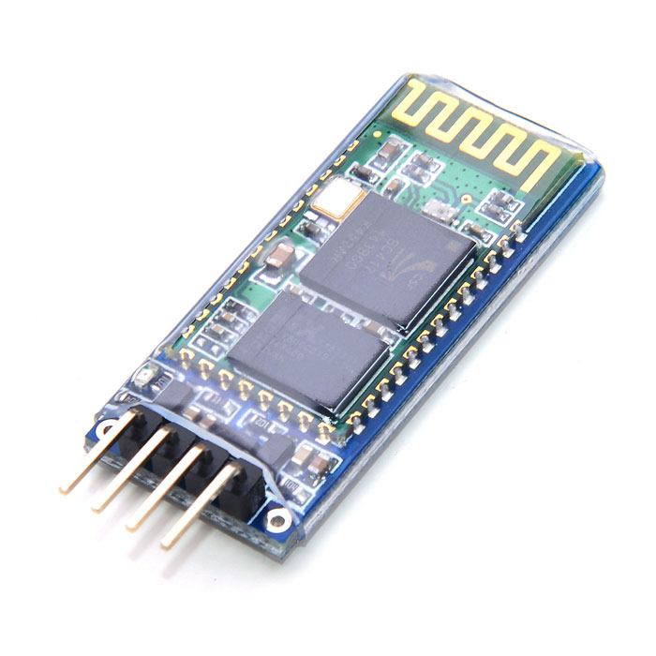
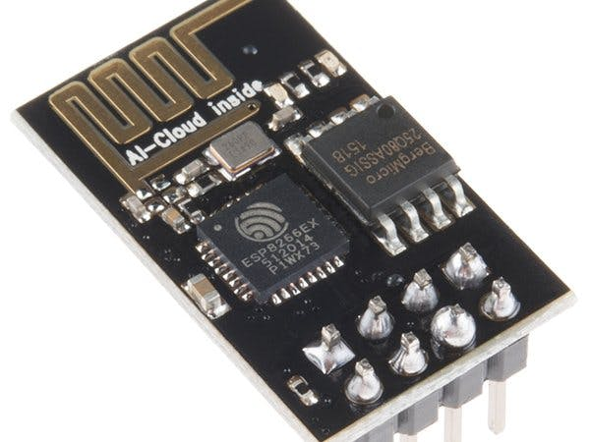
Wireless Communication Technology
GPS Module
Wi-fi Module
Bluetooth Module

Slide 11
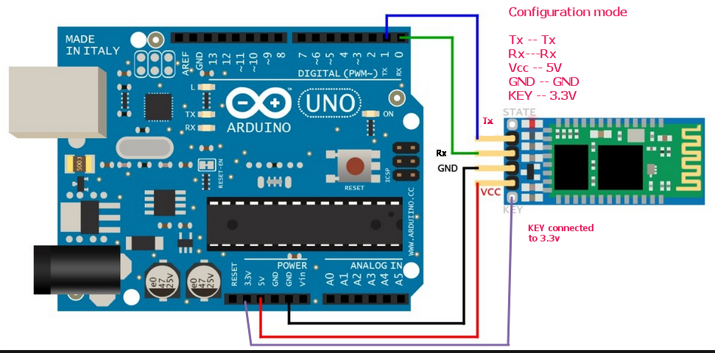
Bluetooth
Circuit Diagram
Bluetooth Module(HC-05)

Slide 12
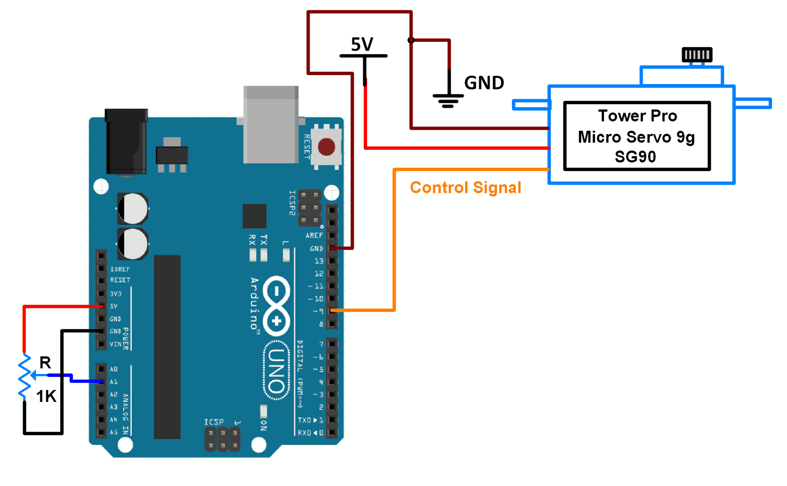
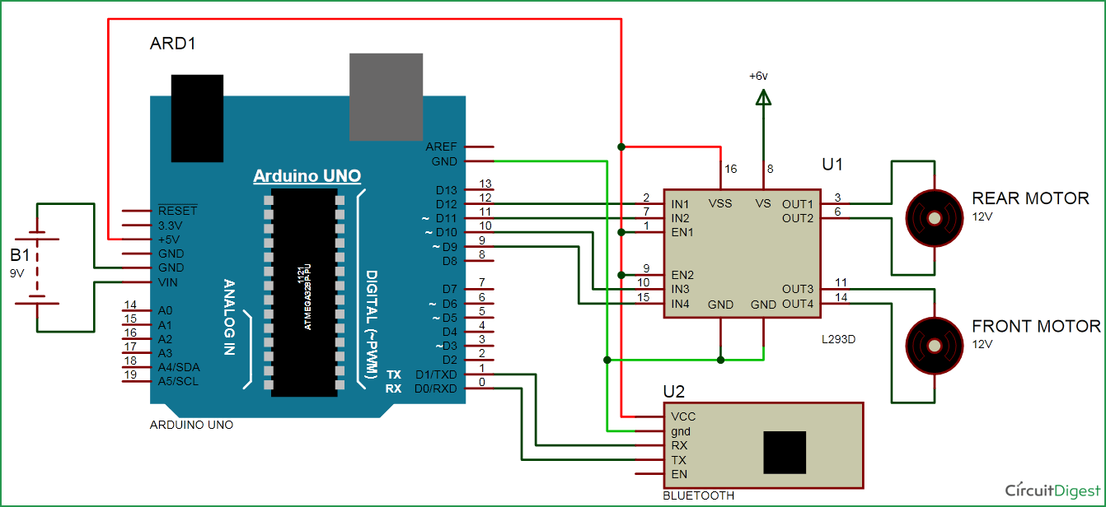
Circuit Diagram
Servo Hand
Bluetooth Robot

Slide 13
Block Diagram
Bluetooth
Device
Arduino
Battery
Motor
driver
Servo
Motor

Slide 14
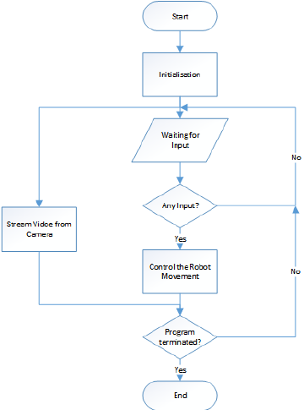
Flowchart

Slide 15
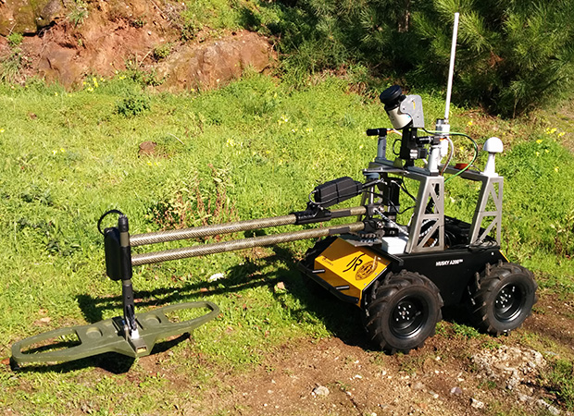
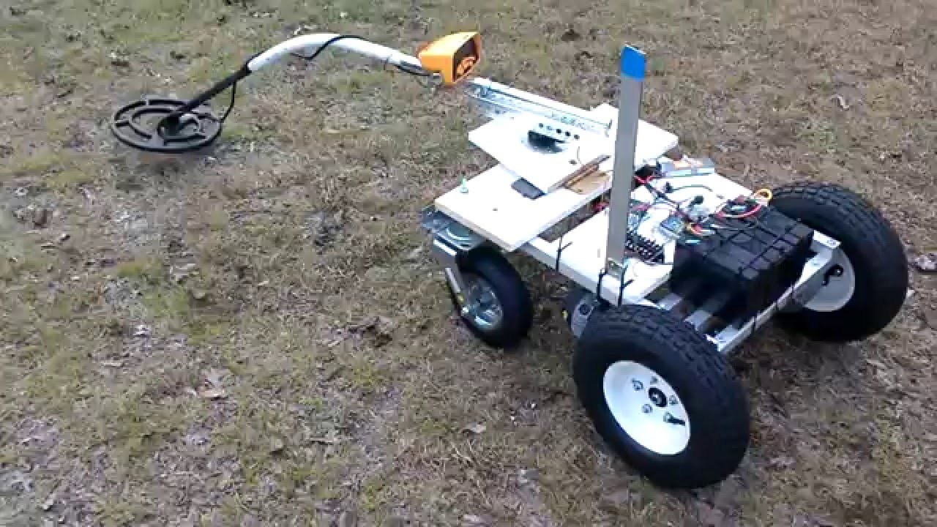
Related Work
Land Mine Detection Technology of Abroad

Slide 16
Our Device
Software
Android Apps
Arduino IDE
Hardware
Bluetooth Control Robot

Slide 17
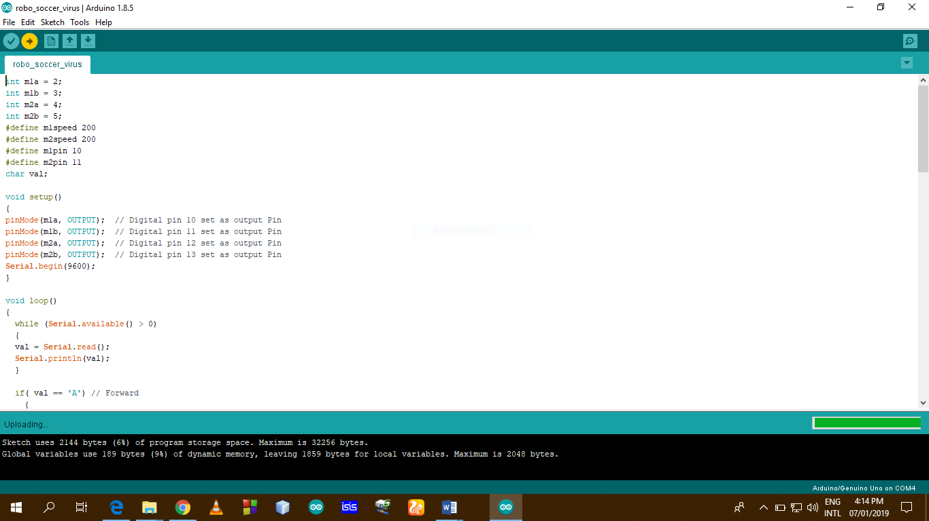
Software
Bluetooth Robot IDE
Servo Hand IDE

Slide 18
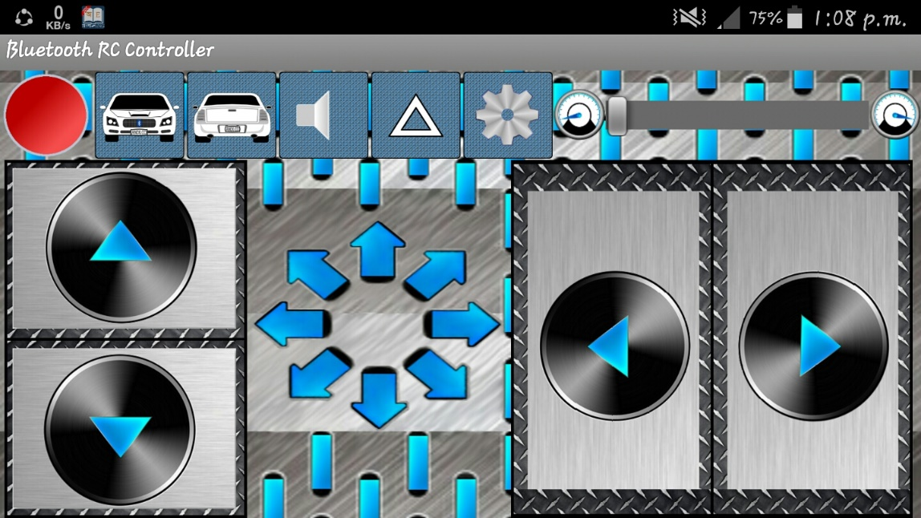
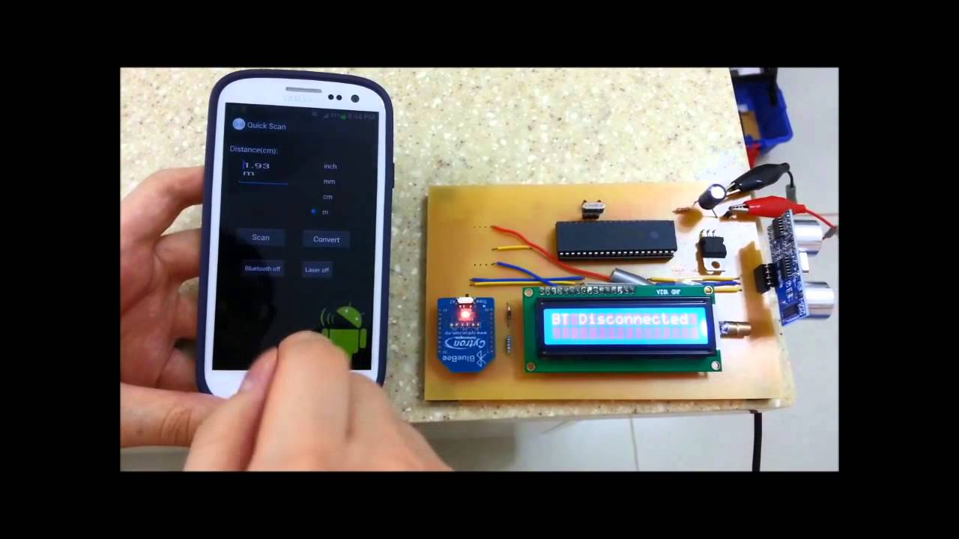
Software
Controlling Software
Monitoring Software

Slide 19
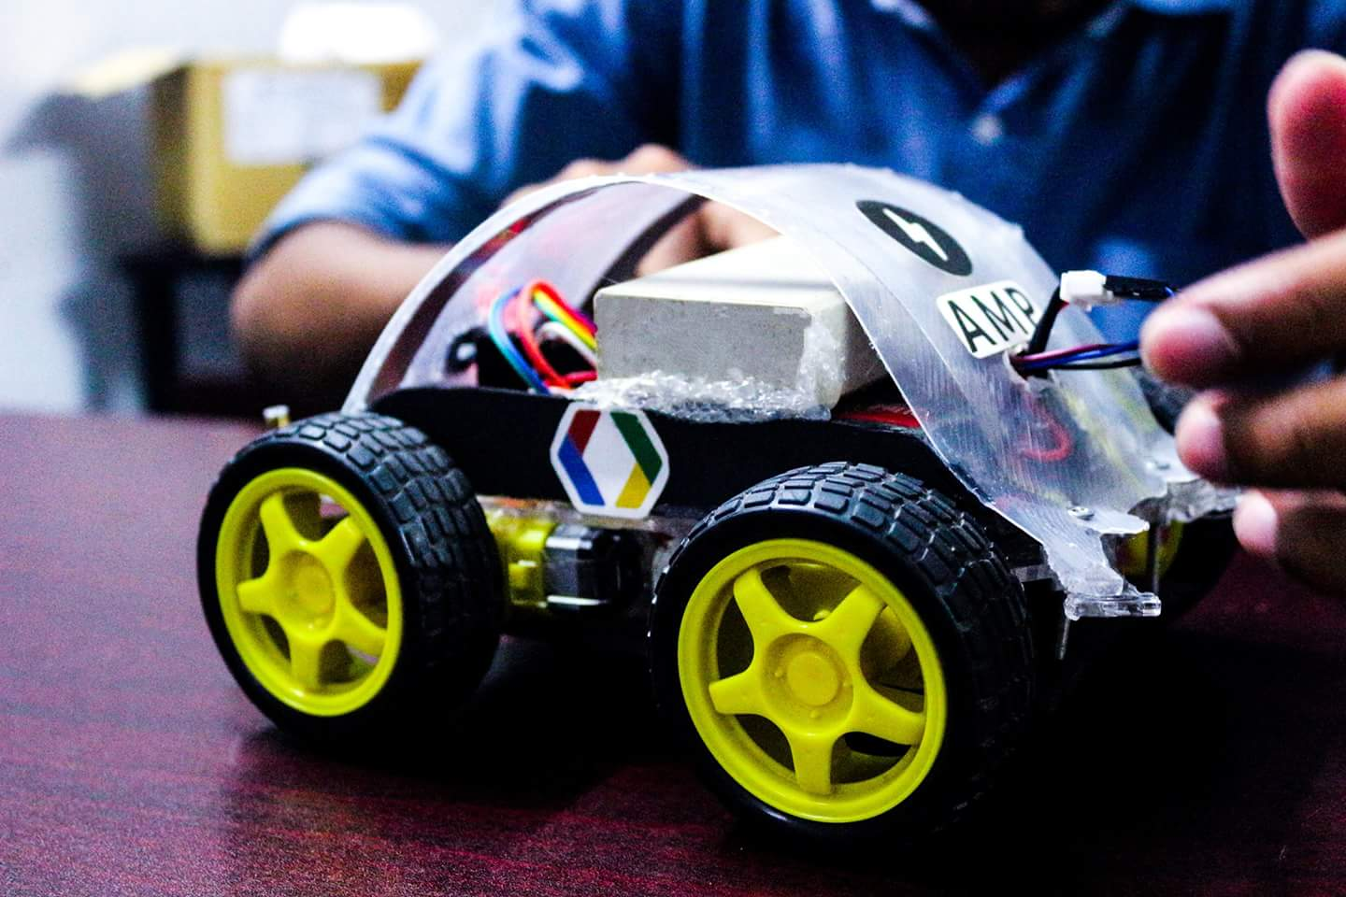
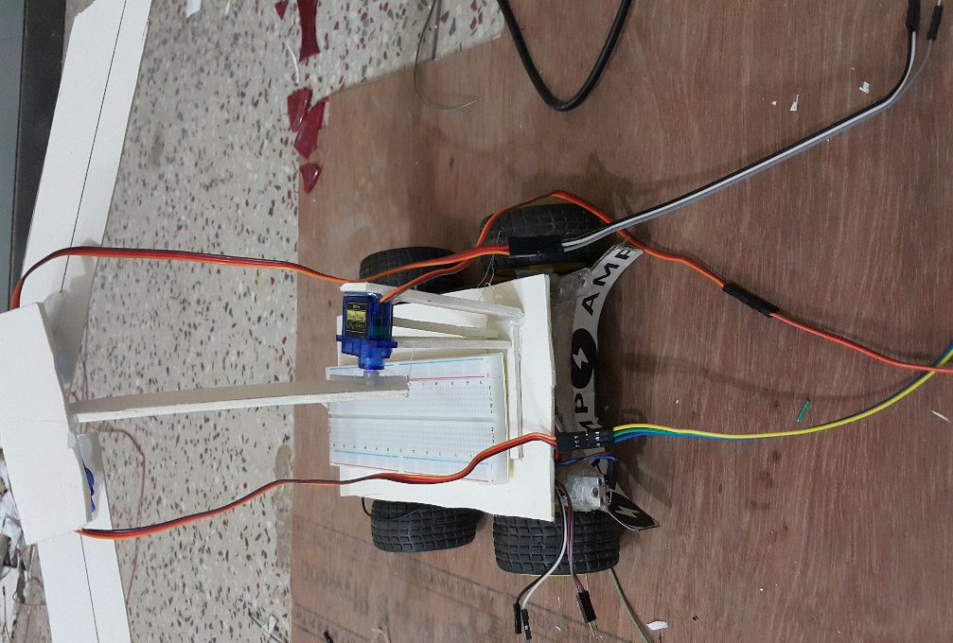
Hardware
Original picture in 11th semester
Original picture in 12th semester

Slide 20
Future Development
Built our own apps
Detecting mine
Wi-Fi or GPS connection

Slide 21
Project Completion Planning
Work/Semester | 10th Semester | 11th Semester | 12th Semester
Topics Selection and Literature Review
Designing of the Project
Software Simulation
Data Calibration
Prototype Designing
Troubleshooting And Final Hardware Implementation

Slide 22
That’s all….

