Slide 1
Advance Joining & Function

Slide 2
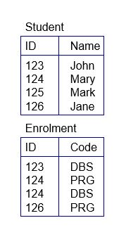
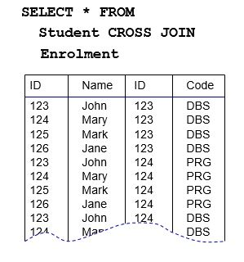
CROSS JOIN
N.B. Cross join doesn’t have any ON clause . As student table has 4 rows and Enrolment table has 4 rows so total 4*4=16 rows will be returned.

Slide 3
Find Non-Matching Rows
Student
Department
ID | NAME | GENDER | EXPECTED_ SALARY | DEPT_ID
101 | Naim | Male | 44000 | 801
102 | Nirjhor | Male | 43000 | 802
103 | Mijan | Male | 45000 | 801
104 | Tareq | Male | 42000 | 802
108 | Sanjida | Female | 43500 | 801
109 | Saudia | Female | 48500 | NULL
ID | DEPT_NAME | LOCATION | SUPERVISOR
801 | CSE | Rajshahi | Shamim Sir
802 | EEE | Dhaka | Sajjad Sir
803 | CIVIL | Khulna | Kamrujjaman Sir

Slide 4
Find Non-Matching Rows (Continue…)
Q. Find only the non-matching rows from left table also show the output .
Ans.
select student.Name,student.Gender,student.Expected_salary,Department.Dept_Name
from student left join Department
on student.Dept_Id=Department.Id
where student.Dept_Id is null
N.B. Here Left join is performed….In some cases right join or full join may have to be performed based on condition.
NAME | GENDER | EXPECTED_ SALARY | DEPT_NAME
Saudia | Female | 48500 | NULL

Slide 5
Find Non-Matching Rows (Continue…)
Q. Find only the non-matching rows from right table also show the output .
Ans.
select student.Name,student.Gender,student.Expected_salary,Department.Dept_Name
from student right join Department
on student.Dept_Id=Department.Id
where student.Dept_Id is null
NAME | GENDER | EXPECTED_ SALARY | DEPT_NAME
NULL | NULL | NULL | CIVIL

Slide 6
Find Non-Matching Rows (Continue…)
Q. Find only the non-matching rows from both table also show the output .
Ans .
select student.Name,student.Gender,student.Expected_salary,Department.Dept_Name
from student full join Department
on student.Dept_Id=Department.Id
where student.Dept_Id is null
NAME | GENDER | EXPECTED_ SALARY | DEPT_NAME
Saudia | Female | 48500 | NULL
NULL | NULL | NULL | CIVIL

Slide 7
Self Join
Self Inner Join
Self Left Join
Self Right Join
Self Cross Join

Slide 8

Self Join(Continue….)
Employee_Detail
Employee_Id | Employee_Name | Manager_Id
1 | Fahim | 2
2 | Parijat | 3
3 | Forhud | NULL
4 | Animesh | 1
Q. Find employee name with his corresponding manager name.
Ans.
select e.Employee_Name, m.Employee_Name as Manager_Name
from Employee_Detail as e inner join Employee_Detail as m
on e.Manager_Id=m.Employee_Id
N.B. If we write e. Employee_Id =m. Manager_Id then output will be wrong

Slide 9
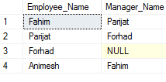
Self Join(Continue….)
Q. Find all employee name from this table with his corresponding manager name.
Ans.
select e.Employee_Name, m.Employee_Name as Manager_Name
from Employee_Detail as e left join Employee_Detail as m
on e.Manager_Id=m.Employee_Id
Employee_Id | Employee_Name | Manager_Id
1 | Fahim | 2
2 | Parijat | 3
3 | Forhud | NULL
4 | Animesh | 1
Employee_Detail

Slide 10
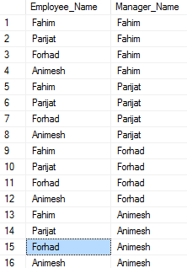
Self Join(Continue….)
Q. Find all possible combination of employee name with his corresponding manager name.
Ans.
select e.Employee_Name, m.Employee_Name as Manager_Name
from Employee_Detail as e cross join Employee_Detail as m
N.B. Cross join doesn’t have any ON clause and it returned 4*4=16 rows.
Employee_Id | Employee_Name | Manager_Id
1 | Fahim | 2
2 | Parijat | 3
3 | Forhud | NULL
4 | Animesh | 1
Employee_Detail

Slide 11
Replacing Null with a value
ISNULL
COALESCE
CASE ….WHEN (condition) THEN …… ELSE …. END
NVL

Slide 12
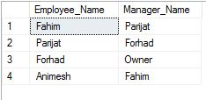
Replacing Null with a value(Continue….)
→ISNULL
select e.Employee_Name,ISNULL( m.Employee_Name, 'Owner') as Manager_Name
from Employee_Detail as e left join Employee_Detail as m
on e.Manager_Id=m.Employee_Id

Slide 13
Replacing Null with a value(Continue….)
→ COALESCE
select e.Employee_Name,COALESCE( m.Employee_Name, 'Owner') as Manager_Name
from Employee_Detail as e left join Employee_Detail as m
on e.Manager_Id=m.Employee_Id
N.B. COALESCE return first Non-Null value.

Slide 14
Replacing Null with a value(Continue….)
→ CASE….END
Select e.Employee_Name,
CASE when m.Employee_Name is null then 'Owner‘ ELSE m.Employee_Name END as Manager_Name
From Employee_Detail as e left join Employee_Detail as m
on e.Manager_Id=m.Employee_Id

Slide 15
Detail of COALESCE function
As COALESCE function return first Non-Null value so when ever there is priority based work we can use this function
For Example Consider the following Name Table
ID | First_Name | Middle_Name | Last_Name
1 | A.P.J. | NULL | NULL
2 | NULL | ABDUL | NULL
3 | NULL | NULL | KALAM
4 | A.P.J. | ABDUL | NULL
5 | NULL | ABDUL | KALAM
6 | A.P.J. | ABDUL | KALAM
First Name has 1st priority
Middle Name has 2nd priority
Last name has 3rd priority.

Slide 16
Detail of COALESCE function(Continue…)
Q. Now write a query that will return a single name(Frist or Middle or Last
Name ) based on their priority.
Ans.
Select COALESCE(First_Name,Middle_Name,Last_Name)
From Name

Slide 17
Do not compare yourself to others. If you do so, you are insulting yourself
Adolf Hitler

