Slide 1
Structured Query Language
(SQL)

Slide 2
SQL
Data Definition
Basic Query Structure
Set Operations
Aggregate Functions
Null Values
Nested Subqueries
Complex Queries
Views
Modification of the Database
Joined Relations**
Notes:
1

Slide 3
History
IBM Sequel language developed as part of System R project at the IBM San Jose Research Laboratory
Renamed Structured Query Language (SQL)
ANSI and ISO standard SQL:
  SQL-86
  SQL-89
  SQL-92
  SQL:1999 (language name became Y2K compliant!)
  SQL:2003
Commercial systems offer most, if not all, SQL-92 features, plus varying feature sets from later standards and special proprietary features.
  Not all examples here may work on your particular system.

Slide 4
Databases: Look up RDBMS SQL databases; the top will be
Oracle,
IBM DB2,
Microsoft SQL Server,
Sybase,
MySQL/MariaDB,
PostgreSQL…etc
Look up NoSQL databases; the top will be Cassandra, MongoDB, Couchbase, HBase etc

Slide 5


Oracle Application Express 4.1 New Features
Mike Hichwa, Vice President, Database Tools

Slide 6

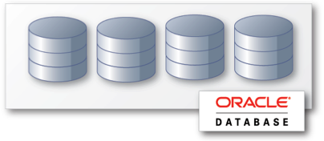
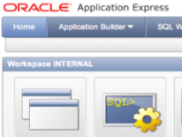

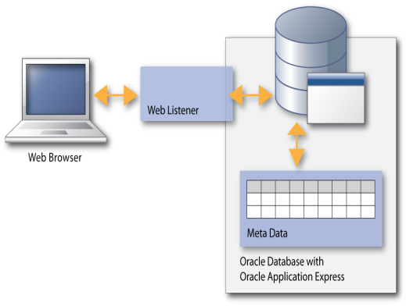
Oracle Application Express (Oracle APEX)
Benefits
Rapid Browser Based Development
Leverage SQL Skills
Point your browser and start developing
Build reports and charts using SQL
Self Service Provisioning
Runs within Database
Out-of-the-box elastic private cloud service
Simple to manage, highly scalable

Slide 7

Oracle Application Express (Oracle APEX)
Architectural Overview
Simple 2-Tier Architecture
Pages dynamically rendered using database Meta data
No code generation or file based compilation
Runs everywhere Oracle Database runs

Slide 8

Oracle Application Express (Oracle APEX)
Fully supported no-cost feature of Oracle DB
Distributed with
  Oracle Enterprise Edition
  Oracle Standard Edition
  Oracle Standard Edition One
  Oracle XE
Supported Database Releases
  10gR2
  11gR1
  11gR2

Slide 9
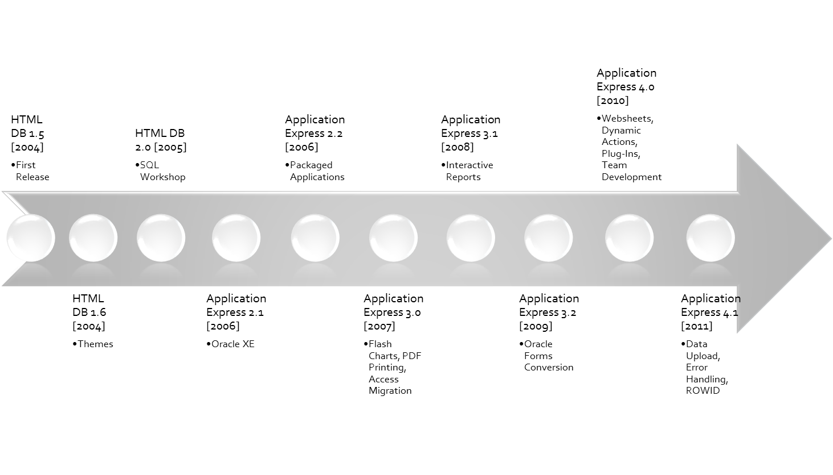
Oracle Application Express (Oracle APEX)
History

Slide 10

Error Handling
    Error Handling Function
    Provide developers full control when an error occurs
    Capabilities include:
        Log all errors
        Map errors raised by the Oracle Database (like “Unique constraint XYZ violated”) to friendlier error messages
        Display all errors “Inline in Notification”
        Increase security by masking internal APEX errors

Slide 11

Data Upload
  Provide the ability for end-users to update spreadsheet data into tables
    Developer uses wizard to specify parameters
    Following pages created:
      Data Load Source
      Data / Table Mapping
      Data Validation
      Data Load Results

Slide 12

Calendar
  Added “Drag and Drop” functionality
    Change Date and Time of records
  Added ability to create “Edit” page as part of calendar wizard
    “Edit” Page types of:
      Existing page
      Pop-up page
      New page

Slide 13
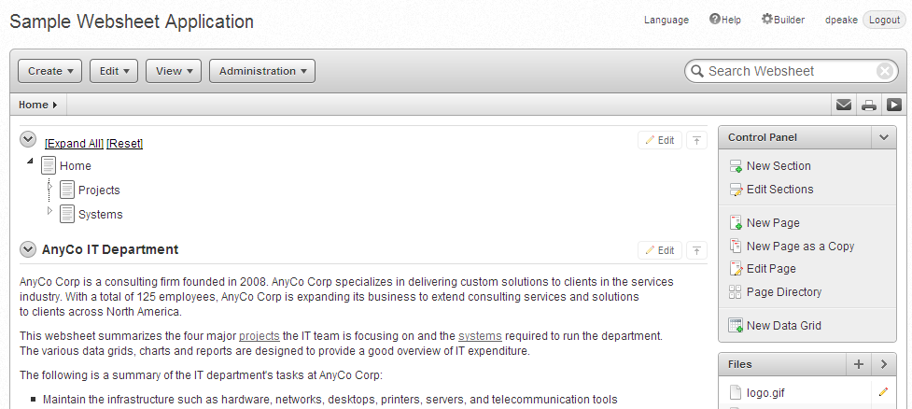
Websheet Enhancements
  Improved User Interface – offers greater control
  New Page Section Type – PL/SQL
  Query using Datagrid
  Presentation mode

Slide 14


Tabular Form Validations and Processes
  Support all the same validation types as a Page Item
  (e.g. PL/SQL Expression, Exists, etc)
  Allow referencing of column values in Validations and Processes
  using Bind Variable syntax:
    :COLUMN_NAME
    Built-in Bind variables -
    APEX$ROW_SELECTOR, APEX$ROW_NUM and APEX$ROW_STATUS
  Validations & Processes can be fired for each submitted row
  or once for the entire submission
  Advisor has been enhanced to check for valid Tabular Form columns

Slide 15

Plug-In Enhancements
  Increased Number of Custom Attributes to 15
  New Attribute Type - ‘Checkboxes’
  Add plug-in Support for
    Authentication Schemes
    Authorization Schemes
  Attribute Usability Enhancements in Application Builder

Slide 16

Dynamic Action Enahncements
Declarative support for buttons to trigger dynamic actions
  Actions performed based on button clicks
  Works for HTML, Image and Template based buttons
Extend the Submit Page dynamic action to gray out the page
and show a processing icon
Improve the ability to define multiple item values within ‘Set Value’

Slide 17
Accessibility
  Improved Menu accessibility
  Added ability to define row headers for tabular form fields
  Added “High Contrast” mode
  Improved usability for screen reader users when dealing with validation errors
  Integrated updated version of Rich Text Editor, offering improved accessibility

Slide 18
Application Translations
  Modernized the Translation user interface
  Streamlined the translation process
  Minimize the translation requirements for repeated values

Slide 19
Dynamic List
  Base list on SQL or PL/SQL functions
    Dynamically create styled list items
  Especially important for mobile based applications

Slide 20

Mobile Applications
  Provide themes & HTML templates suitable for
  smart phones and mobile devices
    jQuery Mobile*
    Dynamic List Support
    Improved HTML out of the box
    * We plan to bundle jQuery Mobile into a future release of Application Express

Slide 21
Other New Features in 4.1
Many Functional & Performance Improvements
New AnyChart Flash Charts
New CKEditor version
New jQuery and jQuery UI versions

Slide 22
A database schema is a collection of metadata that describes the relations in a database. A schema is also described as the layout or blueprint of a database that outlines the way data is organized into tables.
Types of Database Schema:
The physical database schema gives the blueprint for how each piece of data is stored in the database.
The logical schema gives structure to the tables and relationships inside of the database. Generally speaking, the logical schema is created before the physical schema.
Typically, database designers use data modeling to create a database schema based on the software that will interact with the database.

Slide 23

Schema Used in Example

Slide 24
Is a Schema and a Database is same thing…….!
The MySQL documentation states that physically, a schema is synonymous with a database. Therefore, a schema and a database are the same thing.
However, the Oracle Database documentation states that certain objects can be stored inside a database but not inside a schema. Therefore, a schema and a database are two different things.
And according to this SQL Server technical article, a schema is a separate entity inside the database. So, they are two different things.
For Oracle Schema;
A schema is a collection of logical structures of data, or schema objects. A schema is owned by a database user and has the same name as that user. Each user owns a single schema.

Slide 25
Types of SQL Statements
Data Definition Language (DDL) Statements
Data Manipulation Language (DML) Statements(CALL
DELETE,EXPLAIN PLAN,INSERT,LOCK TABLE,MERGE,SELECT,UPDATE )
Transaction Control Statements( Commit, Rollback, Savepoint, Set transection)
Session Control Statements
System Control Statement
Embedded SQL Statements

Slide 26
Data Definition Language
Data definition language (DDL) statements let you to perform these tasks:
Create, alter, and drop schema objects
Grant and revoke privileges and roles
Analyze information on a table, index, or cluster
Establish auditing options
Add comments to the data dictionary
The CREATE, ALTER, and DROP commands require exclusive access to the specified object. For example, an ALTER TABLE statement fails if another user has an open transaction on the specified table.
The GRANT, REVOKE, ANALYZE, AUDIT, and COMMENT commands do not require exclusive access to the specified object. For example, you can analyze a table while other users are updating the table.
Oracle Database implicitly commits the current transaction before and after every DDL statement.

Slide 27
Create Table Construct
An SQL relation is defined using the create table command:
create table r (A₁ D₁, A₂ D₂, ..., A_{n} D_{n},
(integrity-constraint₁),
...,
(integrity-constraint_{k}))
  r is the name of the relation
  each A_{i} is an attribute name in the schema of relation r
  D_{i} is the data type of attribute A_{i}
Example:
create table branch
(branch_name char(15),
branch_city char(30),
assets integer)

Slide 28
Domain Types in SQL
char(n). Fixed length character string, with user-specified length n.
varchar(n). Variable length character strings, with user-specified maximum length n.
int. Integer (a finite subset of the integers that is machine-dependent).
smallint. Small integer (a machine-dependent subset of the integer domain type).
numeric(p,d). Fixed point number, with user-specified precision of p digits, with n digits to the right of decimal point.
float(n). Floating point number, with user-specified precision of at least n digits.

Slide 29
Integrity Constraints on Tables
not null
primary key (A₁, ..., A_{n} )
Example: Declare branch_name as the primary key for branch
.
create table branch
(branch_name char(15),
branch_city char(30) not null,
assets integer,
primary key (branch_name))
primary key declaration on an attribute automatically ensures not null in SQL-92 onwards, needs to be explicitly stated in SQL-89

Slide 30
Basic Insertion and Deletion of Tuples
Newly created table is empty
Add a new tuple to account
insert into account
values ('A-9732', 'Perryridge', 1200)
  Insertion fails if any integrity constraint is violated
Delete all tuples from account
delete from account
Note: Will see later how to delete selected tuples

Slide 31
Drop and Alter Table Constructs
The drop table command deletes all information about the dropped relation from the database.
The alter table command is used to add attributes to an existing relation:
alter table r add A D
where A is the name of the attribute to be added to relation r and D is the domain of A.
  All tuples in the relation are assigned null as the value for the new attribute.
The alter table command can also be used to drop attributes of a relation:
alter table r drop A
where A is the name of an attribute of relation r
  Dropping of attributes not supported by many databases

Slide 32
Basic Query Structure
A typical SQL query has the form:
select A₁, A₂, ..., A_{n}
from r₁, r₂, ..., r_{m}
where P
  A_{i} represents an attribute
  R_{i} represents a relation
  P is a predicate.
The result of an SQL query is a relation.
Notes:
2

Slide 33
The select Clause
The select clause list the attributes desired in the result of a query
  corresponds to the projection operation of the relational algebra
Example: find the names of all branches in the loan relation:
select branch_name
from loan
In the relational algebra, the query would be:
∏_{branch_name} (loan)
NOTE: SQL names are case insensitive (i.e., you may use upper- or lower-case letters.)
  E.g. Branch_Name ≡ BRANCH_NAME ≡ branch_name
  Some people use upper case wherever we use bold font.
Notes:
3

Slide 34
The select Clause (Cont.)
SQL allows duplicates in relations as well as in query results.
To force the elimination of duplicates, insert the keyword distinct after select.
Find the names of all branches in the loan relations, and remove duplicates
select distinct branch_name
from loan
The keyword all specifies that duplicates not be removed.
select all branch_name
from loan
(Schema used in this example)
Notes:
4

Slide 35
The select Clause (Cont.)
An asterisk in the select clause denotes “all attributes”
select *
from loan
The select clause can contain arithmetic expressions involving the operation, +, –, ∗, and /, and operating on constants or attributes of tuples.
E.g.:
select loan_number, branch_name, amount ∗ 100
from loan
Notes:
5

Slide 36
The from Clause
The from clause lists the relations involved in the query
  Corresponds to the Cartesian product operation of the relational algebra.
Find the Cartesian product borrower X loan
select ∗
from borrower, loan
Find the name, loan number and loan amount of all customers
having a loan at the Perryridge branch.
select customer_name, borrower.loan_number, amount
from borrower, loan
where borrower.loan_number = loan.loan_number and
branch_name = 'Perryridge'
(Schema used in this example)
Notes:
8

Slide 37
The where Clause
The where clause specifies conditions that the result must satisfy
  Corresponds to the selection predicate of the relational algebra.
To find all loan number for loans made at the Perryridge branch with loan amounts greater than $1200.
select loan_number
from loan
where branch_name = 'Perryridge' and amount > 1200
Comparison results can be combined using the logical connectives and, or, and not.
SQL includes a between comparison operator
Find the loan number of those loans with loan amounts between $90,000 and $100,000 (that is, ≥$90,000 and ≤$100,000)
select loan-number
from loan
where amount between 90000 and 100000
Notes:
6

Slide 38
The Rename Operation
SQL allows renaming relations and attributes using the as clause:
old-name as new-name
E.g. Find the name, loan number and loan amount of all customers; rename the column name loan_number as loan_id.
select customer_name, borrower.loan_number as loan_id, amount
from borrower, loan
where borrower.loan_number = loan.loan_number
(Schema used in this example)
Notes:
9

Slide 39
Tuple Variables
Tuple variables are defined in the from clause via the use of the as clause.
Find the customer names and their loan numbers and amount for all customers having a loan at some branch.
select customer_name, T.loan_number, S.amount
from borrower as T, loan as S
where T.loan_number = S.loan_number
Find the names of all branches that have greater assets than
some branch located in Brooklyn.
select distinct T.branch_name
from branch as T, branch as S
where T.assets > S.assets and S.branch_city = 'Brooklyn'
Keyword as is optional and may be omitted
borrower as T ≡ borrower T
  Some database such as Oracle require as to be omitted
Notes:
10

Slide 40
String Operations
SQL includes a string-matching operator for comparisons on character strings. The operator “like” uses patterns that are described using two special characters:
  percent (%). The % character matches any substring.
  underscore (_). The _ character matches any character.
Find the names of all customers whose street includes the substring “Main”.
select customer_name
from customer
where customer_street like '% Main%'
Match the name “Main%”
like 'Main\%' escape '\'
SQL supports a variety of string operations such as
  concatenation (using “||”)
  converting from upper to lower case (and vice versa)
  finding string length, extracting substrings, etc.

Slide 41
Ordering the Display of Tuples
List in alphabetic order the names of all customers having a loan in Perryridge branch
select distinct customer_name
from borrower, loan
where borrower. loan_number = loan.loan_number and
branch_name = 'Perryridge'
order by customer_name
We may specify desc for descending order or asc for ascending order, for each attribute; ascending order is the default.
  Example: order by customer_name desc
(Schema used in this example)

Slide 42
Set Operations
The set operations union, intersect, and except operate on relations and correspond to the relational algebra operations ∪, ∩, −.
Each of the above operations automatically eliminates duplicates; to retain all duplicates use the corresponding multiset versions union all, intersect all and except all.
Suppose a tuple occurs m times in r and n times in s, then, it occurs:
  m + n times in r union all s
  min(m,n) times in r intersect all s
  max(0, m – n) times in r except all s

Slide 43
Set Operations
Find all customers who have a loan, an account, or both:
(select customer_name from depositor)
union
(select customer_name from borrower)
Find all customers who have both a loan and an account.
(select customer_name from depositor)
intersect
(select customer_name from borrower)
Find all customers who have an account but no loan.
(select customer_name from depositor)
except
(select customer_name from borrower)

Slide 44
Aggregate Functions
These functions operate on the multiset of values of a column of a relation, and return a value
avg: average value
min: minimum value
max: maximum value
sum: sum of values
count: number of values

Slide 45
Aggregate Functions (Cont.)
Find the average account balance at the Perryridge branch.
select avg (balance)
from account
where branch_name = 'Perryridge'
Find the number of tuples in the customer relation.
select count (*)
from customer
Find the number of depositors in the bank.
select count (distinct customer_name)
from depositor
(Schema used in this example)

Slide 46
Aggregate Functions – Group By
Find the number of depositors for each branch.
select branch_name, count (distinct customer_name)
from depositor, account
where depositor.account_number = account.account_number
group by branch_name
Note: Attributes in select clause outside of aggregate functions must
appear in group by list
(Schema used in this example)

Slide 47
Aggregate Functions – Having Clause
Find the names of all branches where the average account balance is more than $1,200.
select branch_name, avg (balance)
from account
group by branch_name
having avg (balance) > 1200
Note: predicates in the having clause are applied after the
formation of groups whereas predicates in the where
clause are applied before forming groups
(Schema used in this example)

Slide 48
Aggregate Functions – Having Clause
Find the average balance for each customer who lives in Harrison and has at least three accounts.
select depositor.customer-name, avg (balance)
from depositor, account, customer
where depositor.account-number=account.account-number and
depositor.customer-name=customer.customer-name and
customer-city=‘Harrison’
group by depositor.customer-name
having count(distinct depsitor.account-number) > =3
(Schema used in this example)

Slide 49
Null Values
It is possible for tuples to have a null value, denoted by null, for some of their attributes
null signifies an unknown value or that a value does not exist.
The predicate is null can be used to check for null values.
  Example: Find all loan number which appear in the loan relation with null values for amount.
select loan_number
from loan
where amount is null
The result of any arithmetic expression involving null is null
  Example: 5 + null returns null
However, aggregate functions simply ignore nulls
  More on next slide

Slide 50
Null Values and Three Valued Logic
Any comparison with null returns unknown
  Example: 5 < null or null <> null or null = null
Three-valued logic using the truth value unknown:
  OR: (unknown or true) = true,
  (unknown or false) = unknown
  (unknown or unknown) = unknown
  AND: (true and unknown) = unknown,
  (false and unknown) = false,
  (unknown and unknown) = unknown
  NOT: (not unknown) = unknown

Slide 51
Null Values and Aggregates
Total all loan amounts
select sum (amount)
from loan
  Above statement ignores null amounts
  result is null if there is no non-null amount
  All aggregate operations except count(*) ignore tuples with null values on the aggregated attributes.

Slide 52
Nested Subqueries
SQL provides a mechanism for the nesting of subqueries.
A subquery is a select-from-where expression that is nested within another query.
A common use of subqueries is to perform tests for set membership, set comparisons, and set cardinality.

Slide 53
“In” Construct
Find all customers who have both an account and a loan at the bank.
select distinct customer_name
from borrower
where customer_name in (select customer_name
from depositor )
Find all customers who have a loan at the bank but do not have
an account at the bank
select distinct customer_name
from borrower
where customer_name not in (select customer_name
from depositor )
(Schema used in this example)

Slide 54
Example Query
Find all customers who have both an account and a loan at the Perryridge branch
select distinct customer_name
from borrower, loan
where borrower.loan_number = loan.loan_number and
branch_name = 'Perryridge' and
(branch_name, customer_name ) in
(select branch_name, customer_name
from depositor, account
where depositor.account_number =
account.account_number )
(Schema used in this example)

Slide 55
“Some” Construct
Find all branches that have greater assets than some branch located in Brooklyn.
select distinct T.branch_name
from branch as T, branch as S
where T.assets > S.assets and
S.branch_city = 'Brooklyn'
Same query using > some clause (Alternative Style)
select branch_name
from branch
where assets > some
(select assets
from branch
where branch_city = 'Brooklyn')
(Schema used in this example)

Slide 56
“All” Construct
Find the names of all branches that have greater assets than all branches located in Brooklyn.
select branch_name
from branch
where assets > all
(select assets
from branch
where branch_city = 'Brooklyn')
(Schema used in this example)

Slide 57
“Exists” Construct
Find all customers who have an account at all branches located in Brooklyn.
select distinct S.customer_name
from depositor as S
where not exists (
(select branch_name
from branch
where branch_city = 'Brooklyn')
except
(select R.branch_name
from depositor as T, account as R
where T.account_number = R.account_number and
S.customer_name = T.customer_name ))
Note that X – Y = Ø ⇔ X ⊆ Y
Note: Cannot write this query using = all and its variants

Slide 58
Absence of Duplicate Tuples
The unique construct tests whether a subquery has any duplicate tuples in its result.
Find all customers who have at most one account at the Perryridge branch.
select T.customer_name
from depositor as T
where unique (
select R.customer_name
from account, depositor as R
where T.customer_name = R.customer_name and
R.account_number = account.account_number and
account.branch_name = 'Perryridge')

Slide 59
Example Query
Find all customers who have at least two accounts at the Perryridge branch.
select distinct T.customer_name
from depositor as T
where not unique (
select R.customer_name
from account, depositor as R
where T.customer_name = R.customer_name and
R.account_number = account.account_number and
account.branch_name = 'Perryridge')

Slide 60
Modification of the Database – Deletion
Delete all account tuples at the Perryridge branch
delete from account
where branch_name = 'Perryridge'
Delete all accounts at every branch located in the city ‘Needham’.
delete from account
where branch_name in (select branch_name
from branch
where branch_city = 'Needham')

Slide 61
Example Query
Delete the record of all accounts with balances below the average at the bank.
delete from account
where balance < (select avg (balance )
from account )
  Problem: as we delete tuples from deposit, the average balance changes
  Solution used in SQL:
  1. First, compute avg balance and find all tuples to delete
  2. Next, delete all tuples found above (without recomputing avg or
  retesting the tuples)

Slide 62
Modification of the Database – Insertion
Add a new tuple to account
insert into account
values ('A-9732', 'Perryridge', 1200)
or equivalently
insert into account (branch_name, balance, account_number)
values ('Perryridge', 1200, 'A-9732')
Add a new tuple to account with balance set to null
insert into account
values ('A-777','Perryridge', null )

Slide 63
Modification of the Database – Insertion
Provide as a gift for all loan customers of the Perryridge branch, a $200 savings account. Let the loan number serve as the account number for the new savings account
insert into account
select loan_number, branch_name, 200
from loan
where branch_name = 'Perryridge'
To add tuples to depositor table
insert into depositor
select customer_name, loan_number
from loan, borrower
where branch_name = 'Perryridge'
and loan.account_number = borrower.account_number
The select from where statement is evaluated fully before any of its results are inserted into the relation
  Motivation: insert into table1 select * from table1

Slide 64
Modification of the Database – Update
Pay 5% interest to all balances of account relation:
  update account
  set balance = balance ∗ 1.05
Pay 5% interest on accounts whose balance is greater than average:
update account
set balance = balance ∗ 1.05
where balance > (select avg(balance) from account)

Slide 65
Modification of the Database – Update
Increase all accounts with balances over $10,000 by 6%, all other accounts receive 5%.
  Write two update statements:
  update account
  set balance = balance ∗ 1.06
  where balance > 10000
  update account
  set balance = balance ∗ 1.05
  where balance ≤ 10000
  The order is important
  Can be done better using the case statement (next slide)

Slide 66
Case Statement for Conditional Updates
Same query as before: Increase all accounts with balances over $10,000 by 6%, all other accounts receive 5%.
update account
set balance = case
when balance <= 10000 then balance *1.05
else balance * 1.06
end

Slide 67

Joined Relations**
Join operations take two relations and return as a result another relation.
These additional operations are typically used as subquery expressions in the from clause
Join condition – defines which tuples in the two relations match, and what attributes are present in the result of the join.
Join type – defines how tuples in each relation that do not match any tuple in the other relation (based on the join condition) are treated.

Slide 68

Joined Relations – Datasets for Examples
Relation loan
Relation borrower
Note: borrower information missing for L-260 and loan information missing for L-155

Slide 69


Joined Relations – Examples
loan inner join borrower on
loan.loan_number = borrower.loan_number
loan left outer join borrower on
loan.loan_number = borrower.loan_number

Slide 70

Joined Relations – Examples
loan natural inner join borrower
loan natural right outer join borrower
Find all customers who have either an account or a loan (but not both) at the bank.
select customer_name
from (depositor natural full outer join borrower )
where account_number is null or loan_number is null

Slide 71

Joined Relations – Examples
Natural join can get into trouble if two relations have an attribute with
same name that should not affect the join condition
  e.g. an attribute such as remarks may be present in many tables
Solution:
  loan full outer join borrower using (loan_number)

Slide 72
View Definition
A relation that is not of the conceptual model but is made visible to a user as a “virtual relation” is called a view.
A view is defined using the create view statement which has the form
create view v as < query expression >
where <query expression> is any legal SQL expression. The view name is represented by v.
Once a view is defined, the view name can be used to refer to the virtual relation that the view generates.

Slide 73
Example Queries
A view consisting of branches and their customers who have either an account or a loan at that branch
create view all_customer as
(select branch_name, customer_name
from depositor, account
where depositor.account_number =
account.account_number )
union
(select branch_name, customer_name
from borrower, loan
where borrower.loan_number = loan.loan_number )
Find all customers of the Perryridge branch
select customer_name
from all_customer
where branch_name = 'Perryridge'

Slide 74
Uses of Views
Hiding some information from some users
  Consider a user who needs to know a customer’s name, loan number and branch name, but has no need to see the loan amount.
  Define a view
  (create view cust_loan_data as
  select customer_name, borrower.loan_number, branch_name
  from borrower, loan
  where borrower.loan_number = loan.loan_number )
  Grant the user permission to read cust_loan_data, but not borrower or loan
Predefined queries to make writing of other queries easier
  Common example: Aggregate queries used for statistical analysis of data

Slide 75
Processing of Views
When a view is created
  the query expression is stored in the database along with the view name
  the expression is substituted into any query using the view
Views definitions containing views
  One view may be used in the expression defining another view
  A view relation v₁ is said to depend directly on a view relation v₂ if v₂ is used in the expression defining v₁
  A view relation v₁ is said to depend on view relation v₂ if either v₁ depends directly to v₂ or there is a path of dependencies from v₁ to v₂
  A view relation v is said to be recursive if it depends on itself.

Slide 76
Update of a View
Create a view of all loan data in the loan relation, hiding the amount attribute
create view loan_branch as
select loan_number, branch_name
from loan
Add a new tuple to loan_branch
insert into loan_branch
values ('L-37‘, 'Perryridge‘)
This insertion must be represented by the insertion of the tuple
('L-37', 'Perryridge', null )
into the loan relation

Slide 77
Updates Through Views (Cont.)
Some updates through views are impossible to translate into updates on the database relations
  create view v as
  select loan_number, branch_name, amount
  from loan
  where branch_name = ‘Perryridge’
insert into v values ( 'L-99','Downtown', '23')
Others cannot be translated uniquely
  insert into all_customer values ('Perryridge', 'John')
    Have to choose loan or account, and
    create a new loan/account number!
Most SQL implementations allow updates only on simple views (without aggregates) defined on a single relation

Slide 78
Derived Relations
SQL allows a subquery expression to be used in the from clause
Find the average account balance of those branches where the average account balance is greater than $1200.
select branch_name, avg_balance
from (select branch_name, avg (balance)
from account
group by branch_name )
as branch_avg ( branch_name, avg_balance )
where avg_balance > 1200
Note that we do not need to use the having clause, since we compute the temporary (view) relation branch_avg in the from clause, and the attributes of branch_avg can be used directly in the where clause.

Slide 79
With Clause
The with clause provides a way of defining a temporary view whose definition is available only to the query in which the with clause occurs.
Find all accounts with the maximum balance
with max_balance (value) as
select max (balance)
from account
select account_number
from account, max_balance
where account.balance = max_balance.value

Slide 80
Integrity Constraints
Integrity constraints guard against accidental damage to the database, by ensuring that authorized changes to the database do not result in a loss of data consistency.
  A checking account must have a balance greater than $10,000.00
  A salary of a bank employee must be at least $4.00 an hour
  A customer must have a (non-null) phone number

Slide 81
Constraints on a Single Relation
not null
primary key
Foreign key
unique
check (P ), where P is a predicate

Slide 82
The check clause
Example: Declare branch_name as the primary key for branch and ensure that the values of assets are non-negative.
create table branch
(branch_name char(15),
branch_city char(30),
assets integer,
primary key (branch_name),
check (assets >= 0))

Slide 83
The check clause (Cont.)
The check clause in SQL-92 permits domains to be restricted:
  Use check clause to ensure that an hourly_wage domain allows only values greater than a specified value.
  create domain hourly_wage numeric(5,2)
  constraint value_test check(value > = 4.00)
  The domain has a constraint that ensures that the hourly_wage is greater than 4.00
  The clause constraint value_test is optional; useful to indicate which constraint an update violated.

Slide 84
Referential Integrity
Ensures that a value that appears in one relation for a given set of attributes also appears for a certain set of attributes in another relation.
  Example: If “Perryridge” is a branch name appearing in one of the tuples in the account relation, then there exists a tuple in the branch relation for branch “Perryridge”.
Primary and candidate keys and foreign keys can be specified as part of the SQL create table statement:
  The primary key clause lists attributes that comprise the primary key.
  The unique key clause lists attributes that comprise a candidate key.
  The foreign key clause lists the attributes that comprise the foreign key and the name of the relation referenced by the foreign key. By default, a foreign key references the primary key attributes of the referenced table.

Slide 85
Referential Integrity in SQL – Example
create table customer
(customer_name char(20),
customer_street char(30),
customer_city char(30),
primary key (customer_name ))
create table branch
(branch_name char(15),
branch_city char(30),
assets numeric(12,2),
primary key (branch_name ))

Slide 86
Referential Integrity in SQL – Example (Cont.)
create table account
(account_number char(10),
branch_name char(15),
balance integer,
primary key (account_number),
foreign key (branch_name) references branch )
create table depositor
(customer_name char(20),
account_number char(10),
primary key (customer_name, account_number),
foreign key (account_number ) references account,
foreign key (customer_name ) references customer )

Slide 87
Assertions
An assertion is a predicate expressing a condition that we wish the database always to satisfy.
An assertion in SQL takes the form
create assertion <assertion-name> check <predicate>
When an assertion is made, the system tests it for validity, and tests it again on every update that may violate the assertion
  This testing may introduce a significant amount of overhead; hence assertions should be used with great care.
Asserting
for all X, P(X)
is achieved in a round-about fashion using
not exists X such that not P(X)

Slide 88
Assertion Example
Every loan has at least one borrower who maintains an account with a minimum balance or $1000.00
create assertion balance_constraint check
(not exists (
select *
from loan
where not exists (
select *
from borrower, depositor, account
where loan.loan_number = borrower.loan_number
and borrower.customer_name = depositor.customer_name
and depositor.account_number = account.account_number
and account.balance >= 1000)))

Slide 89
Assertion Example
The sum of all loan amounts for each branch must be less than the sum of all account balances at the branch.
create assertion sum_constraint check
(not exists (select *
from branch
where (select sum(amount )
from loan
where loan.branch_name =
branch.branch_name )
>= (select sum (balance )
from account
where loan.branch_name =
branch.branch_name )))

Slide 90
Trigger
Trigger is a statement that the system executes automatically as a side effect of a modification to the database.
Specify when a trigger is to be executed. This is broken up into an event that causes the trigger to be checked and a condition that must be satisfied for trigger execution to proceed.
Specify the actions to be taken when trigger executes.
So, Trigger is referred to as even-condition-action model.
The triggering event can be insert, delete and update.
For updates, the trigger can specify columns whose update causes the trigger to execute.
create trigger overdraft-trigger after update of balance on account
The referencing old row as clause can be used to create variable storing the old value of an updated or deleted value. The referencing new row as clause can be used with inserts in addition to updates.
Triggers can be activated before the event (insert/delete/update) instead of after the event.

Slide 91


Slide 92
To be or not to be, that the question
----Shakespeare

