Slide 1
Union, Union All,
Difference between Join & Union

Slide 2
Union & Union All
Differences:
Union remove duplicate rows
Union sort the returned rows
Union All returned all duplicate rows
Union All doesn’t sort the returned rows
Union is slower bcz its take time to perform distinct sort
but Union All is faster bcz it doesn’t perform any sort
operation.
Notes:
1

Slide 3
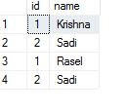
Cntd….
RU_Student RUET_Student
ID | Name
1 | Krisna
2 | Sadi
ID | Name
1 | Rasel
2 | Sadi
select * from RU_Student
Union all
select * from Ruet_student

Slide 4

Cntd….
RU_Student RUET_Student
ID | Name
1 | Krisna
2 | Sadi
ID | Name
1 | Rasel
2 | Sadi
select * from RU_Student
Union
select * from Ruet_student

Slide 5
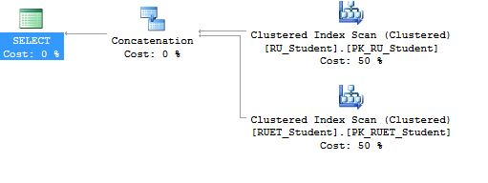
Execution Time
For Union all

Slide 6
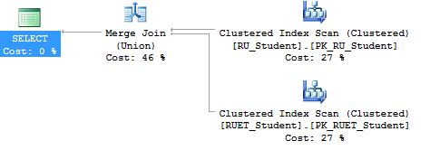
Execution Time
For Union

Slide 7
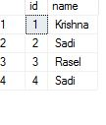
Cntd….
RU_Student RUET_Student
ID | Name
1 | Krisna
2 | Sadi
ID | Name
3 | Rasel
4 | Sadi
select * from RU_Student
Union
select * from Ruet_student

Slide 8
Cntd….
But If we write
select id, name from RU_Student
Union
select id from Ruet_student
Output
All queries combined using a UNION, INTERSECT or EXCEPT
operator must have an equal number of expressions in their
target lists.

Slide 9
Cntd….
RU_Student RUET_Student
ID | Name | Email
1 | Krisna | krish@ru
2 | Sadi | sadi@ru
ID | Name | Email
1 | Rasel | rasel@ruet
2 | Sadi | sadi@ruet
select name, email, id from RU_Student
union
select id, name, email from Ruet_student

Slide 10
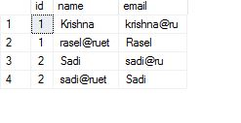
Cntd….
RU_Student RUET_Student
ID | Name | Email
1 | Krisna | krish@ru
2 | Sadi | sadi@ru
ID | Name | Email
1 | Rasel | rasel@ruet
2 | Sadi | sadi@ruet
select id, name, email from RU_Student
union
select id, email, name from Ruet_student

Slide 11
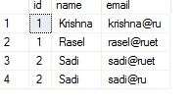
Cntd….
RU_Student RUET_Student
ID | Name | Email
1 | Krisna | krish@ru
2 | Sadi | sadi@ru
ID | Name | Email
1 | Rasel | rasel@ruet
2 | Sadi | sadi@ruet
select * from RU_Student
order by name
union all
select * from Ruet_student
select * from RU_Student
union all
select * from Ruet_student
order by name
Error

Slide 12
Difference between Union and Join
Union combined the result set from two or more select queries into a single result set which includes all rows from all the query
Join receive data from two or more tables based on logical relationship among the tables.

