Slide 1
PUBLIC-KEY CRYPTOGRAPHY AND RSA

Slide 2
Asymmetric encryption
Asymmetric encryption is a form of cryptosystem in which encryption and decryption are performed using the different keys—one a public key and one a private key. It is also known as public-key encryption.
Asymmetric encryption transforms plaintext into ciphertext using a one of two keys and an encryption algorithm. Using the paired key and a decryption algorithm, the plaintext is recovered from the ciphertext.
Asymmetric encryption can be used for confidentiality, authentication, or both.
The most widely used public-key cryptosystem is RSA.

Slide 3
A public-key encryption scheme has the following ingredients:
Plaintext: This is the readable message or data that is fed into the algorithm as input.
Encryption algorithm: The encryption algorithm performs various transformations on the plaintext.
Public and private keys: This is a pair of keys that have been selected so that if one is used for encryption, the other is used for decryption. The exact transformations performed by the algorithm depend on the public or private key that is provided as input.
Ciphertext: This is the scrambled message produced as output. It depends on the plaintext and the key. For a given message, two different keys will produce two different ciphertexts.
Decryption algorithm: This algorithm accepts the ciphertext and the matching key and produces the original plaintext.

Slide 4
The Essential Steps:
1. Each user generates a pair of keys to be used for the encryption and decryption of messages.
2. Each user places one of the two keys in a public register or other accessible file. This is the public key. The companion key is kept private. Each user maintains a collection of public keys obtained from others.
3. If Bob wishes to send a confidential message to Alice, Bob encrypts the message using Alice’s public key.
4. When Alice receives the message, she decrypts it using her private key. No other recipient can decrypt the message because only Alice knows Alice’s private key.

Slide 5
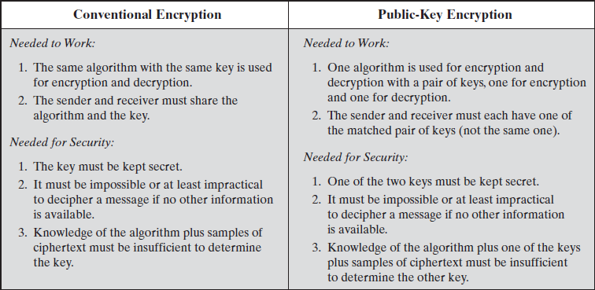
Comparison of Conventional and Public-Key Encryption

Slide 6
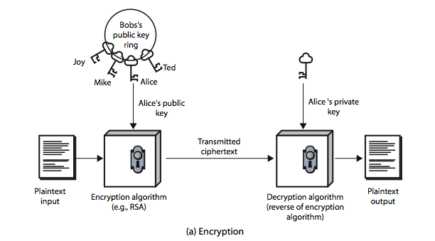
Public-Key Cryptography

Slide 7
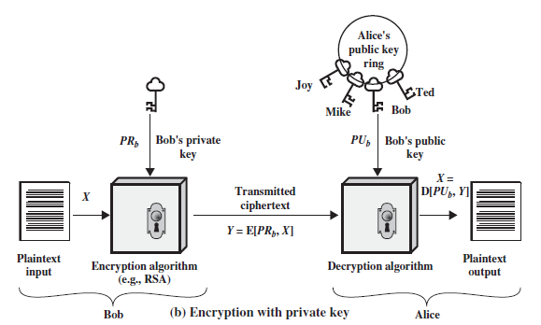
Public-Key Cryptography

Slide 8
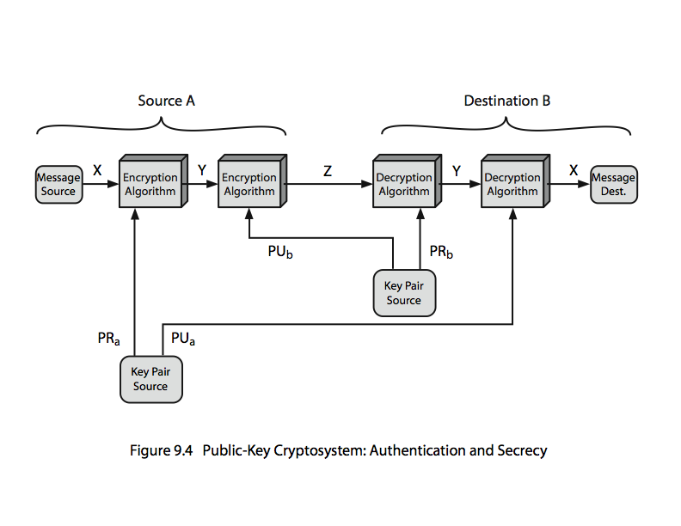

Public-Key Cryptosystems: Authentication and Secrecy

Slide 9
RSA
by Rivest, Shamir & Adleman of MIT in 1977
best known & widely used public-key scheme
RSA is the best known, and by far the most widely used general public key encryption algorithm.

Slide 10
RSA Key Setup
each user generates a public/private key pair by:
selecting two large primes at random - p, q
computing their system modulus N=p.q
note ø(N)=(p-1)(q-1)
selecting at random the encryption key e
where 1<e<ø(N), gcd(e,ø(N))=1
solve following equation to find decryption key d
e.d=1 mod ø(N) and 0≤d≤N
publish their public encryption key: KU={e,N}
keep secret private decryption key: KR={d,p,q}

Slide 11
RSA Use
to encrypt a message M the sender:
obtains public key of recipient KU={e,N}
computes: C=Me mod N, where 0≤M<N
to decrypt the ciphertext C the owner:
uses their private key KR={d,p,q}
computes: M=C^{d} mod N
note that the message M must be smaller than the modulus N

Slide 12
RSA Example
Select primes: p=17 & q=11
Compute n = pq =17×11=187
Compute ø(n)=(p–1)(q-1)=16×10=160
Select e : gcd(e,160)=1; choose e=7
Determine d: de=1 mod 160 and d < 160 Value is d=23 since 23×7=161= 10×160+1
Publish public key KU={7,187}
Keep secret private key KR={23,17,11}

Slide 13
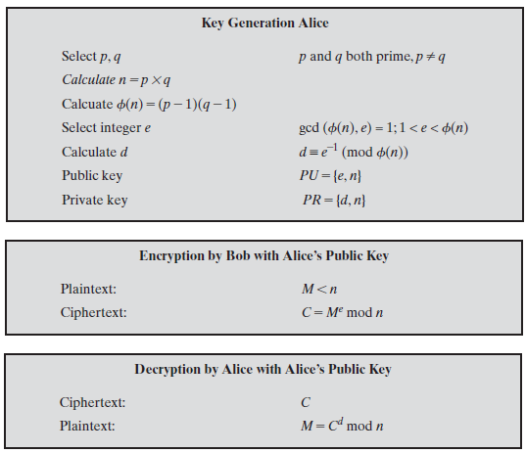

Slide 14
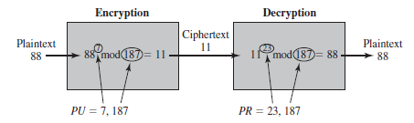
Example of RSA Algorithm

Slide 15
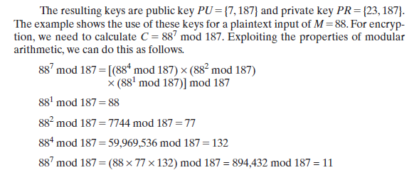
Decryption of RSA:

Slide 16
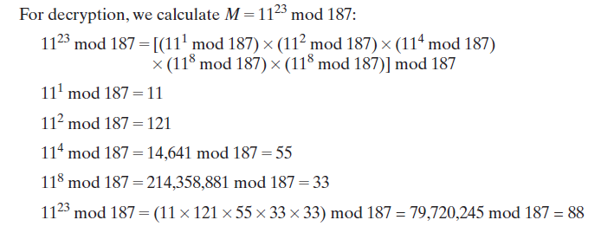
Decryption of RSA:

Slide 17
The Security of RSA
Four possible approaches to attacking the RSA algorithm are
Brute force: This involves trying all possible private keys.
Mathematical attacks: There are several approaches, all equivalent in effort to factoring the product of two primes.
Timing attacks: These depend on the running time of the decryption algorithm.
Chosen ciphertext attacks: This type of attack exploits properties of the RSA algorithm.

Slide 18
The Factoring Problem
Three approaches to attacking RSA mathematically:
1. Factor n into its two prime factors. This enables calculation of φ(n) =(p - 1) × (q - 1),which in turn enables determination of d = e⁻¹ (mod (n)).
2. Determine φ(n) directly, without first determining p and q. Again, this enables determination of
d = e⁻¹ (mod (n)).
3. Determine d directly, without first determining φ(n).

