Slide 1
Diffie-Hellman key exchange

Slide 2
Diffie-Hellman key exchange
A simple public-key algorithm is Diffie-Hellman key exchange.
This protocol enables two users to establish a secret key using a public-key scheme

Slide 3
Diffie-Hellman Key Exchange
A primitive root of a prime number p, generate all the integers from 1 to p-1.
That is, a is a primitive root modulo p, if
a mod p, a² mod p,…, a^{p-1} mod p are distinct and consist of the integers from 1 through p-1 in some permutation.

Slide 4
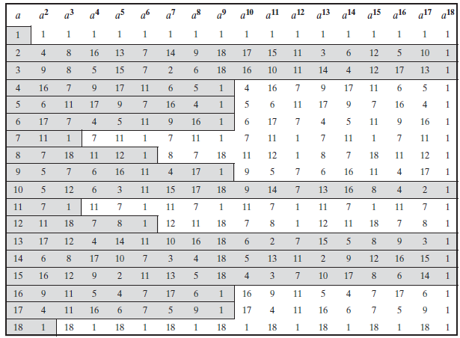
For the prime number 19, primitive roots are 2, 3, 10, 13, 14 and 15.

Slide 5
Diffie-Hellman Setup
all users agree on global parameters:
large prime integer q
α primitive root mod q
each user (eg. A) generates their key
chooses a secret key (number): x_{A} < q
compute their public key: y_{A} = α^{xA} mod q

Slide 6
Diffie-Hellman Key Exchange
shared session key for users A & B is K_{AB}:
K_{AB} = α^{xA.xB} mod q
= y_{A}^{xB} mod q (which B can compute)
= y_{B}^{xA} mod q (which A can compute)

Slide 7
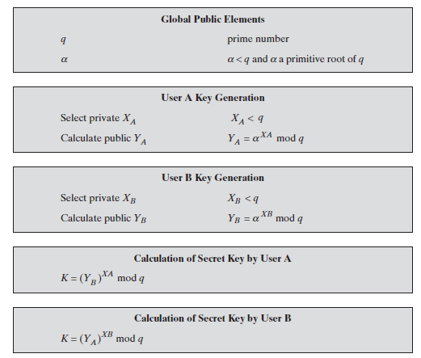
The Diffie-Hellman Key Exchange Algorithm

Slide 8
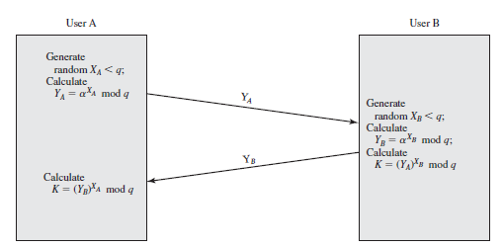
Diffie-Hellman Key Exchange

Slide 9


Diffie-Hellman Key Exchange
Alice A
Public Parameters:
large prime q
primitive root a
Bob
B
Choose a secret X_{A}
Compute Y_{A} = a^{XA} mod q
Send Y_{A}
Choose a secret X_{B}
Compute Y_{B} = a^{XB} mod q
Send Y_{B}
Shared Key
K_{AB} = Y_{B} ^{XA}
= a ^{XBXA} mod q
Shared Key
K_{AB} = Y_{A} ^{X}B
= a ^{XAXB} mod q

Slide 10
Diffie-Hellman Example
users Alice & Bob who wish to swap keys:
agree on prime q=353 and α=3
select random secret keys:
A chooses x_{A}=97, B chooses x_{B}=233
compute public keys:
y_{A}=3⁹⁷ mod 353 = 40 (Alice)
y_{B}=3²³³ mod 353 = 248 (Bob)
compute shared session key as:
K_{AB}= y_{B}^{xA} mod 353 = 248⁹⁷ = 160 (Alice)
K_{AB}= y_{A}^{xB} mod 353 = 40²³³ = 160 (Bob)

Slide 11
Example 2
Alice and Bob get public numbers
q = 23, α = 9
select random secret keys:
A chooses x_{A}=4, B chooses x_{B}=3
Alice and Bob compute public values
y_{A}= 9⁴ mod 23 = 6561 mod 23 (Alice)
y_{B}= 9³ mod 23 = 729 mod 23 (Bob)
Alice and Bob exchange public numbers

Slide 12
Example 2
Bob compute symmetric keys
K_{AB} = y_{B}^{xA} mod q = 16⁴ mod 23 = 9
K_{AB} = y_{A}^{xB} mod q = 6³ mod 23 = 9
Alice and Bob now can talk securely!

Slide 13
Man-in-the-Middle Attack
Alice A
Attacker
Bob
B
Man-in-the-middle attacker shared a key between Alice and Bob.

Slide 14
Man-in-the-Middle Attack
Suppose Alice and Bob wish to exchange keys, and Darth is the adversary. The attack proceeds as follows:
Darth prepares for the attack by generating two random private keys X_{D1} and X_{D2} and then computing the corresponding public keys Y_{D1} and Y_{D2}
Alice transmits Y_{A} to Bob.
Darth intercepts Y_{A} and transmits Y_{D1} to Bob. Darth also calculates K2 = (Y_{A} )^ X_{D2} mod q

Slide 15
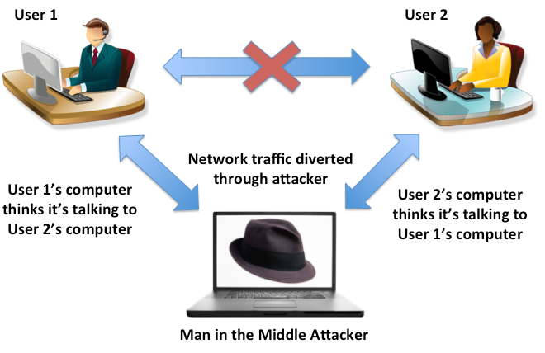
Man-in-the-Middle Attack
Bob receives Y_{D1} and calculates K1=(Y_{D1} )^ X_{B} mod q
Bob transmits Y_{B} to Alice.
Darth intercepts Y_{B} and transmits Y_{D2} to Alice. Darth calculates K1=(Y_{B} )^ X_{D1} mod q
Alice receives Y_{D2} and calculates K2=(Y_{D2} )^ X_{A} mod q .

Slide 16
Man-in-the-Middle Attack
Bob and Alice think that they share a secret key, but instead Bob and Darth share secret key K1 and Alice and Darth share secret key K2.
All future communication between Bob and Alice is compromised in the following way:
Alice sends an encrypted message M: E(K2, M).
Darth intercepts the encrypted message and decrypts it, to recover M.
Darth sends Bob E(K1, M) or E(K1, M'), where M' is any message.
In the first case, Darth simply wants to eavesdrop on the communication without altering it.
In the second case, Darth wants to modify the message going to Bob.

Slide 17
Applications
Diffie-Hellman is currently used in many protocols, namely:
Secure Sockets Layer (SSL)/Transport Layer Security (TLS)
Internet Protocol Security (IPSec)
Public Key Infrastructure (PKI)

Slide 18
Drawback and solution
The key exchange protocol is vulnerable to such an attack because it does not authenticate the participants.
This vulnerability can be overcome with the use of digital signatures and public-key certificates

