Slide 1
Chapter 7
Performance Analysis

Slide 2
Additional References
Selim Akl, “Parallel Computation: Models and Methods”, Prentice Hall, 1997, Updated online version available through website.
(Textbook),Michael Quinn, Parallel Programming in C with MPI and Open MP, McGraw Hill, 2004.
Barry Wilkinson and Michael Allen, “Parallel Programming: Techniques and Applications Using Networked Workstations and Parallel Computers ”, Prentice Hall, First Edition 1999 or Second Edition 2005, Chapter 1..
Michael Quinn, Parallel Computing: Theory and Practice, McGraw Hill, 1994.

Slide 3
Learning Objectives
Predict performance of parallel programs
  Accurate predictions of the performance of a parallel algorithm helps determine whether coding it is worthwhile.
Understand barriers to higher performance
  Allows you to determine how much improvement can be realized by increasing the number of processors used.

Slide 4
Outline
Speedup
Superlinearity Issues
Speedup Analysis
Cost
Efficiency
Amdahl’s Law
Gustafson’s Law (not the Gustafson-Baris’s Law)
Amdahl Effect

Slide 5
Speedup
Speedup measures increase in running time due to parallelism. The number of PEs is given by n.
Based on running times, S(n) = t_{s}/t_{p} , where
  t_{s} is the execution time on a single processor, using the fastest known sequential algorithm
  t_{p} is the execution time using a parallel processor.
For theoretical analysis, S(n) = t_{s}/t_{p} where
  t_{s} is the worst case running time for of the fastest known sequential algorithm for the problem
  t_{p} is the worst case running time of the parallel algorithm using n PEs.

Slide 6
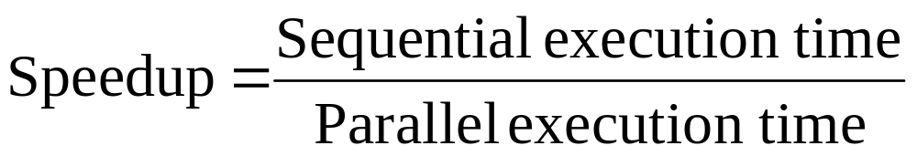
Speedup in Simplest Terms
Quinn’s notation for speedup is
Ψ(n,p)
for data size n and p processors.

Slide 7
Linear Speedup Usually Optimal
Speedup is linear if S(n) = Θ(n)
Theorem: The maximum possible speedup for parallel computers with n PEs for “traditional problems” is n.
Proof:
  Assume a computation is partitioned perfectly into n processes of equal duration.
  Assume no overhead is incurred as a result of this partitioning of the computation – (e.g., partitioning process, information passing, coordination of processes, etc),
  Under these ideal conditions, the parallel computation will execute n times faster than the sequential computation.
  The parallel running time is t_{s} /n.
  Then the parallel speedup of this computation is
  S(n) = t_{s} /(t_{s} /n) = n

Slide 8
Linear Speedup Usually Optimal (cont)
We shall later see that this “proof” is not valid for certain types of nontraditional problems.
Unfortunately, the best speedup possible for most applications is much smaller than n
  The optimal performance assumed in last proof is unattainable.
  Usually some parts of programs are sequential and allow only one PE to be active.
  Sometimes a large number of processors are idle for certain portions of the program.
    During parts of the execution, many PEs may be waiting to receive or to send data.
    E.g., recall blocking can occur in message passing

Slide 9
Superlinear Speedup
Superlinear speedup occurs when S(n) > n
Most texts besides Akl’s and Quinn’s argue that
  Linear speedup is the maximum speedup obtainable.
    The preceding “proof” is used to argue that superlinearity is always impossible.
  Occasionally speedup that appears to be superlinear may occur, but can be explained by other reasons such as
    the extra memory in parallel system.
    a sub-optimal sequential algorithm used.
    luck, in case of algorithm that has a random aspect in its design (e.g., random selection)

Slide 10
Superlinearity (cont)
Selim Akl has given a multitude of examples that establish that superlinear algorithms are required for many nonstandad problems
  If a problem either cannot be solved or cannot be solved in the required time without the use of parallel computation, it seems fair to say that t_{s}=∞.
    Since for a fixed t_{p}>0, S(n) = t_{s}/t_{p} is greater than 1 for all sufficiently large values of t_{s}, it seems reasonable to consider these solutions to be “superlinear”.
  Examples include “nonstandard” problems involving
    Real-Time requirements where meeting deadlines is part of the problem requirements.
    Problems where all data is not initially available, but has to be processed after it arrives.
    Real life situations such as a “person who can only keep a driveway open during a severe snowstorm with the help of friends”.
  Some problems are natural to solve using parallelism and sequential solutions are inefficient.

Slide 11
Superlinearity (cont)
The last chapter of Akl’s textbook and several journal papers by Akl were written to establish that superlinearity can occur.
  It may still be a long time before the possibility of superlinearity occurring is fully accepted.
  Superlinearity has long been a hotly debated topic and is unlikely to be widely accepted quickly.
For more details on superlinearity, see [2] “Parallel Computation: Models and Methods”, Selim Akl, pgs 14-20 (Speedup Folklore Theorem) and Chapter 12.
This material is covered in more detail in my PDA class.

Slide 12
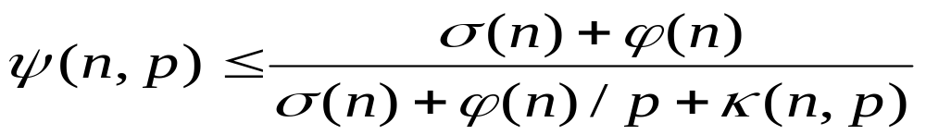
Speedup Analysis
Recall speedup definition: Ψ(n,p) = t_{s}/t_{p}
A bound on the maximum speedup is given by
  Inherently sequential computations are σ(n)
  Potentially parallel computations are ϕ(n)
  Communication operations are κ(n,p)
  The “≤” bound above is due to the assumption in formula that the speedup of the parallel portion of computation will be exactly p.
  Note κ(n,p) =0 for SIMDs, since communication steps are usually included with computation steps.

Slide 13
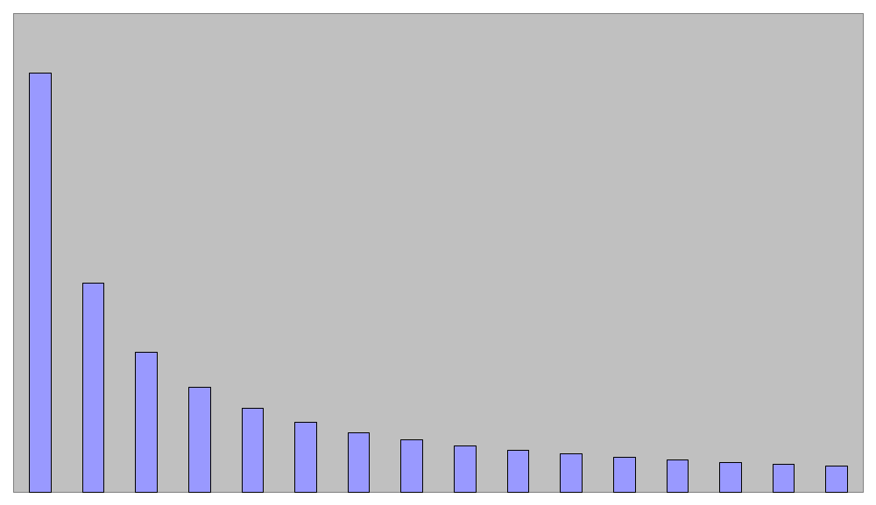
Execution time for parallel portion ϕ(n)/p
time
processors
Shows nontrivial parallel algorithm’s computation component as a decreasing function of the number of processors used.

Slide 14
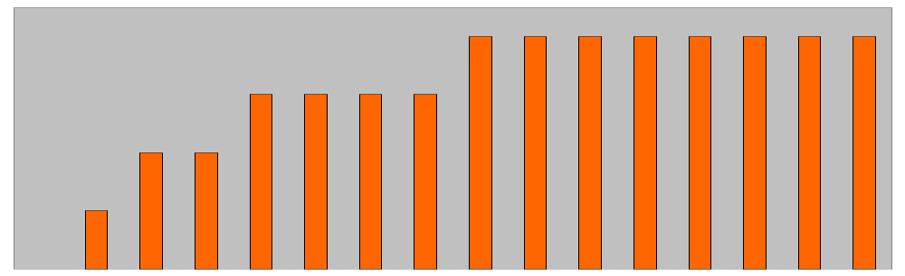
Time for communication κ(n,p)
time
processors
Shows a nontrivial parallel algorithm’s communication component as an increasing function of the number of processors.

Slide 15
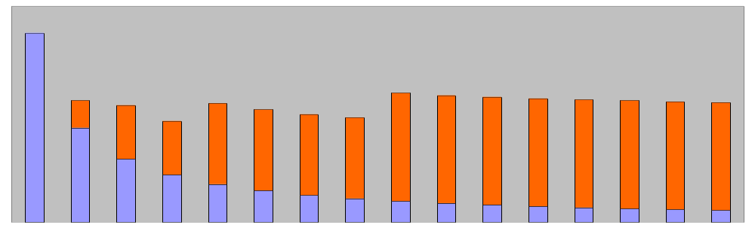
Execution Time of Parallel Portion ϕ(n)/p + κ(n,p)
time
processors
Combining these, we see for a fixed problem size, there is an optimum number of processors that minimizes overall execution time.

Slide 16
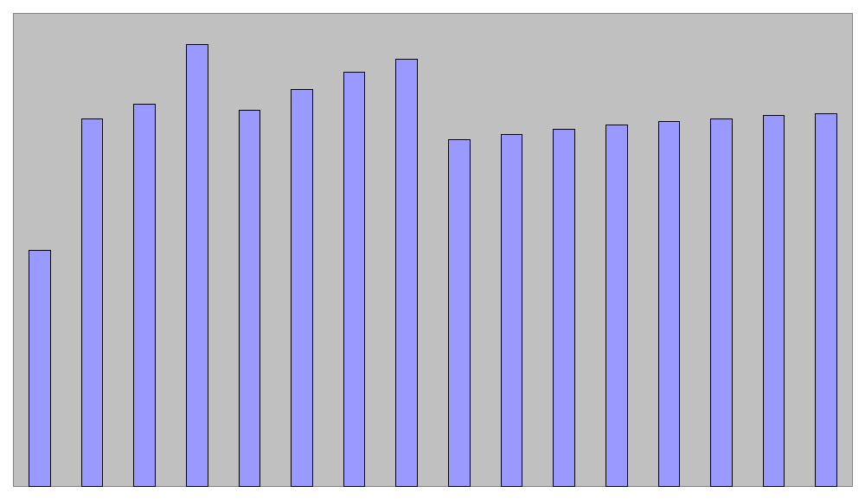
Speedup Plot
“elbowing out”
speedup
processors

Slide 17
Performance Metric Comments
The performance metrics introduced in this chapter apply to both parallel algorithms and parallel programs.
  Normally we will use the word “algorithm”
The terms parallel running time and parallel execution time have the same meaning
The complexity the execution time of a parallel program depends on the algorithm it implements.

Slide 18
Cost
The cost of a parallel algorithm (or program) is
Cost = Parallel running time × #processors
Since “cost” is a much overused word, the term “algorithm cost” is sometimes used for clarity.
The cost of a parallel algorithm should be compared to the running time of a sequential algorithm.
  Cost removes the advantage of parallelism by charging for each additional processor.
  A parallel algorithm whose cost is big-oh of the running time of an optimal sequential algorithm is called cost-optimal.

Slide 19
Cost Optimal
From last slide, a parallel algorithm is optimal if
  parallel cost = O(f(t)),
where f(t) is the running time of an optimal sequential algorithm.
Equivalently, a parallel algorithm for a problem is said to be cost-optimal if its cost is proportional to the running time of an optimal sequential algorithm for the same problem.
  By proportional, we mean that
  cost ≡ t_{p} × n = k × t_{s}
  where k is a constant and n is no. of processors.
In cases where no optimal sequential algorithm is known, then the “fastest known” sequential algorithm is sometimes used instead.

Slide 20
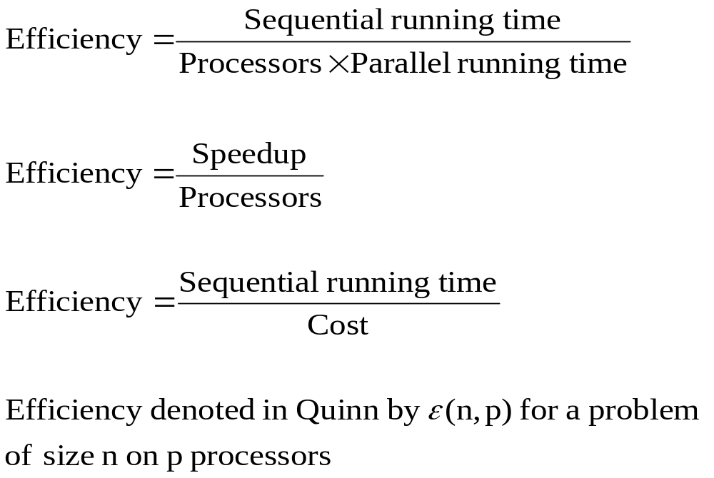
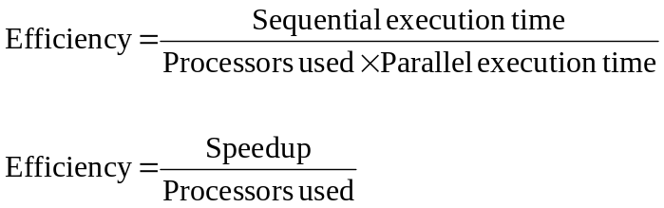
Efficiency

Slide 21
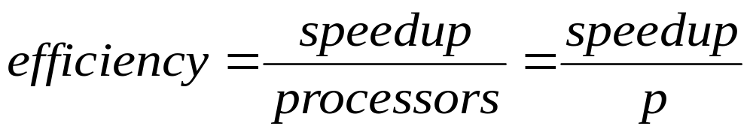
Bounds on Efficiency
Recall
(1)
For algorithms for traditional problems, superlinearity is not possible and
(2) speedup ≤ processors
Since speedup ≥ 0 and processors > 1, it follows from the above two equations that
0 ≤ ε(n,p) ≤ 1
Algorithms for non-traditional problems also satisfy 0 ≤ ε(n,p). However, for superlinear algorithms if follows that ε(n,p) > 1 since speedup > p.

Slide 22
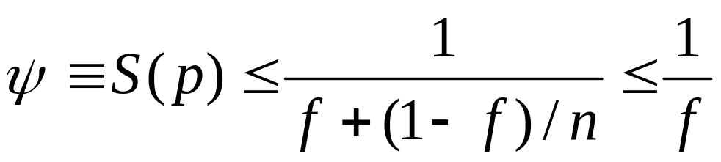
Amdahl’s Law
Let f be the fraction of operations in a computation that must be performed sequentially, where 0 ≤ f ≤ 1. The maximum speedup ψ achievable by a parallel computer with n processors is
The word “law” is often used by computer scientists when it is an observed phenomena (e.g, Moore’s Law) and not a theorem that has been proven in a strict sense.
However, Amdahl’s law can be proved for traditional problems

Slide 23
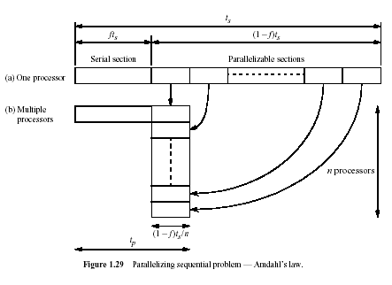
Proof for Traditional Problems: If the fraction of the computation that cannot be divided into concurrent tasks is f, and no overhead incurs when the computation is divided into concurrent parts, the time to perform the computation with n processors is given by t_{p} ≥ ft_{s} + [(1 - f )t_{s}] / n, as shown below:

Slide 24
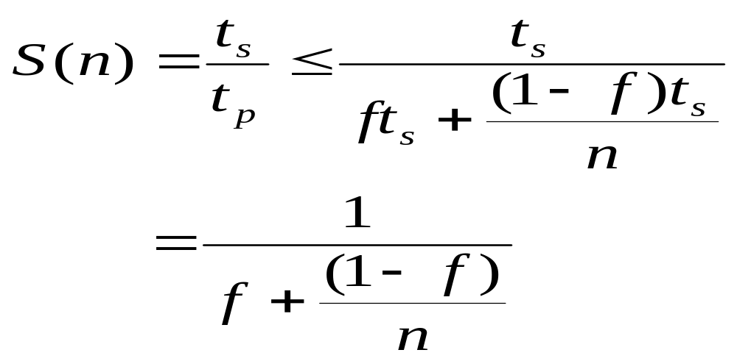
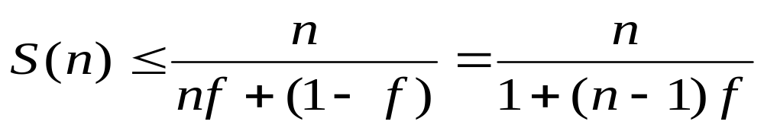
Proof of Amdahl’s Law (cont.)
Using the preceding expression for t_{p}
The last expression is obtained by dividing numerator and denominator by t_{s} , which establishes Amdahl’s law.
Multiplying numerator & denominator by n produces the following alternate version of this formula:

Slide 25
Amdahl’s Law
Preceding proof assumes that speedup can not be superliner; i.e.,
S(n) = t_{s}/ t_{p} ≤ n
  Assumption only valid for traditional problems.
  Question: Where is this assumption used?
The pictorial portion of this argument is taken from chapter 1 of Wilkinson and Allen
Sometimes Amdahl’s law is just stated as
S(n) ≤ 1/f
Note that S(n) never exceeds 1/f and approaches 1/f as n increases.

Slide 26
Consequences of Amdahl’s Limitations to Parallelism
For a long time, Amdahl’s law was viewed as a fatal flaw to the usefulness of parallelism.
Amdahl’s law is valid for traditional problems and has several useful interpretations.
Some textbooks show how Amdahl’s law can be used to increase the efficiency of parallel algorithms
  See Reference (16), Jordan & Alaghband textbook
Amdahl’s law shows that efforts required to further reduce the fraction of the code that is sequential may pay off in large performance gains.
Hardware that achieves even a small decrease in the percent of things executed sequentially may be considerably more efficient.

Slide 27
Limitations of Amdahl’s Law
  A key flaw in past arguments that Amdahl’s law is a fatal limit to the future of parallelism is
    Gustafon’s Law: The proportion of the computations that are sequential normally decreases as the problem size increases.
      Note: Gustafon’s law is a “observed phenomena” and not a theorem.
  Other limitations in applying Amdahl’s Law:
    Its proof focuses on the steps in a particular algorithm, and does not consider that other algorithms with more parallelism may exist
    Amdahl’s law applies only to ‘standard’ problems were superlinearity can not occur

Slide 28
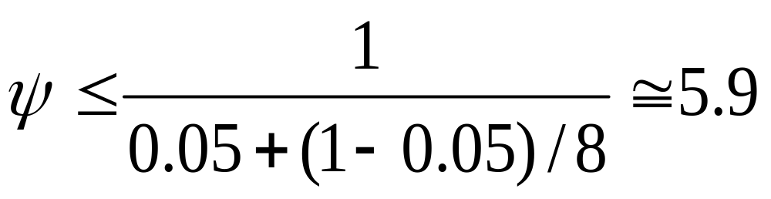
Example 1
95% of a program’s execution time occurs inside a loop that can be executed in parallel. What is the maximum speedup we should expect from a parallel version of the program executing on 8 CPUs?

Slide 29
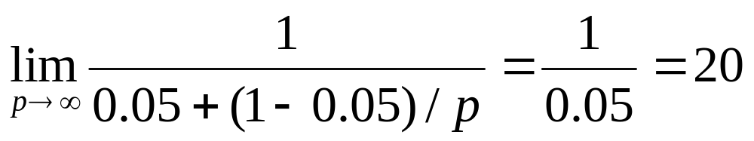
Example 2
5% of a parallel program’s execution time is spent within inherently sequential code.
The maximum speedup achievable by this program, regardless of how many PEs are used, is

Slide 30
Pop Quiz
An oceanographer gives you a serial program and asks you how much faster it might run on 8 processors. You can only find one function amenable to a parallel solution. Benchmarking on a single processor reveals 80% of the execution time is spent inside this function. What is the best speedup a parallel version is likely to achieve on 8 processors?
Answer: 1/(0.2 + (1 - 0.2)/8) ≅ 3.3

Slide 31
Other Limitations of Amdahl’s Law
Recall
Amdahl’s law ignores the communication cost κ(n,p)n in MIMD systems.
  This term does not occur in SIMD systems, as communications routing steps are deterministic and counted as part of computation cost.
On communications-intensive applications, even the κ(n,p) term does not capture the additional communication slowdown due to network congestion.
As a result, Amdahl’s law usually overestimates speedup achievable

Slide 32
Amdahl Effect
Typically communications time κ(n,p) has lower complexity than ϕ(n)/p (i.e., time for parallel part)
As n increases, ϕ(n)/p dominates κ(n,p)
As n increases,
  sequential portion of algorithm decreases
  speedup increases
Amdahl Effect: Speedup is usually an increasing function of the problem size.

Slide 33
Illustration of Amdahl Effect
Speedup
n = 10,000
n = 1,000
n = 100
Processors

Slide 34
Review of Amdahl’s Law
Treats problem size as a constant
Shows how execution time decreases as number of processors increases
The limitations established by Amdahl’s law are both important and real.
  Currently, it is generally accepted by parallel computing professionals that Amdahl’s law is not a serious limit to the benefit and future of parallel computing.

Slide 35
The Isoefficiency Metric
(Terminology)
Parallel system – a parallel program executing on a parallel computer
Scalability of a parallel system - a measure of its ability to increase performance as number of processors increases
A scalable system maintains efficiency as processors are added
Isoefficiency - a way to measure scalability

Slide 36
Notation Needed for the
Isoefficiency Relation
n data size
p number of processors
T(n,p) Execution time, using p processors
Ψ(n,p) speedup
σ(n) Inherently sequential computations
ϕ(n) Potentially parallel computations
κ(n,p) Communication operations
ε(n,p) Efficiency
Note: At least in some printings, there appears to be a misprint on page 170 in Quinn’s textbook, with ϕ(n) being sometimes replaced with φ(n). To correct, simply replace each φ with ϕ.

Slide 37
Isoefficiency Concepts
T₀(n,p) is the total time spent by processes doing work not done by sequential algorithm.
T₀(n,p) = (p-1)σ(n) + pκ(n,p)
We want the algorithm to maintain a constant level of efficiency as the data size n increases. Hence, ε(n,p) is required to be a constant.
Recall that T(n,1) represents the sequential execution time.

Slide 38
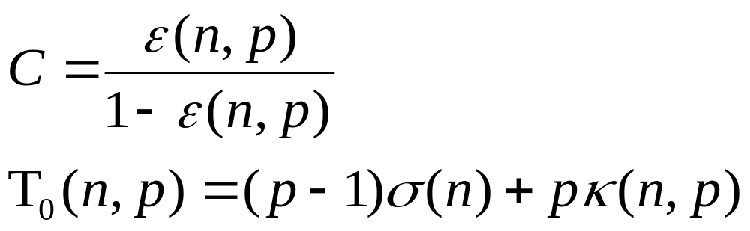
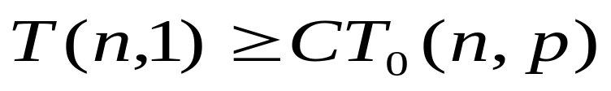
The Isoefficiency Relation
Suppose a parallel system exhibits efficiency ε(n,p). Define
In order to maintain the same level of efficiency as the number of processors increases, n must be increased so that the following inequality is satisfied.

Slide 39
Isoefficiency Relation Derivation
(See page 170-17 in Quinn)
MAIN STEPS:
Begin with speedup formula
Compute total amount of overhead
Assume efficiency remains constant
Determine relation between sequential execution time and overhead

Slide 40
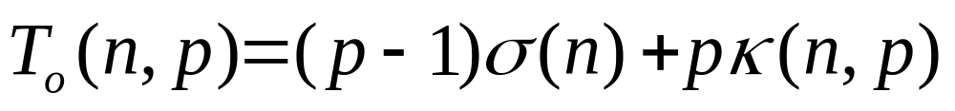
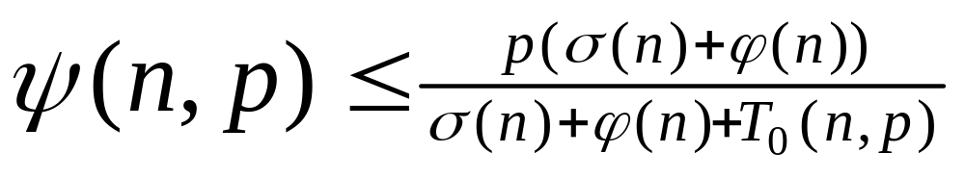
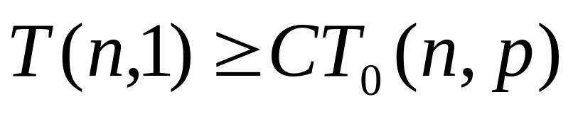
Deriving Isoefficiency Relation
(see Quinn, pgs 170-17)
Determine overhead
Substitute overhead into speedup equation
Substitute T(n,1) = σ(n) + ϕ(n). Assume efficiency is constant.
Isoefficiency Relation

Slide 41
Isoefficiency Relation Usage
Used to determine the range of processors for which a given level of efficiency can be maintained
The way to maintain a given efficiency is to increase the problem size when the number of processors increase.
The maximum problem size we can solve is limited by the amount of memory available
The memory size is a constant multiple of the number of processors for most parallel systems

Slide 42
The Scalability Function
Suppose the isoefficiency relation reduces to n ≥ f(p)
Let M(n) denote memory required for problem of size n
M(f(p))/p shows how memory usage per processor must increase to maintain same efficiency
We call M(f(p))/p the scalability function [i.e., scale(p) = M(f(p))/p) ]

Slide 43
Meaning of Scalability Function
To maintain efficiency when increasing p, we must increase n
Maximum problem size is limited by available memory, which increases linearly with p
Scalability function shows how memory usage per processor must grow to maintain efficiency
If the scalability function is a constant this means the parallel system is perfectly scalable

Slide 44
Interpreting Scalability Function
Cplogp
Cannot maintain
efficiency
Cp
Memory Size
Memory needed per processor
Can maintain
efficiency
Clogp
C
Number of processors

Slide 45
Example 1: Reduction
Sequential algorithm complexity
T(n,1) = Θ(n)
Parallel algorithm
  Computational complexity = Θ(n/p)
  Communication complexity = Θ(log p)
Parallel overhead
T₀(n,p) = Θ(p log p)

Slide 46
Reduction (continued)
Isoefficiency relation: n ≥ C p log p
We ask: To maintain same level of efficiency, how must n increase when p increases?
Since M(n) = n,
The system has good scalability

Slide 47
Example 2: Floyd’s Algorithm
(Chapter 6 in Quinn Textbook)
Sequential time complexity: Θ(n³)
Parallel computation time: Θ(n³/p)
Parallel communication time: Θ(n²log p)
Parallel overhead: T₀(n,p) = Θ(pn²log p)

Slide 48
Floyd’s Algorithm (continued)
Isoefficiency relation
n³ ≥ C(p n³ log p) ⇒ n ≥ C p log p
M(n) = n²
The parallel system has poor scalability

Slide 49
Example 3: Finite Difference
See Figure 7.5
Sequential time complexity per iteration: Θ(n²)
Parallel communication complexity per iteration: Θ(n/√p)
Parallel overhead: Θ(n √p)

Slide 50
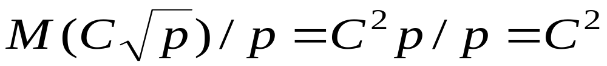
Finite Difference (continued)
Isoefficiency relation
n² ≥ Cn√p ⇒ n ≥ C√ p
M(n) = n²
This algorithm is perfectly scalable

Slide 51
Summary (1)
Performance terms
  Running Time
  Cost
  Efficiency
  Speedup
Model of speedup
  Serial component
  Parallel component
  Communication component

Slide 52
Summary (2)
Some factors preventing linear speedup?
  Serial operations
  Communication operations
  Process start-up
  Imbalanced workloads
  Architectural limitations

