Slide 1
Matching Jobs to Virtual Machines in Cloud Based Environments
Kristen Hines and Ferdinando Romano
12/09/2014

Slide 2
Agenda
Introduction and Background
Problem Formulation
Proposed Algorithm
Results
Future Work

Slide 3
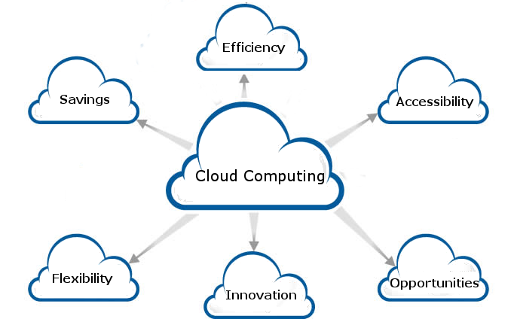
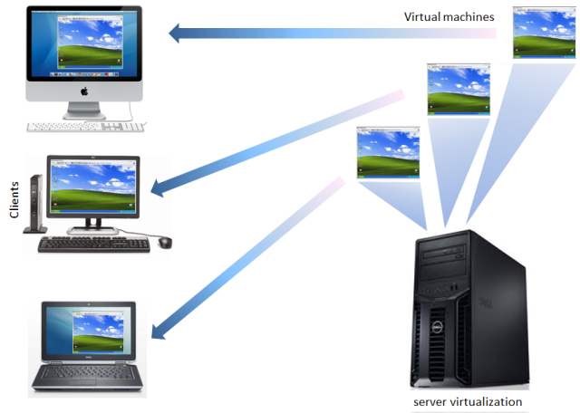
Introduction and Background
What is cloud computing, and why have virtual machines?
How is matching theory involved?
  College admissions game and coscheduling jobs
http://cdn2.hubspot.net/hub/108327/file-16345614-png/images/6_benefits_of_cloud_computing.png
http://securityaffairs.co/wordpress/wp-content/uploads/2014/08/virtual_machines.png
Notes:
Cloud computing: computing in which large groups of remote servers are networked to allow centralized data storage and online access to computer services or resources
Virtual machines: emulation of a particular computer system. Virtual machines operate based on the computer architecture and functions of a real or hypothetical computer, and their implementations may involve specialized hardware, software, or a combination of both.
Virtualization technology provides for composing elastic virtual machines by virtualizing physical resources (processors, main memory, storage, so on). An individual application can run on one or more virtual machines, and these virtual machines can be fine-tuned to optimize the performance of those applications. Cloud computing allows for this virtualization technology to reach more people.
How can matching theory be used:
Matching jobs to appropriate virtual machines.
Alleviating performance degradation when virtual machines start interfering with each other.

Slide 4
Problem Formulation
How can we optimize assignment of jobs to separate compute clusters where
  Each job’s performance is different for different processor types
  Each cluster has a different number of processor types
  Each job can only be divided into some (different) finite number of threads

Slide 5
Problem Formulation Continued
Like College Admissions Game, except
  Institutions have multiple quotas of different types
  Each applicant can fill multiple slots of different types
  Students prefer some slot types over others
  An applicant can’t be divided between multiple institutions

Slide 6
Key Assumptions
Treating multiple virtual machines as ‘flexible computers’
  They don’t interfere with each other
  Processor performance is decided as an initial condition
Jobs are submitted at the same time
Chosen jobs are completed simultaneously
The unchosen jobs are candidates for a next round and not retracted

Slide 7
Proposed Algorithm
1. Calculate preferences of jobs and computers.
  Jobs prefer fastest computers considering available processors.
  Computers prefer jobs that maximize processor utilization.
    i.e. Those that can use the most of the computer’s remaining available processors.
    Incentivizes jobs to optimize threading.
    Proportional Fair: Matching not affected by job length/complexity.
      Larger jobs still take longer. Smaller jobs are still shorter.
    Minimizes total completion time for all jobs.

Slide 8
Proposed Algorithm Continued
Perform 1-1 matching (College Admissions Matching quotas set to 1).
Determine ‘most important’ matching (Job with most processor utilization)
  Designate this pair as optimal and remove job and associated processors from running
Return to step 1. and continue until all processors are utilized or all jobs are matched.

Slide 9
Test Cases
Optimality of Proposed Algorithm can be evaluated against:
  Random Matching (First-come, first-served)
  Simple Matching
    Leftover jobs are placed in queues.
  Modified proposed algorithm
    Use each round of College Admissions Matching as finalized matching.
  Modified proposed algorithm
    Each job restricted to X processors, regardless of ability to use more
    If X = 1 → College Admissions Game

Slide 10
Example Results
Inputs:

Slide 11
Future Work
Prove stability and optimality
Creating more metrics to compare the cases
  Resource allocation
  Speed performance
Consider other factors in job-computer matching
  Software Licensing
  Estimated job length/complexity
Consider another modified College Admissions Game
  Institutions have quotas of different types. (Same as current work)
  Applicants can only fill slots of certain types. (Rather than preferences

Slide 12
Conclusion
Problem is attempting to match jobs in a cloud based environment.
Proposed algorithm can be applied to any matching situation with multiple quotas.
Questions?

Slide 13
Resources
Committee, Nobel Prize, 2012. "Alvin E. Roth and Lloyd S. Shapley: Stable matching: Theory, evidence, and practical design," Nobel Prize in Economics documents 2012-2, Nobel Prize Committee.
Dhillon, Jaspal, Suresh Purini, and Sanidhya Kashyap. "Virtual Machine Coscheduling: A Game Theoretic Approach." IEEE/ACM International Conference on Utility and Cloud Computing 6 (2013): 227-34. IEEExplore. Web..
Gale, D. "College Admissions and the Stability of Marriage." The American Mathematical Monthly 69.1 (1962): 9-15. JSTOR. Web.

