Slide 1

LVCP: A Load Value Correlated Predictor for TAGE-SC-L
Yang Man, Lingrui Gou, Yuhang Liu, Mingyu Chen, Yungang Bao
Institute of Computing Technology, CAS
2025-06-21
Championship Branch Prediction @ Tokyo, Japan

Slide 2
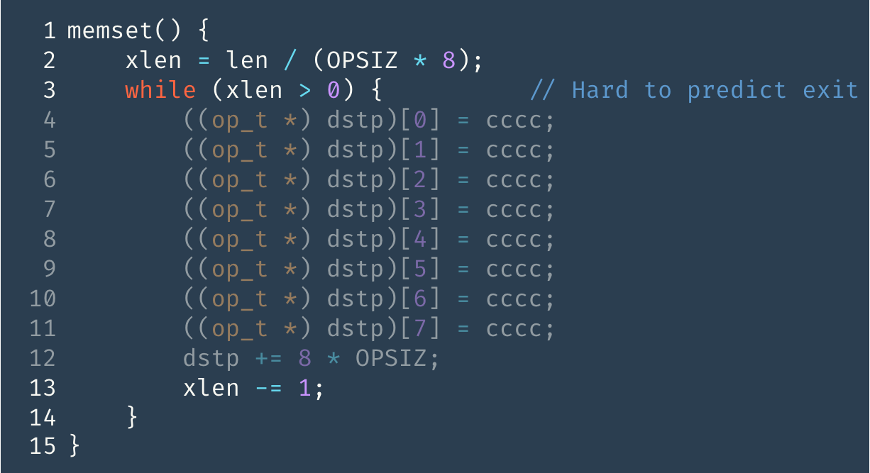
Motivation: Dynamic Size Loop Exit
Hard to predict with history.
Easy to predict with value.
Code snippet from glibc memset()
https://github.com/bminor/glibc/blob/0ef7965e5b251473f7d451739324c45b0fefaf1a/string/memset.c#L54

Slide 3
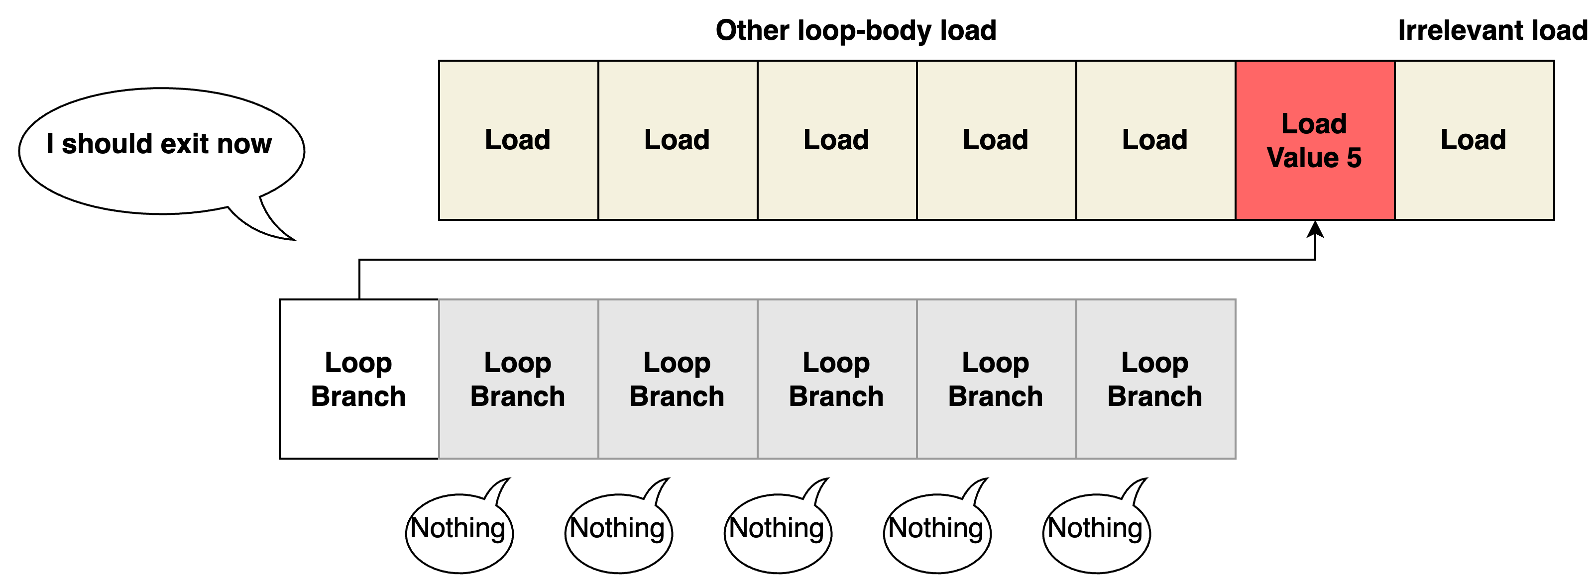
Motivation: Dynamic Size Loop Exit

Slide 4
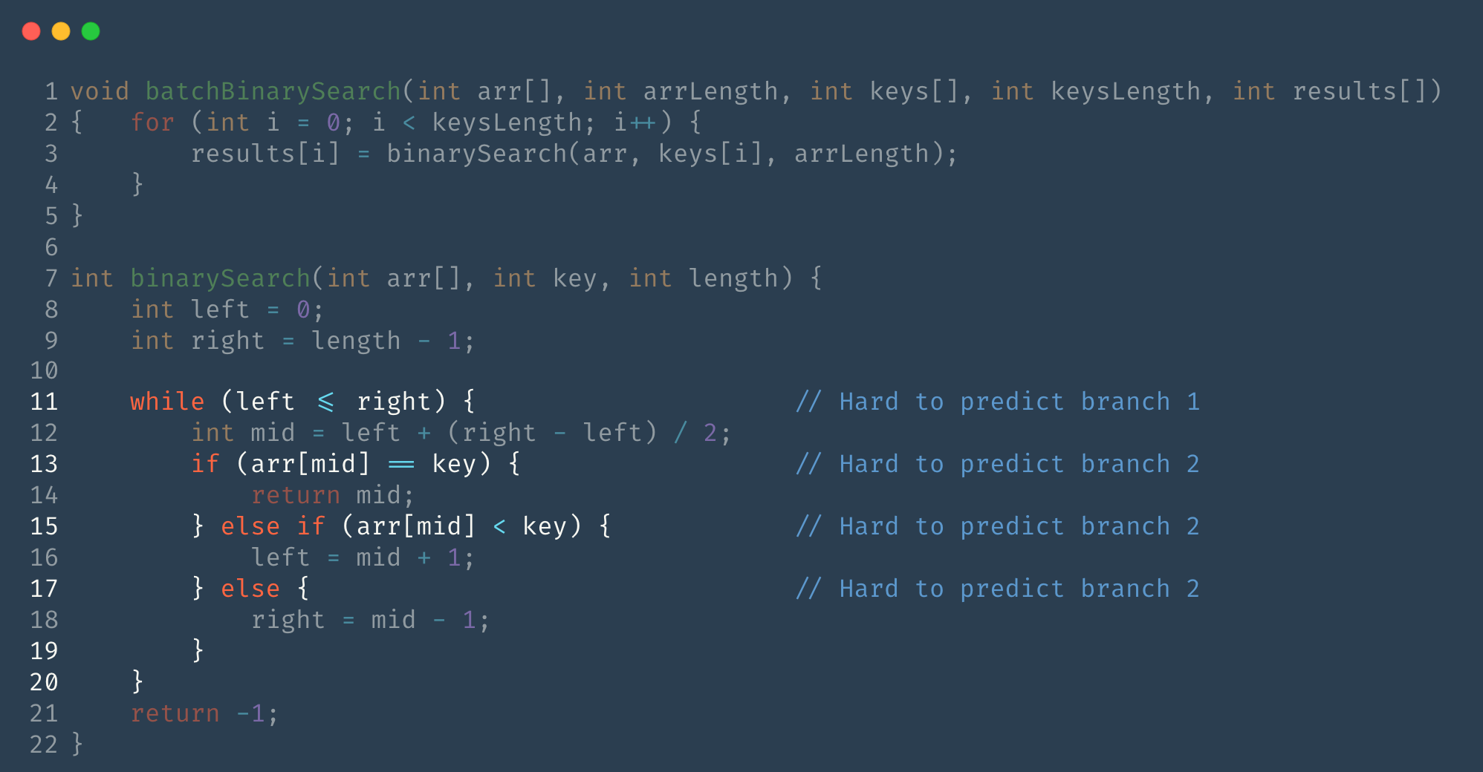
Motivation: Value Locality
Little correlation between branch instances.
The key value has locality -> predict a series of branches.

Slide 5
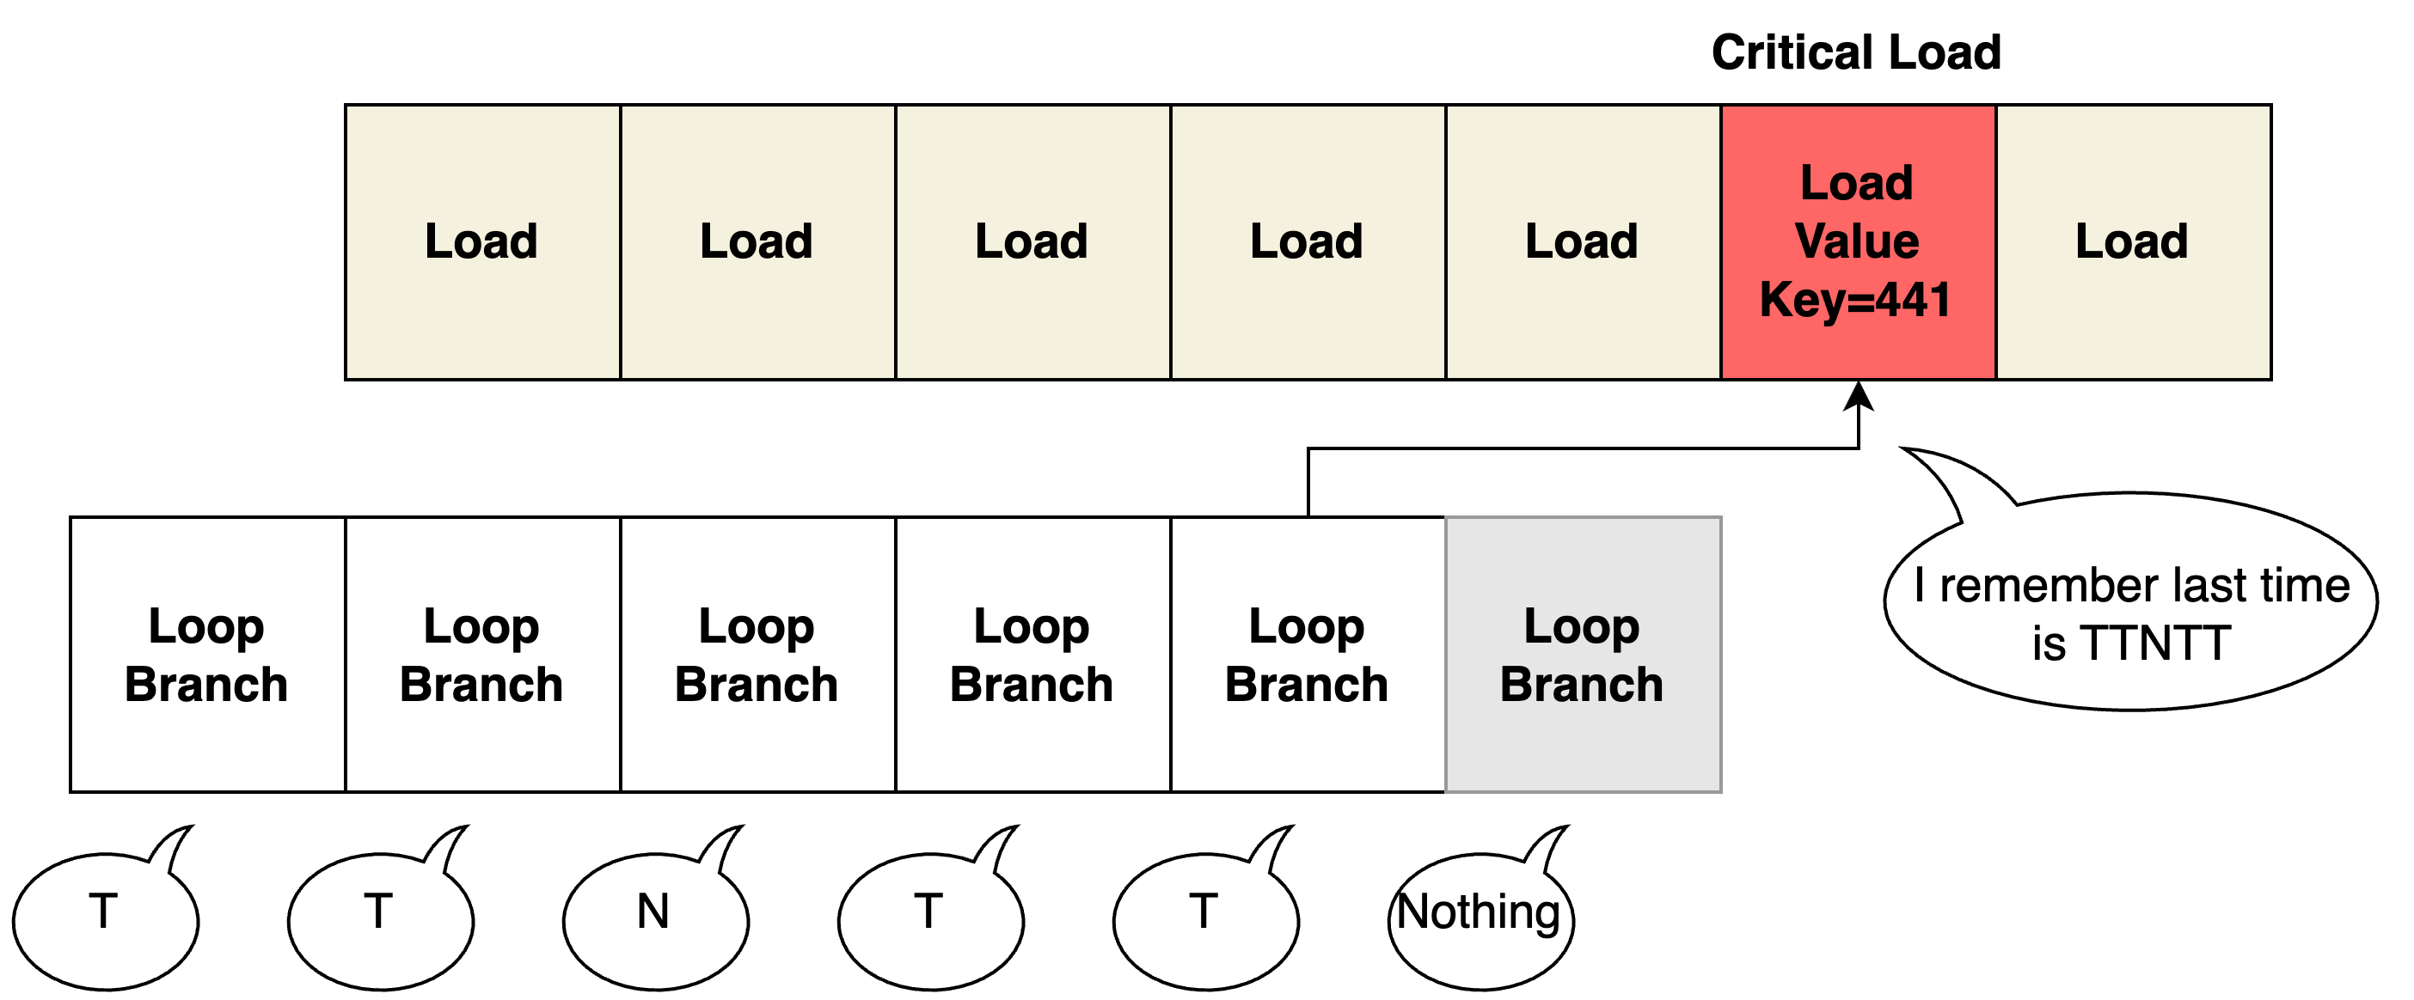
Motivation: Value Locality

Slide 6
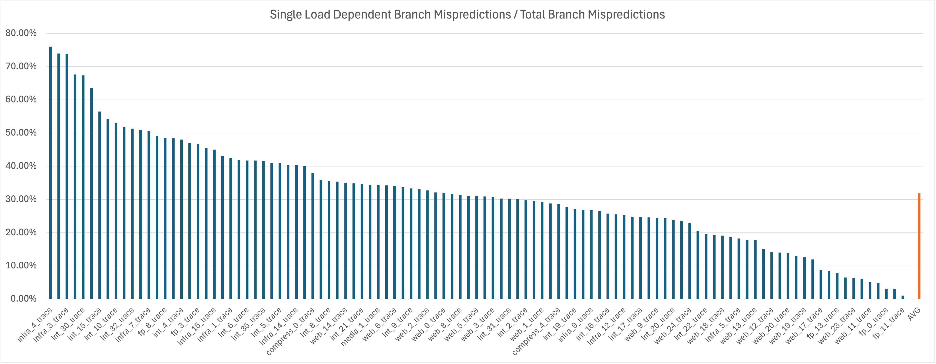
Opportunity
Significant amount (31.83%) of misprediction comes from single-load-dependent branches.
Notes:
This number is measure by using unlimited sized table to train correlation of a four-element tuple: a branch pc, a load pc, a load value and a distance between the branch and the load.
If the direction of a four-element tuple is stable, any misprediction of TAGE that the four-element tuple can correct is count as opportunity.
This opportunity is measured at commit time, so many of them is untimely and difficult to capture at predict time.
That is to say, the load value is not ready when the corresponding branch is being predicted.

Slide 7
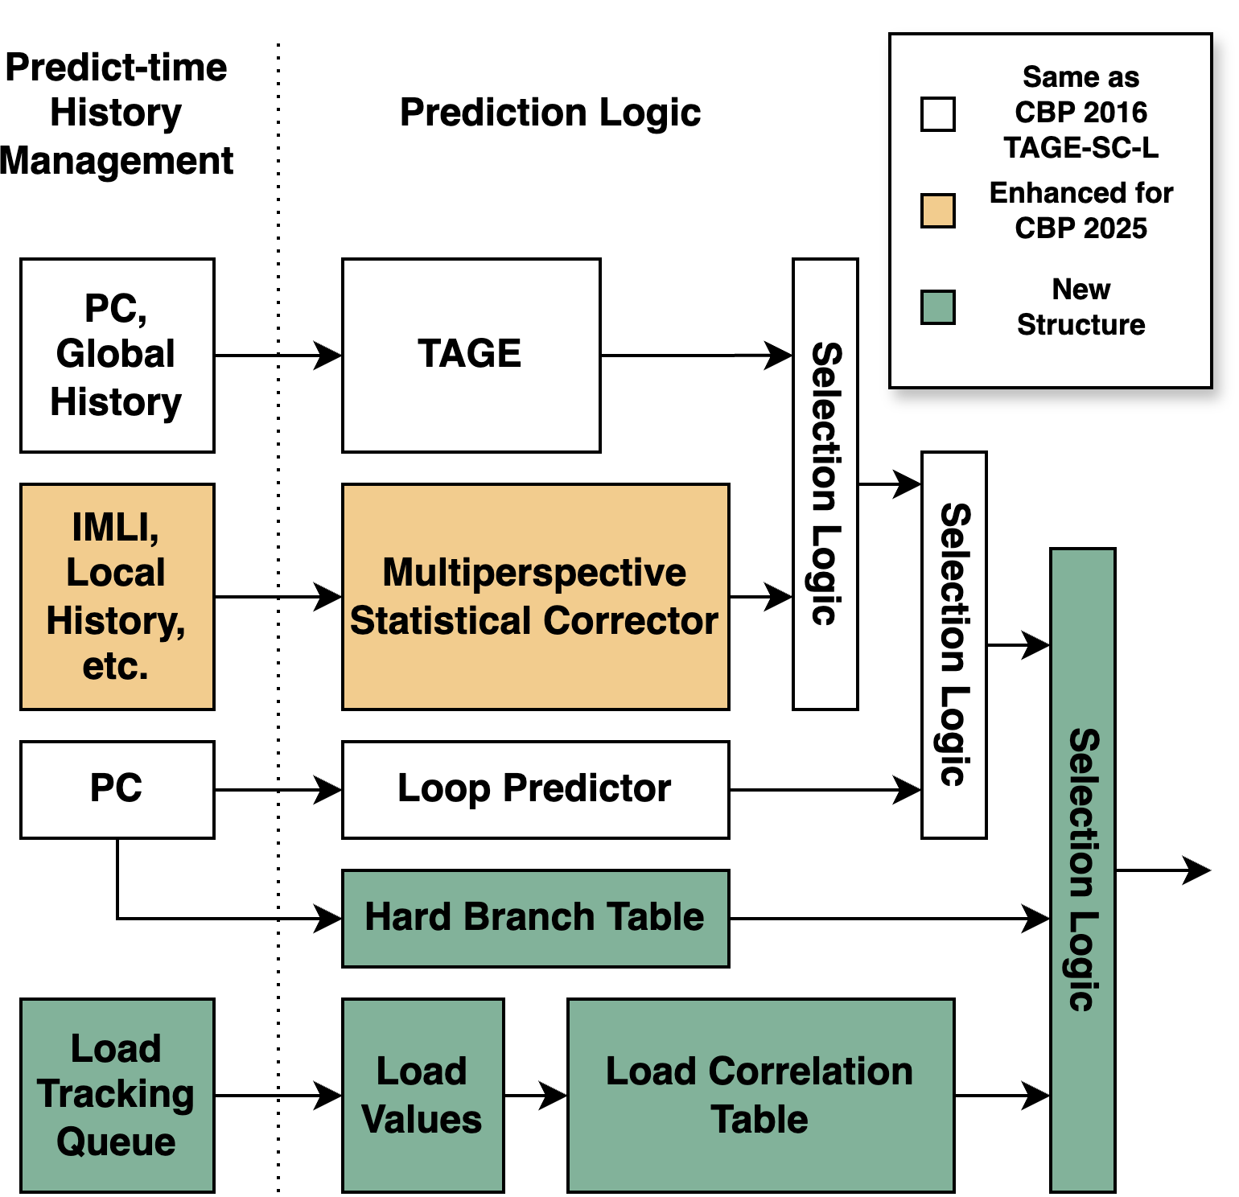
High-Level Architecture
Components accessed in parallel
Use a simple Hard Branch Table to filter out easy branches
If a branch is hard branch and load correlation table provides a prediction, this prediction is used
Otherwise TAGE-SC-L is used

Slide 8
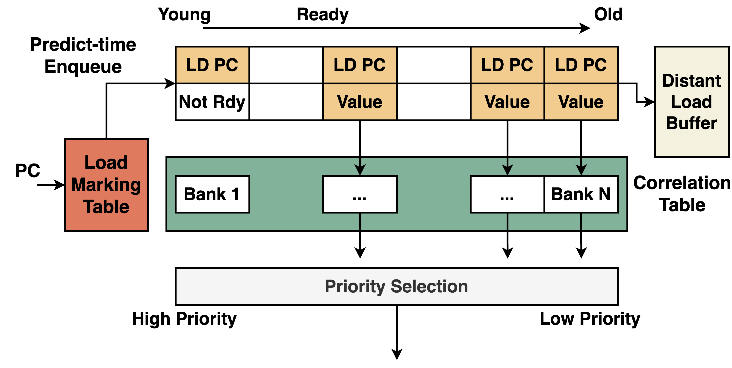
Load Tracking Structure
Notes:
16 entry load tracking queue.
Distant Load Buffer to capture long distance dependency

Slide 9
Load Value Correlated Prediction
Training
Allocates on mispredicted H2P branches
Probabilistic decay & useful counters to keep table fresh
Predicting
Youngest confident hit from queue
Otherwise smallest‑index hit from distant load buffer wins
Implementability
How to know there is a load: Load Marking Table

Slide 10
Multiperspective Statistical Corrector (MPSC)
Bias: same as CBP 2016
Global History: shared with IMLI
Local History
Per-branch: 32 history entries
Per-set: 16 history entries
Path History
Forward Path History
IMLI Filtered Backward Path History
IMLI
Regional IMLI
Forward IMLI
IMLI-OH

Slide 11
Experiment Setup
“Unreal” TAGE-SC-L: similar to CBP 2016, but tuned to 192KB
“Baseline” TAGE-SC-L: hardware implementable
Local history entries 2048 -> 48
IMLI-OH update time: immediately -> commit
Our TAGE-SC-L without LVCP: 173KB
LVC-TAGE-SC-L: +18.7KB LVCP

Slide 12
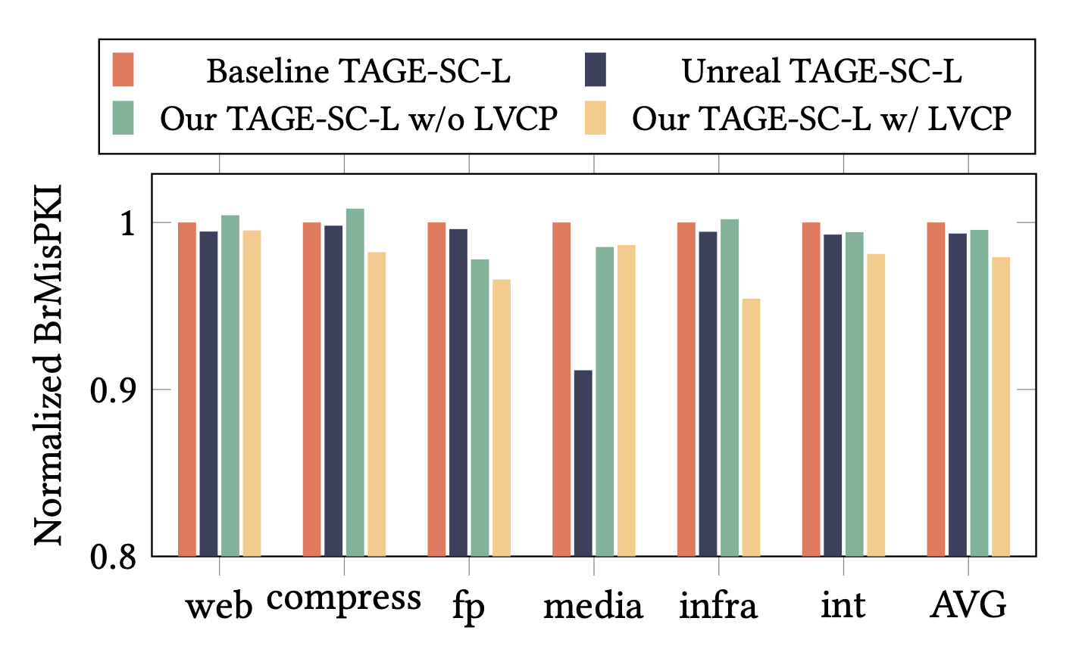
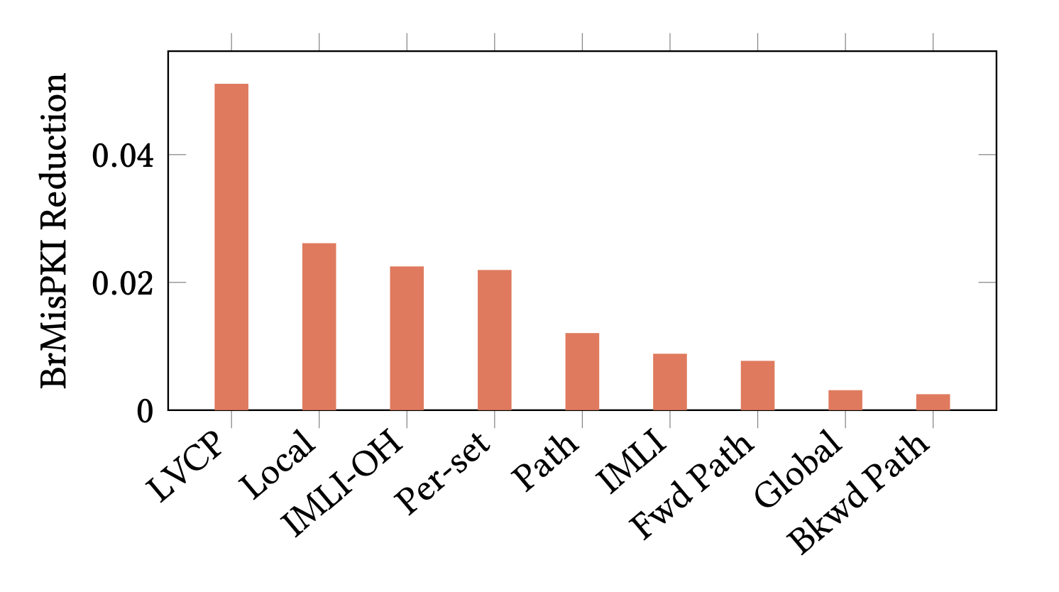
Experiment Result
Load value outperform all other smart SC features.

Slide 13
Conclusion
Good implementability
Iso-storage improvement of BrMisPKI 0.072 (2.07%)
Future improvement
Explore one-branch-multiple-load correlation
Better correlation tracking and training mechanism

Slide 14
Thanks！

