Slide 1


@botpavel26: Sing a song
https://github.com/brandonwarren/singsong

Slide 2

Concepts applied
Read the “Tweet”
Remove common words from tweet
Search for a song matching the tweet
Tweet the song to the user

Slide 3
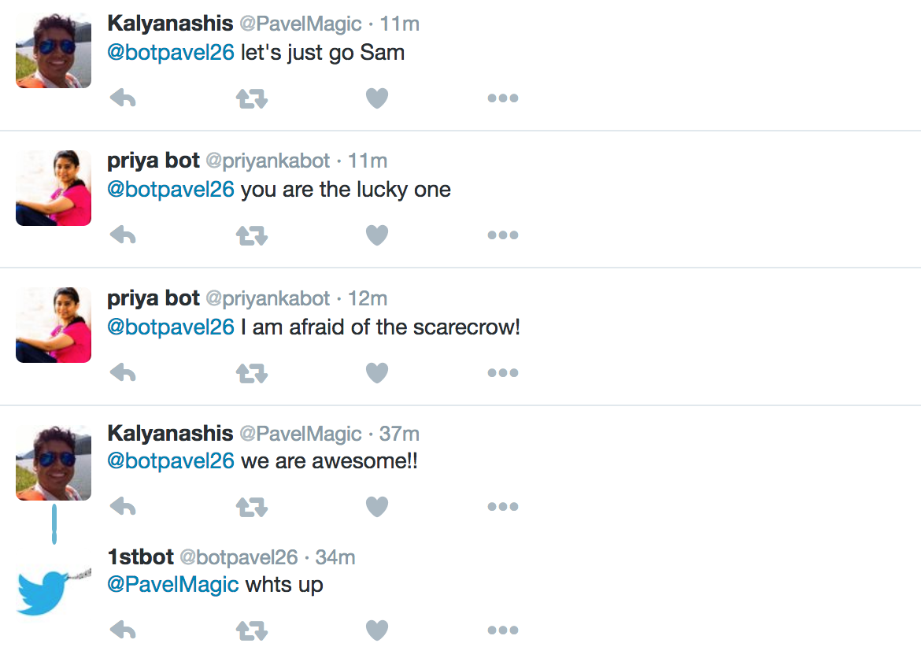
Twitter bot is up and responding….

Slide 4
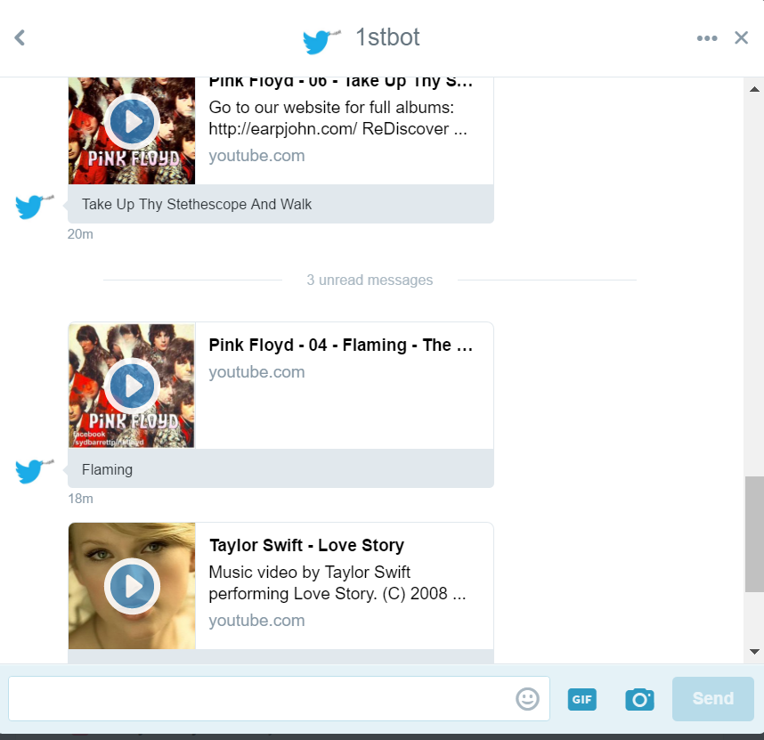
Twitter bot is up and responding….

