Slide 1
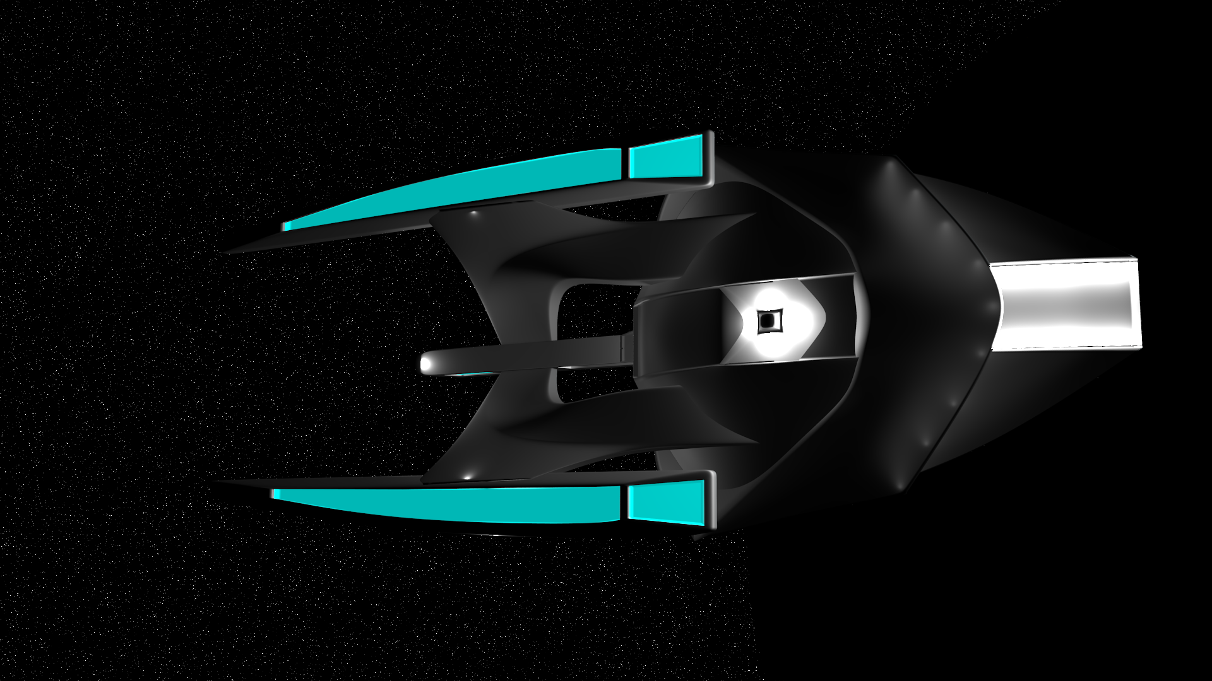
Space Trader Title
New Game
Load Game
Options
Exit

Slide 2
Space Trader Title
New Game
Load Game
Options
Exit

Slide 3
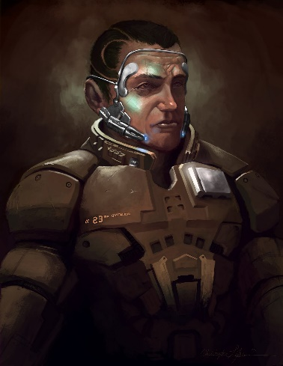
Select Race
Backstory
Skills
Create
Humans
Novula
Homo sapiens are relatively new to inter-stellar travel. They haven’t mapped out most of galaxy, are quick to wage war, and underestimate their business partners and foes. That naivety makes their navigation and charisma stats dismal. However, years of technological progress makes them excel in engineering and piloting to make up for their shortcomings elsewhere.
Segfault
Starturtles
< Back
Next >

Slide 4
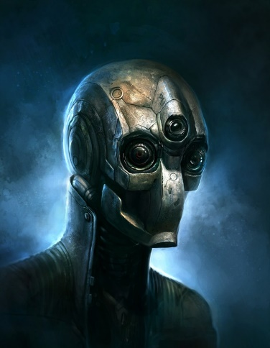
Select Race
Backstory
Skills
Create
Humans
Novula
Self-aware robots. In homo sapien’s early research in artificial intelligence, a rogue segmentation fault was raised on a program running on a intelligent humanoid robot. This Segfault made the robot self-aware. How this happened, humans are still unsure. Segfault start with low charisma, but high piloting and engineering to make up for it.
Segfault
Starturtles
< Back
Next >

Slide 5
Select Race
Backstory
Skills
Create
Question 1 is written here. Wahoo! It is such a great Question
Choice 1
Choice 2
Choice 3
Question 2 is written here. Wahoo! It is such a great Question
Choice 1
Choice 2
Choice 3
Question 3 is written here. Wahoo! It is such a great Question
Choice 1
Choice 2
Choice 3
< Back
Next >

Slide 6
Select Race
Backstory
Skills
Create
Question 1 is written here. Wahoo! It is such a great Question
Choice 1
Choice 2
Choice 3
Question 2 is written here. Wahoo! It is such a great Question
Choice 1
Choice 2
Choice 3
Question 3 is written here. Wahoo! It is such a great Question
Choice 1
Choice 2
Choice 3
< Back
Next >

Slide 7
Select Race
Backstory
Skills
Create
Points to Award: 5
Piloting (5): 5
Navigation (3): 3
-
+
-
+
Engineering (5): 5
Charisma (2): 2
-
+
-
+
< Back
Next >

Slide 8
Select Race
Backstory
Skills
Create
Points to Award: 0
Piloting (5): 5
Navigation (3): 4
-
+
-
+
Engineering (5): 6
Charisma (2): 5
-
+
-
+
< Back
Next >

Slide 9

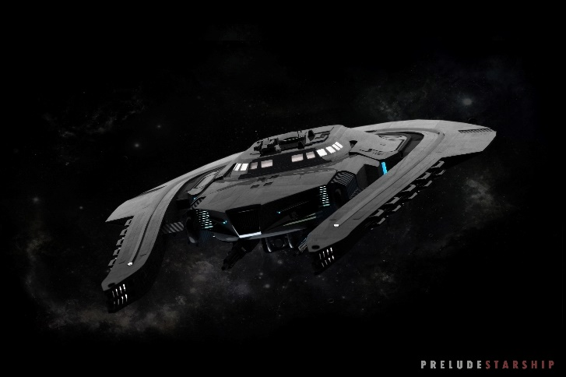
Select Race
Backstory
Skills
Create
Name
Stegfault
Stegfault Jumper
< Back
Create >

Slide 10
Select Race
Backstory
Skills
Create
Name
Thorigin Boopleweed
Stegfault
Stegfault Jumper
< Back
Create >

