Slide 1
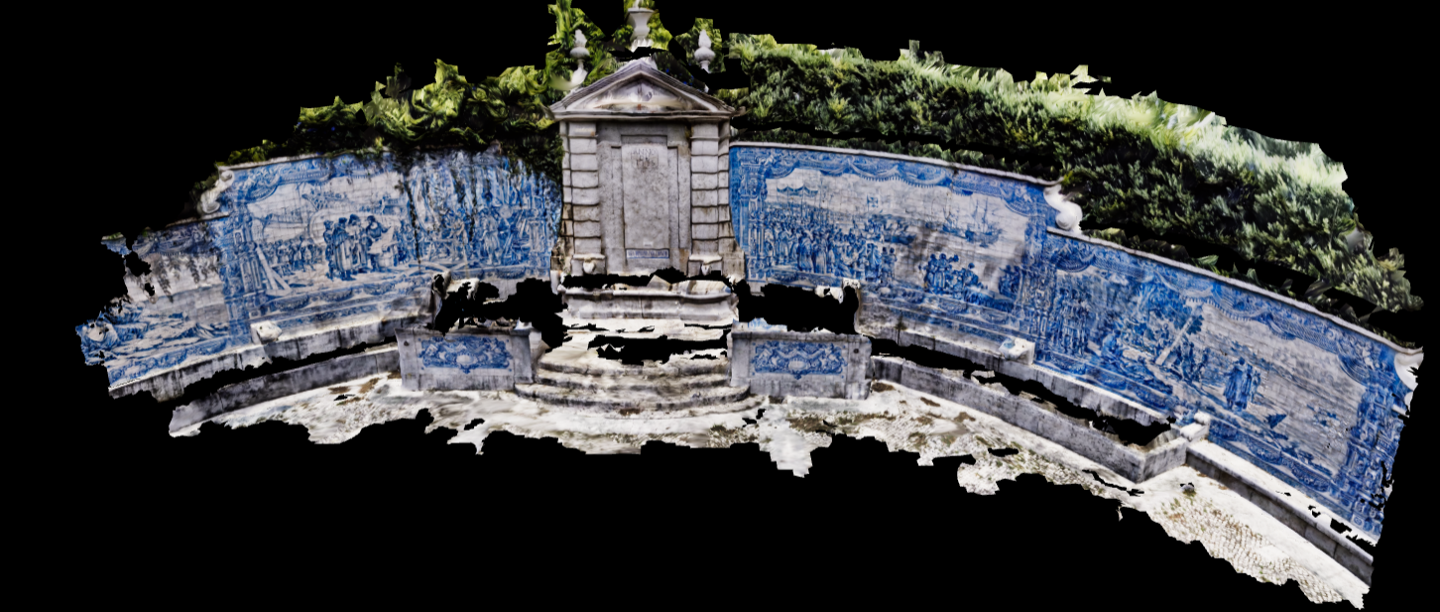
AB1
AB2
y
AB3
AB0
AC2
AC3
AC5
AC6
AC1
AC4
AB4
AC7
AC0
AC9
AB5
-x
x
AC8
AC10
z
AC
11

Slide 2
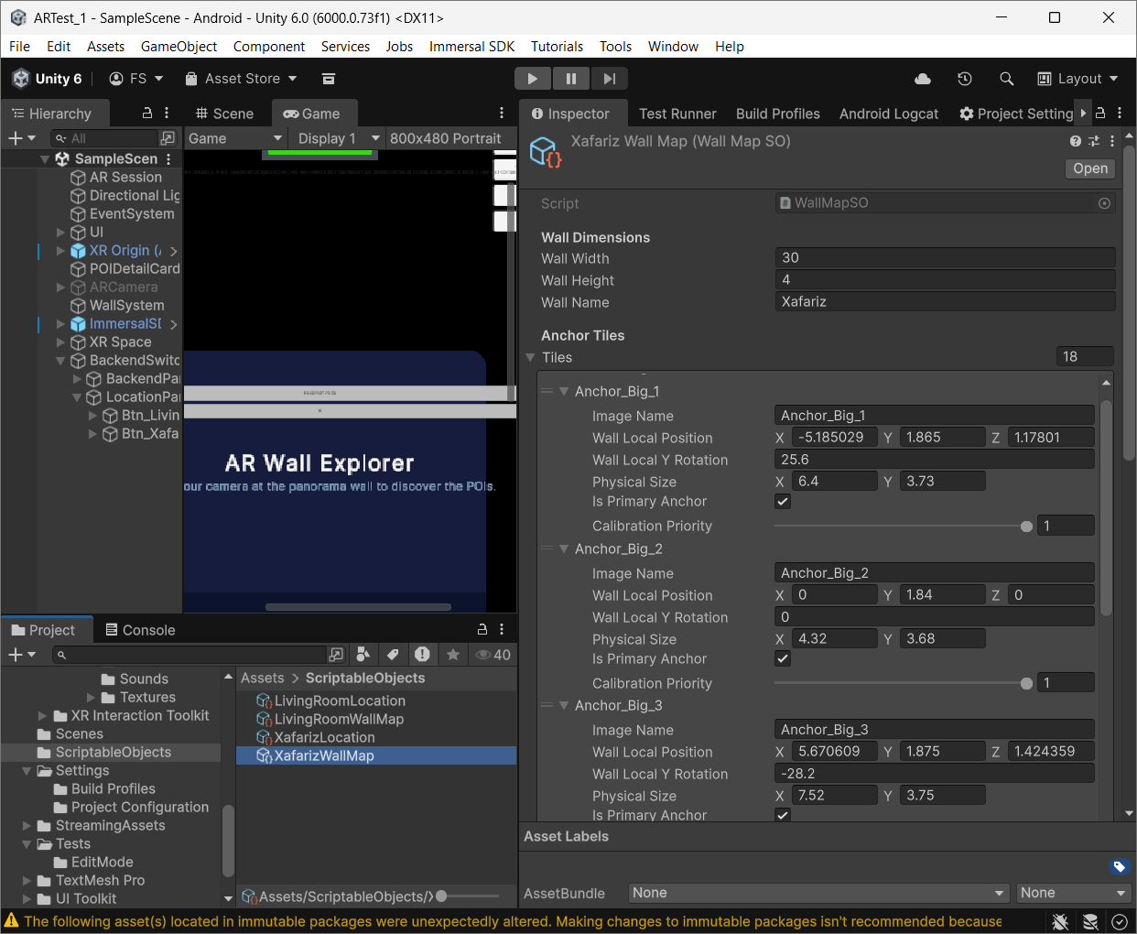
TODO
confirmer cood no unity including rotation

