Slide 1

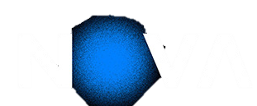

DEEP LEARNING · ASSIGNMENT 1 · TASK 1
Pokémon Type Classification
TASK 1 — Flat-Pixel Multi-Layer Perceptron
70698 – Francisco Silva
73554 – Miguel Cangalhas
73208 – Rúben Silva

Slide 2
What We Cover
1
Data Exploration & Analysis
2
Model Development
EDA · class imbalance · pixel stats · t-SNE
Architecture · 19 experiments · regularisation
3
Training Efficiency
4
Performance Evaluation
Early stopping · GPU budget · checkpointing
Macro-F1 · per-class · confusion matrix

Slide 3
1
Data Exploration & Analysis

Slide 4
1
EDA
The Dataset at a Glance
EDA
3 600
900
9
64x64
training images
test images
Pokémon types
px resolution
Class | Count | % train
Water | 674 | 18.7% ▲
Normal | 606 | 16.8%
Poison | 467 | 13.0%
Fire | 381 | 10.6%
Bug | 374 | 10.4%
Grass | 299 | 8.3%
Fighting | 291 | 8.1%
Rock | 264 | 7.3%
Ground | 244 | 6.8% ▼
Imbalance ratio: 2.76x
Implications:
Predicting "Water" every time
gives 18.7% accuracy
but macro-F1 = 0.021
So accuracy hides the real failure on minority classes.
macro-averaged F1
Weights all 9 classes equally
No advantage for majority classes
Solution:

Slide 5
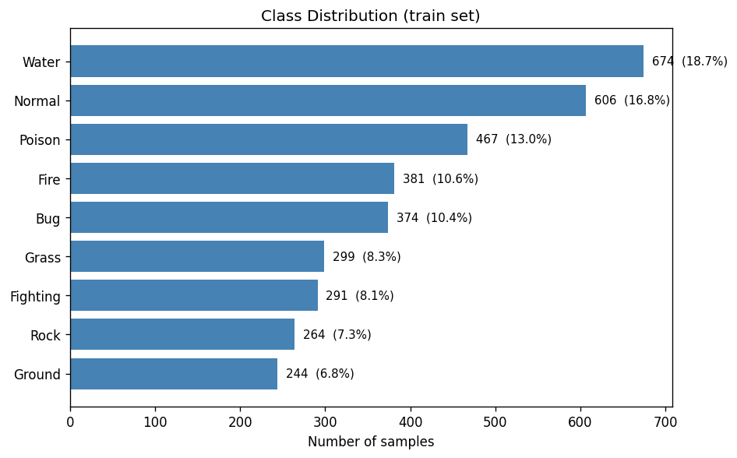
1
EDA
Class Imbalance — Visual Overview
EDA
Class distribution (train set)
2.76×
💧
😐
☠️
🔥
🐛
🌿
⚔️
🗿
🌍
Water / Ground imbalance ratio
18.7%
Water (most common class)
6.8%
Ground (rarest class)
Our mitigation strategy
0.021
Inverse-frequency class weights in CrossEntropyLoss
WeightedRandomSampler (tested separately — see experiments)
Naive baseline: always predict Water

Slide 6
2
Model Development

Slide 7
3
Training Efficiency

Slide 8
4
Performance Evaluation

Slide 9
Conclusions & What's Next
Best MLP result: 0.2428 val F1 (ensemble C+E), 0.2288 Kaggle
Next: Task 2
2.18x above random baseline. All 19 solo + 7 ensemble experiments are above random.
CNN
Convolutional
Neural Network
Label smoothing = most impactful technique
LS=0.15 rescued Rock from F1=0.000. All top-6 solo experiments use LS ≥ 0.1.
Spatial inductive bias — same filters at every position
3×3 conv = 27 params vs 12 288 per MLP node
Augmentation will HELP (not hurt)
Target F1: 0.55 – 0.70
Spatial inductive bias — same filters at every position
3×3 conv = 27 params vs 12 288 per MLP node
Augmentation will HELP (not hurt)
Target F1: 0.55 – 0.70
Augmentation and depth both hurt
Confirmed empirically: MLP has no spatial invariance, and small data can't regularise deeper nets.
MLP ceiling is real and confirmed
val_loss ≈ log(9) = random. Feature-to-sample ratio 4.26:1 = no amount of tuning fixes this.
Ensemble diversity > ensemble quality
C+E (0.2428) beats two top solos (C=0.2395, R=0.2396) because different imbalance mechanisms produce complementary errors.
Task 1 complete · Kaggle score: 0.2288 · 22 experiments · ~44 min on T4

