Slide 1

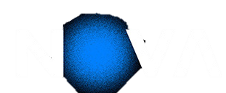

DEEP LEARNING · ASSIGNMENT 1
Pokémon Type Classification
TASK 1 - Multi-Layer Perceptron
TASK 2 - Convolutional Neural Network
TASK 3 – Transfer Learning and Fine-Tunning
70698 – Francisco Silva
73208 – Rúben Silva
73554 – Miguel Cangalhas

Slide 2
What We Cover
Task 1
............................... Slide 3
Task 2
............................... Slide 32
Task 3
............................... Slide 59

Slide 3
DEEP LEARNING · ASSIGNMENT 1 · TASK 1
Pokémon Type Classification
Task 1 - Multi-Layer Perceptron

Slide 4
What We Cover (Task 1)
1.1
Data Exploration & Analysis
1.2
MLP Model Development
EDA · class imbalance · pixel stats · t-SNE
Architecture · 19 experiments · regularization
1.3
MLP Training Efficiency
1.4
MLP Performance Evaluation
Early stopping · GPU budget · checkpointing
Macro-F1 · per-class · confusion matrix

Slide 5
1.1
Data Exploration & Analysis

Slide 6
1.1
EDA
The Dataset at a Glance
3 600
900
9
64x64
training images
test images
Pokémon types
px resolution
Class | Count | % train
Water | 674 | 18.7% ▲
Normal | 606 | 16.8%
Poison | 467 | 13.0%
Fire | 381 | 10.6%
Bug | 374 | 10.4%
Grass | 299 | 8.3%
Fighting | 291 | 8.1%
Rock | 264 | 7.3%
Ground | 244 | 6.8% ▼
Imbalance ratio: 2.76x
💧
😐
☠️
🔥
🐛
🌿
⚔️
🗿
🌍
Implications:
Predicting "Water" every time
gives 18.7% accuracy
but macro-F1 = 0.021
So accuracy hides the real failure on minority classes.
macro-averaged F1
Weights all 9 classes equally
No advantage for majority classes
Solution:

Slide 7
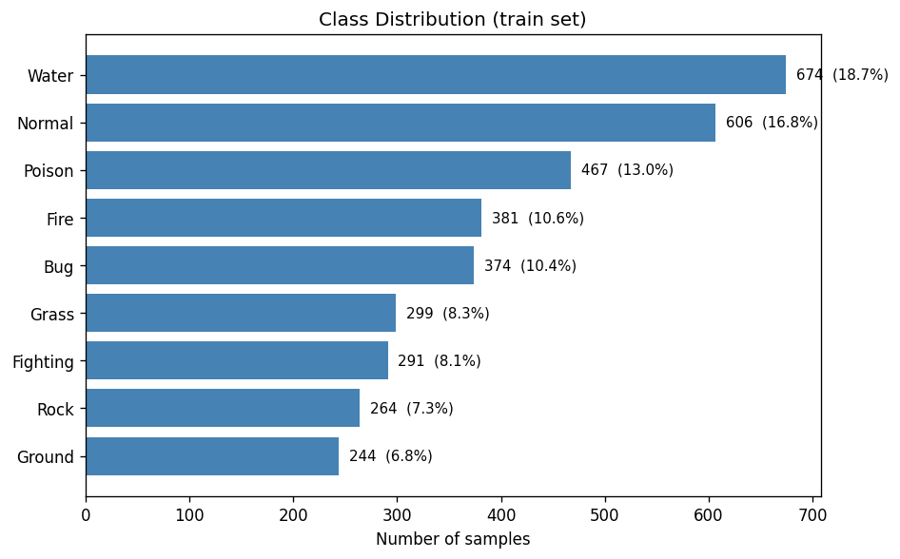
1.1
EDA
Class Imbalance — Visual Overview
EDA
Class distribution (train set)
2.76×
💧
😐
☠️
🔥
🐛
🌿
⚔️
🗿
🌍
Water / Ground imbalance ratio
18.7%
Water (most common class)
6.8%
Ground (rarest class)
Our mitigation strategy
0.021
- Inverse-frequency class weights in CrossEntropyLoss
Used in experiments like B, C, D, F, G, J, L, R, S,
- WeightedRandomSampler
Used in experiments like E, M, O, Q,
Naive baseline: always predict Water

Slide 8
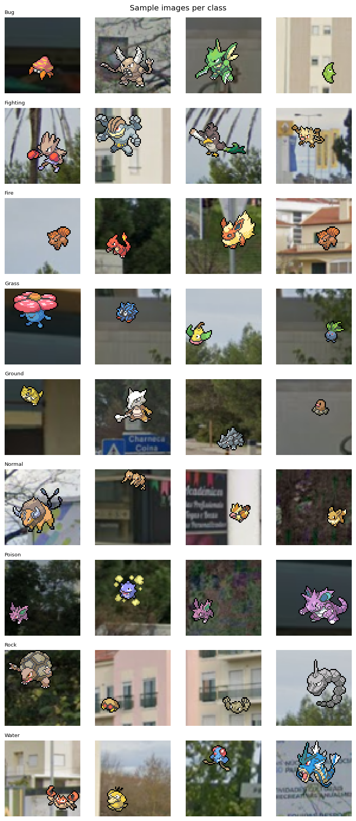
1.1
EDA
What the Data Looks Like
EDA
🐛 Bug
⚔️ Fighting
🔥 Fire
🌿 Grass
🌍 Ground
😐 Normal
☠️ Poison
🗿 Rock
💧 Water
4 samples per class (pokemons overlaid on real-world backgrounds) »»»
Bug vs Grass
Both dominated by green/yellow tones
» color histograms overlap heavily
Fighting vs Normal
Both dominated by brown tones
» color histograms overlap heavily
Rock vs Ground
Brown/grey palettes
» hardest confusion pair in our results
Real backgrounds
Sprites on street photos
» random background noise adds pixel variability

Slide 9
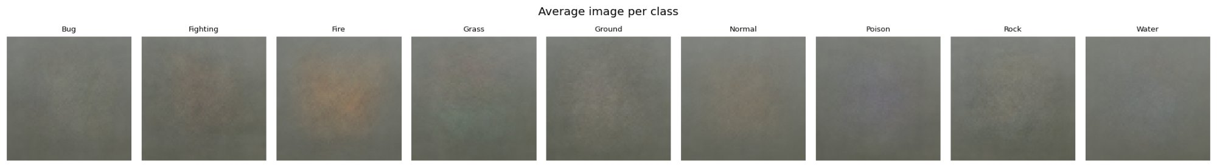
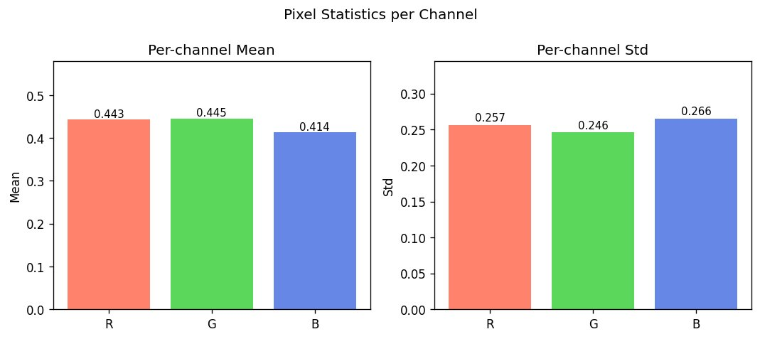
1.1
EDA
Average Image Per Class & Pixel Statistics
DA
Average image per class — blurriness reveals intra-class variance (e.g.: we can expect that Fire will be more correctly identified)
🐛 Bug ⚔️ Fighting 🔥 Fire 🌿 Grass 🌍 Ground 😐 Normal ☠️ Poison 🗿 Rock 💧 Water
Per-channel mean & standard deviation (train split, no leakage)
Ch | Mean | Std | ImageNet mean
R | 0.443 | 0.257 | 0.485
G | 0.445 | 0.246 | 0.456
B | 0.414 | 0.266 | 0.406
< 0.05 difference on all channels between our data set and ImageNet
- Stats computed from train split only: no val leakage.
- ImageNet normalisation is acceptable, and possibly useful for task 3.

Slide 10
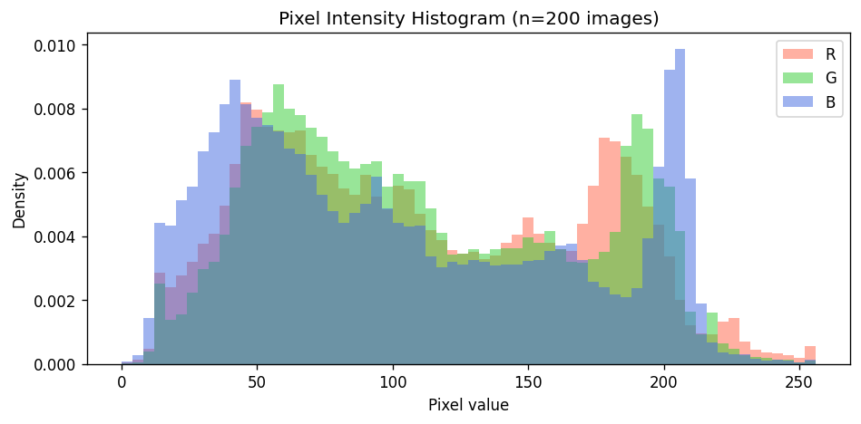
1.1
EDA
Pixel Intensity Distribution
EDA
Bimodal distribution
Two peaks: dark backgrounds (~50) and bright sprites (~200). Pokémon dataset is brighter overall than ImageNet.
B channel prominent at high values
Blue channel spikes above R and G near value 200 — confirms blue bias (Water...)
💧
😐
☠️
🔥
🐛
🌿
⚔️
🪨
🌍

Slide 11
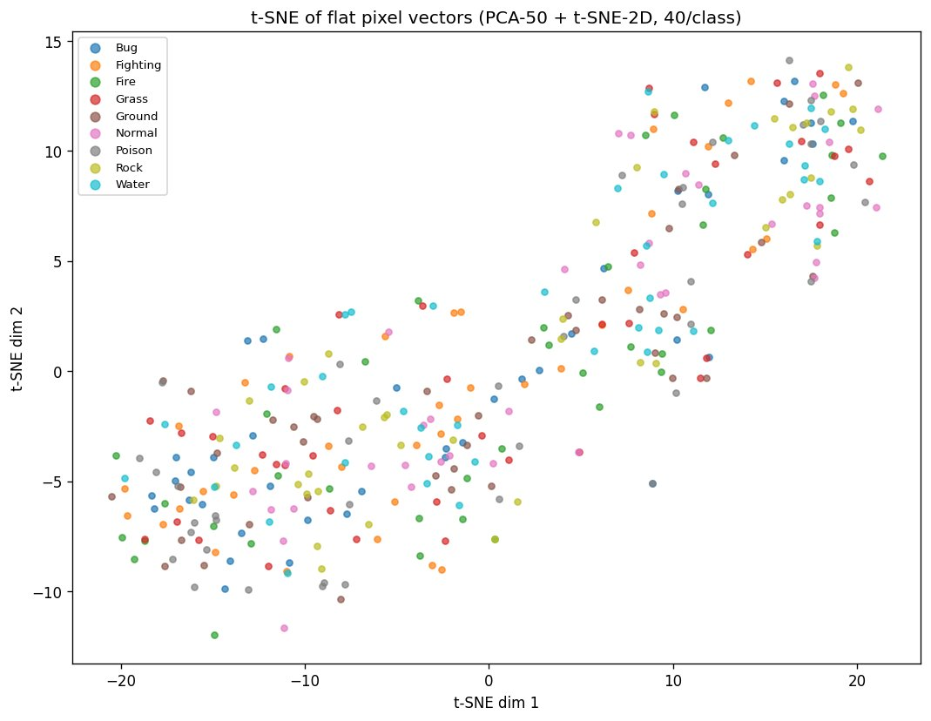
1.1
EDA
t-SNE: Can Flat Pixels Separate the 9 Classes?
EDA
No clean clusters
All 9 types heavily overlap in flat pixel space.
Even with PCA-50 preprocessing, classes are not linearly separable.
Direct motivation for CNN
This scatter is exactly why MLP hits a ceiling.
CNN adds spatial inductive bias — learns position
» MLP physically cannot.

Slide 12
1.2
MLP Model Development

Slide 13
1.2
MLP MODEL DEV
Exploration strategy
Strategy: we started by exploring different base models with different characteristics (number and size of layers, batch normalization, dropout, regularization L2/weight decay, label smoothing, weighted sampler, etc.
Then, having a sense of the best models so we explored different small variations of them.
We explored over 20 different models. Here we present a small sample of them.
ID | Name | Model | Criterion (~loss function) | Optimizer | Purpose
A | vanilla | MLP([128, 64], drop=0, no BN) | CrossEntropy | Adam lr=1e-3 | True bare baseline — no regularisation at all
B | mlp_base | MLP([512, 256, 128], drop=0.4) | CE + class weights | Adam lr=1e-3 | First Colab run result (~0.193)
C | ls01_drop03 | MLP([512, 256, 128], drop=0.3) | CE + weights + label_smoothing=0.1 | Adam lr=1e-3 | Softer targets + lighter dropout
D | wd1e4 | MLP([512, 256, 128], drop=0.3) | CE + weights + label_smoothing=0.1 | Adam lr=1e-3, WD=1e-4 | L2 reg on top of C
E | sampler | MLP([512, 256, 128], drop=0.3) | CE + label_smoothing=0.1 (sampler used instead of class-weights) | Adam lr=1e-3 | WeightedRandomSampler replaces class weights
F | narrow | MLP([256, 128, 64, 32], drop=0.3) | CE + weights + label_smoothing=0.1 | Adam lr=1e-3, WD=1e-4 | Fewer params per layer — less overfit?
G | bottleneck | MLP([512, 1024, 256, 128], drop=0.3) | CE + weights + label_smoothing=0.1 | Adam lr=1e-3, WD=1e-4 | Wide middle captures more combinations?
M | c_sampler | MLP([512, 256, 128], drop=0.3) + WeightedSampler | CE + label_smoothing=0.1 (sampler replaces class-weights) | Adam lr=1e-3 | Sampler on top of C — ~same as E (val_macro_f1=0.2361)
N | cosine_lr | MLP([512, 256, 128], drop=0.3) + CosineAnnealing | CE + weights + label_smoothing=0.1 | Adam lr=1e-3 + CosineAnnealingLR | Cosine schedule, no improvement (val_macro_f1=0.2251)
R | ls015_drop03 | MLP([512, 256, 128], drop=0.3) | CE + weights + label_smoothing=0.15 | Adam lr=1e-3, WD=1e-4 | Best solo — LS=0.15 > LS=0.10 (val_macro_f1=0.2396)

Slide 14
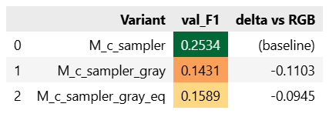
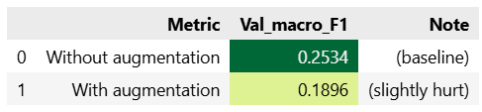
1.2
MLP MODEL DEV
Pre-Processing & Data Augmentation
Strategy: Having the best model we tried to apply different pipelines of pre-processing and data augmentation.
Pre-Processing
Data Augmentation
Grayscale
A 64x64 RGB image results in an initial vector of length = 12.288. If we convert to grayscale it would be a vector of 4096. Could a smaller vector preserve all the necessary important information for the model? Turns out no. Pokemon classification is strongly color-dependent (Fire=orange, water=blue, poison=purple, grass=green)
RandomHorizontalFlip, ColorJitter, RandomRotation...
Could we improve the quality of our training dataset and help the model to generalize better? This is a valid hypothesis for CNN, but as expected, not for MLP, because MLPs convert the image to a simple vector losing all spatial sense.

Slide 15
1.2
MLP MODEL DEV
MLP Best (SOLO) Model (R_ls015_drop03)
Architecture:
Input
12 288
64x64x3 flat
Hidden 1
512
BN + ReLU + D(0.3)
Hidden 2
256
BN + ReLU + D(0.3)
Hidden 3
128
BN + ReLU + D(0.3)
Output
9
logits
Funnel Design
Progressive compression forces generalisation
Better than:
Narrow (256-128-64-32): too bottlenecked for colour histogram learning
Wider first layer (1024): more capacity = more memorisation
4-layer deep: harder to regularise on small data
BatchNorm + ReLU + Output Logits
BatchNorm1d after every Linear
stabilises gradients on 12 288-dim flat input
ReLU
no vanishing gradient for positive activations, simple and efficient
Raw logits at output
CrossEntropyLoss fuses log_softmax internally (numerically stable)
argmax(logits) == argmax(softmax(logits)) — so no softmax needed at inference
Exception: ensemble averages softmax outputs — raw logit scales differ across models

Slide 16
1.2
MLP MODEL DEV
MLP Best (SOLO) Model (R_ls015_drop03)
Regularization Strategy:
Dropout (0.3)
Applied after every hidden layer
Randomly zeroes 30% of neurons each forward pass
Prevents co-adaptation, forces redundant representations
Why 0.3? — Search result:
Drop 0.4 (model B) = 0.222 — too aggressive
Drop 0.2 (model J) = 0.236 — close but weaker
Drop 0.15 (model P) = 0.217 — too light
Drop 0.3 = 0.240 — sweet spot confirmed
Label Smoothing (0.15)
Most impactful single change
Softens hard one-hot targets (0.85/0.15 blend vs 1.0 hard)
Prevents overconfident predictions on visually ambiguous classes
Key on noisy boundaries — Bug/Grass and Rock/Ground share colour palettes
Evidence:
All 6 top-tier solos (F1 > 0.235) use LS >= 0.1
LS=0.15 (R) = 0.2396 vs LS=0.10 (C) = 0.2395 — tiny but consistent
+0.017-0.019 F1 vs baselines with no LS
Imbalance Handling
Weighted CrossEntropyLoss (primary)
Inverse-frequency weights per class (Ground=1.64x, Rock=1.52x, Water=0.59x)
Addresses 2.76x Water/Ground imbalance at gradient level
WeightedRandomSampler (tested separately)
Oversamples minority classes at the data level
Useful as ensemble diversity: different error patterns vs CW
Pitfall: CW + Sampler together
Model O (double-compensating) = F1 0.192 — over-correcting imbalance hurts

Slide 17
1.2
MLP MODEL DEV
MLP Best (SOLO) Model (R_ls015_drop03)
Training Setup — Optimizer, Scheduler & Early Stopping:
Optimiser + Scheduler
Adam lr=1e-3 — robust adaptive LR, standard for MLPs (Kingma & Ba, 2015)
StepLR(step=5, gamma=0.5) — halves LR every 5 epochs; CosineAnnealingLR also tested but no improvement (N=0.225)
Early Stopping (patience=7)
Monitors -val_macro_f1 (competition metric, not val_loss)
Patience=7 — val_f1 is noisy (720 val samples, ~80/class: 1 error = +-1.2% swing); 3 would fire prematurely
Saves best checkpoint automatically; restores at inference

Slide 18
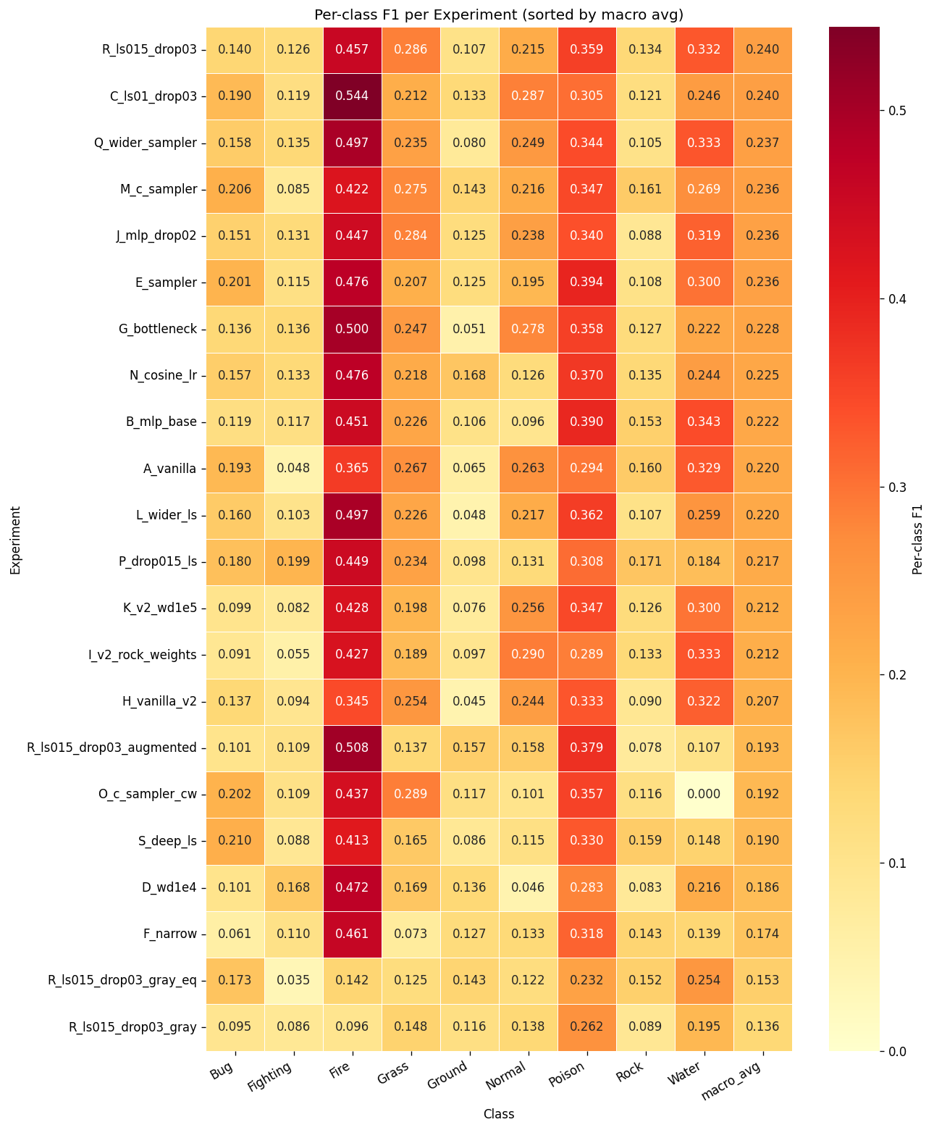
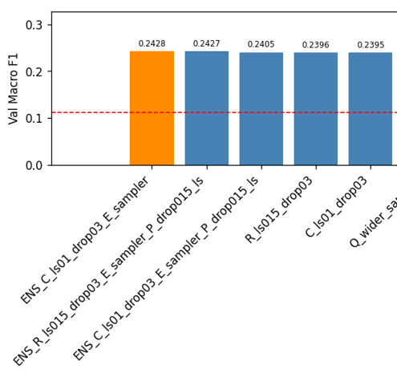
1.2
MLP MODEL DEV
Ensembles
Strategy: Having the best models we tried to combine them to see if we got better results by using some better characteristic of some model to compensate for worse performance in other model.
» To help analyze possible good combinations we draw a heat map so we can see the results of each model for each class.
Ensemble > Solo
As we could confirm some ensembles allowed us to achieve better performance than solo models
🐛 ⚔️ 🔥 🌿 🌍 😐 ☠️ 🗿 💧 avg

Slide 19
1.2
MLP MODEL DEV
What Worked vs. What Did Not
What Worked
Label smoothing (0.10-0.15)
- all top-6 solos use it;
- +0.017-0.019 vs no-LS baselines
Dropout 0.3
- 0.4 was too heavy, 0.15 too light
Weighted CrossEntropyLoss
- prevents collapse on minority classes (Ground, Rock)
WeightedRandomSampler
- creates diversity for ensembles
BatchNorm
- stabilizes gradients on 12 288-dim flat input
- (model B > A by +0.002)
Soft ensemble C+E
- +0.003 over best solo;
- diversity of error correction wins over strength
What Did Not Work
Augmentation (flip/jitter/rotate)
- 0.047 F1; MLP has no spatial invariance, flipped images = different vectors
Wider first layer (1024)
- L=0.220; more capacity = more memorisation on 2 880 samples (doesn’t generalize well)
Deeper net (4 layers)
- S=0.191; extra depth can not be regularised effectively on small data
Grayscale input
- 0.136; colour is the primary discriminative signal, removing it destroys performance
Sampler + CW together (model O)
- 0.192; double-compensating imbalance over-corrects
Strong weight decay (1e-4)
- D=0.186; combined with LS + dropout = too many simultaneous constraints

Slide 20
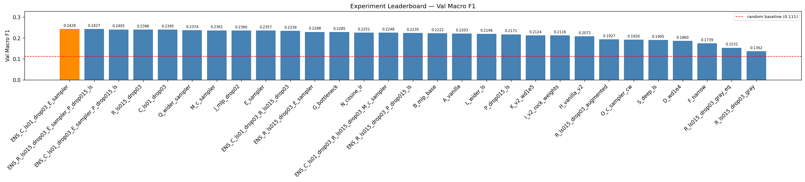
1.2
MLP MODEL DEV
MLP Ceiling ~0.24
Confirmed ceiling metrics
best val macro-F1 (ensemble C+E)
0.2428
Kaggle public score
0.2288
Why ~0.24 is the MLP wall
Feature-to-sample ratio d/n = 4.27 (want <= 1)
12 288 features, only 2 880 training samples — extremely sparse space
No spatial inductive bias — MLP is essentially a colour histogram classifier
All top-6 models within 0.004 F1 — search is saturated
Next: CNN (Task 2) — spatial inductive bias will break this ceiling

Slide 21
1.3
MLP Training Efficiency

Slide 22
1.3
MLP Train Eff
Compute Strategy & Resource Usage
Train Eff
T4 GPU
44 min
< 100 MB
73%
Colab free tier / 15 GB VRAM
total wall-clock (19 solo runs)
GPU memory peak (MLP is tiny)
of 1h budget used
Metric | Value | Note
Fastest experiment | K_v2_wd1e5 — 58.6 s | Stopped at epoch 13 (light reg → fast plateau)
Slowest experiment | Q_wider_sampler — 172 s | 37 epochs; wider model + sampler slows convergence
Avg per experiment | ~108 s | Across 19 solo runs
Best solo (R) | 144 s — 32 epochs | EarlyStopping saved best at epoch 21
FAST_RUN flag | FAST_RUN=True | Smoke-test mode: 5 epochs, 100 samples — used for debugging
Why 80/20 split instead of K-Fold CV?
5-fold CV × 19 experiments ≈ 95 training runs ≈ 144 min — exceeds the 1h Colab budget. Stratified 80/20 with fixed seed is the correct trade-off: relative experiment ranking is valid even if absolute F1 has ±0.02 noise from a single split.

Slide 23
1.3
MLP Train Eff
Early Stopping — Results Across Experiments
Train Eff
Experiment | Epochs | Stopped? | Takeaway
A_vanilla | 21/30 | ✓ Yes | Simple model finds plateau quickly
B_mlp_base | 28/30 | ✓ Late | Heavy dropout delays convergence
C_ls01_drop03 | 28/30 | ✓ Yes | LS adds noise → peak at ep21, patience exhausted ep28
D_wd1e4 | 30/30 | ✗ No | L2 + LS + Dropout = too many constraints, never converges
E_sampler | 23/30 | ✓ Yes | Sampler + LS converges cleanly
F_narrow | 27/30 | ✓ Barely | Narrow arch is the bottleneck — very slow to plateau
G_bottleneck | 30/30 | ✗ No | Wide bottleneck still slowly improving — needs more epochs
O_c_sampler_cw | 30/30 | ✗ No | Double-compensation confuses the optimiser — never peaks
Q_wider_sampler | 37/30 | ✓ Late | Patience=7 allows >30 epochs when plateau is very slow
R_ls015_drop03 ⭐ | 32/30 | ✓ Yes | Best checkpoint at ep21; patience runs out at ep32

Slide 24
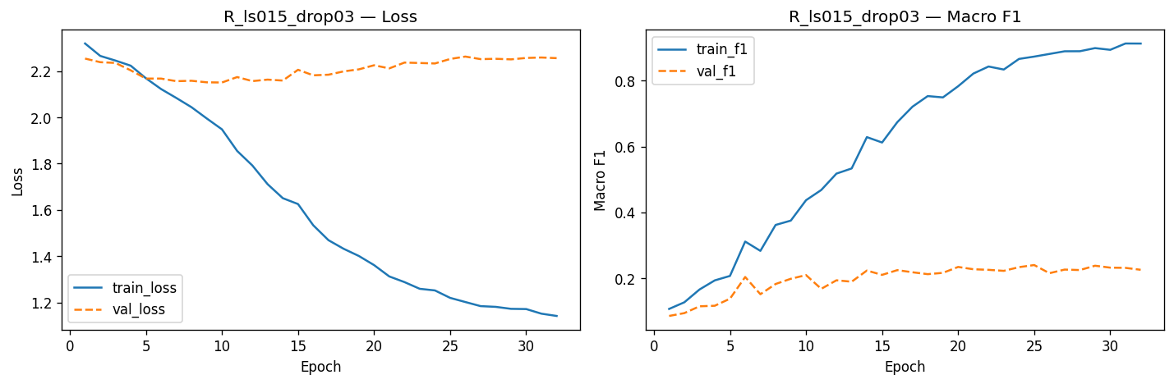
1.3
MLP Train Eff
Training Curves — Best Solo R_ls015_drop03
EarlyStopping metric:
val_loss ≠ val_f1
we use val_macro_f1 (lower = better)
Patience:
7 epochs
Saves best checkpoint .pth per run
Allows >30 epochs when plateau is slow (Q ran 37)
Ep train_loss val_loss train_F1 val_F1
1 2.319 2.254 0.106 0.085
5 2.169 2.167 0.207 0.137
10 1.948 2.150 0.437 0.209
15 1.534 2.181 0.674 0.224
20 1.362 2.225 0.783 0.234
25 * 1.202 2.252 0.873 0.240 ← checkpoint
30 1.172 2.256 0.899 0.231
32 1.142 2.256 0.913 0.225

Slide 25
1.4
MLP Performance Evaluation

Slide 26
1.4
MLP Perf Eval
Results at a Glance
Perf Eval
0.2428
0.2396
0.2288
0.2239
Best val Macro-F1
(ensemble C+E)
Best solo Macro-F1
(R_ls015_drop03)
Kaggle public score
(submitted ENS_C_E)
Kaggle private score
(submitted ENS_C_E)
Metric Comparison vs Baselines
Our Model learned something
2.18x better than random guess
Note: We didn’t select the best local model in Kaggle to be chosen for the private score. The best local model got Kaggle private score:
0.2431
System macro-F1 acc
Random baseline 0.111 11.1%
Always-Water 0.021 18.7%
R_ls015_drop03 (solo) 0.2396 25.8%
ENS_C+E (submitted) ★ 0.2428 26.7%
Kaggle public test 0.2288 —

Slide 27
1.4
MLP Perf Eval
Per-Class F1
🔥 Fire 0.457 distinctive orange palette
☠️ Poison 0.359 unique purple; LS prevents overconfidence
💧 Water 0.332 blue palette helps; confused with Normal
🌿 Grass 0.286 green palette; confused with Bug
😐 Normal 0.215 most diverse; no distinctive colour
🐛 Bug 0.140 green overlaps Grass; confused with Normal
🗿 Rock 0.134 grey/brown shared with Ground and Fighting
⚔️ Fight 0.126 humanoid silhouette = same as Normal for MLP
🌍 Ground 0.107 fewest samples (244) + brown/grey overlap
🐛u⚔️ 🔥 🌿 🌍 😐 ☠️ 🪨 💧 avg
Pattern: Color Palette Drives Performance - distinctive colour = high F1 (Fire/Poison/Water); shared palette or humanoid shape = low F1 (Bug/Rock/Fighting/Ground). MLP on flat pixels is essentially a colour histogram classifier.

Slide 28
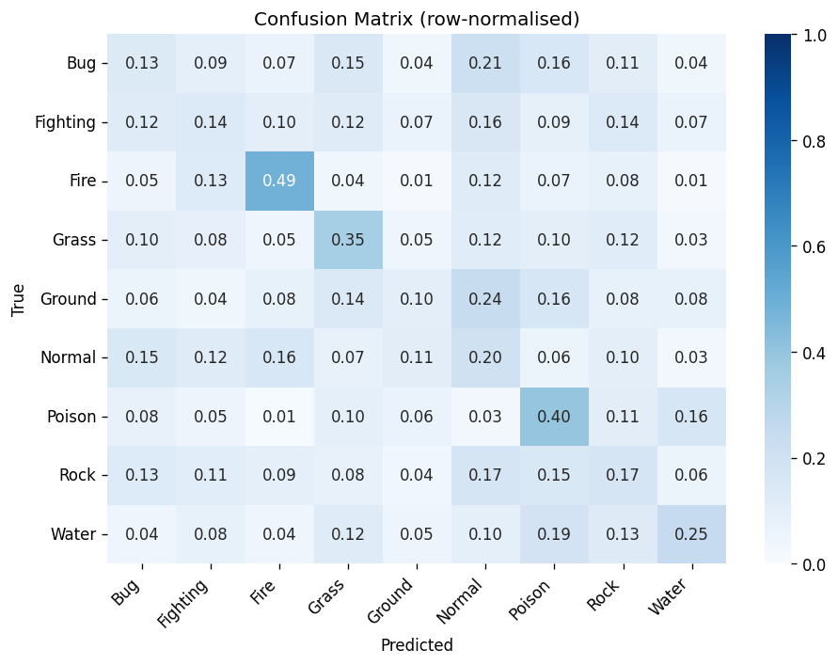
1.4
MLP Perf Eval
Confusion Matrix — Normal as the Catch-All Class
Class | F1 | Main confusion
Fire | 0.49 | Gets 49% of own class right — warm orange unique
Poison | 0.40 | 40% correct; confused with Water (purple→blue)
Water | 0.33 | High precision, low recall — confused with Normal
Grass | 0.35 | 35% correct; confused with Bug (green palette)
Normal | 0.20 | Diverse humanoids — confused with Fire, Bug, Poison
Bug | 0.13 | Only 13% correct — near-identical to Grass
Fighting | 0.14 | Humanoid; 16% sent to Normal, 12% to Bug
Rock | 0.17 | Grey/brown; 17% sent to Normal, 15% to Poison
Ground | 0.10 | Worst class; 24% sent to Normal (fewest samples)
Why Normal is the catch-all
Normal = most diverse class: humanoids of every shape and size, no dominant colour
Bug, Fighting and Ground all lack distinctive palettes — the MLP falls back to predicting Normal

Slide 29
1.4
MLP Perf Eval
Ensemble Analysis & Kaggle Gap
All 7 Ensemble Results (soft-average of softmax outputs)
ENS_C+E ★ F1=0.2428 acc=26.7% SUBMITTED — C (class weights) + E (sampler) = complementary error patterns
ENS_R+E+P F1=0.2427 acc=26.3% Near-identical to C+E; 3-model ensemble
ENS_C+E+P F1=0.2405 acc=26.3% P drags down slightly — weak model adds noise
ENS_C+R F1=0.2339 acc=25.6% Both use CW — same error patterns, no diversity benefit
ENS_R+E / ENS_C+R+M / ENS_R+P F1=0.224–0.229 Too similar models or too weak — no diversity gain
Why C+E wins over any solo
C uses class weights — adjusts gradients per class
E uses sampler — adjusts data frequency
Different mechanisms = different mistakes = soft-average compensates
+0.003 F1 over best solo — small but consistent
C+R fails (0.234): both use CW — too similar, no error diversity
Kaggle validation gap
val - 0.2428
kaggle - 0.2288
−0.014
Why this gap is expected, not a pipeline bug:
Kaggle test may include harder or out-of-distribution sprites
It helps to, AFTER SELECTING A MODEL, to train it again with the full dataset

Slide 30
1.4
MLP Perf Eval
Why MLP Has a Hard Ceiling on This Data
Theoretical reasons
Empirical confirmation
No spatial inductive bias
Augmentation −0.047 F1
A sprite at top-left and bottom-right = completely different 12 288-vector. MLP can't learn 'flame exists somewhere'.
Random flips/jitter/rotation break the pixel vector. CNN will benefit from the same augmentation because filters are position-invariant.
Feature-to-sample ratio: 4.26:1
Grayscale −0.103 F1
12 288 features vs 2 880 samples. Even with Dropout + BN, MLP memorises noise rather than learning patterns.
Removing colour channels reduces dimensionality 3x, but loses the main discriminative signal. Colour is king for Pokémon types.
High intra-class variance
val_loss ≈ random (2.197)
Blastoise and Vaporeon are both Water-type but look nothing alike. MLP can only learn average colour histograms.
Even the best model's val_loss hovers at ~2.22 — barely above log(9). The model discriminates but isn't confident.

Slide 31
Conclusions & What's Next
Best MLP result: 0.2428 val F1 (ensemble C+E), 0.2288 Kaggle
Next: Task 2
2.18x above random baseline. All 19 solo + 7 ensemble experiments are above random.
CNN
Convolutional
Neural Network
Label smoothing = most impactful technique
LS=0.15 rescued Rock from F1=0.000. All top-6 solo experiments use LS ≥ 0.1.
Spatial inductive bias — same filters at every position
3×3 conv = 27 params vs 12 288 per MLP node
Augmentation will HELP (not hurt)
Target F1: 0.55 – 0.70
Augmentation and depth both hurt
Confirmed empirically: MLP has no spatial invariance, and small data can't regularise deeper nets.
MLP ceiling is real and confirmed
val_loss ≈ log(9) = random. Feature-to-sample ratio 4.26:1 = no amount of tuning fixes this.
Ensemble diversity > ensemble quality
C+E (0.2428) beats two top solos (C=0.2395, R=0.2396) because different imbalance mechanisms produce complementary errors.
Task 1 complete · Kaggle score: 0.2288 · 22 experiments · ~44 min on T4

Slide 32
DEEP LEARNING · ASSIGNMENT 1 · TASK 2
Pokémon Type Classification
Task 2 - CNN

Slide 33
What We Cover (Task 2)
2.1
CNN Model Development
2.2
CNN Training Efficiency
Architectures · Experiments · Augmentation · Regularization · Ensembles · Results
Early Stopping · GPU budget · Checkpointing
2.3
CNN Performance Evaluation
Macro-F1 · Per-class · Confusion Matrix

Slide 34
2.1
CNN Model Development

Slide 35
2.1
CNN MODEL DEV
Exploration strategy
Strategy: We explored different several different CNN architectures (number and size of Conv + Pool + FC layers, batch normalization, dropout, regularization, label smoothing, WeightedRandomSampler, and others). After getting a sense of the best ones, we explored different variations of them. This is a small sample of the numerous models we explored:
ID | Name | Model | Criterion (~loss function) | Optimizer | Purpose
A | LeNet5_base | LeNet5(conv=[6,16], fc=[120,84], pool=AvgPool2x2) | CrossEntropy | Adam lr=1e-3 | Baseline - no regularization; compare performance with existing architecture
C | Simple_cw | CNN(conv=[32,64], fc=[9], pool=MaxPool2x2+AvgPool2x2) | CE + class weights | Adam lr=1e-3 | Evaluate the performance of a simple 20k params CNN
G | Medium_dcw | MediumCNN(conv=[32,64,128], fc=[9], pool=MaxPool2x2+AvgPool2x2, drop=0.3, BN) | CE + class weights + dropout | Adam lr=1e-3 | Exploration of the effects of multiple convolution and pooling layers; regularization with inverse-frequency class weights in CrossEntropyLoss and dropout
H | Medium_dwrs | MediumCNN(conv=[32,64,128], fc=[9], pool=MaxPool2x2+AvgPool2x2, drop=0.3, BN) | CE + WRSampler (replaces class weights) + dropout | Adam lr=1e-3 | WeightedRandomSampler replaces class weights
I | Deep_dwrs | DeepCNN(conv=[32x2,64x2,128], fc=[128,9], pool=MaxPool2x2+AvgPool2x2, drop=0.3, BN) | CE + WRSampler + dropout | Adam lr=1e-3 | Deepen network with more conv + pool + non-linearity layers
K | Wide_dwrs | WideCNN(conv=[32,64,128,256], fc=[9], pool=MaxPool2x2+AvgPool2x2, drop=0.3, BN) | CE + WRSampler + dropout | Adam lr=1e-3 | Compare Deep vs Wide CNN; regularization with WeightedRandomSampler and dropout
L | MultiScale_dwrs | MultiScaleCNN(conv=[(3x3+5x5)->32, (3x3+5x5)->64, (3x3+5x5)->128], fc=[9], pool=MaxPool2x2+MaxPool2x2, drop=0.3, BN) | CE + WRSampler + dropout | Adam lr=1e-3 | Capture multiple granularities simultaneously
M | Residual_dwrs | ResidualCNN(conv=[64x2, 128x2, 256x2], fc=[9], pool=MaxPool2x2+AvgPool2x2, drop=0.4, BN, skip) | CE + WRSampler + dropout | Adam lr=1e-3 | Test the effects of skipping layers with a ResNet architecture
⭐

Slide 36
2.1
CNN MODEL DEV
CNN Best (SOLO) Model (I_CNN)
Architecture:

Slide 37
2.1
CNN MODEL DEV
CNN Best (SOLO) Model (I_CNN)
Architecture:
Feature Extraction +
Progressive channel expansion forces the model to increasingly learn broader representations of the features
Coupled with a moderate number of convolution layers (3x3) allows us our model to learn both low, and higher-level features
Pooling to provide robustness (e.g. translation invariance and help with small rotations)
Better than:
Narrow (e.g. 32-32-32): lower abstraction
No convolution: as it was evident by comparing the results with MLP, having convolution layers helps the model generalize better
Too deep: risk of overfitting; increased training time
No pooling
BatchNorm + ReLU
BatchNorm2d after every Conv layer
Normalization step which speeds up training and increases stability
ReLU
No vanishing gradient for positive activations in small networks like the ones developed; simple and efficient

Slide 38
2.1
CNN MODEL DEV
CNN Best (SOLO) Model (I_CNN)
Regularization Strategy:
Dropout (0.3)
Applied after Pooling (before FC layers)
Randomly zeroes p% of neurons each forward pass
Prevents co-adaptation, forces redundant representations
Why 0.3?:
Multiple values were tested (0.1, 0.15, 0.2, 0.3, 0.4, 0.5); 0.3 is the sweet spot - not too much regularization, not too little
Label Smoothing (0.1)
Decreased effectiveness when compared to MLPs. Idea:
Softens hard one-hot targets (0.9/0.1 blend vs 1.0 hard)
Prevents overconfident predictions on visually ambiguous classes
Key on noisy boundaries — Bug/Grass and Rock/Ground share colour palettes
BUT:
LS=0.1 (F) = 0.9750 vs LS=0.0 (C) = 0.9880 — tiny decrease
A lot of models can effectively converge to a near-perfect validation score, adding label smoothing adds unnecessary noise
Imbalance Handling
Weighted CrossEntropyLoss (primary)
Inverse-frequency weights per class (Ground=1.64x, Rock=1.52x, Water=0.59x)
Addresses 2.76x Water/Ground imbalance at gradient level
WeightedRandomSampler (tested separately) - most impactful single change
Oversamples minority classes at the data level
Useful as ensemble diversity: different error patterns vs CW
Pitfall: CW + Sampler together can pose a problem
As seen in the previous task

Slide 39
2.1
CNN MODEL DEV
CNN Best (SOLO) Model (I_CNN)
Training Setup — Optimizer, Scheduler & Early Stopping:
Optimiser + Scheduler
Adam lr=1e-3 — robust adaptive LR, standard for CNNs (Kingma & Ba, 2015)
StepLR(step=5, gamma=0.5) — halves LR every 5 epochs; CosineAnnealingLR also tested but similar results
Early Stopping (patience=7)
Monitors -val_macro_f1 (competition metric, not val_loss)
Patience=7 — val_f1 is noisy (720 val samples, ~80/class: 1 error = +-1.2% swing); 3 would fire prematurely
Saves best checkpoint automatically; restores at inference

Slide 40

2.1
CNN MODEL DEV
Pre-Processing & Data Augmentation
Strategy: There were multiple models that reached a validation Macro-Averaged F1-Score of 1.0, we chose the one that balanced fastest converging with fewest parameters, which was model M - Deep CNN. We then applied different pipelines of pre-processing and data augmentation.
Pre-Processing
Data Augmentation
Grayscale
A 64x64 RGB image results in an initial vector of length = 12.288. If we convert to grayscale the size is reduced by 3, to 4096. Are we able to achieve similar results with this smaller input? Turns out no. Pokemon classification is strongly color-dependent (Fire=orange, water=blue, poison=purple, grass=green, ...)
RandomHorizontalFlip, ColorJitter, RandomRotation...
In the previous task we mentioned that CNNs could benefit from this type of data augmentation, however, doing it gave us WORSE results. Why did this happen? Isn't training with slightly different variants of our images helpful for generalization? This is explored in the next slide.
-4.81%!
-1.5%!
Note that we tried very simple augmentation processes for this analysis; stronger augmentation gave us even worse results

Slide 41





2.1
CNN MODEL DEV
Pre-Processing & Data Augmentation
Why does data augmentation hurt the models? Let's take a look at some samples from the dataset which feature the same pokemon
From this small set of examples we can see that the pokemon always remains in the same upright position, facing the same direction, with the same colours, … and the only thing that changes are: its position in the picture, and the background. Since CNNs are invariant to the object's position in the picture, in reality, the only thing that really changes is the background. So, if we replace a training example that has all these characteristics with a flipped image of Golduck (for example), we're making the model learn something it will never "see" in val/test time by adding unnecessary noise, which hurts our model's performance (specially in the case of colour changes and grayscale since, as explored in task 1, the colour is one of the dominant factors in identifying a pokemon's type).
Even though we're not trying to identify the pokemon itself, but its type, this reasoning can be applied.

Slide 42
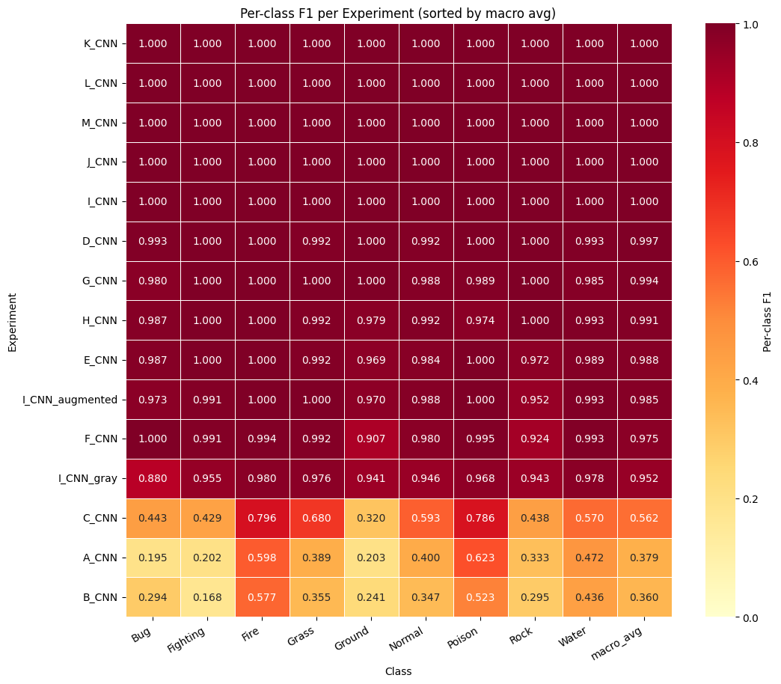
2.1
CNN MODEL DEV
Ensembles
Strategy: Even though some of our models achieve a perfect score, we still decided to combine other to see if the results changed significantly by combining models.
To help analyze possible good combinations we drew a heat map so we can see the results of each model for each class.
Ensemble ~ Solo ?
~
We tried 2 different combinations:
C + H: could a bad model like C affect the performance in an ensemble with H?
I + K: could two models with val score 1.0 be combined together to get a worse performance? (much likely not... but let's test it anyway)

Slide 43
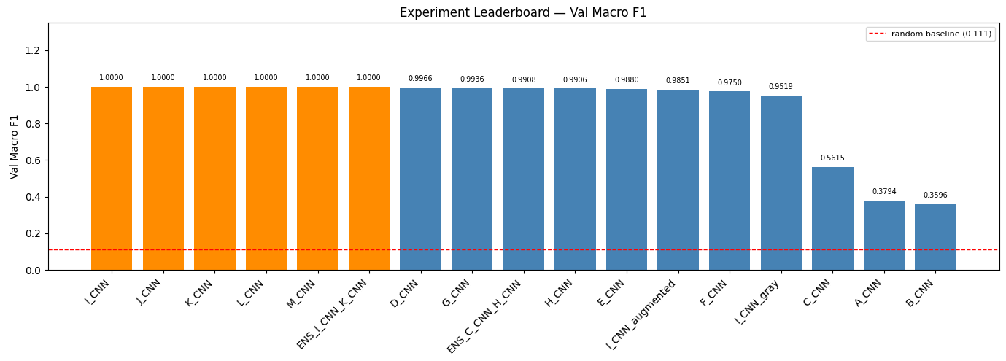
2.1
CNN MODEL DEV
Ensembles
Strategy: As it turns out, [I + K] still gets a validation score of 1.0 as we expected, but [C + H]'s performance stays relatively similar to just using H (with some variance), even though C got a weight of 0.4 and H 0.6. C's bad performance is not enough to drag the ensemble's performance down

Slide 44
2.1
CNN MODEL DEV
What Worked vs. What Did Not
What Worked
Dropout 0.3
- 0.4 was too heavy, 0.15 too light
Weighted CrossEntropyLoss
- prevents collapse on minority classes (Ground, Rock)
WeightedRandomSampler
- all top models use it
BatchNorm
- stabilizes gradients; increases training speed effectively
Deeper/Wider networks
- increases the amount of information/detail passed to the classifier head
What Did Not Work
Augmentation (flip/jitter/rotate/...)
- 0.0149 F1; the pokemons are always the same way, the only thing that changes are the background at the position; CNNs are translation invariant so the only real thing that changes for our network is the background. The more aggressive the augmentation is the bigger the decay in performance
Many FC layers
- 3 or more FC layers starts giving us a slower training and worse results (parameters increase a lot if our convolution channels are wide); keep it simple and let convolutional layers learn the information, then pass them to minimal FC layers
Grayscale input
- 0.0481; colour is a key discriminative signal, removing it degrades performance
Ensembles
- Ensembled models could not achieve a better performance
Label Smoothing
- CNNs can already achieve top performance, introducing noise can hurt our models

Slide 45
2.1
CNN MODEL DEV
MLP Ceiling ~0.24 CNN can achieve a 1.0 score!
Confirmed ceiling metrics
best val macro-F1 (I, J, K, L, M, [I+K])
1.0000
Kaggle public score
1.0000
Why are CNNs so much better than MLP for this task?
The amount of parameters that an MLP generates is too much, we would need a huge dataset to get good results (note that MLPs are more powerful than CNNs - not the contrary)
This problem screams CNN! The dataset has images, In which the pokemons always appear in the same way, only changing their position and the background: CNNs are invariant to translations! MLPs lose all sense of spatial structure
Next: Transfer Learning and Fine-Tuning (Task 3) - can we achieve the same performance by replacing the classifier head of a pretrained model?

Slide 46
2.2
CNN Training Efficiency

Slide 47
2.2
CNN Train Eff
Compute Strategy & Resource Usage
Train Eff
T4 GPU
37 min
< 1500 MB
62%
Colab free tier / 15 GB VRAM
total wall-clock (15 solo runs + data pre-processing/augmentation and ensembles)
GPU memory peak (more than MLP),
according to W&B
of 1h budget used
Metric | Value | Note
Fastest experiment | A_CNN - 87.2 s (excluding ensembles) | Stopped at epoch 19 (no reg -> fast plateau; despite the massive overfit obtained)
Slowest experiment | I_CNN_augmented — 172 s | Full 30 epochs; data augmentation gives us more 53 seconds than base model I_CNN, and worse performance
Avg per experiment | ~134 s | Across 13 solo runs
Best solo (R) | 118.5 s - 25 epochs | EarlyStopping saved best at epoch 25
FAST_RUN flag | FAST_RUN=True | Smoke-test mode: 5 epochs, 100 samples - used for debugging
Why 80/20 split instead of K-Fold CV?
5-fold CV × 13 experiments ≈ 65 training runs ≈ which will exceed the 1h Colab budget. Stratified 80/20 with fixed seed is the correct trade-off: relative experiment ranking is valid even if absolute F1 has ±0.02 noise from a single split.

Slide 48
2.2
CNN Train Eff
Early Stopping — Results Across Experiments
Train Eff
Experiment | Epochs | Stopped? | Takeaway
A - LeNet5_base | 19/30 | ✓ Yes | LeNet5 finds plateau quickly
B - LeNet5_dwrs | 30/30 | ✗ No | Moderate dropout and WRSampler delays convergence
C - Simple_cw | 30/30 | ✗ No | Model fails to converge in 30 epochs (low number and small convolutions)
D - Medium_base | 30/30 | ✗ No | Deeper model allows for more convergence (0.02 train loss); can't find optimum
E - Medium_d | 30/30 | ✗ No | Dropout in previous model doesn't improve convergence; can't find optimum
F - Medium_dls | 30/30 | ✗ No | Dropout and label smoothing hurt the convergence; the problem isn't regularization
G - Medium_dcw | 30/30 | ✗ No | Dropout and class weights; confirms previous theory, we need a deeper/wider network
H - Medium_dwrs | 30/30 | ✗ No | Dropout and WeightedRandomSampler also fails to improve
I - Deep_dwrs ⭐ | 25/30 | ✓ Yes | Two more convolution channels makes finding optimum fast; confirmed theory where regularization was not the issue ✓

Slide 49
2.2
CNN Train Eff
Early Stopping — Results Across Experiments
Experiment | Epochs | Stopped? | Takeaway
J - Wide_d | 22/30 | ✓ Yes | Best checkpoint at epoch 25; patience runs out at 22. Widening channels is an alternative to deepening the network to achieve 1.0
K - Wide_dwrs | 25/30 | ✓ Yes | Apply dropout and WeightedRandomSampler in this wider network gives us a perfect convergence
L - MultiScale_dwrs | 29/30 | ✓ Yes | Early stops with way deep network and multiple scale kernels
M - Residual_dwrs | 19/30 | ✓ Yes | Residual Network converges the fastest (in terms of number of epochs, not time); EarlyStoping occurs earliest

Slide 50
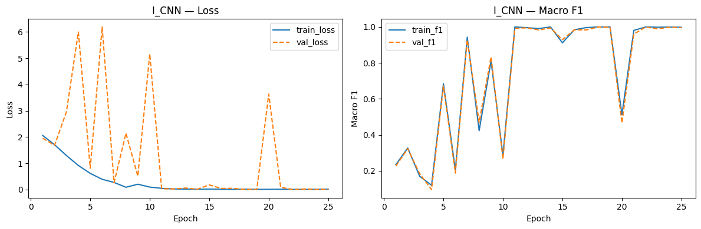
Training Curves — Best Solo R_ls015_drop03
2.2
CNN Train Eff
EarlyStopping metric:
val_loss ≠ val_f1
we use val_macro_f1 (lower = better)
Patience:
7 epochs
Saves best checkpoint .pth per run
Allows >30 epochs when plateau is slow
Ep train_loss val_loss train_F1 val_F1
1 2.0604 1.9553 0.2342 0.2262
5 0.6173 0.8140 0.6838 0.6717
10 0.0970 5.1619 0.2870 0.2652
15 0.0201 0.1798 0.9119 0.9294
18 0.0159 0.0083 1.0000 1.0000 ← checkpoint
20 0.0121 0.3623 0.5121 0.4657
25 0.0173 0.0150 0.9982 0.9964 ← early stopping

Slide 51
2.3
CNN Performance Evaluation

Slide 52
2.3
CNN Perf Eval
Results at a Glance
Perf Eval
1.0000
1.0000
1.0000
0.99752
Best val Macro-F1
(I_CNN)
Best solo Macro-F1
(I_CNN)
Kaggle public score
(submitted M_CNN)
Kaggle private score
(submitted M_CNN)
Metric Comparison vs Baselines
Our model achieved a perfect performance
Kaggle private score:
0.99752
Note: we submitted M (Residual Network) instead of I since it also achieves a perfect score, but with lower losses (10^-3 vs 10^-2). In this report, we decided to analyze I instead of M since it converged faster, and M is so powerful that changing parameters and doing strange augmentation didn't hurt it, making it impossible to come to new conclusions
System macro-F1 acc
Random baseline 0.111 11.1%
Always-Water 0.021 18.7%
M_CNN (submitted) ★ 1.0000 100%
Kaggle public test 1.0000 —
Kaggle private test 0.99752 —

Slide 53
2.3
CNN Perf Eval
Class | CNN F1 | MLP F1 | Improvement
Fire | 1.0 | 0.457 | +0.543
Poison | 1.0 | 0.359 | +0.641
Water | 1.0 | 0.332 | +0.668
Grass | 1.0 | 0.286 | +0.714
Normal | 1.0 | 0.215 | +0.785
Bug | 1.0 | 0.140 | +0.860
Fighting | 1.0 | 0.126 | +0.874
Rock | 1.0 | 0.134 | +0.866
Ground | 1.0 | 0.107 | +0.893
In worse models, the color palette still drives some performance: as in MLPs there's high F1 in Fire/Poison/Water, due to the distinctive colours of these types; shared palette or humanoid shape give us low F1 (Bug/Rock/Fighting/Ground), since they have no predominant colours. These models had more difficulty making the jump from the colours to the shapes of the pokemon themselves

Slide 54
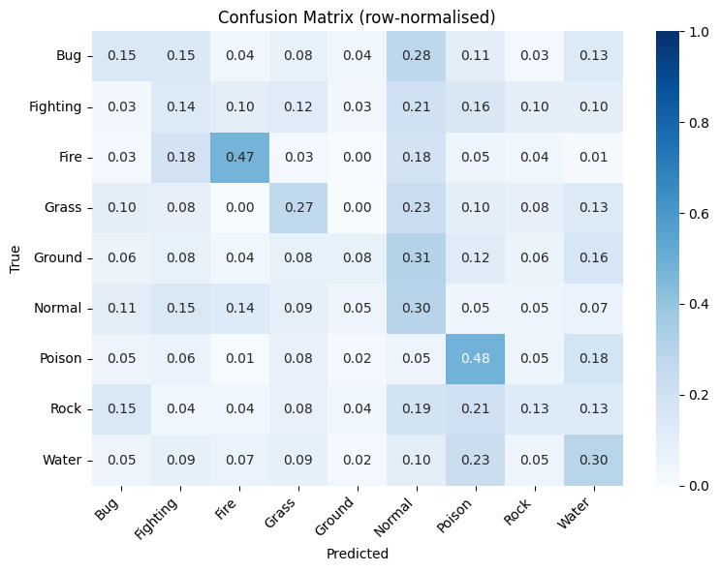
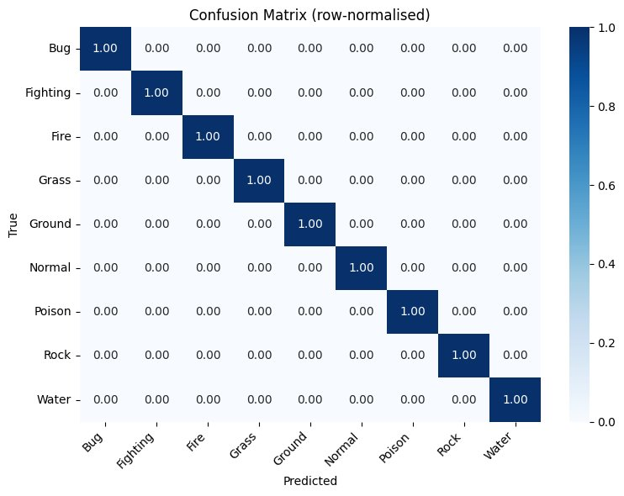
Confusion Matrix — Normal as the Catch-All Class
2.3
CNN Perf Eval
MLP
CNN
Normal is the catch-all for MLP
Normal = most diverse class: humanoids of every shape and size, no dominant colour
Bug, Fighting and Ground all lack distinctive palettes — the MLP falls back to predicting Normal
CNNs are immune to this
As stated before, they can learn other patterns besides colour and independent pixels

Slide 55
Ensemble Analysis & Kaggle Gap
2.3
CNN Perf Eval
All 7 Ensemble Results (soft-average of softmax outputs)
ENSEMBLE I+K ★ F1=1.0000 acc=100% Combining perfect models together doesn't change the result - expected
ENSEMBLE C+H F1=0.9908 acc=99.0% Combining a bad model with a perfect one gave a similar performance, no additional noise (class weights + dropout combination)
Kaggle validation gap
val – 1.0000
kaggle – 0.99752
−0.00248 (-0.2486%)
Negligible gap:
We correctly evaluated our model's performance locally
C + H had a similar performance to solo H
C uses class weights — adjusts gradients per class
H uses dropout — randomly drops neurons
Different mechanisms = different mistakes, but model H's performance doesn't outweigh H's near perfect performance

Slide 56
2.3
CNN Perf Eval
Why Are CNNs Better For This Task?
Perf Eval
Theoretical reasons
Empirical confirmation
Spatial Inductive Bias
CNN vs MLP: +0.7572 F1
A CNN can recognize the same sprite at top-left or bottom-right, even though the input vector is different (translation invariance). MLPs can't learn "this pokemon exists somewhere", even though the pokemons always appears in the same way.
The same pokemon appearing in different positions breaks the pixel vector. CNN doesn't mind this.
Local Feature Learning
CNN vs MLP: -96.7% Parameters
CNNs focus on local pattern (edges, shapes, flame tails, …), rather than treating each pixel independently. MLPs need weights for each pixel, making them prone to overfit on small datasets like this one - too many parameters.
The CNN we analyzed has around 200 000 parameters, while the best MLP model has more than 6 million. With a 4.26/1 feature ratio, the MLP is memorizing noise rather than learning patterns
Hierarchical Feature Learning
CNN Grayscale: -4.81% F1
CNNs can build layered representations from simple edges to more complex shapes. This helps identifying pokemon even when we lose the colour, for example, due to the memorization of the pokemon's shape and details.
The analyzed model has a 4.81% performance decrease (0.9519 F1) when trained with grayscale data, as opposed to RGB. While the performance is worse, it still is much better than the best MLP model (0.2428 F1). The CNN learns the pokemon shapes correctly.

Slide 57
Conclusions & What's Next
Best CNN result: 1.0000 val F1 (I, J, K, L, M, I+K), 0.99752 Kaggle (M)
Next: Task 3
4.12x above MLP best model. All 15 solo + 2 ensemble experiments are above the best MLP.
Transfer Learning and Fine-Tuning
Dropout and WeightedRandomSampler = most impactful techniques
Prevented overfit and handles class imbalance. All top solo experiments use them with dropout=0.3.
Can we use a pre-trained model to our task?
How deep will we need to go to replace the weights? Classifier head only, or further (with minimal learning rates)?
Will augmentation still hurt the models in this new dataset?
Target F1: 0.60 to 0.70
Augmentation hurt
Confirmed empirically: performance decreases while using due to sprites always being presented the same way
CNNs are better than MLPs for this task; ceiling surpassed
Feature-to-sample ratio 4.26:1 = no amount of tuning fixes MLP bad performance; CNN keeps spatial structure, and learns sprite shapes/details
No need for ensembles
Ensembled experiments returned similar results; CNN solo is already good enough for this task
Task 2 complete · Kaggle score: 0.99752 · 17 experiments · ~37 min on T4

Slide 58
DEEP LEARNING · ASSIGNMENT 1 · TASK 3
Pokémon Type Classification
Task 3 – Transfer Learning and Fine-Tunning

Slide 59
What We Cover
1
Model Development
2
Fine-tunning, augmentation and regularization
Architectures · Experiments · Results
Only Head vs Head and Last Layer vs Full · Augmentation techniques · ADMW · Label smoothing · Ensembles
3
Performance Evaluation
Macro-F1 · Per-class · Confusion Matrix

Slide 60
3.1
Model Development

Slide 61
1
MODEL DEV
Exploration strategy
Strategy: We explored different pre-trained models from pytorch. For each one we tested with 2 different heads, a basic linear and another with two linears + ReLu, on some of the models we also tested with the best MLP as the head. This is a small sample of the numerous models we explored:
ID | Name | Model | Criterion (~loss function) | Optimizer | Rationale behind base model selection
A | EfficNetB0_Base | EfficientNet-B0 [total params: 4,019,077] | CE + class weights + dropout | Adam lr=1e-3 | Used as a baseline by google, made to be simpler than other popular choices
B | VGG16_Base | VGG 16 [total params: 134,297,417] | CE + class weights + dropout | Adam lr=1e-3 | Simple architecture, excellent feature extractor, highly used in transfer learning tasks
C | SwinV2t_Base | SwinV2-Tiny [total params: 27,589,491] | CE + class weights + dropout | Adam lr=1e-3 | Testing vision transformers efficacy on our task, smaller than original, highly stable
D | ResNet34_Base | ResNet34 [total params: 21,289,289] | CE + class weights + dropout | Adam lr=1e-3 | Made for small datasets, efficient and lightweight
E | ConvNext_Base | ConvNeXt Tiny [total params: 27,827,049] | CE + class weights + dropout | Adam lr=1e-3 | Combines transformers performance with CNN’s speed and efficiency, smaller than the original
M | ResNet18_Cust | ResNet18 with custom head [total params (base version): 11,756,593] | CE + class weights + dropout | Adam lr=1e-3 | Similar to ResNet18 but with even less layers, might be better for our small dataset
L | Efficientnet_v2_s_Cust | EfficientNetV2-S with custom head[total params (base version): 20,189,017] | CE + class weights + dropout | Adam lr=1e-3 | Optimized for image classification, improves upon the original EfficientNet, and is the smaller version
N | SwinV2t_MLP | SwinV2-Tiny with best MLP head | CE + class weights + dropout | Adam lr=1e-3 | Testing vision transformers efficacy on our task, smaller than original, highly stable
⭐
We prefer the smaller versions due to the resource constraints but manly due to the small dataset

Slide 62
1
MODEL DEV
Rationale for head choices
Best MLP from task 1
Idea: Take advantage of the already extracted features coming from the pre-trained model to improve the original MLP scoring.
Outcome: The large number of layers and the big dimension of those layers, together with the small dataset led to the models having an hard time capturing the patterns.
Simple 2 Linear (in_features -> 64 -> 9) + Relu Layer + Layer norm
Idea: Uses smaller layers than the original MLP, preventing overfit but at the same time giving “space” for the model to capture the patterns.
Outcome: We still got overfit on the models, but they were converging faster, and got better results than the MLP heads, meaning the model is capturing better the patterns, and with regularization we might beat the base model.
Val F1 |Val Acc
-53%!
-14.4%

Slide 63
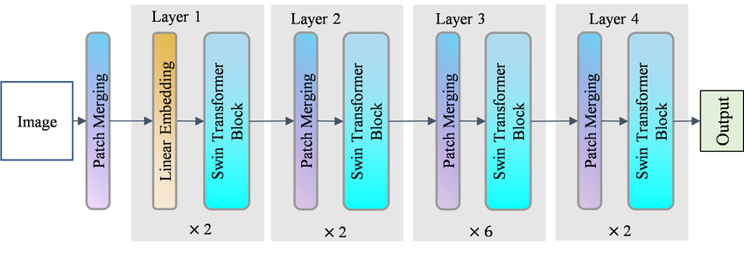
1
MODEL DEV
Best Part 1 Model - SwinV2t_Base
Architecture of a swin transformer:
For our model we substitute the head of the model by a simple linear function with dropout

Slide 64
1
MODEL DEV
Training setup
Optimizer, Scheduler & Early Stopping:
Optimizer + Scheduler, maintained from task 2 since it showed being the best solution
Adam lr=1e-3 — robust adaptive LR, standard for CNNs (Kingma & Ba, 2015)
StepLR(step=7, gamma=0.5) — halves LR every 7 epochs; Changed from the previous task due to the dataset being nosier.
Early Stopping (patience=7), also maintained from the previous task, useful when dealing with this noisy dataset
Monitors -val_macro_f1 (competition metric, not val_loss)
Patience=7 — val_f1 is noisy (720 val samples, ~80/class: 1 error = +-1.2% swing); 3 would fire prematurely
Saves best checkpoint automatically; restores at inference

Slide 65
3.2
Fine-tunning and other techniques

Slide 66
2
FT and AUG
Partial 1 layer Vs Fully Frozen Vs Fully unfrozen
Objective: Analyze the impact of unfreezing on the model generalization and capacity.
Partial
Full
By only unfreezing, the last layer we observed that the model improved its validation f1 score over the full freeze version, this is due to we being essentially further customizing the model to our specific problem.
By fully unfreezing the model we are essentially creating a model from the ground up which might seem counter intuitive for this task, but was made with the intent of analyzing the impact of uncareful unfreezing of a model at extreme levels.
And so we concluded that despite having overfitted, it improved the f1 score even over the partial version, this can be explaining by the total customization that we are making, despite the improved result, the downside is the heavy computation that was needed to train, taking around 20s/Epoch Vs 17s/Epoch of the partial version.
+4.81%
+15%!

Slide 67
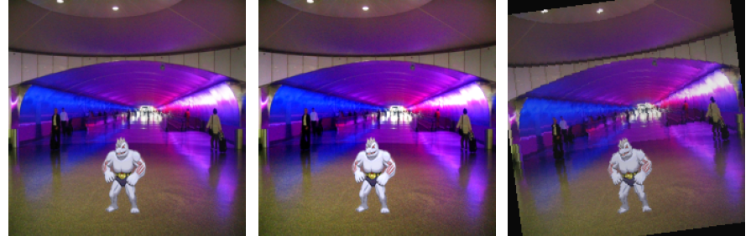
2
FT and AUG
Data Augmentation
New Perspective: On the last task we mentioned that augmentation would hurt our model, but in this task, we viewed it from a different angle
+7.7%!
Since the dataset was smaller and the models had lots of parameters, it was easy for them to overfit, therefore we tried using augmentation strategies as a way to avoid the model to “memorize” and instead learn.
For this we used a custom data loader that applied the following augmentation strategies:
RandomHorizontalFlip (p=0.5): The image has a 50% chance of being flipped horizontally.
RandomRotation (±10°): The image is rotated by a small amount (up to 10 degrees).
ColorJitter (mild): It applies very slight changes to brightness, contrast, and saturation.

Slide 68
2
FT and AUG
Regularization
Objective: Use regularization techniques to prevent the model from overfitting/memorizing the images.
Label Smoothing
AdamW (Adam + Weight Decay)
Technique where instead of hard targets [0,0,1,0,…], uses [ε/K, …, 1−ε+ε/K, …] (ε=0.1, K=9), this helps
preventing overconfident predictions, acting as an implicit regularizer when training data is small, which is the case here.
Decouples weight decay from the gradient update, avoiding its absorption into the gradient descent scaling, essentially applies “true” L2 regularization.
+14%!
+11.6%!

Slide 69
2
FT and AUG
WeightedRandomSampler
Objective: Decrease overfitting by balancing classes frequency
+14%!
WeightedRandomSampler by using a mechanism of sampler over-samples rare classes so each batch has an approximately uniform class frequency, this way the model doesn’t specifies on a specific class and instead implicitly improves its scoring in a similar way for all classes. This is especially important in small datasets like this where if not taken care the classes can become highly unbalanced in the batches.

Slide 70
2
FT and AUG
AdamW + LS Vs AdamW + Ls +Augmentation
Objective: Combine the 2 main regularization techniques and see if the effect “stacks”, and at the same time compare the effects of augmentation on top of them, will it provide the best improvement?
+6.5%
-2.3%!
Observations:
Combining both regularization techniques continues to improve the model but the improvement is smaller when compared with either techniques individually.
Combining the previous model with augmentation, the model validation score decreased when compared with the basic model.
When analyzing this values, two possible explanations are that the swim model is simply too complex for this task, and by heavily regularizing it we are taking away its “memorization” capabilities, showcasing the model true weaknesses, or the head is not complex enough since the gap between val f1 and train f1 effectively decresed.

Slide 71
2
FT and AUG
Best Fine-tunning with best Augmentation/regularization
Objective: Now that we have analyzed fine-tunning and augmentation/regularization separately, its time to compare the them!
+8.5%
Observations:
Improved is larger when compared with the previous combinations
Still falls short in comparation to the individual label smoothing over the fully frozen model
Suggests that the model is just too complex for this task with the amount of data we have

Slide 72
2
FT and AUG
Different approach: ResNet18 with ADMW + LS + Aug
New Perspective: As mentioned before swin is just too complex for this task, with the amount of data we have, and to test this theory we are changing models
+24.6%! (over the base swin)
Previous best
New model:
ResNet18 with custom 2 linear (in_features -> 128 -> 9) + ReLu + batch norm and dropout : It’s one of the simpler models on our list, perfect for small datasets, the head is slightly more complex to be a middle ground between MLP and the new custom head that could not be capturing the patterns.
Observations:
Significant improvement over the base swin and over the previous best model.
The model is now in the “sweet spot” between complexity and efficiency.
Still need to improve generalization, since train score even got to 1.

Slide 73
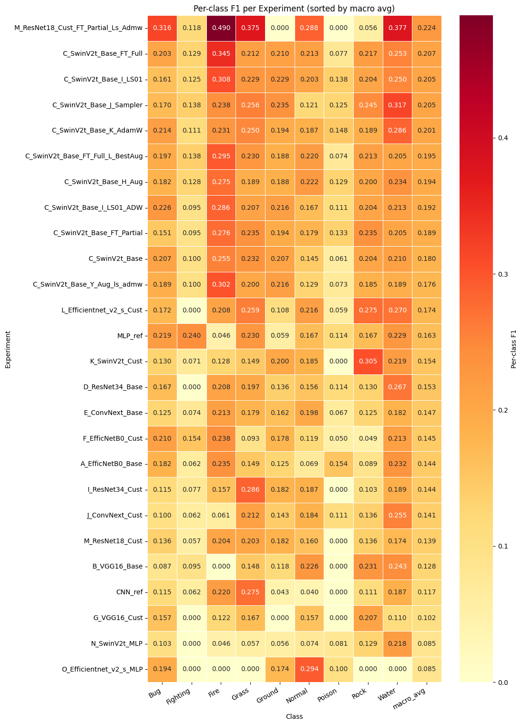
2
FT and AUG
Ensembles
Strategy: Test the impact of ensembles on our new best, can we improve further its score?
For this we are using both ResNets, 34 and the best 18, with the theory that the similar architectures and the fact that both are good for smaller datasets might create a good combination.
Ensemble ~ Solo ?
~
Despite improving over the ResNet34_cust, it falls short when compared to the current best, a good next step might be applying the same fine-tuning/augment to the ResNet34 model

Slide 74
2
FT and AUG
What Worked vs. What Did Not
What Worked
Label Smoothing
Huge improvement over the base model, contains the overfitting
Augmentation
Helps the model to extract the right information from the small and noisy data set
AdamW
Punishes the heavy overfitting of the models that contain main parameters
WeightedRandomSampler
Makes the model “see” the different classes with a more uniform frequency, especially important when we have small datasets
Changing to a simpler model
Swin is just to complex for this task, ResNet18 with all the augmentations, despite still overfitting, can capture the patterns much better
What Did Not Work
Combining Regularization strategies on the previous best
Improvement doesn’t stack, due to the underlying model complexity
Combining best fine-tuning + augmentation on swin
The added augmentation further exposes the underlying model pattern recognition problems
Ensembles
Despite being an improvement over the solo ResNet34 with custom head, didn’t surpass the best model, maybe applying the same strategies that we applied to the ResNet18 to the ResNet34 might be a logic next step.

Slide 75
3.3
Performance Evaluation

Slide 76
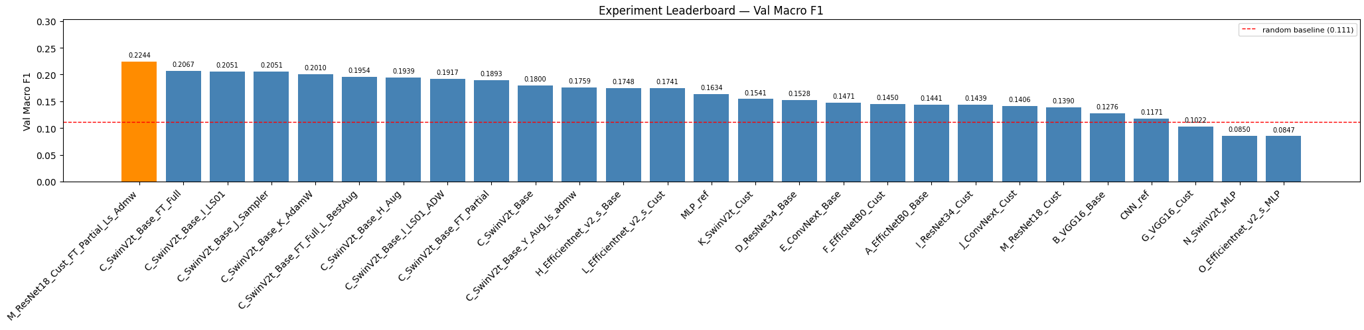
3
Perf Eval
Did we maintain the CNN scoring?
Overfitting consequences
best val macro-F1 (M with full augment and partial unfreezing)
0.2244
Kaggle public score
0.19966
Why weren’t we able to improve more?
The small amount and its noisier nature when compared to different tasks difficulted from the start this task
Even with heavy regularization and data augmentation the overfitting was still very present
Suggests that we might have needed a different model or be even more careful with the fine tunning

Slide 77
3
Perf Eval
Compute Strategy & Resource Usage
Train Eff
T4 GPU
2:10 h
< 15000 MB
72%
Colab free tier / 15 GB VRAM
total wall-clock (26 solo runs + data pre-processing/augmentation and ensembles)
GPU memory peak (more than CNN and MLP),
according to W&B
of 3h budget used
Metric | Value | Note
Fastest experiment | F_EfficNetB0_Cus - 124.4 s (excluding ensembles) | Stopped at epoch 9, severely overfitted, had no regularization strategies
Slowest experiment | C_SwinV2t_Base_H_Aug — 403 s | Full 20 epochs; data augmentation gives us more 73.8 seconds than base model, but better performance
Avg per experiment | ~233.3 s | Across 26 solo runs (excluding ensemble)
Best solo (R) | 281.9 s - 20 epochs | No early stopping needed
FAST_RUN flag | FAST_RUN=True | Smoke-test mode: 2 epochs, 1 patience - used for debugging
Why 80/20 split instead of K-Fold CV?
5-fold CV × 27 experiments ≈ 135 training runs ≈ which will exceed the 3h Colab budget. Stratified 80/20 with fixed seed is the correct trade-off: relative experiment ranking is valid even if absolute F1 has ±0.02 noise from a single split.

Slide 78
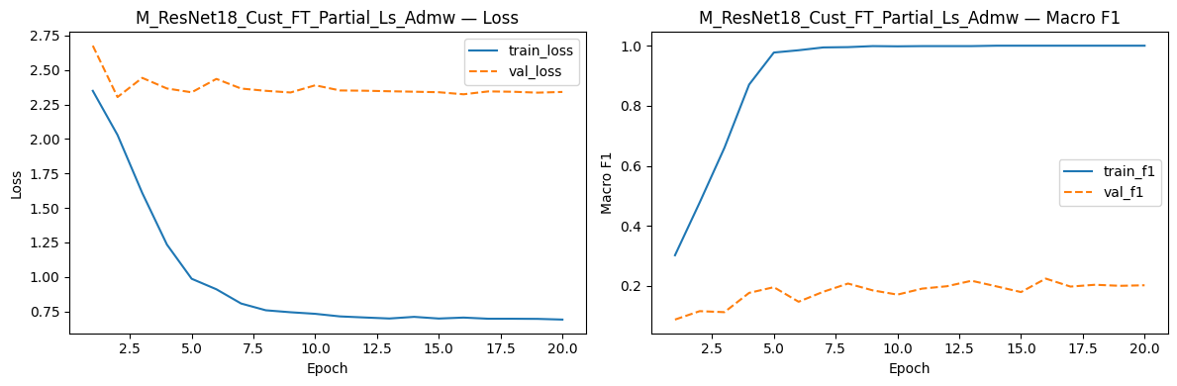
3
Perf Eval
Training Curves — Best Solo M_ResNet18_Cust_FT_Partial_Ls_Admw
EarlyStopping metric:
val_loss ≠ val_f1
we use val_macro_f1 (lower = better)
Patience:
Used full 20 epochs
Saves best checkpoint .pth per run
Allows to compute the 20 epochs when plateau is slow even with early stopping

Slide 79
3
Perf Eval
Results at a Glance
Perf Eval
0.2244
0.2244
0.19966
0.18981
Best val Macro-F1
(ResNet18)
Best solo Macro-F1
(ResNet18)
Kaggle public score
(submitted best ResNet18)
Kaggle private score
(submitted best ResNet18)
Metric Comparison vs Baselines
System macro-F1 acc
Random baseline 0.111 11.1%
Always-Water 0.021 18.7%
ResNet18_best ★ 0.2244 29.3%
Kaggle public test 0.19966 —

Slide 80
3
Perf Eval
Class | CNN F1 | MLP F1 | ResNet18 TL F1 | Improvement (over the MLP)
Fire | 1.0 | 0.457 | 0.490 | +0.033
Poison | 1.0 | 0.359 | 0.00 | -0.359
Water | 1.0 | 0.332 | 0.380 | +0.048
Grass | 1.0 | 0.286 | 0.380 | +0.094
Normal | 1.0 | 0.215 | 0.290 | +0.075
Bug | 1.0 | 0.140 | 0.320 | +0.18
Fighting | 1.0 | 0.126 | 0.120 | 0.00
Rock | 1.0 | 0.134 | 0.06 | -0.074
Ground | 1.0 | 0.107 | 0.00 | -0.107
+91.6% (over the CNN)!
Despite the smaller and noisier dataset our new model showed improvements over the MLP in the majority of the classes when comparing their values for the other tasks.
On the other hand, when we compare the models on the current task, our model is clearly better in F1 score.

Slide 81
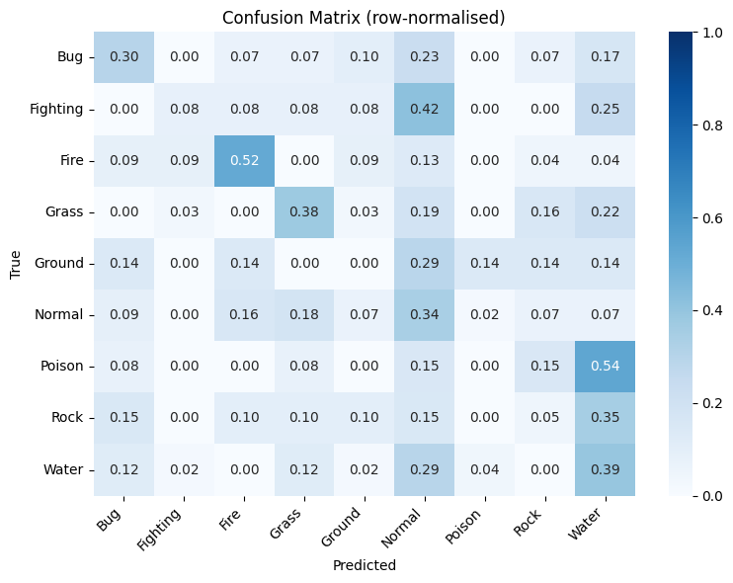
3
Perf Eval
Confusion Matrix — Normal as the Catch-All Class
ResNet 18 best
Transfer Learning:
Worse than CNN, but improved over MLP
The pre-trained model gives the capacity to extract the important features using the CNN computer vision efficiency, but the head, regularization and small data set didn’t allow for a larger improvement.

Slide 82
3
Perf Eval
Kaggle Gap
Kaggle validation gap
val – 0.2244
kaggle – 0.19966
−0.02474 (-0.11%)
Gap Explanation:
As mentioned previously the best model still suffered from overfitting even with the heavy regularization, this led to the discrepancy in values, even if it isn’t much bigger

Slide 83
3
Perf Eval
What can be improved & Possible Next Steps?
Perf Eval
Theoretical reasons
Empirical confirmation
Try new ensembles
Try new base models
Train a new ResNet34 with a similar configuration (regularization and augmentation) than the best model.
Mobile net small can also be a good option for small datasets like this one.
Try even more aggressive regularization
Try to let the model focus on its weaker classes
The main problem of our best model is the quick increase on the training set, reaching an f1 score of 1, while not generalizing to the training set.
There are classes where the model as a 0 score, making the model see more examples of this class at training with different sampling strategies might increase our overall score.
New data augmentation
Use different strategies that can reduce the image noise and let the model focus on the pokemon.

Slide 84
Conclusions
With the decrease of the data set, overfitting becomes very easy to accomplish
Unfreezing models shapes them better to the current task but has complexity drawbacks and can ruin the feature extraction capabilities inherent to their original weights
Regularizationn techniques become essential, and data augmentation can help with seeing variety in the dataset
Simpler Models are better then highly complex ones, models with high numbers of parameters easily overfit by “memorizing” the images
No need for ensembles
Ensembled experiments returned similar results; Best solo is already good enough for this task
Task 3 complete · Kaggle score: 0.19966 · 27 experiments · ~2:10 h on T4

Slide 85

DEEP LEARNING · ASSIGNMENT 1 · TASK 3
Pokémon Type Classification
70698 – Francisco Silva
73208 – Rúben Silva
73554 – Miguel Cangalhas

