Slide 1

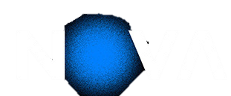

DEEP LEARNING · ASSIGNMENT 1
Pokémon Type Classification
TASK 1 - Multi-Layer Perceptron
TASK 2 - Convolutional Neural Network
70698 – Francisco Silva
73208 – Rúben Silva
73554 – Miguel Cangalhas

Slide 2
What We Cover
Task 1
............................... Slide 3
Task 2
............................... Slide 32

Slide 3
DEEP LEARNING · ASSIGNMENT 1 · TASK 1
Pokémon Type Classification
Task 1 - Multi-Layer Perceptron

Slide 4
What We Cover (Task 1)
1.1
Data Exploration & Analysis
1.2
MLP Model Development
EDA · class imbalance · pixel stats · t-SNE
Architecture · 19 experiments · regularization
1.3
MLP Training Efficiency
1.4
MLP Performance Evaluation
Early stopping · GPU budget · checkpointing
Macro-F1 · per-class · confusion matrix

Slide 5
1.1
Data Exploration & Analysis

Slide 6
1.1
EDA
The Dataset at a Glance
3 600
900
9
64x64
training images
test images
Pokémon types
px resolution
Class | Count | % train
Water | 674 | 18.7% ▲
Normal | 606 | 16.8%
Poison | 467 | 13.0%
Fire | 381 | 10.6%
Bug | 374 | 10.4%
Grass | 299 | 8.3%
Fighting | 291 | 8.1%
Rock | 264 | 7.3%
Ground | 244 | 6.8% ▼
Imbalance ratio: 2.76x
💧
😐
☠️
🔥
🐛
🌿
⚔️
🗿
🌍
Implications:
Predicting "Water" every time
gives 18.7% accuracy
but macro-F1 = 0.021
So accuracy hides the real failure on minority classes.
macro-averaged F1
Weights all 9 classes equally
No advantage for majority classes
Solution:

Slide 7
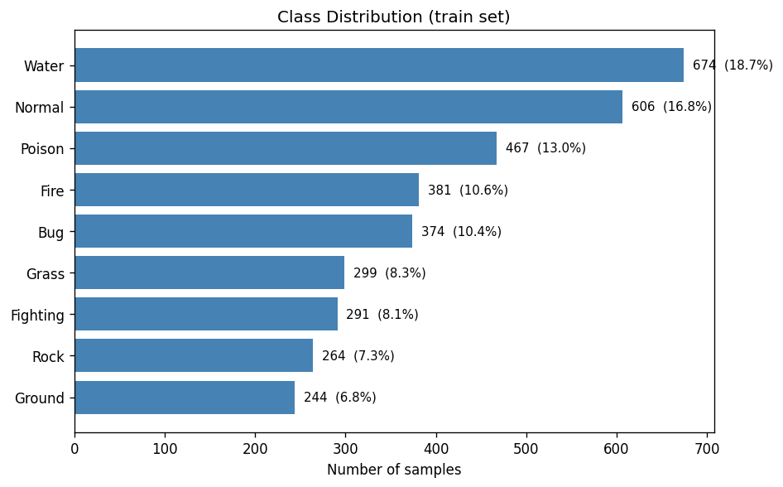
1.1
EDA
Class Imbalance — Visual Overview
EDA
Class distribution (train set)
2.76×
💧
😐
☠️
🔥
🐛
🌿
⚔️
🗿
🌍
Water / Ground imbalance ratio
18.7%
Water (most common class)
6.8%
Ground (rarest class)
Our mitigation strategy
0.021
- Inverse-frequency class weights in CrossEntropyLoss
Used in experiments like B, C, D, F, G, J, L, R, S,
- WeightedRandomSampler
Used in experiments like E, M, O, Q,
Naive baseline: always predict Water

Slide 8
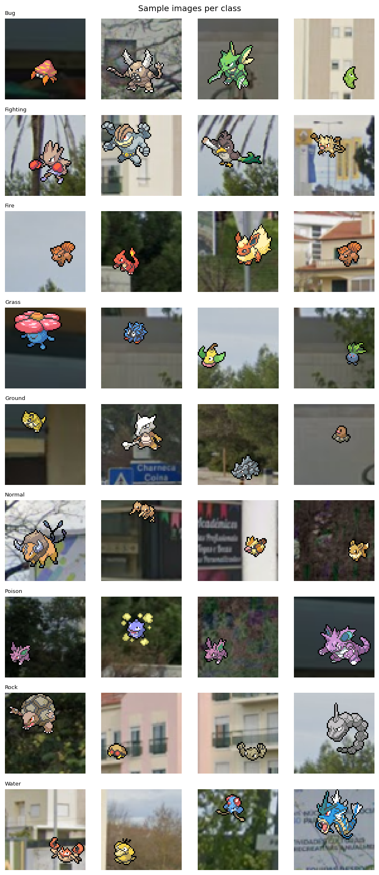
1.1
EDA
What the Data Looks Like
EDA
🐛 Bug
⚔️ Fighting
🔥 Fire
🌿 Grass
🌍 Ground
😐 Normal
☠️ Poison
🗿 Rock
💧 Water
4 samples per class (pokemons overlaid on real-world backgrounds) »»»
Bug vs Grass
Both dominated by green/yellow tones
» color histograms overlap heavily
Fighting vs Normal
Both dominated by brown tones
» color histograms overlap heavily
Rock vs Ground
Brown/grey palettes
» hardest confusion pair in our results
Real backgrounds
Sprites on street photos
» random background noise adds pixel variability

Slide 9
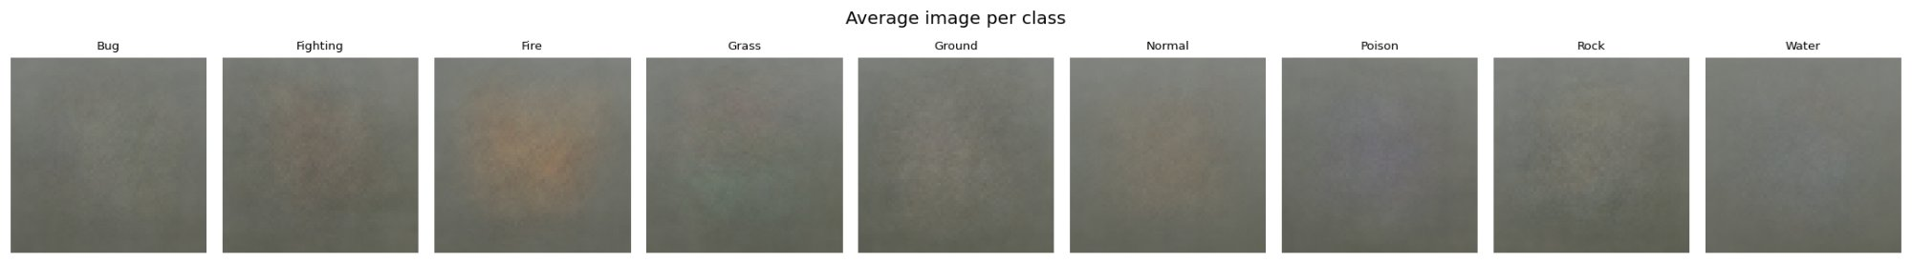
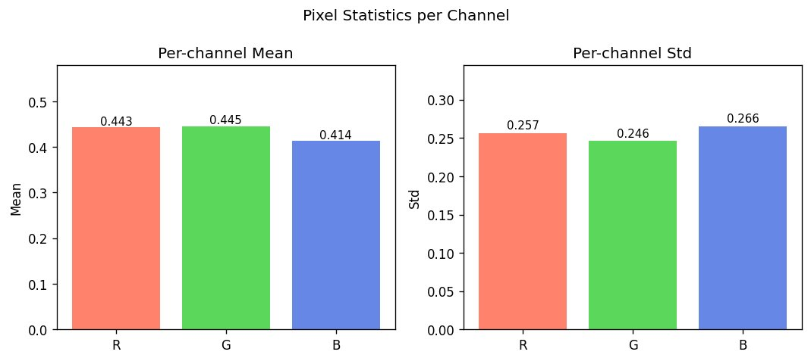
1.1
EDA
Average Image Per Class & Pixel Statistics
DA
Average image per class — blurriness reveals intra-class variance (e.g.: we can expect that Fire will be more correctly identified)
🐛 Bug ⚔️ Fighting 🔥 Fire 🌿 Grass 🌍 Ground 😐 Normal ☠️ Poison 🗿 Rock 💧 Water
Per-channel mean & standard deviation (train split, no leakage)
Ch | Mean | Std | ImageNet mean
R | 0.443 | 0.257 | 0.485
G | 0.445 | 0.246 | 0.456
B | 0.414 | 0.266 | 0.406
< 0.05 difference on all channels between our data set and ImageNet
- Stats computed from train split only: no val leakage.
- ImageNet normalisation is acceptable, and possibly useful for task 3.

Slide 10
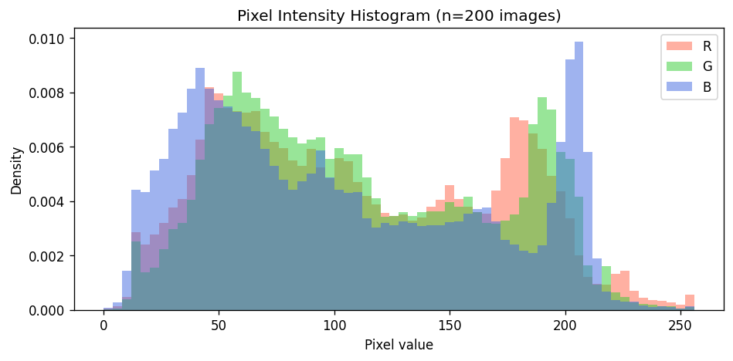
1.1
EDA
Pixel Intensity Distribution
EDA
Bimodal distribution
Two peaks: dark backgrounds (~50) and bright sprites (~200). Pokémon dataset is brighter overall than ImageNet.
B channel prominent at high values
Blue channel spikes above R and G near value 200 — confirms blue bias (Water...)
💧
😐
☠️
🔥
🐛
🌿
⚔️
🪨
🌍

Slide 11
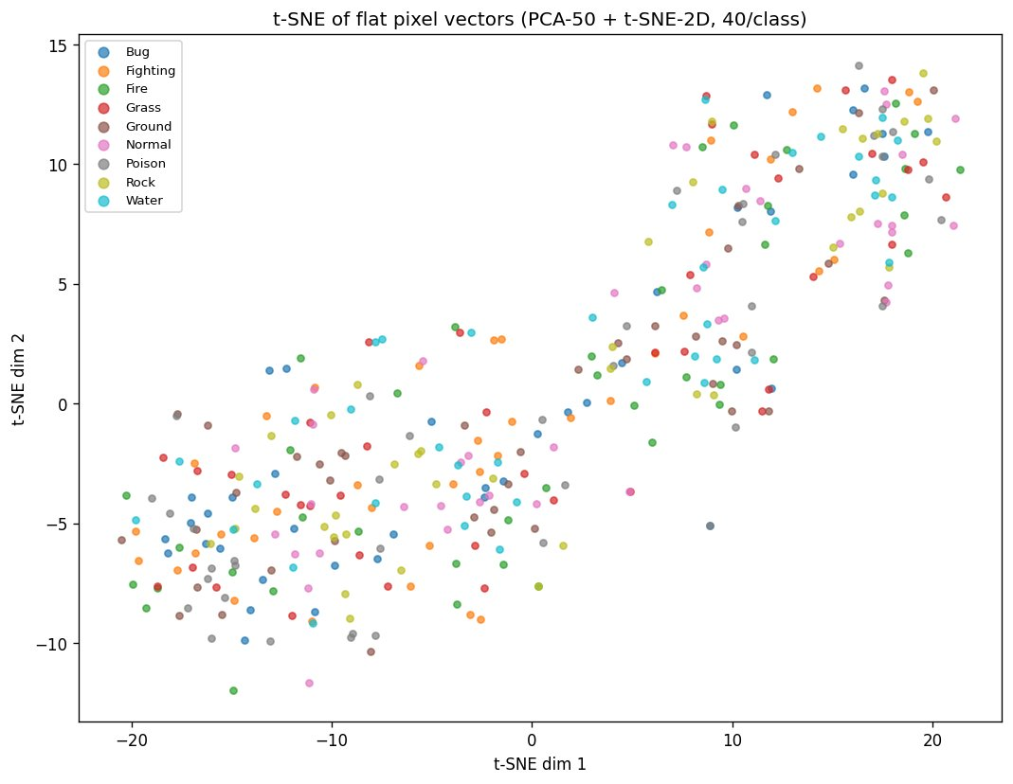
1.1
EDA
t-SNE: Can Flat Pixels Separate the 9 Classes?
EDA
No clean clusters
All 9 types heavily overlap in flat pixel space.
Even with PCA-50 preprocessing, classes are not linearly separable.
Direct motivation for CNN
This scatter is exactly why MLP hits a ceiling.
CNN adds spatial inductive bias — learns position
» MLP physically cannot.

Slide 12
1.2
MLP Model Development

Slide 13
1.2
MLP MODEL DEV
Exploration strategy
Strategy: we started by exploring different base models with different characteristics (number and size of layers, batch normalization, dropout, regularization L2/weight decay, label smoothing, weighted sampler, etc.
Then, having a sense of the best models so we explored different small variations of them.
We explored over 20 different models. Here we present a small sample of them.
ID | Name | Model | Criterion (~loss function) | Optimizer | Purpose
A | vanilla | MLP([128, 64], drop=0, no BN) | CrossEntropy | Adam lr=1e-3 | True bare baseline — no regularisation at all
B | mlp_base | MLP([512, 256, 128], drop=0.4) | CE + class weights | Adam lr=1e-3 | First Colab run result (~0.193)
C | ls01_drop03 | MLP([512, 256, 128], drop=0.3) | CE + weights + label_smoothing=0.1 | Adam lr=1e-3 | Softer targets + lighter dropout
D | wd1e4 | MLP([512, 256, 128], drop=0.3) | CE + weights + label_smoothing=0.1 | Adam lr=1e-3, WD=1e-4 | L2 reg on top of C
E | sampler | MLP([512, 256, 128], drop=0.3) | CE + label_smoothing=0.1 (sampler used instead of class-weights) | Adam lr=1e-3 | WeightedRandomSampler replaces class weights
F | narrow | MLP([256, 128, 64, 32], drop=0.3) | CE + weights + label_smoothing=0.1 | Adam lr=1e-3, WD=1e-4 | Fewer params per layer — less overfit?
G | bottleneck | MLP([512, 1024, 256, 128], drop=0.3) | CE + weights + label_smoothing=0.1 | Adam lr=1e-3, WD=1e-4 | Wide middle captures more combinations?
M | c_sampler | MLP([512, 256, 128], drop=0.3) + WeightedSampler | CE + label_smoothing=0.1 (sampler replaces class-weights) | Adam lr=1e-3 | Sampler on top of C — ~same as E (val_macro_f1=0.2361)
N | cosine_lr | MLP([512, 256, 128], drop=0.3) + CosineAnnealing | CE + weights + label_smoothing=0.1 | Adam lr=1e-3 + CosineAnnealingLR | Cosine schedule, no improvement (val_macro_f1=0.2251)
R | ls015_drop03 | MLP([512, 256, 128], drop=0.3) | CE + weights + label_smoothing=0.15 | Adam lr=1e-3, WD=1e-4 | Best solo — LS=0.15 > LS=0.10 (val_macro_f1=0.2396)

Slide 14
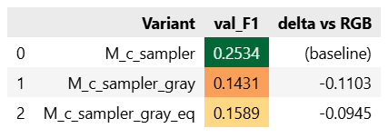
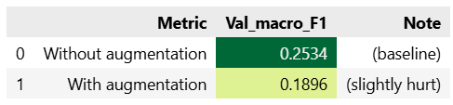
1.2
MLP MODEL DEV
Pre-Processing & Data Augmentation
Strategy: Having the best model we tried to apply different pipelines of pre-processing and data augmentation.
Pre-Processing
Data Augmentation
Grayscale
A 64x64 RGB image results in an initial vector of length = 12.288. If we convert to grayscale it would be a vector of 4096. Could a smaller vector preserve all the necessary important information for the model? Turns out no. Pokemon classification is strongly color-dependent (Fire=orange, water=blue, poison=purple, grass=green)
RandomHorizontalFlip, ColorJitter, RandomRotation...
Could we improve the quality of our training dataset and help the model to generalize better? This is a valid hypothesis for CNN, but as expected, not for MLP, because MLPs convert the image to a simple vector losing all spatial sense.

Slide 15
1.2
MLP MODEL DEV
MLP Best (SOLO) Model (R_ls015_drop03)
Architecture:
Input
12 288
64x64x3 flat
Hidden 1
512
BN + ReLU + D(0.3)
Hidden 2
256
BN + ReLU + D(0.3)
Hidden 3
128
BN + ReLU + D(0.3)
Output
9
logits
Funnel Design
Progressive compression forces generalisation
Better than:
Narrow (256-128-64-32): too bottlenecked for colour histogram learning
Wider first layer (1024): more capacity = more memorisation
4-layer deep: harder to regularise on small data
BatchNorm + ReLU + Output Logits
BatchNorm1d after every Linear
stabilises gradients on 12 288-dim flat input
ReLU
no vanishing gradient for positive activations, simple and efficient
Raw logits at output
CrossEntropyLoss fuses log_softmax internally (numerically stable)
argmax(logits) == argmax(softmax(logits)) — so no softmax needed at inference
Exception: ensemble averages softmax outputs — raw logit scales differ across models

Slide 16
1.2
MLP MODEL DEV
MLP Best (SOLO) Model (R_ls015_drop03)
Regularization Strategy:
Dropout (0.3)
Applied after every hidden layer
Randomly zeroes 30% of neurons each forward pass
Prevents co-adaptation, forces redundant representations
Why 0.3? — Search result:
Drop 0.4 (model B) = 0.222 — too aggressive
Drop 0.2 (model J) = 0.236 — close but weaker
Drop 0.15 (model P) = 0.217 — too light
Drop 0.3 = 0.240 — sweet spot confirmed
Label Smoothing (0.15)
Most impactful single change
Softens hard one-hot targets (0.85/0.15 blend vs 1.0 hard)
Prevents overconfident predictions on visually ambiguous classes
Key on noisy boundaries — Bug/Grass and Rock/Ground share colour palettes
Evidence:
All 6 top-tier solos (F1 > 0.235) use LS >= 0.1
LS=0.15 (R) = 0.2396 vs LS=0.10 (C) = 0.2395 — tiny but consistent
+0.017-0.019 F1 vs baselines with no LS
Imbalance Handling
Weighted CrossEntropyLoss (primary)
Inverse-frequency weights per class (Ground=1.64x, Rock=1.52x, Water=0.59x)
Addresses 2.76x Water/Ground imbalance at gradient level
WeightedRandomSampler (tested separately)
Oversamples minority classes at the data level
Useful as ensemble diversity: different error patterns vs CW
Pitfall: CW + Sampler together
Model O (double-compensating) = F1 0.192 — over-correcting imbalance hurts

Slide 17
1.2
MLP MODEL DEV
MLP Best (SOLO) Model (R_ls015_drop03)
Training Setup — Optimizer, Scheduler & Early Stopping:
Optimiser + Scheduler
Adam lr=1e-3 — robust adaptive LR, standard for MLPs (Kingma & Ba, 2015)
StepLR(step=5, gamma=0.5) — halves LR every 5 epochs; CosineAnnealingLR also tested but no improvement (N=0.225)
Early Stopping (patience=7)
Monitors -val_macro_f1 (competition metric, not val_loss)
Patience=7 — val_f1 is noisy (720 val samples, ~80/class: 1 error = +-1.2% swing); 3 would fire prematurely
Saves best checkpoint automatically; restores at inference

Slide 18
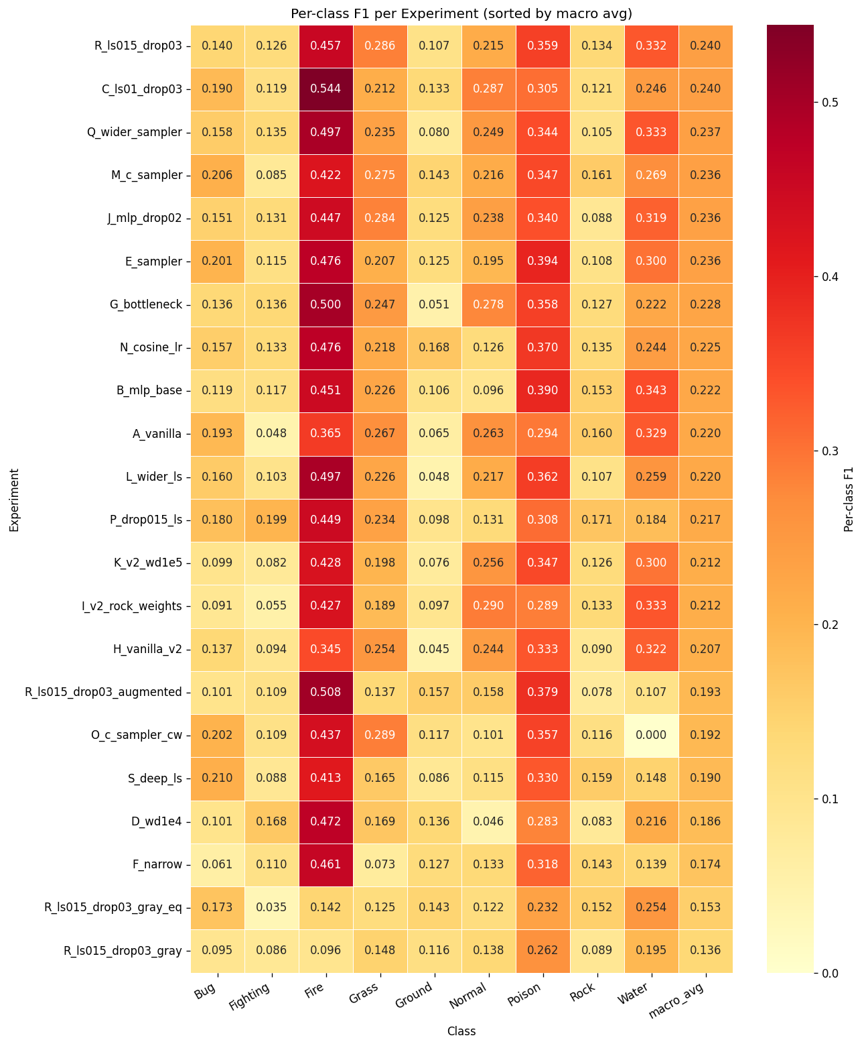
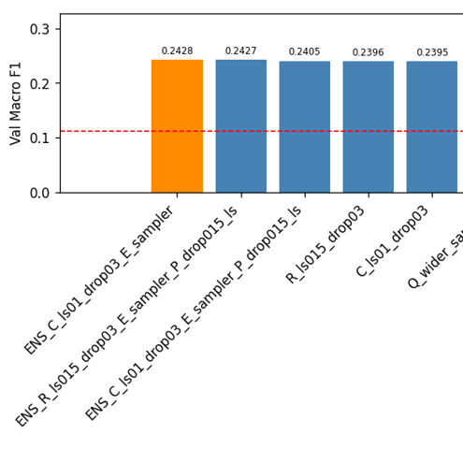
1.2
MLP MODEL DEV
Ensembles
Strategy: Having the best models we tried to combine them to see if we got better results by using some better characteristic of some model to compensate for worse performance in other model.
» To help analyze possible good combinations we draw a heat map so we can see the results of each model for each class.
Ensemble > Solo
As we could confirm some ensembles allowed us to achieve better performance than solo models
🐛 ⚔️ 🔥 🌿 🌍 😐 ☠️ 🗿 💧 avg

Slide 19
1.2
MLP MODEL DEV
What Worked vs. What Did Not
What Worked
Label smoothing (0.10-0.15)
- all top-6 solos use it;
- +0.017-0.019 vs no-LS baselines
Dropout 0.3
- 0.4 was too heavy, 0.15 too light
Weighted CrossEntropyLoss
- prevents collapse on minority classes (Ground, Rock)
WeightedRandomSampler
- creates diversity for ensembles
BatchNorm1d
- stabilizes gradients on 12 288-dim flat input
- (model B > A by +0.002)
Soft ensemble C+E
- +0.003 over best solo;
- diversity of error correction wins over strength
What Did Not Work
Augmentation (flip/jitter/rotate)
- 0.047 F1; MLP has no spatial invariance, flipped images = different vectors
Wider first layer (1024)
- L=0.220; more capacity = more memorisation on 2 880 samples (doesn’t generalize well)
Deeper net (4 layers)
- S=0.191; extra depth can not be regularised effectively on small data
Grayscale input
- 0.136; colour is the primary discriminative signal, removing it destroys performance
Sampler + CW together (model O)
- 0.192; double-compensating imbalance over-corrects
Strong weight decay (1e-4)
- D=0.186; combined with LS + dropout = too many simultaneous constraints

Slide 20
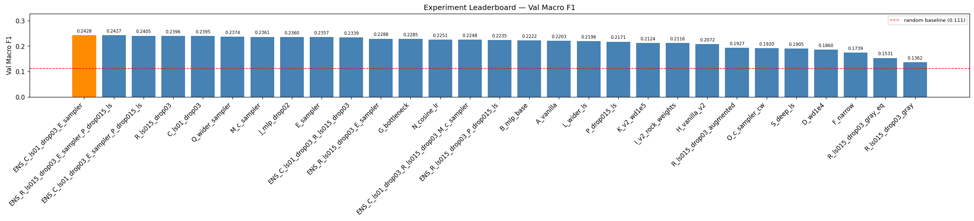
1.2
MLP MODEL DEV
MLP Ceiling ~0.24
Confirmed ceiling metrics
best val macro-F1 (ensemble C+E)
0.2428
Kaggle public score
0.2288
Why ~0.24 is the MLP wall
Feature-to-sample ratio d/n = 4.27 (want <= 1)
12 288 features, only 2 880 training samples — extremely sparse space
No spatial inductive bias — MLP is essentially a colour histogram classifier
All top-6 models within 0.004 F1 — search is saturated
Next: CNN (Task 2) — spatial inductive bias will break this ceiling

Slide 21
1.3
MLP Training Efficiency

Slide 22
1.3
MLP Train Eff
Compute Strategy & Resource Usage
Train Eff
T4 GPU
44 min
< 100 MB
73%
Colab free tier / 15 GB VRAM
total wall-clock (19 solo runs)
GPU memory peak (MLP is tiny)
of 1h budget used
Metric | Value | Note
Fastest experiment | K_v2_wd1e5 — 58.6 s | Stopped at epoch 13 (light reg → fast plateau)
Slowest experiment | Q_wider_sampler — 172 s | 37 epochs; wider model + sampler slows convergence
Avg per experiment | ~108 s | Across 19 solo runs
Best solo (R) | 144 s — 32 epochs | EarlyStopping saved best at epoch 21
FAST_RUN flag | FAST_RUN=True | Smoke-test mode: 5 epochs, 100 samples — used for debugging
Why 80/20 split instead of K-Fold CV?
5-fold CV × 19 experiments ≈ 95 training runs ≈ 144 min — exceeds the 1h Colab budget. Stratified 80/20 with fixed seed is the correct trade-off: relative experiment ranking is valid even if absolute F1 has ±0.02 noise from a single split.

Slide 23
1.3
MLP Train Eff
Early Stopping — Results Across Experiments
Train Eff
Experiment | Epochs | Stopped? | Takeaway
A_vanilla | 21/30 | ✓ Yes | Simple model finds plateau quickly
B_mlp_base | 28/30 | ✓ Late | Heavy dropout delays convergence
C_ls01_drop03 | 28/30 | ✓ Yes | LS adds noise → peak at ep21, patience exhausted ep28
D_wd1e4 | 30/30 | ✗ No | L2 + LS + Dropout = too many constraints, never converges
E_sampler | 23/30 | ✓ Yes | Sampler + LS converges cleanly
F_narrow | 27/30 | ✓ Barely | Narrow arch is the bottleneck — very slow to plateau
G_bottleneck | 30/30 | ✗ No | Wide bottleneck still slowly improving — needs more epochs
O_c_sampler_cw | 30/30 | ✗ No | Double-compensation confuses the optimiser — never peaks
Q_wider_sampler | 37/30 | ✓ Late | Patience=7 allows >30 epochs when plateau is very slow
R_ls015_drop03 ⭐ | 32/30 | ✓ Yes | Best checkpoint at ep21; patience runs out at ep32

Slide 24
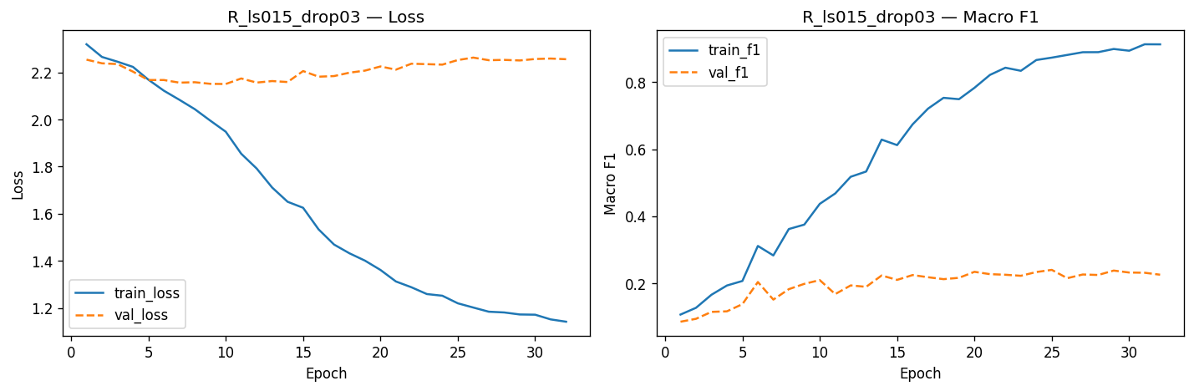
1.3
MLP Train Eff
Training Curves — Best Solo R_ls015_drop03
EarlyStopping metric:
val_loss ≠ val_f1
we use val_macro_f1 (lower = better)
Patience:
7 epochs
Saves best checkpoint .pth per run
Allows >30 epochs when plateau is slow (Q ran 37)
Ep train_loss val_loss train_F1 val_F1
1 2.319 2.254 0.106 0.085
5 2.169 2.167 0.207 0.137
10 1.948 2.150 0.437 0.209
15 1.534 2.181 0.674 0.224
20 1.362 2.225 0.783 0.234
25 * 1.202 2.252 0.873 0.240 ← checkpoint
30 1.172 2.256 0.899 0.231
32 1.142 2.256 0.913 0.225

Slide 25
1.4
MLP Performance Evaluation

Slide 26
1.4
MLP Perf Eval
Results at a Glance
Perf Eval
0.2428
0.2396
0.2288
0.2239
Best val Macro-F1
(ensemble C+E)
Best solo Macro-F1
(R_ls015_drop03)
Kaggle public score
(submitted ENS_C_E)
Kaggle private score
(submitted ENS_C_E)
Metric Comparison vs Baselines
Our Model learned something
2.18x better than random guess
Note: We didn’t select the best local model in Kaggle to be chosen for the private score. The best local model got Kaggle private score:
0.2431
System macro-F1 acc
Random baseline 0.111 11.1%
Always-Water 0.021 18.7%
R_ls015_drop03 (solo) 0.2396 25.8%
ENS_C+E (submitted) ★ 0.2428 26.7%
Kaggle public test 0.2288 —

Slide 27
1.4
MLP Perf Eval
Per-Class F1
🔥 Fire 0.457 distinctive orange palette
☠️ Poison 0.359 unique purple; LS prevents overconfidence
💧 Water 0.332 blue palette helps; confused with Normal
🌿 Grass 0.286 green palette; confused with Bug
😐 Normal 0.215 most diverse; no distinctive colour
🐛 Bug 0.140 green overlaps Grass; confused with Normal
🗿 Rock 0.134 grey/brown shared with Ground and Fighting
⚔️ Fight 0.126 humanoid silhouette = same as Normal for MLP
🌍 Ground 0.107 fewest samples (244) + brown/grey overlap
🐛u⚔️ 🔥 🌿 🌍 😐 ☠️ 🪨 💧 avg
Pattern: Color Palette Drives Performance - distinctive colour = high F1 (Fire/Poison/Water); shared palette or humanoid shape = low F1 (Bug/Rock/Fighting/Ground). MLP on flat pixels is essentially a colour histogram classifier.

Slide 28
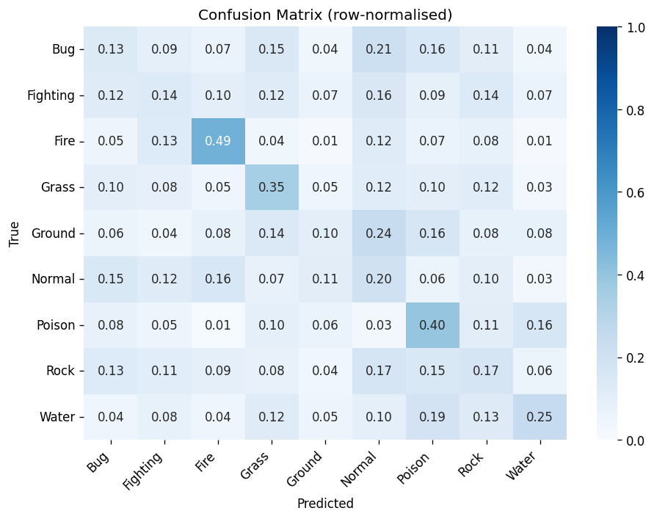
1.4
MLP Perf Eval
Confusion Matrix — Normal as the Catch-All Class
Class | F1 | Main confusion
Fire | 0.49 | Gets 49% of own class right — warm orange unique
Poison | 0.40 | 40% correct; confused with Water (purple→blue)
Water | 0.33 | High precision, low recall — confused with Normal
Grass | 0.35 | 35% correct; confused with Bug (green palette)
Normal | 0.20 | Diverse humanoids — confused with Fire, Bug, Poison
Bug | 0.13 | Only 13% correct — near-identical to Grass
Fighting | 0.14 | Humanoid; 16% sent to Normal, 12% to Bug
Rock | 0.17 | Grey/brown; 17% sent to Normal, 15% to Poison
Ground | 0.10 | Worst class; 24% sent to Normal (fewest samples)
Why Normal is the catch-all
Normal = most diverse class: humanoids of every shape and size, no dominant colour
Bug, Fighting and Ground all lack distinctive palettes — the MLP falls back to predicting Normal

Slide 29
1.4
MLP Perf Eval
Ensemble Analysis & Kaggle Gap
All 7 Ensemble Results (soft-average of softmax outputs)
ENS_C+E ★ F1=0.2428 acc=26.7% SUBMITTED — C (class weights) + E (sampler) = complementary error patterns
ENS_R+E+P F1=0.2427 acc=26.3% Near-identical to C+E; 3-model ensemble
ENS_C+E+P F1=0.2405 acc=26.3% P drags down slightly — weak model adds noise
ENS_C+R F1=0.2339 acc=25.6% Both use CW — same error patterns, no diversity benefit
ENS_R+E / ENS_C+R+M / ENS_R+P F1=0.224–0.229 Too similar models or too weak — no diversity gain
Why C+E wins over any solo
C uses class weights — adjusts gradients per class
E uses sampler — adjusts data frequency
Different mechanisms = different mistakes = soft-average compensates
+0.003 F1 over best solo — small but consistent
C+R fails (0.234): both use CW — too similar, no error diversity
Kaggle validation gap
val - 0.2428
kaggle - 0.2288
−0.014
Why this gap is expected, not a pipeline bug:
Kaggle test may include harder or out-of-distribution sprites
It helps to, AFTER SELECTING A MODEL, to train it again with the full dataset

Slide 30
1.4
MLP Perf Eval
Why MLP Has a Hard Ceiling on This Data
Theoretical reasons
Empirical confirmation
No spatial inductive bias
Augmentation −0.047 F1
A sprite at top-left and bottom-right = completely different 12 288-vector. MLP can't learn 'flame exists somewhere'.
Random flips/jitter/rotation break the pixel vector. CNN will benefit from the same augmentation because filters are position-invariant.
Feature-to-sample ratio: 4.26:1
Grayscale −0.103 F1
12 288 features vs 2 880 samples. Even with Dropout + BN, MLP memorises noise rather than learning patterns.
Removing colour channels reduces dimensionality 3x, but loses the main discriminative signal. Colour is king for Pokémon types.
High intra-class variance
val_loss ≈ random (2.197)
Blastoise and Vaporeon are both Water-type but look nothing alike. MLP can only learn average colour histograms.
Even the best model's val_loss hovers at ~2.22 — barely above log(9). The model discriminates but isn't confident.

Slide 31
Conclusions & What's Next
Best MLP result: 0.2428 val F1 (ensemble C+E), 0.2288 Kaggle
Next: Task 2
2.18x above random baseline. All 19 solo + 7 ensemble experiments are above random.
CNN
Convolutional
Neural Network
Label smoothing = most impactful technique
LS=0.15 rescued Rock from F1=0.000. All top-6 solo experiments use LS ≥ 0.1.
Spatial inductive bias — same filters at every position
3×3 conv = 27 params vs 12 288 per MLP node
Augmentation will HELP (not hurt)
Target F1: 0.55 – 0.70
Augmentation and depth both hurt
Confirmed empirically: MLP has no spatial invariance, and small data can't regularise deeper nets.
MLP ceiling is real and confirmed
val_loss ≈ log(9) = random. Feature-to-sample ratio 4.26:1 = no amount of tuning fixes this.
Ensemble diversity > ensemble quality
C+E (0.2428) beats two top solos (C=0.2395, R=0.2396) because different imbalance mechanisms produce complementary errors.
Task 1 complete · Kaggle score: 0.2288 · 22 experiments · ~44 min on T4

