Slide 1

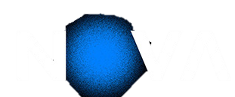

DEEP LEARNING · ASSIGNMENT 1 · TASK 2
Pokémon Type Classification
Task 2 - Convolutional Neural Network

Slide 2
What We Cover (Task 2)
2.1
CNN Model Development
2.2
CNN Training Efficiency
Architectures · Experiments · Augmentation · Regularization · Ensembles · Results
Early Stopping · GPU budget · Checkpointing
2.3
CNN Performance Evaluation
Macro-F1 · Per-class · Confusion Matrix

Slide 3
2.1
CNN Model Development

Slide 4
2.1
CNN MODEL DEV
Exploration strategy
Strategy: We explored different several different CNN architectures (number and size of Conv + Pool + FC layers, batch normalization, dropout, regularization, label smoothing, WeightedRandomSampler, and others). After getting a sense of the best ones, we explored different variations of them. This is a small sample of the numerous models we explored:
ID | Name | Model | Criterion (~loss function) | Optimizer | Purpose
A | LeNet5_base | LeNet5(conv=[6,16], fc=[120,84], pool=AvgPool2x2) | CrossEntropy | Adam lr=1e-3 | Baseline - no regularization; compare performance with existing architecture
C | Simple_cw | CNN(conv=[32,64], fc=[9], pool=MaxPool2x2+AvgPool2x2) | CE + class weights | Adam lr=1e-3 | Evaluate the performance of a simple 20k params CNN
G | Medium_dcw | MediumCNN(conv=[32,64,128], fc=[9], pool=MaxPool2x2+AvgPool2x2, drop=0.3, BN) | CE + class weights + dropout | Adam lr=1e-3 | Exploration of the effects of multiple convolution and pooling layers; regularization with inverse-frequency class weights in CrossEntropyLoss and dropout
H | Medium_dwrs | MediumCNN(conv=[32,64,128], fc=[9], pool=MaxPool2x2+AvgPool2x2, drop=0.3, BN) | CE + WRSampler (replaces class weights) + dropout | Adam lr=1e-3 | WeightedRandomSampler replaces class weights
I | Deep_dwrs | DeepCNN(conv=[32x2,64x2,128], fc=[128,9], pool=MaxPool2x2+AvgPool2x2, drop=0.3, BN) | CE + WRSampler + dropout | Adam lr=1e-3 | Deepen network with more conv + pool + non-linearity layers
K | Wide_dwrs | WideCNN(conv=[32,64,128,256], fc=[9], pool=MaxPool2x2+AvgPool2x2, drop=0.3, BN) | CE + WRSampler + dropout | Adam lr=1e-3 | Compare Deep vs Wide CNN; regularization with WeightedRandomSampler and dropout
L | MultiScale_dwrs | MultiScaleCNN(conv=[(3x3+5x5)->32, (3x3+5x5)->64, (3x3+5x5)->128], fc=[9], pool=MaxPool2x2+MaxPool2x2, drop=0.3, BN) | CE + WRSampler + dropout | Adam lr=1e-3 | Capture multiple granularities simultaneously
M | Residual_dwrs | ResidualCNN(conv=[64x2, 128x2, 256x2], fc=[9], pool=MaxPool2x2+AvgPool2x2, drop=0.4, BN, skip) | CE + WRSampler + dropout | Adam lr=1e-3 | Test the effects of skipping layers with a ResNet architecture
⭐

Slide 5
2.1
CNN MODEL DEV
CNN Best (SOLO) Model (I_CNN)
Architecture:

Slide 6
2.1
CNN MODEL DEV
CNN Best (SOLO) Model (I_CNN)
Architecture:
Feature Extraction +
Progressive channel expansion forces the model to increasingly learn broader representations of the features
Coupled with a moderate number of convolution layers (3x3) allows us our model to learn both low, and higher-level features
Pooling to provide robustness (e.g. translation invariance and help with small rotations)
Better than:
Narrow (e.g. 32-32-32): lower abstraction
No convolution: as it was evident by comparing the results with MLP, having convolution layers helps the model generalize better
Too deep: risk of overfitting; increased training time
No pooling
BatchNorm + ReLU
BatchNorm2d after every Conv layer
Normalization step which speeds up training and increases stability
ReLU
No vanishing gradient for positive activations in small networks like the ones developed; simple and efficient

Slide 7
2.1
CNN MODEL DEV
CNN Best (SOLO) Model (I_CNN)
Regularization Strategy:
Dropout (0.3)
Applied after Pooling (before FC layers)
Randomly zeroes p% of neurons each forward pass
Prevents co-adaptation, forces redundant representations
Why 0.3?:
Multiple values were tested (0.1, 0.15, 0.2, 0.3, 0.4, 0.5); 0.3 is the sweet spot - not too much regularization, not too little
Label Smoothing (0.1)
Decreased effectiveness when compared to MLPs. Idea:
Softens hard one-hot targets (0.9/0.1 blend vs 1.0 hard)
Prevents overconfident predictions on visually ambiguous classes
Key on noisy boundaries — Bug/Grass and Rock/Ground share colour palettes
BUT:
LS=0.1 (F) = 0.9750 vs LS=0.0 (C) = 0.9880 — tiny decrease
A lot of models can effectively converge to a near-perfect validation score, adding label smoothing adds unnecessary noise
Imbalance Handling
Weighted CrossEntropyLoss (primary)
Inverse-frequency weights per class (Ground=1.64x, Rock=1.52x, Water=0.59x)
Addresses 2.76x Water/Ground imbalance at gradient level
WeightedRandomSampler (tested separately) - most impactful single change
Oversamples minority classes at the data level
Useful as ensemble diversity: different error patterns vs CW
Pitfall: CW + Sampler together can pose a problem
As seen in the previous task

Slide 8
2.1
CNN MODEL DEV
CNN Best (SOLO) Model (I_CNN)
Training Setup — Optimizer, Scheduler & Early Stopping:
Optimiser + Scheduler
Adam lr=1e-3 — robust adaptive LR, standard for CNNs (Kingma & Ba, 2015)
StepLR(step=5, gamma=0.5) — halves LR every 5 epochs; CosineAnnealingLR also tested but similar results
Early Stopping (patience=7)
Monitors -val_macro_f1 (competition metric, not val_loss)
Patience=7 — val_f1 is noisy (720 val samples, ~80/class: 1 error = +-1.2% swing); 3 would fire prematurely
Saves best checkpoint automatically; restores at inference

Slide 9

2.1
CNN MODEL DEV
Pre-Processing & Data Augmentation
Strategy: There were multiple models that reached a validation Macro-Averaged F1-Score of 1.0, we chose the one that balanced fastest converging with fewest parameters, which was model M - Deep CNN. We then applied different pipelines of pre-processing and data augmentation.
Pre-Processing
Data Augmentation
Grayscale
A 64x64 RGB image results in an initial vector of length = 12.288. If we convert to grayscale the size is reduced by 3, to 4096. Are we able to achieve similar results with this smaller input? Turns out no. Pokemon classification is strongly color-dependent (Fire=orange, water=blue, poison=purple, grass=green, ...)
RandomHorizontalFlip, ColorJitter, RandomRotation...
In the previous task we mentioned that CNNs could benefit from this type of data augmentation, however, doing it gave us WORSE results. Why did this happen? Isn't training with slightly different variants of our images helpful for generalization? This is explored in the next slide.
-4.81%!
-1.5%!
Note that we tried very simple augmentation processes for this analysis; stronger augmentation gave us even worse results

Slide 10





2.1
CNN MODEL DEV
Pre-Processing & Data Augmentation
Why does data augmentation hurt the models? Let's take a look at some samples from the dataset which feature the same pokemon
From this small set of examples we can see that the pokemon always remains in the same upright position, facing the same direction, with the same colours, … and the only thing that changes are: its position in the picture, and the background. Since CNNs are invariant to the object's position in the picture, in reality, the only thing that really changes is the background. So, if we replace a training example that has all these characteristics with a flipped image of Golduck (for example), we're making the model learn something it will never "see" in val/test time by adding unnecessary noise, which hurts our model's performance (specially in the case of colour changes and grayscale since, as explored in task 1, the colour is one of the dominant factors in identifying a pokemon's type).
Even though we're not trying to identify the pokemon itself, but its type, this reasoning can be applied.

Slide 11
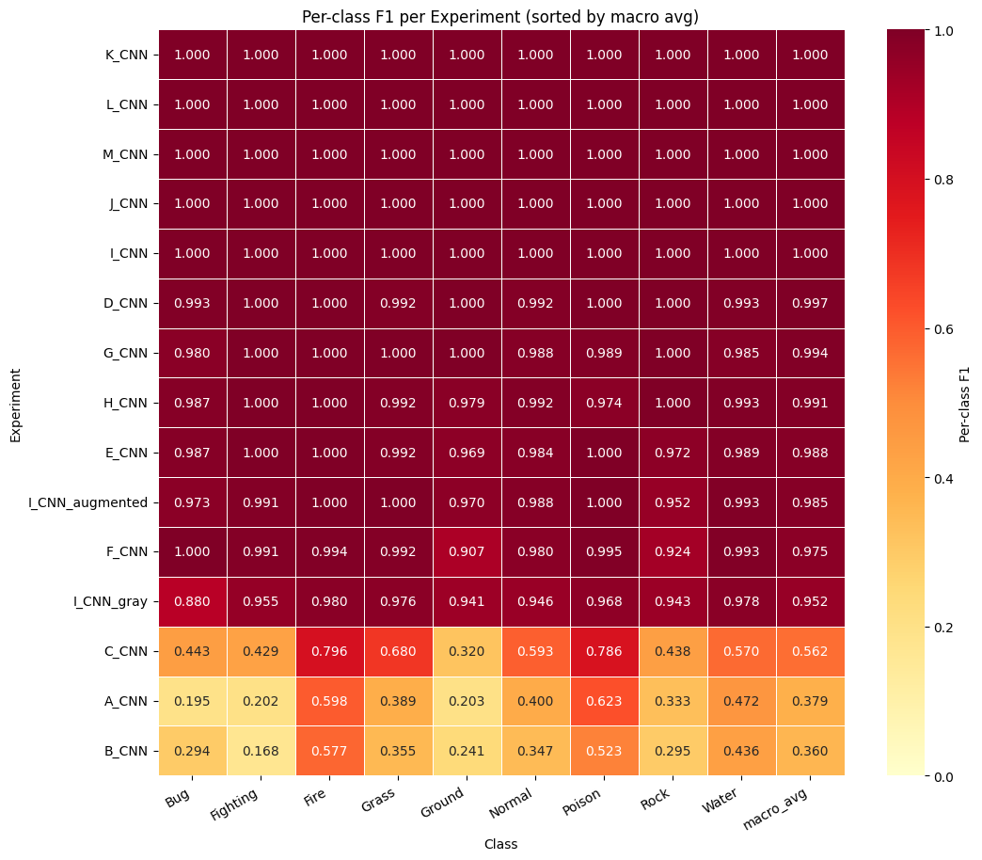
2.1
CNN MODEL DEV
Ensembles
Strategy: Even though some of our models achieve a perfect score, we still decided to combine other to see if the results changed significantly by combining models.
To help analyze possible good combinations we drew a heat map so we can see the results of each model for each class.
Ensemble ~ Solo ?
~
We tried 2 different combinations:
C + H: could a bad model like C affect the performance in an ensemble with H?
I + K: could two models with val score 1.0 be combined together to get a worse performance? (much likely not... but let's test it anyway)

Slide 12
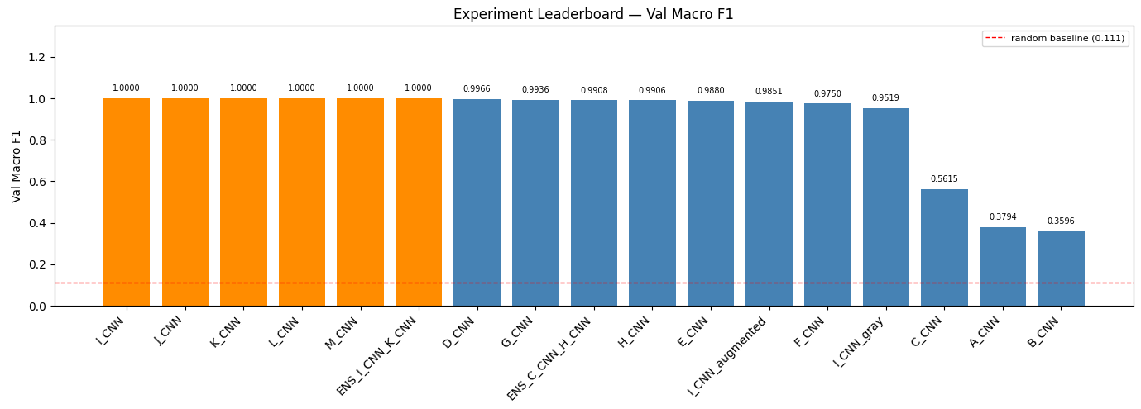
2.1
CNN MODEL DEV
Ensembles
Strategy: As it turns out, [I + K] still gets a validation score of 1.0 as we expected, but [C + H]'s performance stays relatively similar to just using H (with some variance), even though C got a weight of 0.4 and H 0.6. C's bad performance is not enough to drag the ensemble's performance down

Slide 13
2.1
CNN MODEL DEV
What Worked vs. What Did Not
What Worked
Dropout 0.3
- 0.4 was too heavy, 0.15 too light
Weighted CrossEntropyLoss
- prevents collapse on minority classes (Ground, Rock)
WeightedRandomSampler
- all top models use it
BatchNorm
- stabilizes gradients; increases training speed effectively
Deeper/Wider networks
- increases the amount of information/detail passed to the classifier head
What Did Not Work
Augmentation (flip/jitter/rotate/...)
- 0.0149 F1; the pokemons are always the same way, the only thing that changes are the background at the position; CNNs are translation invariant so the only real thing that changes for our network is the background. The more aggressive the augmentation is the bigger the decay in performance
Many FC layers
- 3 or more FC layers starts giving us a slower training and worse results (parameters increase a lot if our convolution channels are wide); keep it simple and let convolutional layers learn the information, then pass them to minimal FC layers
Grayscale input
- 0.0481; colour is a key discriminative signal, removing it degrades performance
Ensembles
- Ensembled models could not achieve a better performance
Label Smoothing
- CNNs can already achieve top performance, introducing noise can hurt our models

Slide 14
2.1
CNN MODEL DEV
MLP Ceiling ~0.24 CNN can achieve a 1.0 score!
Confirmed ceiling metrics
best val macro-F1 (I, J, K, L, M, [I+K])
1.0000
Kaggle public score
1.0000
Why are CNNs so much better than MLP for this task?
The amount of parameters that an MLP generates is too much, we would need a huge dataset to get good results (note that MLPs are more powerful than CNNs - not the contrary)
This problem screams CNN! The dataset has images, In which the pokemons always appear in the same way, only changing their position and the background: CNNs are invariant to translations! MLPs lose all sense of spatial structure
Next: Transfer Learning and Fine-Tuning (Task 3) - can we achieve the same performance by replacing the classifier head of a pretrained model?

Slide 15
2.2
CNN Training Efficiency

Slide 16
2.2
CNN Train Eff
Compute Strategy & Resource Usage
Train Eff
T4 GPU
37 min
< 1500 MB
62%
Colab free tier / 15 GB VRAM
total wall-clock (15 solo runs + data pre-processing/augmentation and ensembles)
GPU memory peak (more than MLP),
according to W&B
of 1h budget used
Metric | Value | Note
Fastest experiment | A_CNN - 87.2 s (excluding ensembles) | Stopped at epoch 19 (no reg -> fast plateau; despite the massive overfit obtained)
Slowest experiment | I_CNN_augmented — 172 s | Full 30 epochs; data augmentation gives us more 53 seconds than base model I_CNN, and worse performance
Avg per experiment | ~134 s | Across 13 solo runs
Best solo (R) | 118.5 s - 25 epochs | EarlyStopping saved best at epoch 25
FAST_RUN flag | FAST_RUN=True | Smoke-test mode: 5 epochs, 100 samples - used for debugging
Why 80/20 split instead of K-Fold CV?
5-fold CV × 13 experiments ≈ 65 training runs ≈ which will exceed the 1h Colab budget. Stratified 80/20 with fixed seed is the correct trade-off: relative experiment ranking is valid even if absolute F1 has ±0.02 noise from a single split.

Slide 17
2.2
CNN Train Eff
Early Stopping — Results Across Experiments
Train Eff
Experiment | Epochs | Stopped? | Takeaway
A - LeNet5_base | 19/30 | ✓ Yes | LeNet5 finds plateau quickly
B - LeNet5_dwrs | 30/30 | ✗ No | Moderate dropout and WRSampler delays convergence
C - Simple_cw | 30/30 | ✗ No | Model fails to converge in 30 epochs (low number and small convolutions)
D - Medium_base | 30/30 | ✗ No | Deeper model allows for more convergence (0.02 train loss); can't find optimum
E - Medium_d | 30/30 | ✗ No | Dropout in previous model doesn't improve convergence; can't find optimum
F - Medium_dls | 30/30 | ✗ No | Dropout and label smoothing hurt the convergence; the problem isn't regularization
G - Medium_dcw | 30/30 | ✗ No | Dropout and class weights; confirms previous theory, we need a deeper/wider network
H - Medium_dwrs | 30/30 | ✗ No | Dropout and WeightedRandomSampler also fails to improve
I - Deep_dwrs ⭐ | 25/30 | ✓ Yes | Two more convolution channels makes finding optimum fast; confirmed theory where regularization was not the issue ✓

Slide 18
2.2
CNN Train Eff
Early Stopping — Results Across Experiments
Experiment | Epochs | Stopped? | Takeaway
J - Wide_d | 22/30 | ✓ Yes | Best checkpoint at epoch 25; patience runs out at 22. Widening channels is an alternative to deepening the network to achieve 1.0
K - Wide_dwrs | 25/30 | ✓ Yes | Apply dropout and WeightedRandomSampler in this wider network gives us a perfect convergence
L - MultiScale_dwrs | 29/30 | ✓ Yes | Early stops with way deep network and multiple scale kernels
M - Residual_dwrs | 19/30 | ✓ Yes | Residual Network converges the fastest (in terms of number of epochs, not time); EarlyStoping occurs earliest

Slide 19
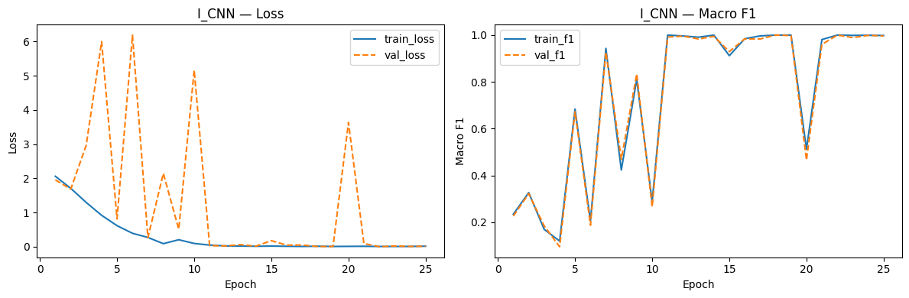
Training Curves — Best Solo R_ls015_drop03
2.2
CNN Train Eff
EarlyStopping metric:
val_loss ≠ val_f1
we use val_macro_f1 (lower = better)
Patience:
7 epochs
Saves best checkpoint .pth per run
Allows >30 epochs when plateau is slow
Ep train_loss val_loss train_F1 val_F1
1 2.0604 1.9553 0.2342 0.2262
5 0.6173 0.8140 0.6838 0.6717
10 0.0970 5.1619 0.2870 0.2652
15 0.0201 0.1798 0.9119 0.9294
18 0.0159 0.0083 1.0000 1.0000 ← checkpoint
20 0.0121 0.3623 0.5121 0.4657
25 0.0173 0.0150 0.9982 0.9964 ← early stopping

Slide 20
2.3
CNN Performance Evaluation

Slide 21
2.3
CNN Perf Eval
Results at a Glance
Perf Eval
1.0000
1.0000
1.0000
0.99752
Best val Macro-F1
(I_CNN)
Best solo Macro-F1
(I_CNN)
Kaggle public score
(submitted M_CNN)
Kaggle private score
(submitted M_CNN)
Metric Comparison vs Baselines
Our model achieved a perfect performance
Kaggle private score:
0.99752
Note: we submitted M (Residual Network) instead of I since it also achieves a perfect score, but with lower losses (10^-3 vs 10^-2). In this report, we decided to analyze I instead of M since it converged faster, and M is so powerful that changing parameters and doing strange augmentation didn't hurt it, making it impossible to come to new conclusions
System macro-F1 acc
Random baseline 0.111 11.1%
Always-Water 0.021 18.7%
M_CNN (submitted) ★ 1.0000 100%
Kaggle public test 1.0000 —
Kaggle private test 0.99752 —

Slide 22
2.3
CNN Perf Eval
Class | CNN F1 | MLP F1 | Improvement
Fire | 1.0 | 0.457 | +0.543
Poison | 1.0 | 0.359 | +0.641
Water | 1.0 | 0.332 | +0.668
Grass | 1.0 | 0.286 | +0.714
Normal | 1.0 | 0.215 | +0.785
Bug | 1.0 | 0.140 | +0.860
Fighting | 1.0 | 0.126 | +0.874
Rock | 1.0 | 0.134 | +0.866
Ground | 1.0 | 0.107 | +0.893
In worse models, the color palette still drives some performance: as in MLPs there's high F1 in Fire/Poison/Water, due to the distinctive colours of these types; shared palette or humanoid shape give us low F1 (Bug/Rock/Fighting/Ground), since they have no predominant colours. These models had more difficulty making the jump from the colours to the shapes of the pokemon themselves

Slide 23
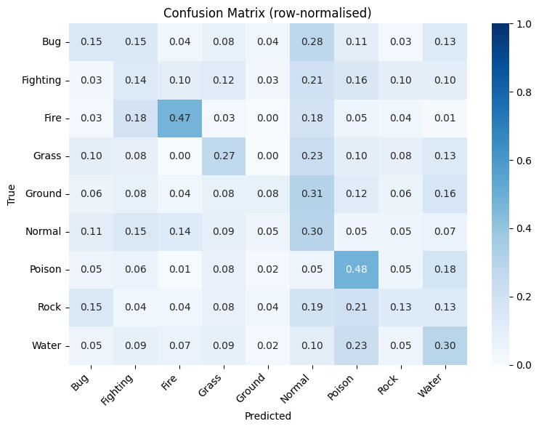
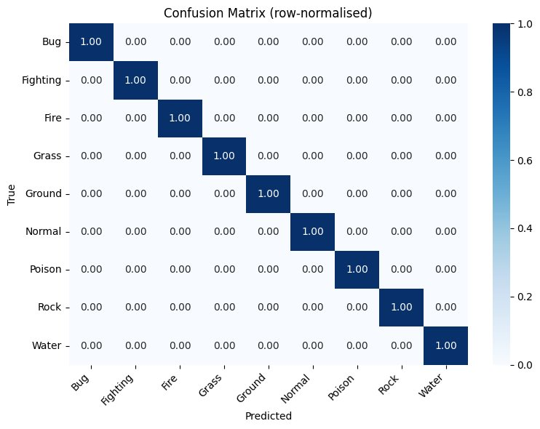
Confusion Matrix — Normal as the Catch-All Class
2.3
CNN Perf Eval
MLP
CNN
Normal is the catch-all for MLP
Normal = most diverse class: humanoids of every shape and size, no dominant colour
Bug, Fighting and Ground all lack distinctive palettes — the MLP falls back to predicting Normal
CNNs are immune to this
As stated before, they can learn other patterns besides colour and independent pixels

Slide 24
Ensemble Analysis & Kaggle Gap
2.3
CNN Perf Eval
All 7 Ensemble Results (soft-average of softmax outputs)
ENSEMBLE I+K ★ F1=1.0000 acc=100% Combining perfect models together doesn't change the result - expected
ENSEMBLE C+H F1=0.9908 acc=99.0% Combining a bad model with a perfect one gave a similar performance, no additional noise (class weights + dropout combination)
Kaggle validation gap
val – 1.0000
kaggle – 0.99752
−0.00248 (-0.2486%)
Negligible gap:
We correctly evaluated our model's performance locally
C + H had a similar performance to solo H
C uses class weights — adjusts gradients per class
H uses dropout — randomly drops neurons
Different mechanisms = different mistakes, but model H's performance doesn't outweigh H's near perfect performance

Slide 25
2.3
CNN Perf Eval
Why Are CNNs Better For This Task?
Perf Eval
Theoretical reasons
Empirical confirmation
Spatial Inductive Bias
CNN vs MLP: +0.7572 F1
A CNN can recognize the same sprite at top-left or bottom-right, even though the input vector is different (translation invariance). MLPs can't learn "this pokemon exists somewhere", even though the pokemons always appears in the same way.
The same pokemon appearing in different positions breaks the pixel vector. CNN doesn't mind this.
Local Feature Learning
CNN vs MLP: -96.7% Parameters
CNNs focus on local pattern (edges, shapes, flame tails, …), rather than treating each pixel independently. MLPs need weights for each pixel, making them prone to overfit on small datasets like this one - too many parameters.
The CNN we analyzed has around 200 000 parameters, while the best MLP model has more than 6 million. With a 4.26/1 feature ratio, the MLP is memorizing noise rather than learning patterns
Hierarchical Feature Learning
CNN Grayscale: -4.81% F1
CNNs can build layered representations from simple edges to more complex shapes. This helps identifying pokemon even when we lose the colour, for example, due to the memorization of the pokemon's shape and details.
The analyzed model has a 4.81% performance decrease (0.9519 F1) when trained with grayscale data, as opposed to RGB. While the performance is worse, it still is much better than the best MLP model (0.2428 F1). The CNN learns the pokemon shapes correctly.

Slide 26
Conclusions & What's Next
Best CNN result: 1.0000 val F1 (I, J, K, L, M, I+K), 0.99752 Kaggle (M)
Next: Task 3
4.12x above MLP best model. All 15 solo + 2 ensemble experiments are above the best MLP.
Transfer Learning and Fine-Tuning
Dropout and WeightedRandomSampler = most impactful techniques
Prevented overfit and handles class imbalance. All top solo experiments use them with dropout=0.3.
Can we use a pre-trained model to our task?
How deep will we need to go to replace the weights? Classifier head only, or further (with minimal learning rates)?
Will augmentation still hurt the models in this new dataset?
Target F1: 0.60 to 0.70
Augmentation hurt
Confirmed empirically: performance decreases while using due to sprites always being presented the same way
CNNs are better than MLPs for this task; ceiling surpassed
Feature-to-sample ratio 4.26:1 = no amount of tuning fixes MLP bad performance; CNN keeps spatial structure, and learns sprite shapes/details
No need for ensembles
Ensembled experiments returned similar results; CNN solo is already good enough for this task
Task 2 complete · Kaggle score: 0.99752 · 17 experiments · ~37 min on T4

Slide 27

DEEP LEARNING · ASSIGNMENT 1
Pokémon Type Classification
TASK 1 - Multi-Layer Perceptron
TASK 2 - Convolutional Neural Network
70698 – Francisco Silva
73208 – Rúben Silva
73554 – Miguel Cangalhas

