Slide 1
Adaptive Inlier-driven Re-ranking for Efficient
Visual Place Recognition
Travaglio Francesco Maria - 349490
Ziccardi Leonardo - 343519
Sanna Matteo - 346296
Feira Geremia - 342726

Slide 2
What is VPR?
The task of understanding where a place is based solely on the visual content of an image
This is done by computing a descriptor of a query image and comparing it against a database full of descriptors to find a match
It’s a critical task for a variety of real-world applications such as autonomous driving, mapping, robotics and many others
Notes:
First of all, what is Visual place recognition? VPR is the task of understanding where a picture was taken using only its visual contents
This is done by turning the image into a descriptor and comparing it with a database to find the most similar candidate
Critical in a variety of real word tasks such us mapping, robotics amd self driving

Slide 3
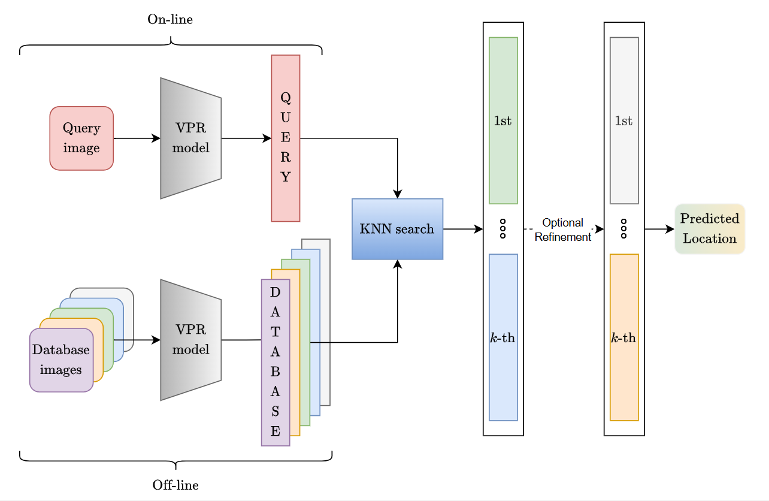
The VPR pipeline
Compute descriptor
Find matches through a similarity search with a database
Re-rank predictions using image matching models (optional)
Obtain the predicted location
Notes:
As we can see from the diagram these are the main blocks that compose any VPR task
The first half is the retrieval part where the most likely candidate for our prediction is found through a similarity search
Then in the second half, the refinement step, the results of the retrieval part can undergo an optional re-ranking thanks to image matching models to better the prediction

Slide 4
The retrieval: VPR methods
Main VPR methods
NetVLAD, CosPlace, MixVPR, MegaLoc
The first step in the pipeline
The image is compressed into a vector containing it’s informations.
A K-Nearest Neighbors (KNN) algorithm is used to finds the first K most similar candidates in the database using the L2 distance as a metric
Pros
Fast and efficient computationally wise
Cons
Lacks awareness of geometrical details
Notes:
To go a bit more in depth on the retrieval part the main models we used are netvlad, cosplace, mixvpr and megaloc
For the similarity search the most common algorithm is a k nearest neighborhood search, in our case implemented using an l2 distance metric.
These vpr methods obtain result fast and efficiently however lack geometric awareness of the environment so they might confuse similar but different places

Slide 5
The refinement: image matching methods
Main image matching methods
Superglue, LoFTR, SuperPoint+LightGlue (SP+LG)
The second step in the pipeline
Local feature matching is applied only on top-K candidates found previously
Applies geometric post-processing to find matching keypoints (inliers)
Pros
Extremely accurate
Cons
Computational bottleneck
Notes:
Then comes the refinements step where we used superglue, loftr and superpoint+lightglue as our matchers. Their job is to apply a local feature matching on the top-k candidates to find inliers, feature that survive geometric post processing to find matching keypoints such as road sign viewed from different perspectives
This makes the prediction a lot more accurate but introduces a considerable computational bottleneck

Slide 6
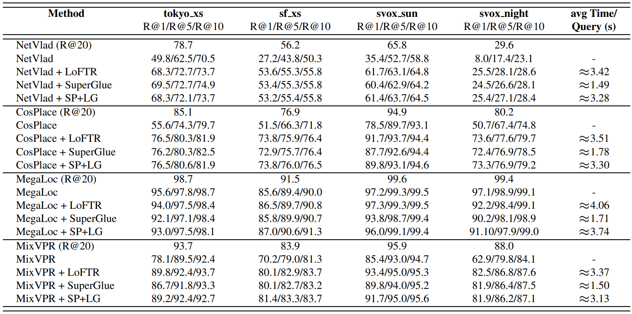
Our baseline analysis
Notes:
Here we can see a table summarizing our analysis, for each vpr method and method/matcher combination we calculated the recall at N on different datasets
The recall at N is a useful metric when evaluating vpr models that represents the percentage of queries where at least one prediction in the top-n was found to be within a defined threshold distance from the ground truth location

Slide 7
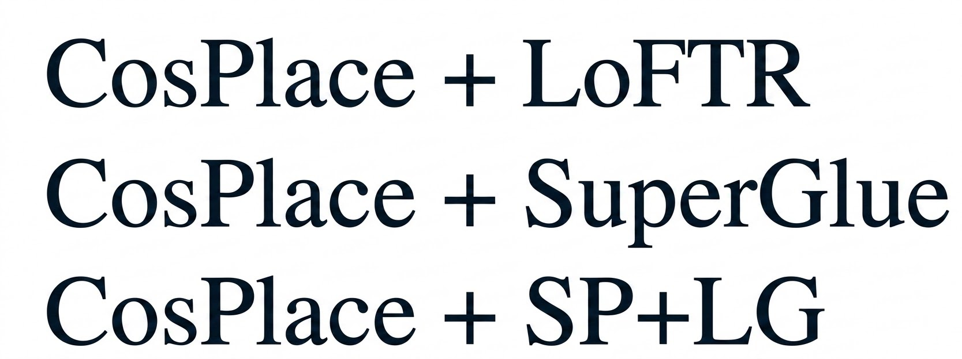
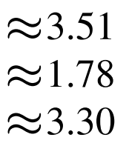
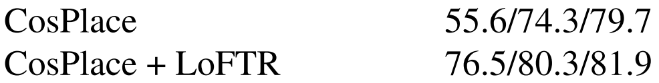
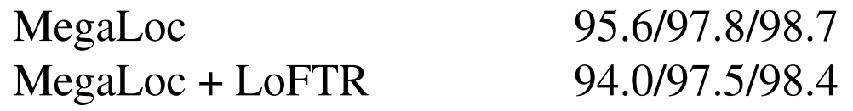
Main takeaways
Effectiveness of re-ranking Computational costs
Diminishing returns Dataset-dependent behaviour
Blindly applying re-ranking is very inefficient
Notes:
The main takeaways that we can deduce from our experiments are as follows First of all the effectiveness of reranking, we can see, for example, how the recall of cosplace rises when matched with loftr
Secondly is the additional time required by the matcher to process a single query- in order we can see loftr, superglue and sp+lg
Thirdly we con observe that an already powerful model like megaloc doesn’t really benefit by using image matching
And lastly the difference in the recalls from differents datasets, on the right we have svox sun and on the left svox night that present, as the name suggests quite different lighting conditions
So, as we can see reranking is incredibly useful but quite expensive and most of all not always necessary
these results made us aware that implementing a strategy where reranking is applied only when needed would be quite beneficial to any vpr task
And now my colleague Leonardo will show you exactly how.

Slide 8
Method Overview: The Adaptive Strategy
An adaptive re-ranking strategy that selectively applies expensive geometric verification only when necessary.
Inliers Analysis
Logistic Regression
Threshold Validation
Transfer Analysis
Vpr models: MixVPR and CosPlace
Image matchers: LoFTR and SuperGlue
Notes:
To address this performance-efficiency trade-off, we propose an adaptive re-ranking strategy. The core principle is to use the number of geometric inliers as a reliable confidence signal. If a query shows a high inlier count relative to the general distribution, we classify it as "easy" and safely bypass the expensive geometric verification. Conversely, queries with low inlier counts are marked as "hard" and proceed to full re-ranking. Our pipeline is organized into four logical stages:
● Inliers Analysis: where we aggregate statistics to characterize the relationship between inlier counts and retrieval correctness.
● Logistic Regression: the training phase where we use Logistic regressors to map inlier counts to a probability score.
● Threshold Validation: where we identify the optimal probability cut-off to balance accuracy and efficiency.
● Transfer Analysis: where we evaluate how well these models generalize across different datasets and conditions.
For our baseline, we utilize the MixVPR and CosPlace ensemble for retrieval, paired with LoFTR or SuperGlue for matching.

Slide 9
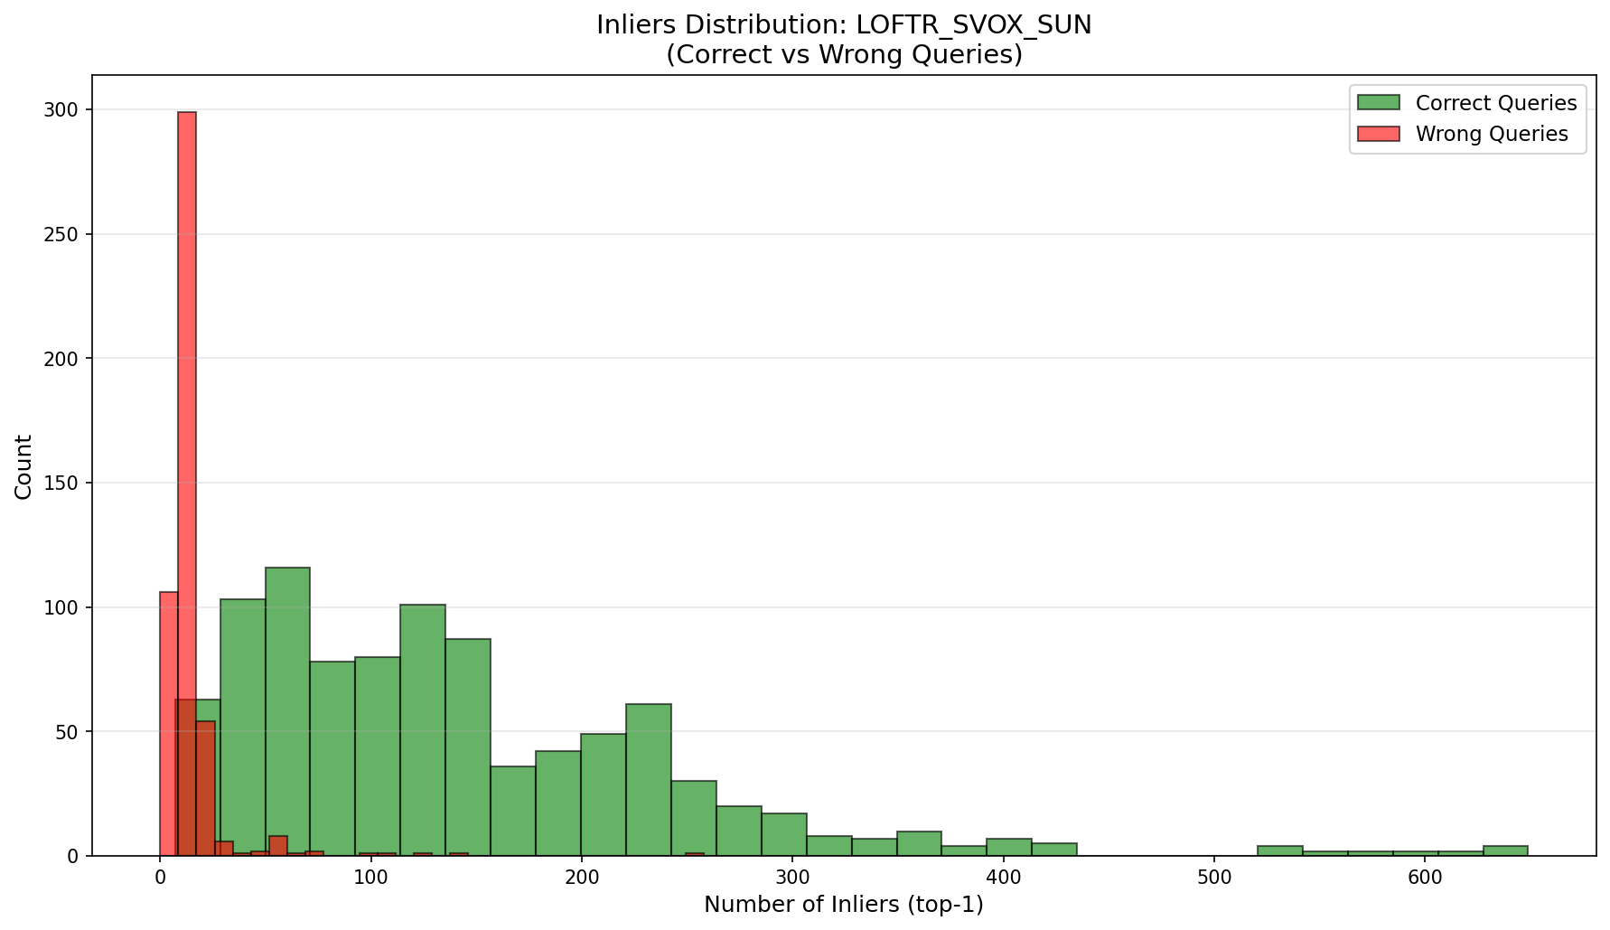
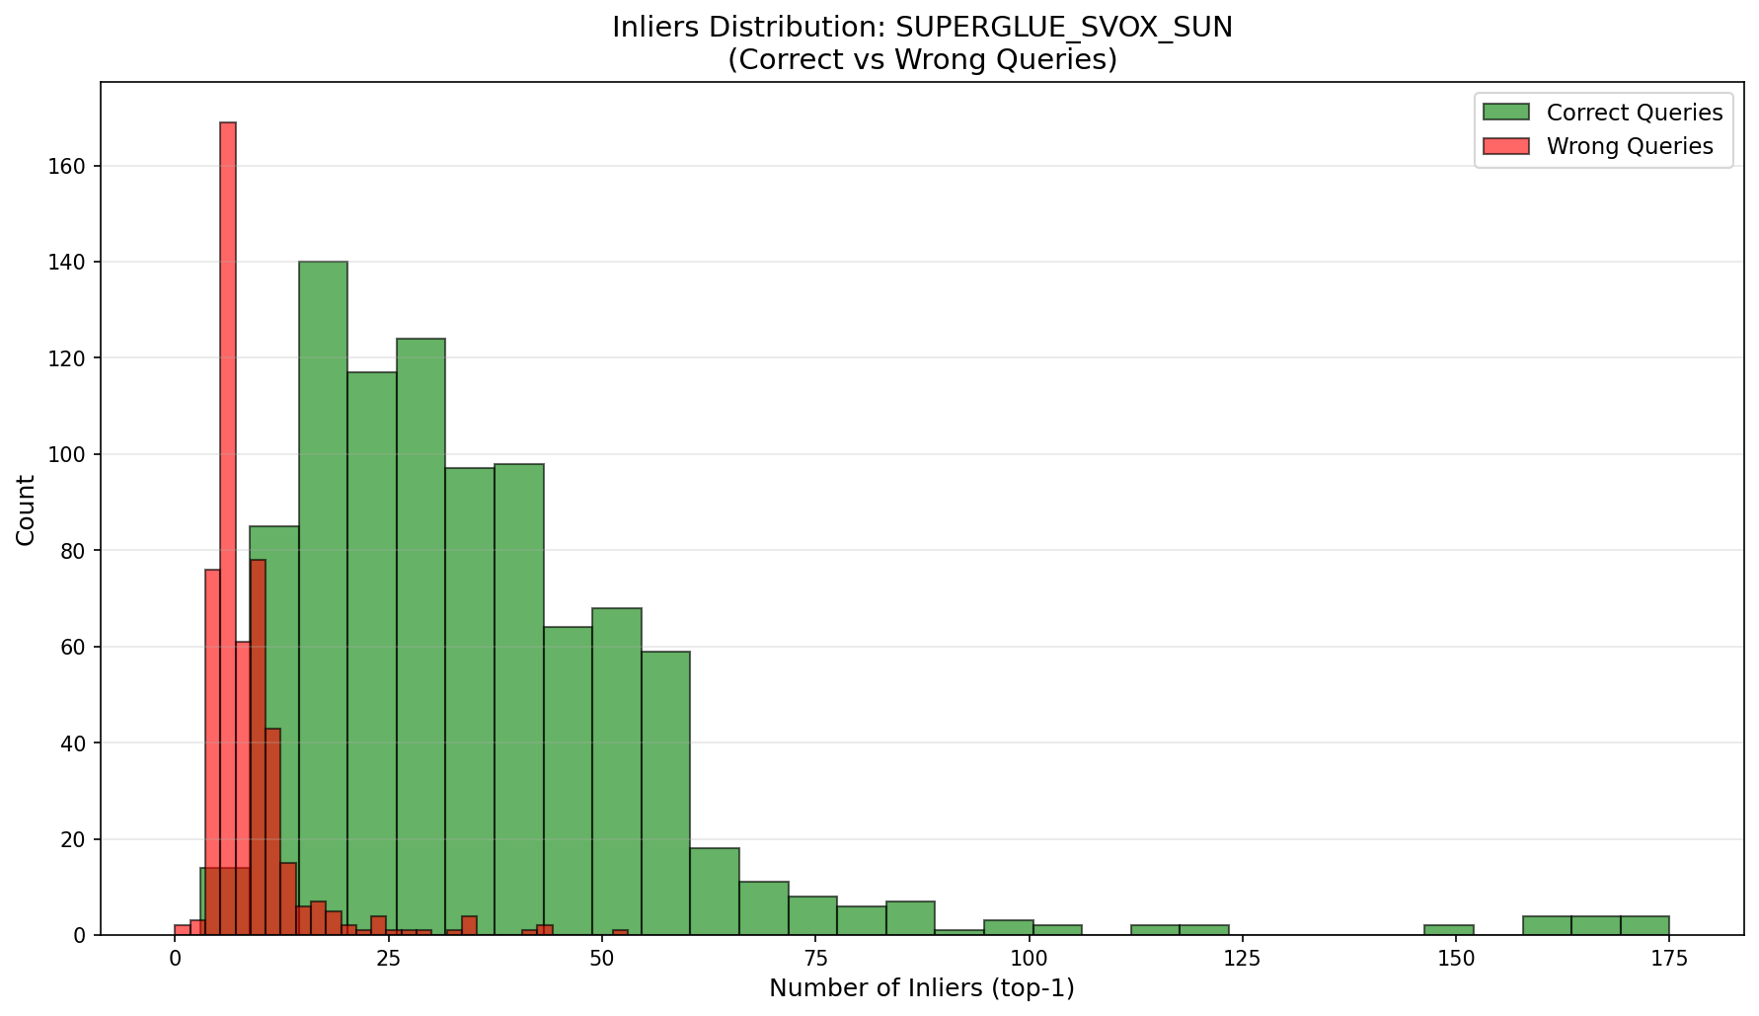
Inliers Analysis: The Confidence Signal
Correct queries typically have 2 to 3 times more inliers than incorrect queries
The bimodal separation between correct and incorrect queries is robust across different matchers and datasets.
Notes:
Let's begin with the first stage: Inliers Analysis. We aggregated the inlier counts from our training datasets, specifically observing the number of geometric inliers obtained from the top-1 retrieved image. In these histograms, the x-axis represents the number of inliers, while the y-axis shows the frequency of queries. The green bars represent the distribution of correct retrievals, and the red bars represent incorrect ones. As you can see, a clear bimodal separation emerges: incorrect queries consistently cluster at lower inlier counts, while correct queries show a broader distribution at higher values. On average, correct queries exhibit 2 to 3 times more inliers than incorrect ones.

Slide 10
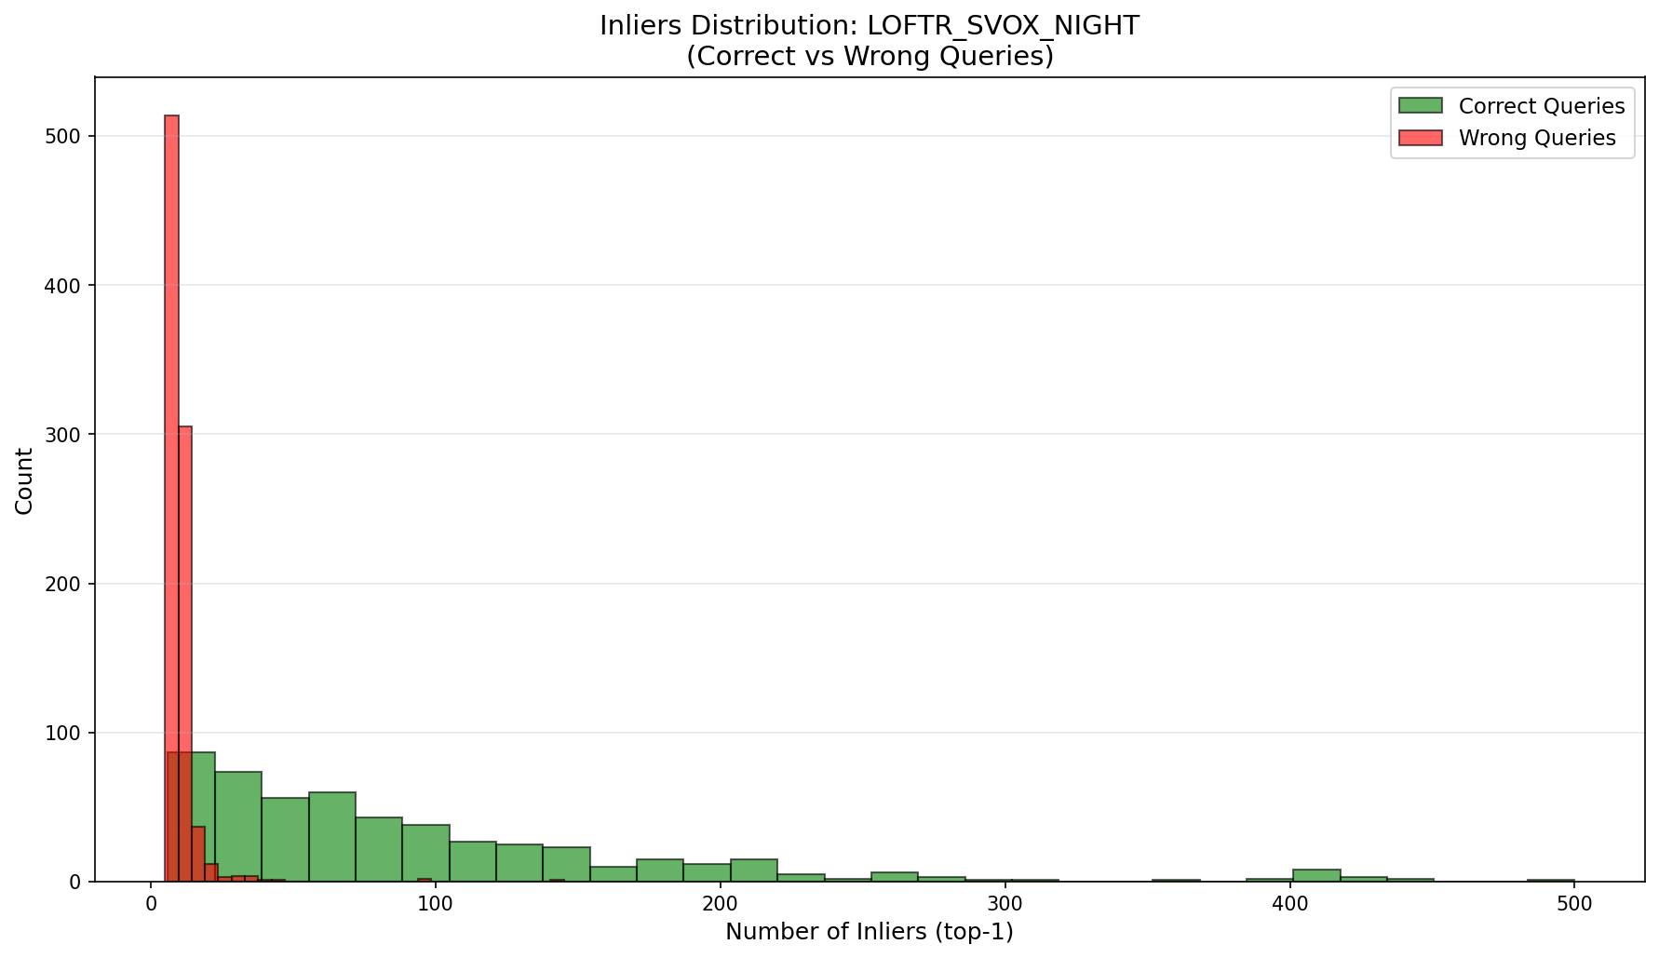
Inliers Analysis: The Confidence Signal
Correct queries typically have 2 to 3 times more inliers than incorrect queries.
The bimodal separation between correct and incorrect queries is robust across different matchers and datasets.
Notes:
This pattern remains consistent across all matchers and datasets, confirming that the top-1 inlier count is a reliable indicator of retrieval correctness and query difficulty

Slide 11
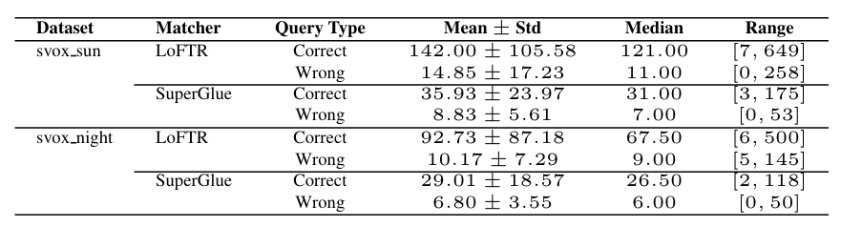
Inliers Analysis: Statistical Insights
Day vs. Night Discrepancy:
Nighttime conditions severely reduce true-positive inliers.
For LoFTR, the median collapses from 121 to 67.5.
This high variability justifies training distinct models for each dataset-matcher pair
Notes:
However, a deeper statistical analysis highlights a significant discrepancy between daytime and nighttime conditions. At night, the number of true-positive inliers decreases sharply. For instance, with the LoFTR matcher, the median count drops from 121 during the day to 67.5 at night. This high variability justifies our decision to train distinct, dataset-specific models for each matcher-dataset combination, with a specific threshold used for classification for each model..

Slide 12
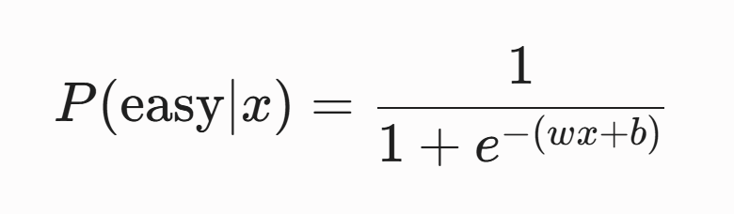
Predicting Difficulty: The Model
Why Logistic Regression?
The one-dimensional input space prevents overfitting.
The probabilistic output enables principled threshold selection.
The inference process is computationally efficient.
Training setup:
Input(x): Inlier count with the top-1 retrieved image
Target (y ⋲ {0,1}): Ground-truth correctness
Notes:
This leads us to the second stage: modeling query difficulty through Logistic Regression. We chose this approach for several reasons: the one-dimensional input space prevents overfitting, the inference process is highly efficient, and the probabilistic output enables a principled selection of the decision threshold. Our training setup is precise: the input x is the inlier count with the top-1 retrieved image, and the target y is 1 if the distance of the prediction from the ground truth is within 25 meters, and 0 otherwise.

Slide 13
Model Training & Evaluation
Dataset specific training:
Separate, dataset-specific models are necessary (Svox_Sun/Night x LoFTR/SuperGlue)
Inlier distributions vary significantly between daytime and nighttime conditions
Models are evaluated using AUPRC and AUC-ROC :
AUPRC
0.91 - 0.98
AUC-ROC
0.93 - 0.97
Notes:
To accommodate the variations we identified, we trained four separate models covering all combinations of SVOX Sun/Night and LoFTR/SuperGlue. The validation results confirm strong and stable performance, with AUPRC values ranging from 0.91 to 0.98 and AUC-ROC between 0.93 and 0.97. These metrics demonstrate that our regressors accurately estimate the probability of a query being "easy". But how do we translate these probabilities into an operational decision? My colleague Matteo will now illustrate the Threshold Validation process.

Slide 14
How Do We choose the threshold?
Two Competing Objectives in Conflict:
Maximize Accuracy on Easy Queries
Maximize Computational Time Saved
These objectives are not aligned.
𝝉 = ?*
Notes:
Now that we have a logistic regressor that outputs a probability, our next challenge was to avoid using a generic, naive threshold of 0.5 for the outputs of our models. Instead, we wanted to find an optimal threshold capable of balancing two conflicting objectives for each specific matcher-dataset pair:
Maximizing accuracy on "easy" queries, which are the ones we choose to skip.
Maximizing the time saved by skipping those queries, which represents our true computational benefit.
Inevitably, these two goals clash. If we lower the threshold, we allow more queries to pass as "easy," which avoids full image matching and saves a massive amount of time. However, this naturally introduces a higher risk of dropping our localization accuracy. So, how did we solve this? Let's move to the next slide.

Slide 15

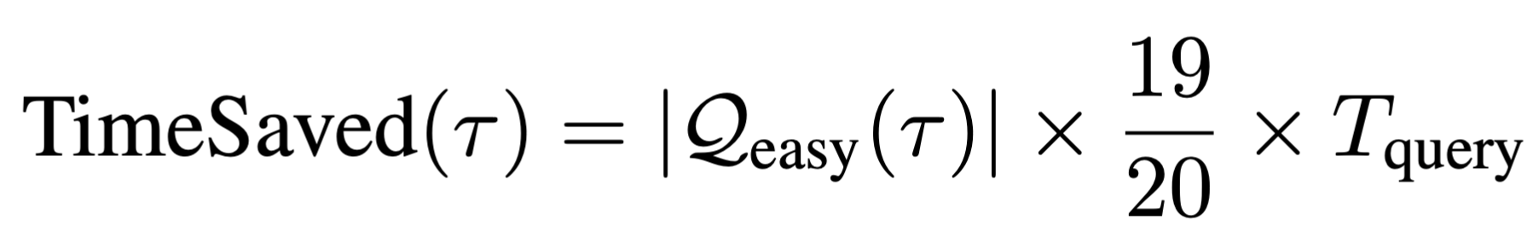
Automated Scoring Function
Our scoring function is designed to balance accuracy and efficiency:
AccuracyOnEasy
Percentage of easy queries that are correctly predicted by the model.
TimeSaved
Total computational time saved relative to the baseline process.
⍺ Tuning Coefficient
Weight factor used to tune the balance between accuracy and time.
⍺ = 0.9
Optimization Goal: Select the threshold that maximizes this global score.
Notes:
To address this trade-off, we developed a straightforward, weighted scoring formula:
Let's break down what this means.
AccuracyOneasy is the percentage of easy queries predicted correctly,
while TimeSaved represents the percentage of total computational time saved compared to the brute-force baseline. And we compute this by multiplying the number of easy queries by 19 over 20 of the average processing time per query.
The parameter α is our tuning coefficient. By varying this, we can give more weight to precision or to computational speed. For our experiments, we set α=0.9, meaning we heavily prioritized retrieval accuracy over speed. Ultimately, the optimal threshold τ∗ is simply the one that maximizes this relationship.

Slide 16
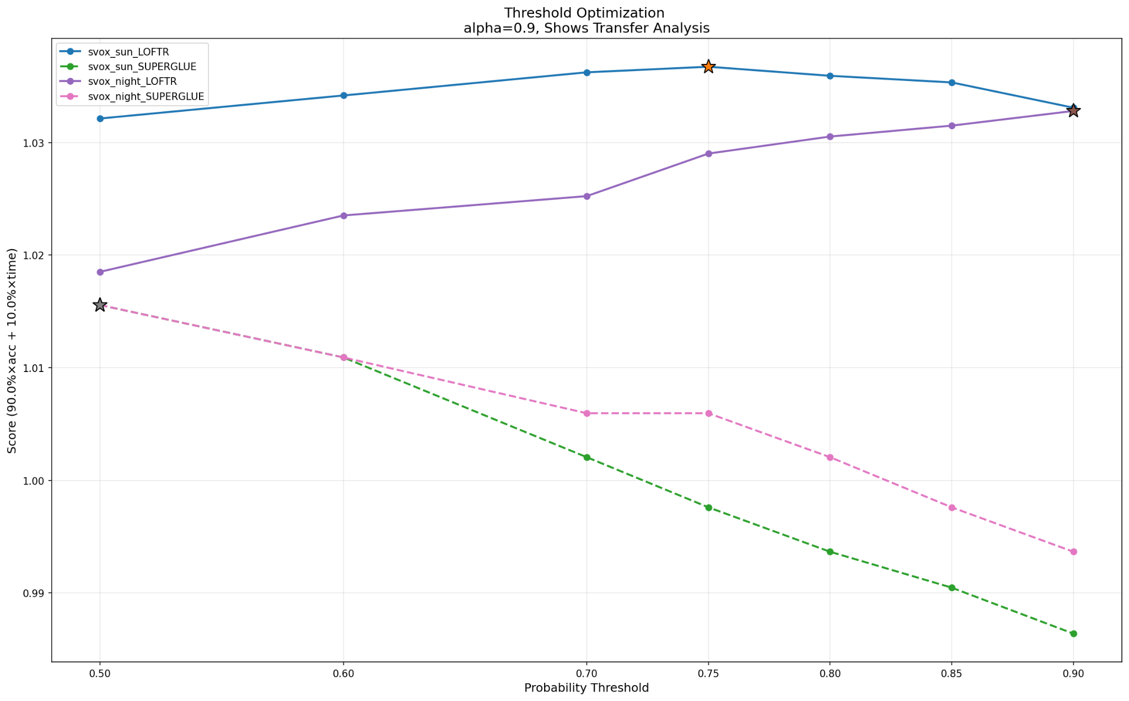
The Threshold Sweep
Notes:
In practice, we perform a grid sweep over candidate threshold values, ranging from 0.5 to 0.9.
For each threshold, we calculate the number of queries classified as easy, the accuracy on those queries, and the matching time saved.
As you can see from the plot, the peak of the curve varies significantly depending on the dataset and the local matcher being used. On the upper part of the plot, we have the results for LoFTR, while the lower part shows SuperGlue.
For example, when using LoFTR on SVOX Sun, the optimal threshold τ∗ is 0.75. Conversely, for LoFTR on SVOX Night, the optimal threshold climbs to 0.90. This highlights a much more conservative approach in nighttime environments.

Slide 17
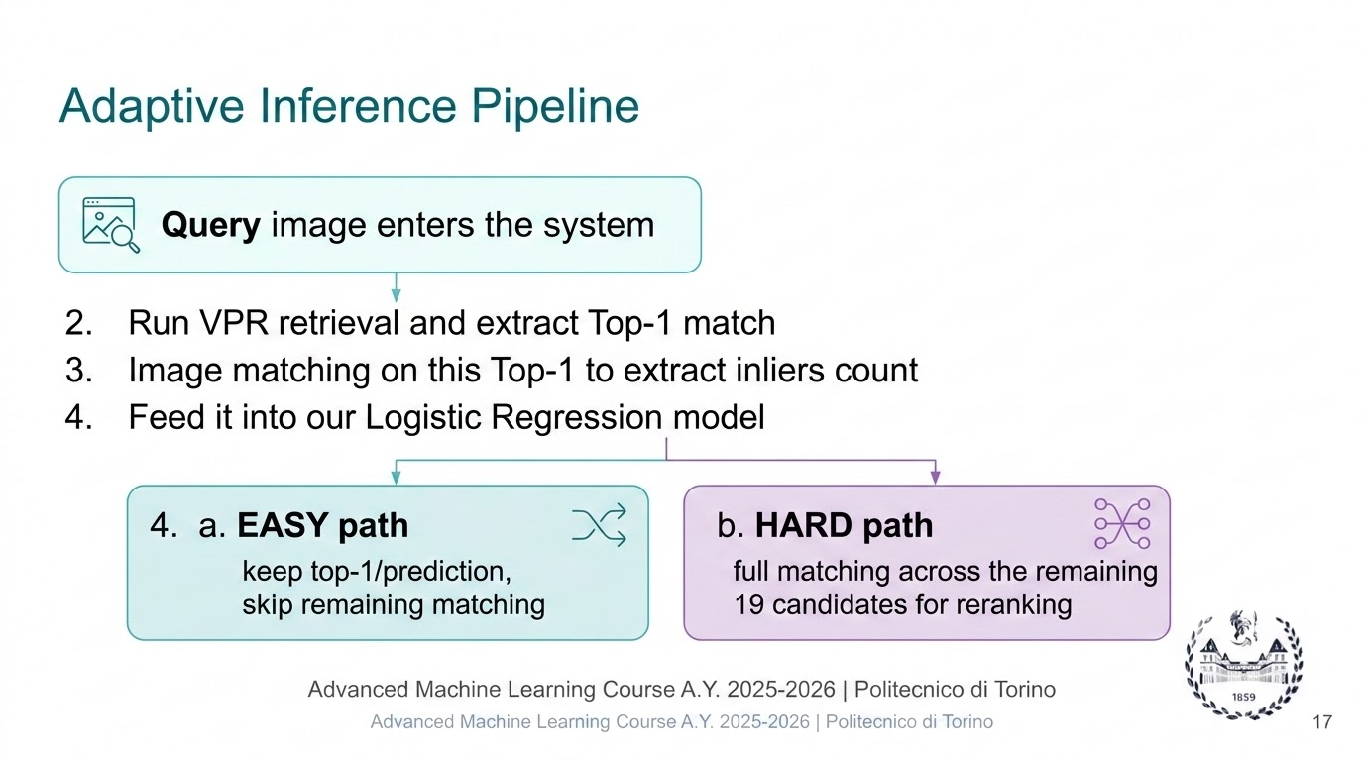
Notes:
Once we have the optimal thresholds for each matcher-dataset pair, we deploy our runtime Adaptive Inference pipeline, which follows a concrete 4-stage process:
First, a Query Image enters the system to be localized.
We run the global VPR retrieval and extract the Top-1 match.
We compute the number of geometric inliers with this top-1 image and feed it into our trained Logistic Regression model to predict whether the query is Easy or Hard.
Based on the calibrated probability and our threshold, the system dynamically splits into two paths:
The EASY path: If the confidence is high, we stop early and keep the top-1 prediction. We are done, completely skipping the remaining 19 matching verifications.
The HARD path: If confidence is low, we route the query to the full matching pipeline across all top-20 candidates for a thorough re-ranking.
And here is the massive computational payoff: if a dominant portion of our queries takes the fast path, we drastically cut down latency!

Slide 18
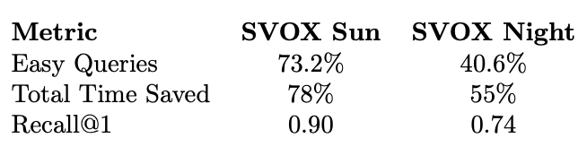
Experimental Results & Transfer
Performance evaluation across diverse datasets using Easy % and Recall metrics (@1, @5, @10).
LoFTR Performance (Trained: SVOX Sun)
Statistical Confidence Logic
Selectively skips images based on confidence levels.
Avoids redundant computational work.
Focuses resources on difficult cases.
ADAPTIVE MEANS SMART
Notes:
To put these concepts into practice, let’s look at how our adaptive framework performs under different conditions, using LoFTR as our first reference point.
As you can see from the metrics, the system exhibits clear environmental awareness. During the day, it exploits visual clarity to skip heavy verification loops—saving massive amounts of time (78%!). At night, it automatically senses the ambiguity, lowers the early-exit rate, and routes queries safely to the full pipeline.
The core takeaway here is that adaptive means smart: the system dynamically scales its computational effort based on statistical confidence.
To walk you through the macro-results, I’ll hand it over to Geremia.

Slide 19
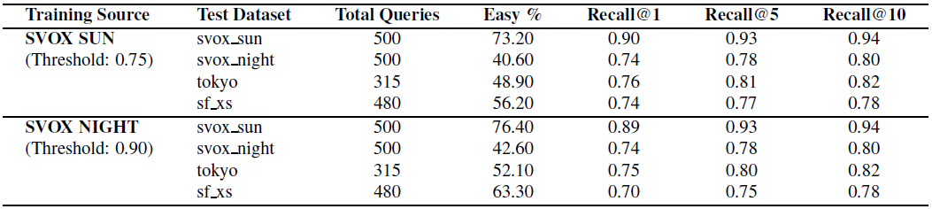
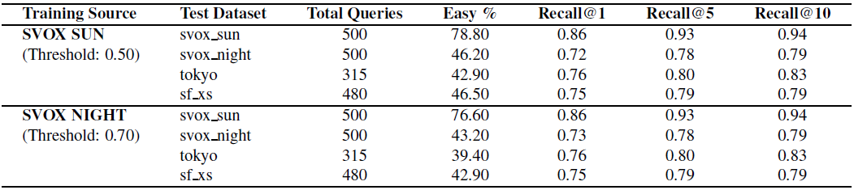
Main Quantitative Results
LoFTR (Probability Thresholds: 0.75 / 0.90)
SuperGlue (Probability Thresholds: 0.50 / 0.70)
Notes:
Thank you. Let's talk about the main macro-results of our framework, visible in the comparison of Tables 3 and 4. We evaluated our adaptive routing policy against two completely different local verification philosophies: the dense matcher, LoFTR, and the sparse matcher, SuperGlue.
A fascinating engineering trade-off emerged. In benign environments with ideal lighting, such as SVOX Sun, our framework successfully flags a dominant portion of queries as 'Easy'—specifically 73.2% for LoFTR and up to 78.8% for SuperGlue. For nearly 80% of the cases, the system stops immediately after the top-1 prediction, completely bypassing the remaining 19 candidates. Remarkably, this massive computation pruning causes zero degradation to accuracy, maintaining a high Recall@1 of 0.90 with LoFTR and 0.86 with SuperGlue.
Furthermore, look at how the framework adapts to SVOX Night. As visibility drops, the 'Easy' rate instantly plunges to roughly 41%, automatically routing nearly 60% of ambiguous queries to full verification. This confirms our selector is highly context-aware: it accurately senses uncertainty and safely backs down to protect localization metrics, keeping the night Recall@1 stable around 74%.

Slide 20

Cross-Dataset Transfer Analysis
nights_stay Cross-Illumination Transfer
public Zero-Shot Geographic Transfer
SVOX Night Model ➔ deployed on SVOX Sun
Excellent Sigmoid Saturation
The highly conservative night-trained model instantly leverages daytime feature clarity.
Efficiency & Precision Boost
Achieves a massive 76.4% Early Exit rate while preserving a robust 0.89 Recall@1.
76.4% Early Exits ✅
Evaluation on Unseen Remote Environments
Architectural Invariance
The trained confidence boundaries generalize seamlessly to unmapped urban landscapes.
Fast-Path Routing Stability
Safely isolates between 48.9% and 63.3% of easy queries on Tokyo and SF-XS.
Inlier Count is a Universal Signal!
Notes:
The next critical question we addressed is: how well does this parametric confidence boundary generalize to new, unseen environments?
The results of our transfer analysis are highly convincing. An excellent example is the cross-illumination transfer: when we take a model trained exclusively on SVOX Night—which is naturally very strict and conservative—and deploy it on the diurnally clear images of SVOX Sun, it saturates the sigmoid curve flawlessly. It converts daytime visual clarity into an immediate boost in efficiency, achieving 76.4% early exits and a robust 0.89 Recall@1.
When subjected to strict zero-shot geographic transfers on remote urban environments like Tokyo and San Francisco, the framework generalizes seamlessly. The selector safely isolates between 48% and 63% of easy queries on these unseen architectural styles while preserving stable recall bounds. This provides our most critical scientific takeaway: the local keypoint inlier count is an environment-agnostic signature for retrieval certainty.

Slide 21
Conclusion: Three Key Contributions
1. Overcoming the Trade-off Selective geometric verification successfully bridges the gap between high localization accuracy and strict runtime latency constraints | 2. Massive Resource Pruning Bypassing exhaustive matching for confident queries yields overall computational savings of up to 78% while fully preserving baseline Recall@1 metrics. | 3. Universal Confidence Signal Spatial inlier count on the top-1 retrieval candidate behaves as an environment-agnostic signature, highly robust to severe illumination and dataset shifts.
Hyper-Efficient Matchers
Richer Spatial Metrics
Single-Stage Uncertainty
Future Works:
Notes:
To conclude, this project successfully presents three key achievements. First, we demonstrated that our selective routing strategy successfully bridges the gap between high precision and strict latency constraints. Second, bypassing exhaustive matching for highly confident queries yields a massive computational time saving of up to 78% while fully preserving baseline recall integrity. Third, we proved that the top-1 spatial inlier count acts as a universal, environment-agnostic signature for retrieval certainty, remaining resilient under severe domain shifts.
Looking ahead to our future works, we plan to push the limits of this architecture further by integrating ultra-fast local feature matchers like LightGlue into our cascading pipeline. Additionally, we aim to investigate richer spatial metrics—such as the actual geometric layout and dispersion of the points across the image matrix, rather than relying solely on a scalar count. Finally, our long-term goal is embedding continuous gating mechanisms directly inside the global architecture for single-stage uncertainty prediction.

Slide 22
THANK YOU!

