Slide 1
Field mapping Task splitting algorithm for given area of interest
A presentation on
Presenters ( Team Geocoders )
Sujan Adhikari
Roshan Kafle
Manjita Pandey
Prajwal Khadgi

Slide 2
introduction
A task splitting algorithm is a method used to divide a larger task or project into smaller, more manageable subtasks.
It becomes easier to distribute the workload, allocate resources effectively, and enhance overall productivity.
Task splitting algorithms play a crucial role in field mapping by enabling efficient and systematic data collection, enhancing productivity, and ensuring high-quality mapping outputs.

Slide 3
Factors considered
Line features acting as Barriers like major highways, waterways , fences and walls
Number of buildings within a range(at the range of 40).
Determining number of buildings within each polygon
Clustering using k means algorithm

Slide 4
OUR IDEA
Identification of complex features like highway, railway,water ways,fences,walls,etc
Splitting project area considering above complex features
Polygonization on the basis of major linear features(primary highway , secondary highway)
Counting the number of features inside each polygon using ST_contains query
Determining the centroid of each polygon
Clustering based on the numbers of features
Splitting polygon into number of clusters consisting almost equal number of features to be mapped
Merging of polygon in case numbers of features are less than threshold number of features.

Slide 5
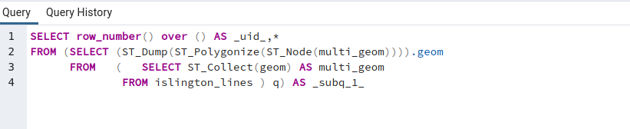
Method used
.geojson files downloaded from GitHub using provided link.
Database created in a localhost using pgAdmin
Aoi, point, line and polygon files were extracted into QGIS.
Extracted features added to created database using DB manager in QGIS
Polygonization of such line features :-used primary highway and secondary highway and avoided residential highway, path , unclassified highway etc.

Slide 6
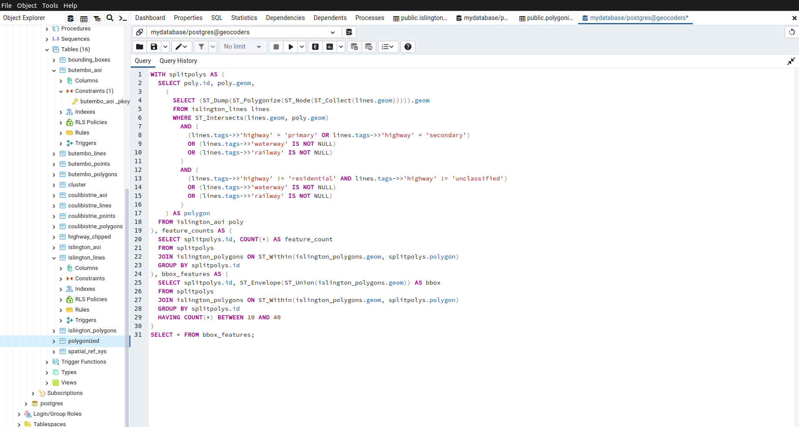
Algorithm prepared

Slide 7
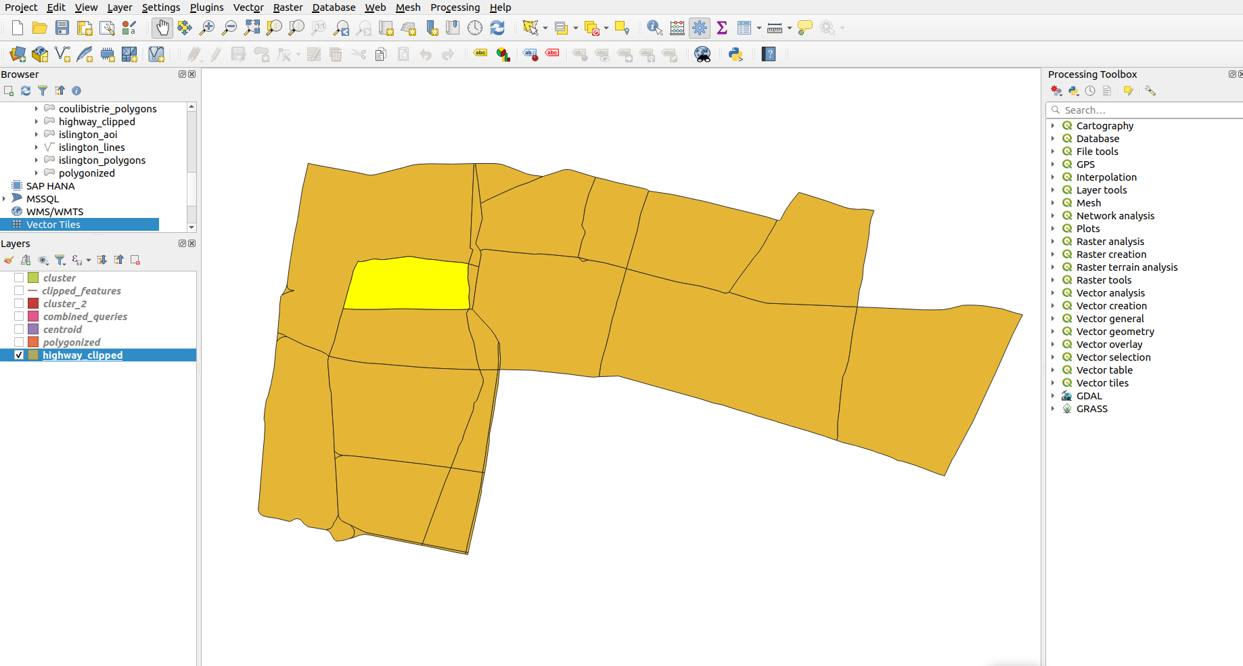
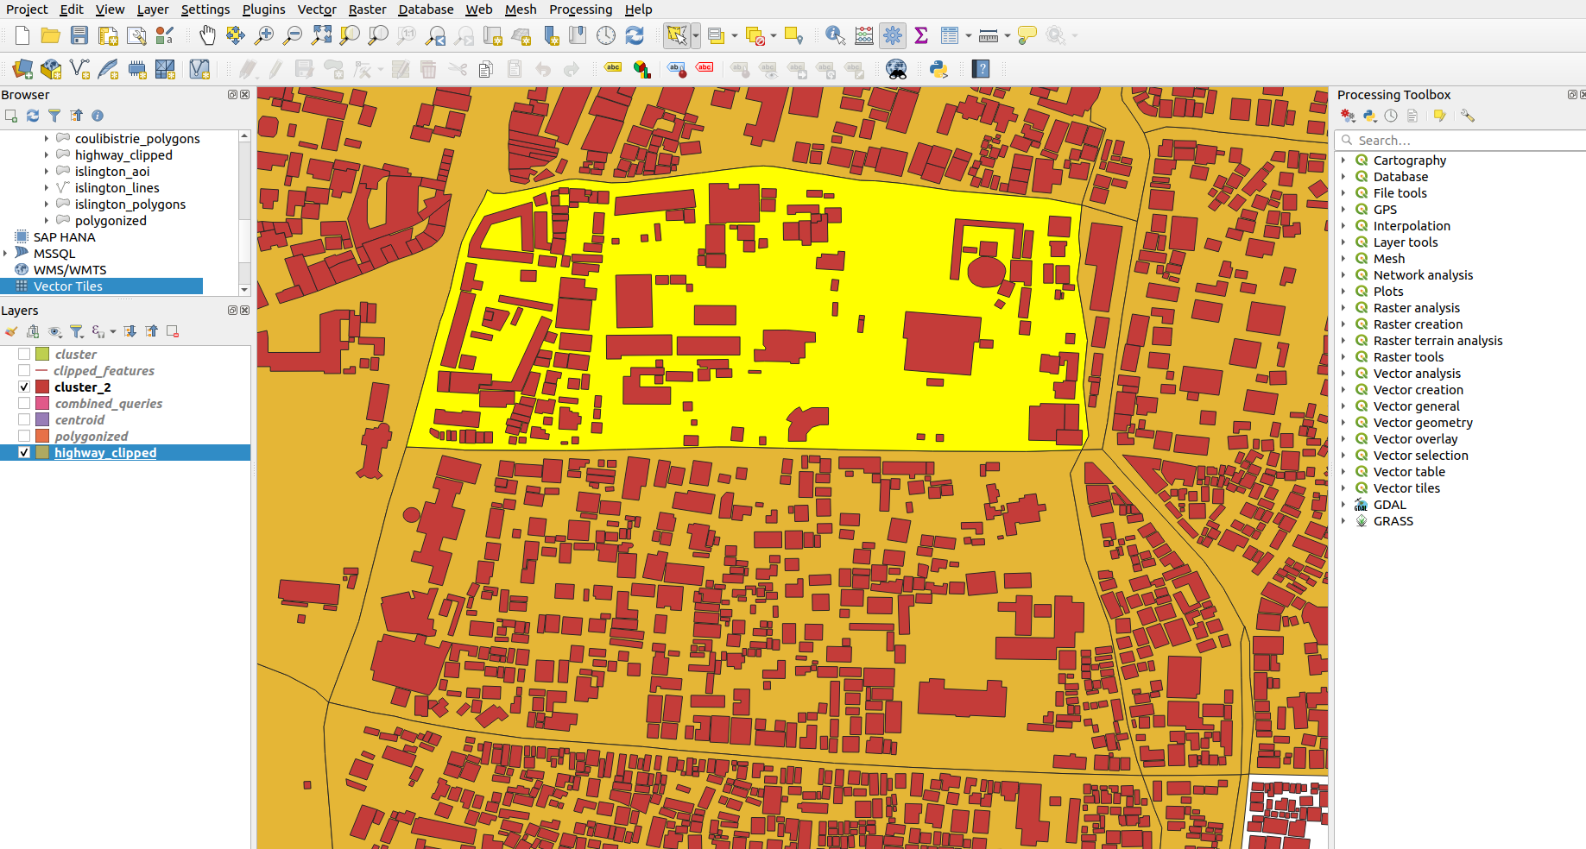
Task performed
Polygonised using Primary and secondary highways only
Clustered building features using their centroids.
Figure shows building features embedded inside the polygonised layer

Slide 8
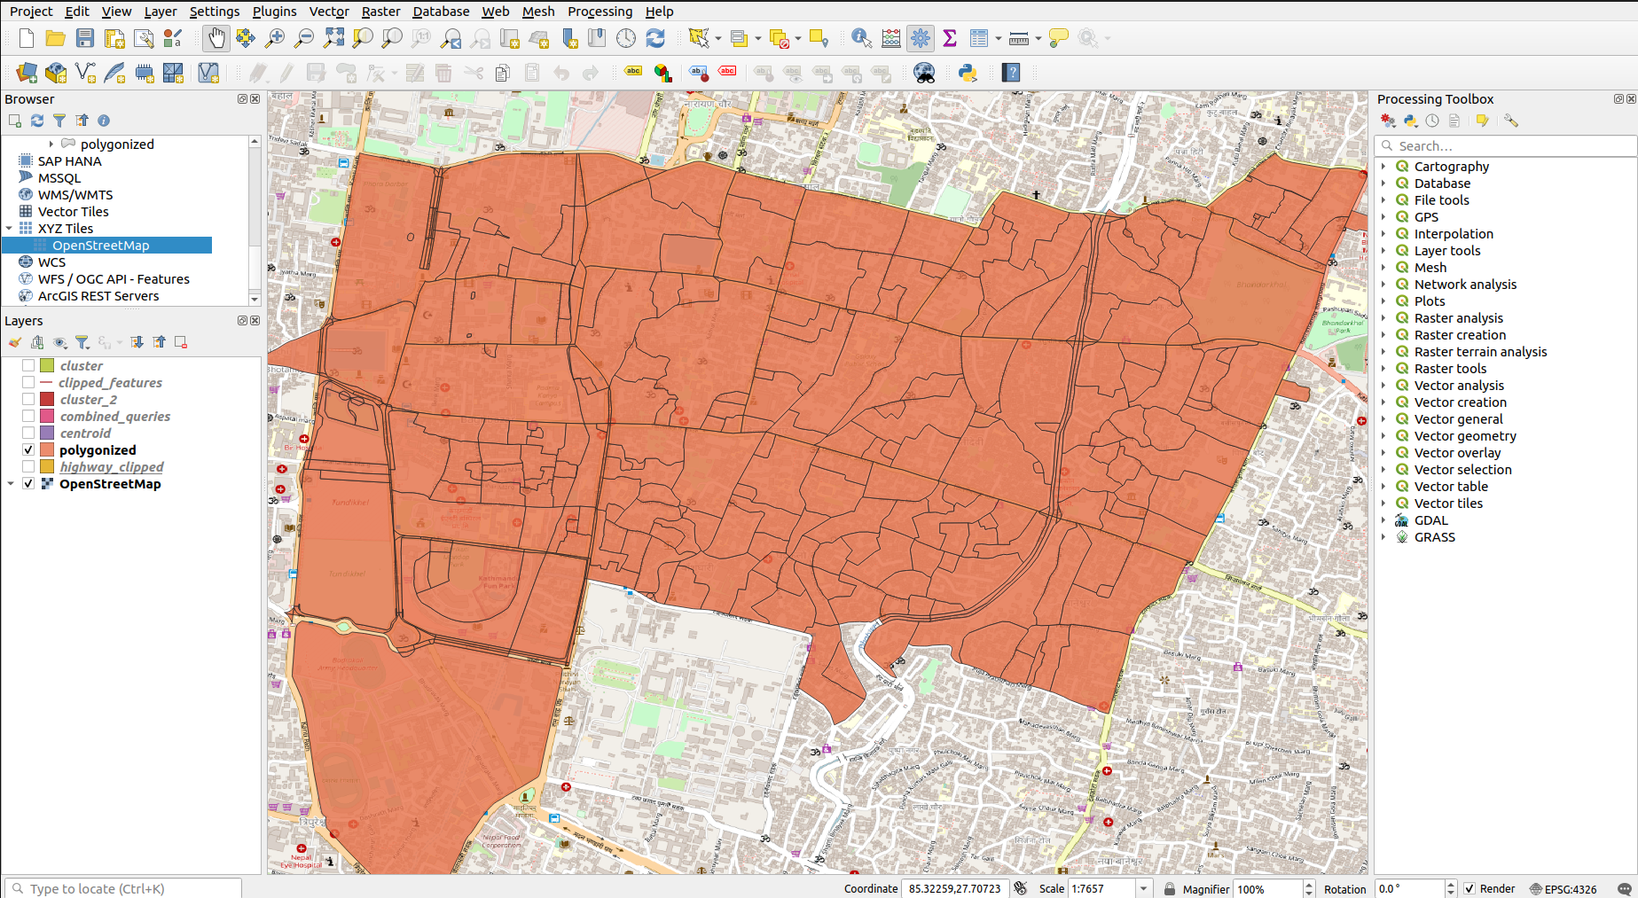
Polygonised using all highway features, yet to determine centroid and clustering.

Slide 9
Raw logics/ scope
Clustering : the code for clustering encountered an error which couldn’t be solved due to lack of time. It can be clustered using below code for polygons.
Counting: Number of buildings were count in each polygon using count function.
Merging: The clustered area having less than threshold number of building featured were merged using ST_union.
Sorting of polygons in database : the final database can be sorted in ascending or descending order to determine range in terms of number of feature or area.

Slide 10
Thank you !!!

