Slide 1
Field mapping Task splitting algorithm for given area of interest
A presentation on
Presenters ( Team Geocoders )
Sujan Adhikari
Roshan Kafle
Manjita Pandey
Prajwal Khadgi

Slide 2
introduction
A task splitting algorithm is a method used to divide a larger task or project into smaller, more manageable subtasks.
It becomes easier to distribute the workload, allocate resources effectively, and enhance overall productivity.
Task splitting algorithms play a crucial role in field mapping by enabling efficient and systematic data collection, enhancing productivity, and ensuring high-quality mapping outputs.

Slide 3
Factors considered
Line features acting as Barriers like major highways, waterways , fences and walls
Number of buildings within a range(at the range of 40).
Determining number of buildings within each polygon
Clustering using k means algorithm

Slide 4
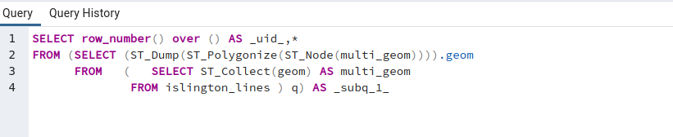
Method used
.geojson files downloaded from GitHub using provided link.
Database created in a localhost using pgAdmin
Aoi, point, line and polygon files were extracted into QGIS.
Extracted features added to created database using DB manager in QGIS
Polygonization of such line features :-used primary highway and secondary highway and avoided residential highway, path , unclassified highway etc.

Slide 5
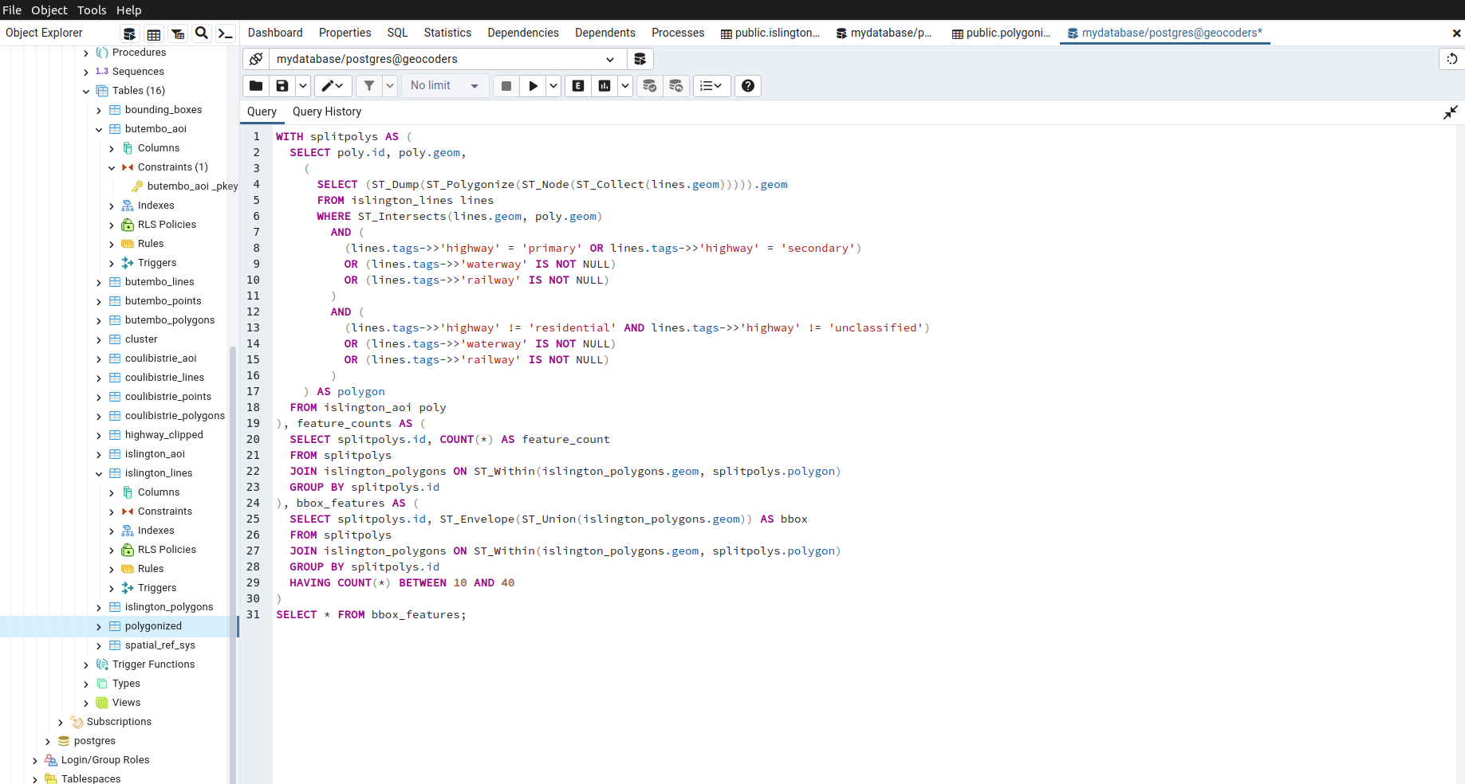
Algorithm prepared

Slide 6
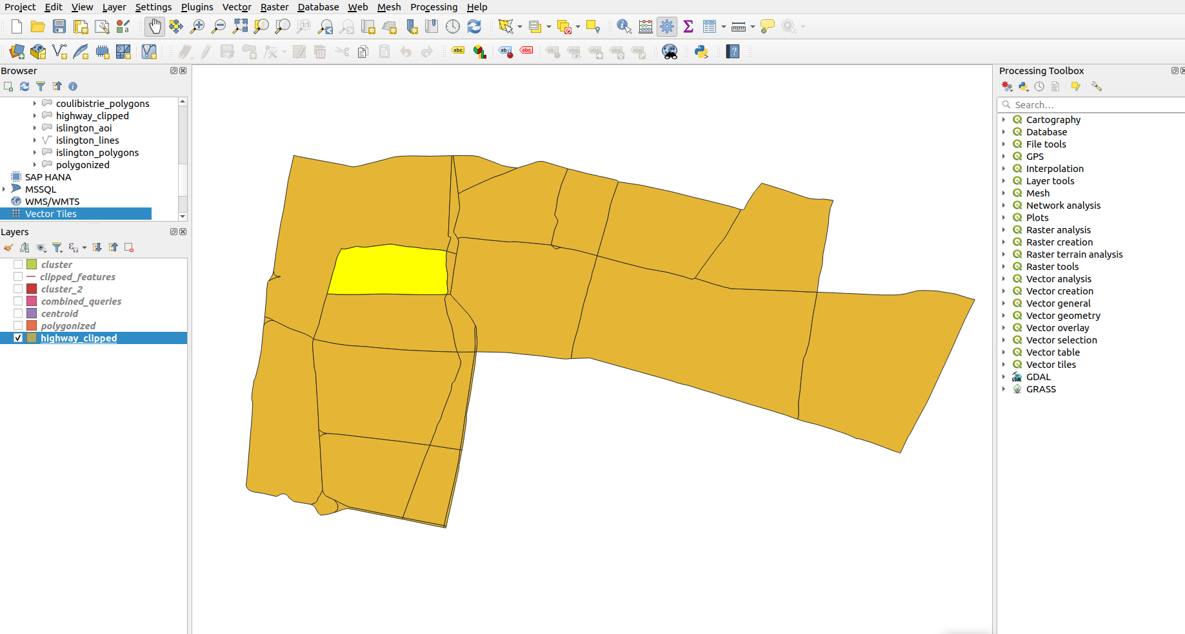
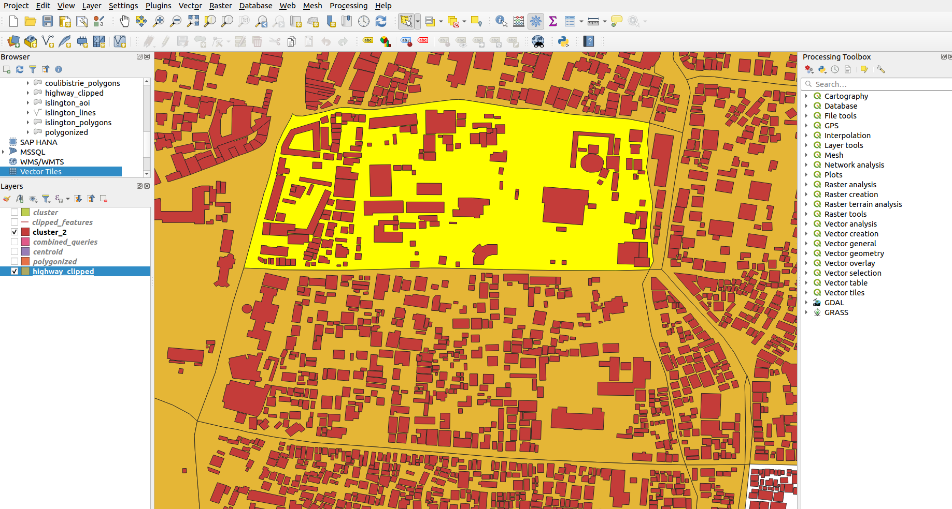
Task performed
Polygonised using Primary and secondary highways only
Clustered building features using their centroids.
Figure shows building features embedded inside the polygonised layer

Slide 7
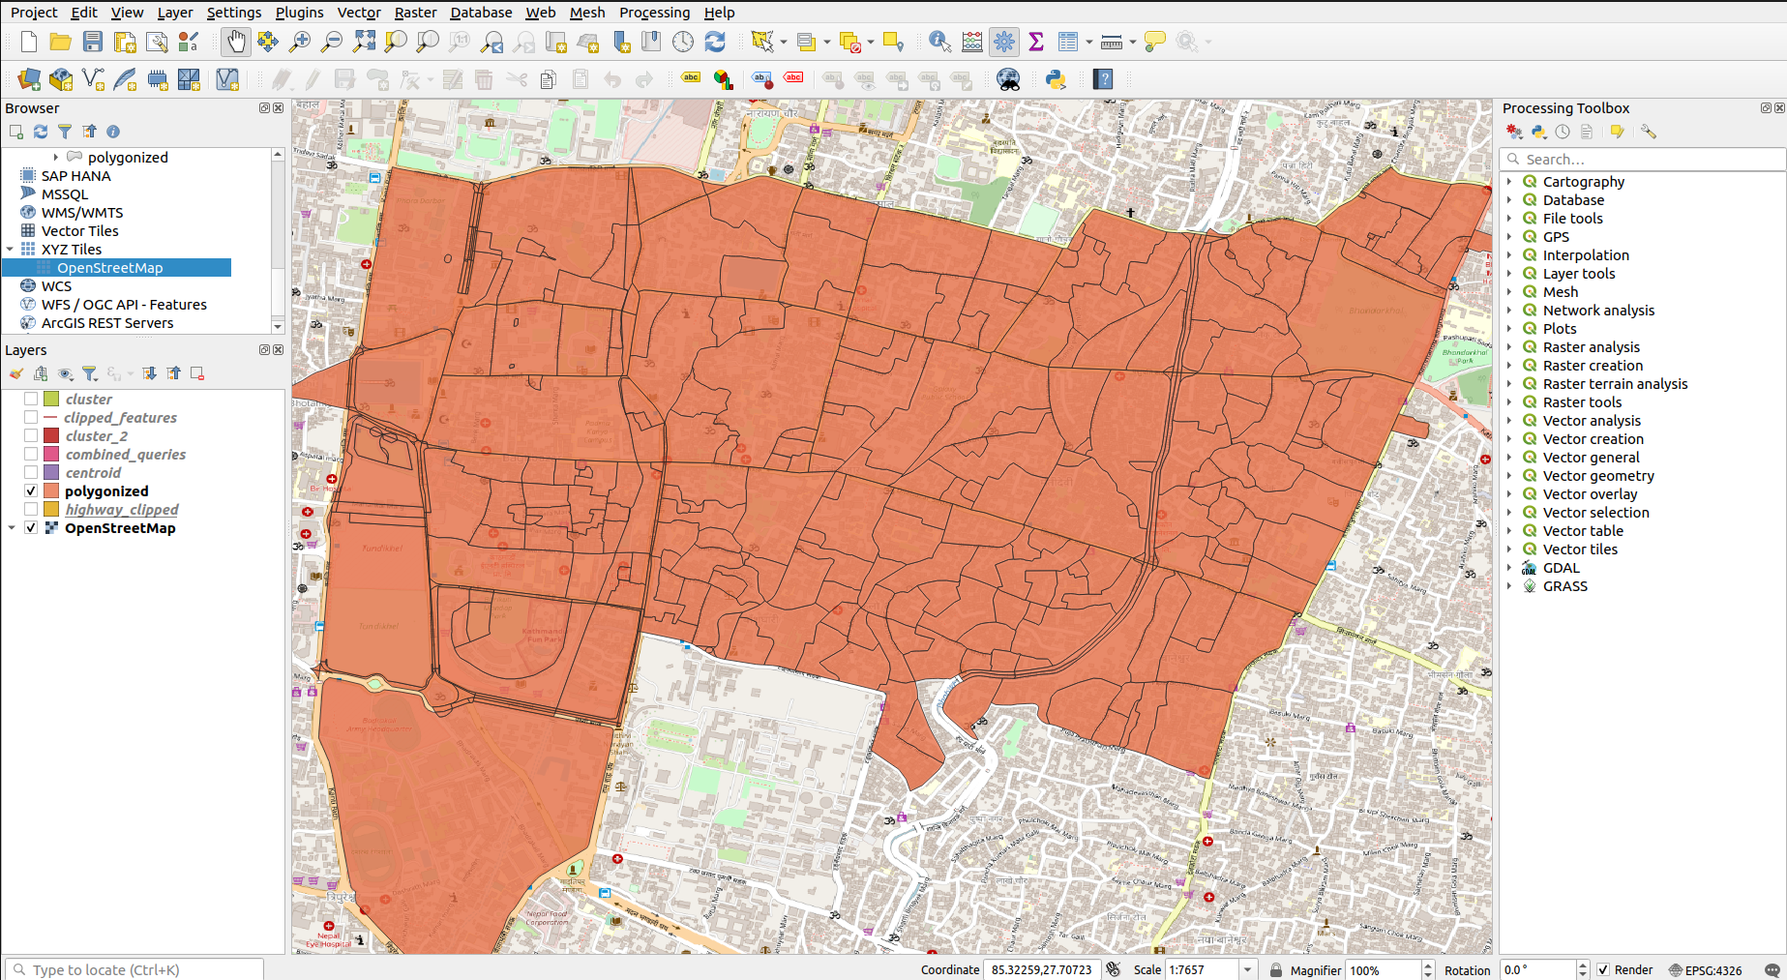
Polygonised using all highway features, yet to determine centroid and clustering.

Slide 8
Raw logics/ scope
Clustering : the code for clustering encountered an error which couldn’t be solved due to lack of time. It can be clustered using below code for polygons.
Counting: Number of buildings were count in each polygon using count function.
Merging: The clustered area having less than threshold number of building featured were merged using ST_union.
Sorting of polygons in database : the final database can be sorted in ascending or descending order to determine range in terms of number of feature or area.

Slide 9
Thank you !!!

