Slide 1

Indoor Contact Tracking Systems
Computer Science Department
Prepared by: FATMA ELGALLAL

Slide 2

Configuration
1
2
3
beacon simulator
scanner
Server

Slide 3






System Layout
Dashboard
Bluetooth
’MQTT
Localhost
Simulator
Server
Scanner

Slide 4
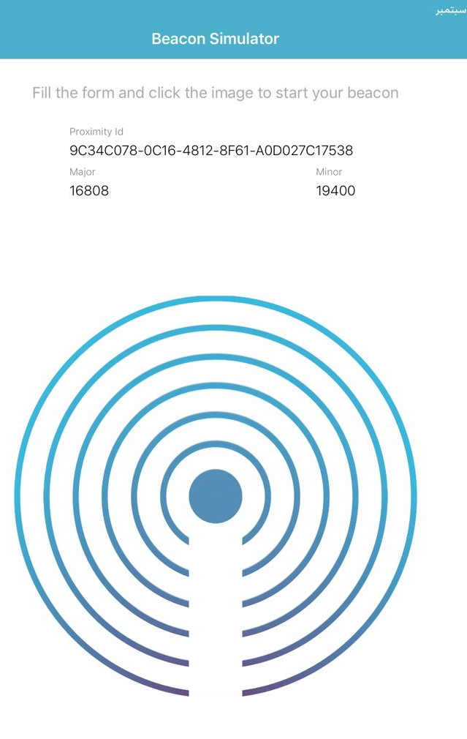
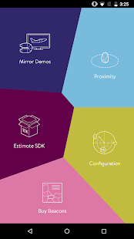
beacon simulator

Slide 5

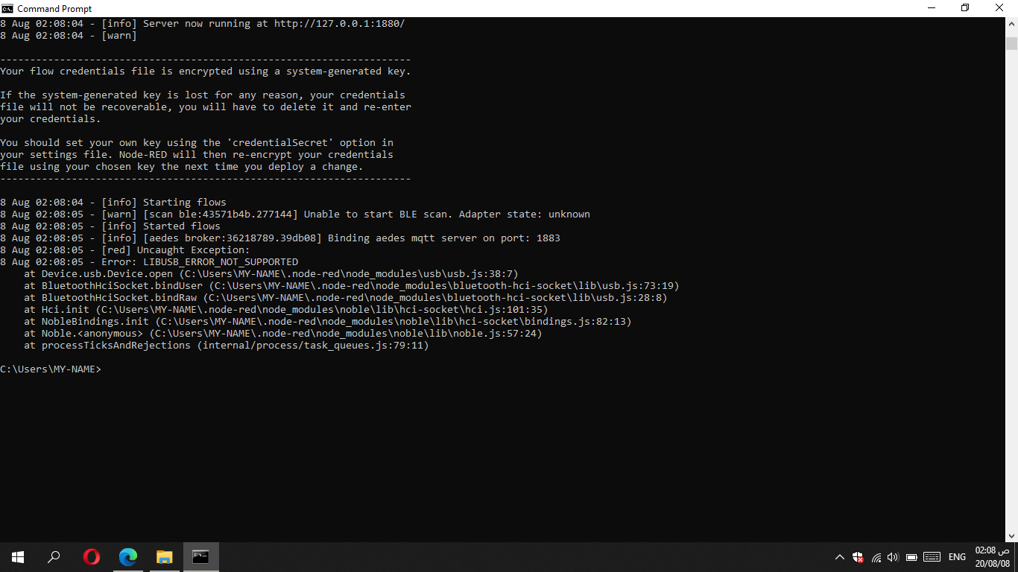
Scanner

Slide 6

Scanner
this app has been used as a scanner for any the nearest beacon devices whatever it has been entered or exited and also it supports the MQTT Protocol in order to publish the to sever by different topic for entered and exited device

Slide 7
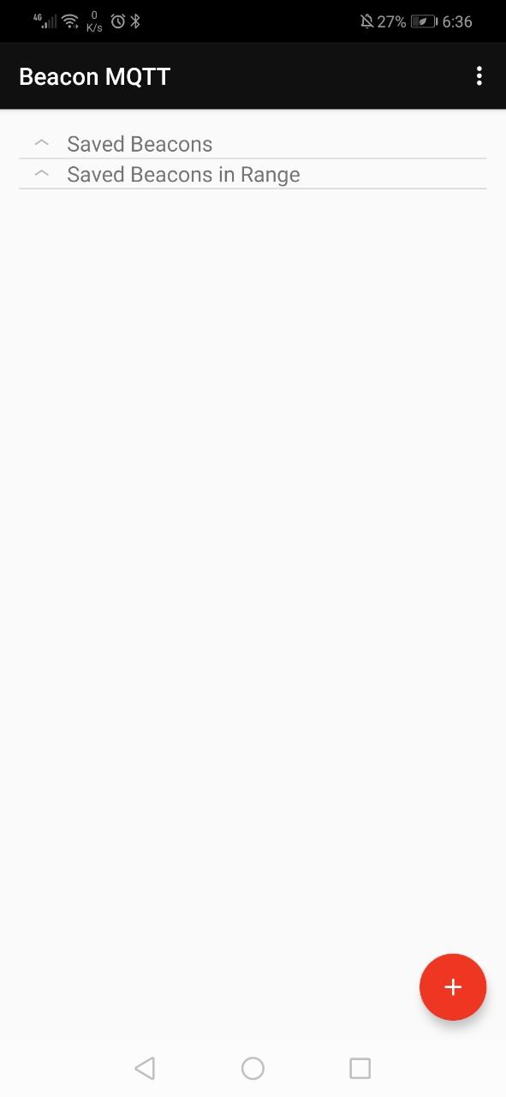
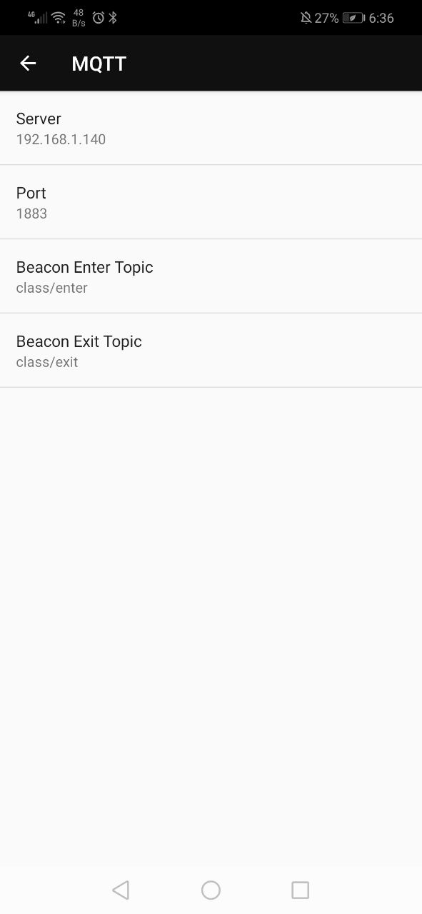
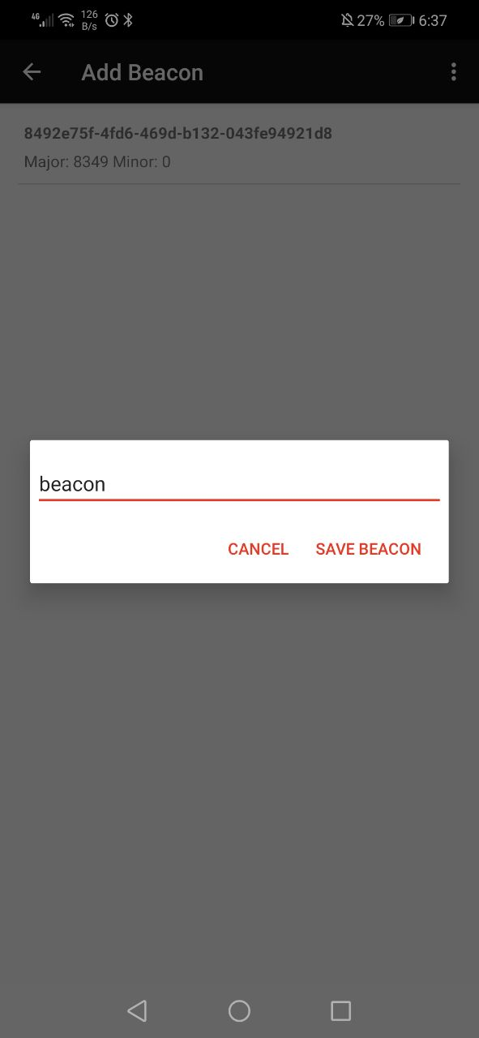
Scanner
Topics
Server configuration
Save the new beacon

Slide 8
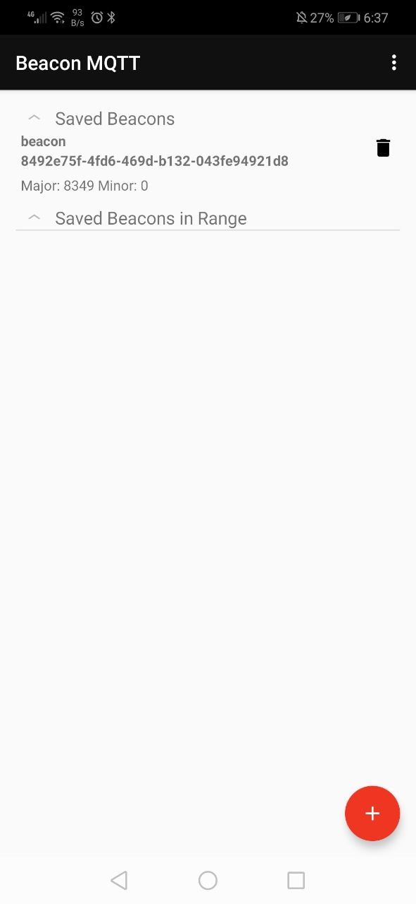
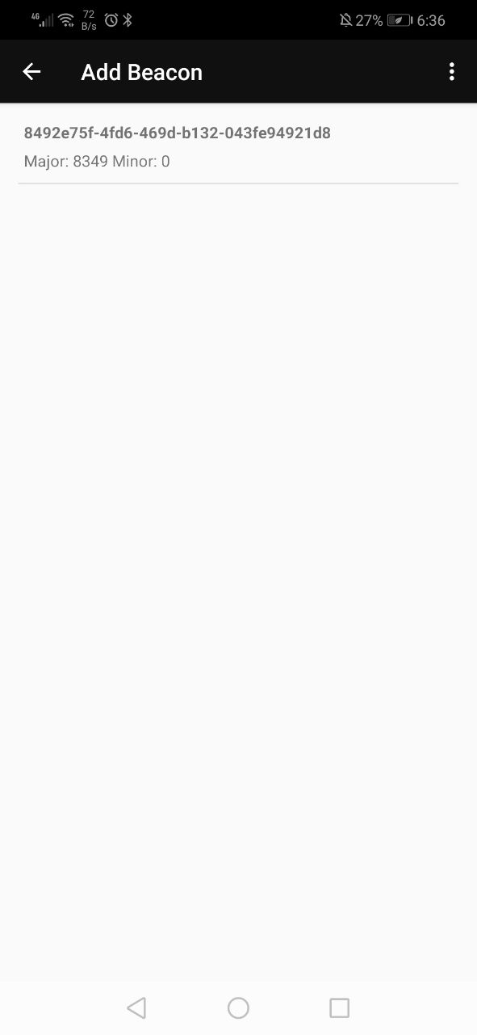
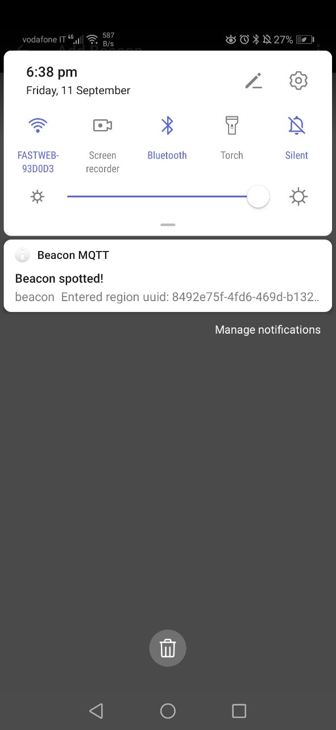
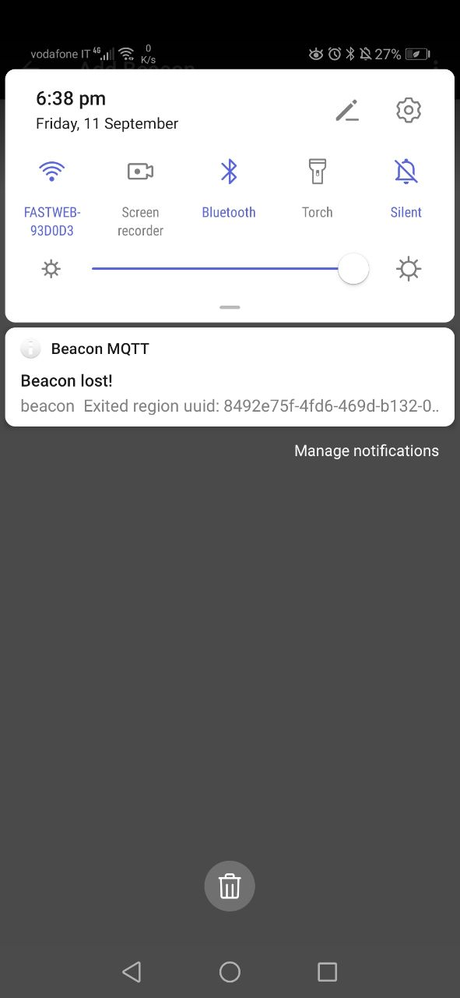
Scanner
Saved beacon
Scan for saved and new beacon
Entered and exited notifications for only saved beacons

Slide 9
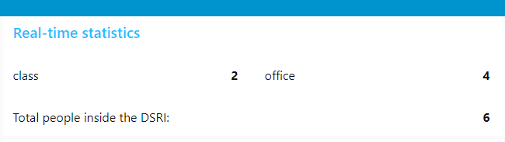
Scanner

Slide 10
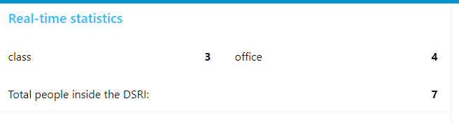
Scanner

Slide 11

Server
Used for create the server part of project with Aedes MQTT broker that can used with localhost To subscribe for entered and exited topics. Also used to store and represent the information in MySQL database and Dashboard.

Slide 12
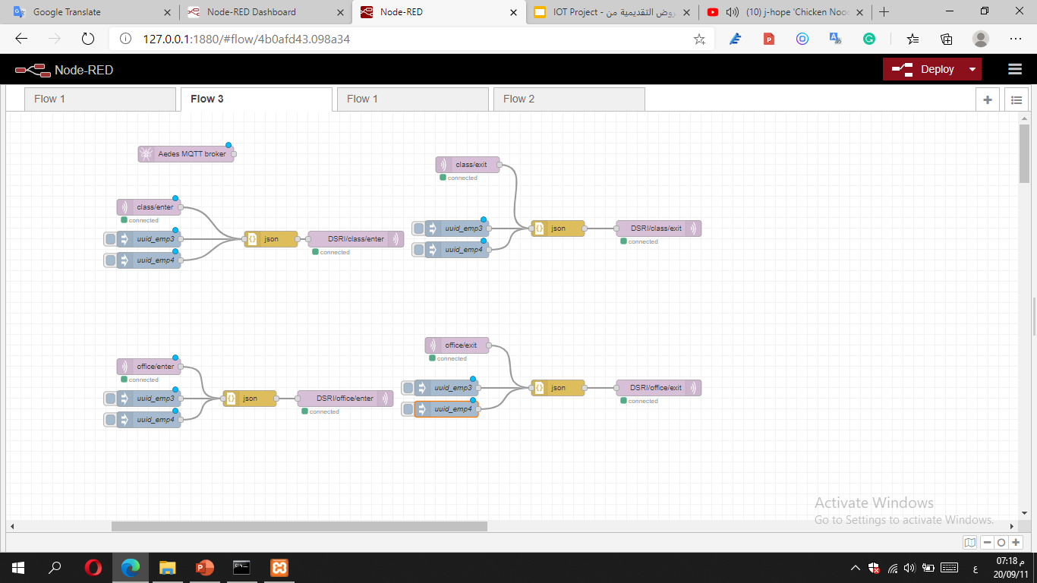
Server
Subscribe virtual beacon form MQTT broker and use two other fake beacon.

Slide 13
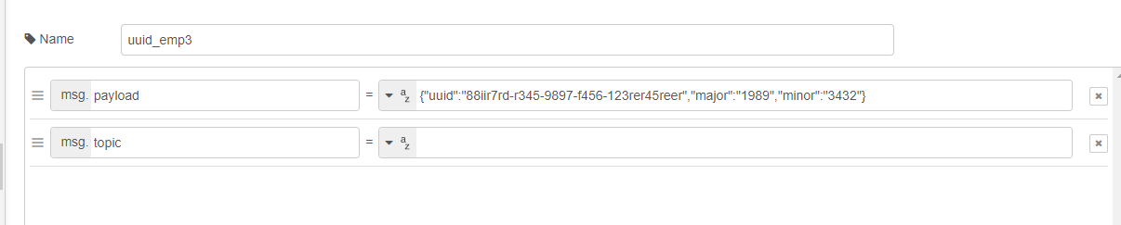
Server
Subscribe virtual beacon by MQTT broker and inject two other fake beacon in order to increase the number of devices.
fake beacon with fake uuid

Slide 14
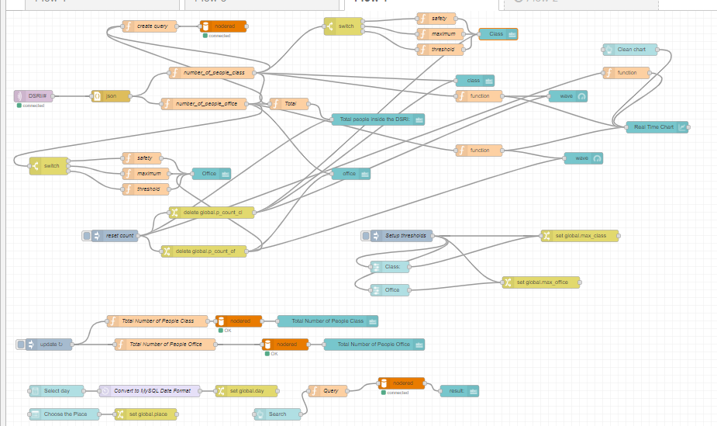
Server

Slide 15
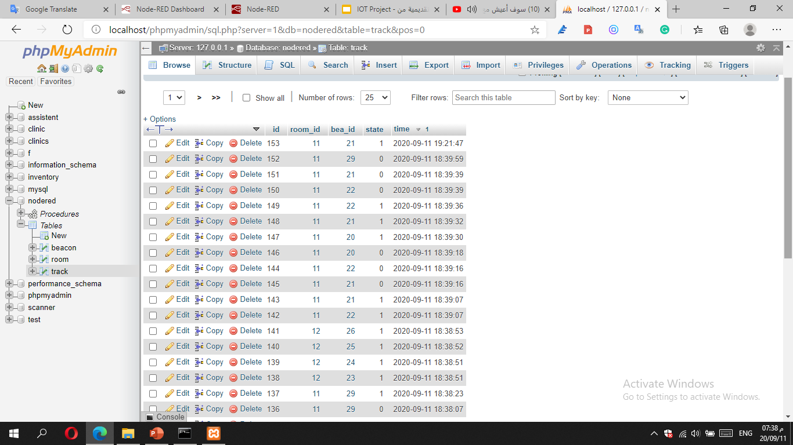
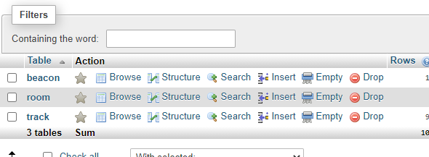
Server Database
Store the new room and new beacon device
Tracking the table for Tracking the entered and exited beacon

Slide 16
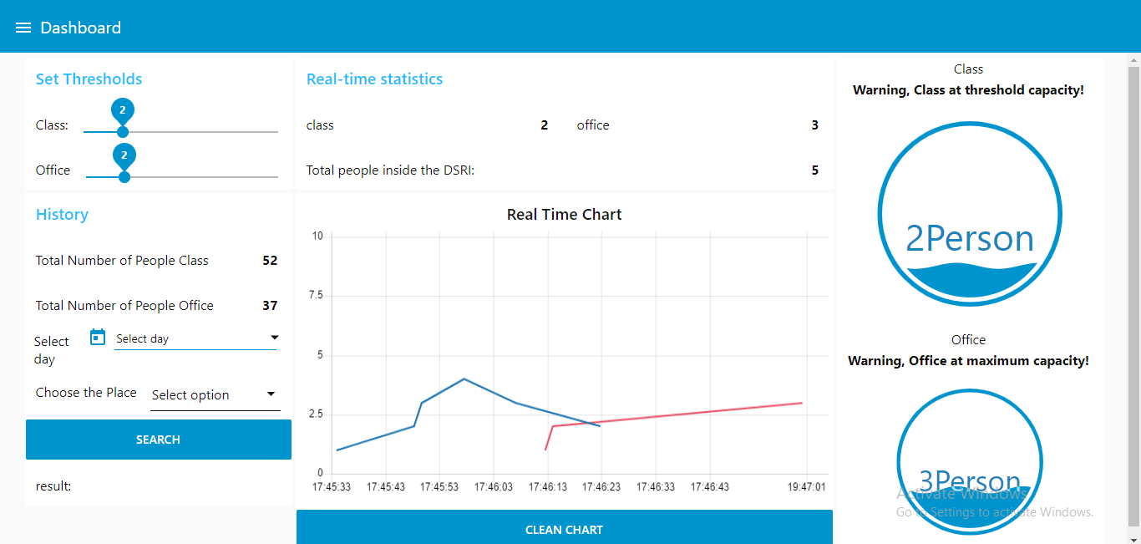
Server Dashboard

Slide 17

Server Dashboard

