Slide 1
USCH
Dharti Tarapara
Roger Halftermeyer
Sara Hu
Francisco Munoz

Slide 2


What USCH Stands For
University Student Connection Help
Web based application that incorporates students to pair with one another
Different courses from Computer Science to English to Biochemistry

Slide 3
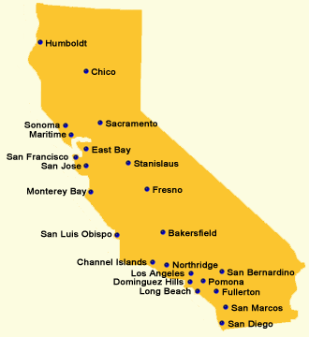
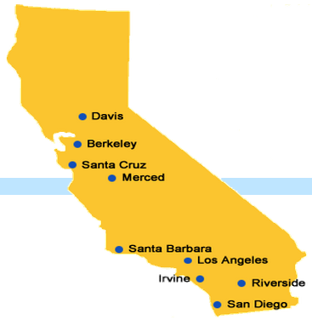
Future Plans
We plan to introduce this application to different schools throughout California and optimize the use of it so that it is convenient for any user.

