Slide 1
A Bitboard Chess Engine
with Alpha–Beta Search
Move generation verified by perft · transposition table · time-budgeted levels
Faris Muratovic · 19958
Artificial Intelligence · Instructor: Prof. Dr. Izudin Dzafic
Notes:
Title. 10 seconds.

Slide 2
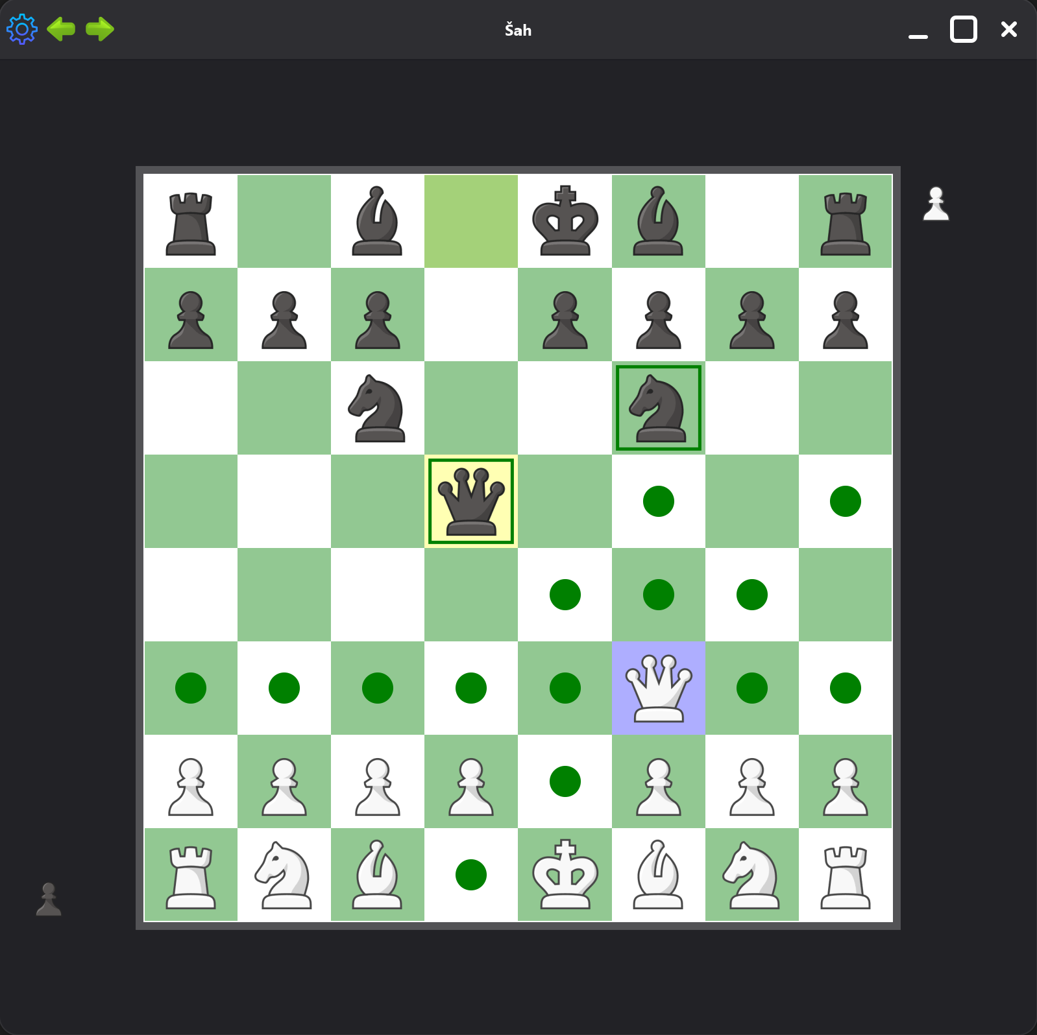
The board, and proving the rules are right
Twelve 64-bit integers — one bit per square, one board per piece type
uint64_t whitePawns, whiteKnights, …
“Which pieces attack this square?” becomes a handful of AND / OR / shift
operations and a population count — the reason every strong engine uses bitboards.
Perft: count every legal leaf, compare with published values
Start position, depth 5
4 865 609
✓ match
Kiwipete, depth 4
4 085 603
✓ match
Position 3, depth 5
674 624
✓ match
Position 4, depth 4
422 333
✓ match
Castling, en passant, promotion and pins — all exercised by the four test positions
Notes:
Board + perft. 45 seconds.

Slide 3
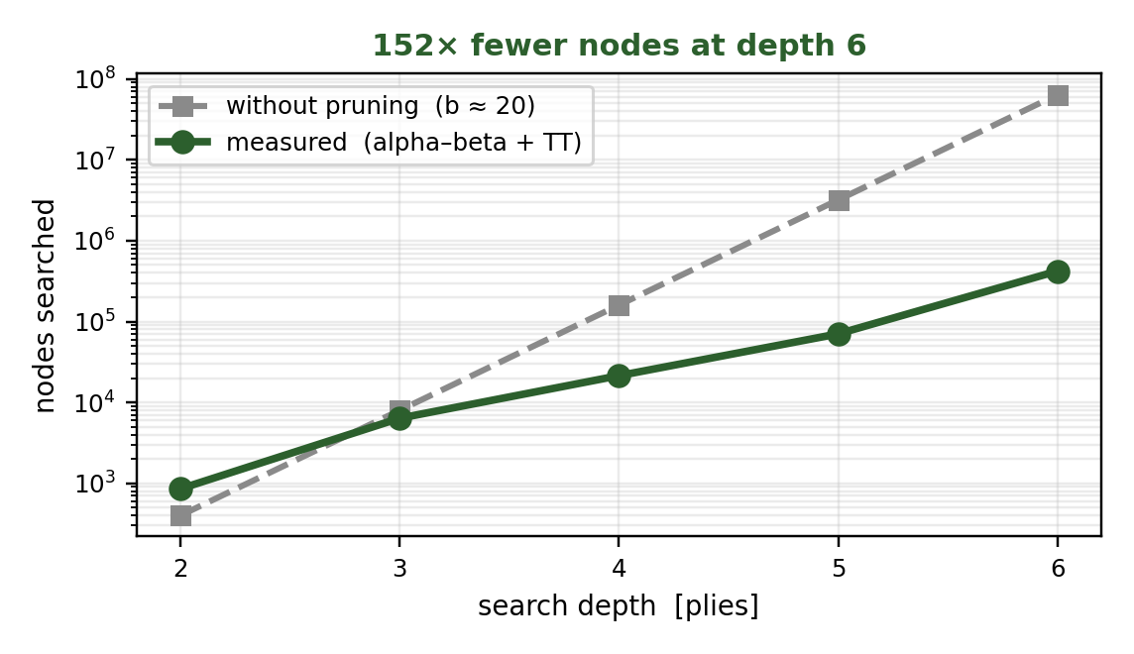
How the opponent thinks
Negamax with alpha–beta: prove a move is too good for the opponent to allow, and stop searching it
Move ordering
captures by MVV–LVA, killer and
history heuristics — cutoffs come
early only if good moves go first
Transposition table
Zobrist hash, 16 MB;
the same position reached by
another move order is not re-searched
Quiescence
keep searching captures past the
horizon so the engine does not
hang a piece one ply too late
Measured effective branching factor: 2 – 6, against 20 – 48 legal moves per position
Notes:
Search. 50 seconds. The chart is the evidence that pruning works.

Slide 4
Difficulty is a clock, not a depth
One extra ply costs 10× more in a dense middlegame than in a sparse endgame
Easy
Normal
Hard
Expert
150 ms
400 ms
1000 ms
2200 ms
per move — the search starts another iteration only if it estimates it will finish in time
Iterative deepening
depth 1, 2, 3 … — each pass makes the next one faster by ordering the best move first
Root-parallel final pass
root moves spread over all cores, each thread with its own board and table
Worker thread
the search never runs on the UI thread, so the board keeps painting while the bot thinks
Notes:
Difficulty + engineering. 40 seconds.

Slide 5
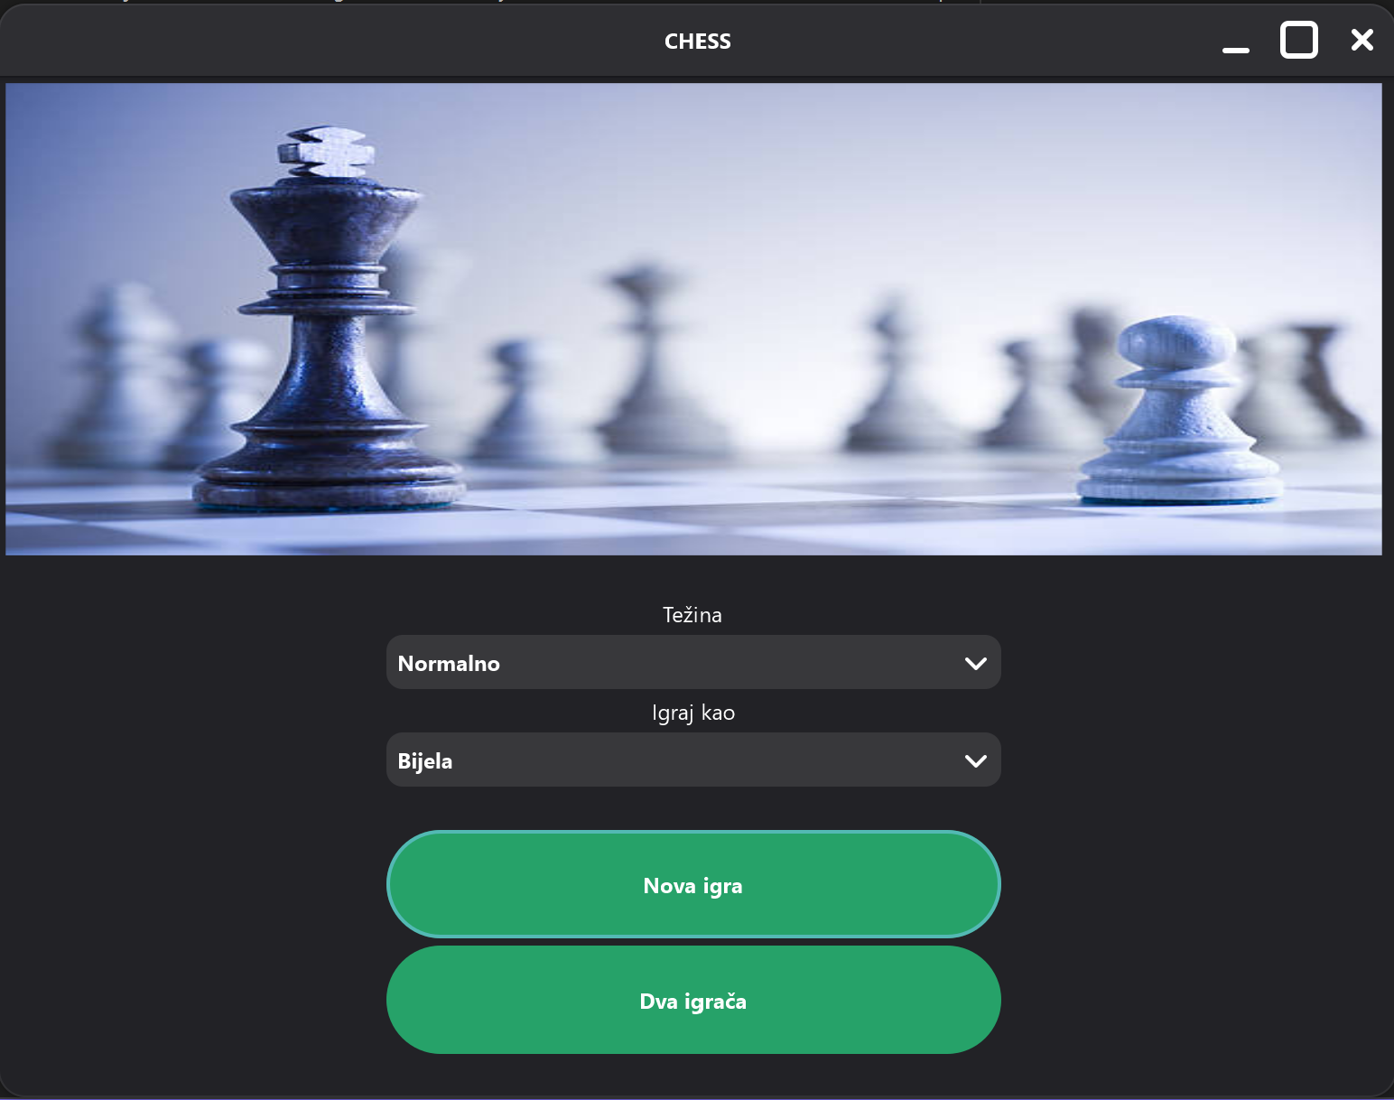
The application
natID / natGUI · drag-and-drop board drawn on a canvas
Human vs human, or vs the bot on either colour
Legal destinations highlighted on pick-up
Promotion picker, undo and redo
Captured-piece panels, Bosnian / English UI
Draws: stalemate, 50-move, repetition, material
The engine compiles stand-alone — every number in the report
was measured without the GUI.
Notes:
Application. 25 seconds.

Slide 6
What I take from it
Make errors visible
1
Perft and an incrementally maintained hash caught two move-generation bugs
that no amount of play-testing would have isolated.
Measure before choosing
2
Difficulty levels, time budgets and the per-ply growth estimate all came from
measurement, not from guessing what felt right.
Keep the search off the UI
3
Copy the position, release the lock, search on the copy — the first version froze
the whole interface for the bot's entire think time.
Bitboards + alpha–beta + a transposition table: a complete, verified opponent in 2 600 lines of engine code.
Notes:
Close. 20 seconds.

