Slide 1
SEASUG 2026 CONFERENCE · PAPER #103
Applying Propensity Score Matching
to Evaluate Interventions
A Doubly-Robust Propensity-Score Analysis of Maternal Smoking
and Preterm Birth in the 2023 U.S. Natality Cohort
Faruk Muritala
Kennesaw State University · STAT 7900 Causal Analysis
Instructor: Dr. Dhrubajyoti Ghosh
github.com/fmurital/Causal-Inference-

Slide 2
WHY THIS QUESTION
Motivation
▪ Preterm birth is a leading driver of infant morbidity and mortality in the United States, and one of the few well-established risk factors for it is modifiable.
▪ Maternal smoking during pregnancy is among the best-established modifiable risk factors for preterm delivery (< 37 completed weeks).
▪ Smoking status is not randomly assigned. A raw comparison of preterm rates between smokers and non-smokers mixes the causal effect of smoking with confounding by the many maternal, socioeconomic, and prenatal-care factors that jointly predict who smokes and who delivers early.
▪ The applied question: what does a defensible, DAG-justified, propensity-score adjustment say the effect actually is — once that confounding is addressed?
In this cohort (2023 NVSS)
13.89% preterm-birth rate among smokers
8.30% preterm-birth rate among non-smokers
5.59 pp crude (unadjusted) risk difference
— but is this the causal effect, or partly confounding?
The confounding problem
Age, race/ethnicity, education, insurance status, prior pregnancy history, and pre-existing conditions all plausibly influence both whether a mother smokes and her risk of preterm delivery. A causal estimate requires adjusting for exactly this shared-cause structure — no more, no less.
Applying Propensity Score Matching to Evaluate Interventions · SEASUG 2026 (Paper #103) · Faruk Muritala, KSU
1

Slide 3
BACKGROUND
Existing Literature
▪ Heiny & Islam (JSM poster). Applied propensity-score matching (PSM) to a similar maternal-smoking / preterm-birth question on a smaller, matched sample. This is the direct motivation for the present project.
▪ Liu et al. (2020, PLOS Medicine). The best-powered evidence: 25,623,479 U.S. singleton births (2011–2018 NVSS — the same data family used here). Found a graded dose-response: OR = 1.31 (1.29–1.33) at 1–2 cig/day up to OR = 1.53 (1.52–1.55) at 20+ cig/day (1st trimester); similar pattern in the 2nd trimester. Overall preterm rate 9.3%. Conclusion: “no safe level or safe trimester.”
▪ Philips et al. (companion perspective, PLOS Medicine 2020). An earlier meta-analysis (~220,000 births) found effects concentrated in the 3rd trimester with a lower baseline rate (4.7%) — attributed to differences in population baseline risk, motivating stratified analyses across baseline-risk groups.
▪ Methodological foundation. The propensity score itself: Rosenbaum & Rubin (1983); its use for matching/weighting/stratification in health research: Austin (2011).
Three additional 2025 sources (a propensity-matched <30-week study; a 2025 systematic review/meta-analysis, Fu et al.; a 2023 prenatal-care-adequacy study) were located but blocked by CAPTCHA/bot-detection from full-text retrieval — cited for design relevance only; their specific effect estimates are deliberately not reproduced here.
Applying Propensity Score Matching to Evaluate Interventions · SEASUG 2026 (Paper #103) · Faruk Muritala, KSU
2

Slide 4
WHAT THIS PROJECT ADDS
Research Gap & Contribution
Relative to the JSM poster this project extends, the contribution is not a different research question — it is a far more heavily instrumented answer to the same one.
Scale
Positivity diagnostics
A disclosed pivot
3.25M births vs. a smaller matched
sample — the full 2023 U.S. national
birth registry, not a subsample.
Explicit propensity-score overlap
checks before any adjustment is
trusted (not always reported in
comparable detail in prior work).
1:1 matching was attempted and
failed to complete at this scale —
reported transparently, with run
times, rather than silently dropped.
Doubly-robust estimator
Full balance reporting
Full reproducibility
IPTW + covariate-adjustment as a
cross-check: stays consistent if
either the PS model or outcome
model (not necessarily both) is right.
Standardized mean differences for
every covariate, before and after
weighting, against the 0.10
imbalance threshold.
Every number traces to executed
R and SAS code, openly available
on GitHub — in two languages.
Applying Propensity Score Matching to Evaluate Interventions · SEASUG 2026 (Paper #103) · Faruk Muritala, KSU
3

Slide 5
FRAMING THE QUESTION
Causal Question, Data & Cohort
"Among singleton U.S. births in 2023, what is the effect of maternal smoking during pregnancy on the odds of preterm birth, after adjusting for measured confounders from a pre-specified causal diagram?"
Five ingredients of the causal question
Cohort composition (2023 NVSS)
Population
Singleton U.S. live births, 2023
N
Preterm births
Crude rate
Treatment (T)
Maternal smoking at any point during pregnancy
Non-smokers (T=0)
3,155,252
261,730
8.30%
Smokers (T=1)
96,698
13,427
13.89%
Comparator
No maternal smoking during pregnancy
Total cohort
3,251,950
275,157
8.46%
Outcome (Y)
Preterm birth: delivery < 37 completed weeks
Time
Single pregnancy episode ending in a 2023 birth
Exposure prevalence: 2.97%. Data source: 2023 NVSS natality public-use file (NCHS / NBER) — de-identified, publicly available, no IRB review required.
Applying Propensity Score Matching to Evaluate Interventions · SEASUG 2026 (Paper #103) · Faruk Muritala, KSU
4

Slide 6
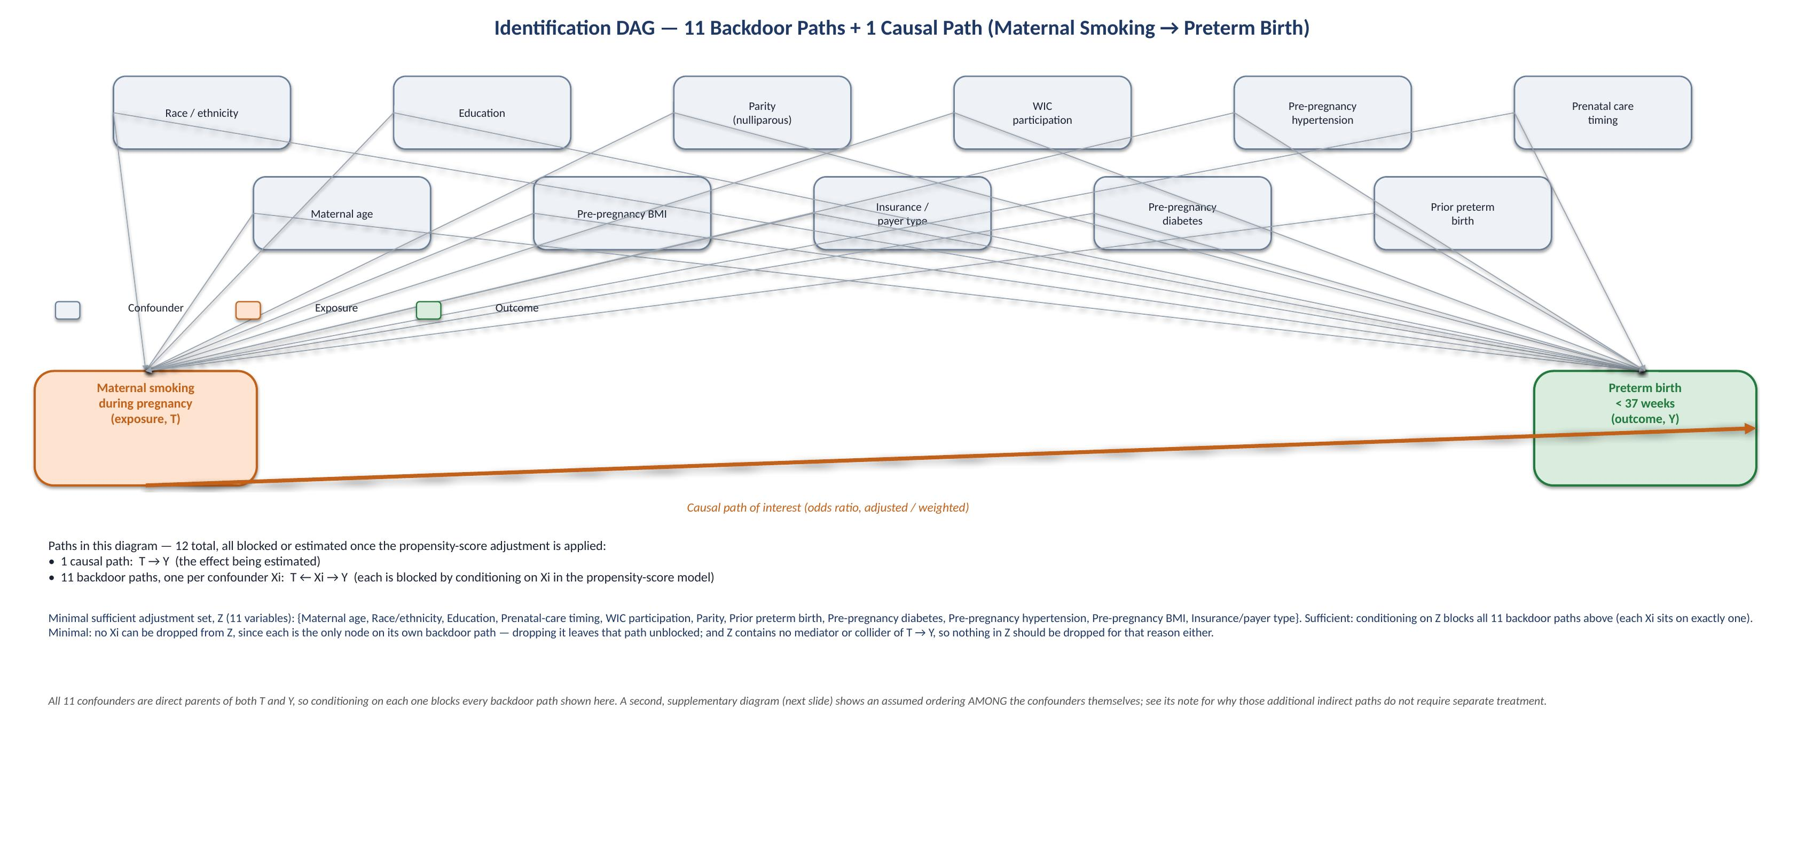
IDENTIFICATION STRATEGY
The Causal Diagram
A directed acyclic graph (DAG) encodes which variables are common causes of both smoking and preterm birth (confounders, to be adjusted for) versus variables realized after smoking status is set (mediators/colliders, excluded).
Eleven pre-treatment covariates → identification DAG; full path enumeration and the minimal-adjustment-set argument follow on the next slide.
Applying Propensity Score Matching to Evaluate Interventions · SEASUG 2026 (Paper #103) · Faruk Muritala, KSU
5

Slide 7
STATED EXPLICITLY
Identification Assumptions & Adjustment Set
Three identifying assumptions
Why this set is sufficient AND minimal
▪ Conditional exchangeability. (Y(1),Y(0)) ⊥ T | X — no unmeasured confounding once the adjustment set X is controlled for.
▪ Positivity. 0 < P(T=1 | X=x) < 1 for every covariate pattern with support in the population — checked via the overlap diagnostic.
▪ Consistency / SUTVA. a mother's observed outcome under her observed exposure equals her potential outcome, with no interference between mothers.
Sufficient
There are exactly 12 T–Y paths in the DAG: 1 causal path (T→Y) and 11 backdoor paths, one per confounder (T←Xi→Y). Conditioning on all 11 Xi blocks every backdoor path, since each passes through exactly one member of the set.
Minimal
No Xi can be dropped: each confounder is the only node on its own backdoor path, so removing it leaves that path open (unblocked). The set contains no mediator or collider of T→Y that would need to be excluded.
Adjustment set X (11 covariates)
Maternal age · race/ethnicity · education · prenatal-care-onset trimester · WIC participation · parity (nulliparous) · prior preterm birth · pre-pregnancy diabetes · pre-pregnancy hypertension · pre-pregnancy BMI · insurance/payer type
Applying Propensity Score Matching to Evaluate Interventions · SEASUG 2026 (Paper #103) · Faruk Muritala, KSU
6

Slide 8
HOW THE ANALYSIS WAS EXECUTED
Methodology — Workflow
1
2
3
4
5
6
7
8
Specify
causal question
Build DAG +
adjustment set
Fit PS
model
Check
positivity
Weight /
stratify
Diagnose
balance
Estimate
effect (×5)
Compare to
literature
5 ingredients;
ATE estimand
11 confounders;
minimal & sufficient
Logistic regression,
15% stratified
subsample (n=487,793)
PS density overlap;
trim to [0.01, 0.99]
Stabilized IPTW
(primary); PS-quintile
strata (Mantel–Haenszel)
SMD before/after;
target |SMD| < 0.10
OR, robust SE,
95% CI, 5 estimators
vs. Liu et al. (2020)
dose-response range
1:1 matching attempted first;
failed to complete → disclosed
pivot to IPTW / stratification
This is the workflow exactly as executed — including the step that did not go as originally planned (Stage 5). Every stage is documented, with exact run parameters, in the openly available R and SAS code.
Applying Propensity Score Matching to Evaluate Interventions · SEASUG 2026 (Paper #103) · Faruk Muritala, KSU
7

Slide 9
A DISCLOSED METHODOLOGICAL PIVOT
From Matching to Weighting
The original plan — mirroring the JSM poster this project extends — was 1:1 nearest-neighbor propensity-score matching (caliper = 0.2 SD of the logit-PS). It was attempted twice.
Attempt 1
Attempt 2
Why it failed
Full control pool
(~3.15M non-smokers)
8:1 sampled control pool
(870,282 controls)
Almost certainly massive ties in the propensity-score distribution at this sample size, which make greedy sequential nearest-neighbor search computationally pathological.
Failed to complete
after 9 min 50 sec
Failed to complete
after 6 min 40 sec
The disclosed pivot
▪ Rather than report a matching analysis that never finished, the strategy switched to inverse probability of treatment weighting (IPTW) and propensity-score-quintile stratification — standard, well-established methods that require no combinatorial search.
▪ This is disclosed, not hidden: no matched-analysis numbers appear anywhere in the paper, because no matching analysis ever finished. Both attempts, with their exact run times, are reported.
Applying Propensity Score Matching to Evaluate Interventions · SEASUG 2026 (Paper #103) · Faruk Muritala, KSU
8

Slide 10
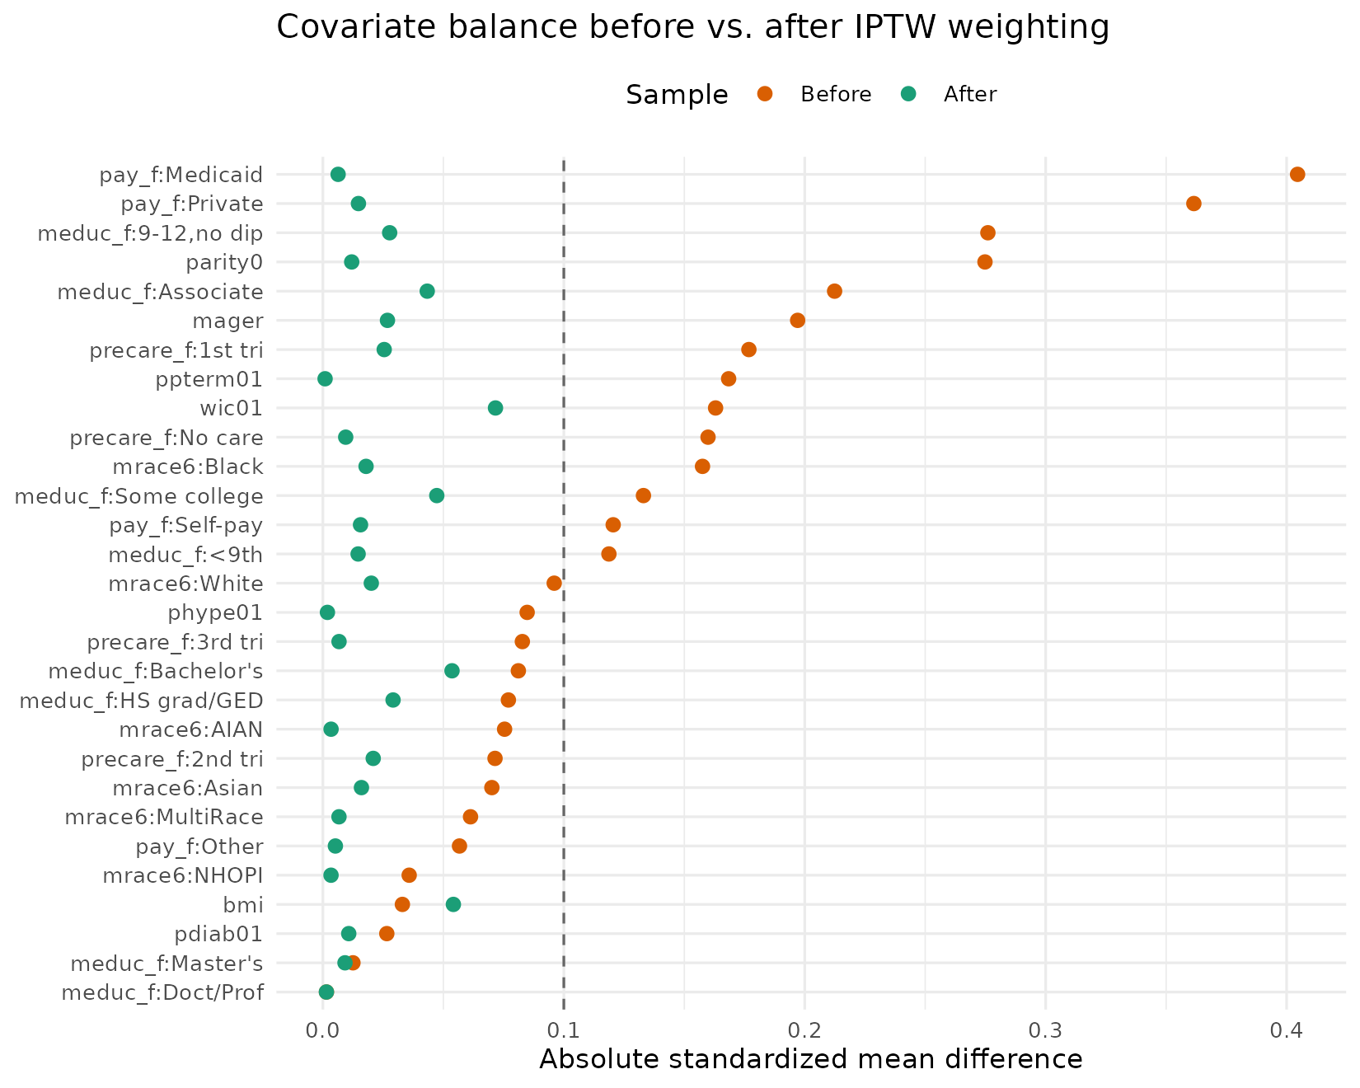
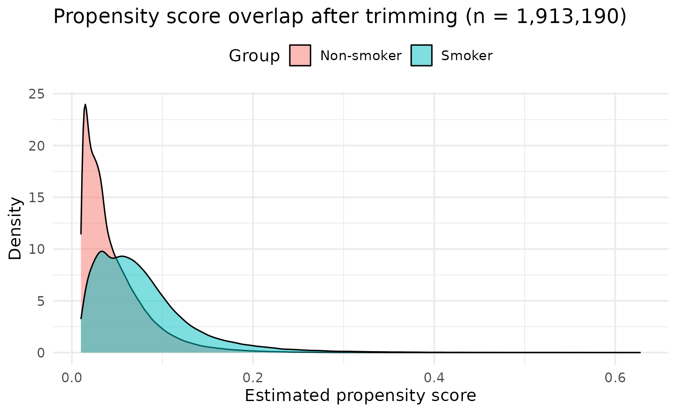
RESULTS — DID THE ADJUSTMENT WORK?
Balance Diagnostics
Before trusting any adjusted estimate, overlap and covariate balance were checked — not assumed.
Metric
Before weighting
After IPTW weighting
Max |SMD| across all covariates
0.405
0.072
Covariates with |SMD| > 0.10 (of 29)
14
0
IPTW weight distribution:
min 0.081 · median 0.985 · mean 1.000 · max 4.85 — none above 10
Applying Propensity Score Matching to Evaluate Interventions · SEASUG 2026 (Paper #103) · Faruk Muritala, KSU
9

Slide 11
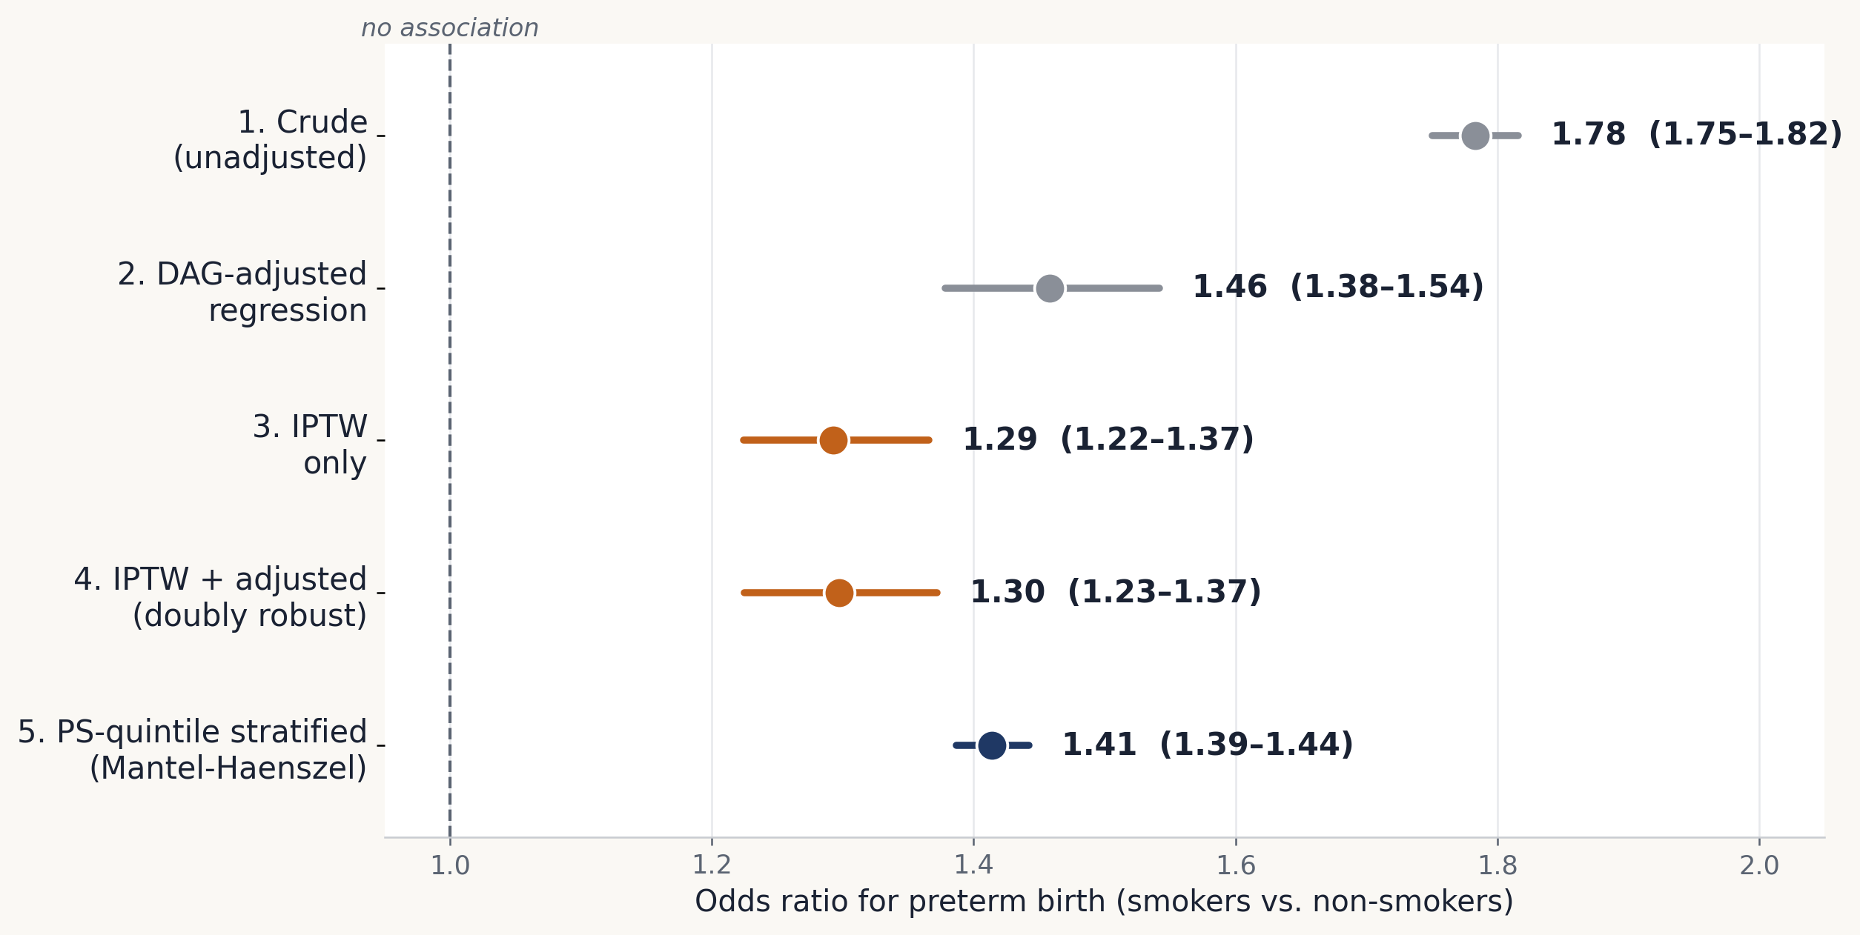
RESULTS — THE ESTIMATED EFFECT
Five Estimators, One Consistent Story
Model
N
OR (95% CI)
1. Crude
3,251,950
1.78 (1.75, 1.82)
2. DAG-adjusted regr.
400,000*
1.46 (1.38, 1.54)
3. IPTW only
400,000*
1.29 (1.22, 1.37)
4. IPTW + adjusted (DR)
400,000*
1.30 (1.23, 1.37)
5. PS-quintile (MH)
1,913,190
1.41 (1.39, 1.44)
*400,000-row exposure-stratified subsample
Crude OR 1.78 attenuates to 1.29–1.46 across every adjustment strategy. Risk difference falls from 5.59 pp (crude) to 2.75 pp after IPTW (12.17% predicted risk among smokers vs. 9.42% among non-smokers).
Applying Propensity Score Matching to Evaluate Interventions · SEASUG 2026 (Paper #103) · Faruk Muritala, KSU
10

Slide 12
PUTTING THE ESTIMATE IN CONTEXT
Interpretation vs. the Literature
The adjusted estimates here (OR ≈ 1.29–1.46) fall within — and toward the lower end of — the dose-response range reported by Liu et al. (2020) using the same national data source for 2011–2018.
This project (2023, binary exposure)
Liu et al. 2020 (2011–2018, by intensity)
1st-trimester smoking
OR = 1.29–1.46
(all intensities pooled)
OR = 1.31 (1–2 cig/day)
to 1.53 (20+ cig/day)
2nd-trimester smoking
— (not separately modeled)
OR = 1.37 to 1.59
by intensity
This is the expected relationship: the present analysis does not stratify by smoking intensity or trimester, so it estimates an effect averaged across all exposure-intensity levels present in the 2023 cohort — naturally landing inside the dose-response envelope rather than at either extreme.
Applying Propensity Score Matching to Evaluate Interventions · SEASUG 2026 (Paper #103) · Faruk Muritala, KSU
11

Slide 13
HONEST ACCOUNTING
Strengths & Limitations
Strengths
Limitations
▪ Near-census national cohort (N > 3.25M), not a matched subsample.
▪ Pre-specified, DAG-justified adjustment set — not a post-hoc “kitchen sink.”
▪ Positivity/overlap diagnostics and balance reporting before and after adjustment.
▪ A doubly-robust estimator as a cross-check on the IPTW-only estimate.
▪ Full, disclosed reproducibility — including the one approach that did not succeed.
▪ Residual confounding. Unmeasured factors (e.g. substance use, detailed SES) cannot be ruled out even with excellent measured balance.
▪ Binary exposure coding. No intensity or trimester timing — both of which Liu et al. (2020) show matter.
▪ Self-reported exposure, known to be under-reported on birth certificates — biases toward the null.
▪ Complete-case analysis. 6.45% dropped for missingness on an adjustment covariate.
▪ Subsampling for tractability. Models 2–4 fit on 400K-row subsamples due to memory limits; coefficients confirmed stable to fixed seeds.
Applying Propensity Score Matching to Evaluate Interventions · SEASUG 2026 (Paper #103) · Faruk Muritala, KSU
12

Slide 14
CONCLUSION
Using the complete 2023 U.S. national birth cohort, maternal smoking during pregnancy is associated with 29–46% higher odds of preterm birth after adjustment — most rigorously, OR = 1.30 (95% CI: 1.23, 1.37) under doubly-robust IPTW.
This is consistent with, and at the conservative end of, prior dose-response evidence from the same data source.
▪ Five convergent estimators — not one model's specification driving the result
▪ Extensive balance diagnostics, before and after adjustment
▪ Full code reproducibility, in both R and SAS
Offered as a template for propensity-score methods on large administrative birth registries when individual matching is not tractable.
13

Slide 15
EVERYTHING IS CHECKABLE
Reproducibility, Code & AI-Use Disclosure
github.com/fmurital/Causal-Inference-
Organized by artifact: code/R/ · code/SAS/ · figures/ · paper/ — with a README documenting the data source, exact run order, and a reproducibility statement.
▪ The full pipeline is implemented independently in both R and SAS.
▪ Every reported number traces to executed code — nothing in this deck is estimated “by eye.”
▪ Includes the abandoned matching attempt, kept for transparency.
AI-use disclosure
Generative AI assistance (Claude, Anthropic) was used for code drafting, debugging, document formatting, and literature-search support, under the author's direction, review, and correction — per STAT 7900 course policy. No result, figure, or number in this work was generated or estimated by the AI independent of author-directed, executed R/SAS code. The author reviewed all code and output and takes full responsibility for the analytic decisions, code, and conclusions presented.
Applying Propensity Score Matching to Evaluate Interventions · SEASUG 2026 (Paper #103) · Faruk Muritala, KSU
14

