Slide 1
Applying Propensity Score Matching to Evaluate Interventions
Does smoking in pregnancy cause preterm birth? A doubly robust (AIPTW) analysis of 3.26 million U.S. births
Faruk Muritala and Dhrubajyoti Ghosh
Kennesaw State University
SEASUG 2026 | Paper 103
Notes:
OPENING (20 seconds). Good morning. I am Faruk Muritala from Kennesaw State University, presenting joint work with Dr. Dhrubajyoti Ghosh. Our question is simple: if a mother smokes during pregnancy, how much does that raise the chance of a preterm birth, once we account for the fact that smokers differ from non-smokers in many other ways? we use the 2023 U.S. birth certificate file, 3.26 million births, and a doubly robust method called AIPTW, short for Augmented IPTW. The program title says propensity score matching; in this talk the propensity score is used for weighting, not matching, and we will explain why on the method slide.

Slide 2
The problem: smokers deliver earlier, but smokers also differ
3.26 M
3.0%
8.5%
5.6 pts
singleton births, U.S. 2023 (analytic cohort)
smoked in pregnancy (97,187 mothers)
delivered preterm (< 37 weeks)
crude gap: 13.9% in smokers vs 8.3% in non-smokers
How much of the 5.6-point gap is caused by smoking, and how much reflects who smokes?
Target: the average causal effect (ATE) of smoking in pregnancy on preterm birth, as a risk difference
Tools: a causal diagram (DAG) to choose adjustment variables, then propensity-score weighting with doubly robust AIPTW
Notes:
PROBLEM (30 seconds). Four numbers frame the talk. Our analytic cohort has 3,259,496 singleton births. 97,187 mothers, 3.0 percent, reported smoking during pregnancy. Overall 8.5 percent of babies were born before 37 weeks. Among smokers it is 13.9 percent and among non-smokers 8.3 percent, a raw gap of 5.6 percentage points. The raw gap is not the causal effect, because mothers who smoke also have less education, later or no prenatal care, more prior preterm births and more chronic conditions, and those things raise preterm risk by themselves. The goal is to separate the part caused by smoking from the part caused by who smokes.

Slide 3
Data: the 2023 U.S. birth certificate file, 3.26 million births
3,476,180
singleton births, known gestational age and smoking status
Exposure (T)
Any smoking during pregnancy (birth certificate report)
3,467,679
after excluding mothers who are not U.S. residents
Outcome (Y)
Preterm birth: gestational age under 37 completed weeks
3,259,496 (93.8%)
complete data on all ten confounders: analytic cohort
Ten confounders (X)
Maternal age, race/ethnicity, education, timing of prenatal care, WIC, parity, prior preterm birth, pre-pregnancy diabetes, hypertension and BMI
97,187 smokers | 3,162,309 non-smokers
Source: NCHS 2023 Natality Public Use File (public, de-identified)
Notes:
DATA (30 seconds). The source is the National Center for Health Statistics 2023 Natality Public Use File, which covers every U.S. birth and has no personal identifiers. We start with 3,476,180 singleton births that have a known gestational age and a known smoking status. We drop 8,501 births to mothers who do not live in the U.S., leaving 3,467,679, and then keep births with complete data on the ten confounders, which leaves 3,259,496, or 93.8 percent. The exposure is any smoking reported during pregnancy. The outcome is preterm birth, under 37 completed weeks by the obstetric estimate. The ten confounders were chosen from the DAG, which we show shortly. Insurance type was left out of the main model and used only as a sensitivity check. Link and run instructions for the data are at the top of the R code.

Slide 4
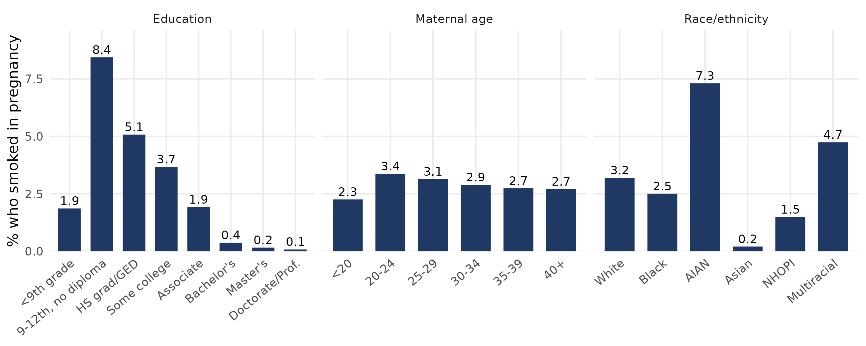
EDA 1: smoking is concentrated among mothers with less education
8.4% of mothers with 9-12th grade and no diploma smoked, versus 0.1% with a doctorate. The groups are not comparable without adjustment.
Notes:
EDA, WHO SMOKES (30 seconds). These bars show the share of mothers who smoked in each group. Education is the strongest pattern: 8.4 percent of mothers with some high school and no diploma smoked, against 0.4 percent with a bachelor's degree and 0.1 percent with a doctorate. Smoking is also much higher among American Indian and Alaska Native mothers, 7.3 percent, and multiracial mothers, 4.7 percent, and very low among Asian mothers, 0.2 percent. Age matters less. The point for the method: smokers and non-smokers come from different parts of the population, so comparing them directly mixes the effect of smoking with the effect of these characteristics. It also foreshadows the overlap problem: some kinds of mothers almost never smoke.

Slide 5
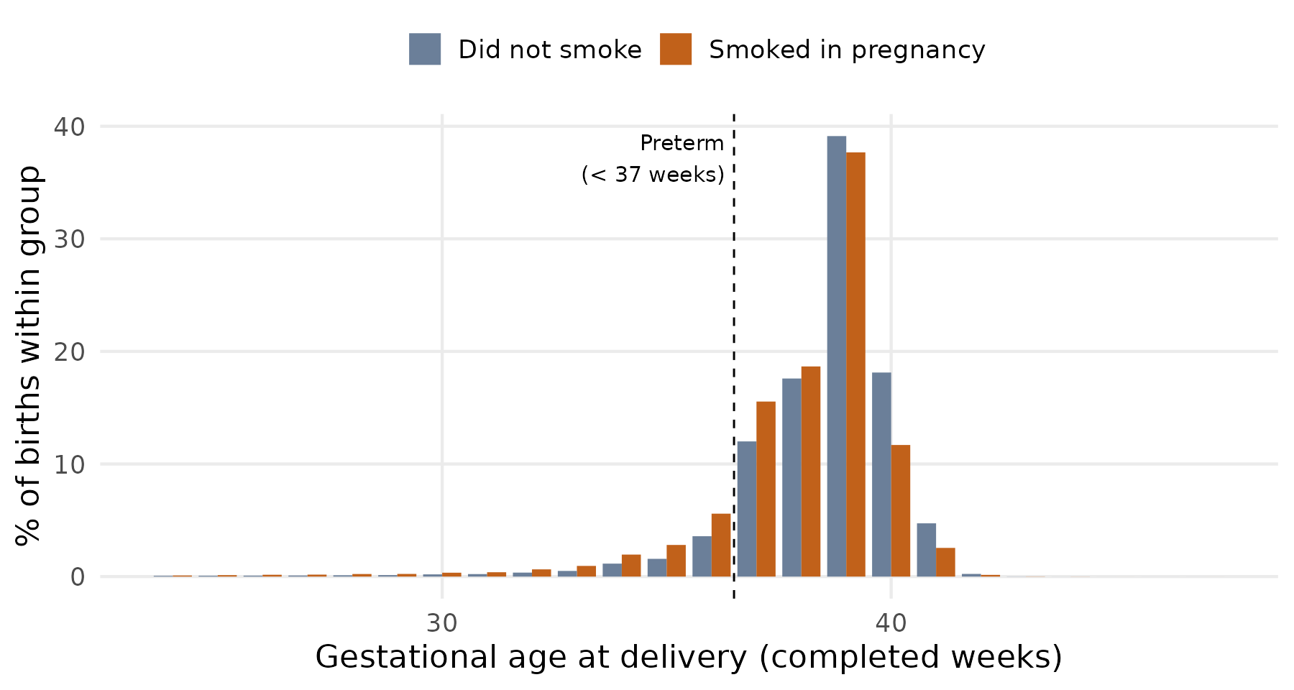
EDA 2: smokers deliver earlier, and risk factors cluster
Preterm: 13.9% vs 8.3%
Mean gestation: 37.97 vs 38.45 weeks (smokers vs non-smokers)
Confounders move both smoking and preterm risk
Prior preterm birth: 8.9% of smokers vs 3.7% of non-smokers; among non-smokers it raises preterm risk from 7.6% to 26.1%
Notes:
EDA, OUTCOME (30 seconds). The histogram shows gestational age at delivery. The whole distribution for smokers is shifted to the left: fewer births at 39 and 40 weeks, more at 34 to 38. The mean is 37.97 weeks for smokers and 38.45 for non-smokers. The preterm share is 13.9 versus 8.3 percent. Notice the other risk factors in the bullets: among non-smokers, a prior preterm birth carries a 26.1 percent preterm risk against 7.6 percent without one, pre-pregnancy diabetes 26.1 percent, hypertension 19.9 percent. Those same factors are more common in smokers, 8.9 percent have a prior preterm birth versus 3.7 percent of non-smokers. This is exactly what confounding looks like in data, and why we adjust.

Slide 6
Literature: what is known, and the gap this study fills
What has been done
What this study adds
Smoking raises preterm risk in 25.6 M U.S. births: odds ratios 1.31 to 1.53 by dose (Liu 2020; Shah & Bracken 2000)
Sibling, Mendelian randomization and tax-instrument designs study birth weight, not gestational age (Juárez & Merlo 2013; Evans & Ringel 1999)
Propensity methods used for birth weight (matching), child development (doubly robust) and fetal growth (IPTW) (Veiga 2008; Duko 2023; Chen 2026)
A recent matching study of preterm birth reports odds ratios only (Heiny & Islam 2026)
AIPTW (doubly robust) estimate for preterm birth in U.S. birth certificate data
Absolute risk difference plus risk ratio and odds ratio
DAG with every edge justified from the literature
Overlap diagnostics, five estimators, E-value
Gap: causal evidence on preterm birth itself, on the absolute scale, with transparent assumptions and diagnostics.
Notes:
LITERATURE (45 seconds). On the left is what has been done. Smoking raises preterm risk: the largest U.S. study, Liu and colleagues in PLOS Medicine 2020, used about 25.6 million births and found odds ratios from 1.31 at one or two cigarettes a day to 1.53 at twenty or more in the first trimester, building on earlier meta-analysis by Shah and Bracken. Stronger causal designs, such as sibling comparisons, Mendelian randomization and cigarette-tax instruments, mostly study birth weight or fetal growth rather than gestational age. Propensity score methods have been used for birth weight, and doubly robust and weighting methods for childhood development and fetal growth restriction. A recent conference study used propensity score matching for preterm birth and reported odds ratios. On the right is what we add: a doubly robust analysis of smoking and preterm birth on U.S. birth certificate data, and we report absolute risk differences, an explicit justified DAG, overlap diagnostics and an E-value.

Slide 7
Causal assumptions behind the estimate
ATE = E[ Y(1) ] - E[ Y(0) ]: risk of preterm birth if every mother smoked minus the risk if none did
1. Conditional exchangeability
2. Positivity
Y(t) independent of T given X. The ten DAG confounders block every back-door path. Untestable, so we add an E-value.
0 < P(T = 1 | X) < 1 for every mother. Checked with propensity-score overlap; scores clamped at the 1st and 99th percentile; weak overlap reported.
3. Consistency, no interference
4. One correct model is enough
Observed Y equals Y(T). 'Any smoking' mixes doses and timing; one mother's smoking does not change another's outcome.
AIPTW is consistent if either the propensity model or the outcome model is correct (double robustness).
Notes:
ASSUMPTIONS (40 seconds). The target, or estimand, is the average treatment effect: the risk of preterm birth if every mother smoked minus the risk if none did. To read our estimate causally we need four things. One, conditional exchangeability: given the ten confounders, smokers and non-smokers would have had the same preterm risk under the same exposure. The DAG is how we argue this, and an E-value tells us how strong an unmeasured confounder would need to be to break it. Two, positivity: every kind of mother has some chance of both smoking and not smoking. We check this with the propensity score overlap and we will be open that it is weak for some mothers. Three, consistency and no interference: 'any smoking' is a coarse exposure covering different doses and timing, and one mother smoking does not change another mother's outcome. Four, for AIPTW specifically, at least one of the two models, propensity or outcome, must be correct. None of these is proven by the data; they are the price of a causal claim.

Slide 8
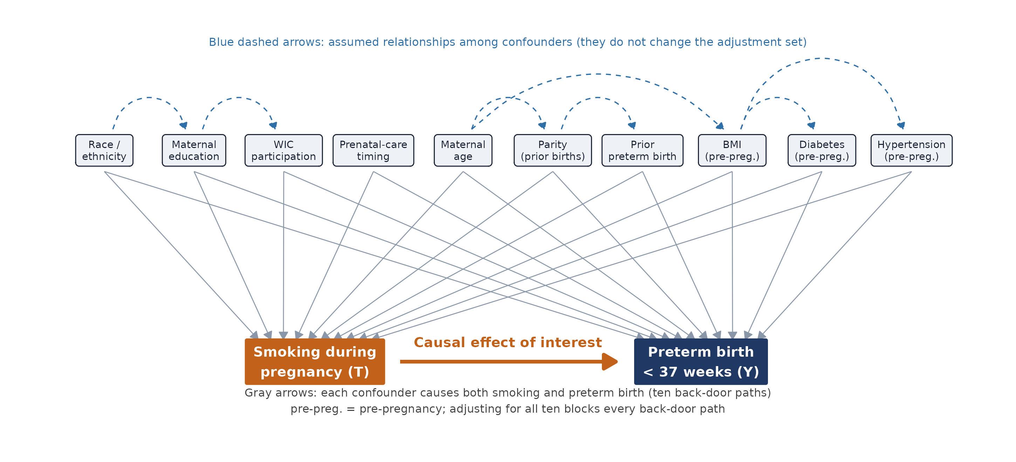
DAG: ten confounders, each a cause of smoking and of preterm birth
Notes:
DAG (45 seconds). This diagram is how the adjustment set was chosen. Smoking, in orange, points to preterm birth, in navy; that arrow is the effect we want. Each of the ten variables on top has an arrow into smoking and an arrow into preterm birth, and each choice is backed by the literature, for example lower education and WIC participation are linked to smoking, and prior preterm birth, diabetes and hypertension are strong predictors of preterm delivery. That creates ten back-door paths, smoking <- X -> preterm. Because every confounder is a direct parent of smoking, conditioning on all ten blocks every back-door path. The blue dashed arrows among the confounders, for example race to education or age to BMI, are plausible relationships, but they do not change which variables we must adjust for. we deliberately left out insurance type, which is shown only in a sensitivity analysis, and we did not adjust for conditions that arise during the pregnancy itself, such as gestational diabetes, because they come after smoking in time. A table with the reason for each edge is in the paper.

Slide 9
Method: AIPTW (Augmented IPTW), a doubly robust estimator
1
Propensity model
e(X) = chance of smoking given the ten confounders (logistic regression)
Why AIPTW, not matching?
Keeps all 3.26 million births; matching discards data and changes who the estimate describes
Targets the population-average effect (ATE)
Doubly robust: one correct model is enough
Fast standard errors from the influence function, checked by bootstrap
2
Two outcome models
mu1(X), mu0(X) = chance of preterm birth if smoking / not smoking
3
Combine and correct
Outcome prediction + weighted residual; ATE = psi1 - psi0
psi1 = mean[ mu1 + T (Y - mu1) / e ] psi0 = mean[ mu0 + (1 - T)(Y - mu0) / (1 - e) ]
Notes:
METHOD (60 seconds on the slide; the calculation below is for your own understanding).
STEP 1, propensity model. Fit a logistic regression of smoking on the ten confounders: e(X) = P(T=1 | X) = expit(X beta). It gives each mother a probability of smoking. we fit it in base R by iteratively reweighted least squares, and checked it matches glm to about 5e-6.
STEP 2, outcome models. Fit two logistic regressions for preterm birth, one among smokers, mu1(X) = P(Y=1 | T=1, X), one among non-smokers, mu0(X) = P(Y=1 | T=0, X). Then predict BOTH for every mother, as if she smoked and as if she did not.
STEP 3, combine. psi1 = mean over all mothers of [ mu1(X) + T (Y - mu1(X)) / e(X) ] and psi0 = mean of [ mu0(X) + (1 - T)(Y - mu0(X)) / (1 - e(X)) ]. The ATE as a risk difference is psi1 - psi0. In words: start from the outcome model prediction, then correct it with the residual of the people who actually received that exposure, weighting the residual by the inverse of their probability of receiving it.
WORKED EXAMPLE. A smoker with e = 0.06 and mu1 = 0.12. If she delivered preterm (Y=1) her contribution to psi1 is 0.12 + (1 - 0.12)/0.06 = 0.12 + 14.67 = 14.79. If she did not (Y=0) it is 0.12 + (0 - 0.12)/0.06 = -1.88. Average over everyone: if mu1 is correct the residual terms average to zero and we get the outcome-model answer; if mu1 is wrong but e is correct the weighted residuals repair the error, and the other way round. That is double robustness.
WHY NOT MATCHING. Weighting keeps all 3.26 million births and estimates the effect for the whole population; matching discards unmatched births, changes who the estimate describes, and can increase imbalance and model dependence (King and Nielsen 2019). It also scales easily to millions of rows. Weighting with the propensity score has a long record (Rosenbaum and Rubin 1983) and doubly robust estimation is described by Robins, Rotnitzky and Zhao 1994, Bang and Robins 2005 and Funk and colleagues 2011.
STANDARD ERRORS. Each mother's contribution minus the average is her influence-function value phi_i; the variance is var(phi)/n. For the risk ratio and odds ratio we use the delta method. A bootstrap on a 200,000-birth subsample (seed 1234) checks these.
PRACTICAL CHOICES. Propensity scores are clamped, not dropped, at the 1st and 99th percentile (0.0002 and 0.163) so extreme weights cannot dominate; sensitivity checks vary this. Five estimators are reported: crude, outcome regression, stabilized IPTW, propensity-score stratification and AIPTW.

Slide 10
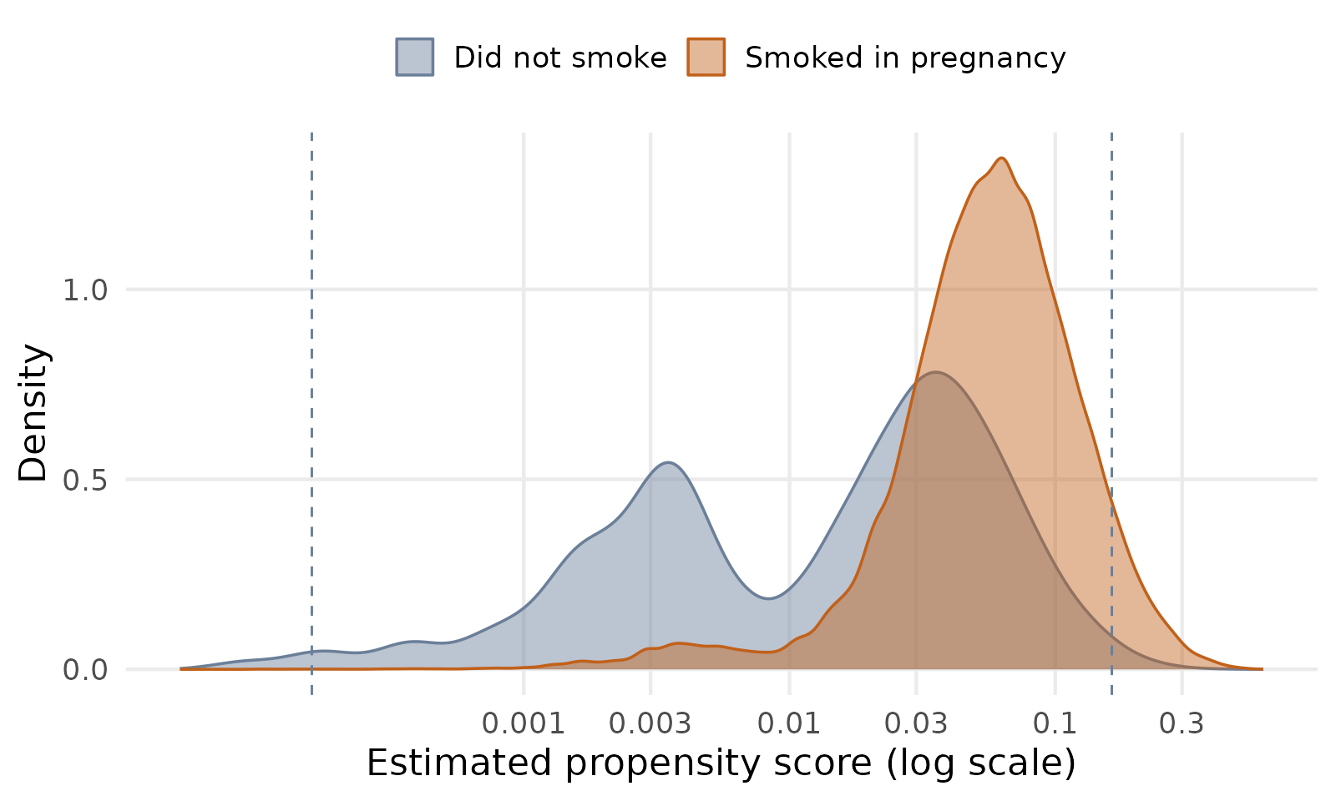
Diagnostics: overlap is limited, so we report it openly
40.8% of non-smokers have a propensity score below 0.01
Smokers: median score 0.058; effective sample after weighting about 6,807 of 97,187
Scores clamped at the 1st and 99th percentile (0.0002 and 0.163); largest weight 187
Balance: largest standardized difference 0.64 before, 0.13 after; 3 of 38 levels stay above 0.10
Dashed lines: 1st and 99th percentiles, where scores are clamped. Consequence: wider interval for the ATE, so we also report the ATT and overlap weights.
Notes:
OVERLAP AND BALANCE (40 seconds). The plot shows the estimated probability of smoking, the propensity score, on a log scale. Smokers, in orange, mostly sit between 0.03 and 0.2, with a median of 0.058. Non-smokers, in gray, have a second hump near 0.003: 40.8 percent of non-smokers have a score under 0.01, so they are very unlikely to smoke and have no real smoker counterpart. The dashed lines mark the 1st and 99th percentiles used to clamp the scores. A smoker with a very small score can receive a big weight: the largest stabilized weight is 187 and the smokers are worth an effective sample of about 6,807 out of 97,187. That widens the confidence interval for the whole-population effect, and it is why we also report the effect among smokers (ATT), which is more stable, and check results with overlap weights. After weighting, the largest standardized mean difference falls from 0.64 to 0.13, and 3 of 38 covariate levels stay slightly above the usual 0.10 threshold; the balance plot is in the backup slide.

Slide 11
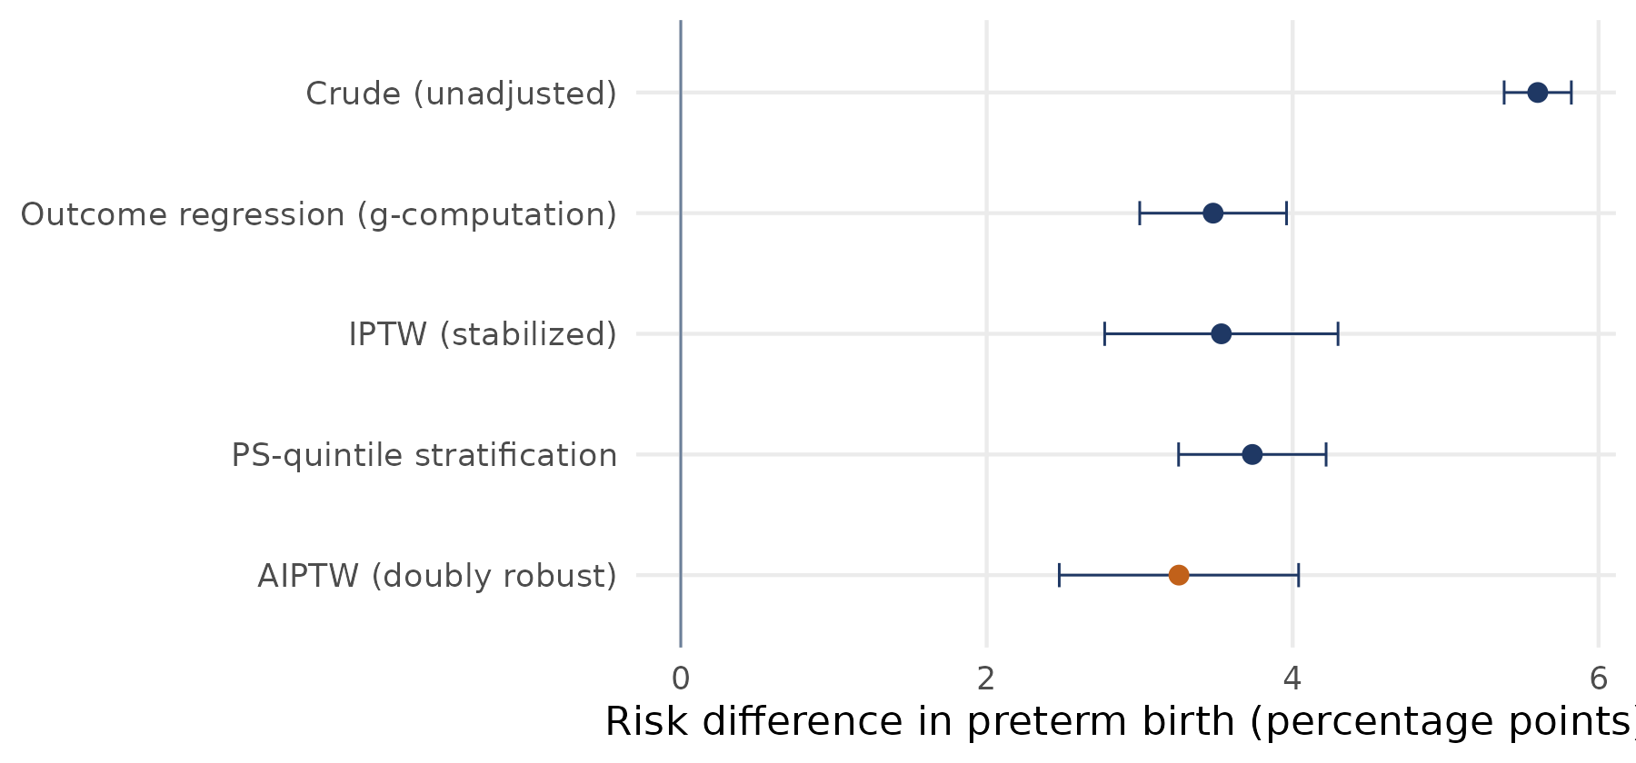
Results: smoking raises preterm risk by about 3.3 points
3.3 pts
AIPTW risk difference (95% CI 2.5 to 4.0)
11.6% vs 8.4%
preterm risk if all smoked vs none smoked
Risk ratio 1.39 (1.30 to 1.49); odds ratio 1.44 (1.33 to 1.55)
Among smokers (ATT): 3.4 points (3.2 to 3.6)
E-value 2.12 (1.92 for the lower limit)
Notes:
RESULTS (60 seconds). The crude difference is 5.6 percentage points. After adjustment all four adjusted estimators agree closely, between 3.3 and 3.7 points, so adjustment removes roughly one-third to two-fifths of the crude gap. Our headline AIPTW estimate, the orange dot, is 3.26 percentage points, 95 percent confidence interval 2.47 to 4.04. Standardized risks are 11.6 percent if all mothers smoked and 8.4 percent if none did, a risk ratio of 1.39 and an odds ratio of 1.44. Among mothers who actually smoked, the ATT, the effect is 3.39 points, 3.17 to 3.61, a tighter interval. The E-value for the risk ratio is 2.12, and 1.92 for the lower confidence limit: an unmeasured confounder would need to raise both smoking and preterm risk about 2-fold, beyond the ten variables already in the model, to explain the whole effect away. Alcohol, cannabis, stress and interpregnancy interval are examples of unmeasured factors that could matter.

Slide 12
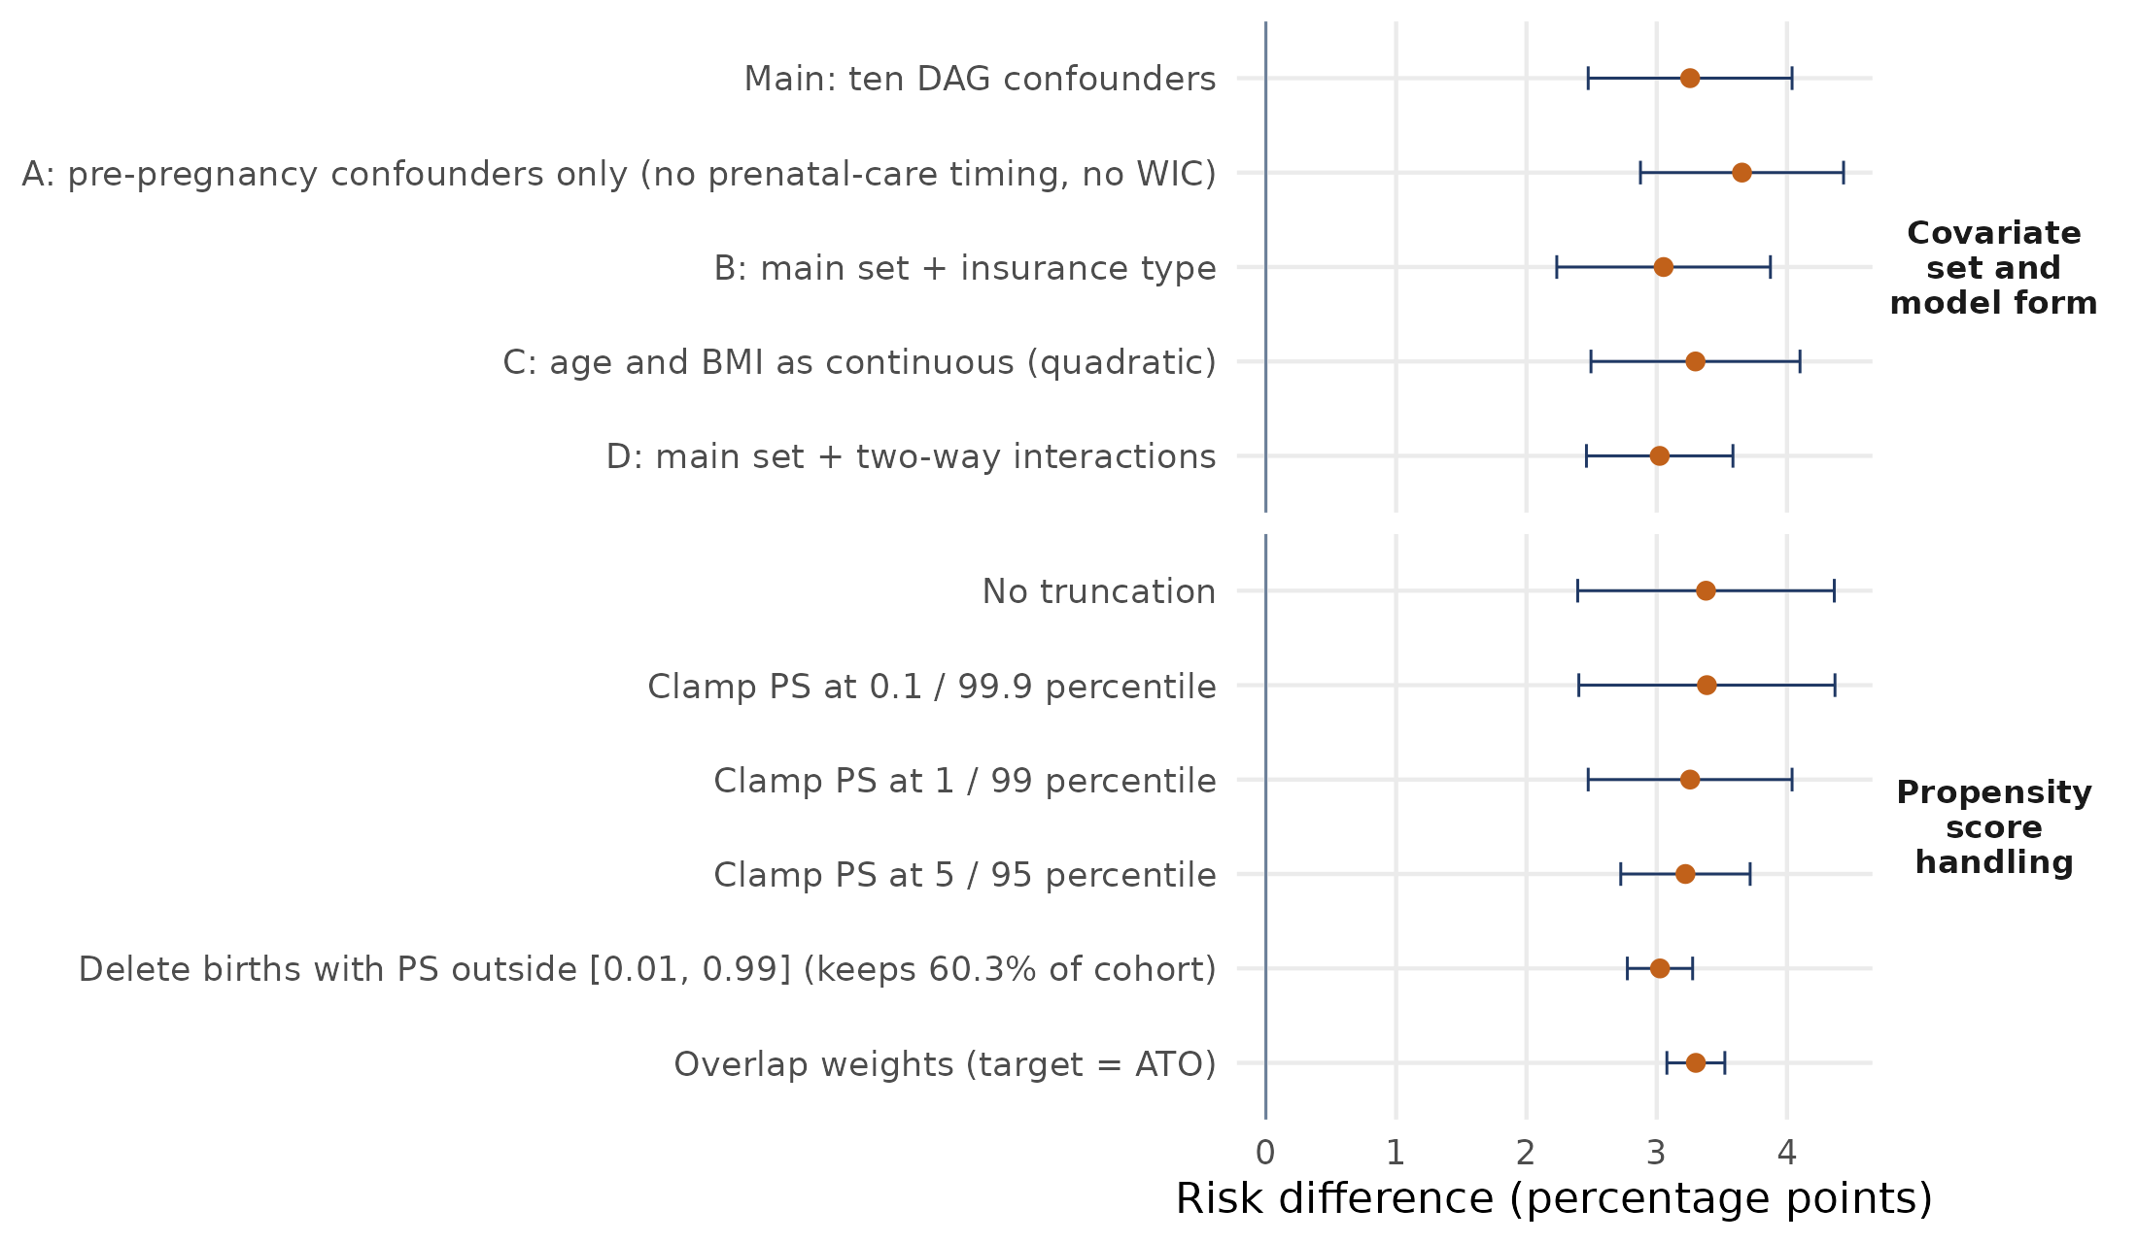
Robustness: the effect holds across analytic choices
Across 5 covariate specifications and 6 propensity-score rules, the risk difference stays between 3.0 and 3.7 points
Dropping prenatal care and WIC gives the largest estimate (3.65); interactions give the smallest (3.02)
Overlap weights, which do not depend on the tails: 3.30 points (3.08 to 3.52)
Notes:
ROBUSTNESS (30 seconds). Each dot is the AIPTW risk difference under a different choice, with its 95 percent interval. The top block changes the covariates: dropping the two variables measured during pregnancy, prenatal care and WIC, raises the estimate to 3.65; adding insurance gives 3.05; quadratic age and BMI give 3.30; adding two-way interactions gives 3.02. The bottom block changes how extreme propensity scores are handled: no truncation 3.38, clamping at 0.1 and 99.9 percent 3.39, at 1 and 99 percent 3.26 (our main analysis), at 5 and 95 percent 3.22, deleting births outside a score of 0.01 to 0.99, which keeps only 60 percent of the cohort, 3.03, and overlap weights 3.30. Every interval excludes zero and every estimate is between 3.0 and 3.7 points. The takeaway is that the headline does not hinge on one analytic choice, although the interval width does depend on the weights.

Slide 13
Conclusion and next steps
What we found, and limits
Next steps
Smoking raises preterm risk by about 3.3 points (RR 1.39)
Stable across five estimators and sensitivity checks
Limits: weak overlap for some mothers, self-reported smoking, coarse exposure, unmeasured confounding (E-value 2.1)
Machine-learning nuisance models with cross-fitting
Dose, timing and quitting
Multiple birth years
SAS implementation and replication code for SEASUG
Notes:
CONCLUSION (45 seconds). Under the stated assumptions, smoking in pregnancy raises the probability of preterm birth by about 3.3 percentage points in this 2023 U.S. cohort, a relative increase of about 39 percent. The result is stable across estimators and sensitivity checks. We are open about the limits: overlap is weak for some mothers; the smoking report is self-reported and probably under-reported; any smoking is a coarse exposure; some pregnancy variables such as prenatal care and WIC occur after conception and are covered in a sensitivity analysis; and unmeasured factors such as alcohol, cannabis, stress and interpregnancy interval could still bias the estimate. Next steps: flexible machine-learning nuisance models with cross-fitting, using the same AIPTW structure; dose and timing of smoking and the effect of quitting; combining several years of data; and a SAS implementation so this audience can reproduce it. All R code, with the data link and run instructions, is in the repository, with seed 1234 throughout.

Slide 14

Thank you for listening
Questions and feedback are welcome.
Faruk Muritala and Dhrubajyoti Ghosh
Kennesaw State University
Scan to connect on LinkedIn
Notes:
CLOSING (15 seconds). Thank you for listening. If you would like to talk about causal inference with birth certificate data, or you want the code, please scan the code to connect with me on LinkedIn. I am happy to take questions now.

Slide 15
References
Liu, B., et al. (2020). Maternal cigarette smoking before and during pregnancy and the risk of preterm birth: A dose-response analysis of 25 million mother-infant pairs. PLOS Medicine. doi:10.1371/journal.pmed.1003158
Shah, N. R., & Bracken, M. B. (2000). A systematic review and meta-analysis of prospective studies on the association between maternal cigarette smoking and preterm delivery. Am J Obstet Gynecol, 182, 465-472.
Juárez, S. P., & Merlo, J. (2013). Revisiting the effect of maternal smoking during pregnancy on offspring birthweight: A quasi-experimental sibling analysis in Sweden. PLOS ONE. doi:10.1371/journal.pone.0061734
Evans, W. N., & Ringel, J. S. (1999). Can higher cigarette taxes improve birth outcomes? J Public Econ, 72(1), 135-154.
Veiga, P. V., & Wilder, R. P. (2008). Maternal smoking during pregnancy and birthweight: A propensity score matching approach. Matern Child Health J, 12(2). doi:10.1007/s10995-007-0238-8
Duko, B., et al. (2023). Average treatment effect of maternal prenatal tobacco smoking on offspring developmental vulnerability in early childhood. Ann Epidemiol. doi:10.1016/j.annepidem.2022.12.007
Chen, J., et al. (2026). Interaction between maternal smoking cessation timing and preexisting hypertension on fetal growth restriction. Clin Epidemiol. doi:10.2147/CLEP.S596174
Heiny, E., & Islam, M. (2026). Impact of maternal smoking during pregnancy on preterm birth risk in the United States [E-poster]. Joint Statistical Meetings 2026.
Rosenbaum, P. R., & Rubin, D. B. (1983). The central role of the propensity score in observational studies for causal effects. Biometrika, 70(1), 41-55.
Robins, J. M., Rotnitzky, A., & Zhao, L. P. (1994). Estimation of regression coefficients when some regressors are not always observed. JASA, 89(427), 846-866.
Bang, H., & Robins, J. M. (2005). Doubly robust estimation in missing data and causal inference models. Biometrics, 61(4), 962-973.
Funk, M. J., et al. (2011). Doubly robust estimation of causal effects. Am J Epidemiol, 173(7), 761-767.
Austin, P. C., & Stuart, E. A. (2015). Moving towards best practice when using inverse probability of treatment weighting. Stat Med, 34(28), 3661-3679.
King, G., & Nielsen, R. (2019). Why propensity scores should not be used for matching. Political Analysis, 27(4), 435-454.
Li, F., Morgan, K. L., & Zaslavsky, A. M. (2018). Balancing covariates via propensity score weighting. JASA, 113(521), 390-400.
VanderWeele, T. J., & Ding, P. (2017). Sensitivity analysis in observational research: Introducing the E-value. Ann Intern Med, 167(4), 268-274.
Pearl, J. (1995). Causal diagrams for empirical research. Biometrika, 82(4), 669-688.
National Center for Health Statistics. (2023). Natality public use file. cdc.gov/nchs/data_access/vitalstatsonline.htm
Notes:
References for the talk. Every item was checked against its journal, publisher or Crossref record. The NCHS data and user guide links are in the R code header.

Slide 16
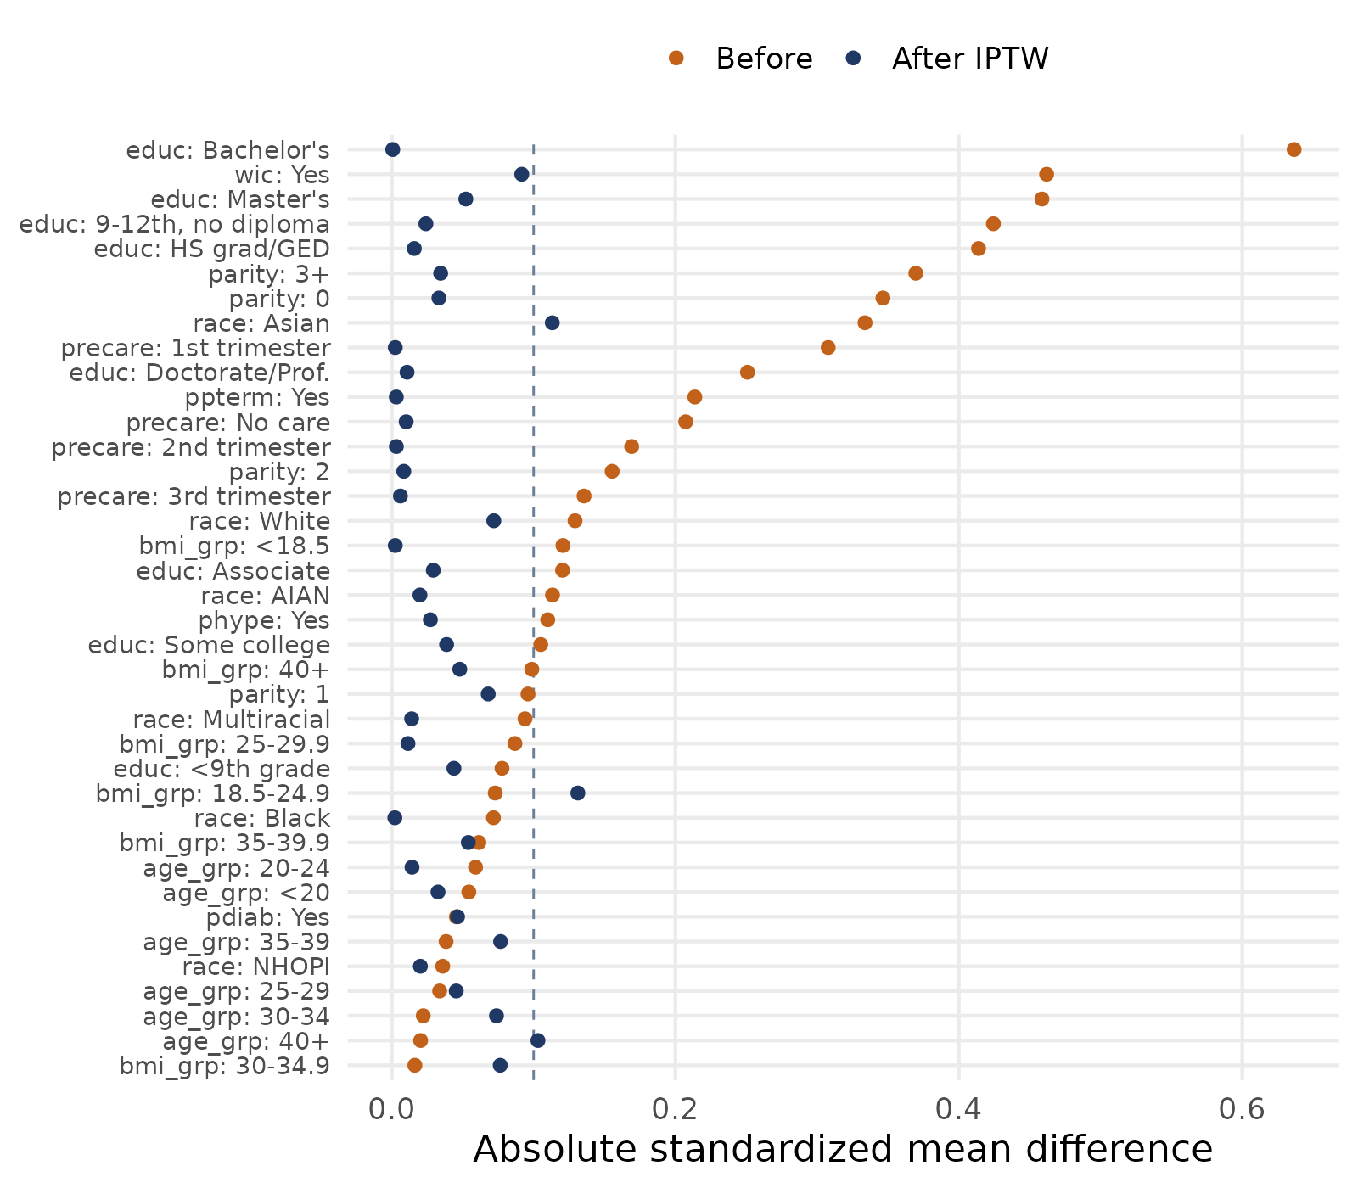
Backup: covariate balance before and after weighting
Dashed line marks the usual 0.10 threshold
Largest standardized difference: 0.64 before weighting, 0.13 after
3 of 38 covariate levels stay above 0.10: BMI 18.5-24.9 (0.13), Asian race (0.11), age 40+ (0.10)
AIPTW adds the outcome model, which also adjusts for these
Notes:
BACKUP. Love plot of absolute standardized mean differences for all 38 covariate levels. Before weighting (orange) education, WIC, parity and prenatal care timing are far apart, up to 0.64. After stabilized IPTW (navy) nearly all are below 0.10. Three levels stay slightly above: BMI 18.5 to 24.9 at 0.13, Asian race at 0.11 and age 40 and over at 0.10. These are small groups with weak overlap and we disclose them. The AIPTW estimator adds the outcome model, which also adjusts for these covariates.

