Slide 1

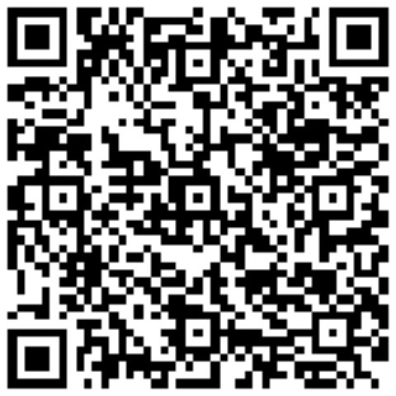


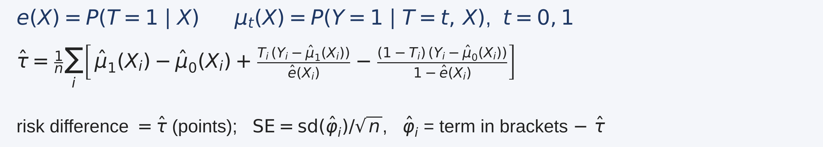
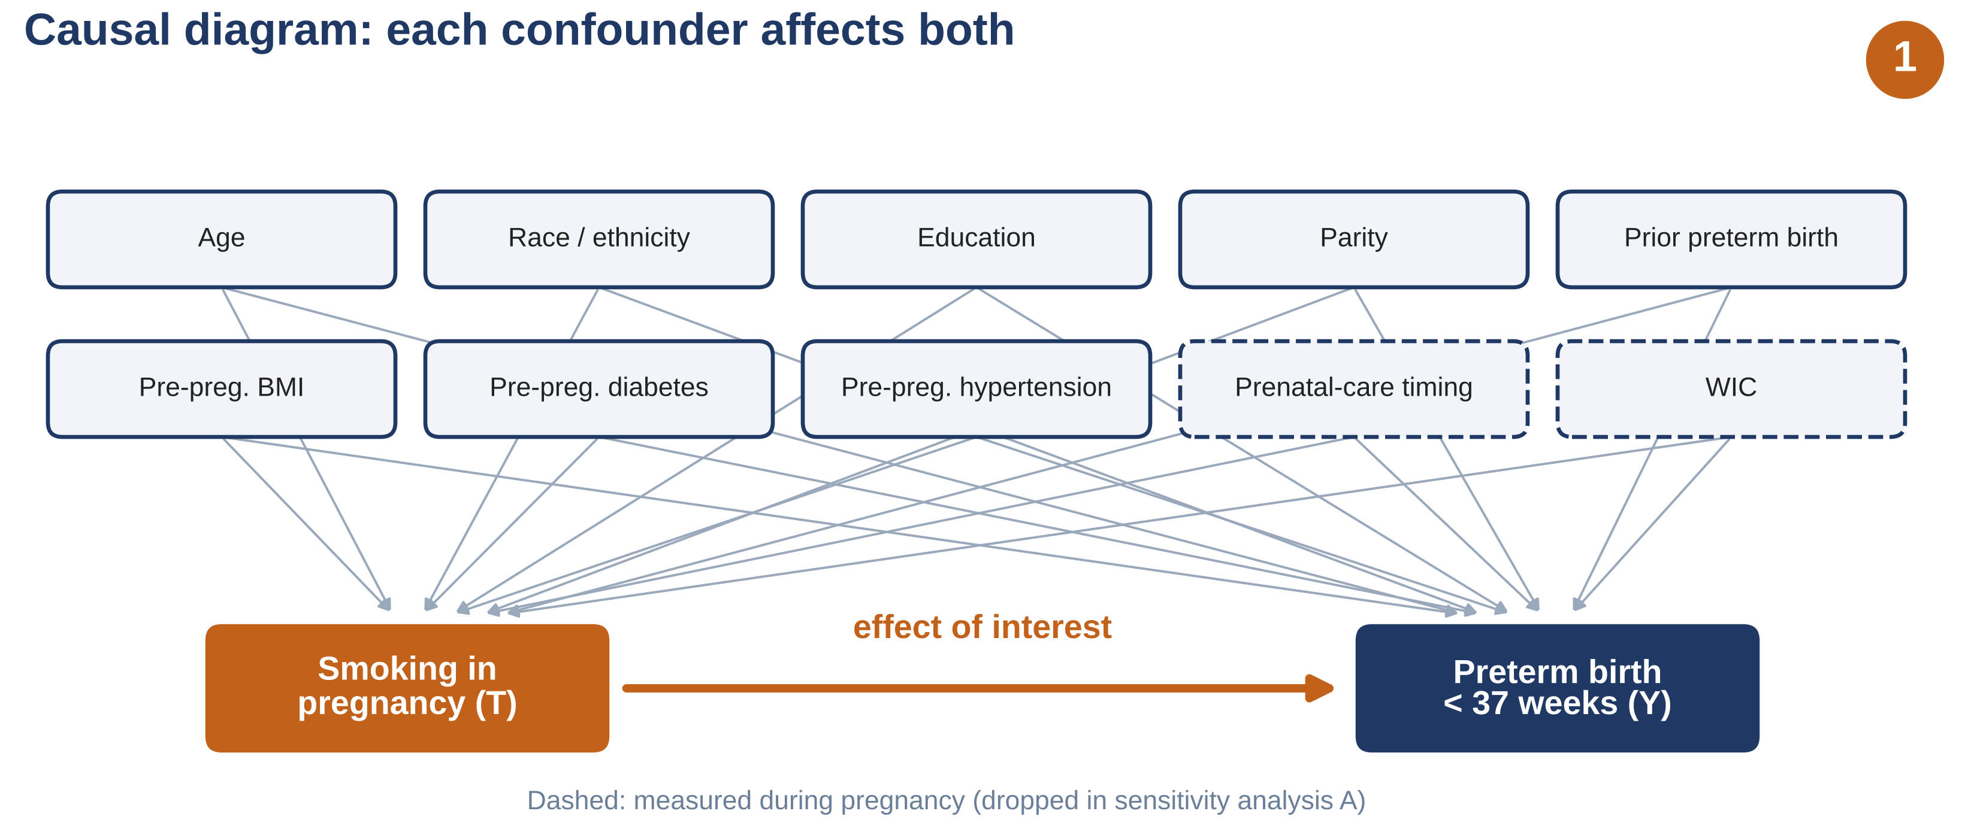
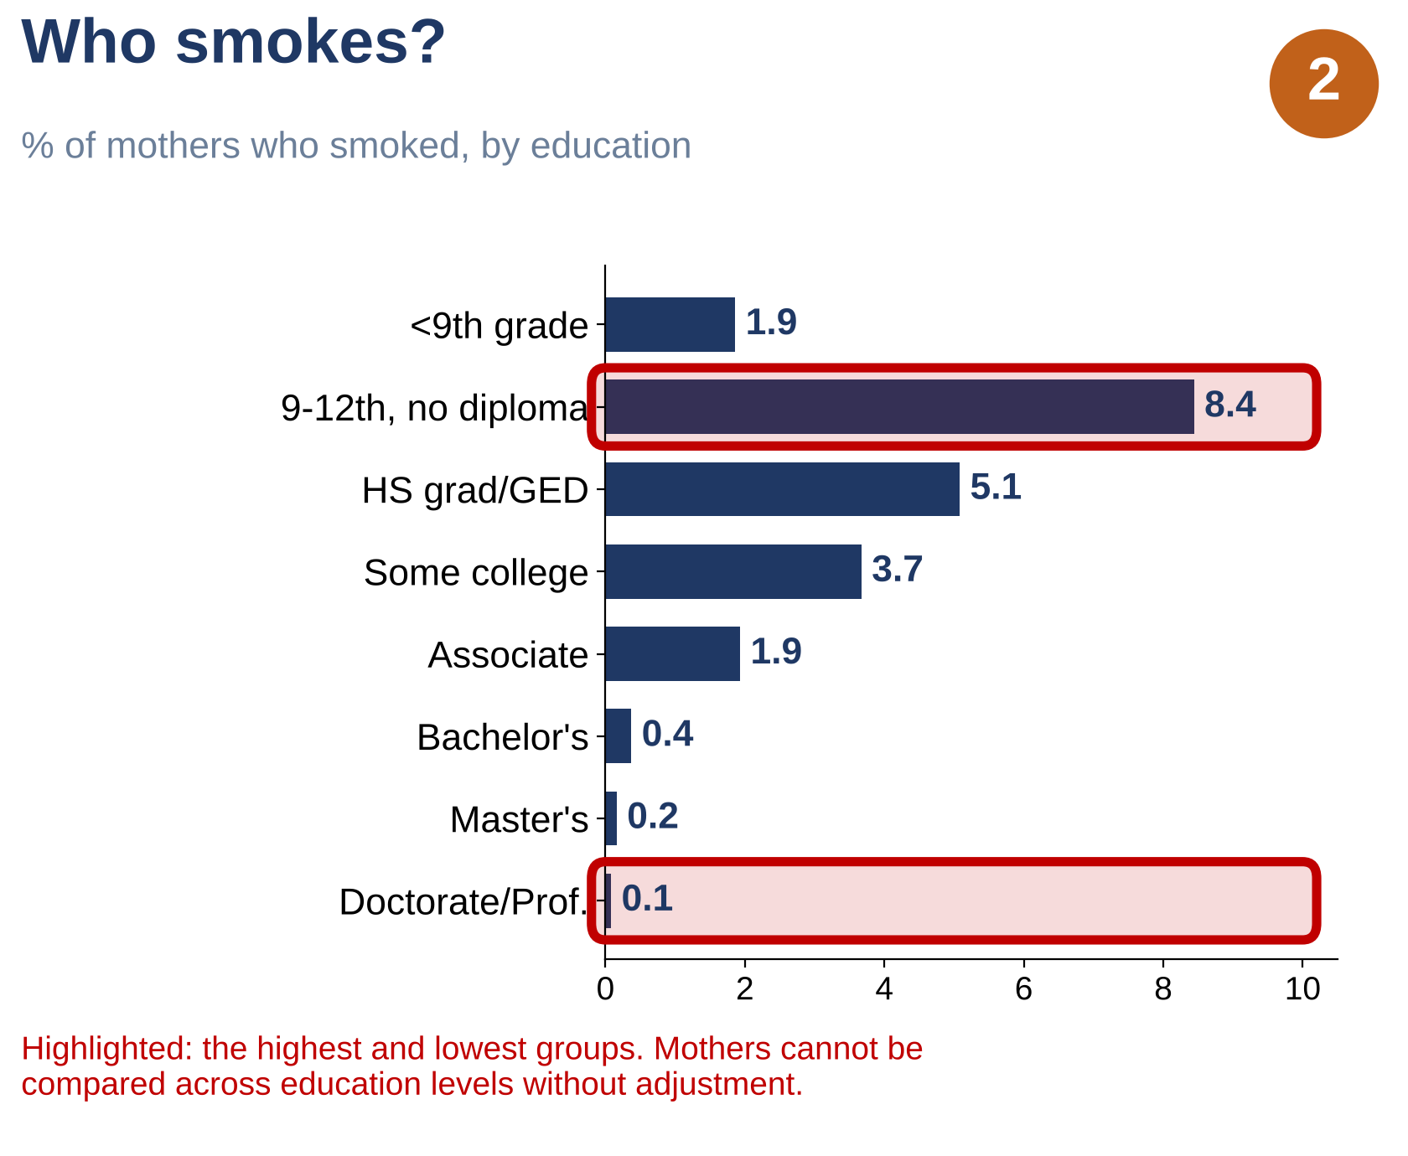
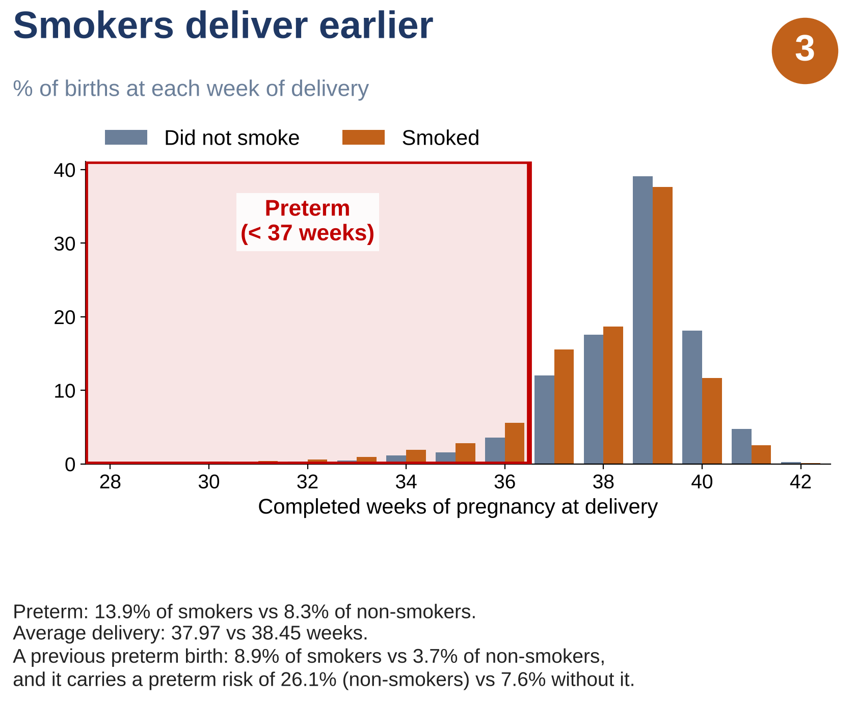
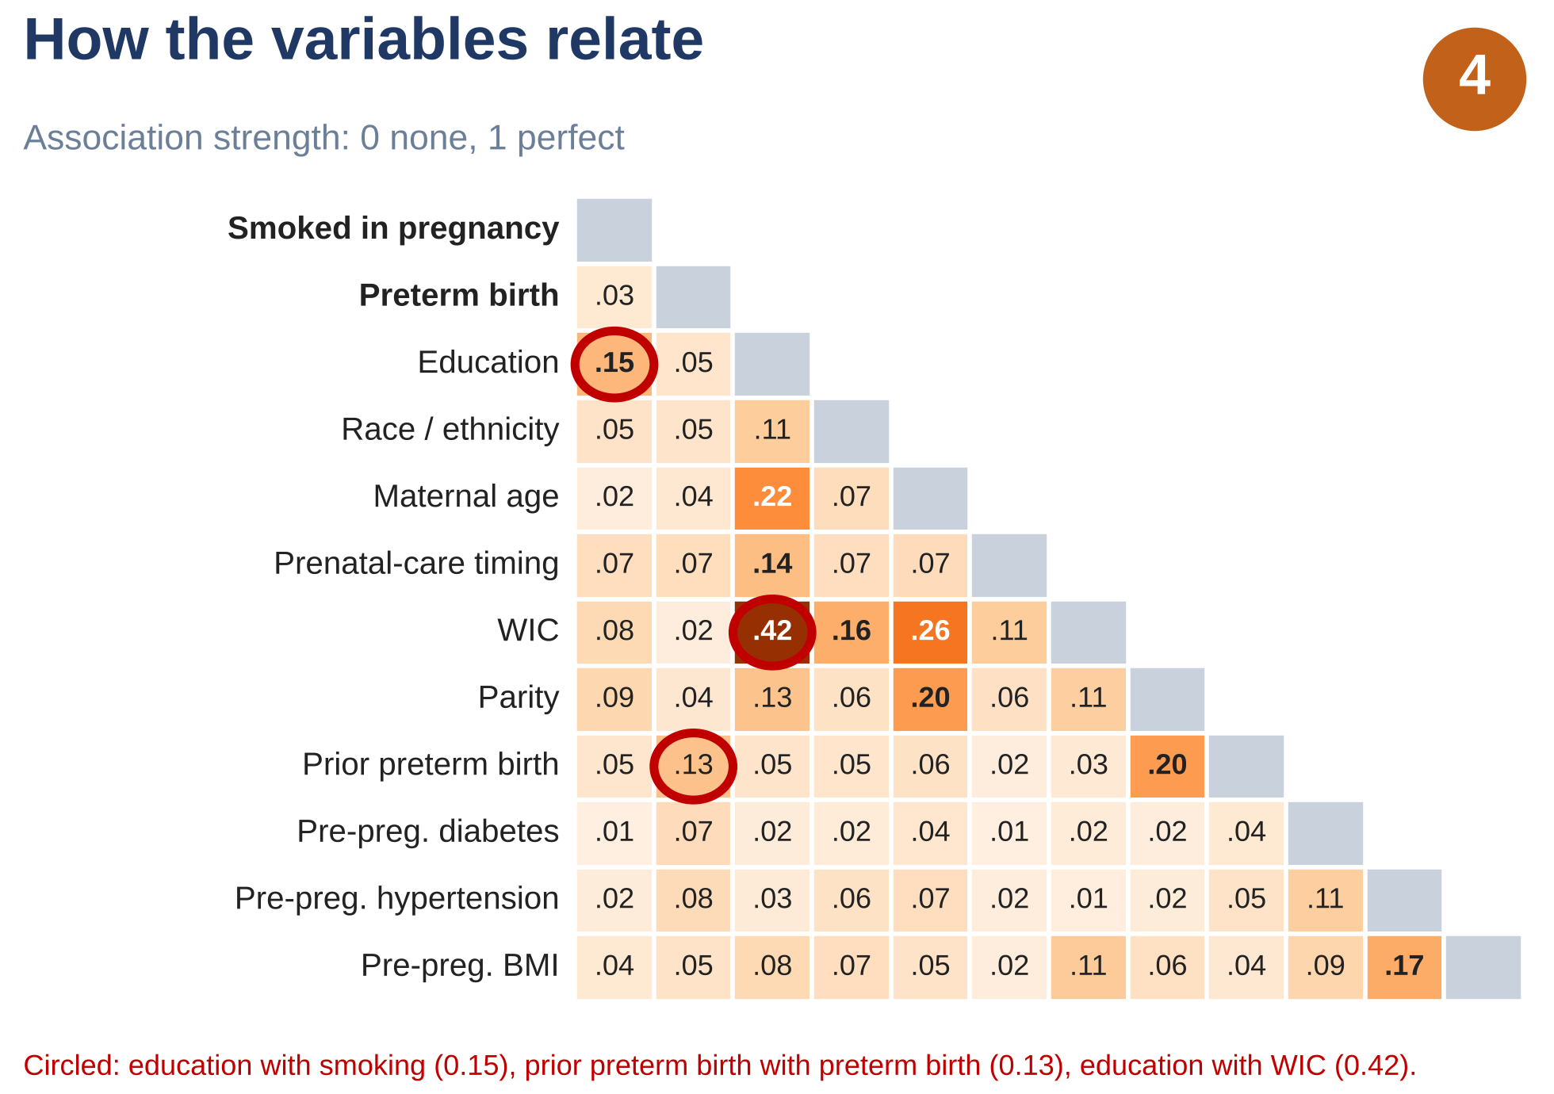
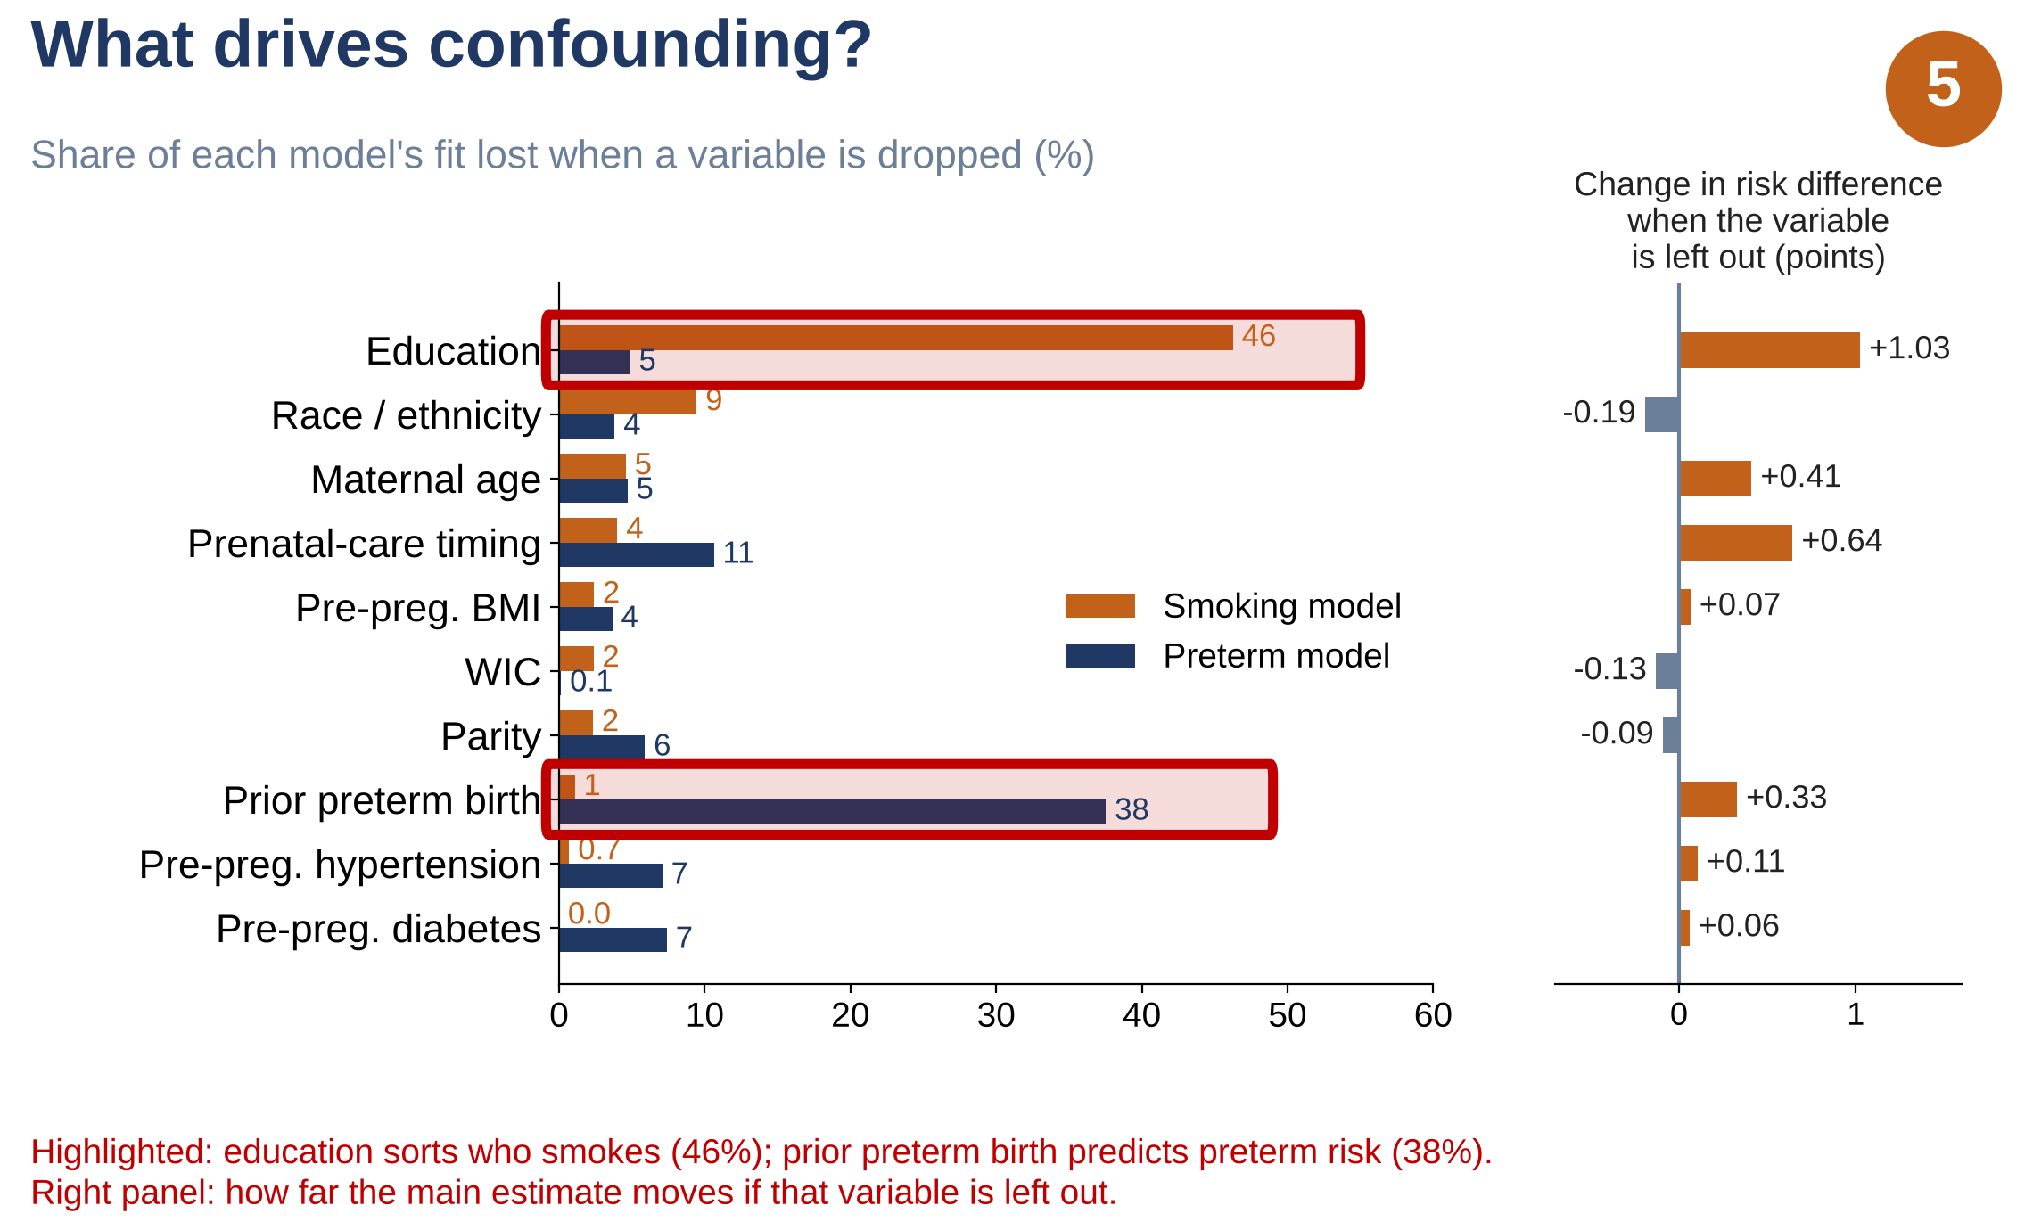
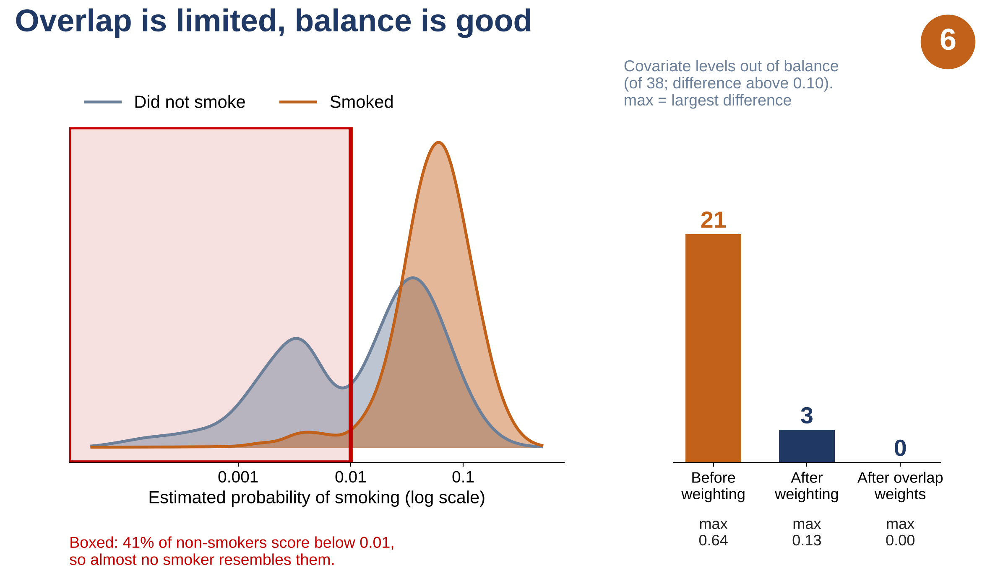
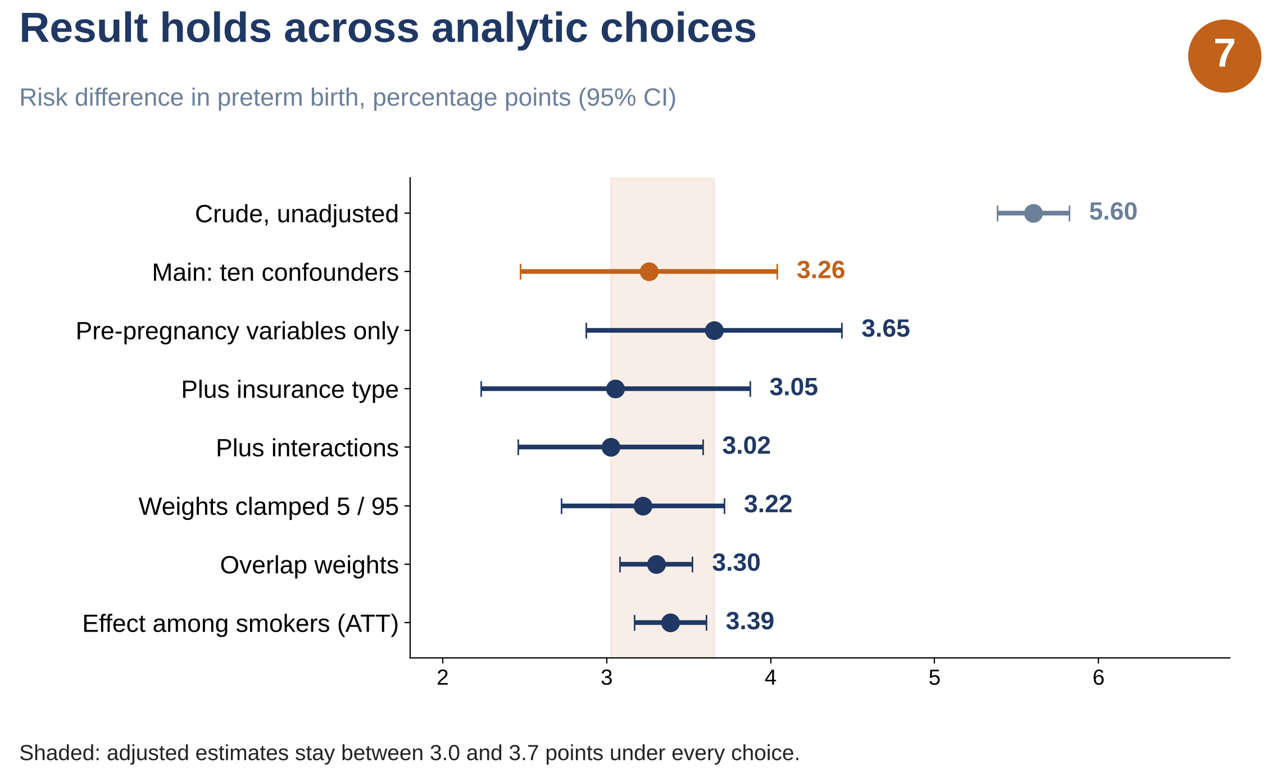
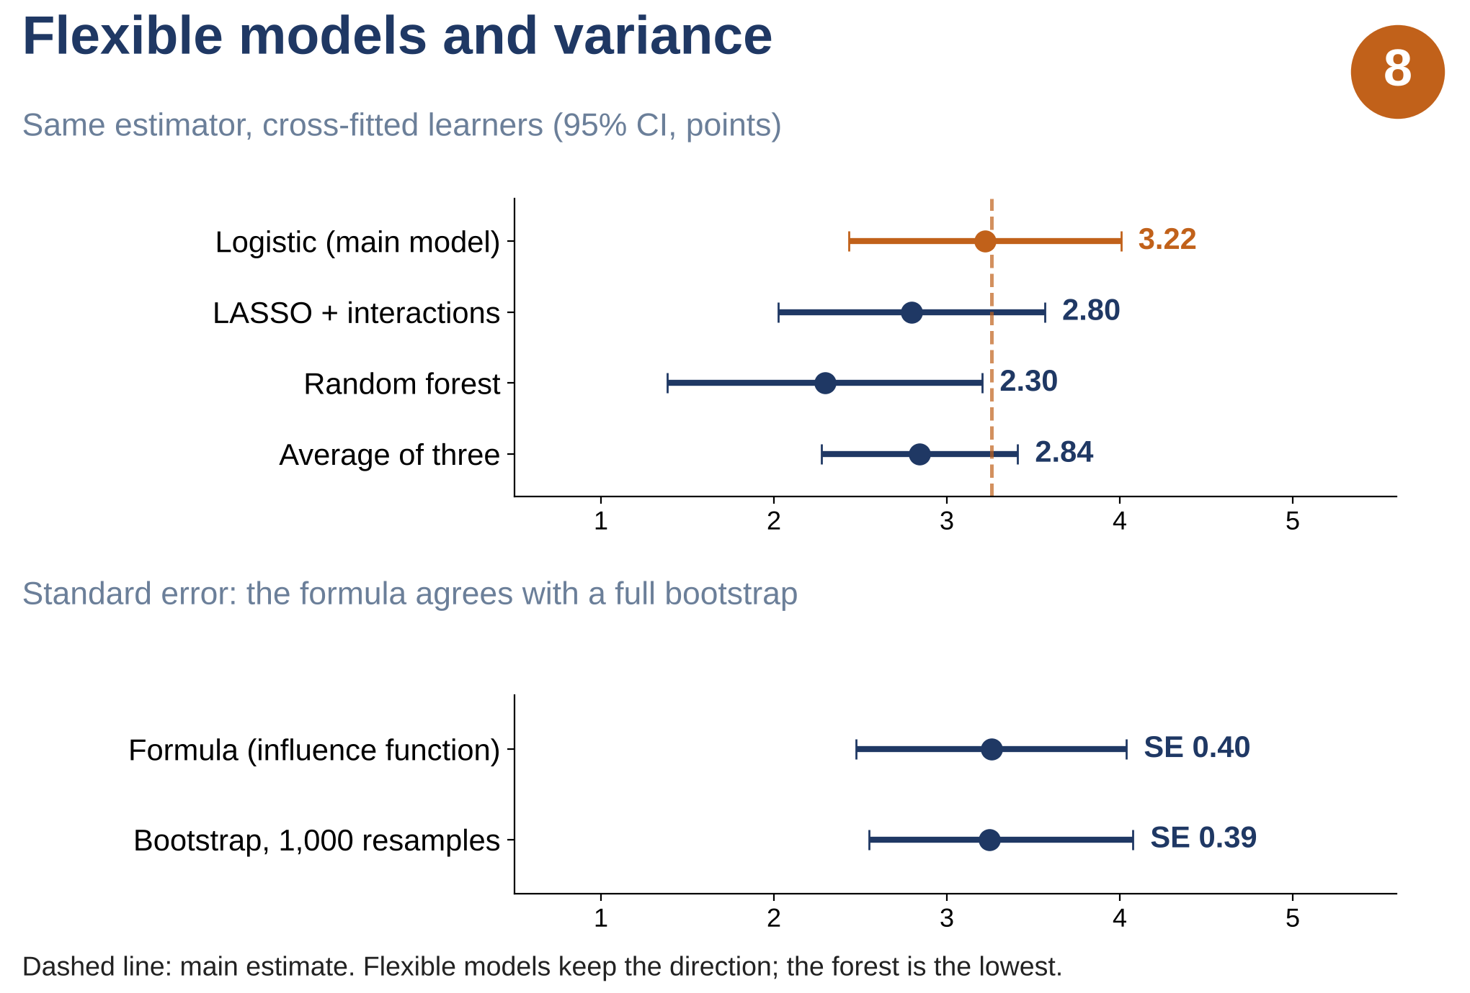
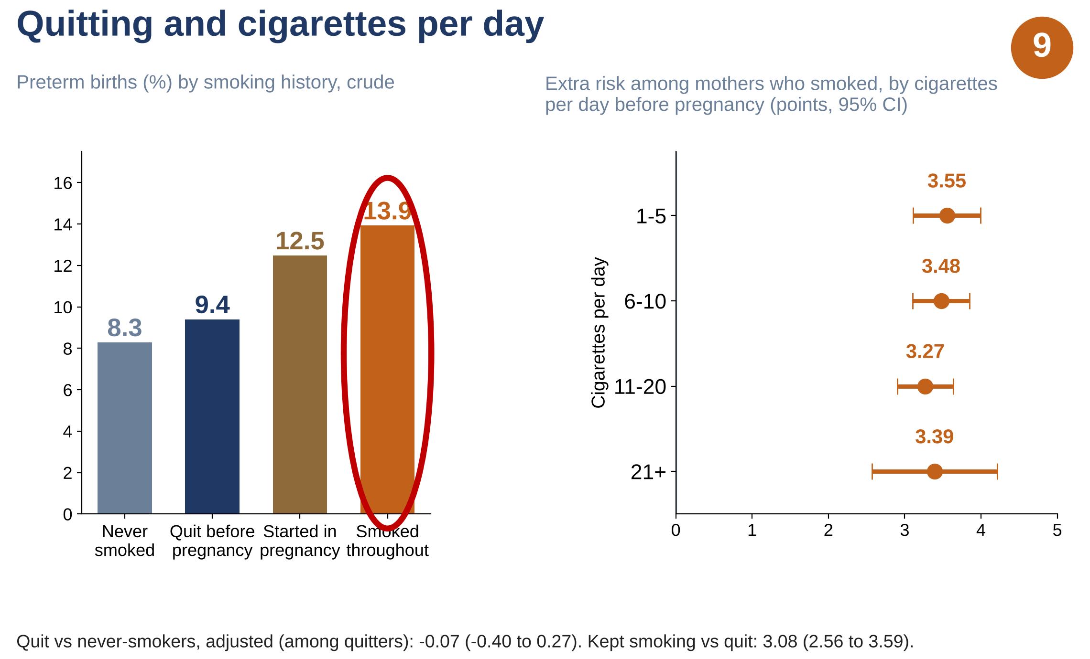
Effect of Smoking During Pregnancy on Preterm Birth: A Doubly Robust Propensity Score Weighting Analysis of Millions of U.S. Births
Author: Faruk Muritala
Advisor: Dhrubajyoti Ghosh, Ph.D.
Scan to connect on LinkedIn
Scan for the poster page, code and data
PROBLEM STATEMENT
After adjustment, mothers who smoked had a 3.3-point higher risk of preterm birth (SE 0.39), a gap two fifths smaller than the raw 5.6 points.
Why it matters. Smoking in pregnancy is a known risk factor for preterm birth, delivery before 37 weeks.
The problem. Mothers who smoke also differ in education, age and health, which affect preterm birth too, so the raw 5.6-point gap overstates what smoking itself does.
The question. How much of that gap does smoking itself cause?
The data. 3,259,496 U.S. singleton births in 2023; 97,187 to mothers who smoked.
The approach. Augmented Inverse Probability of Treatment Weighting (AIPTW), a doubly robust method that adjusts for differences between smokers and non-smokers and produces a valid estimate if either the smoking model or the birth-outcome model is correct.
1 Data
2 Inputs X
3 Working models
4 Estimator
5 Output
6 Checks and extensions
2023 U.S. natality public use file
3,476,180 singleton births
Ten confounders X
Propensity model
e(X) = P(smoke | X)
target T: smoking
weights clamped at 1st / 99th pct.
Risk difference
3.26 pts
Overlap and balance (Fig. 6)
Age
AIPTW
doubly
robust
Race / ethnicity
Adjustment-set and sensitivity checks (Fig. 7)
Education
Risk ratio
1.39
U.S. residents
3,467,679
Prenatal-care timing*
WIC*
Cross-fitting; formula vs 1,000 bootstraps (Fig. 8)
Parity
Prior preterm birth
Outcome models
μ1(X), μ0(X)
target Y: preterm birth (< 37 weeks)
Odds ratio
1.44
Complete confounders
3,259,496
(97,187 smoked)
Pre-preg. diabetes
METHODS
Pre-preg. hypertension
E-value 2.12: how strong a hidden factor must be
Pre-preg. BMI
1. Two models. From ten confounders X, a propensity model e(X) gives each mother's chance of smoking; outcome models μ1(X), μ0(X) give her chance of preterm birth with and without smoking.
2. Cross-fitting. Births are split into 5 folds. Logistic, LASSO (all two-way interactions) and random-forest models are fit on 4 folds and score the 5th, so no birth is scored by a model that saw it.
* measured during pregnancy
Logistic (main), LASSO or forest;
cross-fitted in 5 folds
ATE, ATT and overlap weights are compared (Fig. 7)
Exploratory: quitting and dose (Fig. 9)
Assumptions: exchangeability given X · positivity (overlap) · consistency · at least one of the two models correct
Note. The first two terms are the outcome-model prediction; the last two correct it with weights 1/e(X), so the estimate is right if either model is right.
3. Uncertainty. Standard error from the formula and from a full-sample bootstrap of 1,000 resamples.
4. Checks. Overlap and covariate balance, alternative adjustment sets, E‑value.
RESULTS AND FINDINGS
Raw gap. 13.9% of births to mothers who smoked were preterm against 8.3% for others, a 5.6-point gap (Figs. 2, 3).
Main estimate. Adjusted risk difference 3.26 points (bootstrap SE 0.39; 95% interval 2.5 to 4.1). Among mothers who smoked, about 34 extra preterm births per 1,000 (Fig. 7).
Who is compared. 8.4% of mothers with some high school but no diploma smoked, against 0.1% of those with a doctorate (Fig. 2). Education best separates smokers from others and a prior preterm birth best predicts early delivery; dropping education would move the estimate by +1.03 points (Figs. 4, 5).
Balance. Covariate levels out of balance fall from 21 to 3 after weighting and 0 with overlap weights (Fig. 6).
Robustness. Adjusted estimates stay between 3.0 and 3.7 across analytic choices; LASSO (2.80) and forest (2.30) agree in direction. Formula and bootstrap SEs match (Figs. 7, 8).
Sensitivity analysis. An unmeasured factor would need a risk ratio of about 2.1 with both smoking and preterm birth to explain the result away (E‑value).
Quitting and dose. Preterm risk was 8.3% in never-smokers, 9.4% in quitters, 12.5% in mothers who started during pregnancy and 13.9% in those who smoked throughout. After adjustment quitters look like never-smokers (−0.07 points, 95% CI −0.40 to 0.27); the extra risk is similar at every cigarette level (3.3 to 3.6 points). (Fig. 9).
LIMITATIONS
Unmeasured confounding. A strong unmeasured confounder, beyond the E‑value above, could still make this study not meaningful.
Self-reported smoking may be under-reported.
Limited overlap. 41% of non-smokers have almost no smoker like them (Fig. 6), so the effect among smokers is sturdier.
Care timing and WIC may follow smoking; without them the estimate is 3.7 (Fig. 7).
Observational data; quit and cigarette results are exploratory and use intake before pregnancy.

