Slide 1
Applying Propensity Score Matching to Evaluate Interventions
Does smoking in pregnancy cause preterm birth? A doubly robust (AIPTW) analysis of 3.26 million U.S. births
Faruk Muritala and Dhrubajyoti Ghosh
Kennesaw State University
SEASUG 2026
Applying Propensity Score Matching Weighting to Evaluate Interventions
Notes:
OPENING (20 seconds). Good morning. This presentation is joint work of Faruk Muritala and Dr. Dhrubajyoti Ghosh of Kennesaw State University. The question is simple: if a mother smokes during pregnancy, how much does that raise the chance of a preterm birth, once the differences between smokers and non-smokers in many other characteristics are accounted for? The data are the 2023 U.S. birth certificate file, 3.26 million births, and the method is a doubly robust estimator called AIPTW, short for Augmented IPTW. The program title refers to propensity score matching; in this talk the propensity score is used for weighting, and the reason is given on the method slide.
IPW - Allows us to use the whole data set

Slide 2
The problem: smokers deliver earlier, but smokers also differ
3.26 M
3.0%
8.5%
5.6 pts
singleton births, U.S. 2023 (analytic cohort)
smoked in pregnancy (97,187 mothers)
delivered preterm (< 37 weeks)
crude gap: 13.9% in smokers vs 8.3% in non-smokers
How much of the 5.6-point gap is caused by smoking, and how much reflects who smokes?
Target: the average causal effect (ATE) of smoking in pregnancy on preterm birth, as a risk difference
Tools: a causal diagram (DAG) to choose adjustment variables, then propensity-score weighting with doubly robust AIPTW
Notes:
PROBLEM (30 seconds). Four numbers frame the talk. The analytic cohort has 3,259,496 singleton births. 97,187 mothers, 3.0 percent, reported smoking during pregnancy. Overall 8.5 percent of babies were born before 37 weeks. Among smokers it is 13.9 percent and among non-smokers 8.3 percent, a raw gap of 5.6 percentage points. The raw gap is not the causal effect, because mothers who smoke also have less education, later or no prenatal care, more prior preterm births and more chronic conditions, and those things raise preterm risk by themselves. The goal is to separate the part attributable to smoking from the part attributable to who smokes.

Slide 3
Data: the 2023 U.S. birth certificate file, 3.26 million births
3,476,180
singleton births, known gestational age and smoking status
Exposure (T)
Any smoking during pregnancy (birth certificate report)
3,467,679
after excluding mothers who are not U.S. residents
Outcome (Y)
Preterm birth: gestational age under 37 completed weeks
3,259,496 (93.8%)
complete data on all ten confounders: analytic cohort
Ten confounders (X)
Maternal age, race/ethnicity, education, timing of prenatal care, WIC, parity, prior preterm birth, pre-pregnancy diabetes, hypertension and BMI
97,187 smokers | 3,162,309 non-smokers
Source: NCHS 2023 Natality Public Use File (public, de-identified)
Notes:
DATA (30 seconds). The source is the National Center for Health Statistics 2023 Natality Public Use File, which covers every U.S. birth and has no personal identifiers. The file contains 3,476,180 singleton births that have a known gestational age and a known smoking status. 8,501 births to mothers who do not live in the U.S. are dropped, leaving 3,467,679, and births with complete data on the ten confounders are kept, which leaves 3,259,496, or 93.8 percent. The exposure is any smoking reported during pregnancy. The outcome is preterm birth, under 37 completed weeks by the obstetric estimate. The ten confounders were chosen from the DAG, shown shortly. Insurance type was left out of the main model and used only as a sensitivity check. Link and run instructions for the data are at the top of the R code.

Slide 4
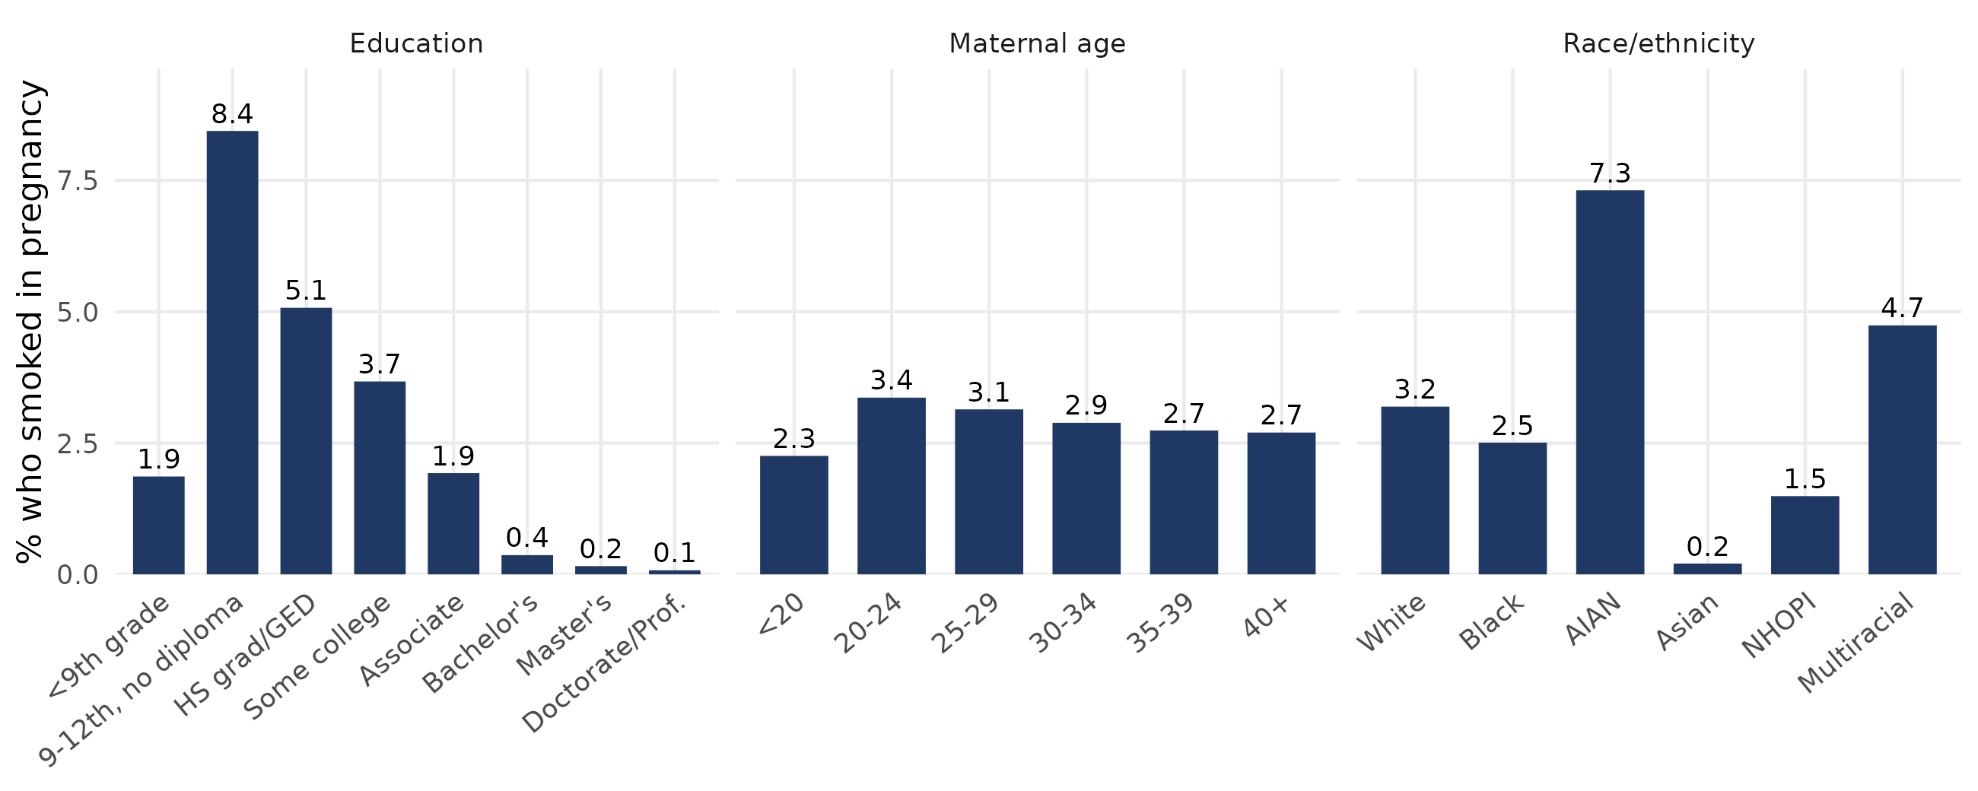
EDA 1: smoking is concentrated among mothers with less education
8.4% of mothers with 9-12th grade and no diploma smoked, versus 0.1% with a doctorate. The groups are not comparable without adjustment.
Notes:
EDA, WHO SMOKES (30 seconds). These bars show the share of mothers who smoked in each group. Education is the strongest pattern: 8.4 percent of mothers with some high school and no diploma smoked, against 0.4 percent with a bachelor's degree and 0.1 percent with a doctorate. Smoking is also much higher among American Indian and Alaska Native mothers, 7.3 percent, and multiracial mothers, 4.7 percent, and very low among Asian mothers, 0.2 percent. Age matters less. The point for the method: smokers and non-smokers come from different parts of the population, so comparing them directly mixes the effect of smoking with the effect of these characteristics. It also foreshadows the overlap problem: some kinds of mothers almost never smoke.

Slide 5
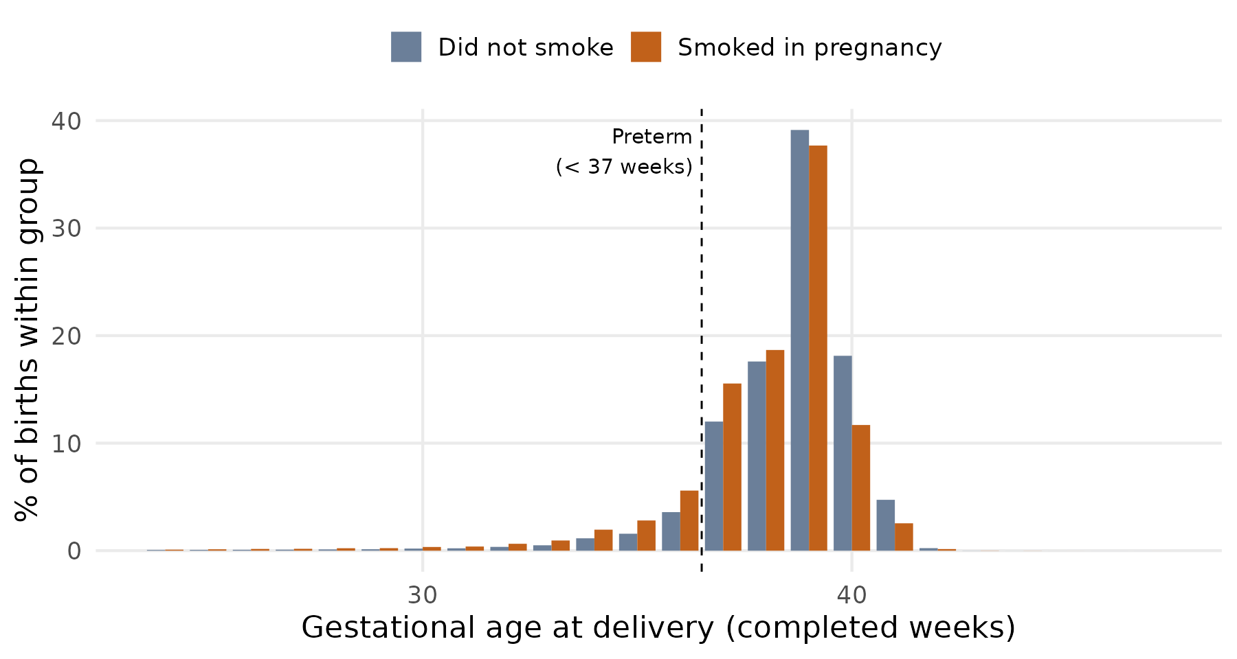
EDA 2: smokers deliver earlier, and risk factors cluster
Preterm: 13.9% vs 8.3%
Mean gestation: 37.97 vs 38.45 weeks (smokers vs non-smokers)
Confounders move both smoking and preterm risk
Prior preterm birth, diabetes and hypertension are more frequent in smokers and carry higher preterm risk (prior preterm birth: 8.9% vs 3.7%; risk 26.1% vs 7.6% among non-smokers)
Notes:
EDA, OUTCOME (30 seconds). The histogram shows gestational age at delivery. The whole distribution for smokers is shifted to the left: fewer births at 39 and 40 weeks, more at 34 to 38. The mean is 37.97 weeks for smokers and 38.45 for non-smokers. The preterm share is 13.9 versus 8.3 percent. Notice the other risk factors in the bullets: among non-smokers, a prior preterm birth carries a 26.1 percent preterm risk against 7.6 percent without one, pre-pregnancy diabetes 26.1 percent, hypertension 19.9 percent. Those same factors are more common in smokers: 8.9 percent have a prior preterm birth versus 3.7 percent of non-smokers. This pattern is the signature of confounding, and the reason for ++adjustment.

Slide 6
Literature: what is known, and the gap this study fills
What has been done
What this study adds
Smoking associated with preterm birth in 25.6 M U.S. births: odds ratios 1.31 to 1.53 by dose (Liu 2020; Shah & Bracken 2000)
Sibling, Mendelian randomization and tax-instrument designs study birth weight, not gestational age (Juárez & Merlo 2013; Evans & Ringel 1999)
Propensity methods used for birth weight (matching), child development (doubly robust) and fetal growth (IPTW) (Veiga 2008; Duko 2023; Chen 2026)
A recent matching study of preterm birth reports odds ratios only (Heiny & Islam 2026)
AIPTW (doubly robust) estimate for preterm birth in U.S. birth certificate data
Absolute risk difference plus risk ratio and odds ratio
DAG with the evidence for every edge documented
Overlap diagnostics, five estimators, E-value
Gap addressed: a doubly robust estimate for preterm birth itself, on the absolute scale, with stated assumptions and diagnostics.
Notes:
LITERATURE (45 seconds). On the left is what has been done. Smoking raises preterm risk: the largest U.S. study, Liu and colleagues in PLOS Medicine 2020, used about 25.6 million births and found odds ratios from 1.31 at one or two cigarettes a day to 1.53 at twenty or more in the first trimester, building on earlier meta-analysis by Shah and Bracken. Stronger causal designs, such as sibling comparisons, Mendelian randomization and cigarette-tax instruments, mostly study birth weight or fetal growth rather than gestational age. Propensity score methods have been used for birth weight, and doubly robust and weighting methods for childhood development and fetal growth restriction. A recent conference study used propensity score matching for preterm birth and reported odds ratios. On the right is what this study adds: a doubly robust analysis of smoking and preterm birth on U.S. birth certificate data, with absolute risk differences, an explicit justified DAG, overlap diagnostics and an E-value.

Slide 7

Causal assumptions behind the estimate
Y(1) = the baby's preterm status if the mother smoked; Y(0) = if she did not. ATE = risk of preterm birth if every mother smoked minus the risk if none did
1. Conditional exchangeability
2. Positivity
Among mothers with the same ten characteristics (X), whether she smoked (T = 1) or not (T = 0) says nothing about how her baby would have fared either way, Y(1) or Y(0). The ten DAG confounders block every back-door path. Untestable; E-value reported.
Every kind of mother has some chance of smoking (T = 1) and some chance of not smoking (T = 0): 0 < P(T = 1 | X) < 1. Checked with propensity-score overlap; scores clamped at the 1st and 99th percentile; weak overlap reported.
3. Consistency, no interference
4. One correct model is enough
The baby's observed outcome Y equals the outcome under the smoking status the mother actually had, Y(T). 'Any smoking' mixes doses and timing; one mother's smoking does not change another mother's baby's outcome.
AIPTW is consistent if either the propensity model (chance of smoking) or the outcome model (chance of preterm birth) is correct (double robustness).
Notes:
ASSUMPTIONS (40 seconds). The target, or estimand, is the average treatment effect: the risk of preterm birth if every mother smoked minus the risk if none did. A causal reading of the estimate requires four conditions. One, conditional exchangeability: given the ten confounders, smokers and non-smokers would have had the same preterm risk under the same exposure. The DAG is the argument for this condition, and an E-value quantifies how strong an unmeasured confounder would need to be to violate it. Two, positivity: every kind of mother has some chance of both smoking and not smoking. This is checked with the propensity score overlap, which is weak for some mothers and is reported as such. Three, consistency and no interference: 'any smoking' is a coarse exposure covering different doses and timing, and one mother smoking does not change another mother's outcome. Four, for AIPTW specifically, at least one of the two models, propensity or outcome, must be correct. None of these is proven by the data; they are the price of a causal claim.

Slide 8
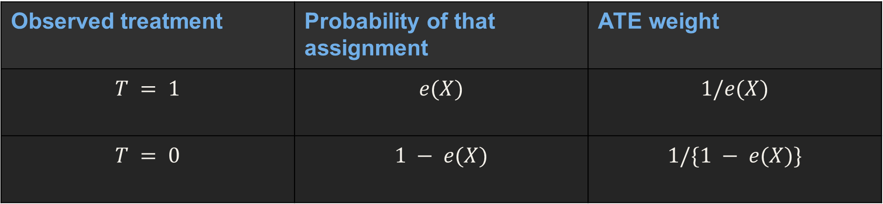
ATE weights: how many mothers each mother stands for
T = 1 / T = 0 mother smoked / did not smoke Y = 1 her baby was born preterm X her ten characteristics e(X) = chance that she smokes, given X
What the mother did | Chance of that | ATE weight
Smoked (T = 1) | e(X), her chance of smoking | 1/𝑒(𝑋)
Did not smoke (T = 0) | 1 − e(X), her chance of not smoking | 1/{1 − 𝑒(𝑋)}
Example: a smoker who had only a 2% chance of smoking counts as 1/0.02 = 50 mothers. A non-smoker with that same 2% chance counts as 1/0.98 = 1.02 mothers. Rare smokers speak for many mothers, which is why a few weights can get very large.
$$w_{i} =\frac{T_{i}}{{\hat{e}}_{i}} +\frac{1 − T_{i}}{1 −{\hat{e}}_{i}}$$
Notes:
This is the weighting rule. A mother who smoked gets weight one over her chance of smoking. A mother who did not smoke gets weight one over her chance of not smoking. The rarer her situation, the more mothers she stands for. A smoker who looked like a typical non-smoker, say with a master's degree, had a tiny chance of smoking, so she counts for many mothers. This is how weighting makes smokers and non-smokers look alike.

Slide 9
Actual weights for mothers in our study
S1 and N1 have the same ten characteristics, so the same chance of smoking (0.0489). S1 smoked: weight 1/0.0489 = 20.45. N1 did not: weight 1/(1 − 0.0489) = 1.05.
Mother | Smoked (T) | Chance she smokes | ATE weight
S1 (smoker) | 1 | 0.0489 | 20.45
S2 (rarest smoker) | 1 | 0.00016 | 6,272
N1 (non-smoker) | 0 | 0.0489 | 1.05
N2 (non-smoker) | 0 | 0.163 | 1.20
S2 is the rarest smoker in our data (Asian, age 30 to 34, master's degree). Her weight of 6,272 shrinks to 187 after stabilizing, the largest in the study. N2 is the non-smoker with the highest chance of smoking.
For a mother who did not smoke, use 1/(1 − score), not 1/score.
Notes:
These are four real mothers from our 3.26 million. S1 and N1 have exactly the same characteristics, so the same chance of smoking, 0.0489. The one who smoked counts for about 20 mothers. The one who did not counts for about one. S2 is the extreme case: a smoker who had almost no chance of smoking, so before stabilizing she stands for over six thousand mothers. After stabilizing and clamping, the largest weight in the study is 187. That is why the weighting method has a wider interval.

Slide 10
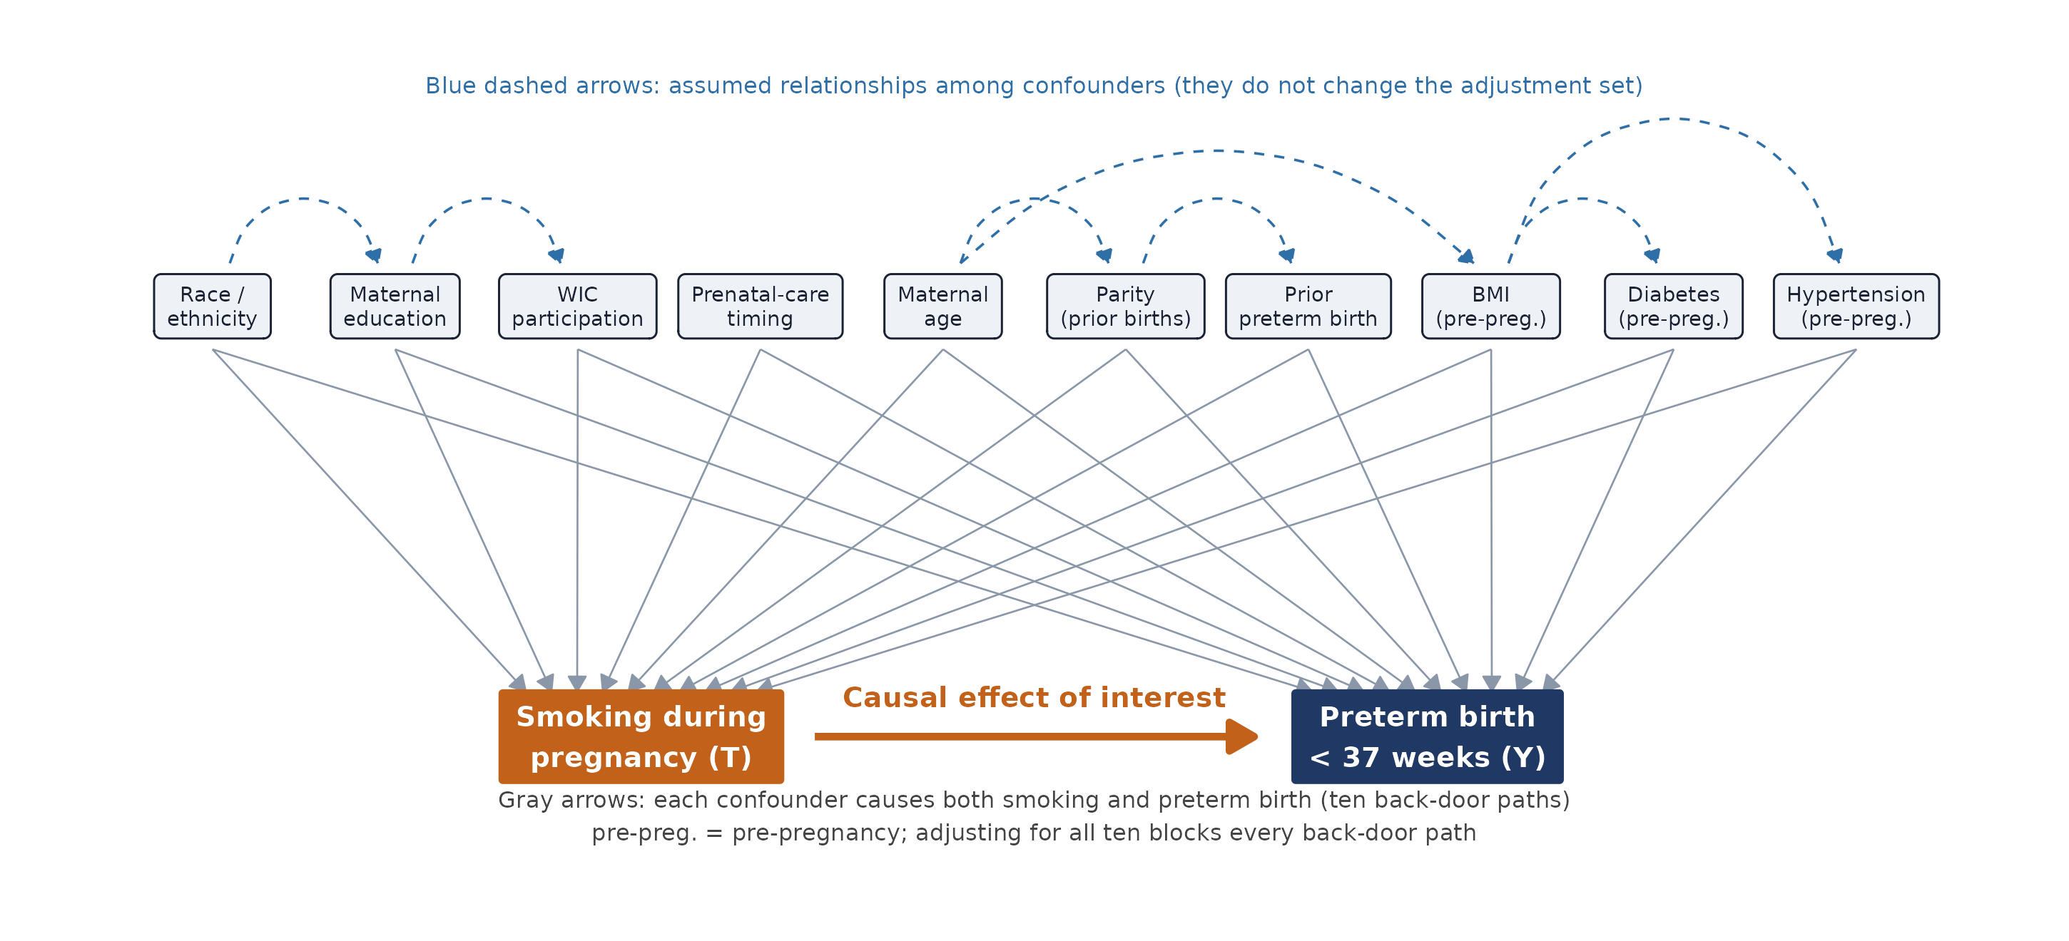
DAG: ten confounders, each a cause of smoking and of preterm birth
Notes:
DAG (45 seconds). This diagram determines the adjustment set. Smoking, in orange, points to preterm birth, in navy; that arrow is the effect of interest. Each of the ten variables on top has an arrow into smoking and an arrow into preterm birth, and each choice is backed by the literature, for example lower education and WIC participation are linked to smoking, and prior preterm birth, diabetes and hypertension are strong predictors of preterm delivery. That creates ten back-door paths, smoking <- X -> preterm. Because every confounder is a direct parent of smoking, conditioning on all ten blocks every back-door path. The blue dashed arrows among the confounders, for example race to education or age to BMI, are assumed relationships, and they do not change which variables must be adjusted for. Insurance type is deliberately left out of the main model and appears only in a sensitivity analysis, and conditions that arise during the pregnancy itself, such as gestational diabetes, are not adjusted for because they come after smoking in time. A table with the reason for each edge is in the paper.

Slide 11
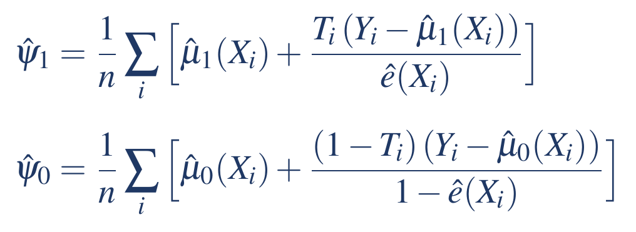
Method: AIPTW (Augmented IPTW), a doubly robust estimator
1
Propensity model
e(X) = chance that a mother smokes (T = 1), given her ten confounders X (logistic regression)
Why AIPTW, not matching?
Keeps all 3.26 million births; matching discards data and changes who the estimate describes
Targets the population-average effect (ATE)
Doubly robust: one correct model is enough
Fast standard errors from the influence function, checked by bootstrap
2
Two outcome models
μ1(X) = chance her baby is born preterm (Y = 1) if she smokes; μ0(X) = chance if she does not
3
Combine and correct
Outcome prediction + weighted residual; ATE = ψ1 - ψ0 (preterm risk if all smoke minus if none)
READING THE SYMBOLS
T = 1 / T = 0: mother smoked / did not smoke
Y = 1: baby born preterm (before 37 weeks)
X: the ten mother characteristics
e(X): her chance of smoking
μ1, μ0: chance of a preterm baby if she smokes / does not
Notes:
Three pieces. One: a model for each mother's chance of smoking, the propensity score. Two: two models for her chance of a preterm baby, one if she smokes and one if she does not. Three: combine them and correct the prediction using the weights. Doubly robust means that if either the propensity model or the outcome models are right, the answer is right.

Slide 12
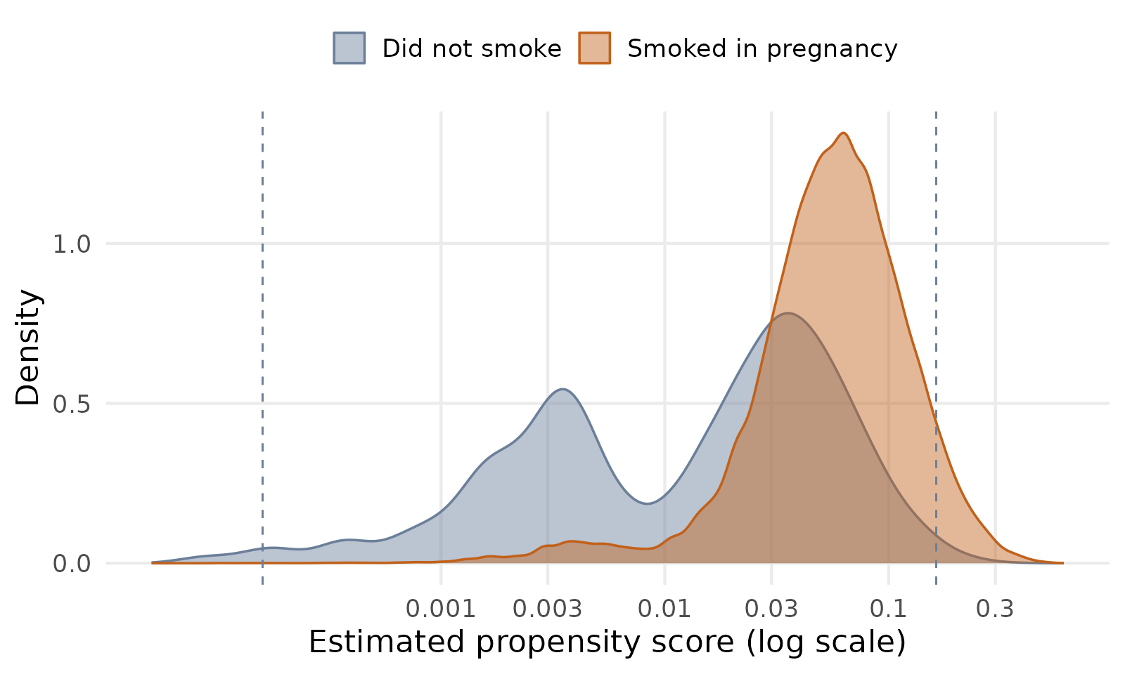
Diagnostics: limited overlap and covariate balance
40.8% of non-smokers have a propensity score below 0.01
Smokers: median score 0.058; effective sample after weighting about 6,807 of 97,187
Scores clamped at the 1st and 99th percentile (0.0002 and 0.163); largest weight 187
Balance: largest standardized difference 0.64 before, 0.13 after; 3 of 38 levels stay above 0.10
Dashed lines: 1st and 99th percentiles, where scores are clamped. Consequence: wider interval for the ATE. The ATT and overlap-weighted estimates are reported alongside.
Notes:
OVERLAP AND BALANCE (40 seconds). The plot shows the estimated probability of smoking, the propensity score, on a log scale. Smokers, in orange, mostly sit between 0.03 and 0.2, with a median of 0.058. Non-smokers, in gray, have a second hump near 0.003: 40.8 percent of non-smokers have a score under 0.01, so they are very unlikely to smoke and have no real smoker counterpart. The dashed lines mark the 1st and 99th percentiles used to clamp the scores. A smoker with a very small score can receive a big weight: the largest stabilized weight is 187 and the smokers are worth an effective sample of about 6,807 out of 97,187. That widens the confidence interval for the whole-population effect. For this reason the effect among smokers (ATT), which has a narrower interval, is reported alongside, and results are checked with overlap weights. After weighting, the largest standardized mean difference falls from 0.64 to 0.13, and 3 of 38 covariate levels stay slightly above the usual 0.10 threshold; the balance plot is in the backup slide.

Slide 13
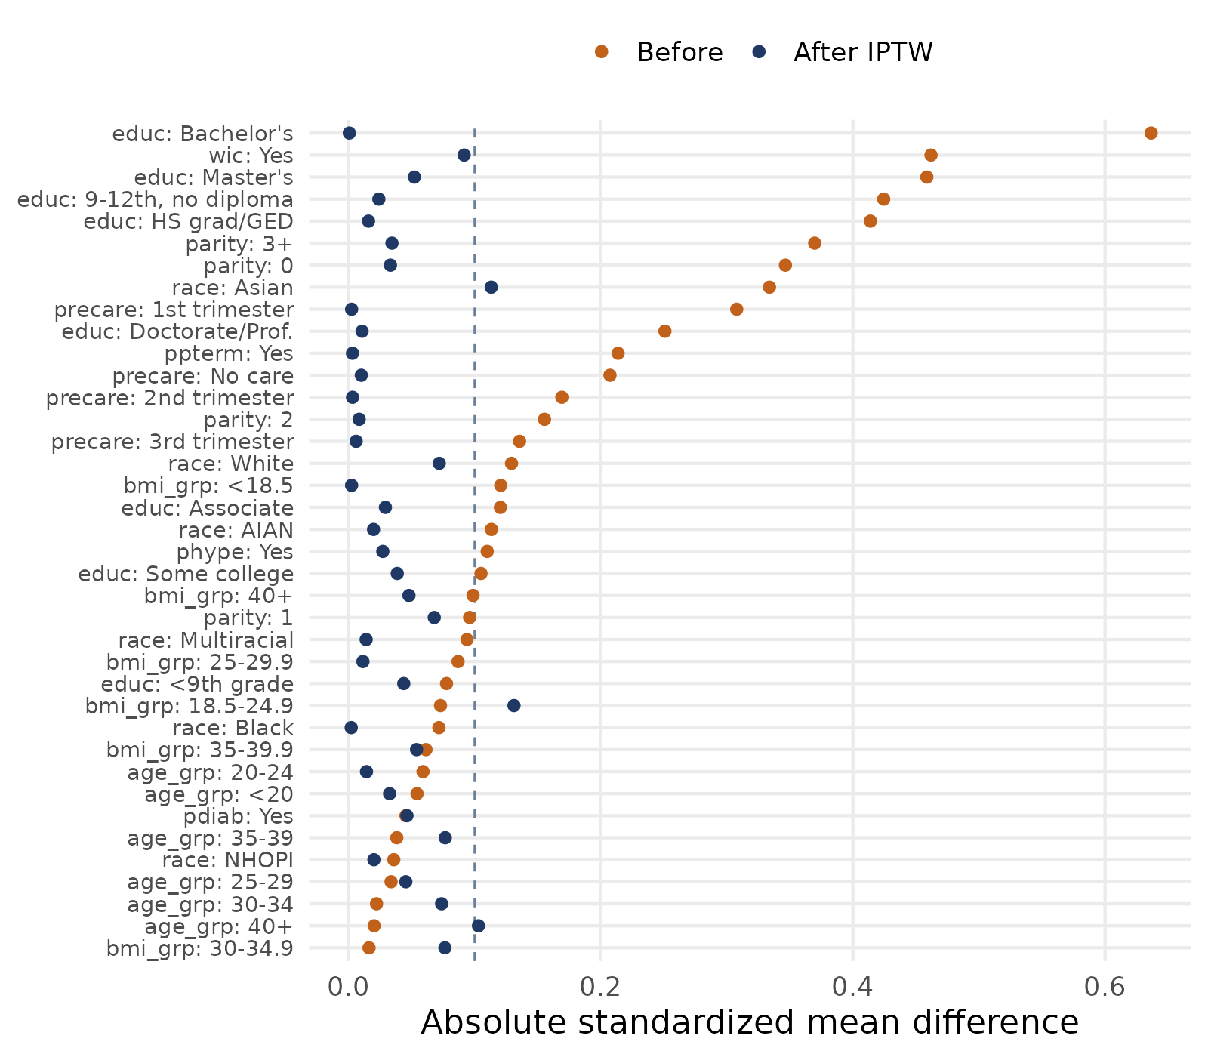
Covariate balance before and after weighting
Dashed line marks the usual 0.10 threshold
Largest standardized difference: 0.64 before weighting, 0.13 after
3 of 38 covariate levels stay above 0.10: BMI 18.5-24.9 (0.13), Asian race (0.11), age 40+ (0.10)
AIPTW adds the outcome model, which also adjusts for these
Notes:
BACKUP. Love plot of absolute standardized mean differences for all 38 covariate levels. Before weighting (orange) education, WIC, parity and prenatal care timing are far apart, up to 0.64. After stabilized IPTW (navy) nearly all are below 0.10. Three levels stay slightly above: BMI 18.5 to 24.9 at 0.13, Asian race at 0.11 and age 40 and over at 0.10. These levels are reported here. The AIPTW estimator adds the outcome model, which also adjusts for these covariates.

Slide 14
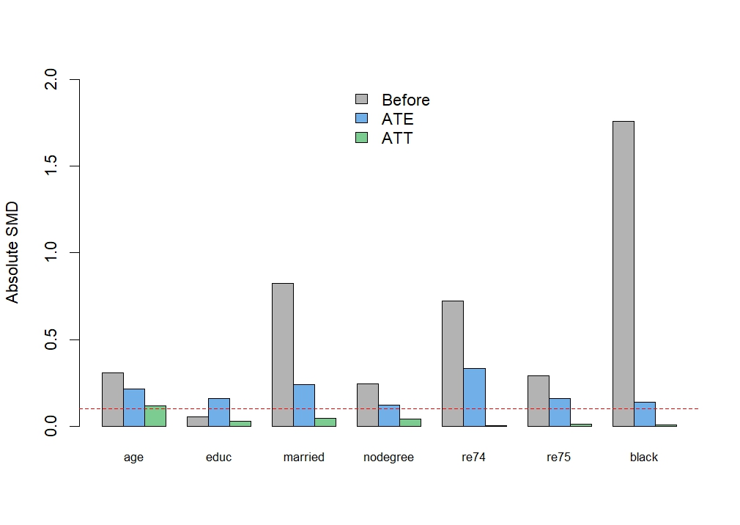
Balance after weighting (class example)
Class example, job-training data. In our study the same plot compares smokers with non-smokers on the ten mother characteristics (education, prenatal care, prior preterm birth and so on). Our own plot is on slide 13.
How to read it: after weighting, dots close to zero mean the two groups now look alike. The usual limit is 0.10. In our study the largest difference after weighting is 0.13.
Notes:
This picture comes from the class example. It shows what balance looks like. Each dot is a characteristic. Before weighting the dots are far from zero. After weighting they sit close to zero. In our study, the groups are smokers and non-smokers and the characteristics are the ten mother variables. Our balance plot is on slide 13.

Slide 15
Before the methods: what each term produces in our study
Term | What it is, in our study | What comes out
Risk difference | Extra preterm births per 100 pregnancies caused by smoking: risk if all mothers smoked minus risk if none did | 3.3 points (AIPTW)
Propensity score, e(X) | Each mother’s chance of smoking, given her ten characteristics | One number per mother, 0 to 1
G-computation (outcome regression) | A prediction of each mother’s chance of a preterm baby if she smoked and if she did not, averaged over all mothers | 11.8% if all smoked, 8.4% if none
Weight (IPTW) | How many mothers she stands for: 1 over the chance of the smoking status she actually had | One number per mother, largest 187
Residual correction | The real outcome (preterm = 1, not = 0) minus the prediction, divided by her chance; added back to fix prediction errors | Moves 11.8% to 11.6%
Balance (standardized difference) | How different smokers and non-smokers still look on a characteristic such as education; under 0.10 is good | Largest 0.13 after weighting
E-value | How strongly a hidden factor would need to be tied to both smoking and preterm birth to explain the effect away | 2.12 (1.92 lower limit)
KEY TAKEAWAY
Every method below answers one question: preterm risk if all mothers smoked versus if none did.
Notes:
Before the results, let me say what each of these words produces in our study, so nobody is lost. The risk difference is the answer we want: extra preterm births per 100 pregnancies because of smoking. The propensity score is one number per mother, her chance of smoking given her ten characteristics. G-computation, also called outcome regression, produces a prediction for every mother: her chance of a preterm baby if she smoked and if she did not, and we average those over all mothers. A weight says how many mothers she stands for, so a rare smoker counts for many. The residual correction checks the prediction against what really happened and adds the gap back. Balance tells us whether smokers and non-smokers now look alike, and the E-value tells us how strong a hidden factor would have to be to explain the result away.

Slide 16
Five ways to answer one question (1 of 2)
1. Crude
STATISTICAL
Compare the preterm rate of smokers with non-smokers.
IN PLAIN WORDS
No adjustment. It mixes smoking with who smokes.
2. Outcome regression
STATISTICAL
Fit logistic models for preterm birth; predict each mother with and without smoking; average over all.
IN PLAIN WORDS
A what-if question for every mother, answered by a prediction model.
3. IPTW (weighting)
STATISTICAL
Weight each mother by 1 / probability of the exposure she had (stabilized).
IN PLAIN WORDS
Rare kinds of mothers count more, so the two groups look alike.
KEY TAKEAWAY
Five ways to answer one question. If they agree, we can trust the answer.
Notes:
We have one question and five ways to answer it. If five different methods land in the same neighborhood, we can trust the answer more. Method one is the crude comparison: smokers against non-smokers, nothing else. Method two is outcome regression: we build a prediction model for preterm birth and ask it a what-if question for every mother, what if she smoked and what if she did not. Method three is weighting: instead of predicting, we count unusual mothers more, so smokers and non-smokers end up looking alike.

Slide 17
Five ways to answer one question (2 of 2)
4. Propensity score strata
STATISTICAL
Cut mothers into five groups (quintiles) by estimated chance of smoking; compare within each group; average.
IN PLAIN WORDS
Compare mothers who were about equally likely to smoke.
5. AIPTW (our main method)
STATISTICAL
Outcome-model prediction plus a weighted correction of its residuals. Doubly robust.
IN PLAIN WORDS
Prediction and weights together: two chances to be right.
How to read the plot
THE PLOT
Dot = estimate of the risk difference (percentage points). Line = 95% CI. Zero = no effect.
REMEMBER
The farther the dot is from zero, the bigger the effect.
KEY TAKEAWAY
Methods 4 and 5, then how to read the plot: dot = estimate, line = 95% CI, zero = no effect.
Notes:
Method four sorts mothers into five groups by how likely they were to smoke, and compares smokers with non-smokers only inside each group. Method five, AIPTW, is our main method. It uses the prediction and the weights together, so it has two chances to be right. On the next slides you will see the same plot five times. The dot is the estimate, the line is the 95% confidence interval, and zero would mean no effect. Each time, I highlight one row and we go through what it means.

Slide 18
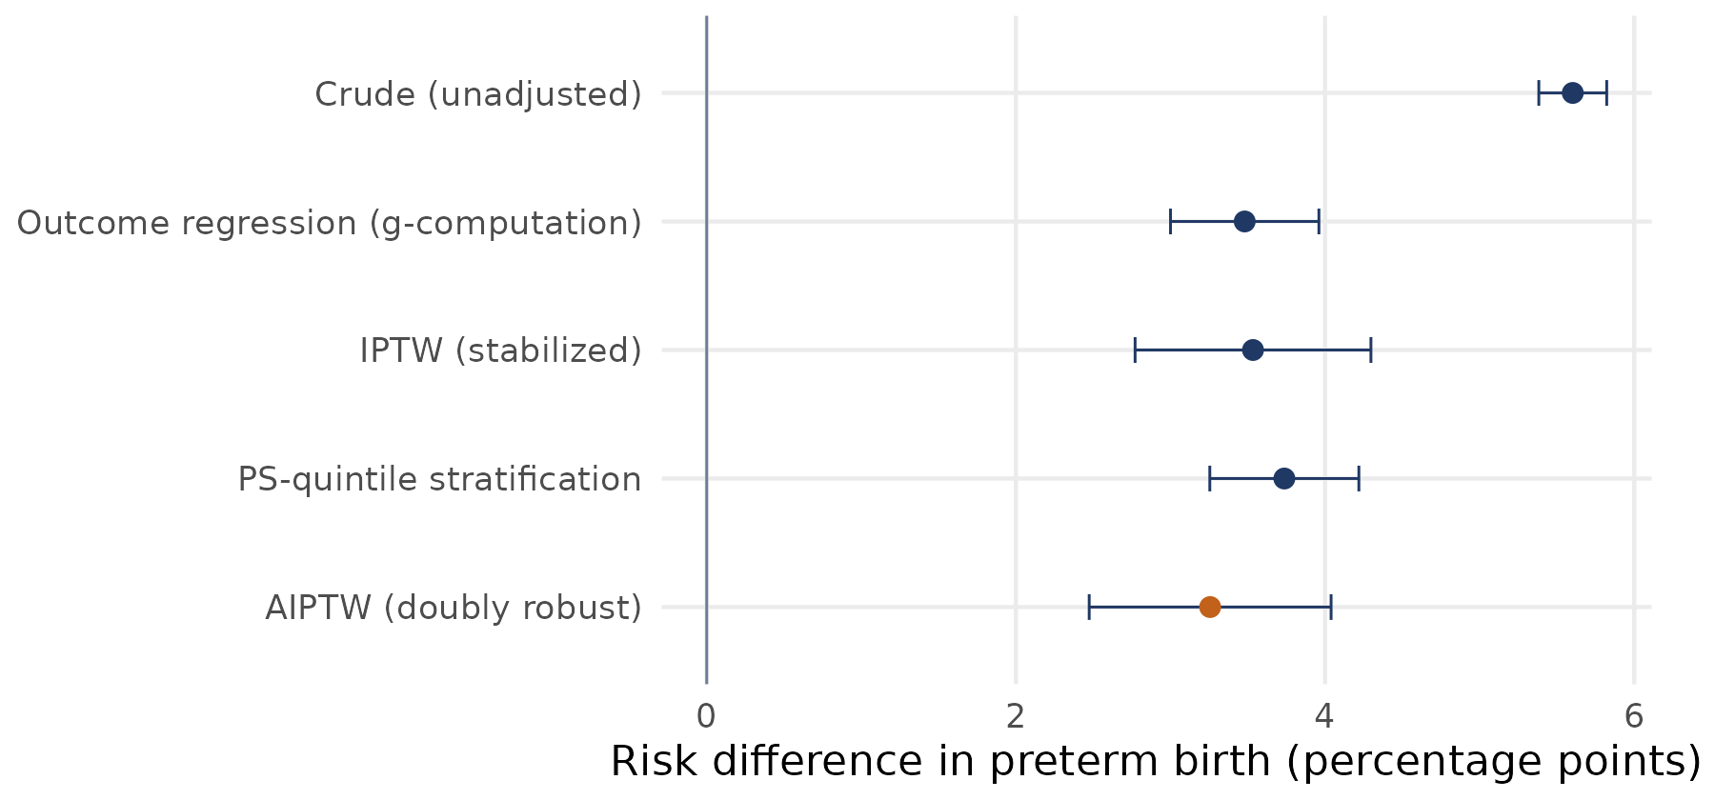
Result 1 of 5: Crude, the raw comparison
13.90%
8.30%
5.60
smokers preterm
non-smokers preterm
difference, points
IN STATISTICAL TERMS
Unadjusted risk difference 5.60 points (95% CI 5.38 to 5.82)
Risk ratio 1.68; odds ratio 1.78
Very narrow interval, but it mixes smoking with who smokes
KEY TAKEAWAY
The crude gap of 5.6 points mixes smoking with who smokes, so it is likely too high.
Notes:
This is the starting point. Among mothers who smoked, about 14 in 100 delivered preterm. Among mothers who did not, about 8 in 100. The gap is 5.6 points. The line is very short, which makes it look precise, but short does not mean right. This number still mixes two things: the effect of smoking, and the fact that smokers are different kinds of mothers, with less education, later prenatal care and more previous preterm births. So 5.6 is likely too high. Everything that follows tries to remove the part that is not smoking.

Slide 19
Result 2 of 5: Outcome regression
11.84%
8.36%
3.48
if all smoked
if none smoked
difference, points
IN STATISTICAL TERMS
Risk difference 3.48 points (95% CI 3.00 to 3.96)
Risk ratio 1.42; odds ratio 1.47
Depends on the prediction model being right
KEY TAKEAWAY
Predicting each mother's risk with and without smoking gives 3.5 points.
Notes:
Here we stop comparing different mothers and ask a what-if question for every mother. What would her chance of a preterm birth be if she smoked? What if she did not? We average the answers over all 3.26 million mothers. That gives about 11.8 in 100 if everyone smoked and 8.4 in 100 if nobody did, a gap of 3.5 points, about 2 points lower than the raw gap. The catch is that this is only as good as the prediction model. If the model handles education or previous preterm birth badly, the answer is off.

Slide 20
Result 3 of 5: IPTW, the weighting method
11.89%
8.36%
3.53
if all smoked
if none smoked
difference, points
IN STATISTICAL TERMS
Risk difference 3.53 points (95% CI 2.77 to 4.30)
Risk ratio 1.42; odds ratio 1.48
No outcome model; wider interval because a few smokers get large weights
KEY TAKEAWAY
Reweighting mothers so the groups look alike gives 3.5 points, with a wider interval.
Notes:
This method does not predict anything about the outcome. It rebalances the groups. A smoker who looks like a typical non-smoker, for example a mother with a college degree, is rare among smokers, so she counts as many mothers. After weighting, smokers and non-smokers have the same mix of education, age and health, so we can compare them directly. The answer is 3.5 points, almost the same as outcome regression. That is reassuring, because the two methods work in completely different ways. The interval is wider because a few mothers carry very large weights.

Slide 21
Result 4 of 5: Propensity score strata
12.08%
8.35%
3.74
if all smoked
if none smoked
difference, points
IN STATISTICAL TERMS
Risk difference 3.74 points (95% CI 3.25 to 4.22)
Risk ratio 1.45; odds ratio 1.51
Coarser: mothers in the same group are only roughly alike
KEY TAKEAWAY
Comparing mothers inside five similar groups gives 3.7 points.
Notes:
This is the oldest and simplest idea. We sort all mothers by how likely they were to smoke and cut them into five equal groups. Then we compare smokers with non-smokers only inside the same group, where they are more alike, and average the five answers. It gives 3.7 points, the highest of the four adjusted methods. It is a little rougher, because mothers inside a group still differ somewhat, but again it lands in the same neighborhood as the others.

Slide 22
Result 5 of 5: AIPTW, our main estimate
11.62%
8.37%
3.26
if all smoked
if none smoked
difference, points
IN STATISTICAL TERMS
Risk difference 3.26 points (95% CI 2.47 to 4.04)
Risk ratio 1.39; odds ratio 1.44
Doubly robust: right if either the propensity model or the outcome models are right
KEY TAKEAWAY
Our main estimate is 3.3 points, and it is right if either model is right.
Notes:
This is our main method. It starts with the prediction from the outcome model, checks that prediction against what really happened, mother by mother, and corrects it using the weights. If the prediction model is wrong, the weights repair it. If the weights are wrong, a good prediction model repairs it. So it has two chances to be right. In our data the correction was small: it moved the smoking group from 11.8 to 11.6 in 100. The answer is 3.3 points, with a 95% interval from 2.5 to 4.0. The interval is slightly the widest, and that is the honest cost of weak overlap.

Slide 23
Putting the five together: about 3.3 points
3.3 pts
11.6% vs 8.4%
AIPTW risk difference (95% CI 2.5 to 4.0)
risk if all smoked vs none smoked
IN STATISTICAL TERMS
Risk ratio 1.39 (1.30 to 1.49); odds ratio 1.44 (1.33 to 1.55)
Among smokers (ATT): 3.4 points (3.2 to 3.6)
E-value 2.12 (1.92 for the lower limit)
Adjusted methods: 3.3 to 3.7 points, against 5.6 crude
KEY TAKEAWAY
All four adjusted methods land between 3.3 and 3.7 points, against 5.6 crude.
Notes:
Now put the five side by side. The raw gap is 5.6 points. Once we account for the ten differences between mothers, all four adjusted methods land between 3.3 and 3.7, and that agreement matters more than any single number. Our main estimate is 3.3: about 11.6 in 100 would deliver preterm if every mother smoked, against 8.4 in 100 if none did. That is a risk ratio of 1.39, about 39% higher risk. Among mothers who actually smoked, it is 3.4 points, or about 34 extra preterm births per 1,000 smoking pregnancies. And a hidden factor would need to be about twice as strongly linked to both smoking and preterm birth to explain this away.

Slide 24
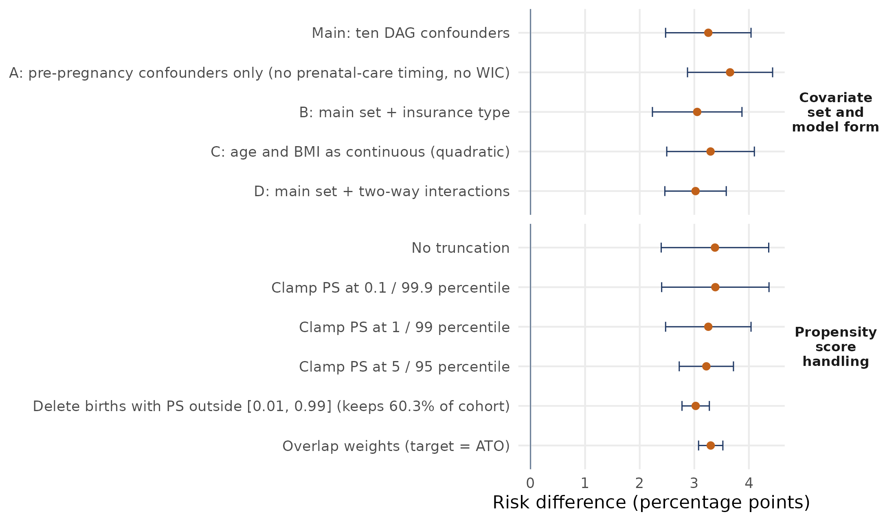
Robustness 1 of 4: do our choices drive the answer?
3.26
3.02
3.65
main analysis
smallest
largest
IN STATISTICAL TERMS
Each dot is AIPTW under one changed choice
11 analyses: risk difference between 3.0 and 3.7 points
Every 95% interval excludes zero
KEY TAKEAWAY
Changing our choices one at a time keeps the answer between 3.0 and 3.7 points.
Notes:
A skeptic can ask: did you get 3.3 only because of choices you made? So we changed the choices, one at a time. Each dot here is the same method under a different choice. The top dot is our main analysis, 3.26. If the answer swung wildly we would be in trouble. If it stays in the same neighborhood, we can be more confident. There are two kinds of changes: which mother characteristics go in the model, and how we handle mothers with extreme weights.

Slide 25
Robustness 2 of 4: changing which variables go in
3.65
3.05
3.30
3.02
A: no prenatal care or WIC
B: add insurance
C: age, BMI as curves
D: interactions
IN STATISTICAL TERMS
A drops two variables measured during pregnancy: 3.65
B adds insurance type: 3.05
C age and BMI as smooth curves: 3.30
D adds two-way interactions: 3.02
KEY TAKEAWAY
Using different sets of mother characteristics keeps the effect between 3.0 and 3.7.
Notes:
First change: which mother characteristics we adjust for. In A we remove prenatal-care timing and WIC, because they are recorded during pregnancy and could be affected by it. The estimate goes up a little, to 3.65. In B we add insurance type, 3.05. In C we let age and BMI follow smooth curves instead of bands, 3.30. In D we let variables interact, for example education with age, 3.02. No single choice about variables makes the effect disappear or double. It stays between 3.0 and 3.7.

Slide 26
Robustness 3 of 4: handling extreme weights
3.38
3.39
3.26
3.22
no clamping
clamp 0.1 / 99.9
clamp 1 / 99 (main)
clamp 5 / 95
IN STATISTICAL TERMS
Clamping caps the propensity score; nobody is deleted
Largest smoker weight: 453, 388, 187, 42
Tighter clamping gives a narrower interval (2.72 to 3.72 at 5 / 95)
KEY TAKEAWAY
Capping extreme weights barely moves the estimate (3.2 to 3.4); it only changes the interval.
Notes:
Second change: extreme weights. Some smokers look like typical non-smokers and receive huge weights. Without any limit, the biggest weight is 453, meaning one mother counts as 453. Clamping means we cap very small chances of smoking at a floor, and nobody is removed. We tried no clamp, a mild clamp, our choice, and a strong clamp. The estimate hardly moves, from 3.2 to 3.4. What changes is the width of the interval: the tighter we cap, the narrower the interval, because fewer mothers dominate.

Slide 27
Robustness 4 of 4: two other options
3.03
3.30
delete scores outside 0.01 to 0.99
overlap weights
IN STATISTICAL TERMS
Deleting keeps 60.3% of the cohort: 3.03 (2.77 to 3.28)
Overlap weights: 3.30 (3.08 to 3.52), no huge weights
All 11 intervals exclude zero
KEY TAKEAWAY
Deleting low-overlap mothers or using overlap weights gives 3.03 and 3.30, still above zero.
Notes:
Last, two more drastic options. We can delete every mother whose chance of smoking is below 1%. That throws away about 40% of the mothers and answers a different question, about mothers who could realistically go either way, and it gives 3.03. Or we can use overlap weights, which give the most weight to mothers who could realistically go either way and never produce huge weights, and that gives 3.30. Across all eleven analyses the answer is between 3.0 and 3.7, and no interval includes zero. So our conclusion does not depend on one lucky choice.

Slide 28
Findings and limits
Findings and limits
Next steps
AIPTW risk difference 3.3 points (RR 1.39), under stated assumptions
3.0 to 3.7 points across adjusted estimators and sensitivity analyses
Limits: weak overlap for some mothers, self-reported smoking, coarse exposure, unmeasured confounding (E-value 2.1)
Machine-learning nuisance models with cross-fitting
Dose, timing and quitting
Multiple birth years
SAS implementation and replication code for SEASUG
Notes:
CONCLUSION (45 seconds). Under the stated assumptions, the AIPTW estimate is an increase in the probability of preterm birth of about 3.3 percentage points with smoking in pregnancy in this 2023 U.S. cohort, a risk ratio of 1.39. Estimates range from 3.0 to 3.7 points across the estimators, propensity score handling rules and covariate specifications examined. The limits are: overlap is weak for some mothers; smoking is self-reported; any smoking is a coarse exposure; prenatal care and WIC are measured during pregnancy and are examined in a sensitivity analysis; and factors not recorded in the file, such as alcohol, cannabis and stress, are not adjusted for. The E-value quantifies the strength an unmeasured confounder would need. Next steps are flexible machine-learning nuisance models with cross-fitting within the same AIPTW structure; dose and timing of smoking; combining several years of data; and a SAS implementation for this audience. All R code, with the data link and run instructions, is in the repository, with seed 1234 throughout.

Slide 29

Thank you for listening
Questions and feedback are welcome.
Faruk Muritala and Dhrubajyoti Ghosh
Kennesaw State University
Scan to connect on LinkedIn
Notes:
CLOSING (15 seconds). Thank you for listening. For discussion of causal inference with birth certificate data, or for the code, the QR code links to the first author on LinkedIn. Questions are welcome.

Slide 30
References
Liu, B., et al. (2020). Maternal cigarette smoking before and during pregnancy and the risk of preterm birth: A dose-response analysis of 25 million mother-infant pairs. PLOS Medicine. doi:10.1371/journal.pmed.1003158
Shah, N. R., & Bracken, M. B. (2000). A systematic review and meta-analysis of prospective studies on the association between maternal cigarette smoking and preterm delivery. Am J Obstet Gynecol, 182, 465-472.
Juárez, S. P., & Merlo, J. (2013). Revisiting the effect of maternal smoking during pregnancy on offspring birthweight: A quasi-experimental sibling analysis in Sweden. PLOS ONE. doi:10.1371/journal.pone.0061734
Evans, W. N., & Ringel, J. S. (1999). Can higher cigarette taxes improve birth outcomes? J Public Econ, 72(1), 135-154.
Veiga, P. V., & Wilder, R. P. (2008). Maternal smoking during pregnancy and birthweight: A propensity score matching approach. Matern Child Health J, 12(2). doi:10.1007/s10995-007-0238-8
Duko, B., et al. (2023). Average treatment effect of maternal prenatal tobacco smoking on offspring developmental vulnerability in early childhood. Ann Epidemiol. doi:10.1016/j.annepidem.2022.12.007
Chen, J., et al. (2026). Interaction between maternal smoking cessation timing and preexisting hypertension on fetal growth restriction. Clin Epidemiol. doi:10.2147/CLEP.S596174
Heiny, E., & Islam, M. (2026). Impact of maternal smoking during pregnancy on preterm birth risk in the United States [E-poster]. Joint Statistical Meetings 2026.
Rosenbaum, P. R., & Rubin, D. B. (1983). The central role of the propensity score in observational studies for causal effects. Biometrika, 70(1), 41-55.
Robins, J. M., Rotnitzky, A., & Zhao, L. P. (1994). Estimation of regression coefficients when some regressors are not always observed. JASA, 89(427), 846-866.
Bang, H., & Robins, J. M. (2005). Doubly robust estimation in missing data and causal inference models. Biometrics, 61(4), 962-973.
Funk, M. J., et al. (2011). Doubly robust estimation of causal effects. Am J Epidemiol, 173(7), 761-767.
Austin, P. C., & Stuart, E. A. (2015). Moving towards best practice when using inverse probability of treatment weighting. Stat Med, 34(28), 3661-3679.
King, G., & Nielsen, R. (2019). Why propensity scores should not be used for matching. Political Analysis, 27(4), 435-454.
Li, F., Morgan, K. L., & Zaslavsky, A. M. (2018). Balancing covariates via propensity score weighting. JASA, 113(521), 390-400.
VanderWeele, T. J., & Ding, P. (2017). Sensitivity analysis in observational research: Introducing the E-value. Ann Intern Med, 167(4), 268-274.
Pearl, J. (1995). Causal diagrams for empirical research. Biometrika, 82(4), 669-688.
National Center for Health Statistics. (2023). Natality public use file. cdc.gov/nchs/data_access/vitalstatsonline.htm
Notes:
References for the talk. Every item was checked against its journal, publisher or Crossref record. The NCHS data and user guide links are in the R code header.

Slide 31
Backup: covariate balance before and after weighting
Dashed line marks the usual 0.10 threshold
Largest standardized difference: 0.64 before weighting, 0.13 after
3 of 38 covariate levels stay above 0.10: BMI 18.5-24.9 (0.13), Asian race (0.11), age 40+ (0.10)
AIPTW adds the outcome model, which also adjusts for these
Notes:
BACKUP. Love plot of absolute standardized mean differences for all 38 covariate levels. Before weighting (orange) education, WIC, parity and prenatal care timing are far apart, up to 0.64. After stabilized IPTW (navy) nearly all are below 0.10. Three levels stay slightly above: BMI 18.5 to 24.9 at 0.13, Asian race at 0.11 and age 40 and over at 0.10. These levels are reported here. The AIPTW estimator adds the outcome model, which also adjusts for these covariates.

Slide 32
AIPW ATE: the average gap in preterm risk
T = 1 / T = 0 mother smoked / did not smoke Y = 1 her baby was born preterm X her ten characteristics ψ1, ψ0 = a mother's contribution to the preterm risk if all smoked / if none smoked. m̂₁, m̂₀ = predicted chance of a preterm baby if she smokes / does not. ê = her estimated chance of smoking
$${\hat{τ}}_{AIPW} = n^{−1}Σ_{i} \left[ψ_{1i} − ψ_{0i}\right].$$
Prediction contrast, if she smokes minus if she does not: ${\hat{m}}_{1}\left(X_{i}\right) −{\hat{m}}_{0}\left(X_{i}\right).$
Add the smokers' residual correction $T_{i}\{Y_{i} −{\hat{m}}_{1}(X_{i})\}/{\hat{e}}_{i}$.
Subtract the non-smokers' residual correction $\left(1 − T_{i}\right)\{Y_{i} −{\hat{m}}_{0}(X_{i})\}/(1 −{\hat{e}}_{i}).$
The non-smokers' correction enters with a minus sign.
Notes:
Here is the AIPTW formula in one line. For every mother we compute a contribution if she smoked, psi one, and a contribution if she did not, psi zero. The estimate is the average of psi one minus psi zero over all mothers. Each psi starts from the prediction of her preterm risk. Then, for smokers, we add a correction: the real outcome, preterm or not, minus the prediction, divided by her chance of smoking. For non-smokers the same correction enters with a minus sign. The next two slides do this for two real mothers.

Slide 33
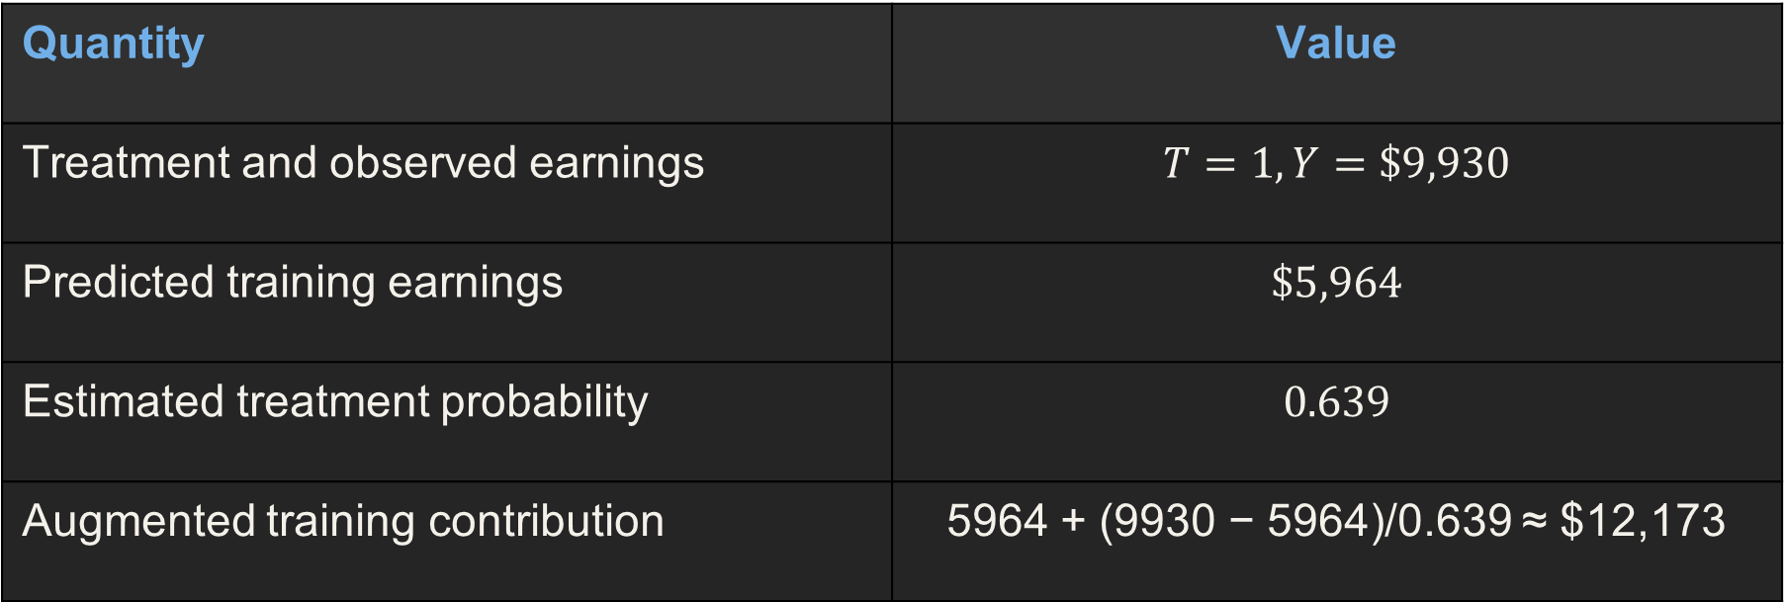
Worked real mother S1: a smoker with a preterm baby
Real mother S1: smoked, age 25 to 29, high-school graduate, prenatal care in the first trimester; her baby was born at 32 weeks. Her 19.04 is one ingredient, not a risk: averaging the ingredients of all 3.26 million mothers gives 11.62%.
Quantity | Value
Smoking status and baby's outcome | T = 1 (smoked), Y = 1 (preterm)
Predicted preterm risk if she smokes | 0.0727 (7.3%)
Estimated chance she smokes | 0.0489
Augmented smoking contribution | 0.0727 + (1 − 0.0727)/0.0489 ≈ 19.04
Her not-smoking contribution is the prediction ${\hat{m}}_{0}(X) ≈ 0.0568$.
Notes:
This is one real mother from our data, S1. She smoked and her baby was born preterm, at 32 weeks. The outcome model predicted a 7.3% chance of preterm birth if she smokes. The model said she had only a 4.9% chance of smoking. So her contribution is 0.0727 plus, the gap between what happened, one, and the prediction, divided by 0.0489. That is 19.04. It is not a risk. It is one ingredient. A smoker who has a preterm baby is rare and surprising, so she counts for about twenty mothers. Averaging the ingredients over all 3.26 million mothers gives the 11.62 percent that you see in the results.

Slide 34
Worked real mother N1: a non-smoker with a preterm baby
Real mother N1: did not smoke, has the same ten characteristics as S1 (so the same chance of smoking, 0.0489), baby born at 34 weeks, preterm. She counts only 1.05 here, while S1 counted 20.45.
Quantity | Value
Smoking status and baby's outcome | T = 0 (did not smoke), Y = 1 (preterm)
Predicted preterm risk if she does not smoke | 0.0568 (5.7%)
Estimated chance she smokes | 0.0489
Augmented non-smoking contribution | 0.0568 + (1 − 0.0568)/(1 − 0.0489) ≈ 1.05
Her smoking contribution is the prediction ${\hat{m}}_{1}(X) ≈ 0.0727$.
Notes:
Now a real mother who did not smoke, N1, with exactly the same characteristics as S1, and whose baby was also born preterm, at 34 weeks. The model predicted a 5.7 percent chance of a preterm baby if she does not smoke. Her chance of smoking is the same 0.0489. Her contribution is 0.0568 plus the gap, one minus 0.0568, divided by one minus 0.0489. That is 1.05. She counts about once, while the smoker S1 counted twenty times. The same preterm outcome weighs very differently, because smoking was rare for this kind of mother.

Slide 35
Why it works: a correct preterm-risk prediction
m1(X) = true chance of a preterm baby if the mother smokes, given X. m̂₁(X) = our model’s prediction of it. T = 1 = she smoked
Suppose ${\hat{m}}_{1}(X)$ converges to the true $m_{1}(X)$.
Then $E[Y − m_{1}(X) | T=1, X] = 0.$
For smokers, the prediction is right on average, so the correction is zero.
The average prediction gives the risk if all smoked, $E[Y(1)].$
A correct preterm-risk prediction makes the correction average zero.
Notes:
Why does AIPTW work? Case one: the outcome model is right. If our prediction of a smoker's preterm risk is right, then among smokers with the same characteristics, the real outcomes match the prediction on average. So the correction, real minus predicted, averages to zero. What is left is the average prediction, which is the risk if all mothers had smoked.

Slide 36
Why it works: a correct chance-of-smoking model
e(X) = true chance that a mother smokes. ê(X) = our model’s estimate. m̃₁(X) = a prediction of preterm risk that may be wrong. T = smoked or not
Suppose $\hat{e}(X)$ converges to the true $e(X)$.
Let ${\tilde{m}}_{1}(X)$ be a possibly wrong prediction of preterm risk.
$$E[{\tilde{m}}_{1}(X) + T\{Y −{\tilde{m}}_{1}(X)\}/e\left(X\right) | X]$$
$$={\tilde{m}}_{1}\left(X\right)+ m_{1}(X) −{\tilde{m}}_{1}(X)= m_{1}(X).$$
Correct chances of smoking cancel any error in the prediction.
Notes:
Case two: the chance-of-smoking model is right but the preterm-risk prediction may be wrong. Look at the algebra. The prediction error appears once and is cancelled by the weighted correction. What remains is the true risk. So when the weights are right, even a poor prediction does not hurt us.

Slide 37
When both models are wrong: the remaining bias
g(X) = what our chance-of-smoking model settles on. e(X) = the true chance of smoking. m̃₁(X) = our preterm-risk prediction. m1(X) = the truth.
Let g(X) be what our model of the chance of smoking settles on.
Let ${\tilde{m}}_{1}(X)$ be what our preterm-risk prediction settles on.
Bias of the estimated risk if all mothers smoked:
$$E\left[\frac{\left\{g\left(X\right)− e\left(X\right)\right\}\left\{{\tilde{m}}_{1}\left(X\right)− m_{1}\left(X\right)\right\}}{g\left(X\right)}\right].$$
If either model is right, the bias vanishes.
Notes:
If both models are slightly wrong, a bias remains. It is the product of the two errors: how wrong the chance-of-smoking model is, times how wrong the preterm-risk prediction is. If either error is zero, the product is zero. That is double robustness. It is also why a small error in each gives a very small bias.

Slide 38
Backup: the small example used on the next five slides
Education | Smoking | Mothers | Preterm | Risk
High school or less (X = 1) | Smoked (T = 1) | 100 | 25 | 25%
High school or less (X = 1) | Did not smoke (T = 0) | 400 | 60 | 15%
Some college or more (X = 0) | Smoked (T = 1) | 60 | 9 | 15%
Some college or more (X = 0) | Did not smoke (T = 0) | 1,440 | 144 | 10%
WHAT TO NOTICE
2,000 mothers; 160 smoked (8%)
Smoking is more common with less education: 20% vs 4%
Within each group smokers still have more preterm births: 25% vs 15% and 15% vs 10%
The true effect in this example is 6.25 points
KEY TAKEAWAY
Small example: smoking and preterm birth are both more common with less education.
Notes:
To show the arithmetic, I shrink our study to 2,000 mothers with one characteristic, education. Every mother either smoked or did not, and her baby was either preterm or not. Notice two facts. Smoking is more common among mothers with less education, 20% against 4%, and mothers with less education have more preterm births anyway. That is the confounding the five methods try to remove. Inside each education group, smokers still have more preterm births, 25% against 15%, and 15% against 10%. The effect we are after is a mix of those two gaps.

Slide 39
Backup 1 of 5: crude, how it is calculated
Small example: 2,000 mothers. X = education: high school or less (500 mothers) or some college or more (1,500). T = 1 smoked. Y = 1 preterm baby.
STEPS
Smokers: 25 + 9 = 34 preterm out of 160, so 34 / 160 = 21.25%
Non-smokers: 60 + 144 = 204 preterm out of 1,840, so 204 / 1,840 = 11.09%
Crude gap: 21.25 − 11.09 = 10.16 points
21.25%
11.09%
10.16
smokers preterm
non-smokers preterm
gap, points
WHY IT IS NOT ENOUGH
Less education: 62.5% of smokers (100 of 160) vs 21.7% of non-smokers (400 of 1,840)
The gap mixes smoking with education, so it is too high (truth here: 6.25)
Real study: 13.90% vs 8.30% = 5.60
KEY TAKEAWAY
The crude gap of 10.16 points is too high; the truth in this example is 6.25.
Notes:
The crude method just counts. Among the 160 smokers, 34 had a preterm baby, which is 21.25%. Among the 1,840 non-smokers, 204 did, which is 11.09%. The gap is 10.16 points. But look at who the smokers are: 62.5% of smokers have less education, against only 21.7% of non-smokers. So part of that gap is education, not smoking. In this example the right answer is 6.25, so the crude number is too high. In our real data the same thing happens: 5.6 crude against about 3.3 adjusted.

Slide 40
Backup 2 of 5: outcome regression (g-computation)
Small example: 2,000 mothers. X = education: high school or less (500 mothers) or some college or more (1,500). T = 1 smoked. Y = 1 preterm baby.
Group | Mothers | Risk if she smoked | Risk if she did not
High school or less (X = 1) | 500 | 25% | 15%
Some college or more (X = 0) | 1,500 | 15% | 10%
17.5%
11.25%
6.25
if all smoked
if none smoked
difference, points
THREE STEPS
Predict both outcomes for every mother
Average over everyone
Real study: 11.84% vs 8.36% = 3.48
AVERAGE THE PREDICTIONS OVER ALL 2,000 MOTHERS
If everyone smoked: (500 × 0.25 + 1,500 × 0.15) / 2,000 = 17.5%
If no one smoked: (500 × 0.15 + 1,500 × 0.10) / 2,000 = 11.25%
Difference: 17.5 − 11.25 = 6.25 points
KEY TAKEAWAY
Predict both outcomes for every mother and average them: 6.25 points.
Notes:
For outcome regression, also called g-computation, we first learn from the data how risky each kind of mother is. Smokers with less education had 25% preterm, so we predict 25% for a high-school mother if she smokes. Non-smokers with less education had 15%, so we predict 15% if she does not. Then comes the key step: we give every mother both predictions, even the one that never happened, and average. If everyone smoked, the average risk is 17.5%. If no one smoked, 11.25%. The difference is 6.25 points, the right answer here. In the real study a logistic model with ten characteristics does this step, and we get 11.8% against 8.4%.

Slide 41
Backup 3 of 5: IPTW (weights), how it is calculated
Small example: 2,000 mothers. X = education: high school or less (500 mothers) or some college or more (1,500). T = 1 smoked. Y = 1 preterm baby.
Group | Smoking | Mothers | Chance of what she did | Weight | Stands for
Less education | Smoked | 100 | 0.20 | 5.00 | 500
Less education | Did not | 400 | 0.80 | 1.25 | 500
More education | Smoked | 60 | 0.04 | 25.00 | 1,500
More education | Did not | 1,440 | 0.96 | 1.0417 | 1,500
WHAT TO NOTICE
After weighting both groups are 25% less-educated (before: 62.5% vs 21.7%)
Smokers: 160 mothers act like 100 (effective sample size)
Real study: largest weight 187; result 3.53
Weighted smokers: (25 × 5 + 9 × 25) / 2,000 = 17.5% preterm
Weighted non-smokers: (60 × 1.25 + 144 × 1.0417) / 2,000 = 11.25% preterm
Difference: 17.5 − 11.25 = 6.25 points
KEY TAKEAWAY
Weight mothers so the groups look alike, then compare: 6.25 points.
Notes:
For weighting, we do not predict anything. Each mother gets a weight: one over the chance of the smoking status she actually had. A smoker with less education had a 20% chance of smoking, so she stands for 5 mothers. A smoker with more education had only a 4% chance, so she stands for 25 mothers. Now count what the weighted groups look like. Weighted smokers and weighted non-smokers are both exactly 25% less-educated, the same as everyone. Compare their preterm rates: 17.5% against 11.25%, a gap of 6.25. The price is that 160 smokers now act like only 100 independent mothers, which widens the interval.

Slide 42
Backup 4 of 5: propensity score strata, how it is calculated
Small example: 2,000 mothers. X = education: high school or less (500 mothers) or some college or more (1,500). T = 1 smoked. Y = 1 preterm baby.
Group (same chance of smoking) | Smokers preterm | Non-smokers preterm | Gap, points | Share of mothers
Less education (chance 0.20) | 25% | 15% | 10 | 500 / 2,000 = 25%
More education (chance 0.04) | 15% | 10% | 5 | 1,500 / 2,000 = 75%
WHAT TO NOTICE
Compare like with like inside each group
Here 2 groups; in the study 5 groups (quintiles)
Real study: 3.74 (3.25 to 4.22)
Average the gaps by group size: 0.25 × 10 + 0.75 × 5 = 2.5 + 3.75 = 6.25 points
KEY TAKEAWAY
Compare inside similar groups, then average the gaps: 6.25 points.
Notes:
Stratification is the simplest idea. We group mothers who had the same chance of smoking, and compare smokers with non-smokers only inside each group. In this tiny example the chance of smoking has only two values, so there are two groups. Among less-educated mothers, smokers had 25% and non-smokers 15%, a gap of 10 points. Among more-educated mothers, 15% against 10%, a gap of 5 points. Then we average the two gaps by how many mothers are in each group: a quarter and three quarters. That gives 6.25 again. In the real study we use five groups cut at the quintiles of the estimated chance of smoking, and we get 3.74.

Slide 43
Backup 5 of 5: AIPTW, how it is calculated
Small example: 2,000 mothers. X = education: high school or less (500 mothers) or some college or more (1,500). T = 1 smoked. Y = 1 preterm baby.
Smoker with | Prediction | Chance of smoking | If preterm | If not preterm
Less education | 0.25 | 0.20 | 0.25 + 0.75/0.20 = 4.00 | 0.25 − 0.25/0.20 = −1.00
More education | 0.15 | 0.04 | 0.15 + 0.85/0.04 = 21.40 | 0.15 − 0.15/0.04 = −3.60
Preterm-risk prediction | Chance-of-smoking model | AIPTW
Right | Right | 6.25
Wrong | Right | 6.25
Right | Wrong | 6.25
Wrong | Wrong | 10.16
Check, less education: (25 × 4.00 + 75 × −1.00) / 100 = 0.25, the prediction
Check, more education: (9 × 21.40 + 51 × −3.60) / 60 = 0.15, the prediction
So: the correction averages zero and AIPTW = 6.25
Real mother S1: contribution 19.04 (slide 22). Real study: 3.26.
KEY TAKEAWAY
Prediction plus a weighted correction gives 6.25 if either model is right.
Notes:
For AIPTW, every mother gets a contribution. It starts with the prediction, then adds a correction when the real outcome differs from it, scaled by the weight. Take a smoker with less education: prediction 0.25, chance of smoking 0.20. If her baby was preterm, her contribution is 0.25 plus 0.75 over 0.20, which is 4.00. If not, it is 0.25 minus 0.25 over 0.20, which is minus 1.00. Averaged over the 100 smokers, that is exactly 0.25, so when the prediction is right, the correction averages zero. That is why the answer equals outcome regression here, 6.25. The table on the right shows the double robustness: if either model is wrong, we still get 6.25. Only when both are wrong do we fall back to the crude 10.16.

