Slide 1

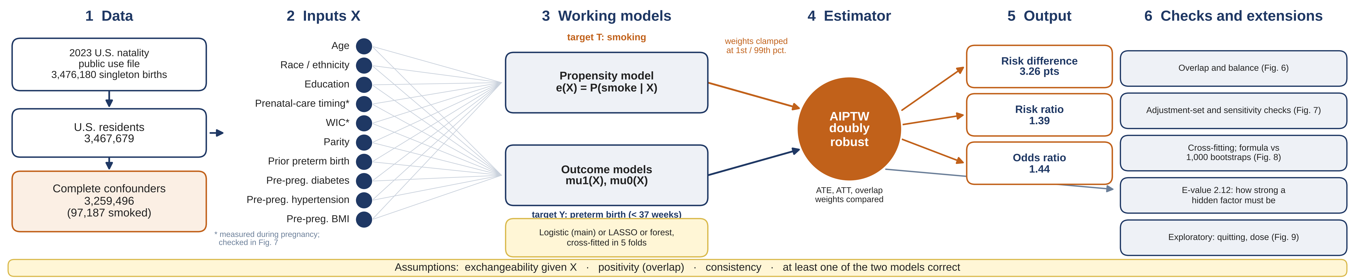
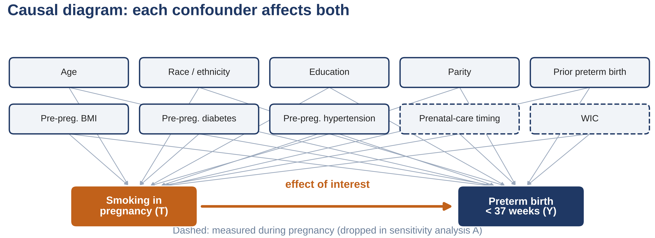
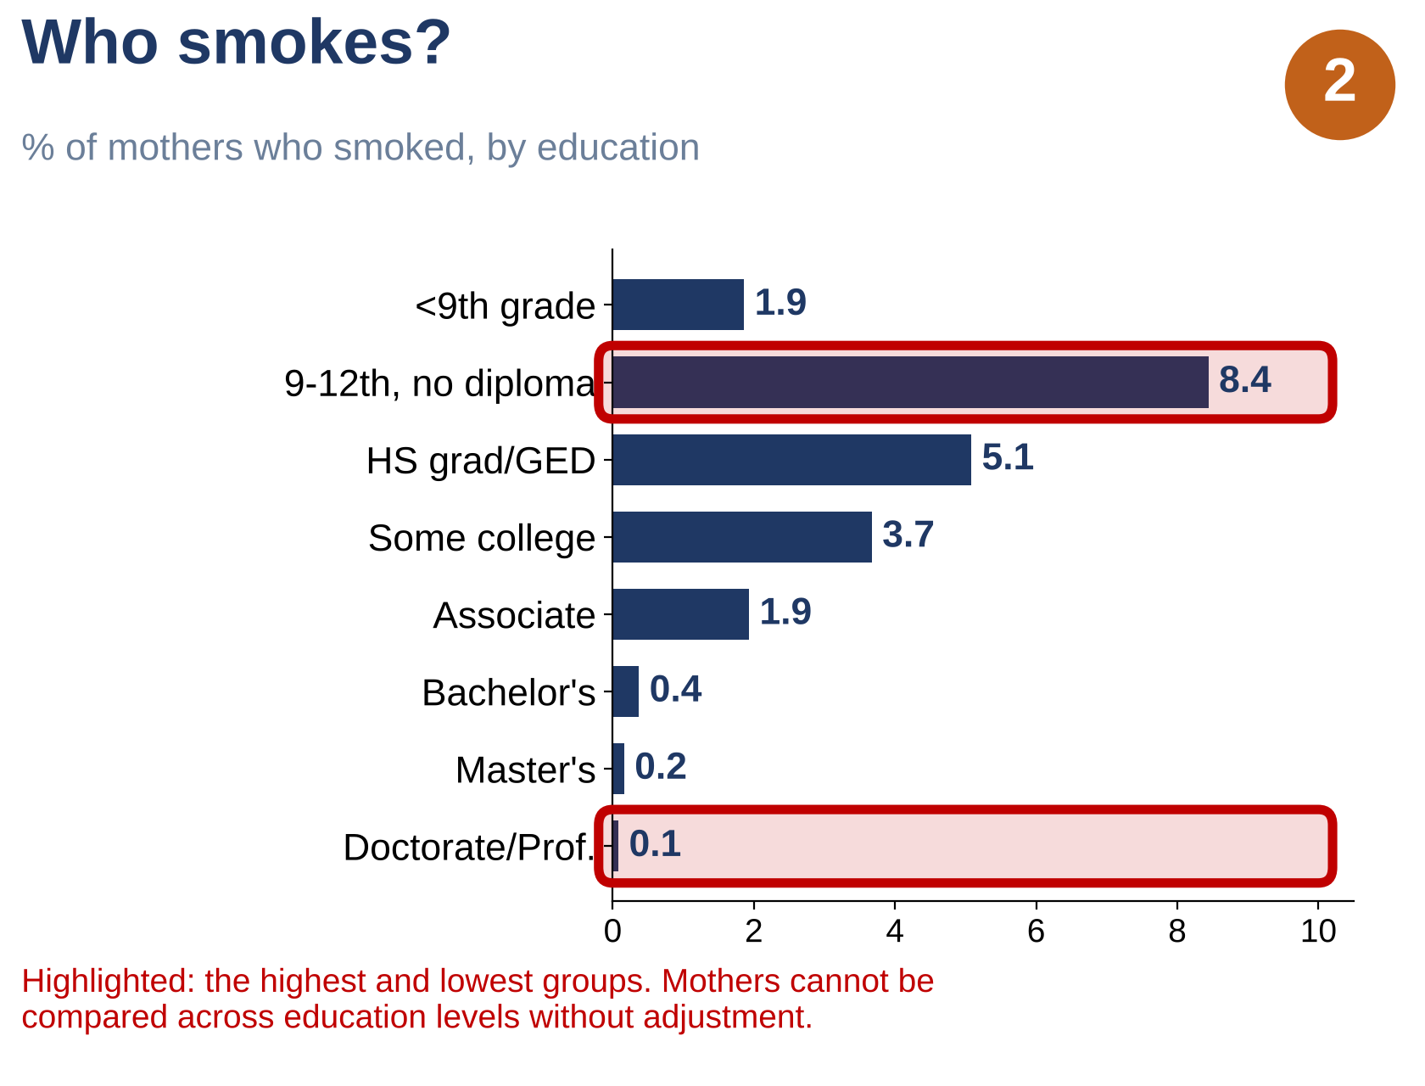
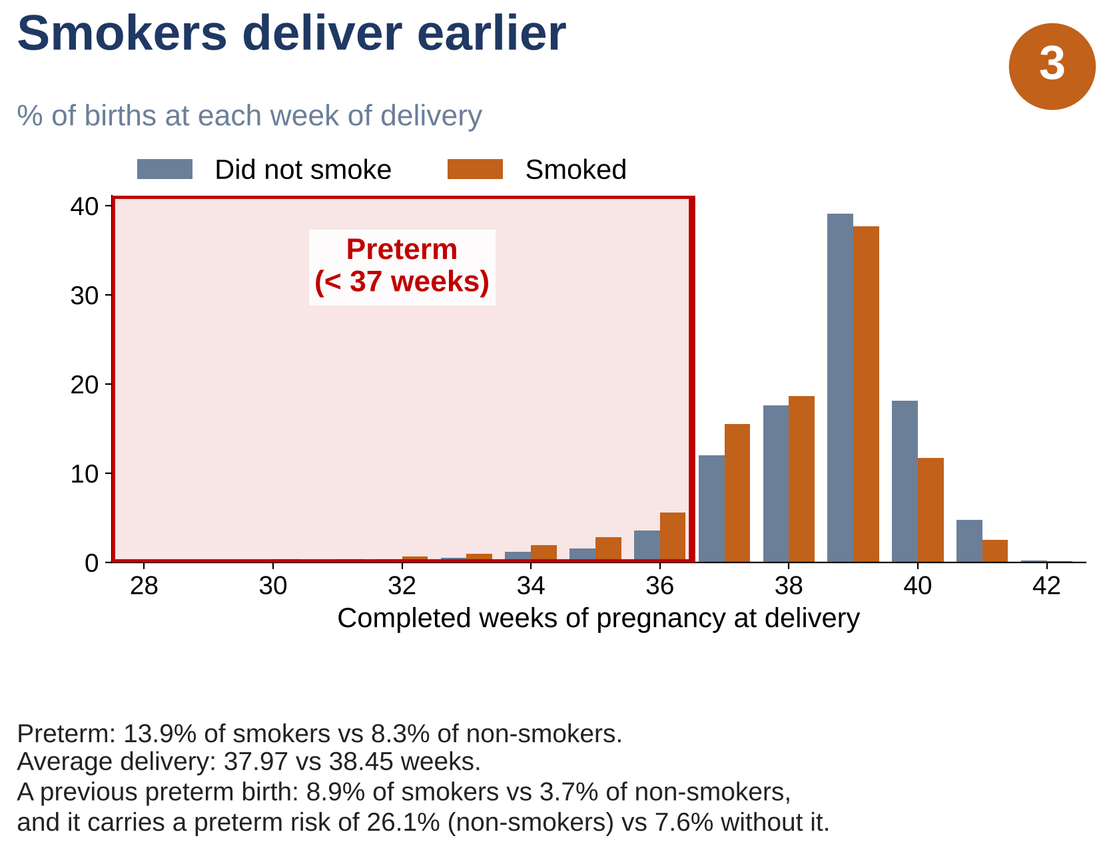
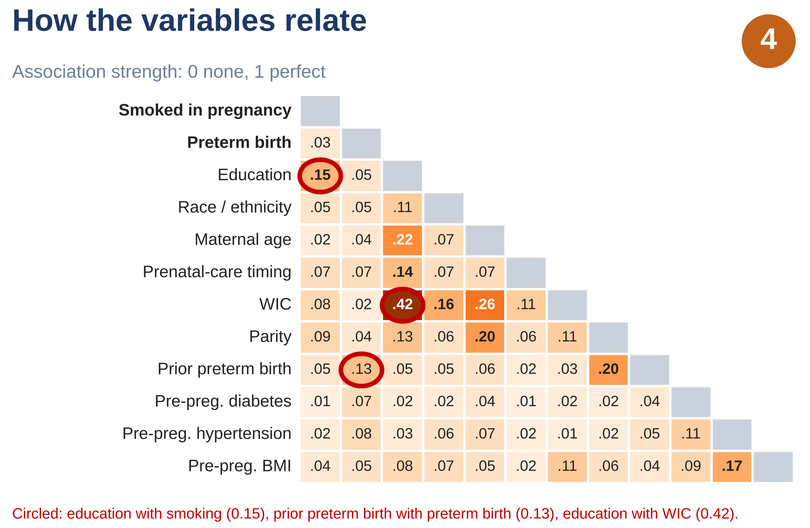
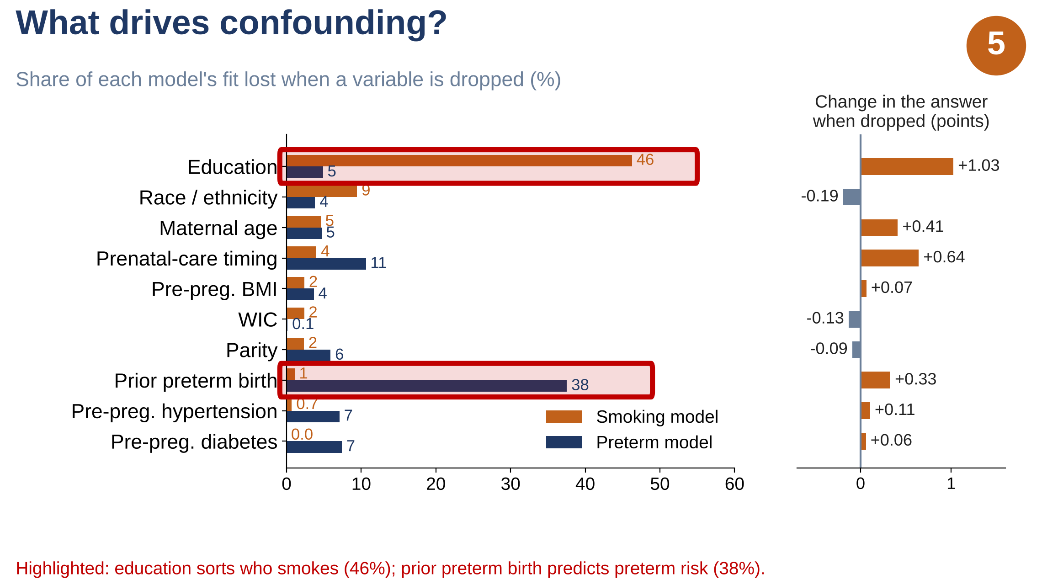
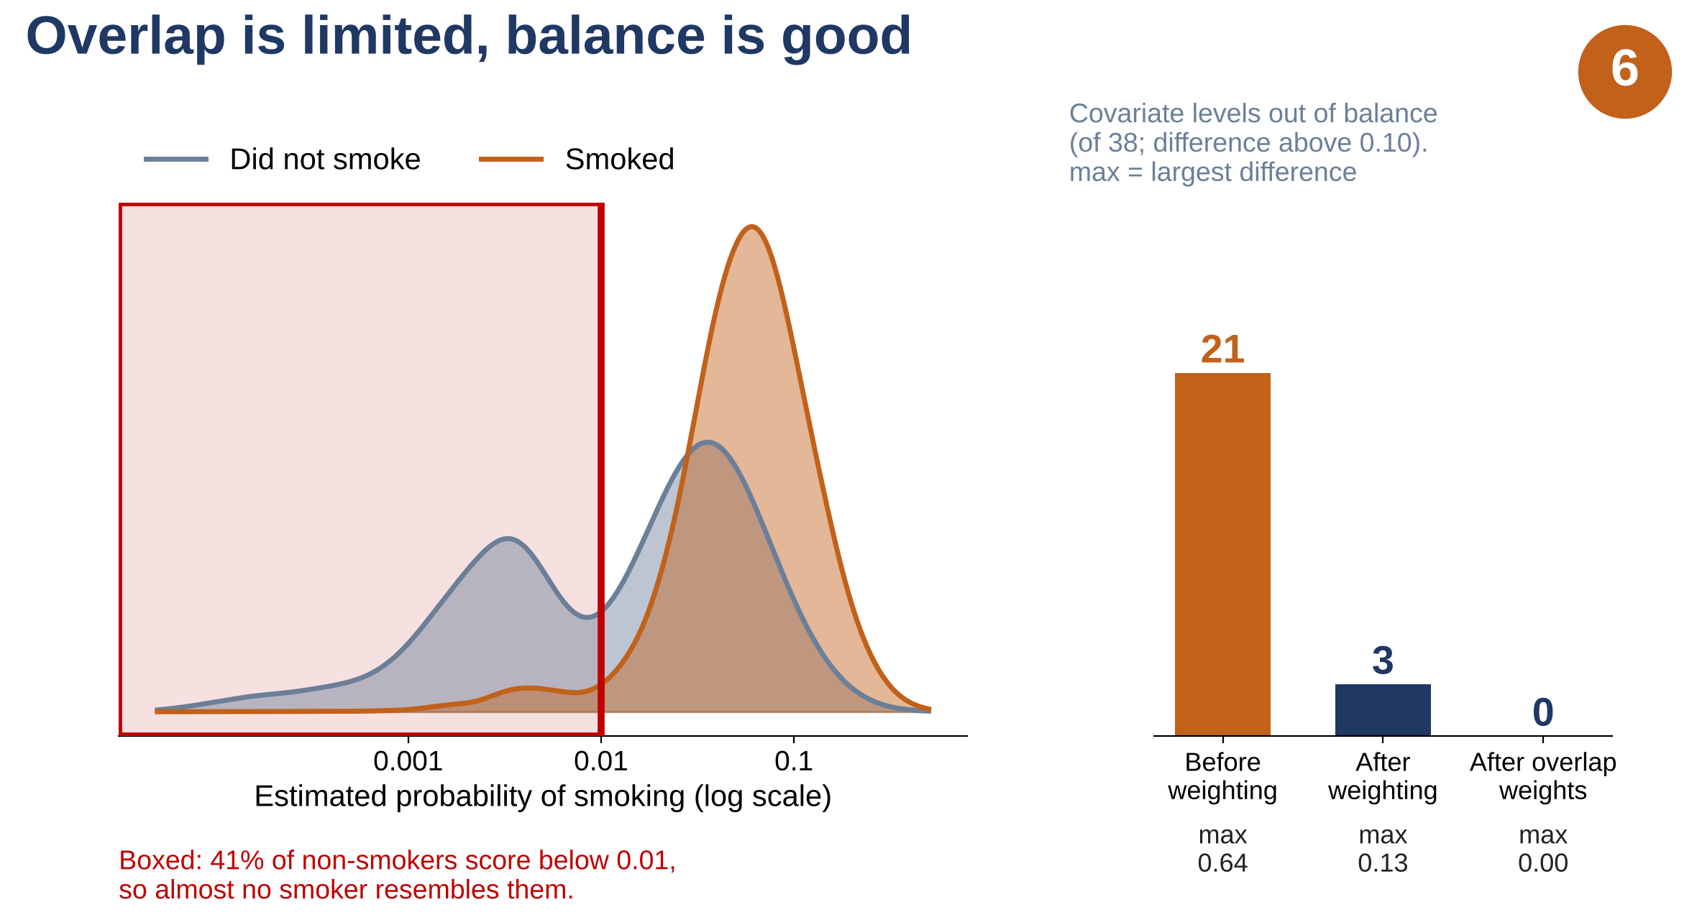
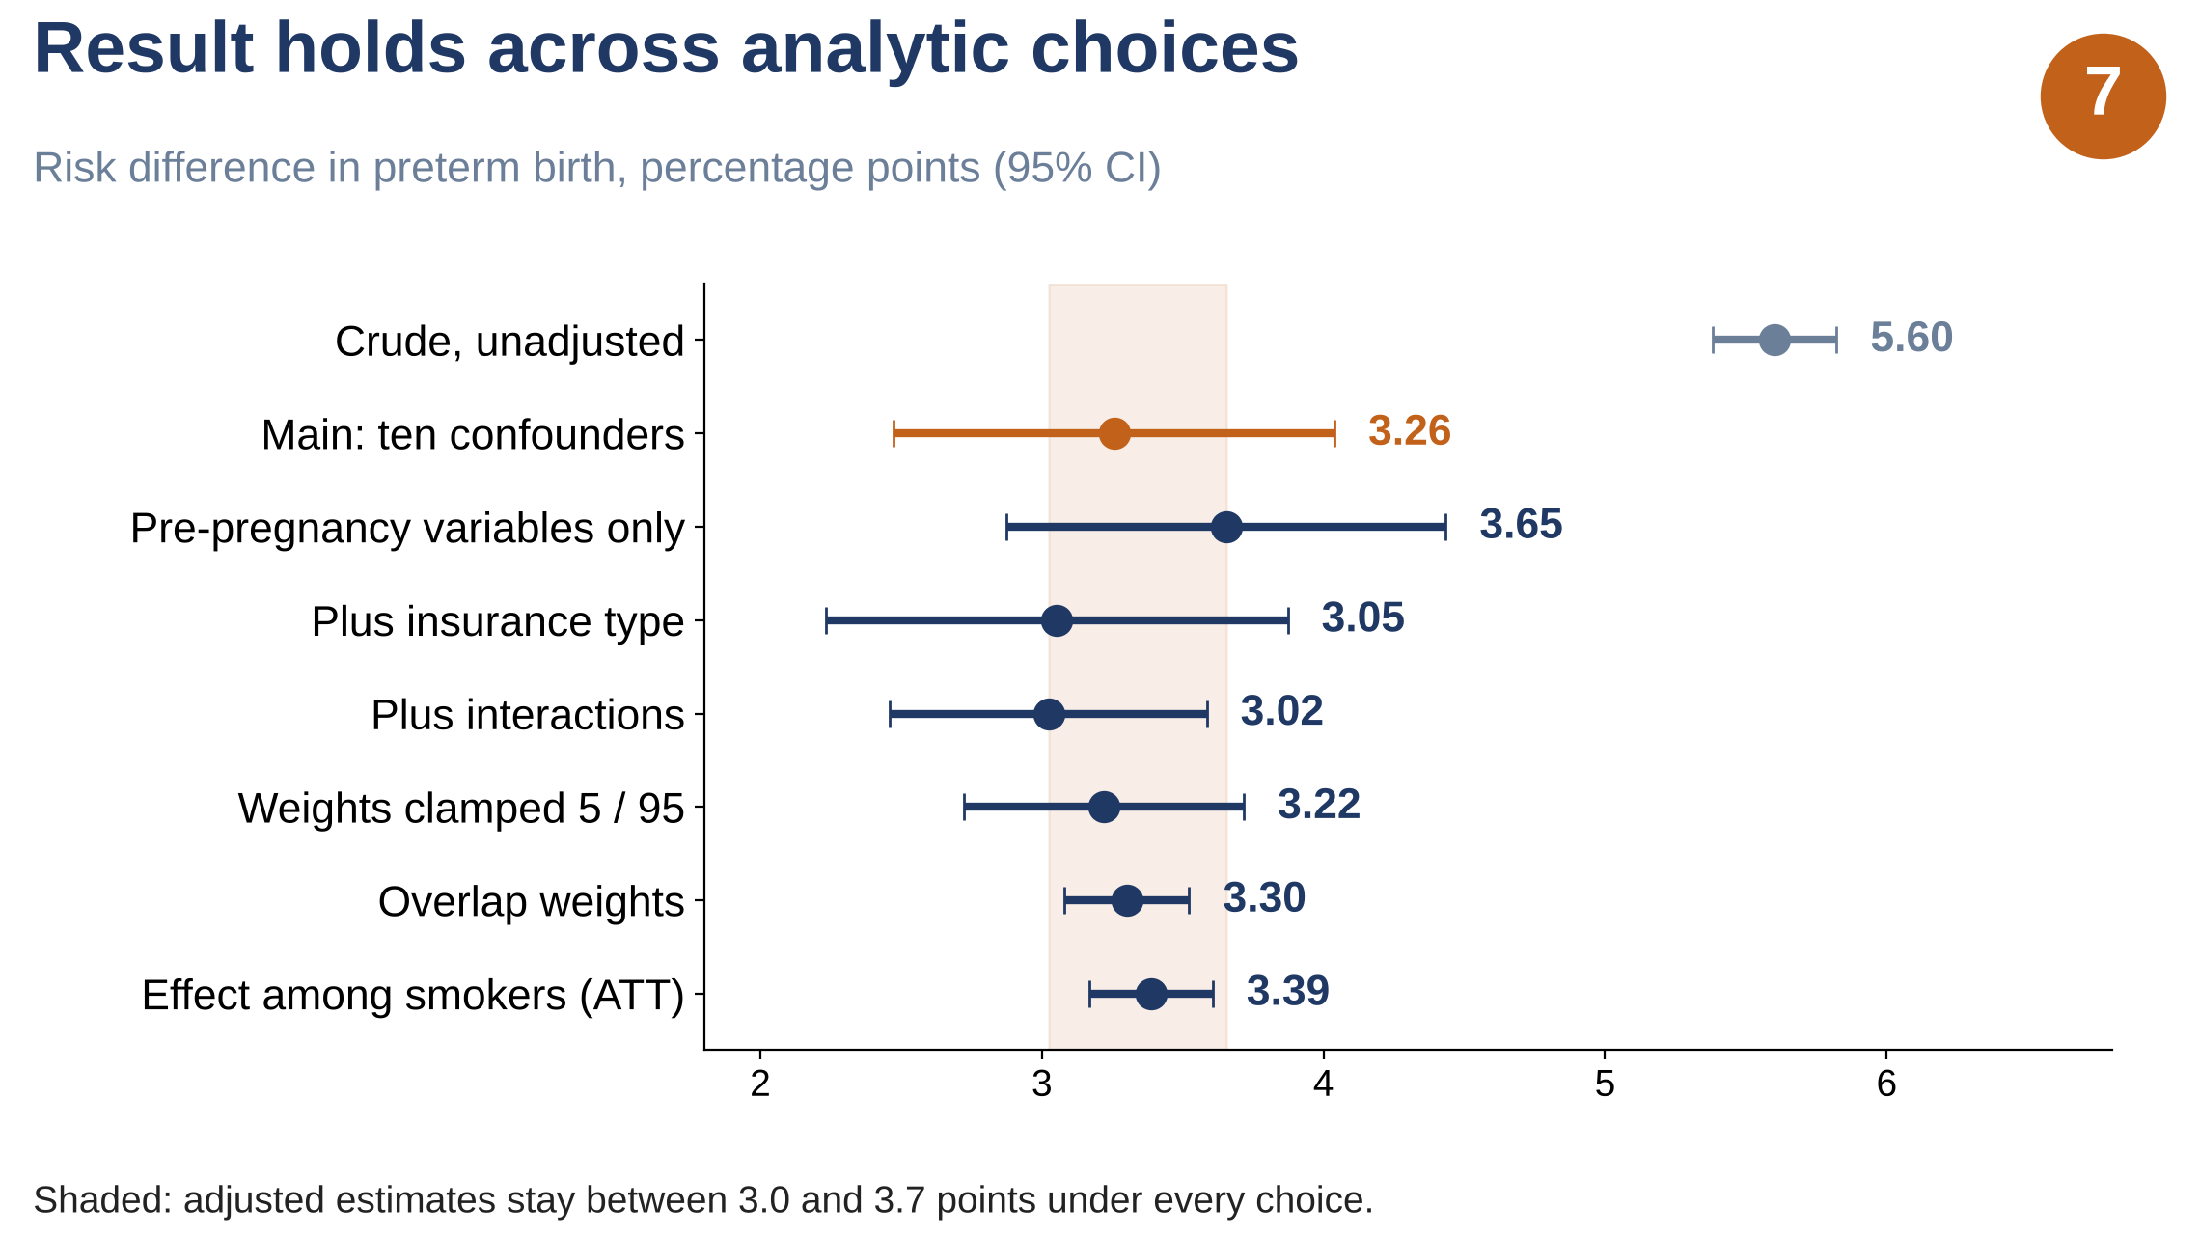
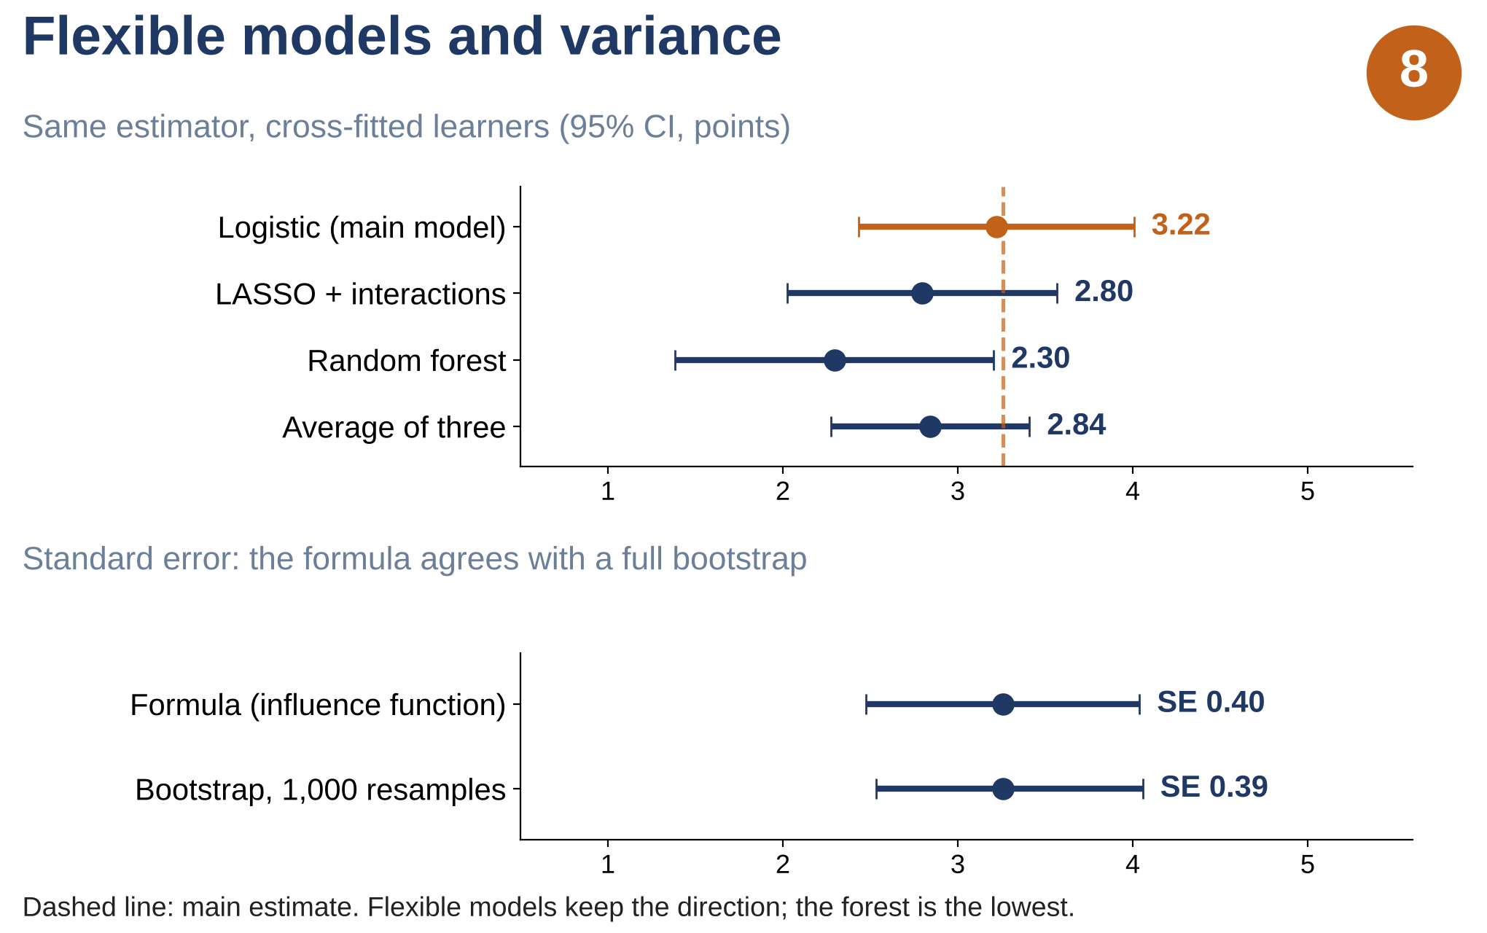
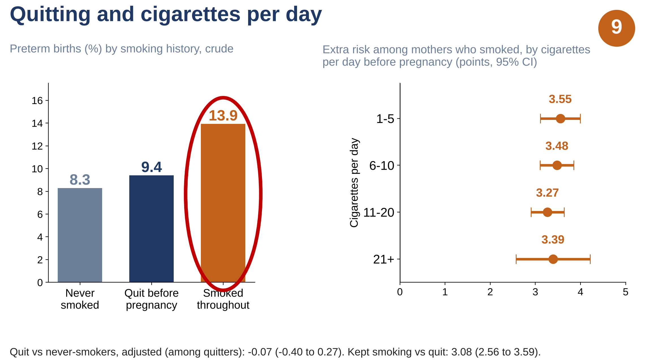

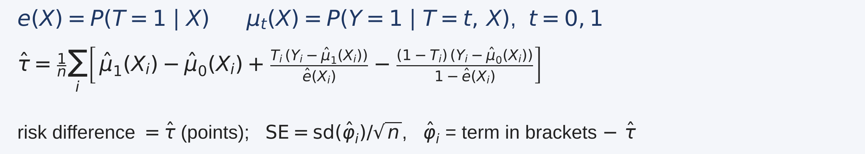
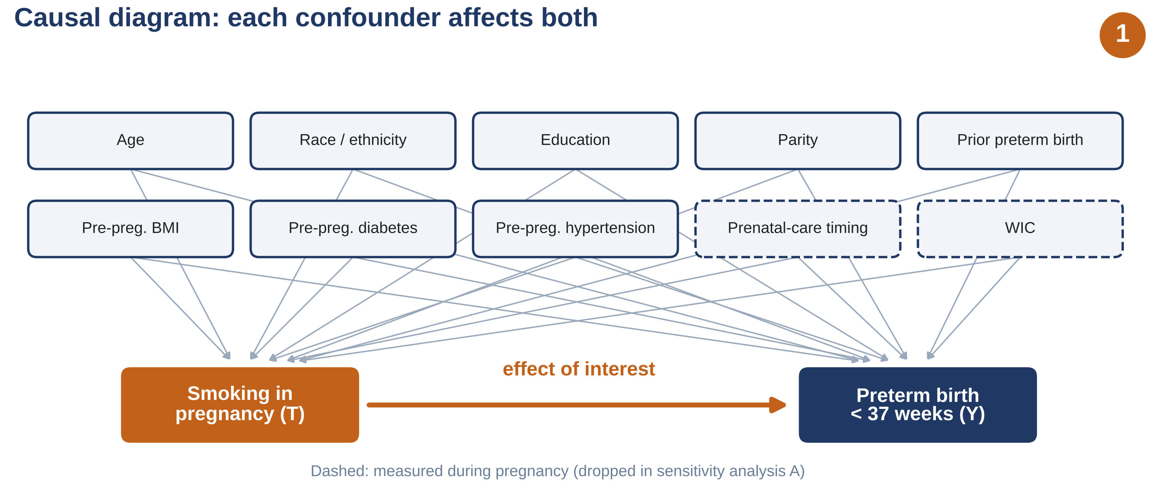

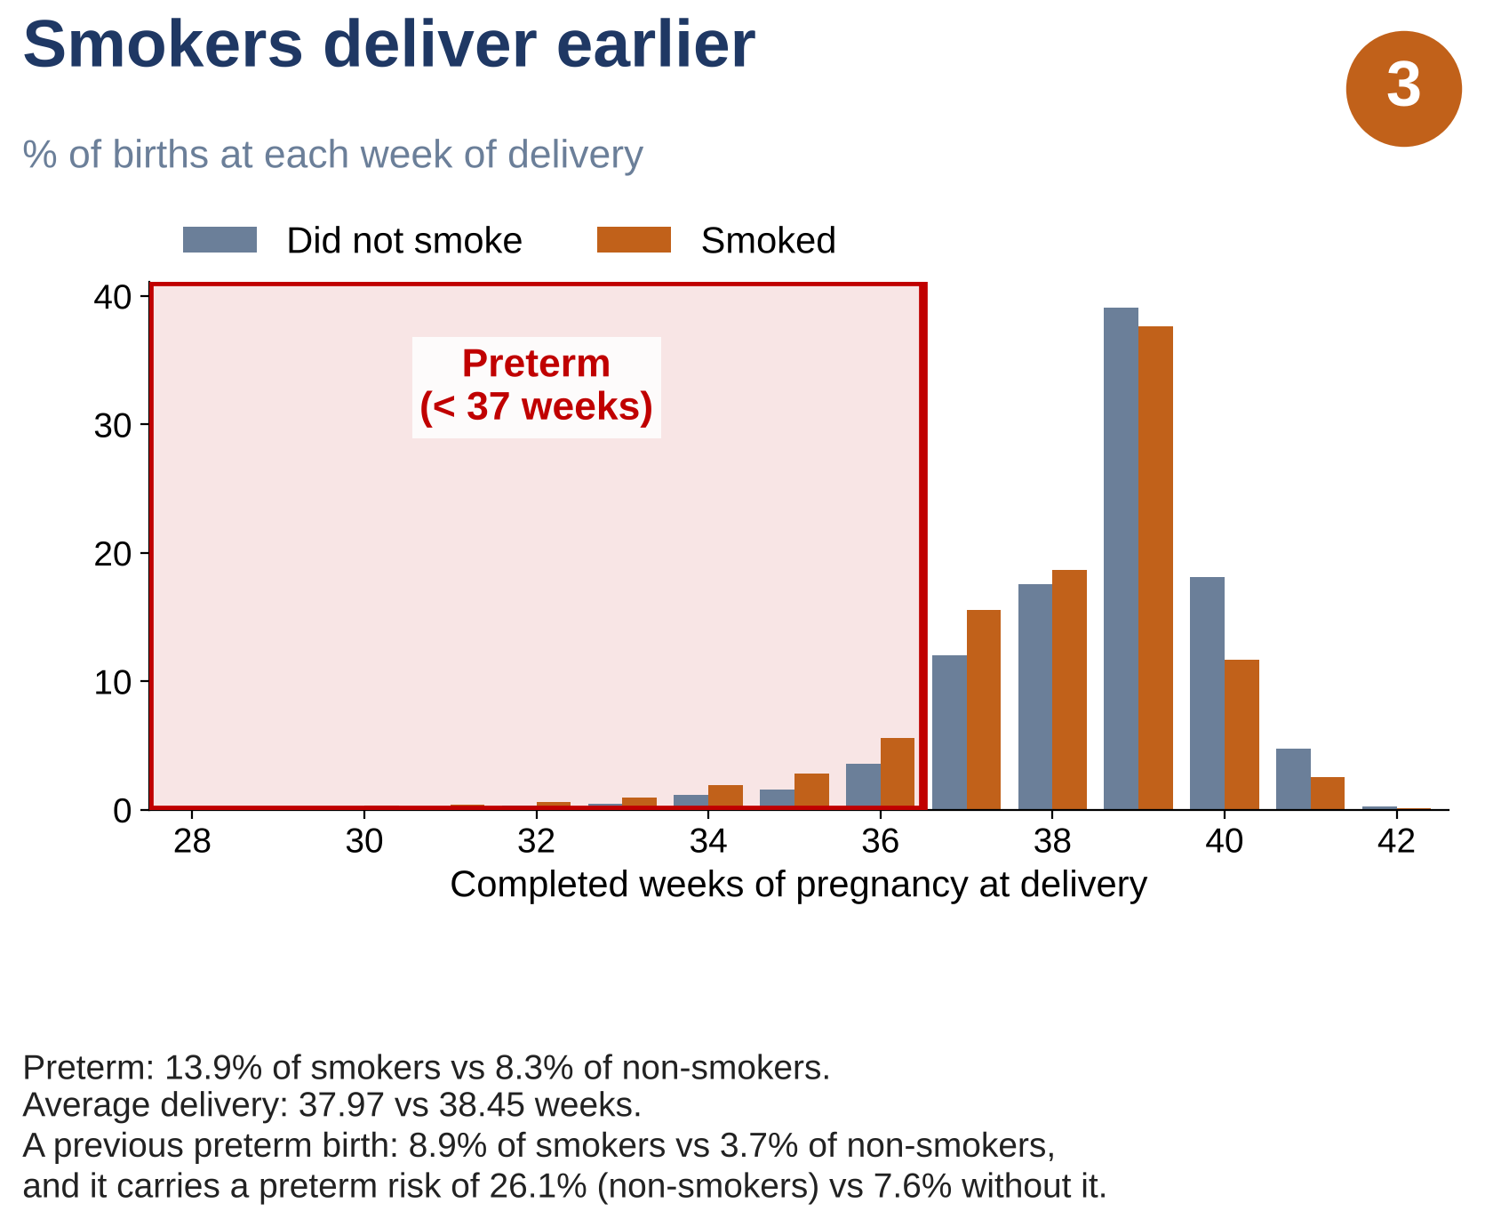
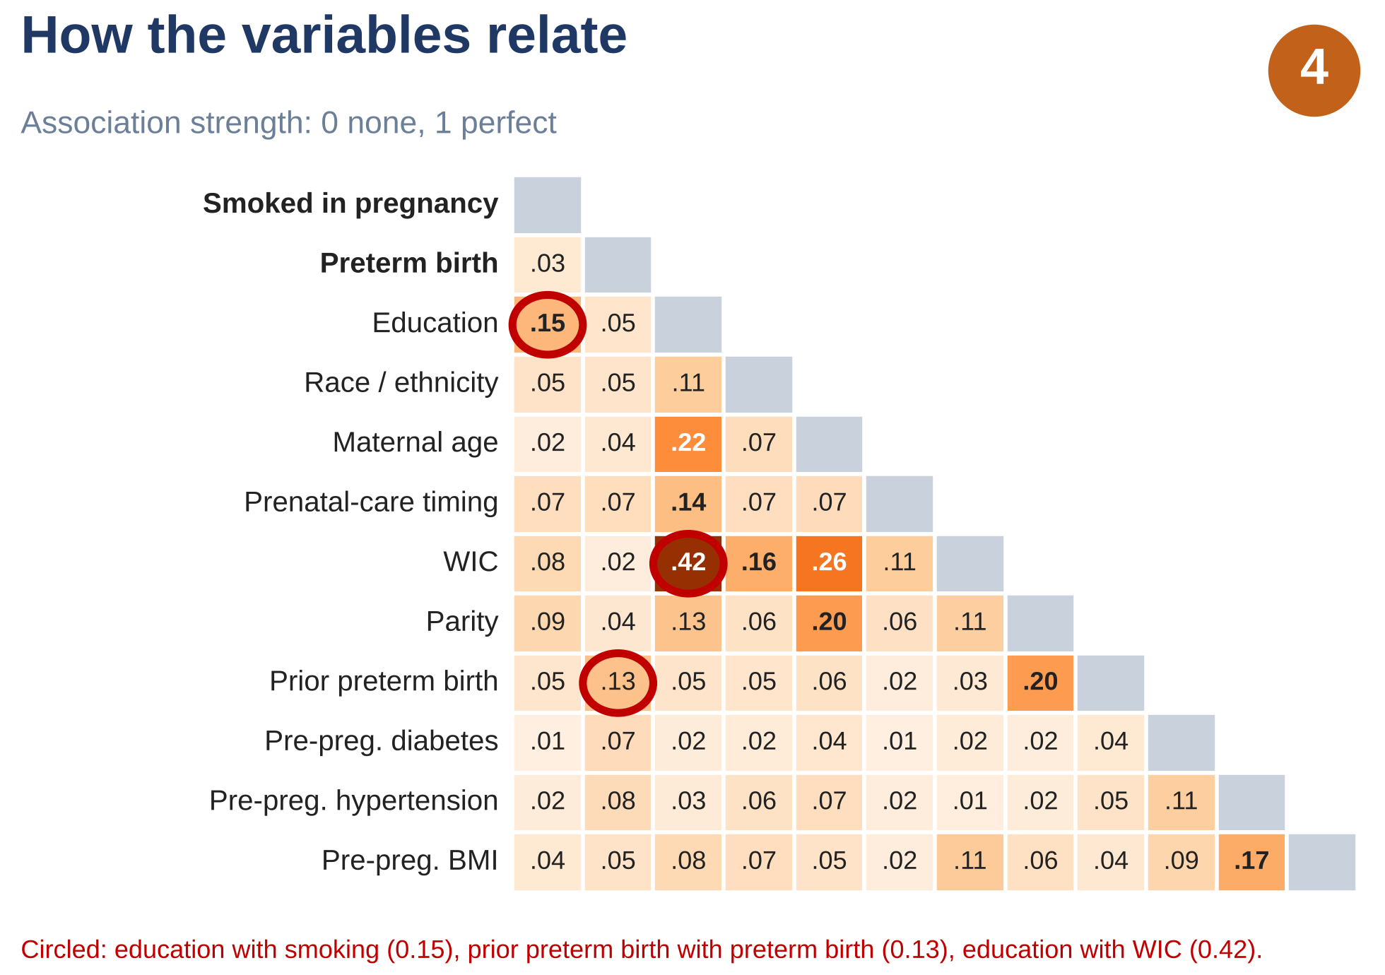
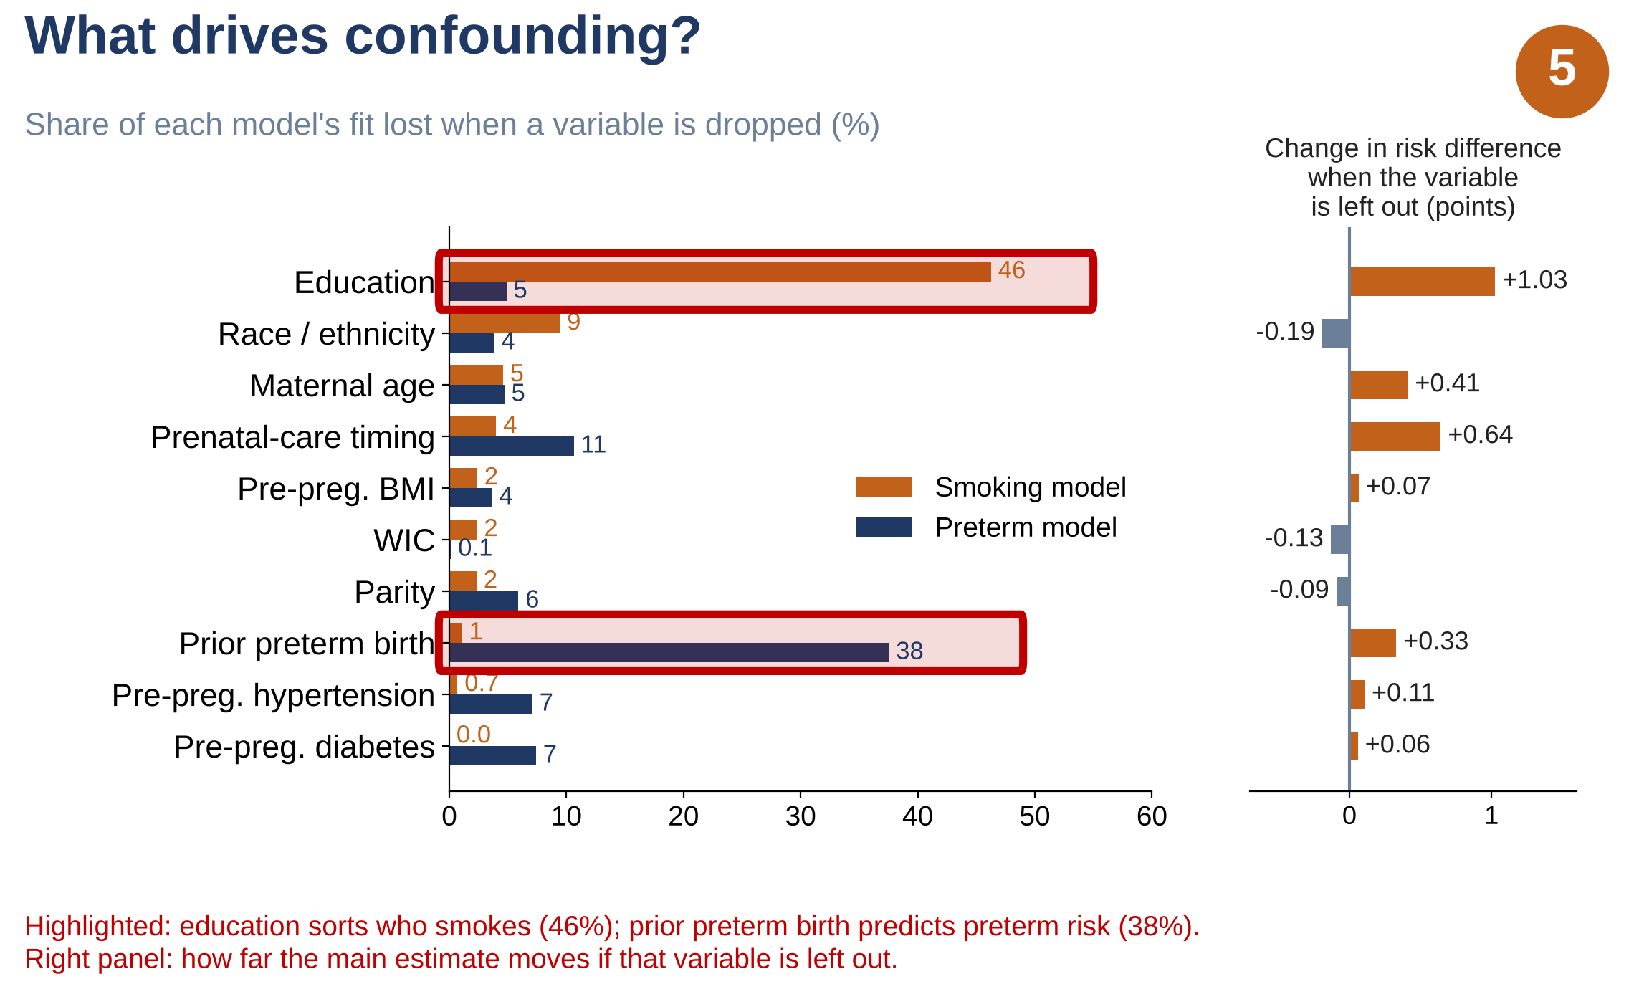
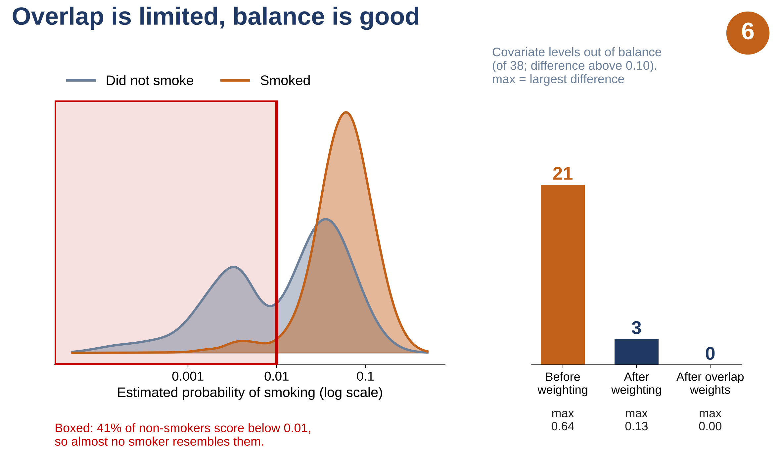

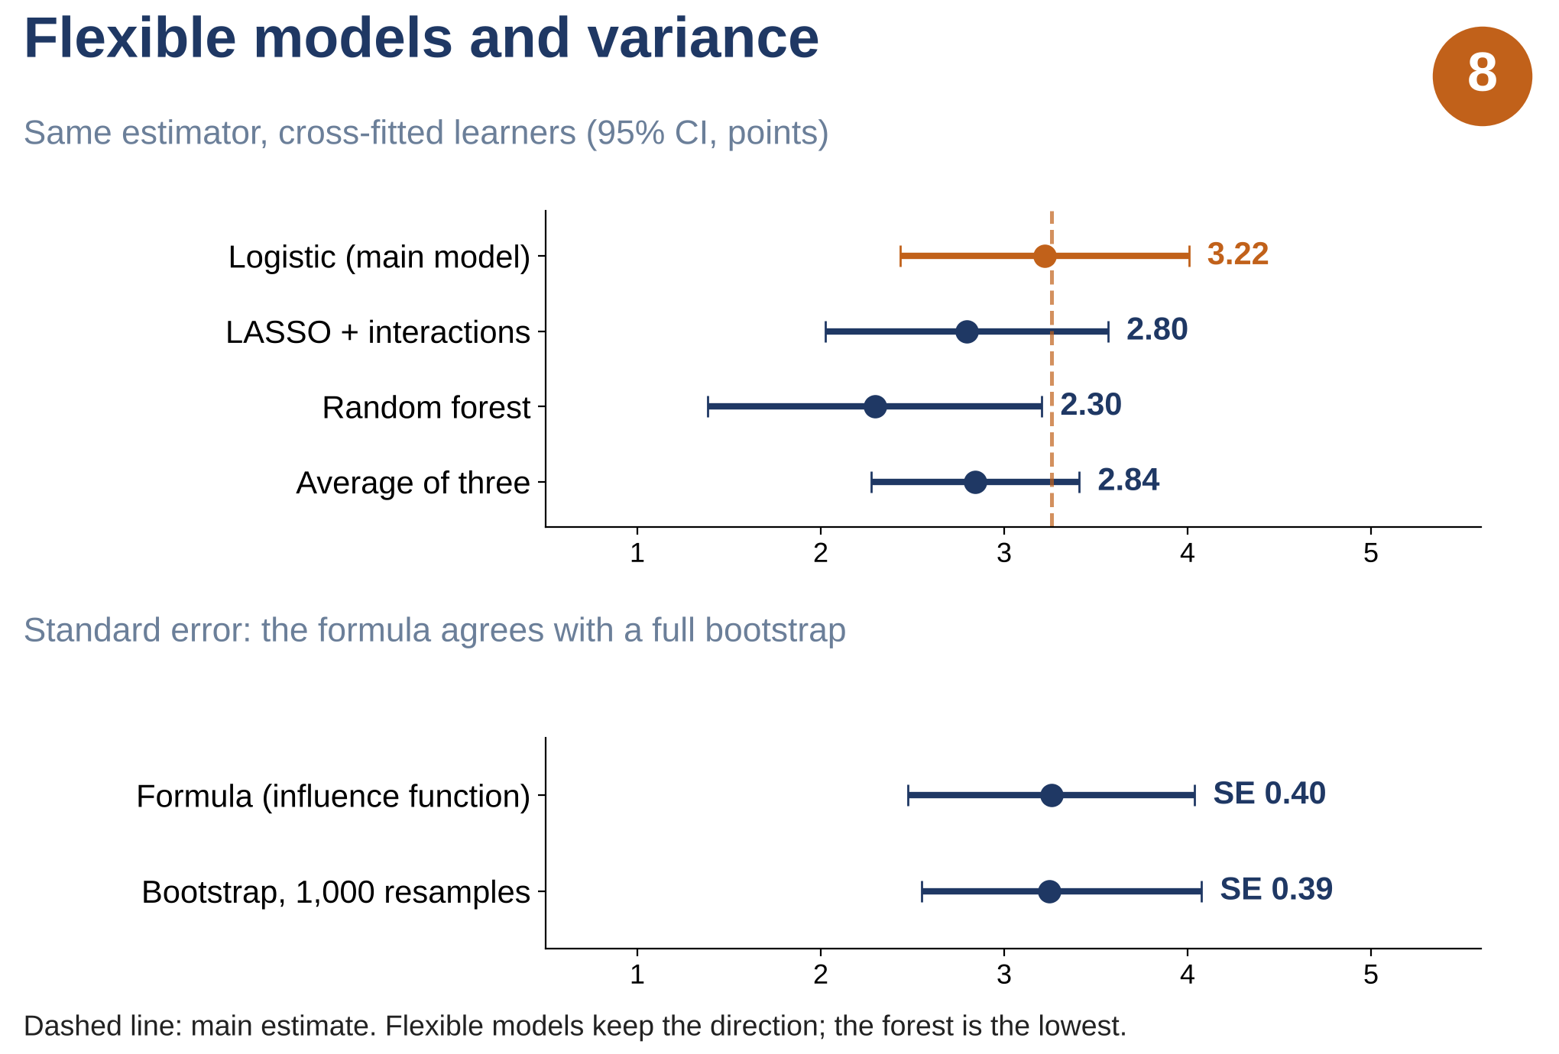
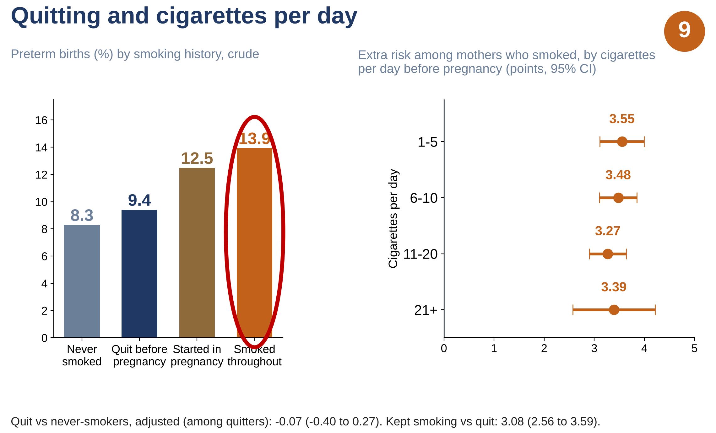
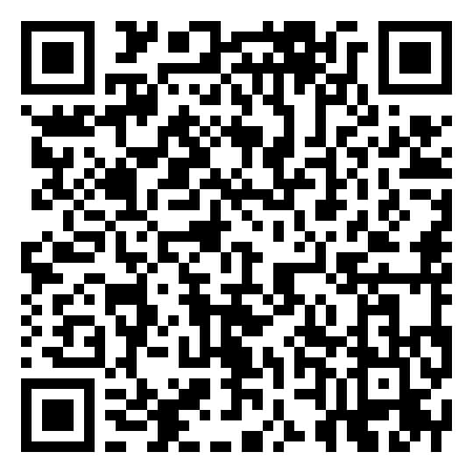
1 Data
2 Inputs X
3 Working models
4 Estimator
5 Output
6 Checks and extensions
2023 U.S. natality public use file
3,476,180 singleton births
Ten confounders X
weights clamped at 1st / 99th pct.
Propensity model
e(X) = P(smoke | X)
target T: smoking
Overlap and balance (Fig. 6)
Risk difference
3.26 pts
Age
AIPTW
doubly
robust
Race / ethnicity
Adjustment-set and sensitivity checks (Fig. 7)
Education
U.S. residents
3,467,679
Prenatal-care timing*
Risk ratio
1.39
WIC*
Cross-fitting; formula vs 1,000 bootstraps (Fig. 8)
Parity
Outcome models
μ1(X), μ0(X)
target Y: preterm birth (< 37 weeks)
Prior preterm birth
Odds ratio
1.44
E-value 2.12: how strong a hidden factor must be
Pre-preg. diabetes
Complete confounders
3,259,496
(97,187 smoked)
Pre-preg. hypertension
Pre-preg. BMI
Exploratory: quitting and dose (Fig. 9)
* measured during pregnancy; checked in Fig. 7
Logistic (main), LASSO or forest;
cross-fitted in 5 folds
ATE, ATT and overlap weights are compared (Fig. 7)
Assumptions: exchangeability given X · positivity (overlap) · consistency · at least one of the two models correct

