Slide 1
SPORTS ANALYTICS · GRADUATE
Advanced Basketball Data Science
Module 01 · Getting Started with Advanced Basketball Analytics
Week 1
Graduate · 3-hour session
Maps to Chapter 1:
Zuccolotto, P., Manisera, M., & Sandri, M. (2026). Advanced Basketball Data Science: With Applications in R. CRC Press.

Slide 2
BEFORE WE START
What's Coming Up
Due This Week
-- update before class --
Coming Up
-- update before class --
Office Hours
-- update before class --

Slide 3
OUTLINE FOR THE DAY
Where We're Headed
I
Segment 1
II
Segment 2
What this course covers, and getting our tools set up
A real first analysis: individual stats with dplyr, then a look beyond individual skills
III
Segment 3
IV
Before Next Class
The rest of the course, the PhD/injury-detection track, and your first assignment
The Module 1 lab and quiz

Slide 4
LEARNING OBJECTIVES
By the End of Today, You Will Be Able To
1
Explain what this course covers, and set up the R environment the rest of the semester runs on.
2
Use dplyr verbs (filter, mutate, arrange, select) to answer a real question from real box-score data.
3
Build and read a real assist network for an NBA team, and explain why it can surface a team's actual offensive structure better than a single-stat leaderboard.
4
Describe, at a glance, what each remaining chapter of the textbook covers and how it builds toward the course's injury-detection track.
5
Understand how this course's quizzes, assignments, and projects fit together across the semester.

Slide 5
CONCEPT · SEGMENT 1
Same Lab, Higher Complexity Level
This course runs on the BasketballAnalyzeR package throughout, and adds the tools from the book's own second step: statistical models, data mining, machine learning, and computer vision, applied to basketball.
Zuccolotto, Manisera & Sandri (2026), Preface, p. xx-xxi.

Slide 6
CONCEPT · SEGMENT 1
What's Actually New In This Book
More kinds of data
Not only the NBA, but an Italian championship too. Not only box scores and play-by-play, but player tracking, images, video, pose-detection data, and ball trajectories.
More kinds of tools
BasketballAnalyzeR is still here, but the book now integrates many other R packages, and even calls Python from inside R for some of the computer-vision work.
Zuccolotto, Manisera & Sandri (2026), Preface and Chapter 1.

Slide 7
CONCEPT · SEGMENT 1
The Nine Chapters Ahead (Part 1 of 2)
Ch. 2
Beyond individual skills: lineups and player combinations
Ch. 3
Clutch performance and situational splits
Ch. 4
Season segments and final rankings
Ch. 5
Spatial dynamics and player tracking data
Ch. 6
Athletic motion and pose estimation
Table 1.1, Zuccolotto, Manisera & Sandri (2026), p. 2.

Slide 8
CONCEPT · SEGMENT 1
The Nine Chapters Ahead (Part 2 of 2)
Ch. 7
Ball trajectories and object detection
Ch. 8
Performance maps and court segmentation
Ch. 9
Machine learning models for scoring probability
Ch. 10
Our own signature module: injury-risk indicators (the PhD track)
Table 1.2, Zuccolotto, Manisera & Sandri (2026), p. 3; Module 10 is this course's own addition.

Slide 9
CONCEPT · SEGMENT 1
Setting Up: pacman and dplyr
# the book installs pacman once, then uses it to load everything else
install.packages("pacman")
library(pacman)
# dplyr is used constantly -- if %>% or filter() misbehave:
library(conflicted)
conflict_prefer("%>%", "dplyr")
conflict_prefer("filter", "dplyr")
We'll hit this exact conflict warning later today -- now you'll know what it means.
Zuccolotto, Manisera & Sandri (2026), Section 1.2, p. 6.

Slide 10
LET'S RUN THIS TOGETHER
Let's open RStudio and get dplyr loaded together.
Pull up your own session. We'll run it line by line and look at the real output together.

Slide 11
WORKED EXAMPLE, STEP 1
A Real Question: Who Actually Led The League?
library(BasketballAnalyzeR); library(dplyr)
data(Pbox)
top_scorers <- Pbox %>%
filter(MIN >= 500) %>%
mutate(PPG = round(PTS / GP, 1)) %>%
arrange(desc(PPG)) %>%
select(Player, Team, GP, MIN, PTS, PPG) %>%
slice(1:8)
print(top_scorers)
Four verbs, one pipeline: filter, mutate, arrange, select. Run this yourself before the next slide.

Slide 12
WORKED EXAMPLE, STEP 2
2017-18's Real Top Scorers (Min. 500 Minutes)
Player | Team | PPG
James Harden | Houston Rockets | 30.4
Anthony Davis | New Orleans Pelicans | 28.1
LeBron James | Cleveland Cavaliers | 27.5
Giannis Antetokounmpo | Milwaukee Bucks | 26.9
Damian Lillard | Portland Trail Blazers | 26.9
Kevin Durant | Golden State Warriors | 26.4
Stephen Curry | Golden State Warriors | 26.4
Data: Pbox, BasketballAnalyzeR (Zuccolotto & Manisera, 2020); 2017-18 NBA regular season.
Notes:
Discussion: point out that a single leaderboard number hides a lot about how a player actually produces those points. Ask the class what this table can't tell you about a player's actual value to a team -- use it to set up why we're about to look at assist NETWORKS instead of single-number leaderboards. Timing: about 5 minutes.

Slide 13
CONCEPT · SEGMENT 1
One Number Never Tells The Whole Story
A points-per-game leaderboard tells you who scores. It says nothing about how a team actually moves the ball, or which player is quietly the hub everything runs through. That's what the rest of today builds toward: looking beyond one player's own stat line at how players connect.

Slide 14
INTERACTIVE ACTIVITY
Try It Yourself
Using the same Pbox data, change the pipeline to answer a different question: which eight players had the best rebounds-per-game among those who played at least 1,000 minutes? Compare your top eight with the person next to you -- did you get the same list?
Notes:
Timing: about 8 minutes. Common mistake: forgetting to change PTS to REB in both the filter threshold and the mutate line -- use it as a teaching moment about reading your own pipeline back to yourself.

Slide 15
RECAP · SEGMENT 1
Setup and a First Real Pipeline, Covered
Covered
Next
What this course covers, how to set up pacman and dplyr, and a real dplyr pipeline on real 2017-18 data.
Segment 2 goes beyond one player's own stat line and builds a real assist network for an NBA team.

Slide 16
10-Minute Break
Back at the top of the hour. Next: beyond individual skills.

Slide 17
CONCEPT · SEGMENT 2
Beyond Individual Skills
Chapter 2 of the textbook moves past individual box-score stats to lineups and player combinations. Today we take a first real step in that direction with something you can build in the next ten minutes: an assist network for an actual NBA team.
Zuccolotto, Manisera & Sandri (2026), Table 1.1, Chapter 2.

Slide 18
CONCEPT · SEGMENT 2
What An Assist Network Actually Shows
Every made basket that follows a pass is one edge in the network: passer to scorer. Add up every one of those across a season and you get a real map of who a team's offense actually runs through -- which is not always the players with the most points.

Slide 19
LET'S RUN THIS TOGETHER
Let's open our R package and build a real assist network together.
Pull up your own session. We'll run it line by line and look at the real output together.

Slide 20
WORKED EXAMPLE, STEP 1
Building The Golden State Warriors' Assist Network
data(PbP.BDB)
PbP2 <- PbPmanipulation(PbP.BDB)
pbp_gsw <- subset(PbP2, team == "GSW")
net <- assistnet(pbp_gsw)
ns <- net$nodeStats
ns[order(-ns$AST), c("player","AST","FGM","FGM_AST")][1:6, ]
GSW = Golden State Warriors, 2017-18 regular season play-by-play.

Slide 21
WORKED EXAMPLE, STEP 2
Who Actually Leads This Team In Assists?
Player | Assists | Makes Assisted
Draymond Green | 509 | 216 of 281
Kevin Durant | 366 | 342 of 630
Stephen Curry | 309 | 221 of 428
Andre Iguodala | 210 | 96 of 148
Klay Thompson | 185 | 475 of 575
Data: assistnet(PbPmanipulation(PbP.BDB)), BasketballAnalyzeR, GSW 2017-18 regular season.
Notes:
Discussion: Draymond Green is a forward, not a point guard, yet he led this team in assists by a wide margin. Ask the class why -- Golden State ran offense through him at the elbow and top of the key ('point-Draymond'). This is the module's core hook: a leaderboard by points would have buried this. Timing: about 6 minutes.

Slide 22
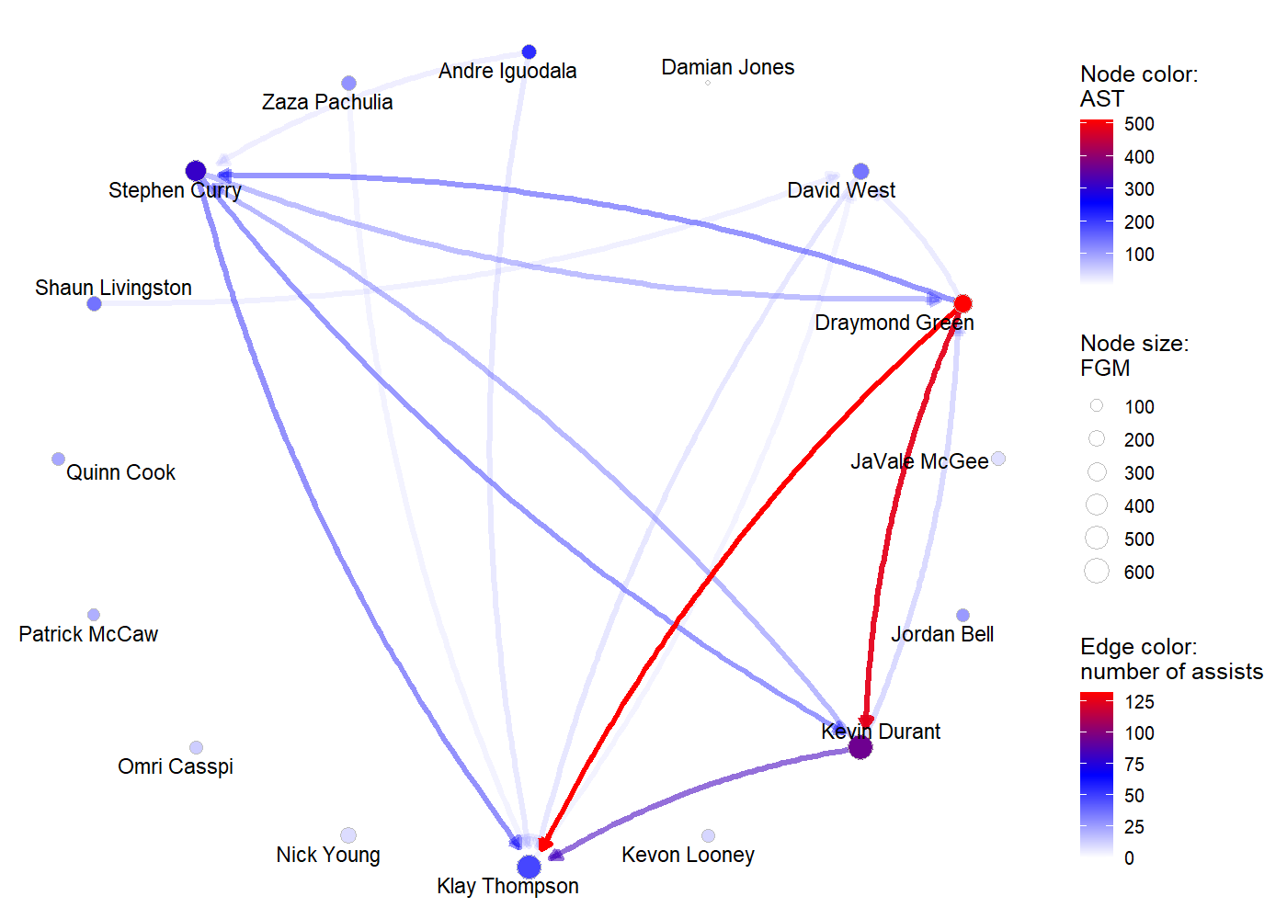
WORKED EXAMPLE, STEP 3
The Full Network
Node size = shots made. Node color and edge color = assists. Draymond Green -> Kevin Durant is the team's single heaviest assist connection.

Slide 23
CONCEPT · SEGMENT 2
Same Team, Two Different Roles
Compare that to: only 54% of Kevin Durant's made shots were assisted -- the rest he created for himself.
The takeaway: raw shot totals treat every made basket the same. A network shows you who finishes plays other people started, and who starts most of their own.
83%
of Klay Thompson's made
shots were assisted
Computed from assistnet(PbPmanipulation(PbP.BDB)) node stats, GSW 2017-18 regular season.

Slide 24
VIDEO · SEEING IT ON FILM
What This Looks Like On The Court
The numbers say Draymond Green was Golden State's real passing hub. Here's what that looked like in an actual game breakdown.

Slide 25
VIDEO
Draymond Green, Playmaking
▶
NBA Breakdown: Draymond Green Playmaking
NBA.com, published November 18, 2022
https://www.nba.com/watch/video/nba-breakdown-draymond-green-playmaking
A short official NBA.com breakdown of exactly the playmaking role the network chart just showed you in numbers.

Slide 26
INTERACTIVE ACTIVITY
Read The Network, Out Loud
Turn to the person next to you. One of you argues Draymond Green was Golden State's most important offensive player that season; the other argues it was Stephen Curry. Use only the numbers on these last few slides -- no outside knowledge of the team.
Notes:
Timing: about 8 minutes. There's no single right answer -- the point is that both arguments now have to use real numbers (assist count, assisted-FG share, points) instead of just reputation. Cold-call two or three pairs after.

Slide 27
RECAP · SEGMENT 2
From One Stat Line To A Real Network
Covered
Next
Built a real assist network from real 2017-18 play-by-play data, and found a genuinely surprising real result: a forward, not a guard, led the team in assists.
Segment 3 maps out where the rest of the course goes, including this course's own injury-detection track.

Slide 28
10-Minute Break
Back at the top of the hour. Next: where this course is headed.

Slide 29
CONCEPT · SEGMENT 3
Not Restricted To The Textbook
The textbook is our spine, not our ceiling. At this level, whenever a real, current journal article adds something the book doesn't, I'll bring it to a slide directly and cite it in the notes -- this matters more the further we get, especially if you're aiming at a larger independent project.

Slide 30
CONCEPT · SEGMENT 3
This Course's Own Track: Injury Detection
By Module 10, the goal is for you to be able to find a real indicator of injury risk in data and connect it to a specific model. If you want to go further with a larger project, three of my own published papers are the jumping-off point:
• Muritala, Brown & Haller (2026), Research in Sports Medicine -- MLB pitcher reinjury.
• West et al. (2026), Journal of Strength and Conditioning Research -- statistical process control for sport-science data quality.
• Kanwal et al. (2025) -- a critique of the Acute:Chronic Workload Ratio (ACWR).

Slide 31
CONCEPT · SEGMENT 3
Course Structure: What You'll Turn In
Lab Activity
Guided, ungraded practice with the same real data as class.
Course-Wide Assignments
3 assignments, a midterm project, and a final project run at set points across the whole semester, graded and hand-checked -- not one per module.
Auto-graded Quiz
Short, D2L-based check of the module's key definitions.

Slide 32
INTERACTIVE ACTIVITY
Picking A Project Direction
I want you to spend five minutes on your own writing down one question about basketball you'd genuinely like to answer with data by the end of the semester. Then tell the person next to you. You are not committing to it yet -- we'll come back to this before Module 10.
Notes:
Timing: about 8 minutes total. Walk the room during the individual-writing part. Save a few of the more interesting questions to reference later in the semester when we reach the modules that could actually answer them.

Slide 33
SUMMARY
What We Did Today
1
Set up the tools this course runs on: pacman, dplyr, and the BasketballAnalyzeR package.
2
Built a real dplyr pipeline on real 2017-18 box scores.
3
Built a real assist network for the Golden State Warriors and found that Draymond Green, not a guard, led the team in assists.
4
Previewed the rest of the course, including this course's own injury-detection track.

Slide 34
BEFORE NEXT CLASS
Get These Done
1
Lab 1: rebuild today's assist network for a different team of your choice.
2
Practice questions in this module's folder, any time you want extra reps.
3
Module 1 quiz on D2L.
4
Bring one question about today's material to next class -- we'll open with it.

Slide 35
REFERENCES
Cited Today
Zuccolotto, P., Manisera, M., & Sandri, M. (2026). Advanced Basketball Data Science: With Applications in R. CRC Press / Chapman & Hall.
Zuccolotto, P., & Manisera, M. (2020). Basketball Data Science: With Applications in R. Chapman & Hall/CRC.
NBA.com (2022, November 18). NBA Breakdown: Draymond Green Playmaking. https://www.nba.com/watch/video/nba-breakdown-draymond-green-playmaking

Slide 36
See You Next Class
Module 02: Beyond Individual Skills, Lineups and Combinations

