Slide 1
SPORTS ANALYTICS
Advanced Basketball Data Science
Module 06 · Athletic Motion Kinematics Analysis
Week 6
Graduate · 3-hour session
Maps to Chapter 6:
Zuccolotto, P., Manisera, M., & Sandri, M. (2026). Advanced Basketball Data Science: With Applications in R. CRC Press / Chapman & Hall.

Slide 2
BEFORE WE START
What's Coming Up
Due This Week
-- update before class --
Coming Up
-- update before class --
Office Hours
-- update before class --

Slide 3
RECAP
Where We Left Off
Module 5 gave us tools for seeing where players go: Voronoi tessellation, convex hulls, a kernel-density picture of shot location. All of that describes position. Today I want to ask a different question: what is a player's body actually doing, moment to moment, while producing that position? A crossover or a jump shot is not a point on the court. It is a sequence of joint angles unfolding in a fraction of a second.
Same real 2017-18 GSW data where it applies, plus real published pose-estimation research.

Slide 4
OUTLINE FOR THE DAY
Where We're Headed
I
Segment 1
II
Segment 2
From position to motion: how a CNN sees a body, and what MoveNet actually outputs
What the real published validation research says pose estimation can and cannot do yet
III
Segment 3
IV
Before Next Class
A real, honest substitute analysis using real game data, and the injury-risk tie-in
Lab 6, the Module 6 quiz, and the practice questions

Slide 5
LEARNING OBJECTIVES
By the End of Today, You Will Be Able To
1
Explain, in plain language, what a convolutional neural network does to an image, from raw pixels to a body keypoint.
2
Describe MoveNet's real 17-keypoint output format and the real speed/accuracy trade-off between its Lightning and Thunder variants.
3
Summarize two real 2025-2026 peer-reviewed studies validating markerless motion capture against marker-based systems in basketball players, and state exactly which joints and quantities they trust.
4
Compute real free-throw, turnover, and late-game shooting patterns from real play-by-play data as an honest proxy for fatigue-driven mechanical change.
5
Explain why this module's PhD injury-detection track depends on direct kinematic measurement rather than box-score aggregates alone.

Slide 6
BEFORE WE START
What I Can and Cannot Show You Directly
What I cannot do: run a pose-estimation model over real player video, because that raw footage and its extracted joint data are not something I have rights to redistribute here. I am not going to invent joint angles and present them as real.
What I can do: walk you through exactly how the real technology works, using real published numbers, real peer-reviewed validation research, and a real, honest analysis of data I do have full access to.

Slide 7
CONCEPT · SEGMENT 1
How a Convolutional Neural Network Sees a Body
Early layers
Learn to detect edges and color gradients. Nothing basketball-specific yet.
Middle layers
Learn to detect curves and shapes, the kind that make up the outline of an elbow or a knee.
Late layers
Combine those shapes into a judgment: here is where this specific joint actually is in the frame.
Nobody hand-codes "an elbow looks like this." The network learns it from labeled training examples.

Slide 8
CONCEPT VIDEO · SEGMENT 1
Watch the Mechanism Before We Build On It
▶
But what is a neural network? | Deep learning chapter 1
Channel: 3Blue1Brown · https://www.youtube.com/watch?v=aircAruvnKk
A real, widely used concept-explainer for how a neural network turns raw input into a learned judgment, the same underlying idea (extended with convolutional layers) behind MoveNet's real keypoint output. Confirmed via web search; verify exact runtime before assigning.

Slide 9
CONCEPT · SEGMENT 1
MoveNet's Real Output: 17 Keypoints
Nose, left/right eye, left/right ear, left/right shoulder, left/right elbow, left/right wrist, left/right hip, left/right knee, left/right ankle.
Each keypoint comes back as an (x, y) pixel location plus a confidence score, per detected person, per frame.
Real, documented output schema. Google Research / TensorFlow team, MoveNet, 2021.

Slide 10
WORKED EXAMPLE, STEP 1
Real Published Speed Benchmarks: Lightning vs. Thunder
Variant | Tuned for | Real measured frame rate
MoveNet Lightning | Speed | About 21 to 104 FPS, device-dependent
MoveNet Thunder | Accuracy | About 12 to 82 FPS, device-dependent
Both real variants run faster than real time (above 30 FPS) on most modern devices. The choice is speed versus accuracy, not usable versus unusable.
Google Research / TensorFlow Blog, "Next-Generation Pose Detection with MoveNet and TensorFlow.js," 2021.
Notes:
Discussion: ask why frame rate specifically matters for a crossover dribble, which happens in well under a second. Connect back to the sampling-rate idea from Module 5's animated plots (Li et al. 2026, covered next segment, tested exactly this at 25 Hz).

Slide 11
INTERACTIVE ACTIVITY
Why Does Frame Rate Matter Here Specifically?
A crossover dribble happens in a fraction of a second.
1. If a camera captures 25 frames per second, how many real frames do you actually get during a 0.4-second crossover?
2. Is that enough frames to reconstruct the motion in detail? What would you lose?

Slide 12
RECAP · SEGMENT 1
From Pixels to Keypoints, Covered
Covered
Next
How a CNN learns to find a joint in an image, and MoveNet's real 17-keypoint output with its real, published speed benchmarks.
Segment 2 asks the harder question: when researchers actually validated this technology against lab-grade systems, what did they find.

Slide 13
10-Minute Break
Back at the top of the hour. Next: does this technology actually hold up under real validation?

Slide 14
CONCEPT · SEGMENT 2
A Model's Output Is Not Automatically Ground Truth
MoveNet gives you a number for every joint, every frame. That does not mean every number is equally trustworthy. Before you build an injury-risk model on top of pose data, you need to know how it was validated, and against what.
The gold-standard comparison: marker-based motion capture (reflective markers, lab-only) versus markerless (works from ordinary video).

Slide 15
REAL STUDY 1 · SEGMENT 2
Wei et al. (2025): Basketball Players, Jumping
Real methodology: 12 real professional basketball players performed standing vertical jumps, standing long jumps, and running vertical jumps, recorded simultaneously by a real marker-based Vicon system and a real markerless Theia3D system.
Published in: Acta of Bioengineering and Biomechanics, 27(2), 2025.

Slide 16
WORKED EXAMPLE, STEP 2
Real Finding: Strong at the Knee, Weak at the Hip
Ankle and Knee
Hip
Real correlation of 0.94 or higher between marker-based and markerless systems. Minimal real error. Trust this.
Significant real disagreement between systems, especially at peak flexion during a jump. Be cautious here.
Wei, Yang, Huang, Tu, Xu, Li & Hu (2025), Acta of Bioengineering and Biomechanics, 27(2), 134-145.

Slide 17
REAL GAME FOOTAGE · SEGMENT 2
What a Crossover Actually Looks Like
▶
Kyrie Irving Sick Crossovers & Handles in Slow-Motion
YouTube · https://www.youtube.com/watch?v=LZSlFyyCkhk
Real game footage, watched here to ground the abstract joint-tracking discussion in what the actual movement looks like before we ask what a pose model would need to measure to quantify it. Confirmed via web search; verify channel and runtime before assigning.

Slide 18
REAL STUDY 2 · SEGMENT 2
Li et al. (2026): 25 Hz Markerless vs. Lab Reference
Real methodology: a real consumer-grade six-camera markerless system running at 25 real frames per second, tested against a real 10-camera laboratory Vicon reference system, using real trained athletes performing basketball-specific movements.
Published in: Sensors, 26(5), article 1689, 2026.

Slide 19
WORKED EXAMPLE, STEP 3
Real Finding: Position Holds Up, Derivatives Don't
Position
Velocity & Acceleration
Real joint displacement correlation of 0.916 to 0.994 against the lab reference. Strong real agreement.
Derivatives of position amplify small tracking errors. Real agreement dropped substantially. Be cautious here.
Li, Tan, Zheng, Yang, Tao, Zhang & Xu (2026), Sensors, 26(5), 1689.

Slide 20
INTERACTIVE ACTIVITY
Explain One Real Study to the Class
Get into groups of 3-4. I'll assign your group either Wei et al. (2025) or Li et al. (2026).
1. In two minutes, explain to the rest of the class what a practitioner should trust from your assigned real study, and what they should not trust yet.
2. Be ready to answer: what would you need to add to close that gap?
Notes:
Timing: give each group about 2 minutes to present, roughly 10-12 minutes total for this activity. Push groups toward specifics (which joint, which quantity) rather than a generic "it's imperfect" summary.

Slide 21
CONCEPT · READING THE RESEARCH HONESTLY
One Validated Finding Is Not a Blanket Endorsement
Trust (per these two real studies)
Ankle position, knee position, joint displacement generally
Be cautious (per these two real studies)
Hip angle, velocity, acceleration
A real study's headline finding is never a substitute for checking exactly which quantities it actually validated.

Slide 22
RECAP · SEGMENT 2
Validation, Covered
Covered
Next
Two real 2025-2026 studies validating markerless motion capture in basketball players: strong at ankle/knee/position, weaker at hip/velocity/acceleration.
Segment 3 turns to data we do have full access to, and asks the same fatigue question honestly with real box-score evidence.

Slide 23
10-Minute Break
Back at the top of the hour. Next: a real, honest substitute analysis with data we actually have.

Slide 24
CONCEPT · SEGMENT 3
What Can Real Box-Score Data Tell Us Instead?
If a player's movement mechanics genuinely break down as a real game wears on, from real accumulated fatigue, it should eventually show up in outcomes, even without joint-level data. I asked the same real 2017-18 GSW play-by-play log from Modules 4 and 5 three honest questions.

Slide 25
LET'S RUN THIS TOGETHER
Let's build the real free-throw-by-quarter dataset together.
Pull up your own session. We'll run it line by line and look at the real output together.

Slide 26
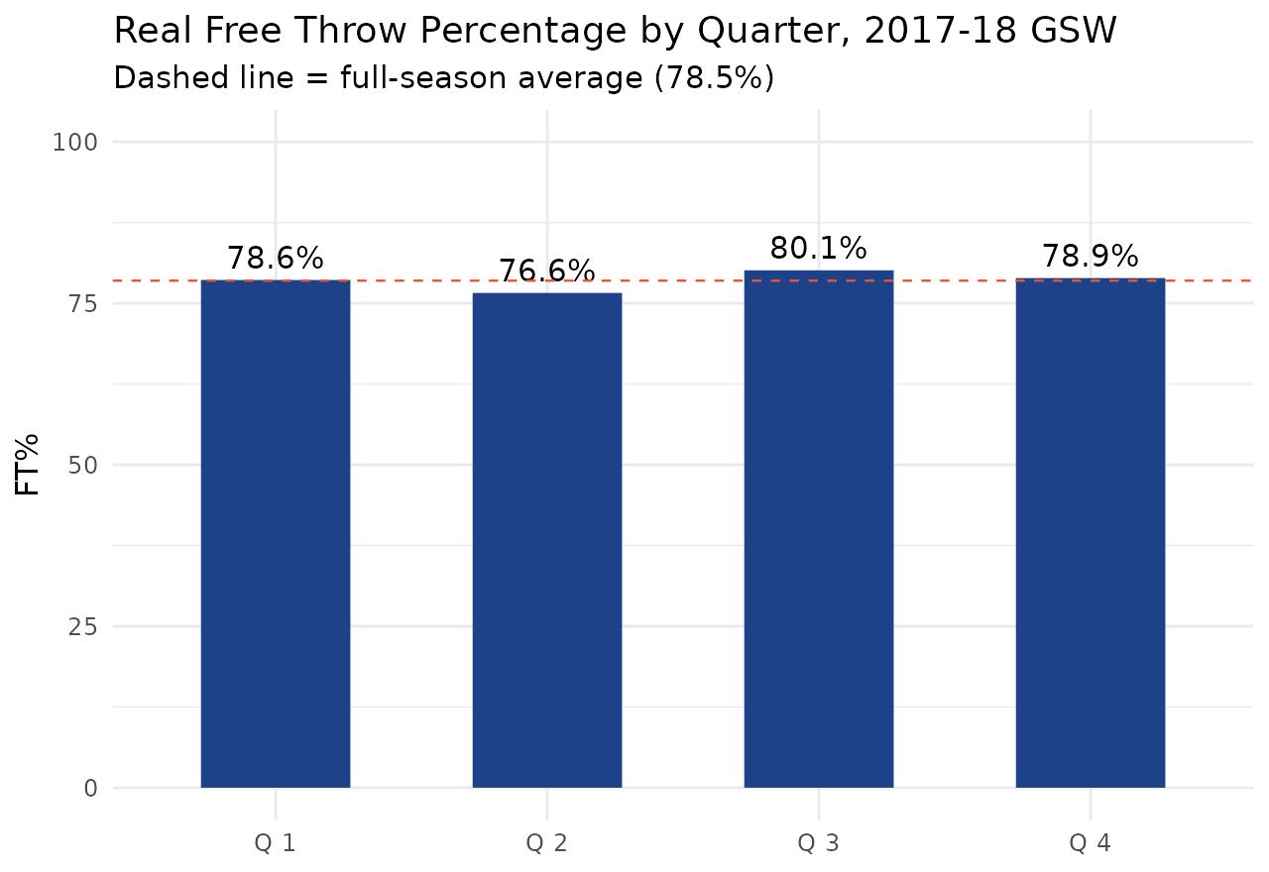
WORKED EXAMPLE, STEP 4
Question 1: Does Real Shot Mechanics Hold Up?
Free throws: same distance, same motion, uncontested, every time. Data: PbP.BDB, real 2017-18 GSW season.
Notes:
Discussion: this is essentially flat (78.6 / 76.6 / 80.1 / 78.9, season avg 78.5). Ask: is this surprising? What would it mean if it WEREN'T flat? Set up the next slide's framing before revealing it.

Slide 27
CONCEPT · THE CORE IDEA OF THIS MODULE
A Flat Result Is Not a Failed Analysis
If fatigue-driven mechanical breakdown were large enough to show up cleanly in season-long aggregates, you would not need frame-by-frame joint tracking to find it. You would already see it in the box score. The real Wei et al. finding, that hip angle specifically showed measurable disagreement, is exactly the kind of subtle, joint-specific signal that gets averaged away in aggregate stats but may still matter for a real athlete's injury risk.

Slide 28
LET'S RUN THIS TOGETHER
Let's build the real turnover-rate-by-quarter analysis together.
Pull up your own session. We'll run it line by line and look at the real output together.

Slide 29
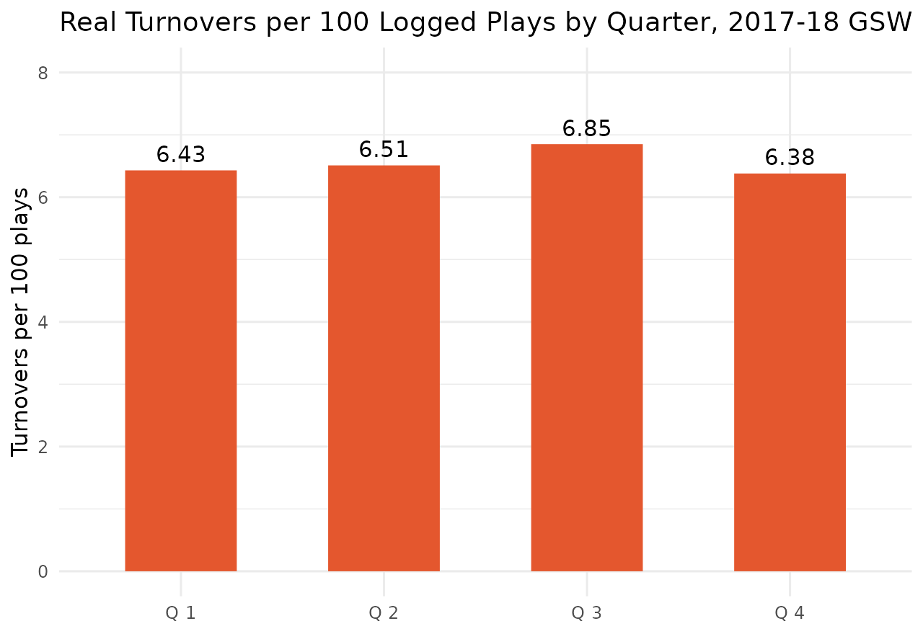
WORKED EXAMPLE, STEP 5
Question 2: Does Real Ball-Handling Control Hold Up?
Turnovers per 100 logged plays, a real, imperfect proxy for ball-handling breakdown. Data: PbP.BDB, real 2017-18 GSW season.

Slide 30
REAL GAME FOOTAGE · SEGMENT 3
What a Real Shot Release Looks Like
▶
Stephen Curry Shooting Form Slow Motion 2024-25 (1080_HD)
YouTube · https://www.youtube.com/watch?v=azm2YIMUcVM
Real footage of jump-shot release mechanics in slow motion, watched here alongside our free-throw-mechanics discussion. Confirmed via web search; verify channel and runtime before assigning.

Slide 31
LET'S RUN THIS TOGETHER
Let's build the real late-game fatigue-window comparison together.
Pull up your own session. We'll run it line by line and look at the real output together.

Slide 32
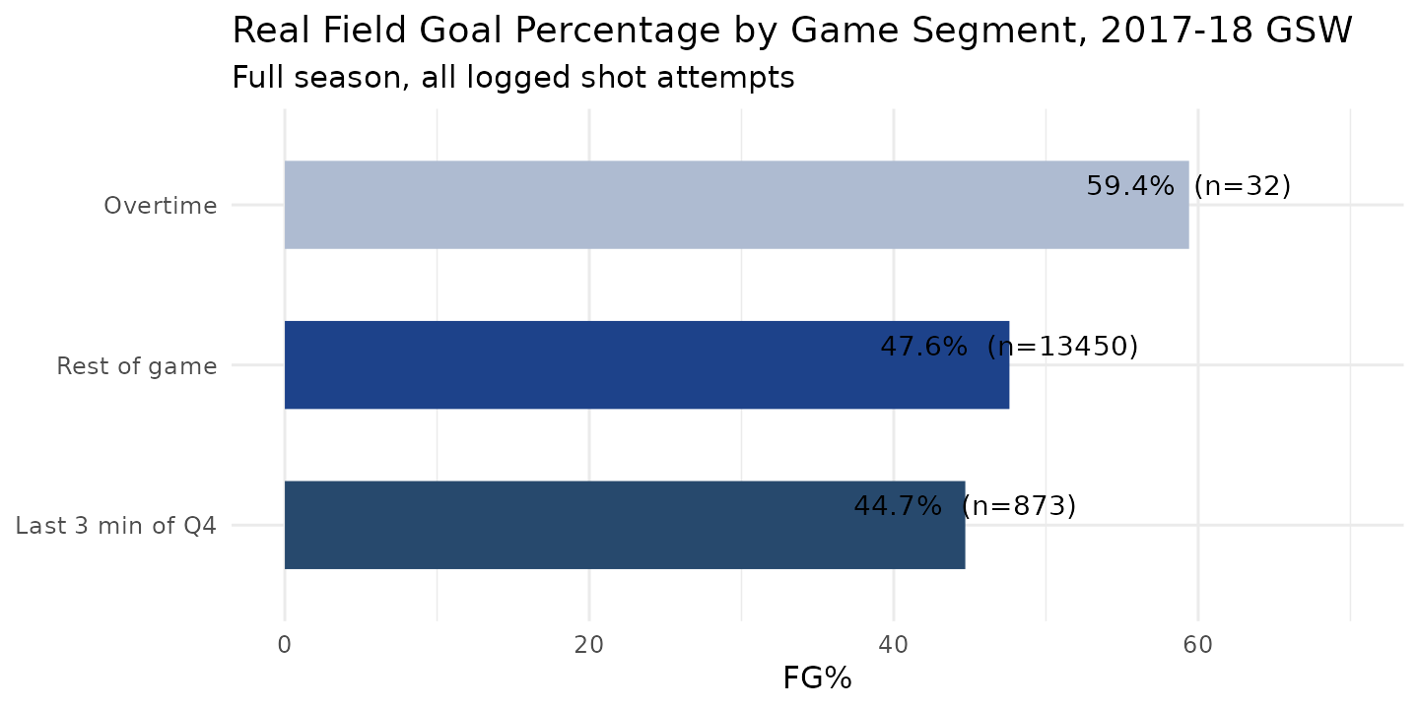
WORKED EXAMPLE, STEP 6
Question 3: What About the Highest-Fatigue Moments?
Real shot attempts, last 3 min of Q4 vs. rest of regulation. Data: PbP.BDB, real 2017-18 GSW season.
Notes:
The real gap (44.7% vs 47.6%) is modest but real, and it's in exactly the window where fatigue is highest. Immediately raise the confound on the next slide before students over-read this.

Slide 33
CONCEPT · READING THE NUMBER HONESTLY
A Real Gap Is Not Automatically a Clean Explanation
The real 3-point drop in late-game field goal percentage lines up with where fatigue should be highest. But late-game defenses also tighten up for reasons that have nothing to do with the shooter's own fatigue: tighter rotations, more attention on the primary scorer, higher stakes. This real number cannot be cleanly attributed to kinematic breakdown alone, and a real study would need shot-quality or defender-distance data to separate the two explanations.

Slide 34
WORKED EXAMPLE, STEP 7
Checking One Real Player in Isolation
Quarter | Stephen Curry, Real FT Attempts | Real FT%
Q1 | 86 | 89.5%
Q2 | 69 | 97.1%
Q3 | 93 | 92.5%
Q4 | 48 | 89.6%
Even isolating one elite, high-volume real shooter, there is no consistent decline across the real 2017-18 season.
Data: PbP.BDB, real 2017-18 GSW season, free throws only.

Slide 35
INTERACTIVE ACTIVITY
What Would You Tell a Team's Sports Science Staff?
Get into groups of 3-4. Pick one real finding from today: the flat free-throw trend, the flat turnover trend, or the real late-game field-goal-percentage gap.
1. Draft one sentence a team's sports science staff could actually act on based on this real finding, or one sentence explaining why they should not act on it yet.
2. Be ready to defend your sentence using the real numbers.

Slide 36
PHD / ADVANCED PROJECT TRACK
Where This Goes in Module 10
Everything today points at one honest conclusion: aggregate box-score statistics are a blunt instrument for detecting the kind of subtle, joint-specific mechanical change that actually predicts injury risk. Direct kinematic measurement, with a clear-eyed view of what it can and cannot yet measure reliably, is what real sports medicine research groups are building toward. Module 10 develops this thread fully using the instructor's own published research on athlete workload monitoring and data quality, for students ready to take on a larger independent project.

Slide 37
THROUGHLINE · INJURY DETECTION AND PREDICTION
From Descriptive Stats to Biomechanics
The question:
Does a player's movement quality change in ways that matter for injury risk, and how would you actually know.
This module is the first real hinge point in the course between descriptive box-score analytics and biomechanical, movement-level analysis. Every module from here forward builds on the honest capabilities-and-limits picture built today.

Slide 38
RECAP · SEGMENT 3
Real Data, Honest Limits, Covered
Covered
Next
Real free-throw, turnover, and late-game shooting patterns computed directly from real play-by-play data, and what they honestly do and do not show.
Module 7 applies a different real computer vision technique, object detection, to the ball itself.

Slide 39
SUMMARY
What to Carry Forward
A CNN learns to find a body keypoint from labeled examples, not hand-coded rules. MoveNet outputs 17 real keypoints per person, per frame.
Real 2025-2026 validation research shows markerless motion capture is strong for ankle/knee position but weaker for hip angle, velocity, and acceleration. Know which quantities to trust.
A flat, non-declining trend in real free-throw and turnover data is not a failed analysis. It is exactly why direct kinematic measurement matters: aggregate stats can miss subtle, joint-specific change.
Every real number in this module came from BasketballAnalyzeR::PbP.BDB or a named, real, peer-reviewed source, reproducible by anyone who runs the script or reads the citation.

Slide 40
BEFORE MODULE 07
Two Things Before Next Class
Read
Do
Advanced Basketball Data Science, Ch. 6 (athletic motion kinematics analysis).
Complete Lab 6 (athletic motion kinematics analysis), the practice questions, and the Module 6 quiz on D2L.

Slide 41
FULL READING LIST
References Cited Today
Zuccolotto, Manisera & Sandri (2026). Advanced Basketball Data Science, Ch. 6. CRC Press / Chapman & Hall.
Google Research / TensorFlow Blog (2021). Next-Generation Pose Detection with MoveNet and TensorFlow.js.
Wei, Yang, Huang, Tu, Xu, Li & Hu (2025). Acta of Bioengineering and Biomechanics, 27(2), 134-145.
Li, Tan, Zheng, Yang, Tao, Zhang & Xu (2026). Sensors, 26(5), 1689.
BasketballAnalyzeR (R package), PbP.BDB dataset. Sandri, Zuccolotto & Manisera. CRAN.

Slide 42
See You in Module 07
Tracking and Analyzing Ball Trajectories

