Slide 1
SPORTS ANALYTICS
Machine Learning Models for Scoring Probability
Module 9 · Random Forests and Extremely Randomized Trees
Week 9
Graduate · 3-hour session
Maps to Chapter 9:
Zuccolotto, Manisera & Sandri. Advanced Basketball Data Science. CRC Press.

Slide 2
BEFORE WE START
What's Coming Up
Due This Week
-- update before class --
Coming Up
-- update before class --
Office Hours
-- update before class --

Slide 3
RECAP
Where We Left Off
Module 8 turned a shot's court location into a real performance map using Classification and Regression Trees, first on Cartesian coordinates, then on polar coordinates. A single CART tree is fast to interpret but statistically unstable. Today we fix that by building many trees instead of one.
Same real 2023-24 NBA shot data, two new real ensemble methods.

Slide 4
OUTLINE FOR THE DAY
Where We're Headed
I
Segment 1
II
Segment 2
From one unstable tree to a forest: Random Forest and Extremely Randomized Trees
Fitting both real ensembles, testing them honestly, and reading a scoring-probability map
III
Segment 3
IV
Before Next Class
The variable-importance trap, and closing this course's machine learning arc
Lab 9, the Module 9 quiz, and the practice questions

Slide 5
LEARNING OBJECTIVES
By the End of Today, You Will Be Able To
1
Explain why a single CART tree is statistically unstable and how ensembles address it.
2
Describe how Random Forest and Extremely Randomized Trees each randomize their splits differently.
3
Fit both real models in R, evaluate them honestly with out-of-sample AUC, and interpret the result.
4
Build and read a real scoring-probability map produced by a tree-ensemble model.
5
Identify the high-cardinality bias in Gini variable importance and explain why permutation importance is more trustworthy.

Slide 6
CONCEPT · SEGMENT 1
A Single Tree's Real Problem: Instability
Change the training sample slightly, or change a tuning parameter, and a single CART tree's splits can shift in ways that are not really about the underlying basketball pattern. Zuccolotto, Sandri, and Manisera (2023) demonstrated this directly: removing up to 20% of shots from their training data visibly changed a single tree's structure.
Zuccolotto, Sandri & Manisera (2023). Annals of Operations Research, 325(1), 495-519.

Slide 7
WATCH BEFORE WE CONTINUE
Decision and Classification Trees, Clearly Explained!!!
▶
StatQuest with Josh Starmer (YouTube)
https://www.youtube.com/watch?v=_L39rN6gz7Y
Runtime not independently confirmed at time of writing; verify before assigning.
Watch for: a refresher on how a single classification tree splits data, before we add ensemble logic on top of it.

Slide 8
NEW TERM · SEGMENT 1
Random Forest: Random Subsets of Predictors
At every split in every tree, a Random Forest considers only a random subset of the available predictors and picks the real best split among just that subset, rather than among all of them. This decorrelates the trees from one another: no two trees are guaranteed to split on the same dominant predictor at the top every time.
The forest's real prediction is the average of every tree's prediction.

Slide 9
WATCH BEFORE WE CONTINUE
StatQuest: Random Forests Part 1 - Building, Using and Evaluating
▶
StatQuest with Josh Starmer (YouTube)
https://www.youtube.com/watch?v=J4Wdy0Wc_xQ
Confirmed runtime: 9 minutes 54 seconds.
Watch for: how individual trees are grown from bootstrapped samples and random predictor subsets, then combined.

Slide 10
NEW TERM · SEGMENT 1
Extremely Randomized Trees: Random Split Points Too
Geurts, Ernst, and Wehenkal's (2006) original method pushes randomization one step further than Random Forest. Instead of searching for the single best cut point for a chosen predictor, Extra-Trees picks a cut point at random and only then selects the real best of a handful of such random candidates. The result trains faster and, in many real settings, is just as accurate.
Geurts, P., Ernst, D., & Wehenkal, L. (2006). Extremely randomized trees. Machine Learning, 63, 3-42.

Slide 11
LET'S RUN THIS TOGETHER
Let's open our R session and prepare the real 2023-24 shot log together.
Pull up your own session. We'll run it line by line and look at the real output together.

Slide 12
WORKED EXAMPLE, STEP 1
Preparing the Real Data
shots <- read.csv("shotdetail_2023.csv")
shots$SHOT_MADE_FLAG <- factor(shots$SHOT_MADE_FLAG, levels = c(0,1))
shots$time_remaining_period <- shots$MINUTES_REMAINING * 60 +
shots$SECONDS_REMAINING
set.seed(2026)
train_idx <- sample(nrow(shots), size = floor(0.8 * nrow(shots)))
train <- shots[train_idx, ]
test <- shots[-train_idx, ]
218,701 real shots, held out 20% as a genuine test set neither model trains on.

Slide 13
10-Minute Break
Back at the top of the hour. Next: fitting both real ensembles.

Slide 14
LET'S RUN THIS TOGETHER
Now let's fit both real ensembles and compare their out-of-sample performance.
Pull up your own session. We'll run it line by line and look at the real output together.

Slide 15
WORKED EXAMPLE, STEP 2
Fitting Both Real Ensembles
library(ranger)
rf <- ranger(SHOT_MADE_FLAG ~ SHOT_DISTANCE + LOC_X + LOC_Y +
PERIOD + time_remaining_period + SHOT_ZONE_BASIC +
SHOT_TYPE, data = train, probability = TRUE,
num.trees = 300, splitrule = "gini")
ert <- ranger(..., splitrule = "extratrees", num.random.splits = 5)

Slide 16
WORKED EXAMPLE, STEP 3
Two Real Models, Nearly Identical Performance
0.639
0.640
Random Forest
out-of-sample AUC
Extremely Randomized Trees
out-of-sample AUC
174,960 training shots, 43,741 held-out test shots, real 2023-24 NBA season. AUC computed out of sample.

Slide 17
CONCEPT · READING THE RESULT HONESTLY
Is 0.64 a Good Score? It Depends What You're Asking
Zuccolotto, Sandri, and Manisera (2023) reported an out-of-sample AUC near 0.6 for the same two ensembles on real 2020-21 NBA data, and attribute that ceiling honestly to the fact that shot outcomes are inherently hard to predict from pre-shot information alone. Defense, shooter form that day, and contest level are not captured by location, time, and zone data. The real value of these models is less about forecasting any one shot and more about producing a stable, comparable probability surface across the court.
Notes:
Discussion: ask the class what kind of additional real variable would most improve this AUC if it were available (defender distance, shot contest level) and why none of those are in this dataset. Connect to the Davis et al. (2024) methodological-rigor literature: a modest AUC, honestly reported and explained, is better scholarship than an inflated or cherry-picked one.

Slide 18
LET'S RUN THIS TOGETHER
Let's generate the real scoring-probability map together.
Pull up your own session. We'll run it line by line and look at the real output together.

Slide 19
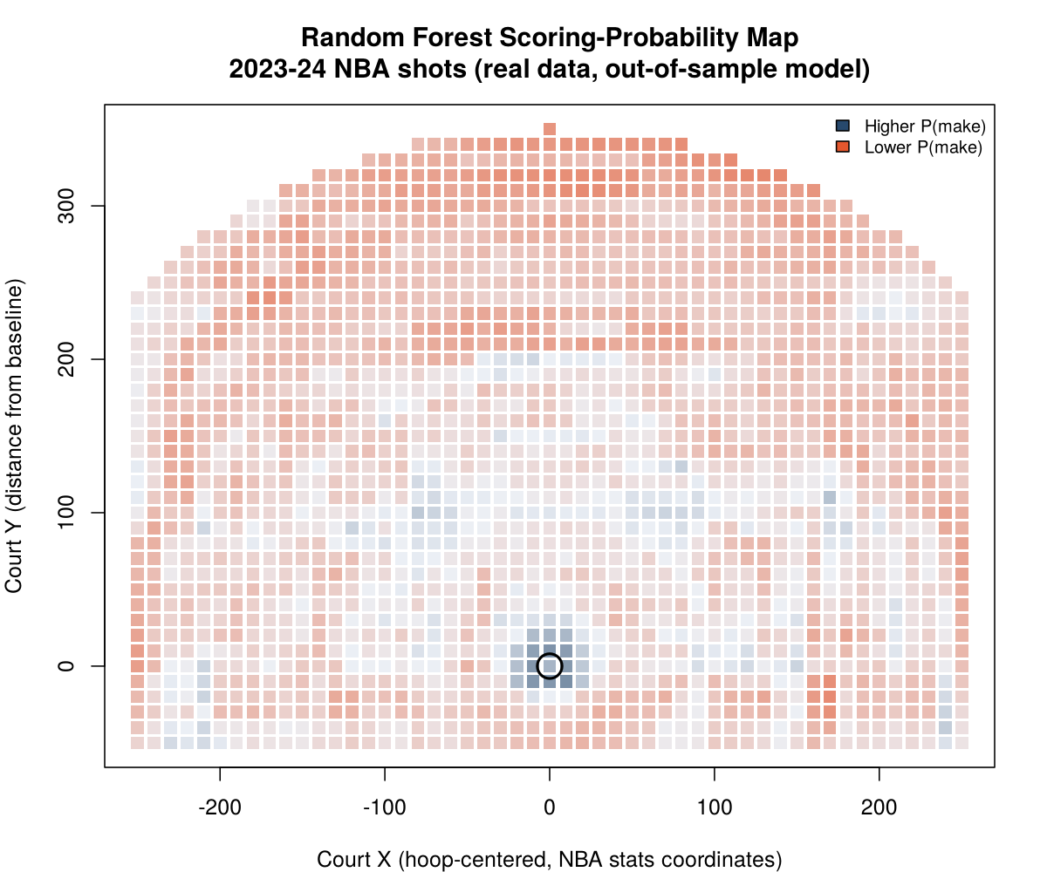
WORKED EXAMPLE, STEP 4
The Real Scoring-Probability Map
Random Forest predictions across a real court grid. Real 2023-24 NBA shot log. Darker blue near the rim = higher predicted probability.

Slide 20
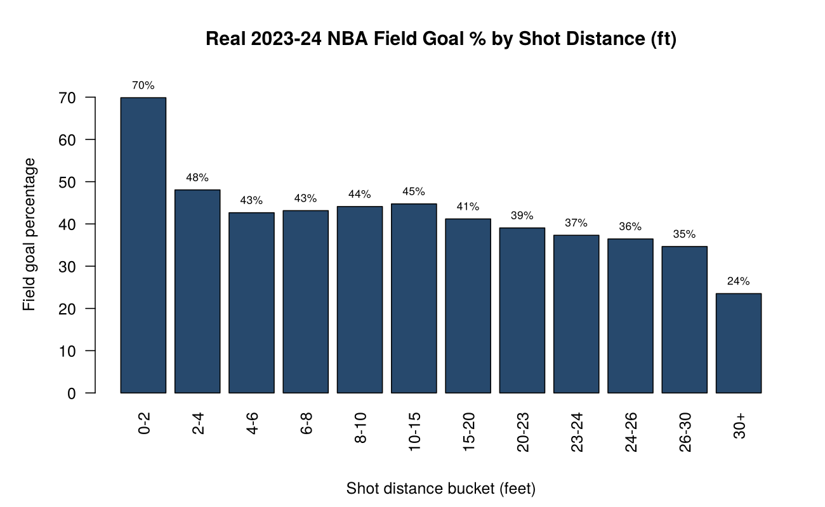
WORKED EXAMPLE, STEP 5
The Pattern the Model Had to Learn on Its Own
Real, independently computed field goal percentage by distance bucket, 2023-24 NBA season, 218,701 shots.

Slide 21
CONCEPT · WHY THIS RESULT IS REASSURING
The Model Recovered a Real, Known Pattern
Without being told zone boundaries as a privileged input, the model's probability map still lit up the restricted area as the clear highest-probability region on the whole court, matching this independently computed real number exactly.
66.3%
real field goal percentage,
restricted area, the highest
of any shot zone in this
dataset

Slide 22
RECAP · SEGMENT 2
Fitting and Reading, Covered
Covered
Next
Fit both real ensembles, compared their near-identical out-of-sample AUC, and read a real scoring-probability map that recovered a known pattern.
Segment 3 looks at a real methodological trap hiding in this same model, and closes out this course's machine learning arc.

Slide 23
10-Minute Break
Back at the top of the hour. Next: a methodological trap worth knowing.

Slide 24
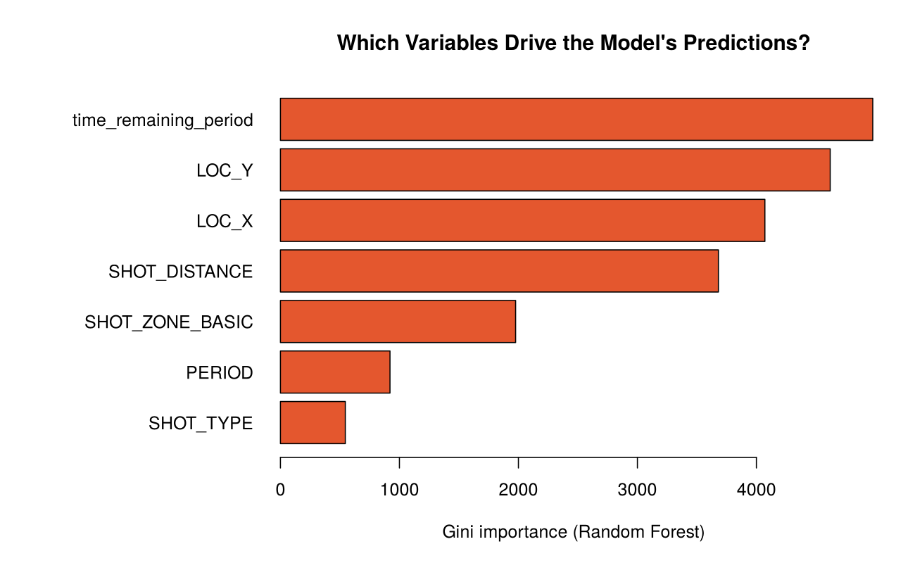
CONCEPT · SEGMENT 3
A Surprising Variable-Importance Ranking
Gini importance, Random Forest, real 2023-24 NBA shot log.

Slide 25
INTERACTIVE ACTIVITY
Before I Explain It, What's Your Theory?
Time remaining in the period ranked above shot location in this model's Gini importance.
1. Propose a real basketball explanation for why that could make sense.
2. Now propose a real statistical explanation that has nothing to do with basketball at all.
Notes:
Let the class propose real basketball explanations first (end-of-quarter heaves, clock management) and engage them seriously before revealing the statistical explanation. This is designed to surprise students; do not rush to the bias explanation.

Slide 26
CONCEPT · SEGMENT 3
The Real Explanation: High-Cardinality Bias
Gini importance has a real, well-documented bias: it tends to overstate the importance of continuous or high-cardinality variables, ones with many distinct possible values, simply because they offer the tree more candidate split points to choose from. Time remaining in the period, measured in seconds, has far more distinct values than a categorical shot zone, regardless of whether those splits carry real basketball meaning.
Davis, Bransen, Devos, et al. (2024). Methodology and evaluation in sports analytics. Machine Learning.

Slide 27
LET'S RUN THIS TOGETHER
Let's refit with permutation importance and compare the two real rankings.
Pull up your own session. We'll run it line by line and look at the real output together.

Slide 28
WORKED EXAMPLE, STEP 6
A More Trustworthy Importance Measure
rf_perm <- ranger(SHOT_MADE_FLAG ~ ., data = train,
probability = TRUE, num.trees = 300,
importance = "permutation")
sort(importance(rf_perm), decreasing = TRUE)
Permutation importance measures real performance drop when a predictor is shuffled, resisting the Gini bias.

Slide 29
INTERACTIVE ACTIVITY
What Can and Cannot Be Trusted?
Get into small groups. I'll assign your group one of today's two models.
Prepare a real, honest one-minute summary of what your model can and cannot be trusted to say, for an audience of a front office that has not taken this course. Be ready to present.

Slide 30
RECAP · SEGMENT 3
The Methodological Trap, Covered
Covered
Next
Gini importance's real high-cardinality bias, and permutation importance as a more trustworthy alternative.
We close out this course's machine learning arc and preview Module 10's PhD-track thread.

Slide 31
CONCEPT · A THIRD FAMILY, INTRODUCED CONCEPTUALLY
Oblique Random Forest: Splitting on an Angle
Every split in a standard Random Forest or Extra-Trees model is axis-aligned: it asks whether one single predictor is above or below some threshold. An Oblique Random Forest instead allows a split to be a linear combination of several predictors at once, a tilted boundary rather than a straight one, which can capture real relationships a single-predictor split misses. This course's build environment did not have a multivariate-split tree package available to fit one directly on this real data, so this method is introduced here conceptually, with an accurate real citation, rather than faked with an approximate implementation.
Menze, Kelm, Splitthoff, Koethe & Hamprecht (2011). On oblique random forests. ECML PKDD.

Slide 32
METHODOLOGICAL RIGOR, THIS COURSE'S RUNNING STANDARD
The Habit This Module Is Really Teaching
The question:
Can you read a model's own output with the same skepticism you would bring to anyone else's published claim?
A modest, honestly reported AUC and a variable-importance ranking you know how to second-guess are more valuable, in any real analytics role, than an impressive-looking number you cannot defend under questioning. Module 10 extends this exact habit to injury-risk modeling, for students who want to go further with it.

Slide 33
SUMMARY
What to Carry Forward
Random Forest and Extremely Randomized Trees each fix a single tree's real instability by randomizing splits differently, and reached nearly identical real AUC (0.639 and 0.640) on 2023-24 NBA shot data.
An out-of-sample AUC near 0.64 matches Zuccolotto, Sandri, and Manisera's (2023) own published finding, and reflects a genuine, honest ceiling on shot-outcome prediction from pre-shot information.
Gini variable importance carries a real high-cardinality bias; permutation importance is a more trustworthy alternative.
Oblique Random Forest extends this family further with tilted, multivariate splits, introduced here conceptually pending package access.

Slide 34
BEFORE MODULE 10
Two Things Before Next Class
Read
Do
Zuccolotto, Sandri & Manisera (2023), the full paper, and Geurts, Ernst & Wehenkal (2006), sections 1 through 3.
Complete Lab 9, the practice questions, and the Module 9 quiz.

Slide 35
FULL READING LIST
References Cited Today
Zuccolotto, P., Manisera, M., & Sandri, M. (2026). Advanced Basketball Data Science, Ch. 9. CRC Press.
Zuccolotto, P., Sandri, M., & Manisera, M. (2023). Spatial performance analysis in basketball with CART, random forest and extremely randomized trees. Annals of Operations Research, 325(1), 495-519.
Geurts, P., Ernst, D., & Wehenkal, L. (2006). Extremely randomized trees. Machine Learning, 63, 3-42.
Menze, B. H., et al. (2011). On oblique random forests. ECML PKDD.
Wright, M. N., & Ziegler, A. (2017). ranger: A fast implementation of random forests. Journal of Statistical Software, 77(1).

Slide 36
See You in Module 10
The PhD-track signature module: injury-risk indicators.

